Slide 1
Predicting if BTC % Price Change is Positive or Negative
Project by Lim Wei Zi, Gracie, Alphonsus

Slide 2
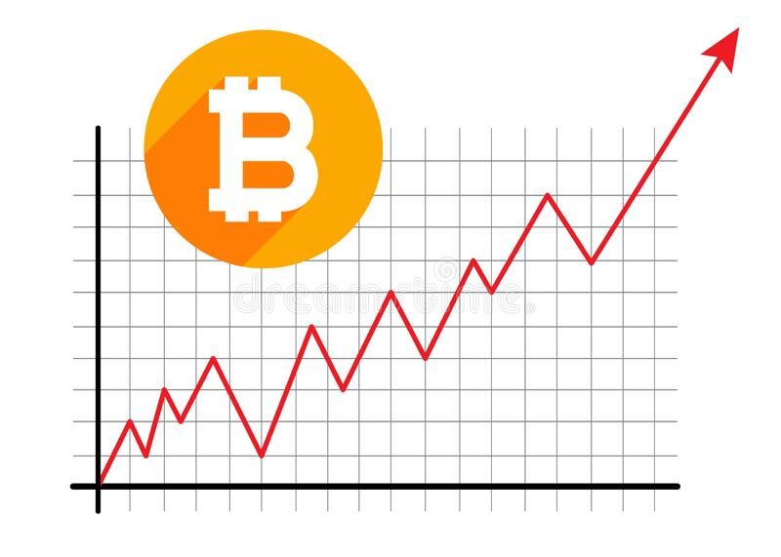
Problem Definition
Can we predict if there will be a Positive or Negative percentage change in the price of bitcoin for tomorrow using the percentage changes of correlated variables today?
We will consider Zero percentage change 'Z' as still positive.
This is because Buying with 0 % change is still without loss.
This means a negative change will be ‘N’, positive ‘P’ and zero 'Z' still ‘P’ in the dataset we have created.

Slide 3

Problem Dataset:
The variables will be results from one day before the response
(Ie: target entry will have a BTC market price % change for 24/3/2022 compared with the variable % change from 23/3/2022).
A quick search shows, aside from variables directly related to BTC itself, Litecoin’s price % change is also correlated to BTC.

Slide 4
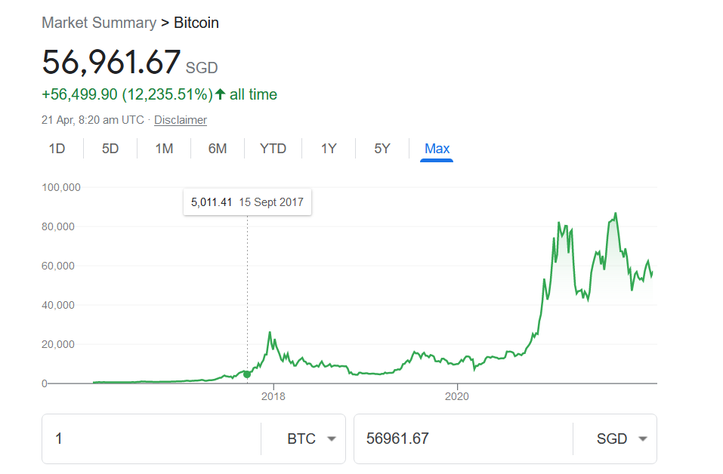
Problem Dataset:
The data for BTC is pulled from Quandl
The data for Litecoin is pulled from investing.com.csv
(both require accounts to login)
The dataset formed from these will be cmb1.csv
Time period: 24/3/2022 – 14/9/2017 (when BTC begins to reach substantial prices)

Slide 5
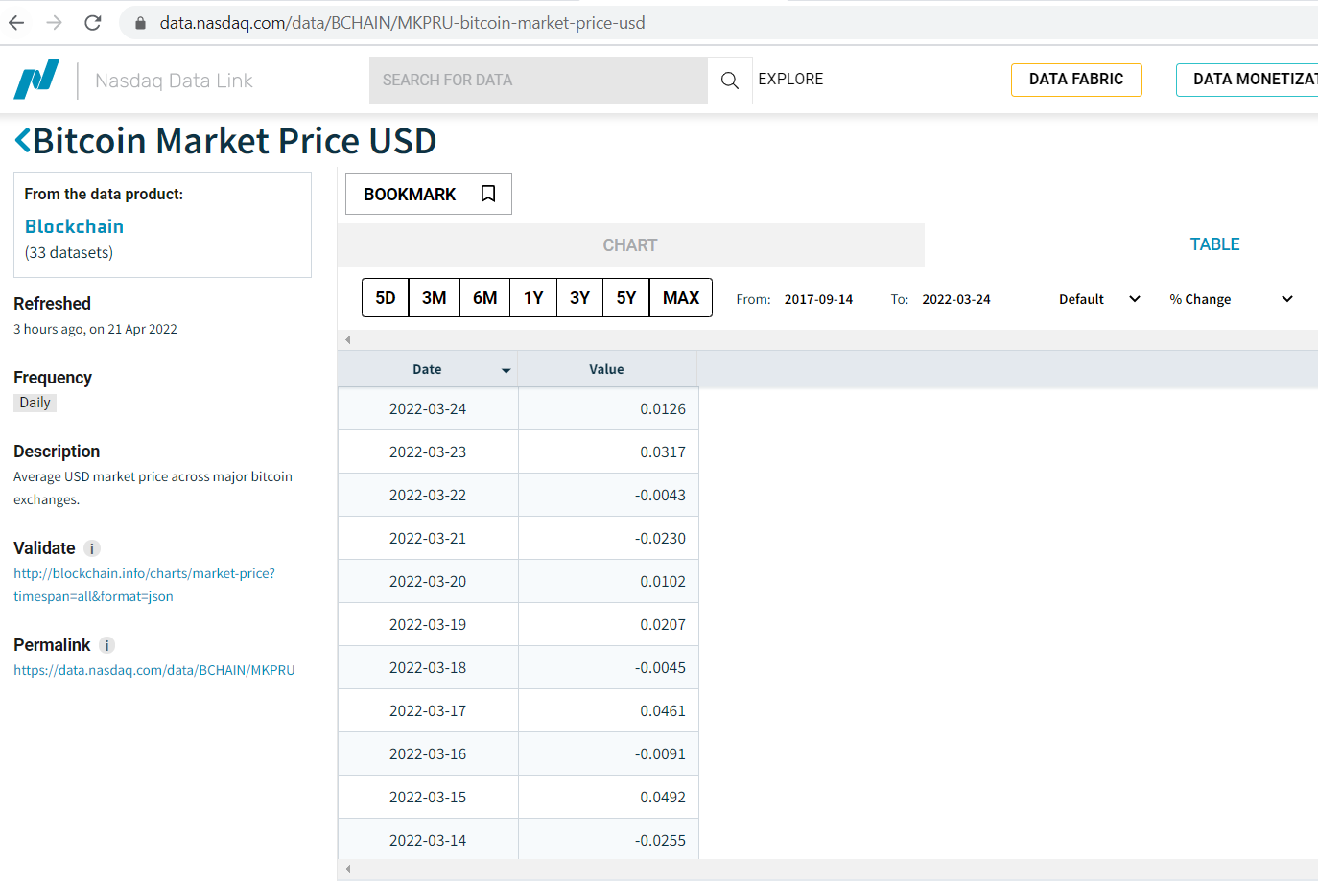
Data Extraction:
Duration set to daily.
Transform set to % change

Slide 6
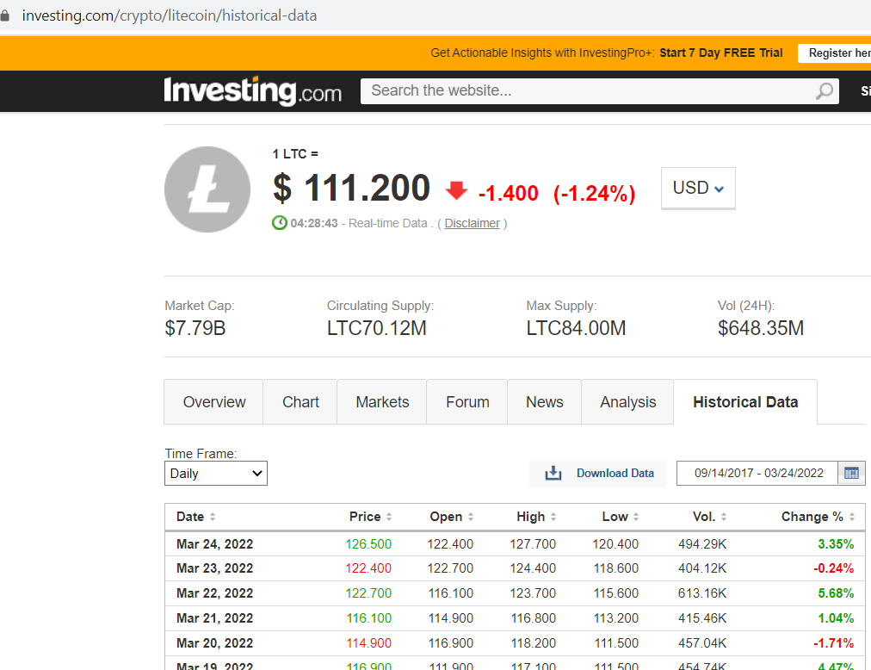
Data Extraction:
Duration set to daily.
Keep Only % change row.

Slide 7
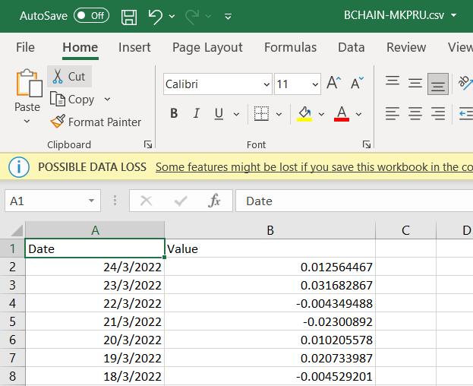
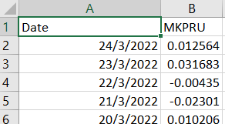
Data Preparation:
For all CSVs, the generic header of 'value' will be changed to their specific variable short-form name, ie: 'value' - > MKPRU (Market Price).

Slide 8
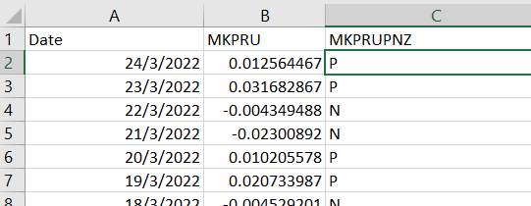
Data Preparation:
2. For Specifically the MKPRU.csv, a new header will be made to determine if the % change is Positive, Negative or Zero using the excel function: =IF(B2<0,"N",IF(B2>0,"P","Z"))

Slide 9
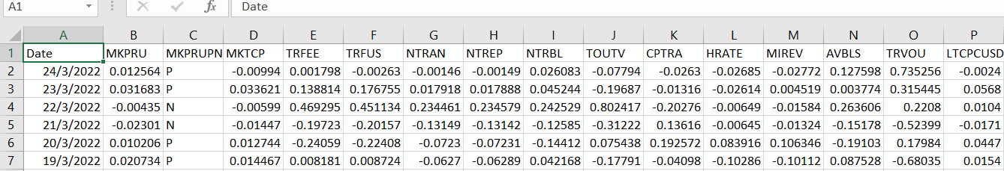
Data Preparation:
3. For all CSVs outside of MKPRU.csv, the entries from 23/3/2022- 14/9/2017 will be merged into MKPRU.csv.
4. The last unaligned row at MKPRU.csv on the bottom will be deleted. The result will look like this:
Columns A-C data will be from: 24/3/2022 - 15/9/2017
Columns D-P data will be from: 23/3/2022 - 14/9/2017 (one day prior)

Slide 10
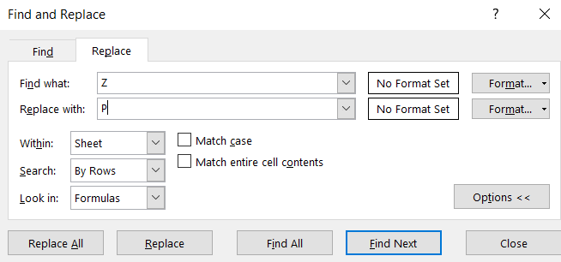


Data Cleaning:
In excel, using the 'Find & Replace' utility, the entries with 'Z' are replaced with 'P'.

Slide 11
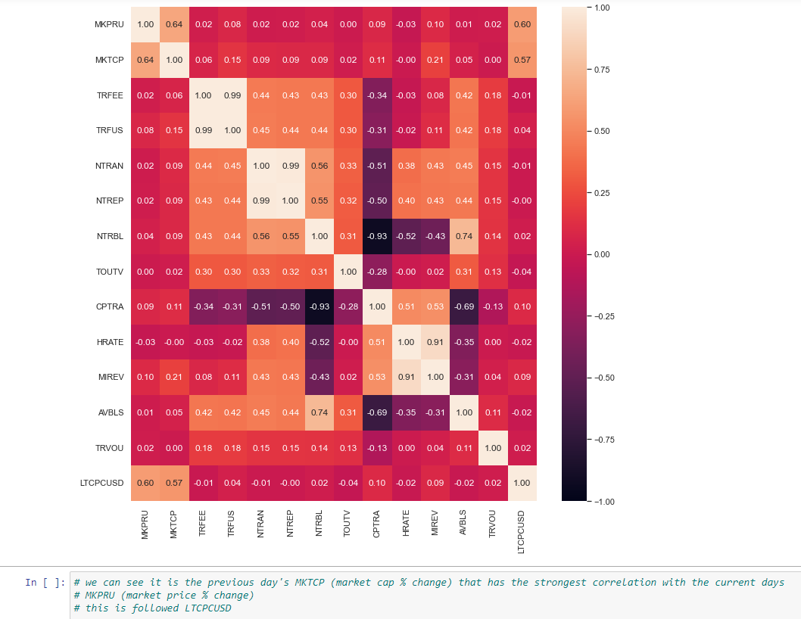
Data Visualization
Here we see:
BTC’s Market Cap (MKTCP)
Litecoin’s Price (LTCPCUSC)
For all the % change variables, these two are the most highly correlated with the next day’s BTC market price % change (MKPRU)
We will thus use these two in our models.

Slide 12
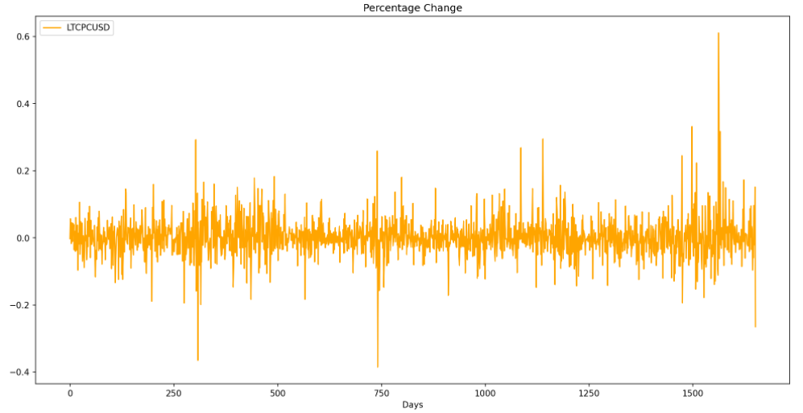
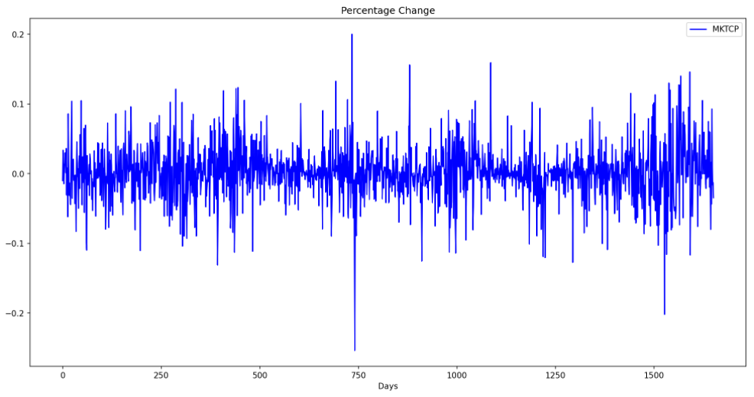
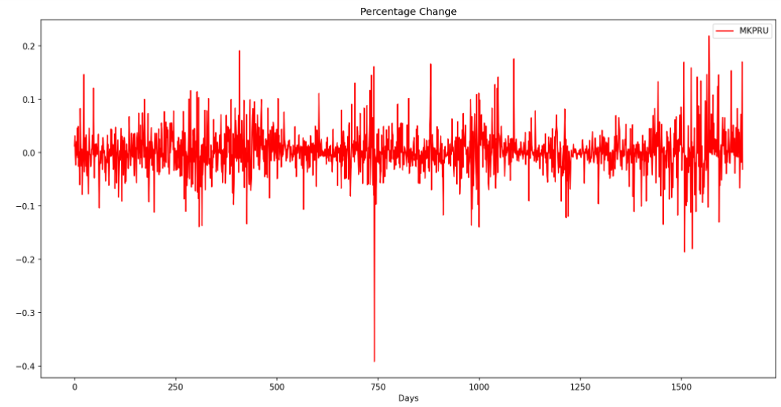
Time Series

Slide 13
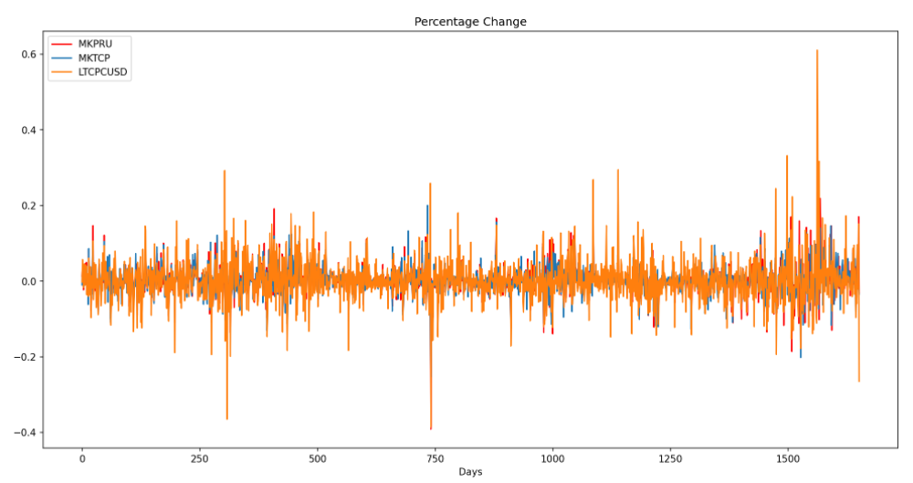
Time Series

Slide 14
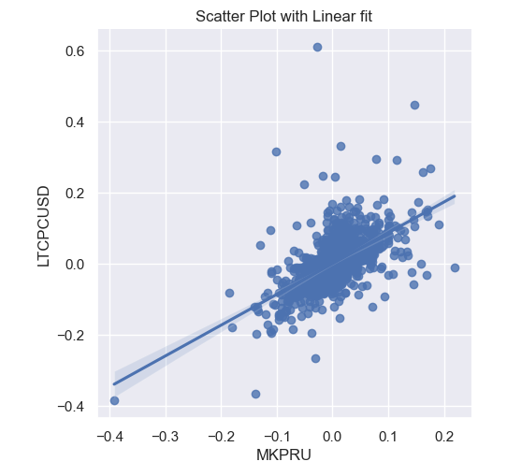
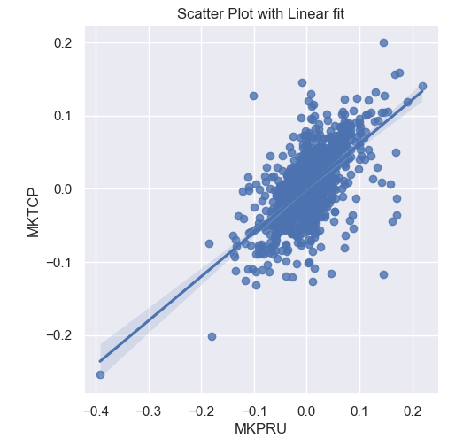
Scatterplot With Linear Fit:

Slide 15
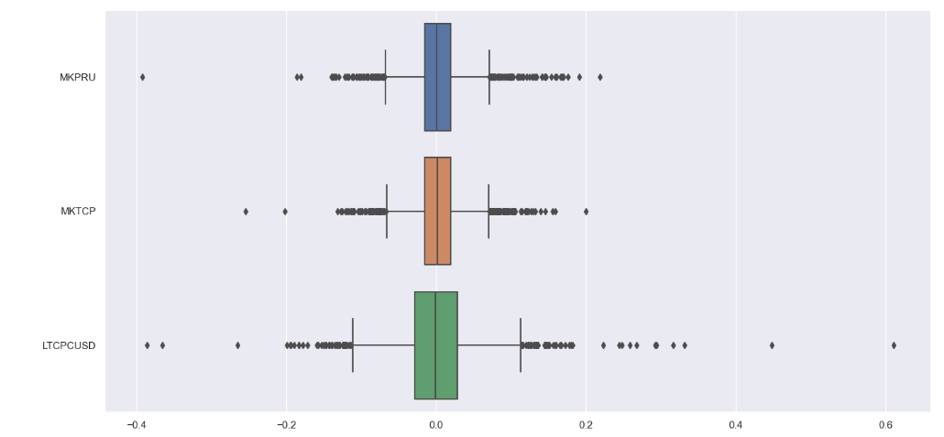
Boxplot:

Slide 16
Models used:
In summary we are using the % variables (% change for BTC Market Cap & Litecoin price) of today to determine if BTC's Price % Change tomorrow will be Positive or Not (Categorical "P" or "N", where "P" also include "Z" / zero percentage change)
Thus, in our project, we will use:
Classification trees
Random Forest
Support vector machine

Slide 17
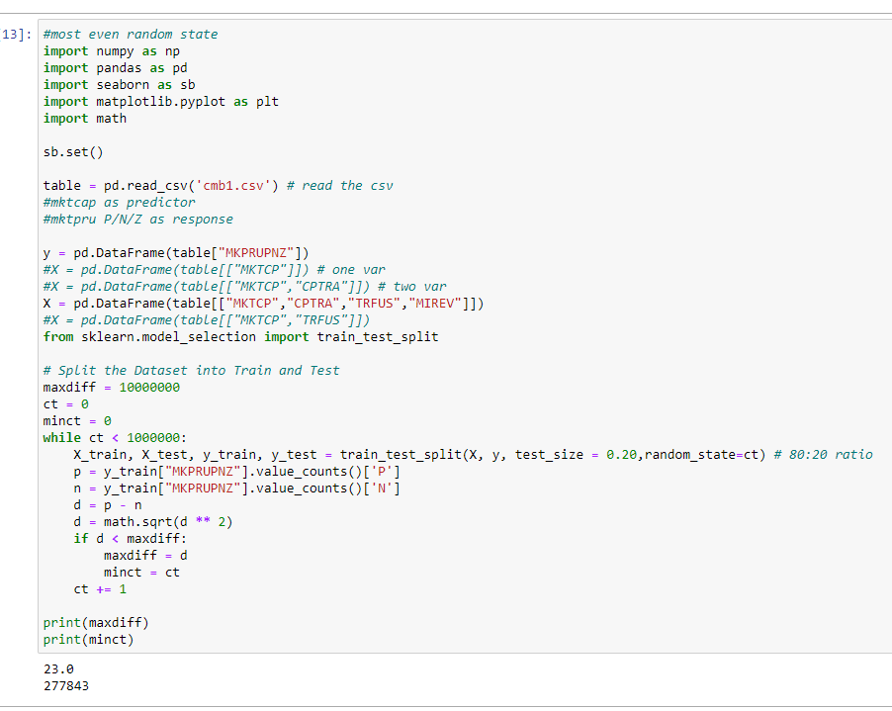
Finding Ideal Train Test Split
This script will help find the ideal random_state number to use for train-test-split for a balanced number of 'P' and 'N' entries.
We find here that under a million, the ideal number is 277843
We will use this number throughout

Slide 18
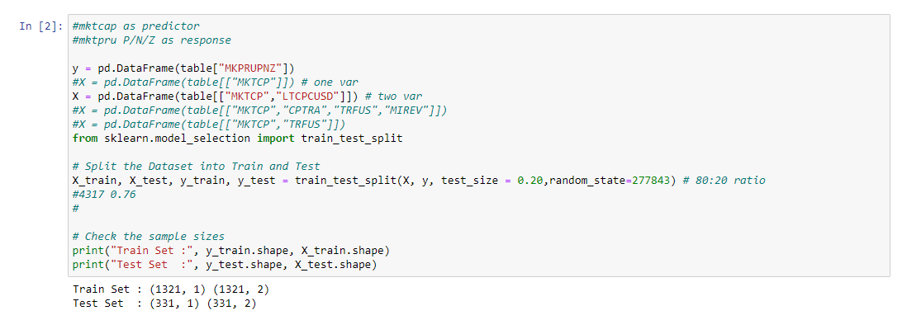
Finding Ideal Train Test Split

Slide 19
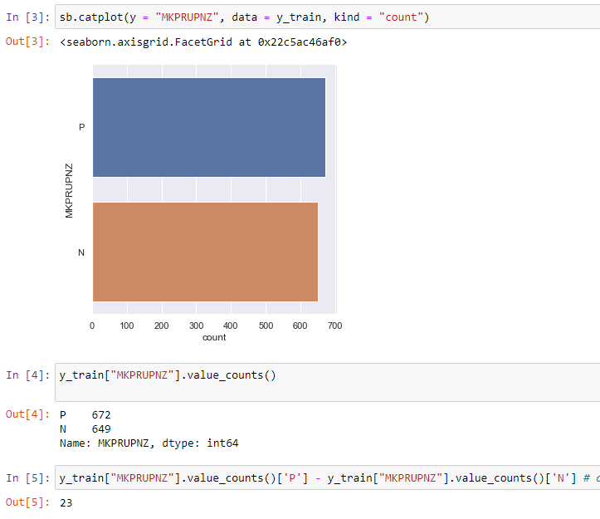
Finding Ideal Train Test Split
Thus, we can see a relatively equal number of 'P's and 'N's has been achieved using this random_state value.
This is ideally what is needed for training data.

Slide 20
Classification Tree / Decision Tree
A predictive model used to predict a categorical result based on questions with specific numeric values & the specific categorical result with the highest probability.
In our case, the questions are based on the values of MKTCP & LTCPCUSD.
The categorical results would be either 'P' or 'N'.
A good way to summarize it would be to quote:
"A Classification tree labels, records, and assigns variables to discrete classes. A Classification tree can also provide a measure of confidence that the classification is correct."
"A Classification tree is built through a process known as binary recursive partitioning. This is an iterative process of splitting the data into partitions, and then splitting it up further on each of the branches."

Slide 21
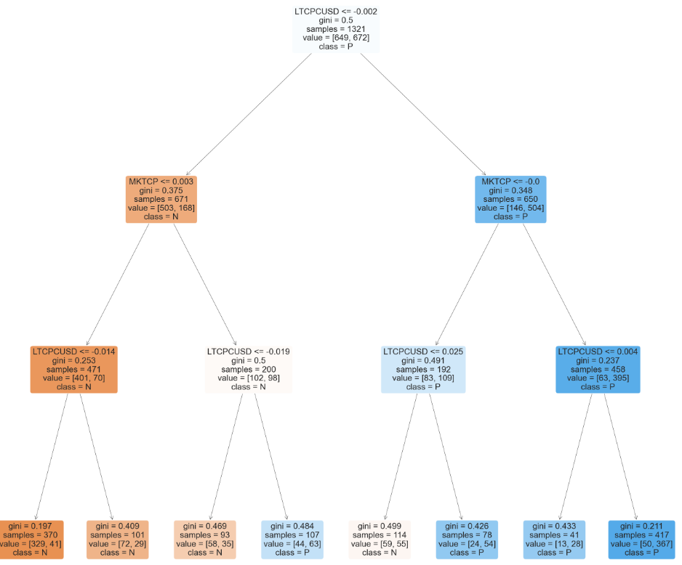
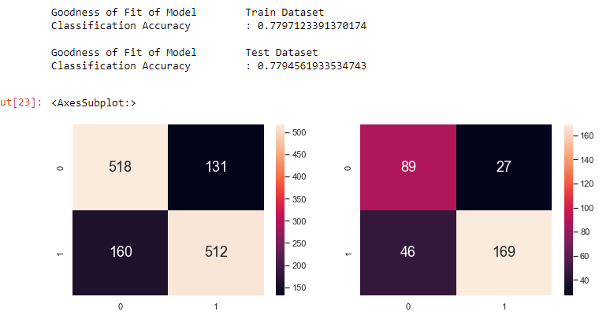
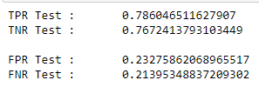
Classification Tree
Depth of 3

Slide 22
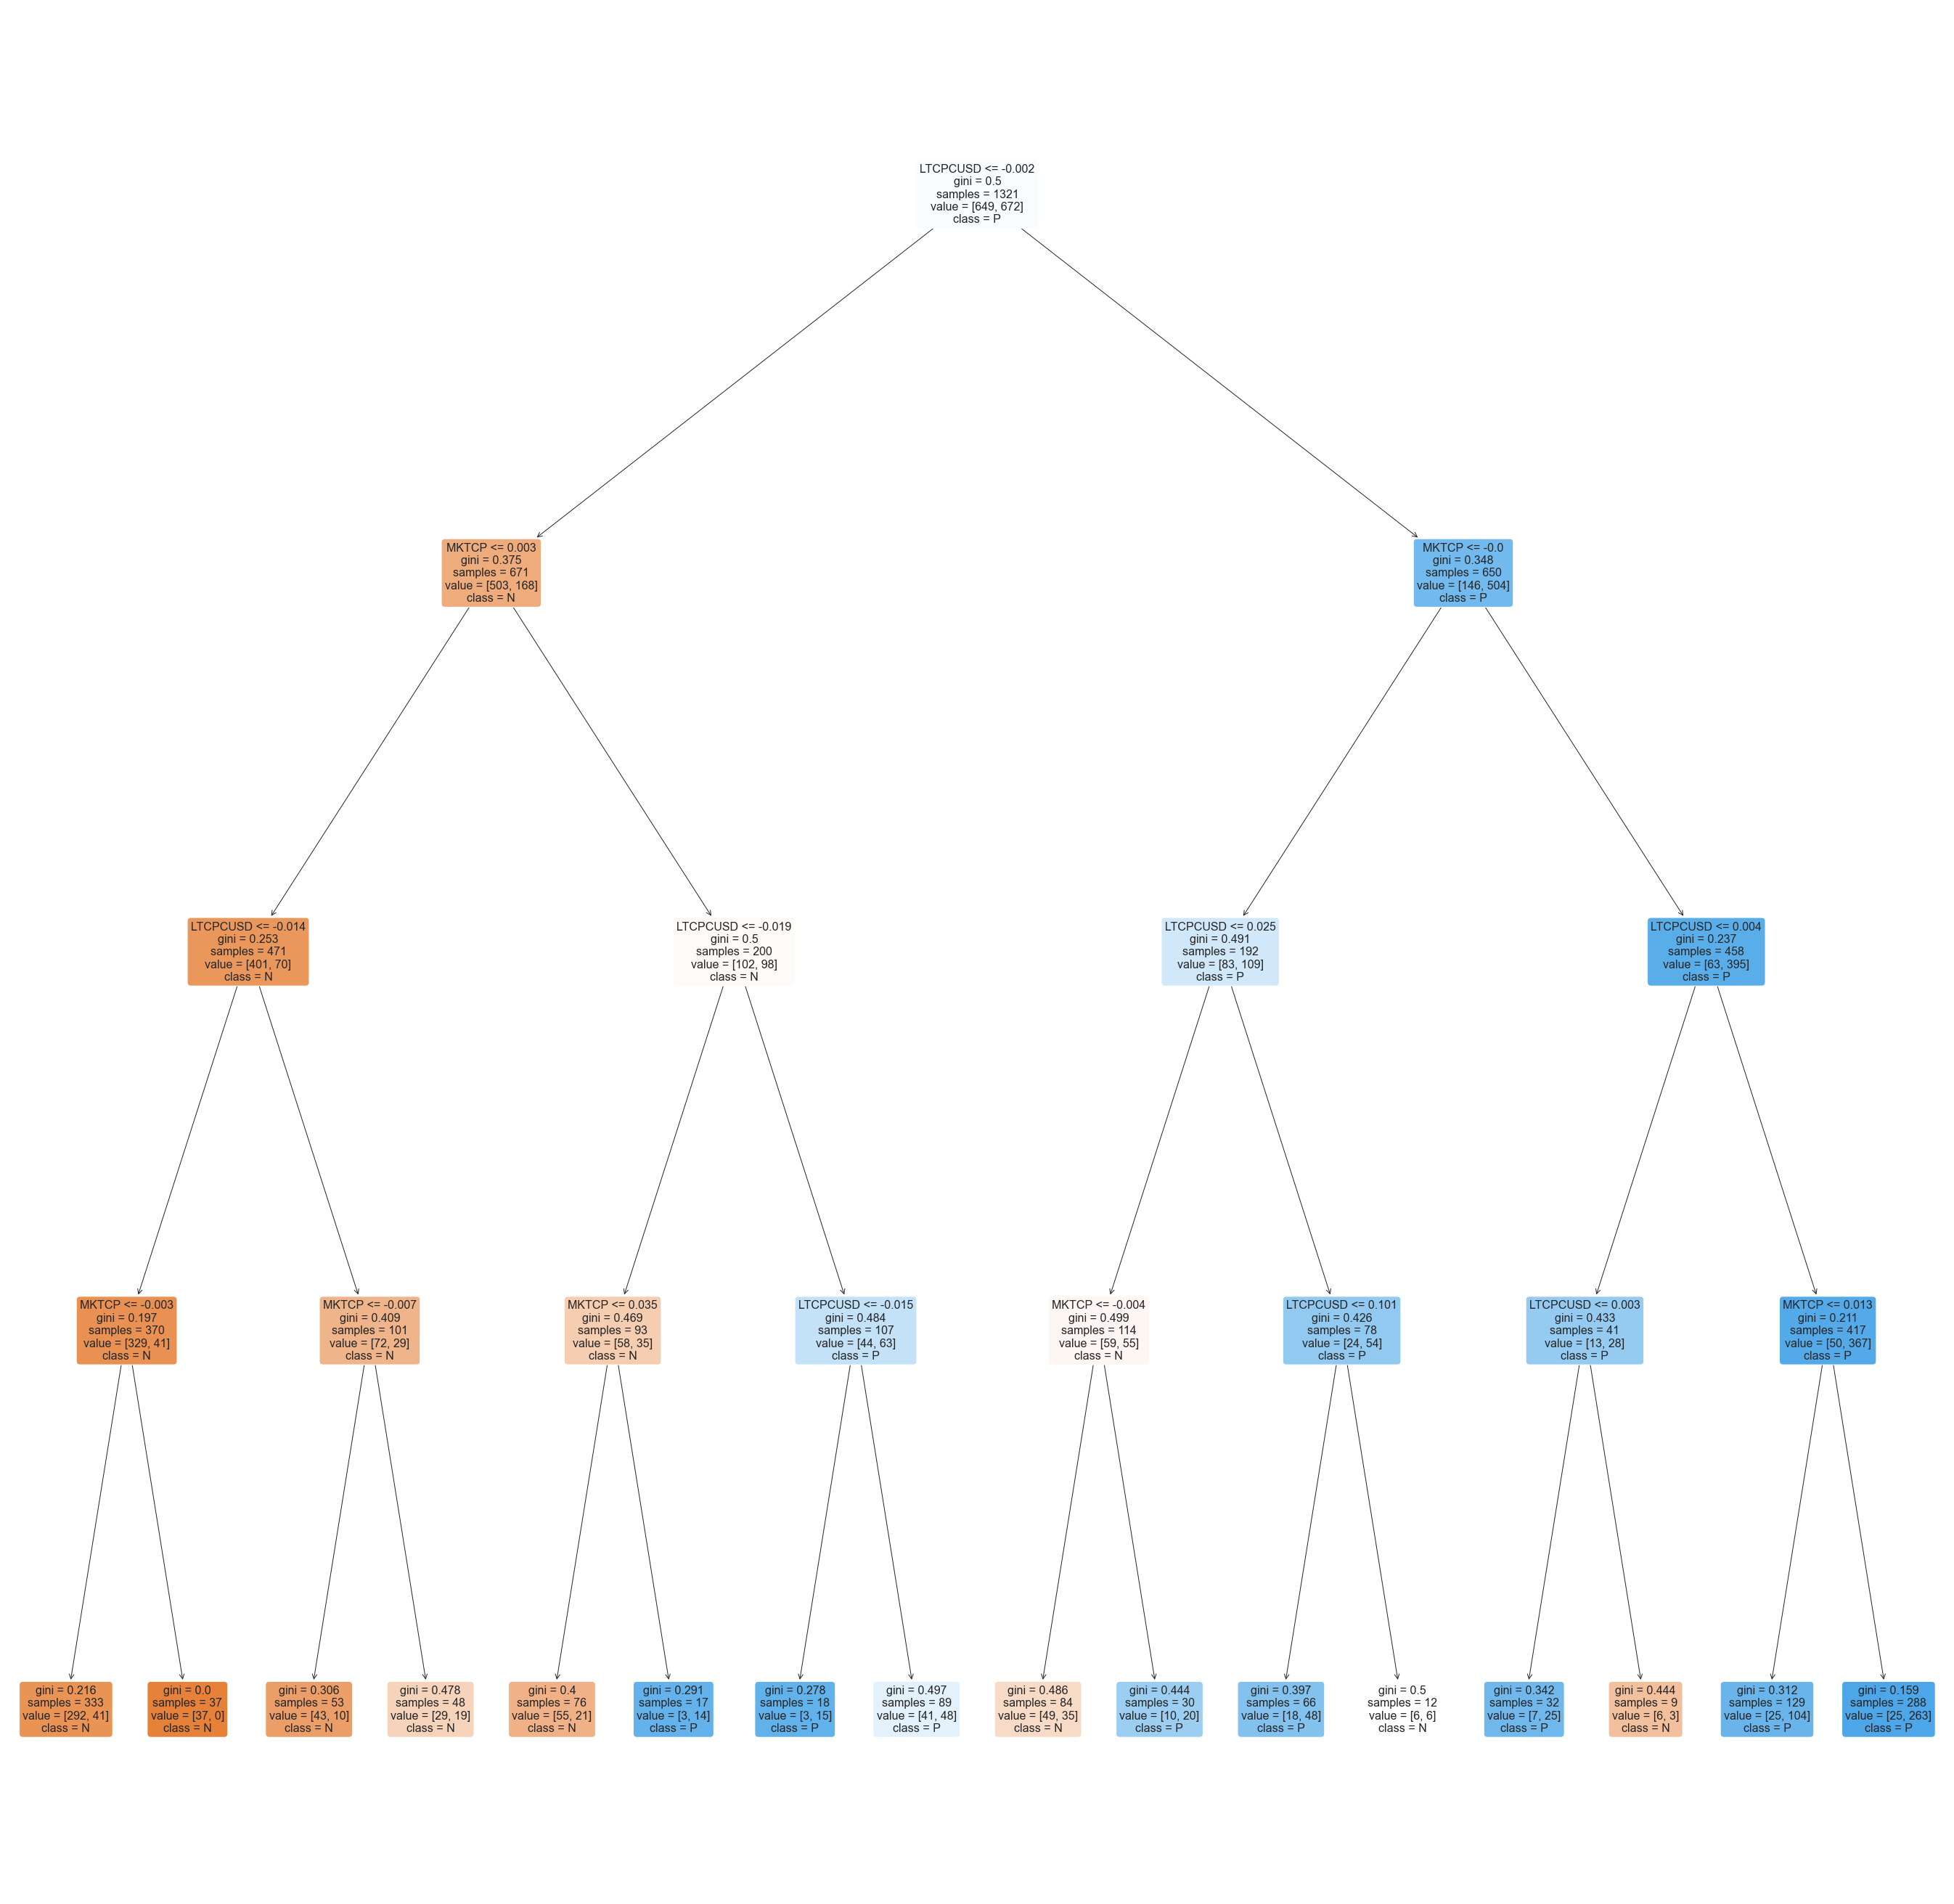
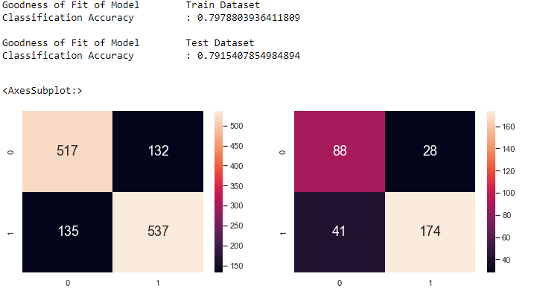

Classification Tree
Depth of 4

Slide 23
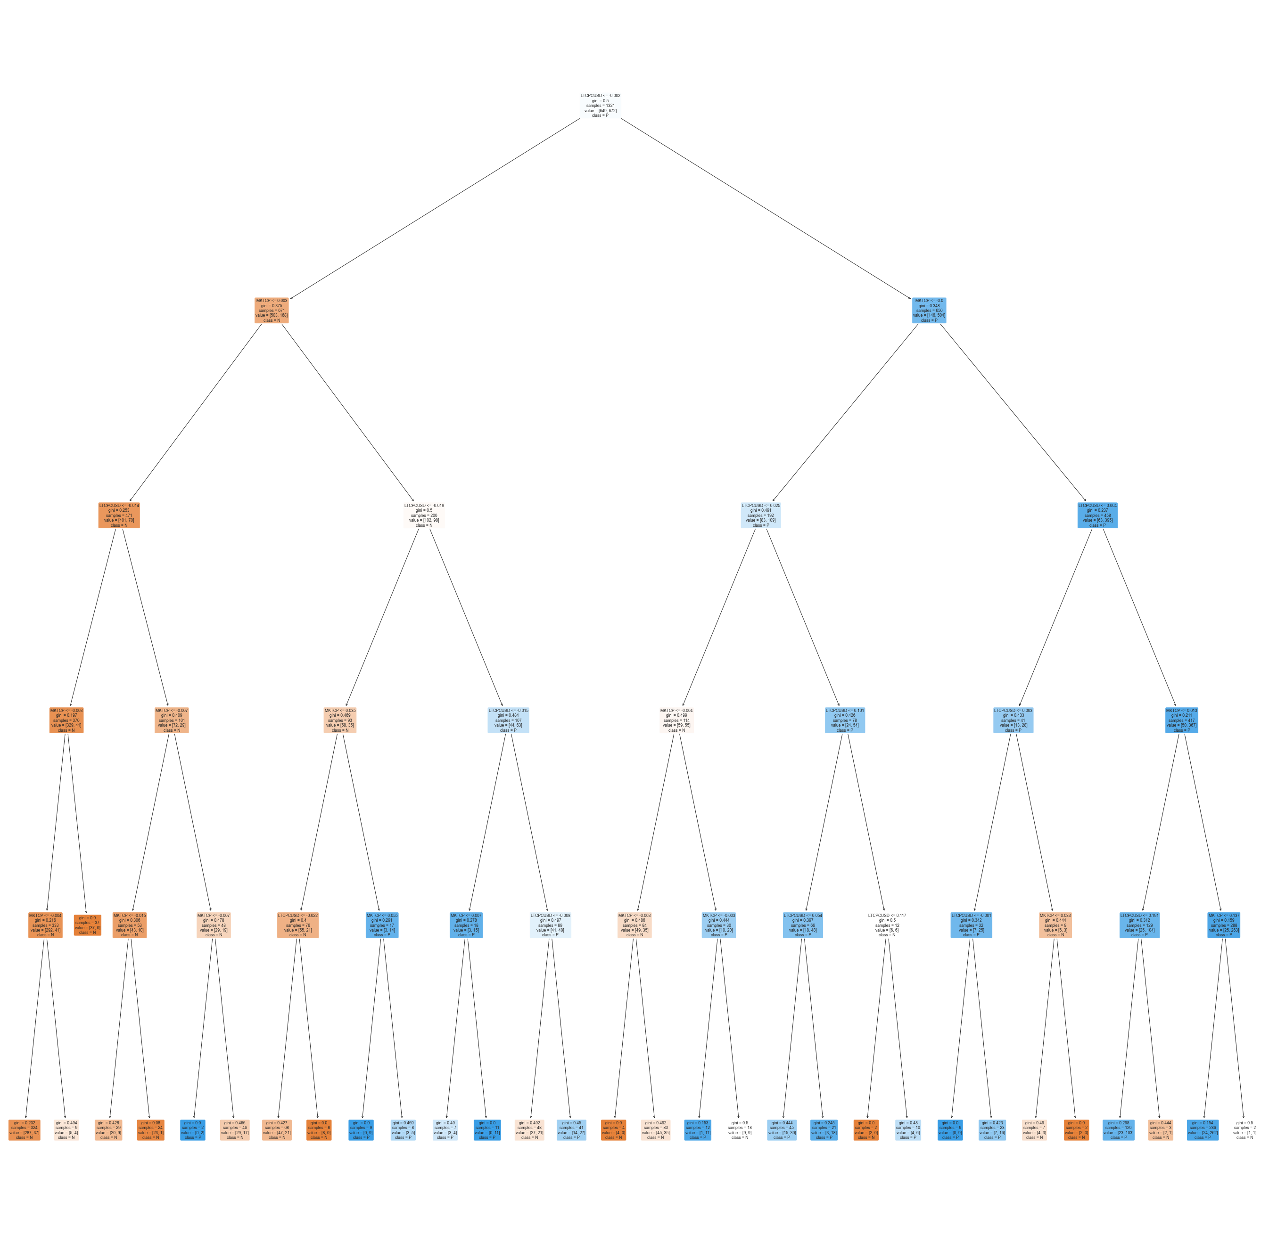
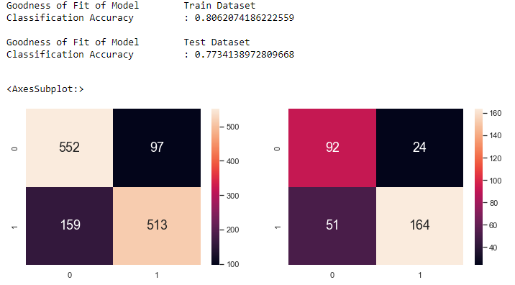
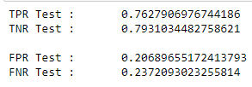
Classification Tree
Depth of 5

Slide 24
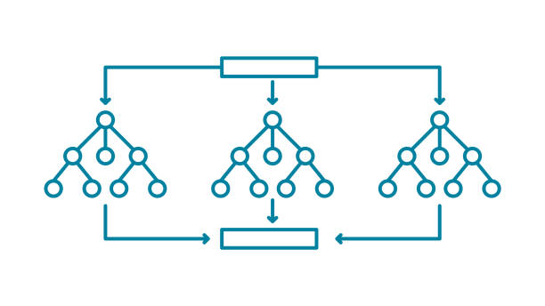
Classification Tree Result Conclusions
Using depths > 4 allows for better training classification accuracy but worse test classification accuracy.
Going too deep would cause overfitting as well.
Using depths < 4 gives us worse test & training classification accuracy overall.
The depth of 4 gives us the most optimal test & training classification accuracy. (Both approximately 0.79~)

Slide 25
Classification Tree Result Conclusions
However, there are some scenarios where other depths might be better, namely:
Should we choose to minimize the risk of a false positive (where our prediction of a positive % change turns out to be wrong and instead a negative % change in BTC's price happens), a depth of 5 may be preferred since it has the lowest FPR (False Positive Rate).
If the decision is made to only buy BTC based on positive changes in its price (no shorting), regardless of the losses from a negative % change prediction turning out to be positive, then prioritization of FPR over FNR (False Negative Rate) may promote greater depths.

Slide 26
Random Forest
A collection of multiple random decision trees
Much less sensitive to the training data
Bagging (Bootstrapping + Aggregating)
Random feature selection

Slide 27
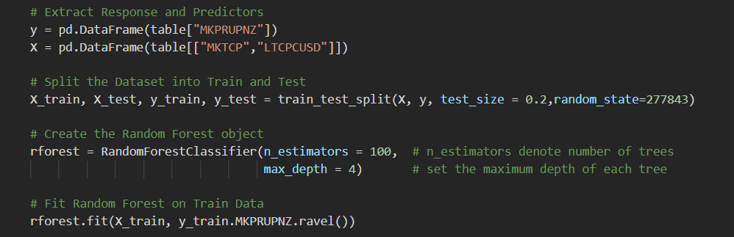
Creating the Random Forest
Random selection of rows from original dataset to build our new datasets (bootstrapping)
We used depth of 4 and 100 estimators

Slide 28
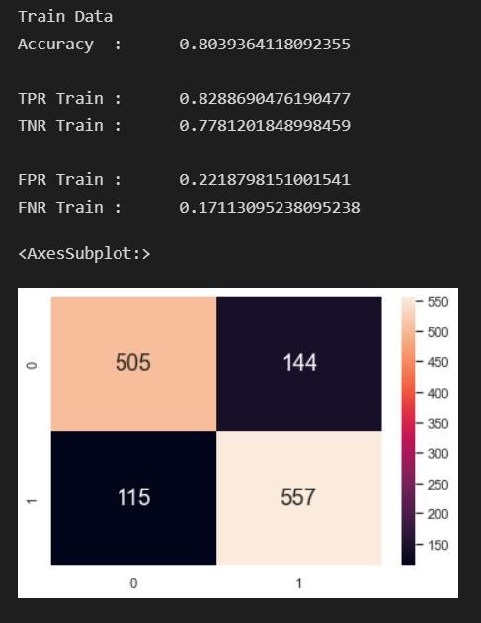
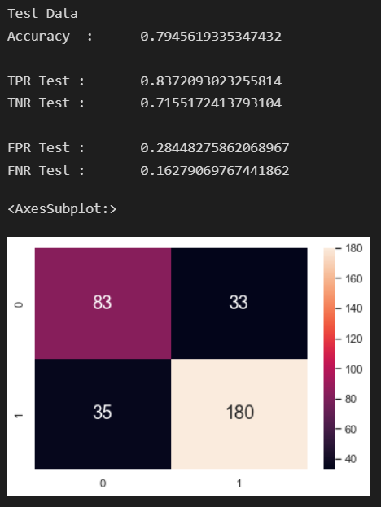
Accuracy of the Random Forest

Slide 29
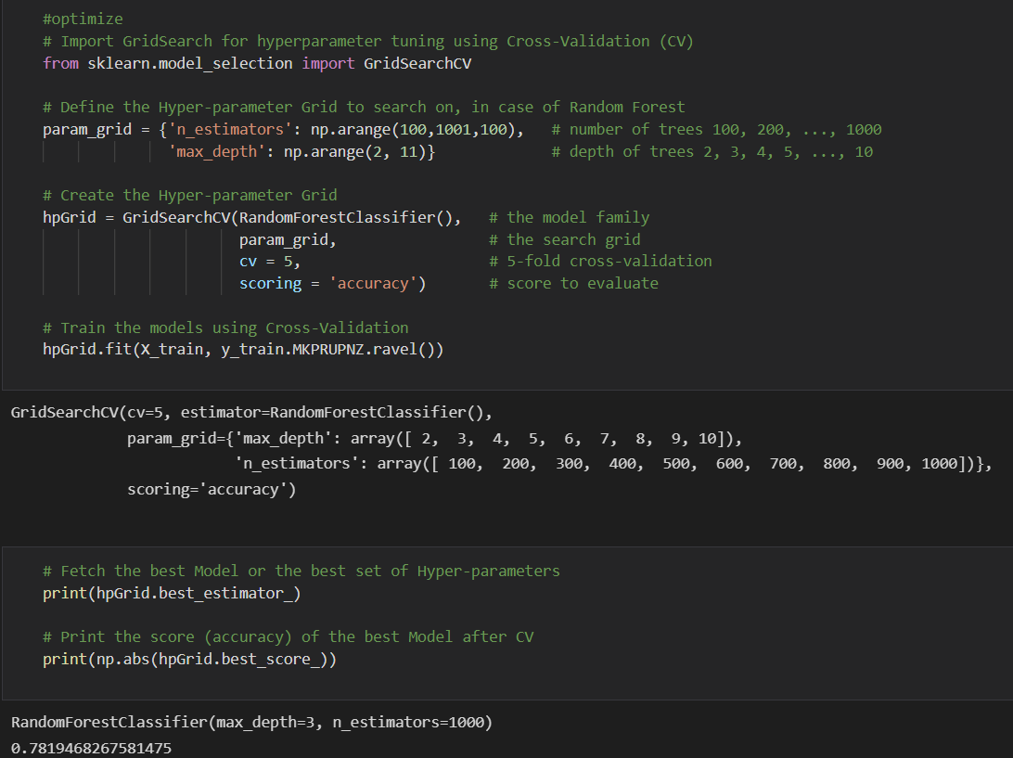
Improving the Random Forest
We found the optimal depth and estimators to use using GridSearch

Slide 30
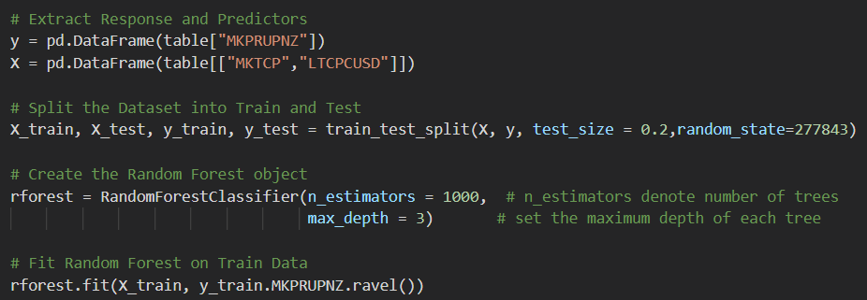
Improving the Random Forest
We now used a depth of 3 and 1000 estimators

Slide 31
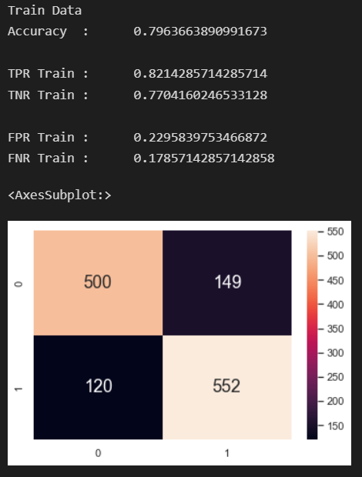
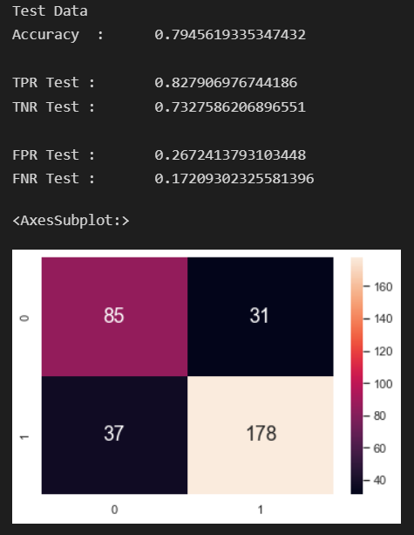
Accuracy of the optimal Random Forest

Slide 32
Our Conclusion
Although our classification for the train and test datasets decrease after using the optimal depth and estimators, our False positive rates (FPR) improved
Lower FPR --> less likely to get wrong when buying bitcoin

Slide 33
Support Vector Machine
Supervised machine-learning model that uses classification algorithms for two-group classification problems.
Takes in data points and outputs a line (2D) or plane (3D) that best separates the groups (decision boundary).
To separate non-linearly separable data, a third dimension is added (2D --> 3D).
SVM is efficient: it does not need every vector to transform, it just needs the dot products between them.

Slide 34
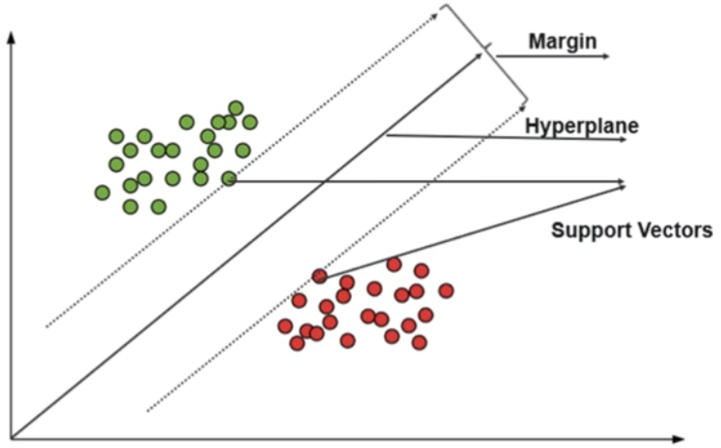
Illustration of SVM
Best boundary maximises the margins (distance between boundary and data points) from both groups.

Slide 35
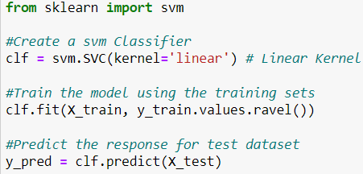
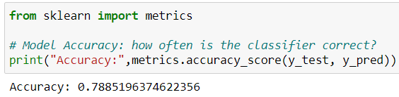
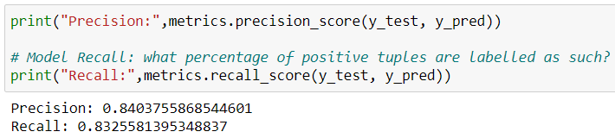
Creating the Classifier
Fitting the training set into the model
Finding out the accuracy of the classifier
- 0.789
Comparing y_test and y_pred
- Precision (Tp / (Tp + Fp)): 0.840
- Recall (Tp / (Tp + Fn)): 0.833

Slide 36
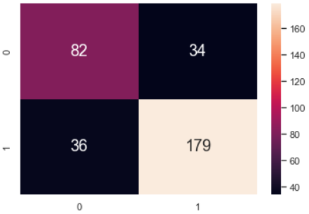
Results
True Positive Rate: 0.833
True Negative Rate: 0.707
False Positive Rate: 0.293
False Negative Rate: 0.167
Accuracy can be improved

Slide 37
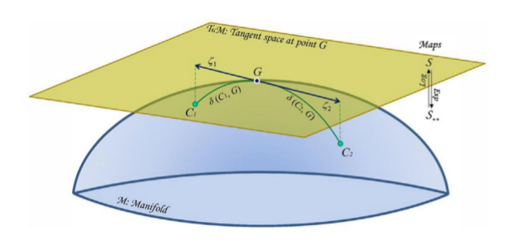
Areas for Improvement
Modifying the kernel (function) of the SVM to improve its performance as a classifier.
Adding variables (2D to 3D classifier)
Combining functions e.g. f(x) + g(x)
Based on Riemannian geometry, which produces smooth manifolds to maximise separation between classes.
Larger train dataset to enhance the prediction accuracy of the SVM model.
Optimising the parameters by doing a grid search
Exhaustively considers all parameter combinations

Slide 38
Evaluation of SVMs
Advantages | Disadvantages
Works well when there is significant margin between tags/classes | Algorithm will not work on large data sets
More productive in high dimensional spaces | Does not work well when tags/classes overlap
Memory systematic | No probabilistic clarification for classification (either or only)

Slide 39
Conclusions:
Classification Tree has the best test classification accuracy.
But depending on different requirements, other models may still be used:
Ie: Random Forest has the best FPR.
Thank You!

