Slide 1
Feature Flags
flag: ON
rollout 30%
Ship code without releasing features
variant B
DH2643 Seminar 4 · Group 5 · 18 Sept. 2026
Jintong Jiang · Emma Lindblom · Lexuan Zhang

Slide 2
Friday, 2 a.m. — the deploy went out. Then…
23:40
02:00
02:15
Deploy
Bug reports
Your options
new checkout + 5 other features
checkout is broken for everyone
rollback the WHOLE version — or hotfix at 2 a.m.
Why is this so painful? Because in this world, deploying and releasing are the same event — the moment code goes out, users get everything in it.
Every choice after that is damage control.
Feature Flags · Group 5
2

Slide 3
The idea — split the event in two
ONE deploy — the code package
Deploying
old checkout
(hidden) new checkout
putting code on the server
(hidden) new home page
billing fix
Releasing
turning the flag on — for everyone, 30%, or just your team
gold = behind a flag, shipped but not released
Two levers, two different days.
Ship Friday morning behind a switch. Release Monday 9 a.m. — or never, if the flag stays off. Turning a flag off takes seconds and touches no code.
Feature Flags · Group 5
3

Slide 4
What is a feature flag?
if (flags.isEnabledFor('new-cart', user))
renderNewCart(); else
renderOldCart();
Where flags live
NOT React state in the browser
state + bucketing live server-side; pages only consume them
Swap our demo server for LaunchDarkly — the page wouldn't change
Every decision you saw was made by the server, per user id
The if is trivial — the engineering is where the flag lives
a config service, evaluated server-side, per user, changeable in seconds without touching code
Three flag types you'll meet in the wild
1
on / off
release toggle · kill switch
2
percentage
gradual rollout · canary
3
experiment
A/B variants by bucket
Feature Flags · Group 5
4

Slide 5
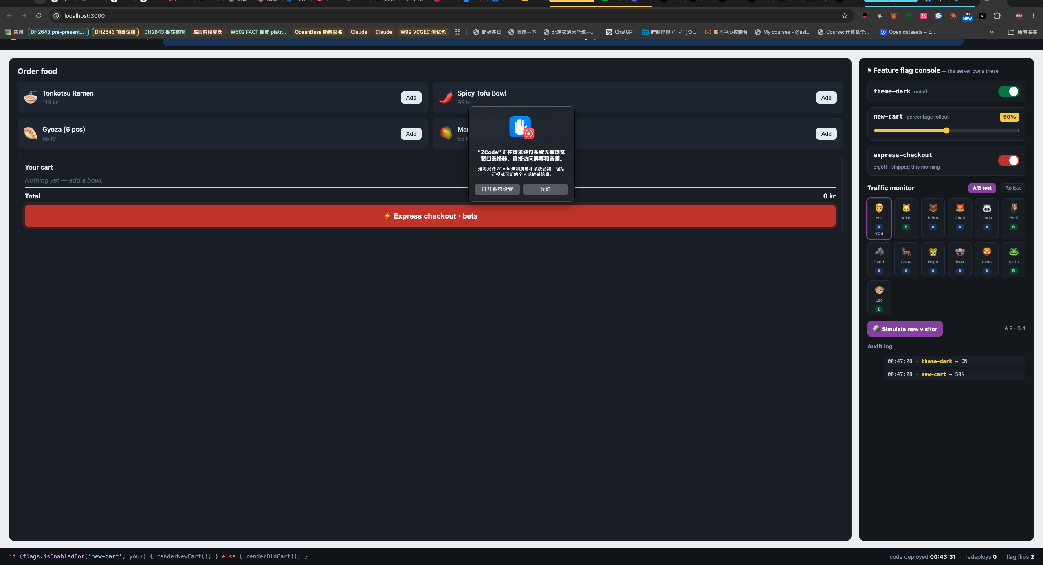
Live demo — Noodle Noodle + a real flag console
Left: the app customers see
Right: the console engineers see
Gold cart = my user fell inside the rollout bucket
Bottom strip: redeploys 0 · flag flips live count
One page, five scenes — every change driven by the console
30% rollout · A/B board · express-checkout ON (the bug)
dark theme · canary board · coin-flip visitors · a Friday-night incident · a 5-second rescue
Feature Flags · Group 5
5

Slide 6
What just happened?
1
Theme flip
one switch, instant re-render — the whole primitive in one click
“Both versions ship together.
The flag chooses.”
New checkout never replaced the old one — it arrived next to it, hidden. That's why turning the broken one off was instant: the reliable path never left.
2
30% rollout
hash-bucketed users light up; small blast radius, canary release
3
A/B test
same hashing primitive, two variants — product decisions from flags
4
Incident
express-checkout breaks orders at 2 a.m. — flag OFF, orders resume, redeploys 0
five scenes · zero typing · one localhost command
Feature Flags · Group 5
6

Slide 7
Deploying is not releasing.
— the one sentence to remember from today
Code can sit in production, hidden, for days
Releases become reversible decisions, not one-way doors
The blast radius of any mistake becomes a percentage you choose
The best rollback button is a light switch
Feature Flags · Group 5
7

Slide 8
This is how real software ships
LaunchDarkly
GitHub
Netflix
a billion-dollar company built on flag infrastructure
ships dark features behind flags, flips them on per account
canary-releases new code to fractions of users first
Your phone already works this way. The next feature of your favourite app is very likely already downloaded on your device — just not switched on for you yet.
flags: the quiet layer under trunk-based development and continuous delivery
Feature Flags · Group 5
8

Slide 9
The one piece of math — bucketing
hash( flagName + ":" + userId ) % 100
< rolloutPct → user is IN
Why hash, not random?
Random per visit → your dark mode flickers off tomorrow
Hash of user id → the user never notices the machinery
Different flag name → independent buckets for every experiment
Deterministic
same user + same flag → same bucket, every visit — stable experience
Monotonic
raising the rollout only ADDS users — nobody flips out mid-experience
~20 lines
FNV-1a hash at the top of our server.js — same trick LaunchDarkly documents
Feature Flags · Group 5
9

Slide 10
Be honest — the costs
Flag debt
flags accumulate; every stale flag is a code path nobody understands — removal is part of the discipline
Combinatorics
4 flags = 16 configurations — you cannot test them all; keep independent and few
Ops dependency
the flag service becomes critical infrastructure — real SDKs cache locally and define safe defaults
Not a branch
flags are not feature branches — long-lived branches that merge badly are the disease flags exist to cure
None of these kill the idea — they are the price of the lever, paid in discipline.
Feature Flags · Group 5
10

Slide 11
Takeaways
Deploy ≠ release — split the event, keep the levers
Try it yourself
Percentage + hash = gradual, reversible rollouts
npm start
# → localhost:3000
# zlxdengtianhei/dh2643-seminar4-featureflags
The kill switch is your 2 a.m. insurance policy
Clean up your flags — the lever is rented, not owned
flip flags · drag the rollout · break checkout · rescue it
Feature Flags · Group 5
11

Slide 12
References
1
Pete Hodgson — Feature Toggles, Part 1: classification of flag types
martinfowler.com/articles/feature-toggles.html
2
Martin Fowler — Feature Flags & continuous delivery
martinfowler.com/blogs/feature-flags.html
3
LaunchDarkly docs — bucketing & percentage rollouts
docs.launchdarkly.com
4
Node.js test-less demo: our zero-dependency server
server.js (repo)
Demo + slides + script: github.com/zlxdengtianhei/dh2643-seminar4-featureflags
Thanks — questions?
Feature Flags · Group 5
12

Slide 13

Demo recording
All five scenes in one take — real flags, real checkout.
theme flag → rollout 60%
A/B visitors → cart items
incident → kill switch
redeploys: 0
Feature Flags · Group 5
13

