Slide 1
Highway Design

Slide 2
Motivation
Simulate traffic congestion in an urban area
Predominately in smaller city
Simulate a possible improvement to the traffic problem
Expansion of already existing roads
Potential benefit of improved infrastructure
Less travel time
Enhanced transportation network
Positive Influence on the city's development
Notes:
Traffic is annoying for everyone involved.
Example Graz Glacis at rush-hour.
Plan-> Expand current existing road network
Create big highway f.e. through the city
Where would it be placed to maximize throughput
Most likely not realistic to put a highway through the city centre
Maybe we get a result like the Plabutsch tunnel for Graz (lifesaver)

Slide 3
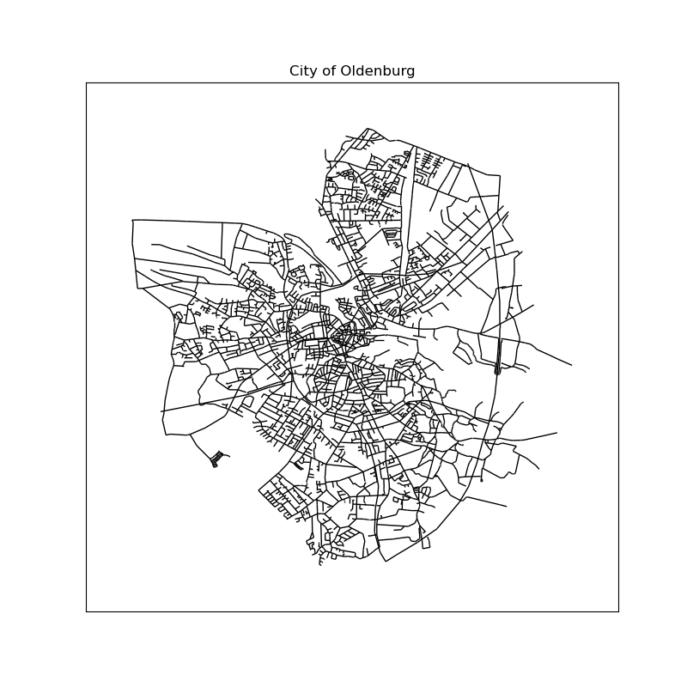
Experimental Setup
City of Oldenburg (2005)
6105 Nodes (Crossings)
7029 Edges (Roads)
About the size (inhabitants) of Salzburg
Agent based simulation
Baseline analysis on the unmodified dataset
Identify bottlenecks
Determine which roads to expand
Determine if the efficiency has been improved with the expansion of the road to a highway
Notes:
Inhabitants Oldenburg 2005 158k, 2019 168k
Inhabitants Salzburg 2017 152k
https://users.cs.utah.edu/~lifeifei/SpatialDataset.htm

Slide 4

Methodology
General Approach
Find n furthest node pairs (Euclidean)
Find the shortest paths between the pairs (Dijkstra)
Pick m most visited edges
Adapt / add attributes to simulate highways
For different setups:
Repeat finding shortest paths & visualize
Compare metrics for different setups
Metrics
Average shortest path
Graph resilience

Slide 5
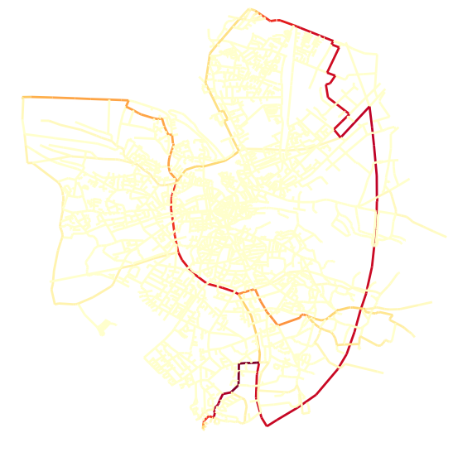
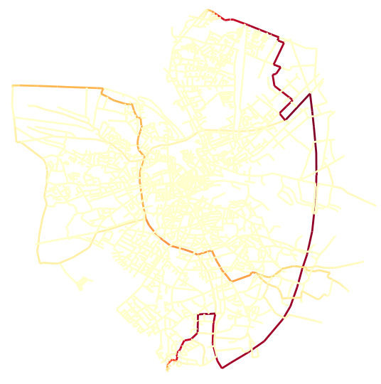
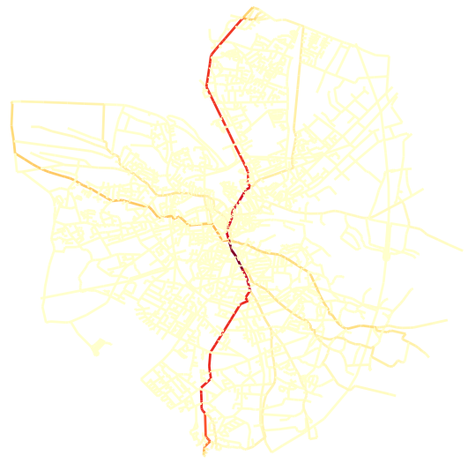
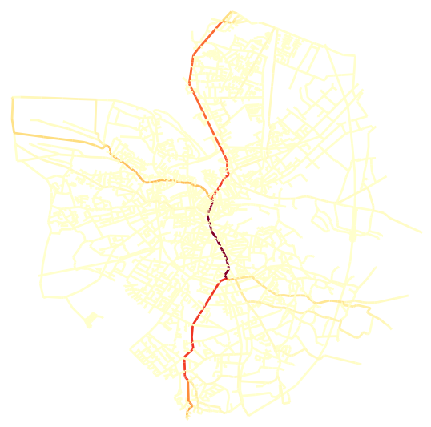
Results
The shortest path is one with the minimum weight
The shortest path is one with the shortest length
Before
After
Weight 40.69 Length 4667.39 Resilience 1
Weight 31.05 Length 3269.11
Resilience 1
Weight 35.43
Length 3538.07
Resilience 1

Slide 6
Results
The shortest path is one with the least number of edges in it
The shortest path is one with the shortest length
Before
After
Weight 31.05 Length 3269.11
Resilience 1
Weight 40.69 Length 4667.39 Resilience 1
Weight 35.43
Length 3538.07
Resilience 1

Slide 7
Discussion
01
The algorithm can redirect traffic to the most used edges
Lower travel time on average
Minimization through weights performs better
Chosen edges might not be connected
Not all paths in the network are taken into account
Depends on the number of node pairs and the number of chosen edges
02
03
04
05
06

Slide 8
Thank you for your attention!

