Slide 1
Instructions for the Data Analysis Demos
1
You have 3 minutes to present – load your slides into PowerPoint (or whatever program you use), put it into “slide show” mode so the slides are full-screen (without the toolbar, etc.), and be ready to share your screen when your group is called. Practice first! There are five people in your group: hold a short Zoom session to practice sharing in full-screen presentation mode. We can only offer you one opportunity to present so make the most of it.
The next few slides give you all the alternatives for how to present your Data Analysis for swift feedback. Select only the slides that fit your RQ. Before presenting DELETE all slides and text (and instructions) that you do not use (including this slide). You can then enlarge your selection, so it is clearly visible on the slide.
Appointment slots will appear on Canvas soon (calendar) and will take place on Monday during your usual tutorial slots. Sign up early. When space runs out, we cannot issue any further slots. If you do not turn up at the start of your slot you will not be given another opportunity. All the group members should attend but select one person to present. DO NOT SIGN UP unless you can attend. You will not be graded on this presentation but if you do not attend your booked space, your group will have 5 points deducted from the Data Analysis assignment.
At this point we assume you are using your allocated datasets. We are not going to check during the presentation, but your assignment will not be graded if the dataset you use in the analysis has not been allocated to your group.
We look forward to giving you feedback. If your group is not presenting, still attend the tutorial as the feedback will help you too.

Slide 2
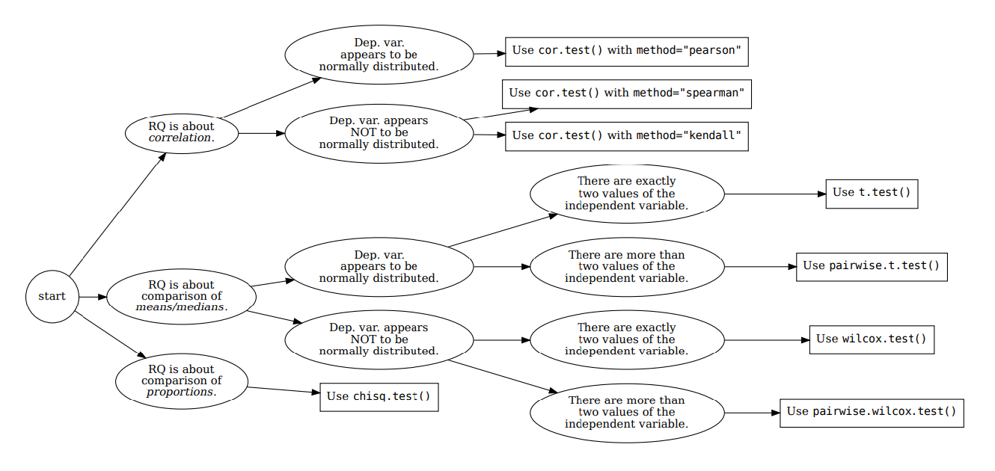







How your RQ + distribution of data (Histogram) leads to a statistical test. Visualization requirements highlighted in yellow.
Histogram & Scatterplots
Histogram and Boxplots
Stacked bar chart (no histogram)
Figure: Decision tree – how Research Questions relate to Visualizations and Statistical Test.

Slide 3

7COM1079-2022 Student Group No: Names of Student Attendees (all group should attend to get feedback):
3
Group Id: A026 Name of Student Presenting: Mohammed Riyan Ahmed
Data Analysis – The analysis compared the proportions of matches won by toss winners versus toss losers using a stacked bar plot Tutorial Presentation for Feedback Date:

Slide 4
7COM1079-2022 Student Group ID:
We are using the dataset (DS238 and Match.csv) to answer our Research question (replace this text with your RQ …… starting, “Is there a difference in the proportions of matches won (Match_Winner) between teams that won the toss (Toss_Winner) and teams that did not win the toss (Not Toss_Winner)?” ¹
4
Team_1 | Team_2 | Toss_Winner | Match_Winner
2 | 1 | 2 | 1
4 | 3 | 3 | 3
6 | 5 | 5 | 6
7 | 2 | 7 | 2
1 | 8 | 8 | 1
5 | 4 | 4 | 5
8 | 6 | 8 | 6
3 | 7 | 7 | 3
8 | 5 | 5 | 5
4 | 7 | 7 | 4
2 | 5 | 5 | 5
3 | 1 | 1 | 3
Include a sample of your .csv dataset to include the column names (variables) in your RQ².
List the following:
The dataset has 578 rows
The dependent variable³ is Match_Winner
The independent variable⁴ is Toss_Winner
¹ Follow one of the three prescribed RQ Templates – If you do not have a correctly formulated RQ, we will stop your presentation here.
² The variable name in your RQ may differ from the column name in cases where the column names are abbreviations.
^{3.4.}Be sure to identify which variable is your dependent variable and which one is your independent variable on this slide
Notes:
4

Slide 5
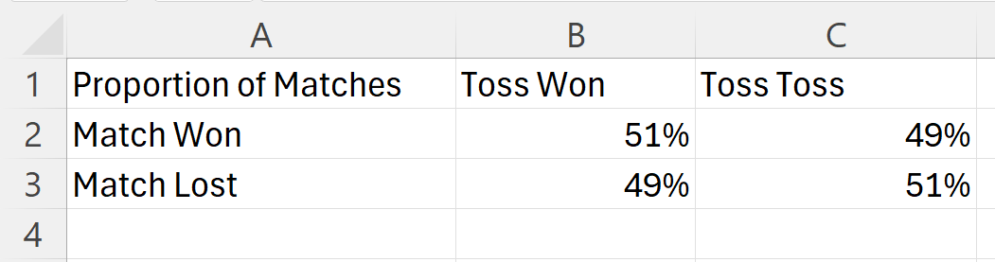
Here is a table (matrix/cross tabulation) showing our dependent variable as rows, and our independent variable as columns. We have at least two values for both variables that are independent of each other (no overlap).
For example:
Our RQ is about differences in proportions
For comparison of proportions analysis, we will use a chi-square test to check for the likelihood that there is a relationship between the two nominal variables (reason for absenteeism and age group in example). This non-parametric test makes no assumptions about the shape of the data (which is nominal, not interval) so we do not include a histogram for this test.
5
Notes:
5

Slide 6
R Script and Results (For ALL types of test) – The Analysis
PRE 7COM1079-2022 Student Group No: ?????
6
data <- read.csv("Match.csv")
table <- table(data$Toss_Winner, data$Match_Winner)
print(table)
chi_result <- chisq.test(table)
print(chi_result)
value of the test statistic : 1638
p-value = 2.2e-16 , which Is < 0.05.
Yes Result is Significant
We reject the null hypothesis.
What does the result actually mean in the wider context of learning something useful / answering your RQ? (P.T.O)
Notes:
6

Slide 7
What the Results Mean:
The plot shows how often teams that won the toss also won the match compared to teams that lost the toss. Here's what we can take away:
If Toss Winners Win More Matches: This means that winning the toss gives teams an advantage, possibly because they can choose favorable conditions (like batting or bowling first in cricket).
If Toss Winners and Losers Have Similar Results: This suggests that the toss doesn’t play a big role in deciding the outcome. Other factors, like team skills, strategy, or execution during the match, matter more.
Why This Matters:
Understanding Strategy: If toss results are influential, teams might need to focus on optimizing their decisions after winning the toss. On the other hand, if the toss has little impact, teams should concentrate on improving their gameplay regardless of the toss result.
Leveling the Playing Field: In sports, it's important to ensure fairness. If winning the toss has too much influence on match outcomes, organizers might consider ways to minimize its impact, like tweaking the rules or conditions.
Using Data to Improve Decisions: This analysis gives teams and coaches clear evidence to shape their match strategies. If the toss isn’t critical, they might invest more in preparation or adaptability during the game.
Why It Answers Your Question:
This analysis directly shows if there’s a meaningful difference in match outcomes based on the toss result. It gives you a way to understand whether the toss has a real impact or if it’s just one small factor among many in determining the winner.
Next Steps:
You can test whether these differences are statistically significant to confirm the findings.
If winning the toss matters a lot, it would be worth exploring specific match conditions (e.g., weather or pitch type) that amplify this effect.
In short, this analysis helps us figure out whether the toss really matters or if success in matches comes down to other factors.
PRE 7COM1079-2022 Student Group No: ?????
7
Notes:
7

