Slide 1
HOSPITAL MANAGEMENT SYSTEM
Database Design & Implementation
CS27 – The Relational Model & Databases
End-of-Semester Group Project
GROUP MEMBERS:
ZARAINI M. A. Kader (Leader) • TRAORE Z. Mathias • NOMBRE Ange C. • NKUNA Isrël • NACOULMA Betsaleel • OUEDRAOGO Jonathan • BASSINGA Keya
Burkina Institute of Technology | Instructor: Kweyakie Afi Blebo

Slide 2
Problem Statement & Objectives
CHALLENGES IN HOSPITAL DATA MANAGEMENT:
OUR SOLUTION
Patient Information Management
Tracking thousands of patients with complete medical histories, allergies, blood types, and emergency contacts
Appointment Scheduling
Coordinating schedules between patients and doctors across multiple departments while avoiding conflicts
Prescription Tracking
Ensuring every medication prescribed is properly documented and traceable
Medical Records Management
Maintaining comprehensive, searchable patient history over time
6 Interconnected Tables:
✓ Patients - Complete patient profiles
✓ Doctors - Healthcare provider data
✓ Departments - Hospital organization
✓ Appointments - Scheduling system
✓ Prescriptions - Medication tracking
✓ Medical Records - Patient history
Benefits:
• Zero data redundancy
• Enforced referential integrity
• Fast, efficient queries
• Scalable architecture

Slide 3
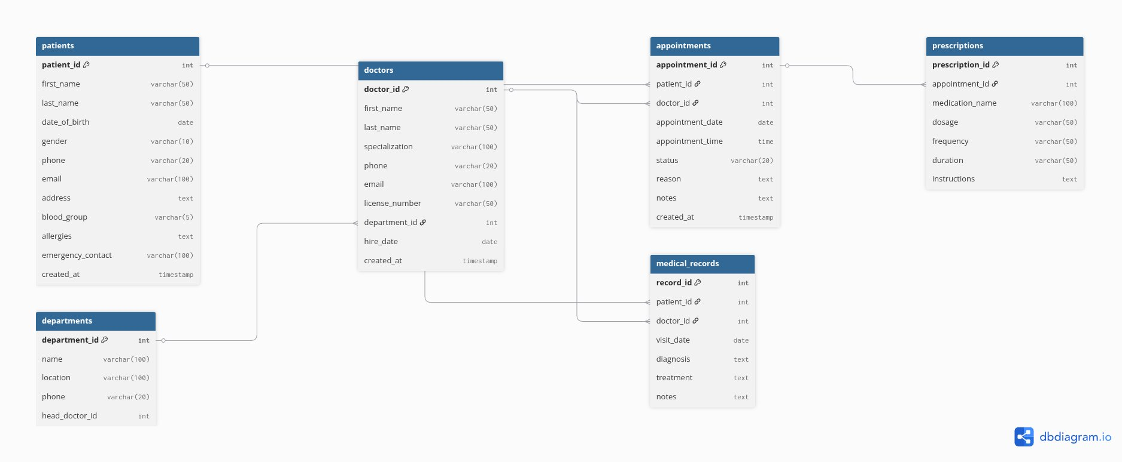
Database Schema & Relationships
KEY RELATIONSHIPS:
Patients → Appointments (1:M)
Doctors → Appointments (1:M)
Departments → Doctors (1:M)
Appointments → Prescriptions (1:M)
Patients/Doctors → Medical Records (1:M)

Slide 4
Normalization: The Problem (Denormalized Table)
Appt_ID
Patient_Name
Patient_Phone
Doctor_Name
Specialization
Dept_Name
Medication1
Medication2
1 | Alice Kabore | 70123456 | Dr. Ouedraogo | Cardiology | Cardiology Dept | Aspirin, Metoprolol | ...
2 | Bob Traore | 70234567 | Dr. Sawadogo | Pediatrics | Pediatrics Dept | Amoxicillin | ...
PROBLEMS WITH THIS DESIGN:
❌ 1NF Violation:
Repeating columns (Medication1, Medication2...) and multi-value cells
❌ 2NF Violation:
Partial dependencies - Patient_Phone depends only on Patient_Name, not the full key
❌ 3NF Violation:
Transitive dependency - Dept_Name depends on Doctor_Name, not Appt_ID directly
❌ Massive Redundancy:
Department names repeated hundreds of times
❌ Update Anomalies:
Changing a patient's phone number requires updating multiple rows

Slide 5
Normalization: The Solution (Normalized Schema)
PATIENTS
DEPARTMENTS
patient_id (PK)
first_name
last_name
phone
...
department_id (PK)
name
location
...
DOCTORS
APPOINTMENTS
doctor_id (PK)
first_name
last_name
department_id (FK)
...
appointment_id (PK)
patient_id (FK)
doctor_id (FK)
date
...
PRESCRIPTIONS
MEDICAL_RECORDS
prescription_id (PK)
appointment_id (FK)
medication
...
record_id (PK)
patient_id (FK)
doctor_id (FK)
...
✓ BENEFITS OF NORMALIZATION:
Zero Redundancy - Each fact stored exactly once
Data Integrity - Foreign keys prevent invalid references
Easy Updates - Change department name in one place
Scalability - Adding new entities is straightforward

Slide 6
Key Design Decisions
Foreign Key Constraints
Data Types Selection
• ON DELETE CASCADE for appointments and prescriptions
• Ensures data consistency when records are removed
• Prevents orphaned records in the database
• VARCHAR for variable-length text (names, emails)
• TEXT for long content (medical notes, diagnoses)
• DATE/TIME for temporal data
• INT AUTO_INCREMENT for primary keys
Unique Constraints
Default Values
• Doctor license_number must be unique
• Patient email must be unique if provided
• Department names must be unique
• Appointment status defaults to 'Scheduled'
• TIMESTAMP fields auto-set to CURRENT_TIMESTAMP
• Maintains audit trail of record creation

Slide 7
Most Complex Query: Performance Report
This query generates a comprehensive doctor performance report by combining multiple tables:
SELECT
doctors.first_name, doctors.last_name,
departments.name AS Department,
COUNT(DISTINCT appointments.patient_id) AS Patients_Treated,
COUNT(appointments.appointment_id) AS Total_Appointments,
COUNT(prescriptions.prescription_id) AS Prescriptions_Written
FROM doctors
JOIN departments ON doctors.department_id = departments.department_id
JOIN appointments ON doctors.doctor_id = appointments.doctor_id
LEFT JOIN prescriptions ON appointments.appointment_id = prescriptions.appointment_id
GROUP BY doctors.doctor_id, doctors.first_name, doctors.last_name, departments.name
HAVING Total_Appointments > 0
ORDER BY Patients_Treated DESC, Prescriptions_Written DESC;
QUERY FEATURES:
✓ Four-table JOIN (doctors, departments, appointments, prescriptions)
✓ GROUP BY to aggregate by doctor
✓ COUNT DISTINCT to avoid duplicate patient counting
✓ HAVING clause to filter doctors with appointments
✓ ORDER BY for ranking doctors by performance
USE CASE: Hospital administration uses this for performance reviews, workload balancing, and resource planning.

Slide 8
Live Demo Highlights
Watch our video demonstration to see:
Database Creation
• Creating all 6 tables
• Setting up foreign keys
• Defining constraints
Data Insertion
• 10+ realistic records per table
• Burkinabè names and locations
• Complete medical scenarios
Complex Queries
• Multi-table JOINs
• Aggregate functions
• Performance analytics
Data Integrity
• Referential integrity demo
• CASCADE operations
• Constraint violations
▶ WATCH FULL VIDEO ON YOUTUBE

Slide 9
Project Summary
WHAT WE ACCOMPLISHED:
✓ Designed a fully normalized database (1NF, 2NF, 3NF)
✓ Implemented 6 interconnected tables with referential integrity
✓ Created 10+ realistic records per table with authentic data
✓ Demonstrated complex SQL queries (4-table JOINs, aggregates)
✓ Built a scalable solution for real-world hospital management
SKILLS DEMONSTRATED:
Database Design • Normalization • SQL • Data Modeling • ERD Creation
📁 Complete project available on GitHub
https://github.com/zmak5/Hospital_Management_System
Thank You!
Professor Kweyakie Afi Blebo

