Slide 1
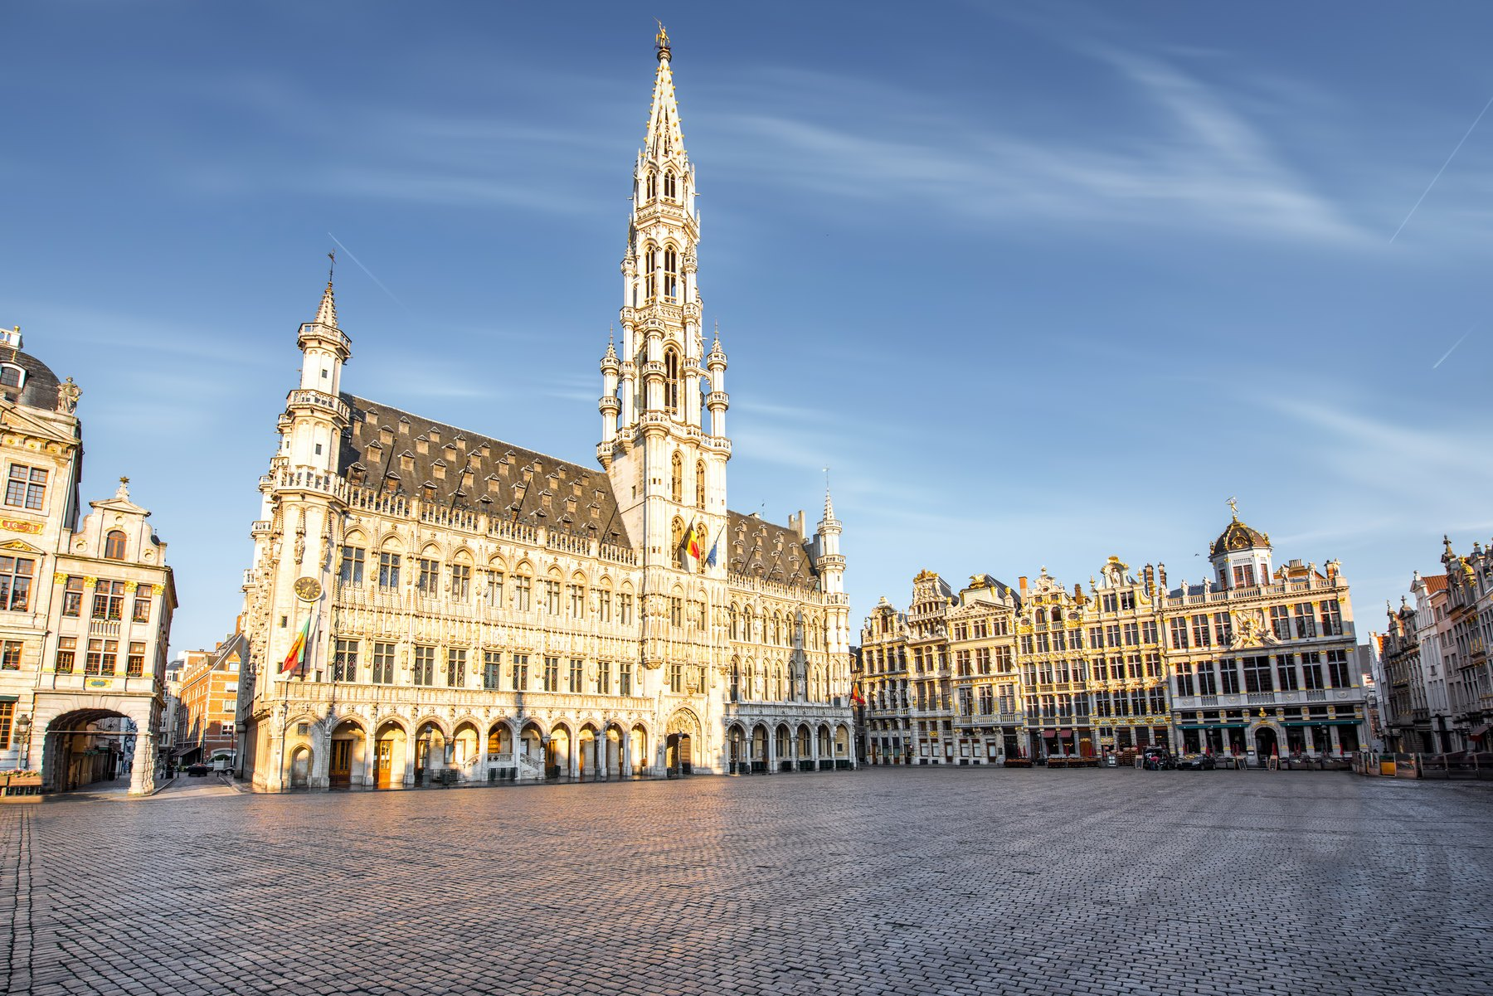
FRENCH-SPEAKING WORLD PROJECT · FREN 201
BELGIUM
The Kingdom of Belgium
A French-speaking country in the heart of Europe —
and the capital of the European Union.
Name ______________________________ Date ____________________
Notes:
[0:15] Belgium — a French-speaking country in Europe, and the country that hosts the capital of the EU. Region chosen for the assignment: Europe.

Slide 2
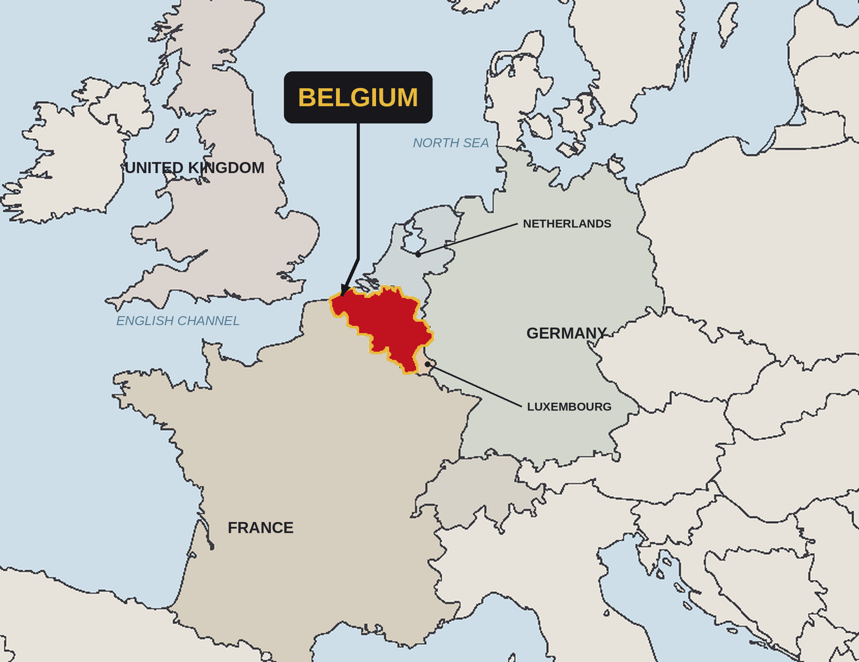
LOCATION
Western Europe, on the North Sea
FOUR NEIGHBOURS
France
south
Netherlands
north
Germany
east
Luxembourg
south-east
THE LAND
Flat coast and farmland in the north. Rolling plateaus in the middle, where Brussels sits. Forested Ardennes hills in the south.
30,689 km² — about the size of Maryland.
Belgium marked in red on the blank outline map supplied with the assignment.
2
Belgium · FREN 201 · French-Speaking World Project
Notes:
[0:45] The map requirement. Belgium is the red country, surrounded by France, the Netherlands, Germany and Luxembourg, with a short North Sea coast facing Britain. Small country, but it sits exactly where Germanic and Latin Europe meet.

Slide 3
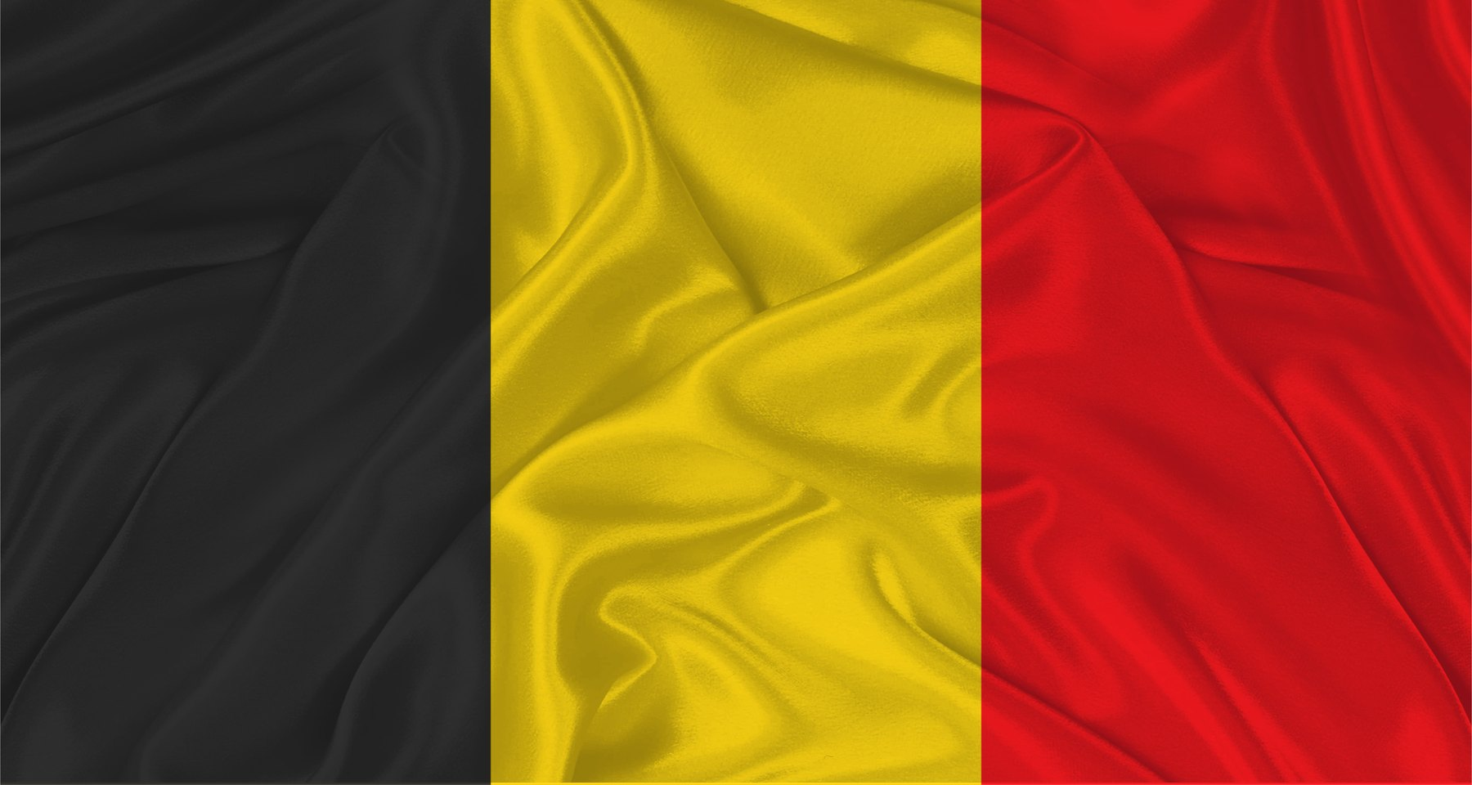
KEY FACTS
Belgium at a glance
11.8 M
30,689
3
1830
people
square km
official languages
independence
Official name
Kingdom of Belgium
Capital
Brussels
Status
Independent since 1830
Government
Federal parliamentary constitutional monarchy
Head of State
King Philippe, since 2013
The tricolour of 1830 — black, yellow and red.
Prime Minister
Bart De Wever, since 2025
Languages
Dutch, French and German
INDEPENDENT COUNTRY
Belgium is not a French territory. It is a sovereign state that happens to share the language.
Currency
Euro (€)
3
Belgium · FREN 201 · French-Speaking World Project
Notes:
[0:35] Two things to stress: Belgium is fully independent — not a French territory — and it is a monarchy that also has a prime minister. The next slides explain how that works.

Slide 4
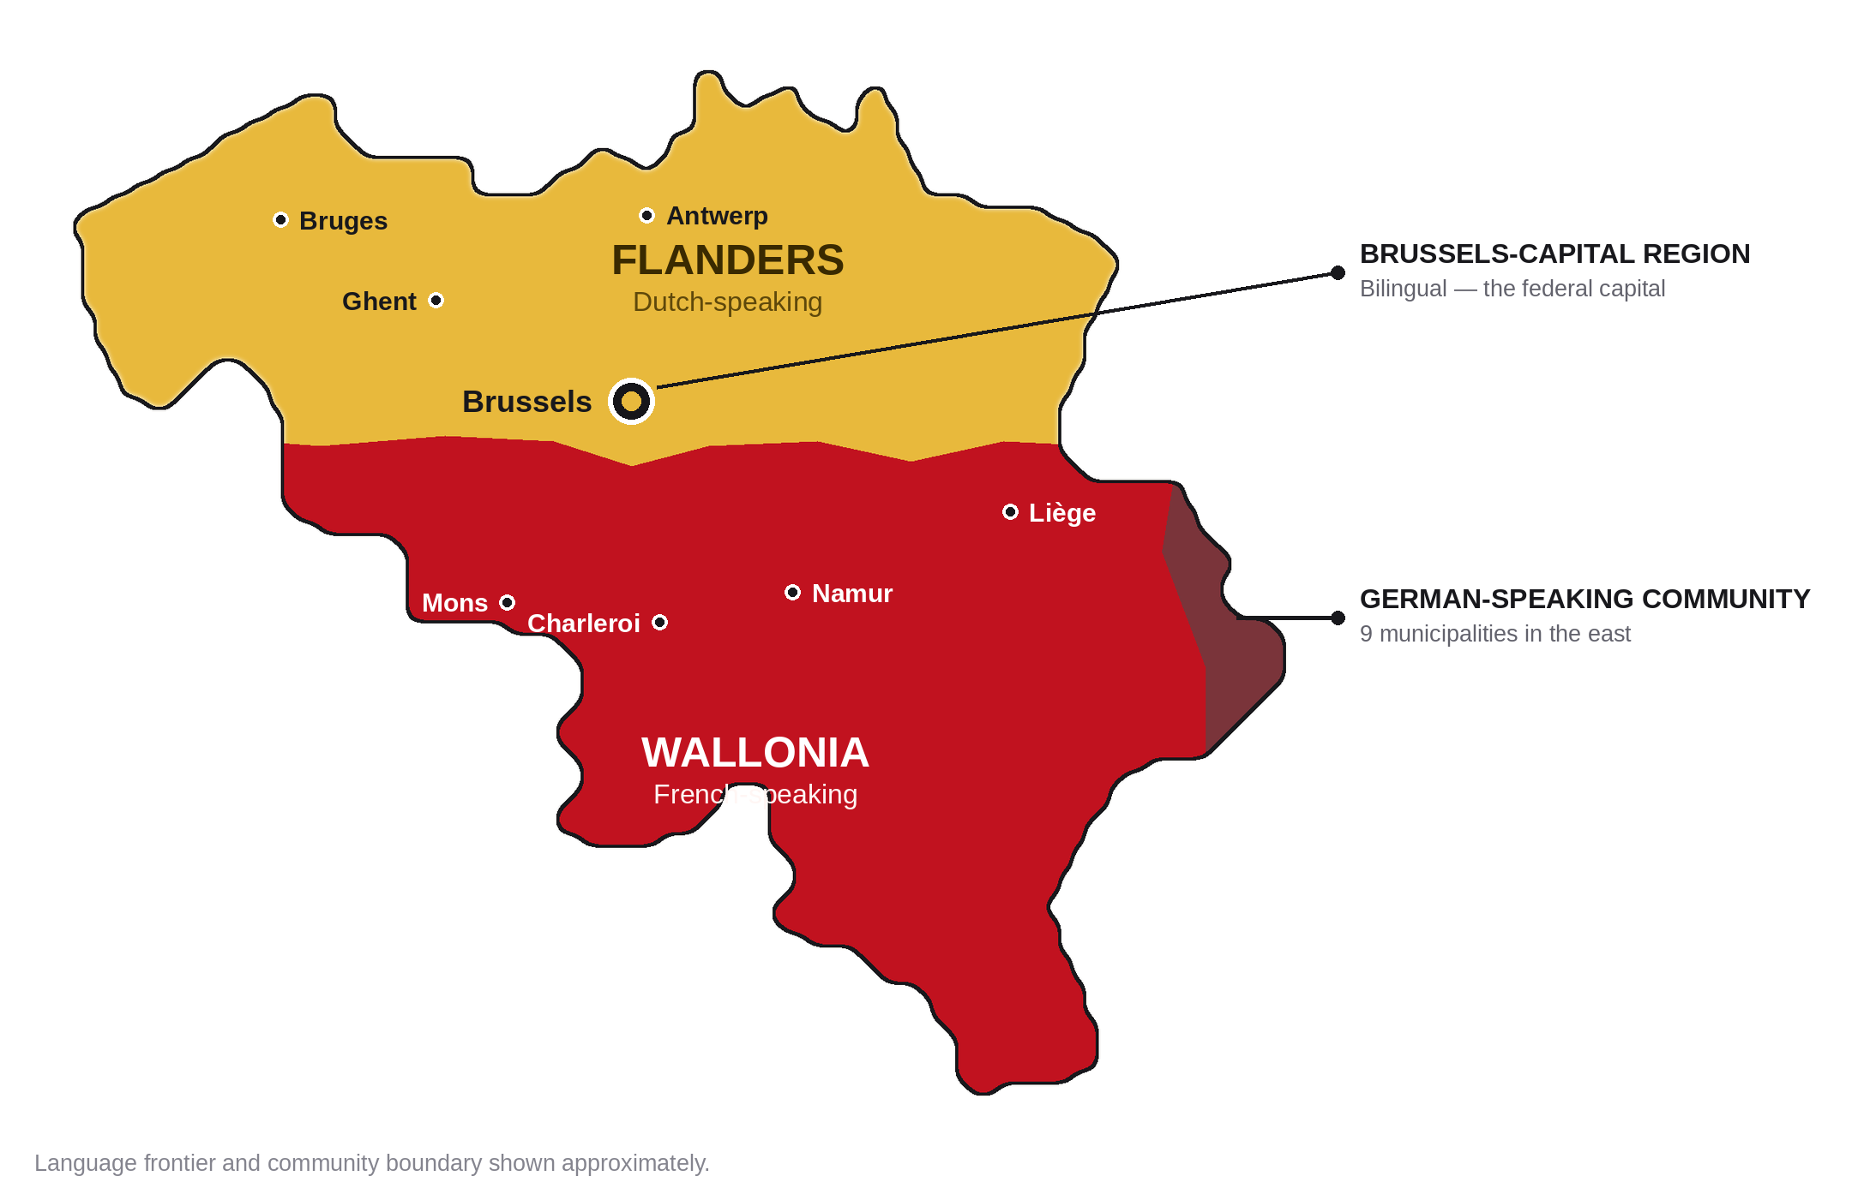
REGIONS AND LANGUAGES
One country, three languages
FLANDERS
Dutch-speaking, in the north
58 % of the population
WALLONIA
French-speaking, in the south
32 % of the population
BRUSSELS
Bilingual, the capital
11 % of the population
Each region has its own parliament and government. There is also a small German-speaking community of about 78,000 people in the east.
About 60 % of Belgians speak Dutch, 40 % speak French, and under 1 % speak German.
4
Belgium · FREN 201 · French-Speaking World Project
Notes:
[0:45] The most important slide for understanding Belgium. Gold is Dutch-speaking Flanders, red is French-speaking Wallonia, and Brussels is the bilingual capital — a French-speaking island inside Flanders. This split runs through everything.

Slide 5
THE NAME
What Belgium used to be called
57 BC
The Belgae
Julius Caesar writes about the Belgae, the tribes living here. Every later name comes from theirs.
“Of all these peoples, the bravest are the Belgae.”
22 BC
Gallia Belgica
Rome makes the territory a province and gives the name to a piece of land for the first time.
Julius Caesar, 57 BC
1556–1794
The Spanish, then Austrian Netherlands
Ruled from Madrid and then from Vienna — the Catholic southern half of the Low Countries.
A DETAIL WORTH KNOWING
The title is King of the Belgians, not King of Belgium. The crown belongs to a people, not to a piece of land — and that wording was chosen deliberately in 1831.
1830
The Kingdom of Belgium
The modern name. In Dutch, Koninkrijk België; in German, Königreich Belgien.
5
Belgium · FREN 201 · French-Speaking World Project
Notes:
[0:30] The name goes straight back to Caesar. Use the quote and the King of the Belgians detail — both are easy to remember and both make the same point about people rather than territory.

Slide 6
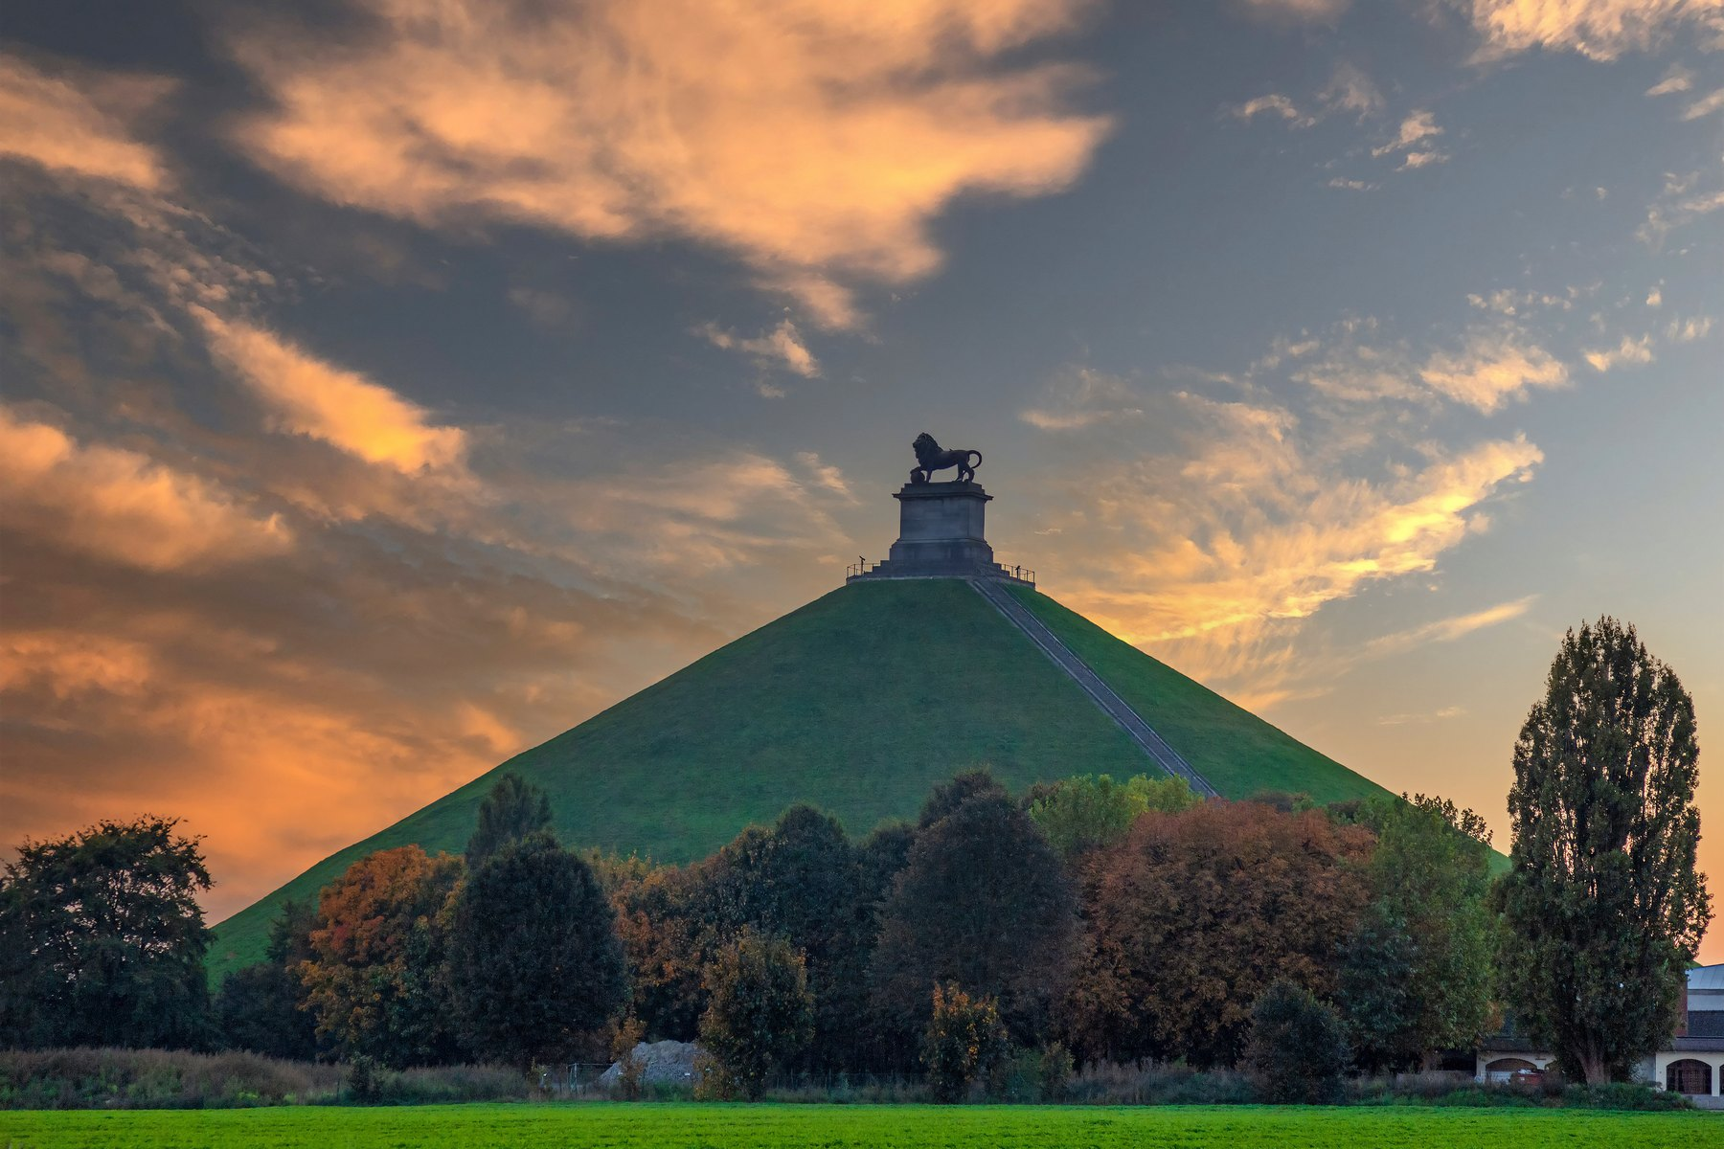
HISTORY, PART 1
Ruled by everyone else
57 BC
Rome conquers the Belgae
The land becomes a Roman province and stays Roman for four hundred years.
5th c.
The Franks
Frankish kings take over and rule from the Meuse valley — Charlemagne's family heartland.
11th–15th c.
Rich cloth cities
Bruges, Ghent and Ypres grow wealthy weaving wool, and Flemish painting has its golden age.
1556–1794
Spanish, then Austrian rule
The Catholic south splits away from the Protestant Dutch north — the border we still have today.
1795–1815
France, then Waterloo
France annexes the land and makes French official. Napoleon falls at Waterloo in 1815.
THE LION'S MOUND, WATERLOO
Napoleon was defeated here on 18 June 1815, 15 km south of Brussels.
6
Belgium · FREN 201 · French-Speaking World Project
Notes:
[0:45] One idea: for two thousand years this land was ruled from somewhere else — Rome, Burgundy, Madrid, Vienna, Paris. Independence in 1830 is very recent. Don't read every row; make that point and gesture at Waterloo.

Slide 7
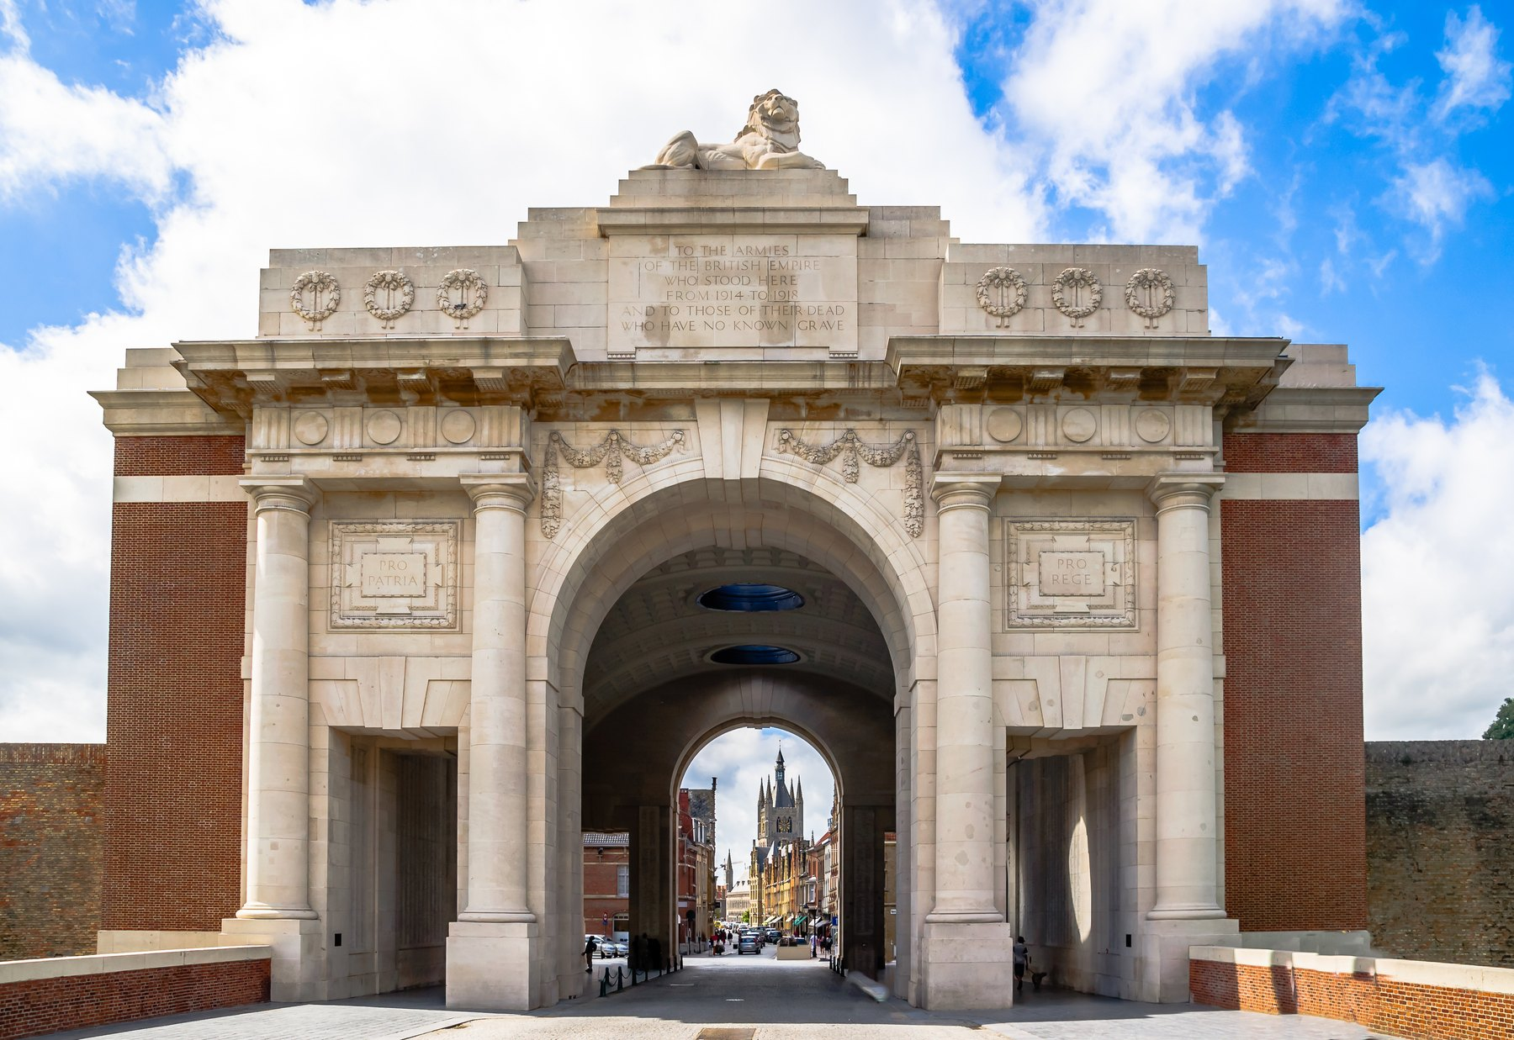
HISTORY, PART 2
Independence, empire and war
1830
Revolution and independence
Riots in Brussels drive out the Dutch. Independence is declared on 4 October.
1831
A king and a constitution
Leopold I is sworn in on 21 July — a date that is still the national day.
1885–1960
The Congo
Leopold II runs the Congo as a brutal private colony; Belgium takes it over in 1908. The Congo becomes independent in 1960.
1914–1945
Invaded twice
Germany breaks Belgian neutrality in 1914 and again in 1940. The Western Front settles into Flanders.
1970–2014
Six state reforms
Tension between Dutch and French speakers turns a single unified state into today's federation.
THE MENIN GATE, YPRES
A memorial to 54,000 missing soldiers. The Last Post has sounded here every evening since 1928.
7
Belgium · FREN 201 · French-Speaking World Project
Notes:
[0:50] Worth saying out loud: in 2020 King Philippe expressed his 'deepest regrets' for the wounds of the colonial past — the first Belgian monarch to do so. Then finish on the Menin Gate: the Last Post still sounds there every night.

Slide 8
POLITICAL ORGANISATION
How Belgium is governed
DEMOCRACY
MONARCHY
FEDERAL
PARLIAMENTARY
not a dictatorship
not a republic
not one central state
government answers to parliament
1
THE FEDERAL GOVERNMENT
King Philippe as Head of State, Prime Minister Bart De Wever, and a Chamber of 150 elected members
Defence, justice, police, foreign affairs, taxes
2
THE THREE REGIONS
Flanders, Wallonia and Brussels-Capital — each with its own parliament and government
Economy, transport, housing, environment
3
THE THREE COMMUNITIES
The Flemish, French and German-speaking communities
Education, culture and language
Voting is compulsory from age 18, and every federal government is a coalition.
8
Belgium · FREN 201 · French-Speaking World Project
Notes:
[0:50] This answers the assignment's question directly. The four boxes across the top are the whole answer: a democracy, a monarchy, federal, parliamentary. Then point at the three levels — a country of 11.8 million with six parliaments. Compulsory voting usually gets a reaction.

Slide 9
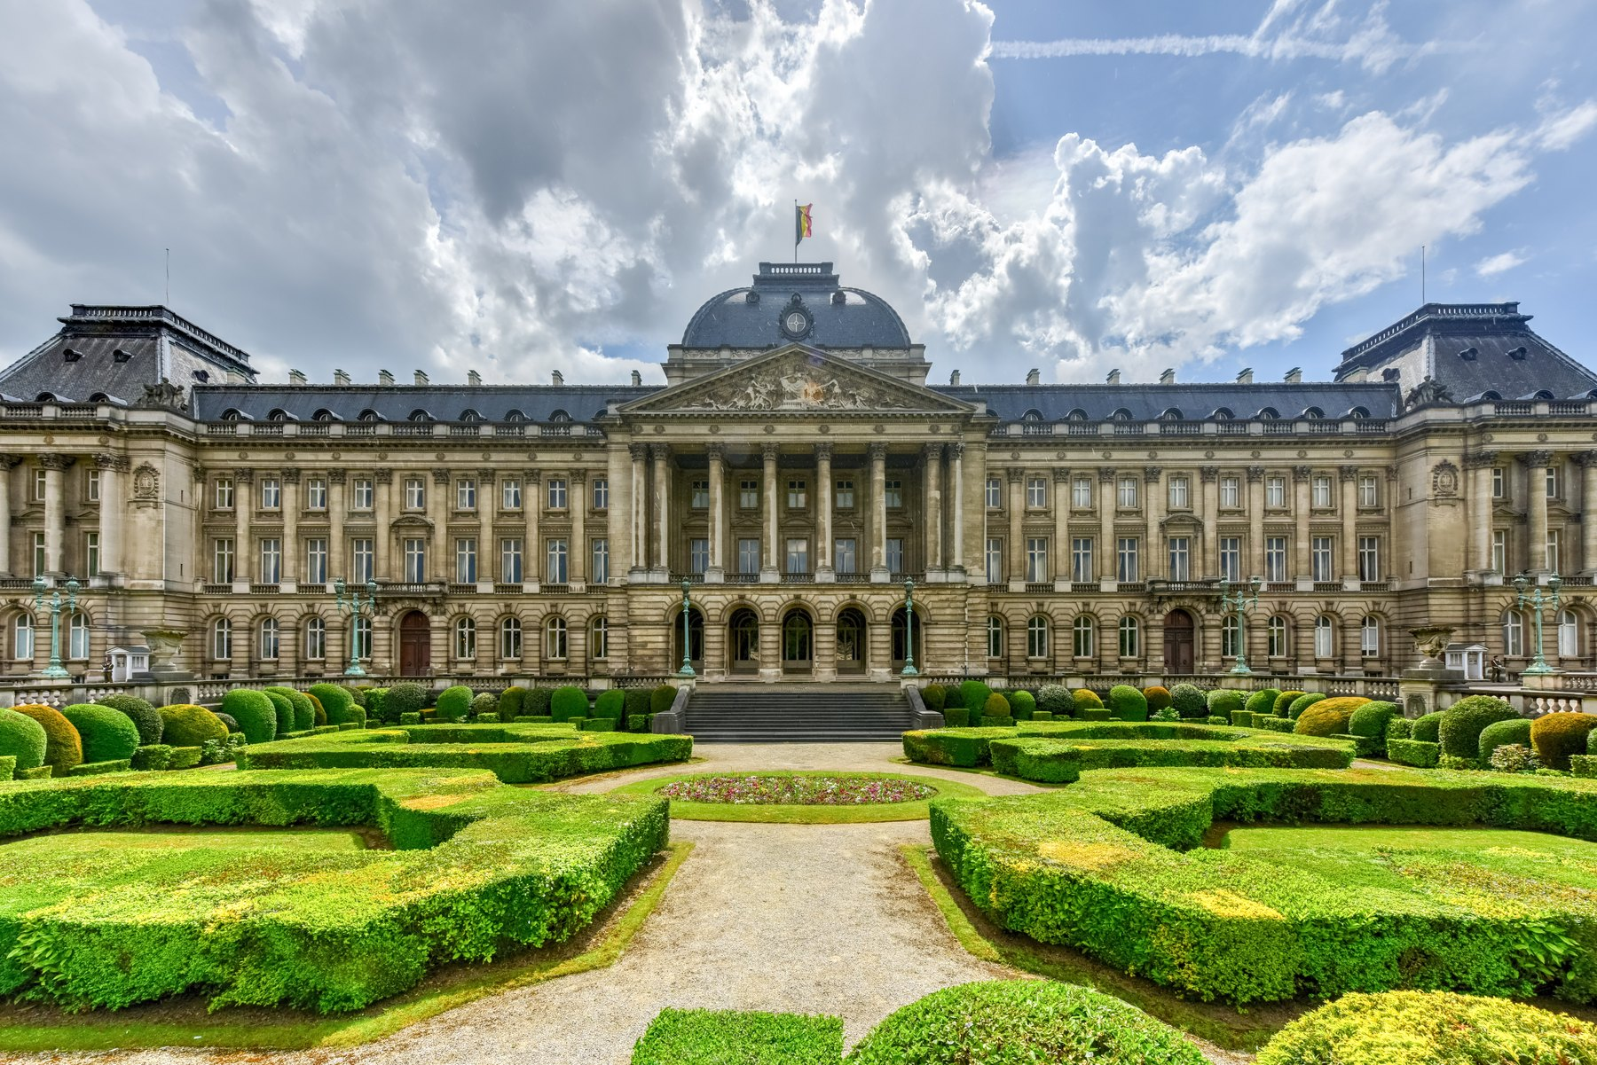
LEADERSHIP
Who leads Belgium today
HEAD OF STATE
King Philippe
The seventh King of the Belgians, on the throne since 2013. His heir, Princess Elisabeth, will be Belgium's first reigning queen.
He signs laws but cannot veto them.
HEAD OF GOVERNMENT
Bart De Wever
Prime Minister since February 2025, leading a coalition of five parties. He answers to parliament, not to the King.
Belgium once went 541 days without an elected government.
THE ROYAL PALACE, BRUSSELS
The King's official workplace. The royal family lives at Laeken, outside the city.
9
Belgium · FREN 201 · French-Speaking World Project
Notes:
[0:45] Two people, two different jobs. The King reigns but does not rule — no veto. De Wever governs. The 541-day record is the line people remember: use it to explain why the language split makes forming a government so hard.

Slide 10
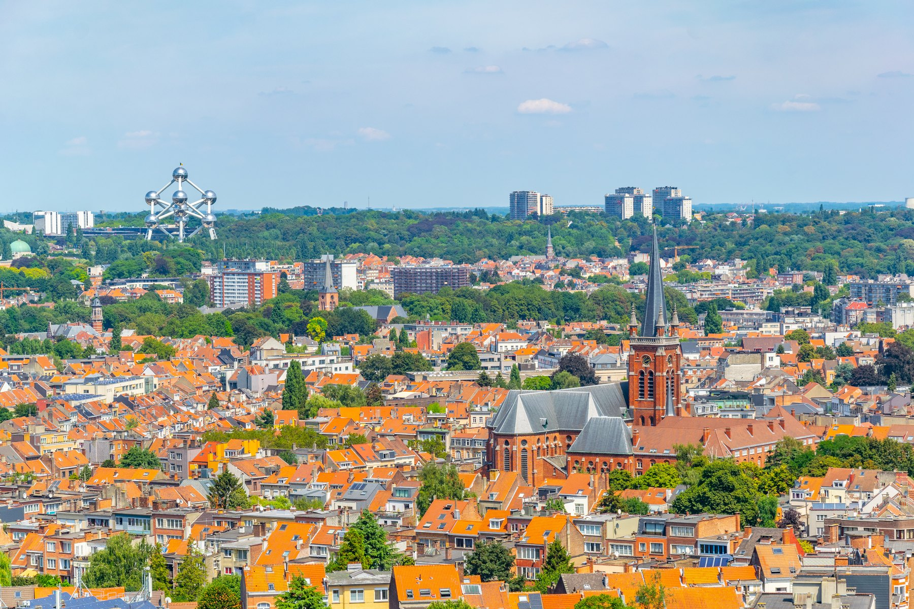
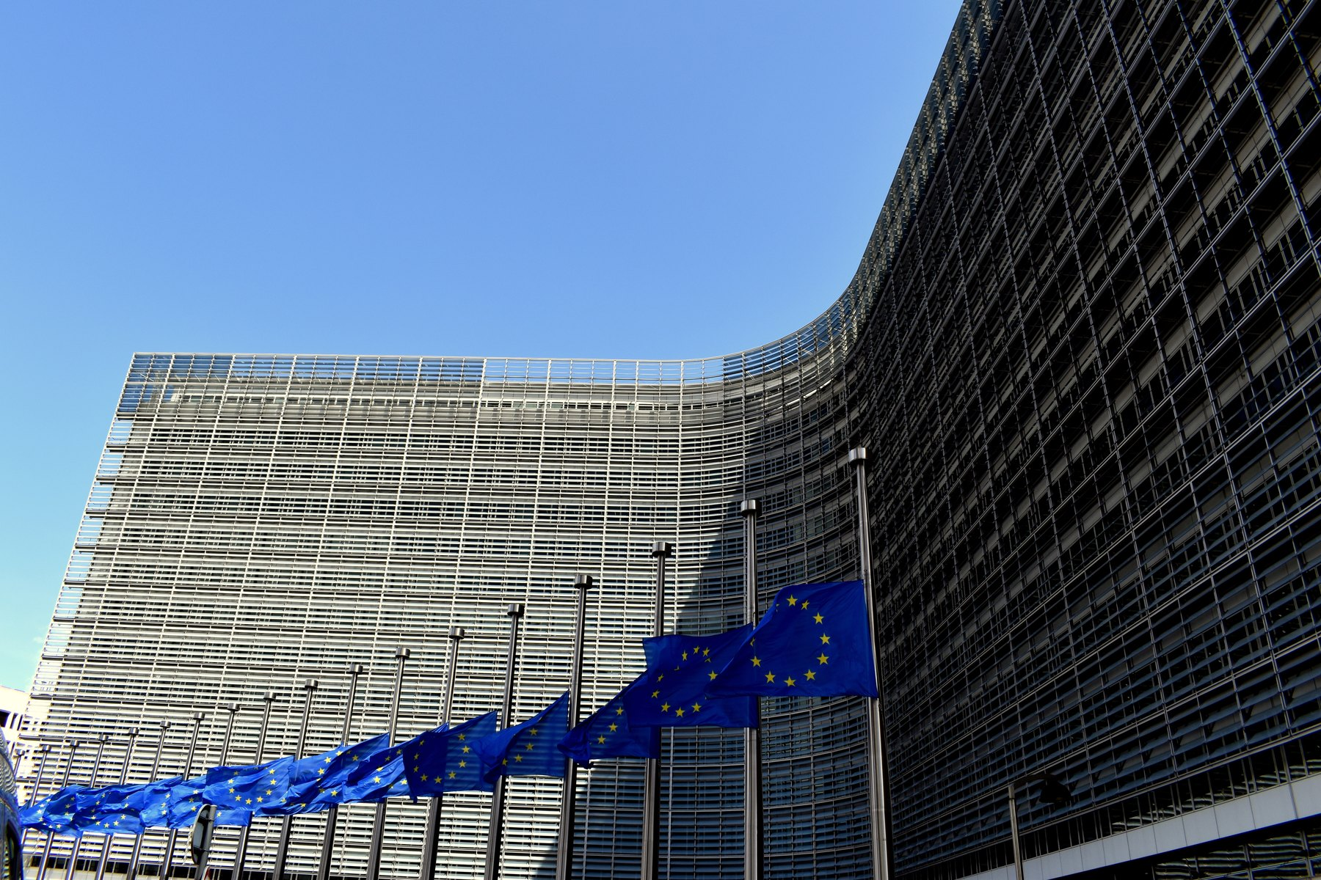
THE CAPITAL
Brussels — capital of Belgium and of Europe
1.25 million people
in the Brussels-Capital Region; about 2.1 million in the wider area.
Officially bilingual
French and Dutch are equal, but about 80 % of residents speak French.
Capital of the EU
Home to the European Commission and the Council of the EU.
NATO headquarters
Left: Brussels, with the Atomium on the horizon. Right: the Berlaymont, home of the European Commission.
Since 1967. Belgium was a founding member of NATO in 1949.
TO SEE IN BRUSSELS
The Grand-Place, a UNESCO World Heritage site · Manneken Pis · the Atomium · the Magritte Museum · the Belgian Comic Strip Center
10
Belgium · FREN 201 · French-Speaking World Project
Notes:
[0:40] The payoff slide. A city of 1.25 million that runs a continent: the European Commission, the Council, and NATO. And it is a French-speaking island inside Dutch-speaking Flanders, which is part of why it works as neutral ground.

Slide 11
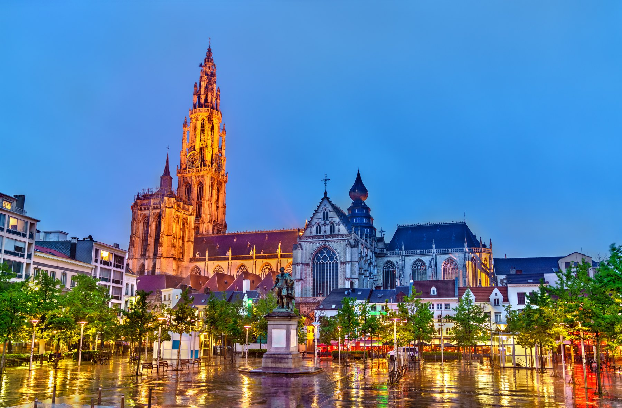
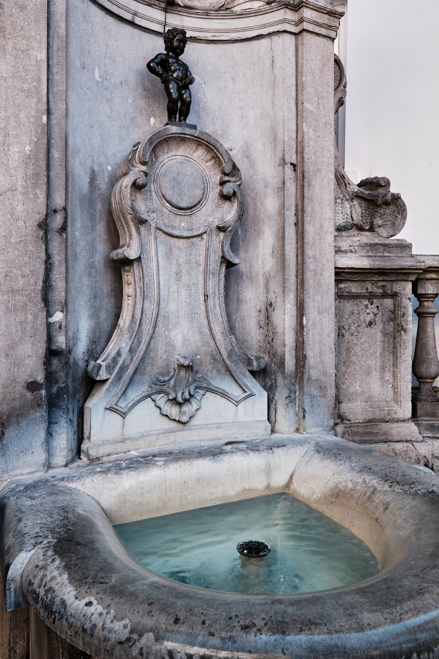
CULTURE
Painting, comics and music
PAINTING
Jan van Eyck, Pieter Bruegel and Peter Paul Rubens all worked here. In the 20th century René Magritte made Belgian surrealism famous with the painting of a pipe labelled “this is not a pipe”.
COMICS
Belgium invented the modern European comic and calls it the ninth art. Tintin, the Smurfs and Lucky Luke are all Belgian. Brussels has a comic museum and a trail of painted murals.
The Cathedral of Our Lady, Antwerp — it holds four Rubens altarpieces.
MUSIC AND FILM
Adolphe Sax, born in Dinant in 1814, invented the saxophone. The Dardenne brothers have won the top prize at Cannes twice.
Manneken Pis, Brussels — cast in bronze in 1619.
11
Belgium · FREN 201 · French-Speaking World Project
Notes:
[0:35] Pick two, don't read all three. Best bets: Magritte, because everyone has seen the pipe painting, and Tintin and the Smurfs, because almost nobody knows they are Belgian. Finish with the saxophone.

Slide 12
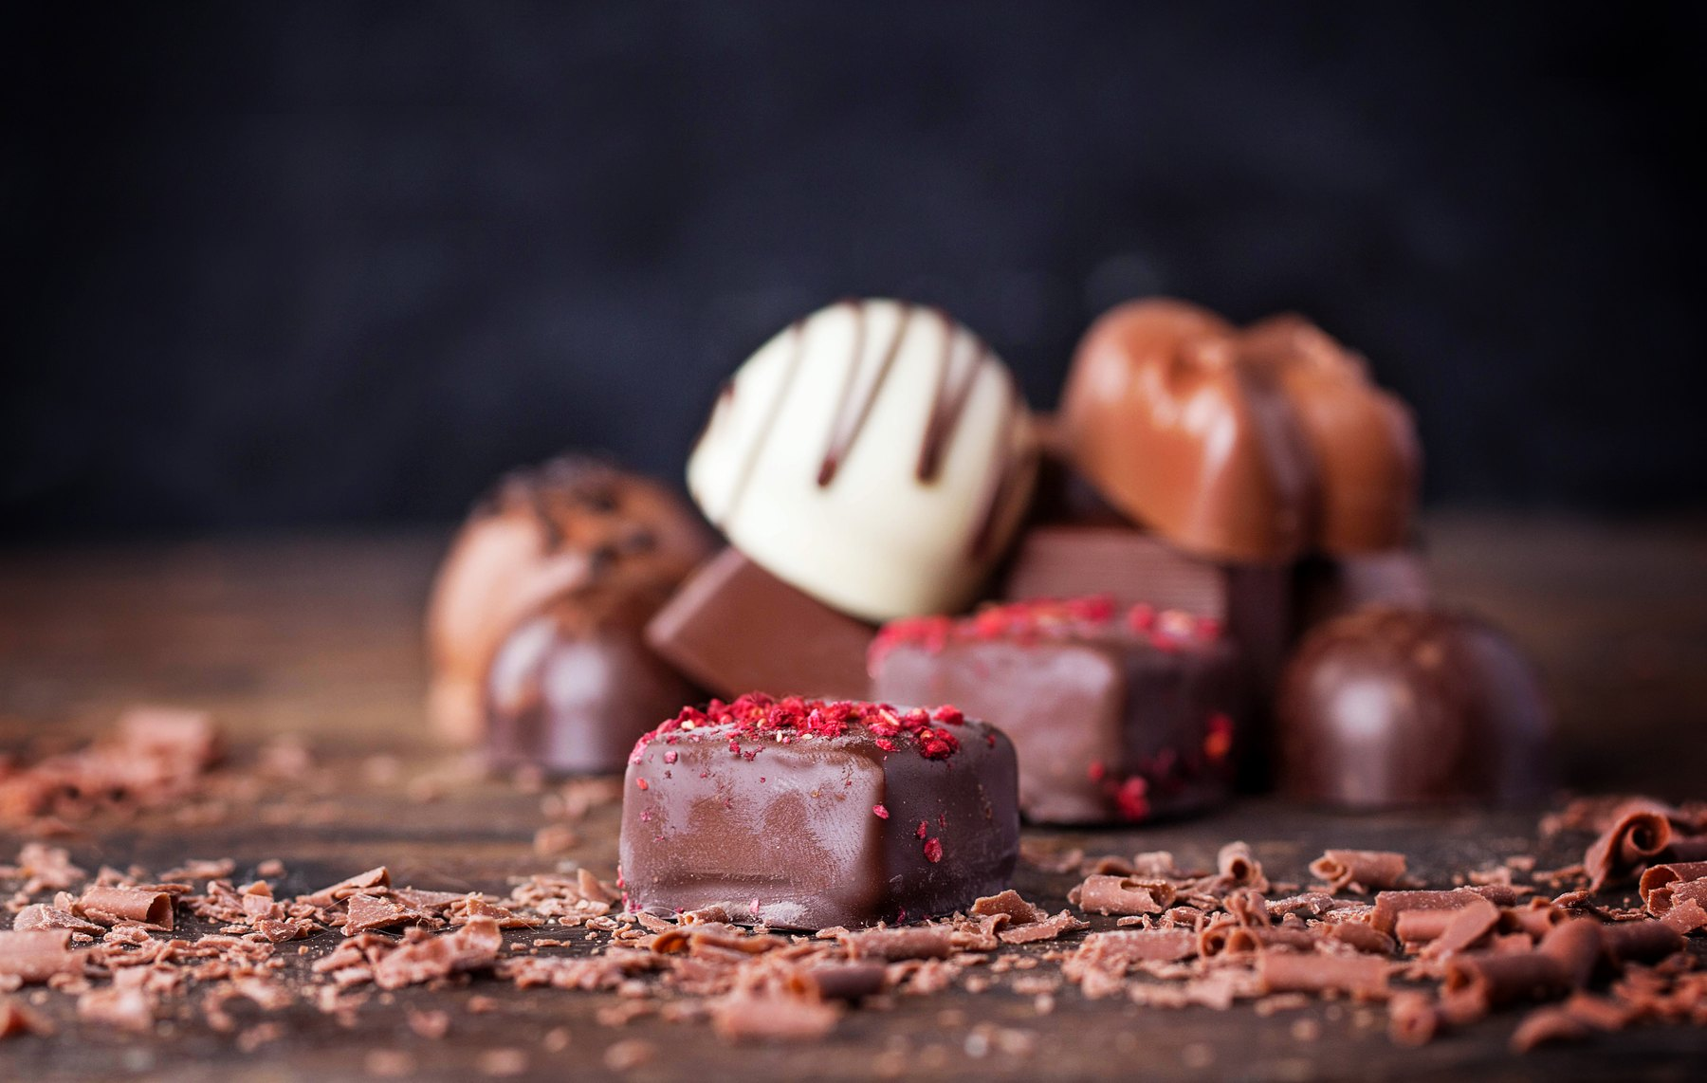
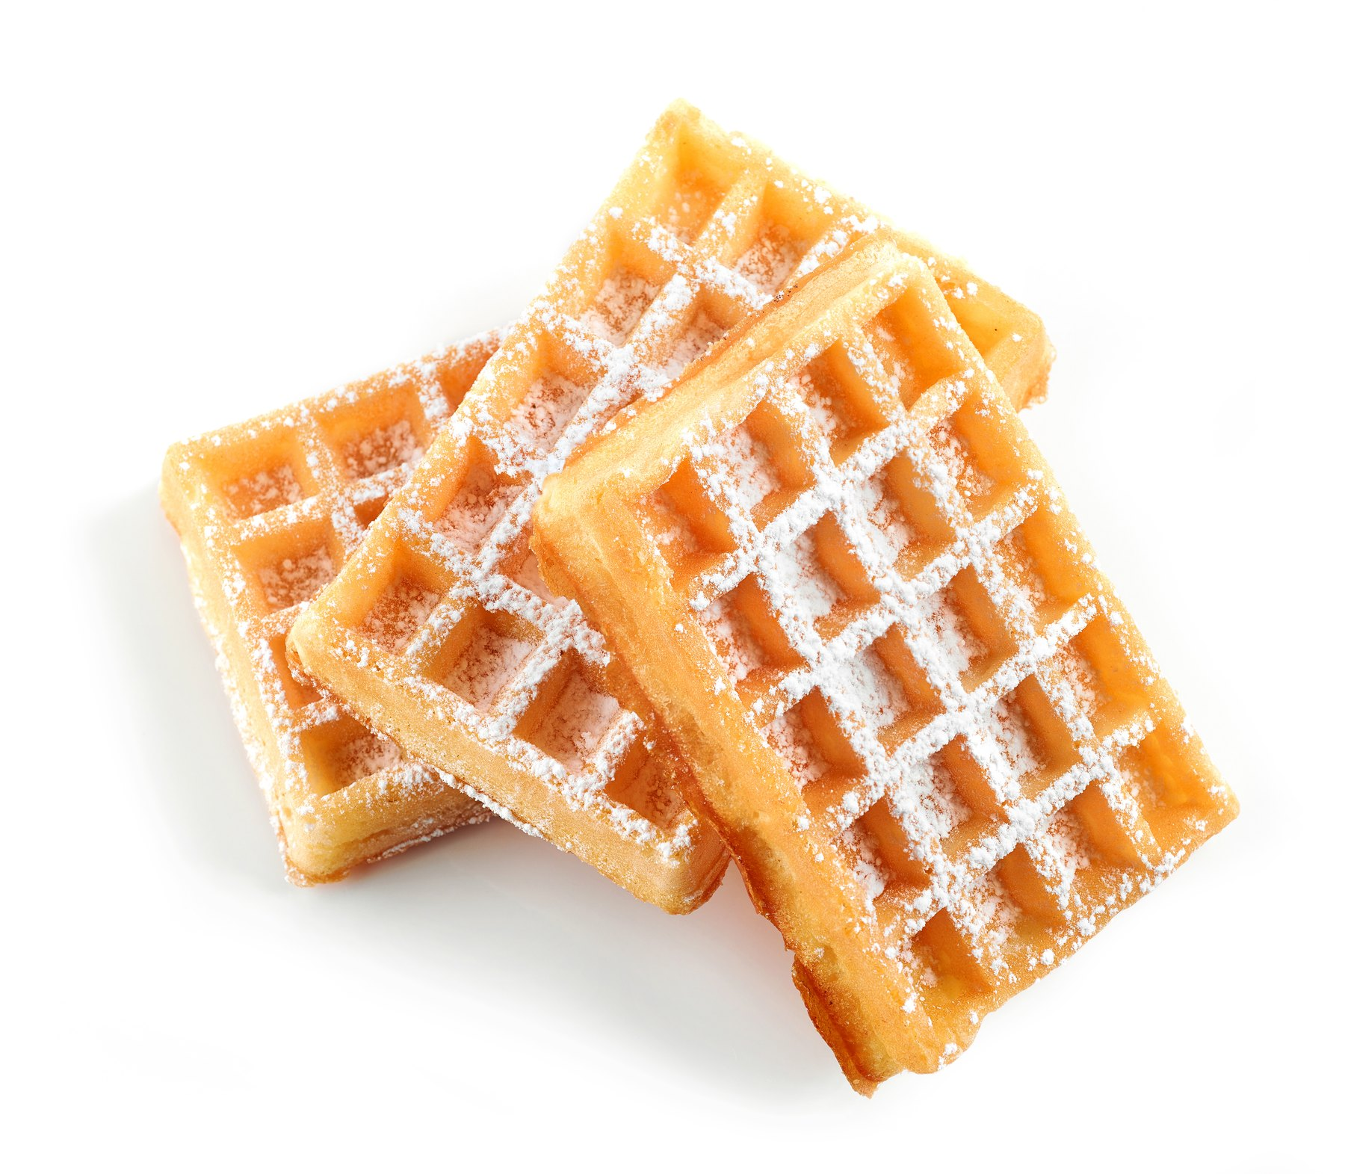
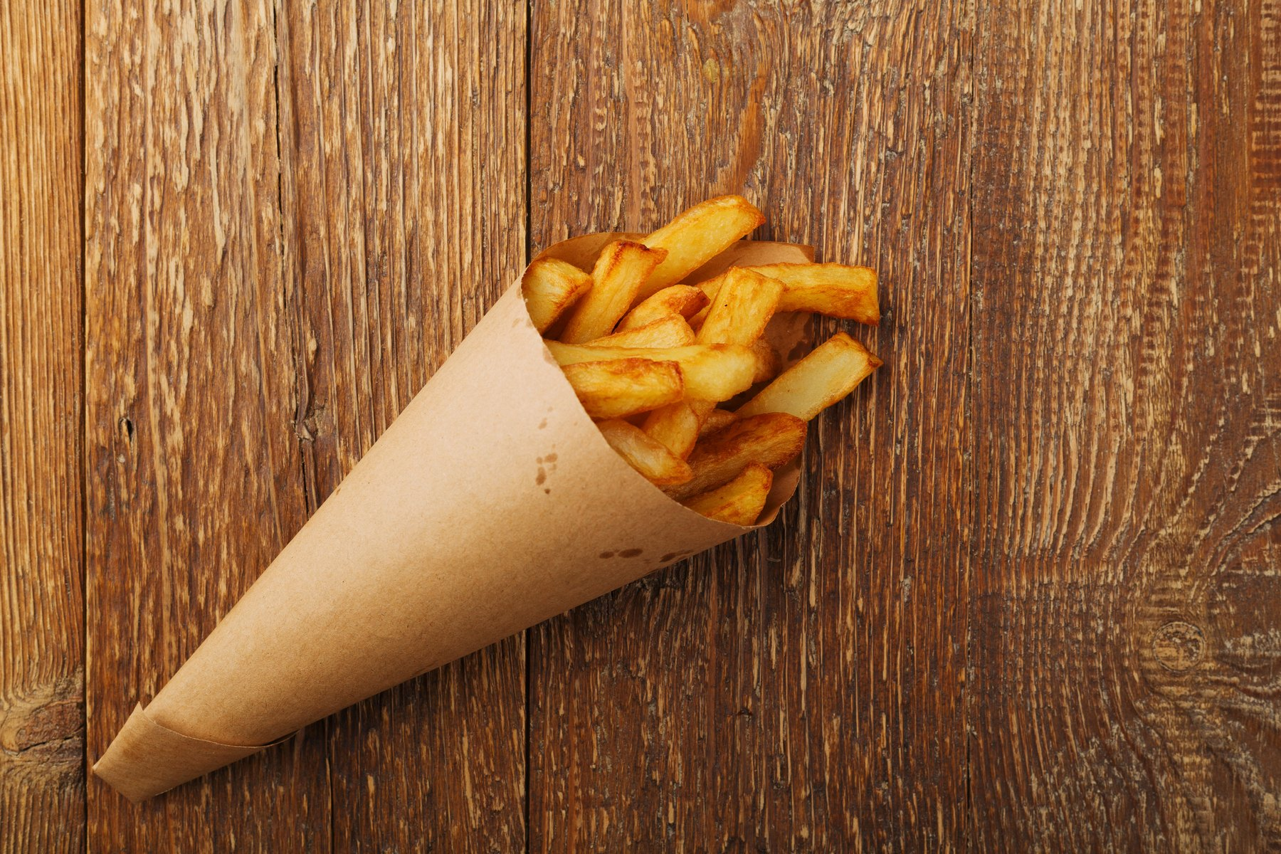
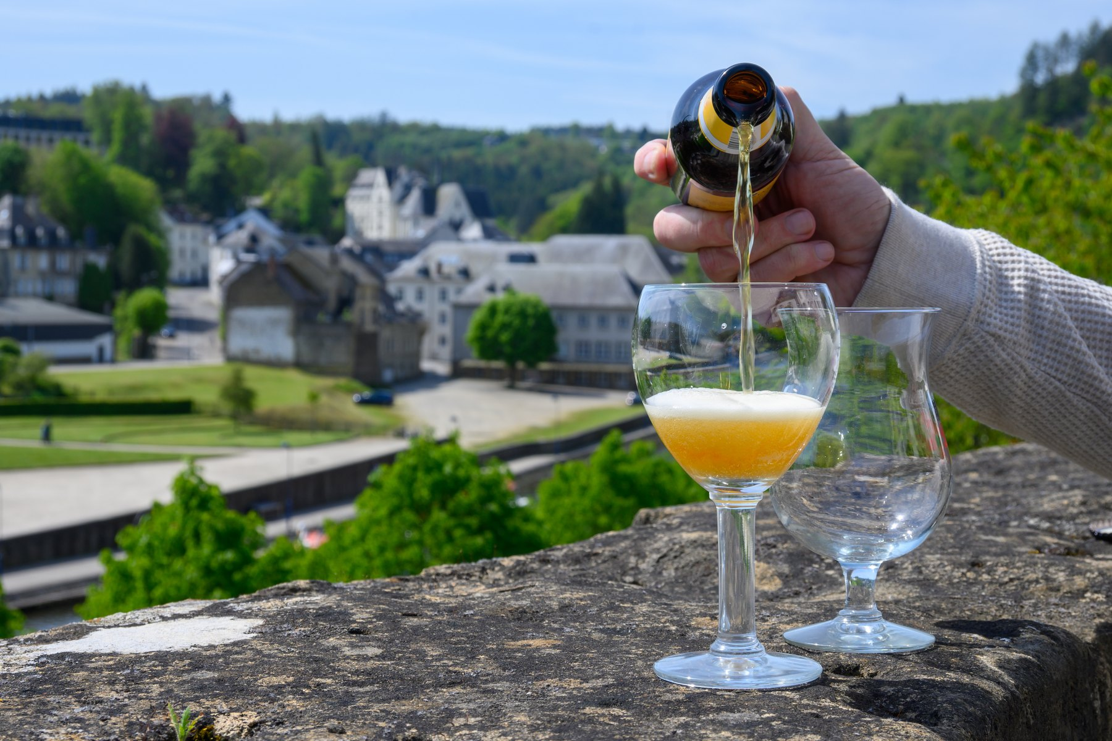
FOOD AND DRINK
Four things Belgium is famous for
CHOCOLATE
WAFFLES
FRIES
BEER
The filled praline was invented in Brussels in 1912. Belgium has hundreds of chocolate makers.
Two rival kinds: the light Brussels waffle, and the dense Liège waffle made with pearl sugar.
Belgians say they invented them. They fry them twice and serve them in a paper cone with mayonnaise.
Over a thousand Belgian beers. UNESCO added Belgian beer culture to its heritage list in 2016.
Other Belgian dishes: mussels and fries, beef stewed in beer, waterzooi, and speculoos biscuits.
12
Belgium · FREN 201 · French-Speaking World Project
Notes:
[0:25] Move fast, the pictures do the work. Two facts: the praline was invented in Brussels in 1912, and Belgian beer culture is on the UNESCO heritage list. The fries-are-Belgian-not-French claim usually gets a laugh.

Slide 13
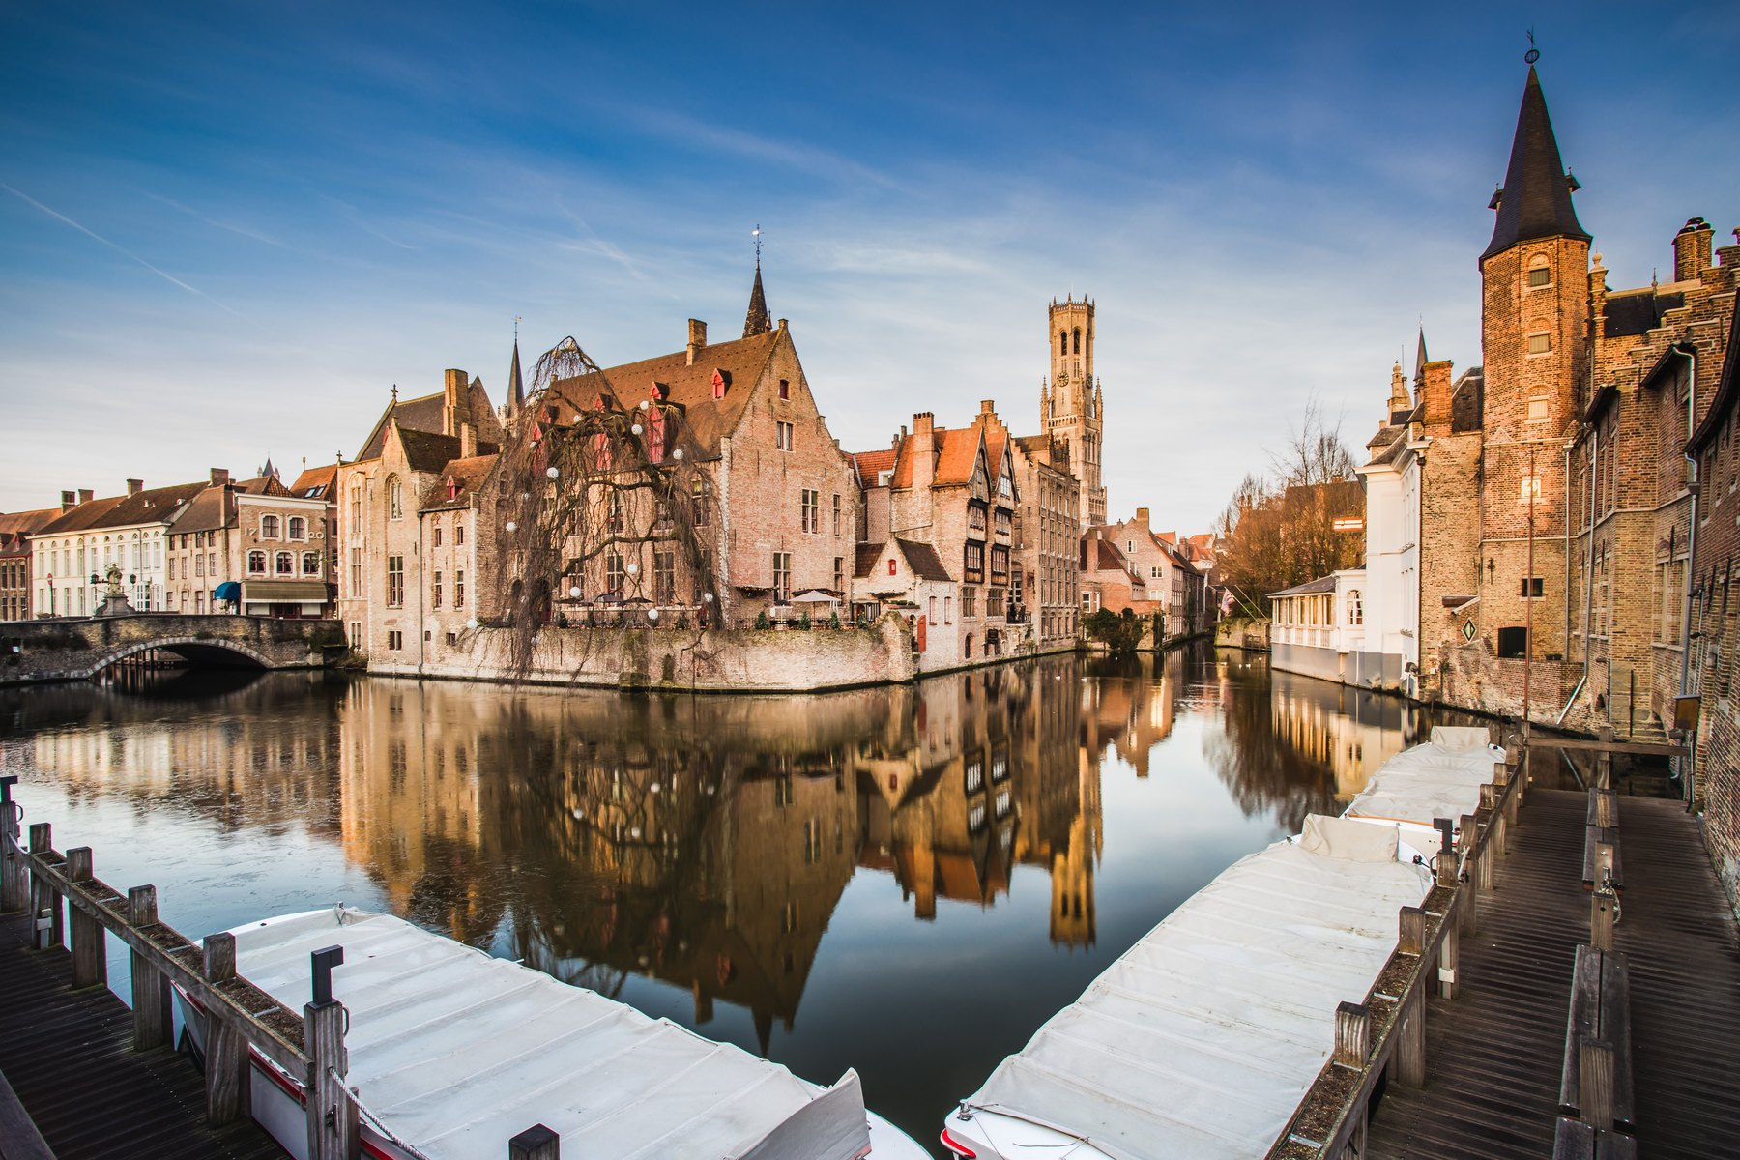
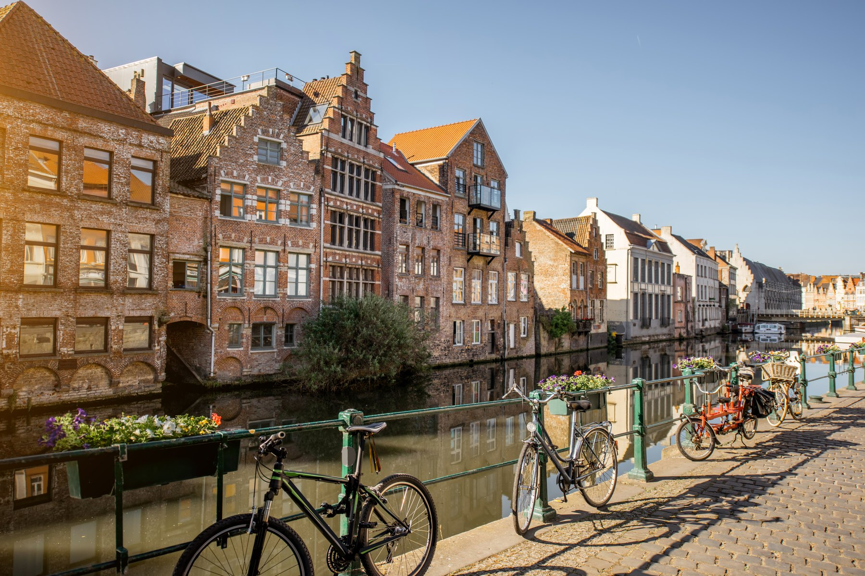
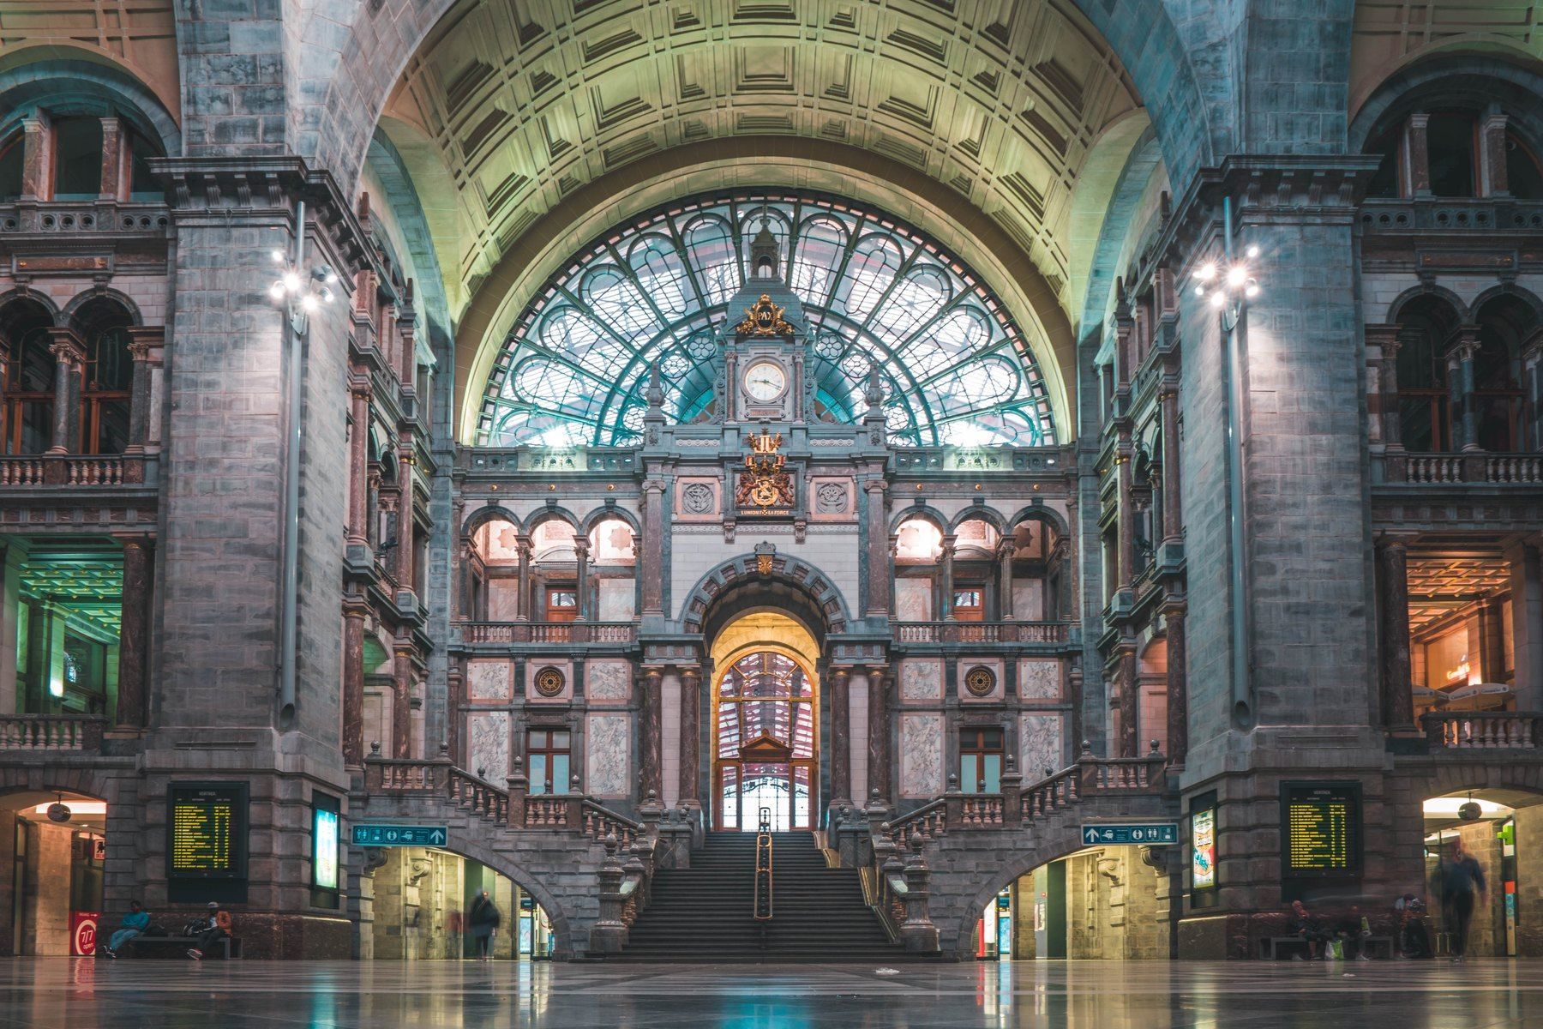
CITIES TO VISIT
Three cities worth the trip
BRUGES
GHENT
ANTWERP
Called the Venice of the North. The whole historic centre is a UNESCO World Heritage site — medieval brick houses, canals and a famous belfry.
A working city rather than a museum. A medieval castle, guild houses along the river, and van Eyck's Ghent Altarpiece in the cathedral.
Rubens' city and Belgium's port. Its central station is called the railway cathedral, and over 70 % of the world's rough diamonds pass through here.
Belgium has 13 UNESCO World Heritage sites in a country the size of Maryland.
13
Belgium · FREN 201 · French-Speaking World Project
Notes:
[0:30] Bruges is the postcard, Ghent is the one locals prefer, Antwerp is the working city. The diamond figure — over 70 % of the world's rough diamonds — is the one that lands.

Slide 14
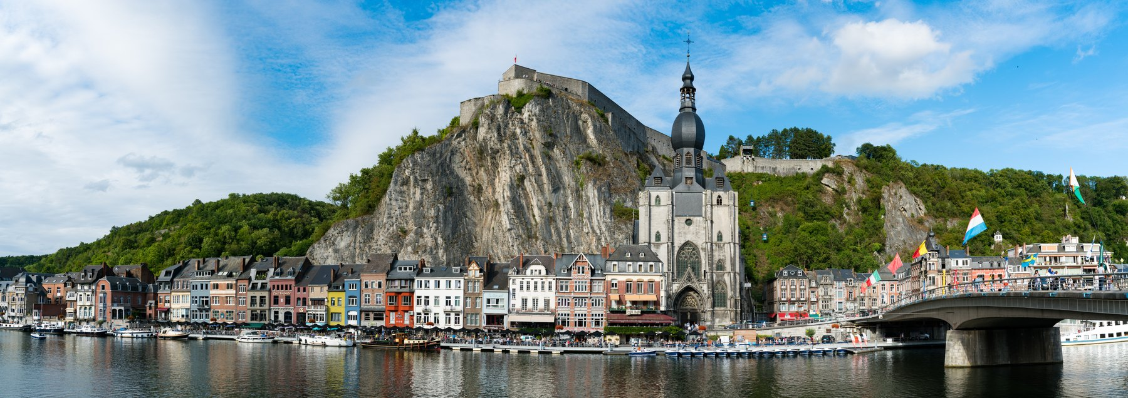
VISITOR INFORMATION
What a visitor needs to know
1
MONEY
2
GETTING IN
The euro. Cards work almost everywhere, and tipping is not expected.
Belgium is in the Schengen area. Americans can stay 90 days without a visa. Fly into Brussels.
3
GETTING AROUND
4
LANGUAGE
One of the densest rail networks in the world — almost nowhere is more than two hours away.
French in the south and in Brussels, Dutch in the north. English is widely spoken in cities.
5
WHEN TO GO
6
DON'T MISS
May to September for the weather, December for the Christmas markets. Bring a raincoat.
The Grand-Place at night, a canal boat in Bruges, and fries from a street stand.
Dinant, on the Meuse river — the birthplace of Adolphe Sax.
14
Belgium · FREN 201 · French-Speaking World Project
Notes:
[0:25] Fastest slide in the deck — do not read the boxes. Say three things: no visa for 90 days, the trains reach everything in two hours, and which language you open with matters. Then move on.

Slide 15
BELGIUM AND THE FRENCH-SPEAKING WORLD
A French-speaking country at the centre of Europe
4.5 million
2 seats
Different French
Belgians speak French as their first language — about 40 % of the country, living in Wallonia and Brussels.
Belgium helped found the international organisation of French-speaking countries, and holds two seats in it.
Belgians say septante for 70 and nonante for 90, where France says soixante-dix and quatre-vingt-dix.
Belgian French has its own words: un GSM for a mobile phone, une drache for a downpour, un kot for a student room.
Belgium is where Germanic and Latin Europe meet. It is a small, young country that has learned to hold three languages and six parliaments together — and it houses the capital of Europe while doing it.
15
Belgium · FREN 201 · French-Speaking World Project
Notes:
[0:30] Close here. Read the gold box out loud — that is the thesis of the whole presentation. Then stop and take questions.

Slide 16
SOURCES
Where these facts come from
1
belgium.be
The Belgian government's official portal — history, regions and institutions.
2
monarchie.be
The Belgian Monarchy — the King's role and duties.
3
premier.be
Office of the Prime Minister — the current federal government.
4
european-union.europa.eu
European Union country profile: Belgium.
5
whc.unesco.org
UNESCO World Heritage Centre — Belgium's listed sites and its beer culture.
6
Britannica · CIA World Factbook
Population, area, borders and geography.
7
visitflanders.com · visitwallonia.be
Official tourist boards — visitor information.
Photographs licensed from Adobe Stock. Both maps were drawn from the blank outline map supplied with the assignment; language boundaries are approximate.
16
Belgium · FREN 201 · French-Speaking World Project
Notes:
[0:05] Leave this up during questions. Slide timings add up to about 9 minutes 15, leaving buffer in a 10-minute slot.

