Slide 1
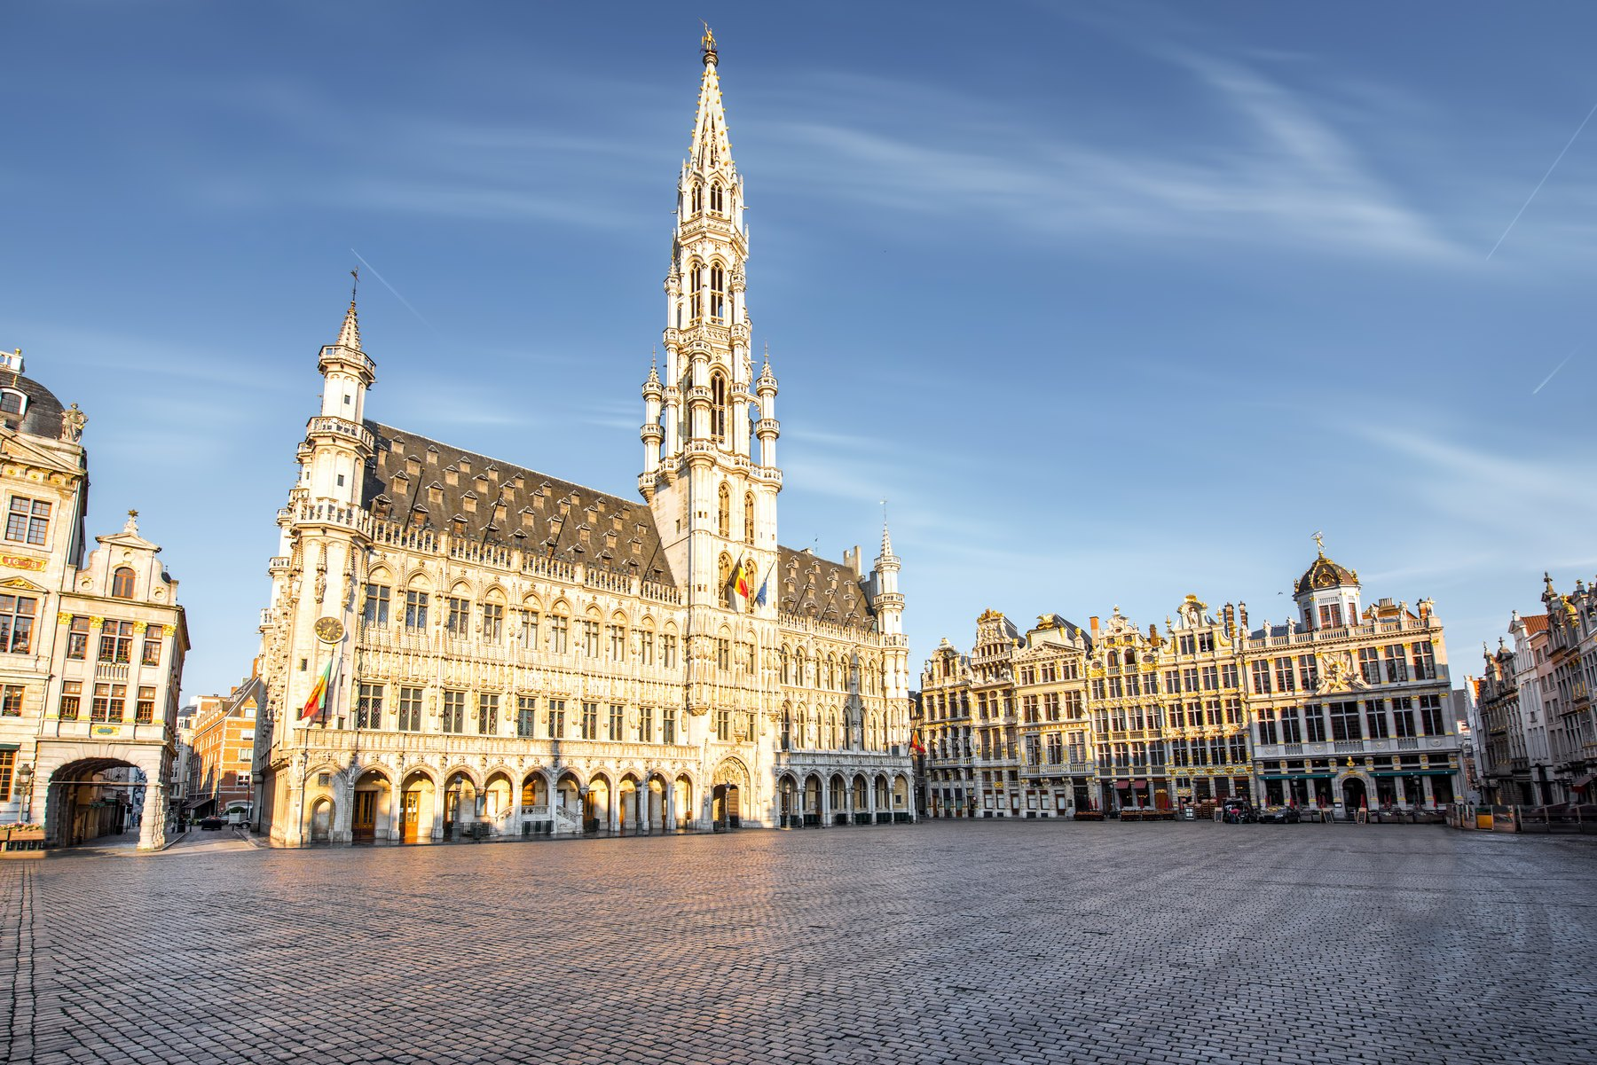
PROJET FRANCOPHONIE · FREN 201
LA BELGIQUE
Le Royaume de Belgique
Koninkrijk België · Königreich Belgien · Kingdom of Belgium
A French-speaking country in the heart of Europe —
and the capital of the European Union.
Nom ______________________________ Date ____________________
Notes:
[0:15] Open: Belgium — a French-speaking country in Europe, and the one that happens to host the capital of the EU. Region chosen for the assignment: Europe.

Slide 2
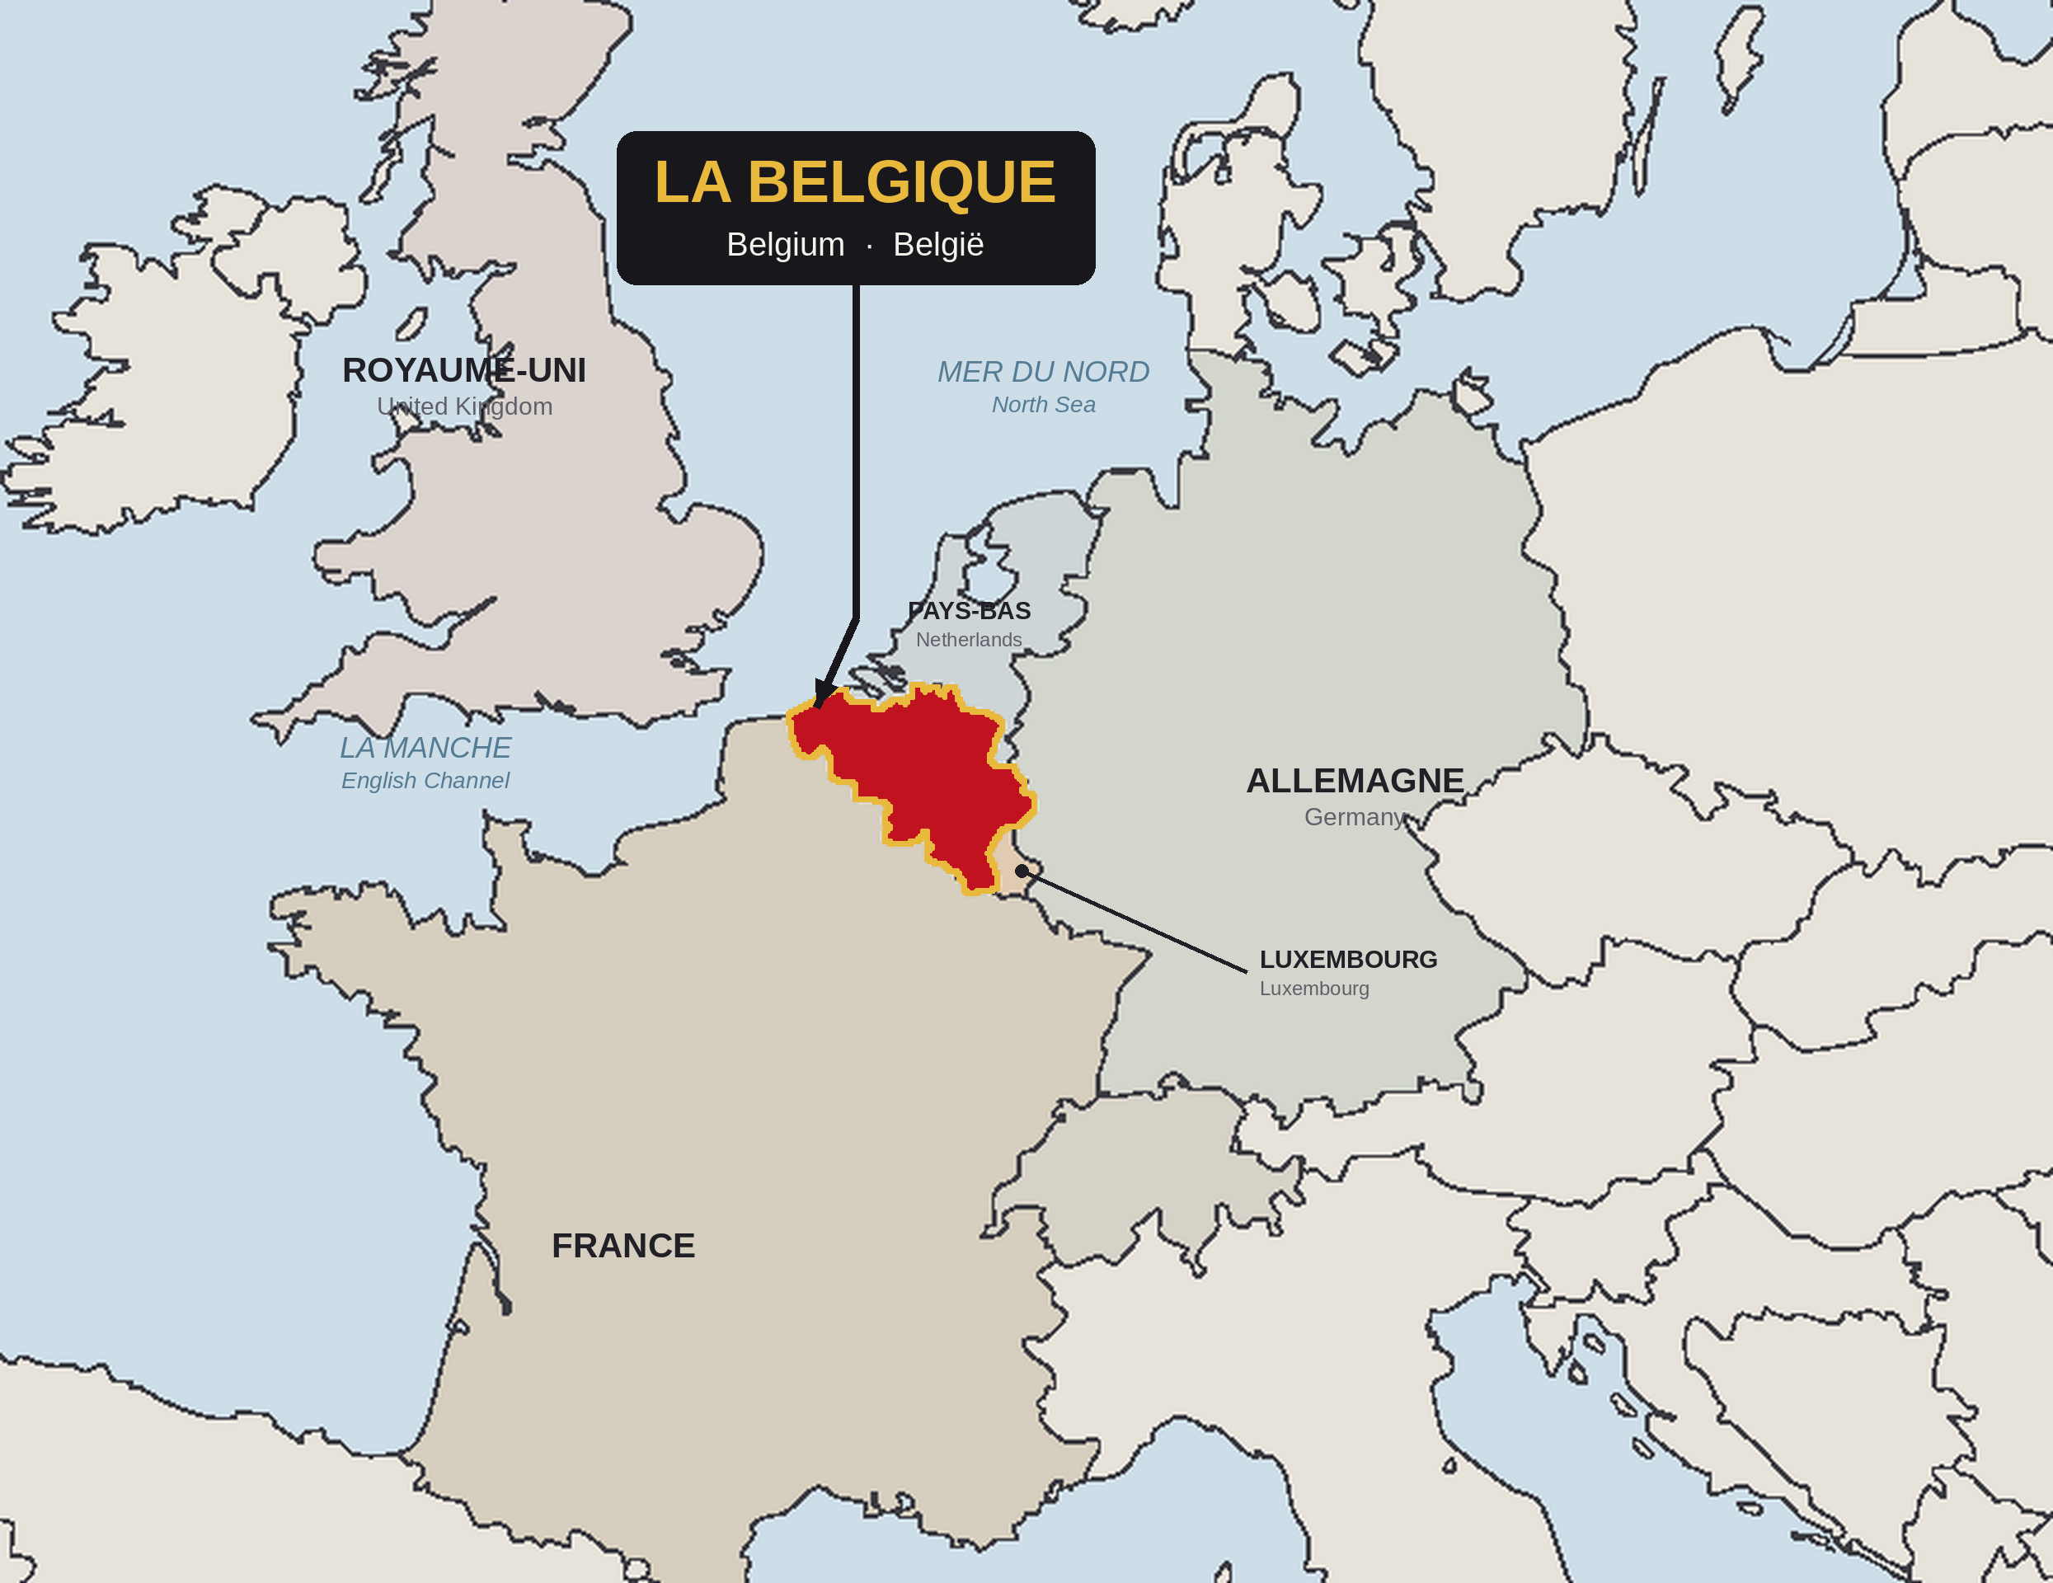
OÙ SE TROUVE LA BELGIQUE ?
Western Europe, on the North Sea
LAND BORDERS · 1,297 km IN TOTAL
France
556 km — south and south-west
Netherlands
478 km — north
Germany
133 km — east
Luxembourg
130 km — south-east
THREE LANDSCAPES
Coast
66.5 km of North Sea beach and polder
Middle
Fertile loam plateaus — Brussels sits here
Ardennes
Forest and river valleys, up to 694 m
About 50° N, 4° E — where Germanic and Latin Europe meet.
Belgium marked in red on the blank outline map supplied with the assignment.
2
La Belgique · FREN 201 · Projet Francophonie
Notes:
[0:45] The assignment's map requirement. Belgium is the red country: France below, the Netherlands above, Germany and Luxembourg to the east, and a short North Sea coast facing Britain. It is small — 30,689 km2, about Maryland — but it sits exactly where Germanic and Latin Europe meet, which explains both its wealth and its wars.

Slide 3
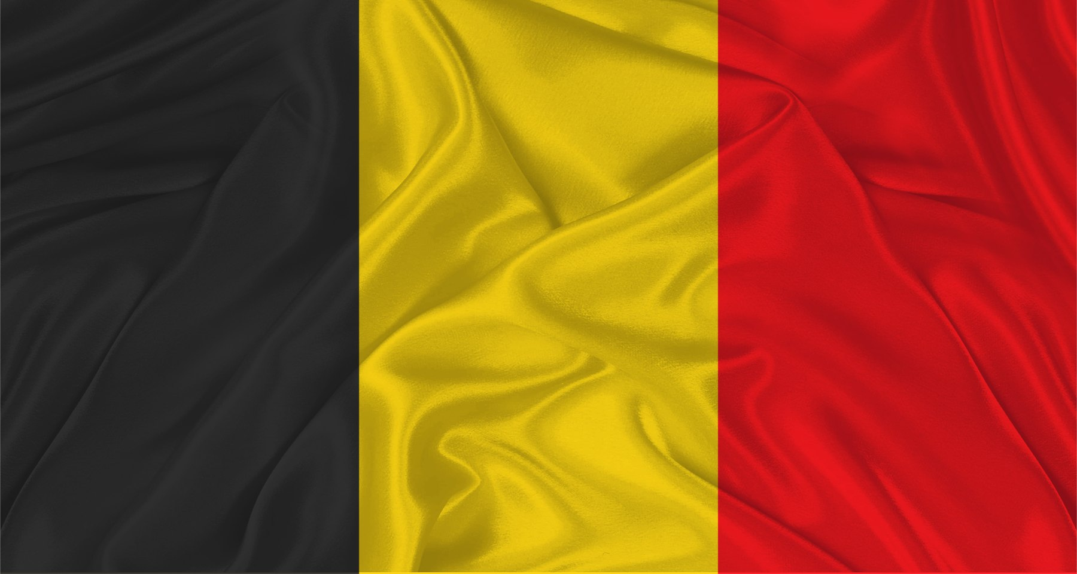
LA BELGIQUE EN CHIFFRES
The country's identity card
11.8 M
30,689
389
3
1830
inhabitants (2025)
square kilometres
people per km²
official languages
independence declared
CARTE D'IDENTITÉ
Official name
Royaume de Belgique · Koninkrijk België · Königreich Belgien
Capital
Brussels (Bruxelles / Brussel) — officially bilingual
Status
Fully independent sovereign state since 1830
Government
Federal parliamentary constitutional monarchy
Head of State
King Philippe, King of the Belgians (since 21 July 2013)
Prime Minister
Bart De Wever (since 3 February 2025)
Currency
Euro (€) — founding member of the eurozone
The tricolour of 1830 — black, yellow and red, from the arms of Brabant.
National day
21 July — accession of Leopold I in 1831
INDEPENDENT — NOT A TERRITORY
Member of
EU · NATO · UN · eurozone · Schengen · Benelux · Francophonie
A sovereign state since 1830, not a French possession — it simply shares the language.
3
La Belgique · FREN 201 · Projet Francophonie
Notes:
[0:35] The identity card. Two things to stress: Belgium is fully independent — it is NOT a French territory, it just shares the language. And it is a monarchy with a prime minister, which the next slides unpack.

Slide 4
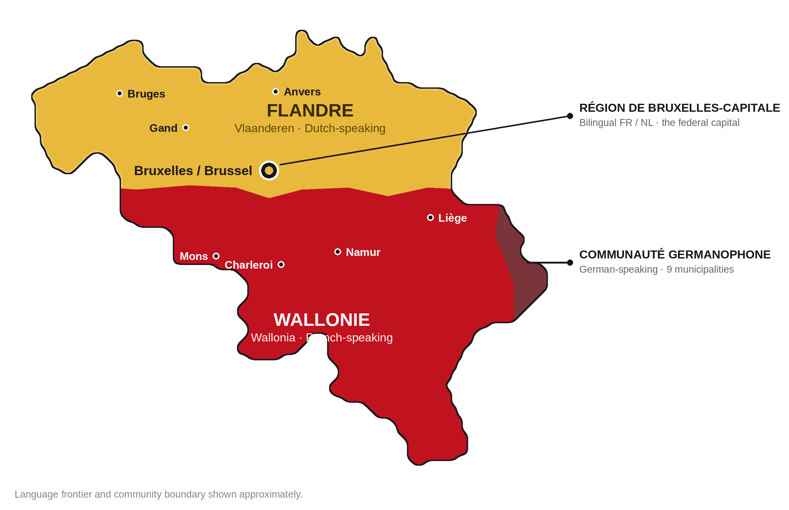
RÉGIONS, COMMUNAUTÉS, LANGUES
One country, three languages
FLANDRE / VLAANDEREN
Dutch-speaking · north
≈ 13,600 km² · 58 % of the population
WALLONIE
French-speaking · south
≈ 16,900 km² · 32 % of the population
BRUXELLES-CAPITALE
Bilingual French / Dutch
162 km² · 11 % of the population
AND THREE COMMUNITIES
Regions govern territory — economy, transport, environment. Communities govern people — language, education and culture. The German-speaking Community has about 78,000 members.
Dutch is spoken by about 60 % of Belgians, French by about 40 %, German by under 1 %.
4
La Belgique · FREN 201 · Projet Francophonie
Notes:
[0:50] The single most important thing to understand about Belgium. Gold is Dutch-speaking Flanders, red is French-speaking Wallonia, and Brussels is the bilingual capital — a French-speaking island inside Flanders. This split runs through everything: the parties, the parliaments, the governments.

Slide 5
LE NOM, HIER ET AUJOURD'HUI
Former names and the name today
57 BC
Belgae
Julius Caesar describes the Belgae, the tribes living between the Seine and the Rhine, in his account of the Gallic Wars. Their name is the root of every later one.
“Of all these peoples, the bravest are the Belgae.”
c. 22 BC
Gallia Belgica
Rome organises the conquered land as the province of Gallia Belgica — the first time the name marks a territory.
Julius Caesar, De Bello Gallico, Book I — the sentence Belgian schoolchildren still learn.
1556–1794
Pays-Bas espagnols, puis autrichiens
The Spanish Netherlands, then the Austrian Netherlands: the southern, Catholic half of the Low Countries, ruled from Madrid and then Vienna.
1790
États-Belgiques-Unis
A DETAIL THAT MATTERS
The short-lived United Belgian States — the first time a country actually calls itself Belgian. It lasted less than a year.
The monarch's title is Roi des Belges — King of the Belgians, not King of Belgium. The crown belongs to a people, not to a piece of land. That wording was deliberate in 1831 and it still says something about how the country understands itself.
1830 →
Royaume de Belgique
The modern kingdom. In Dutch Koninkrijk België, in German Königreich Belgien — three official names for one country.
5
La Belgique · FREN 201 · Projet Francophonie
Notes:
[0:30] The name traces straight back to Caesar. Hit the Caesar quote and the King of the Belgians detail — both are memorable and both make the point that Belgium's identity is about a people, not a fixed territory.

Slide 6
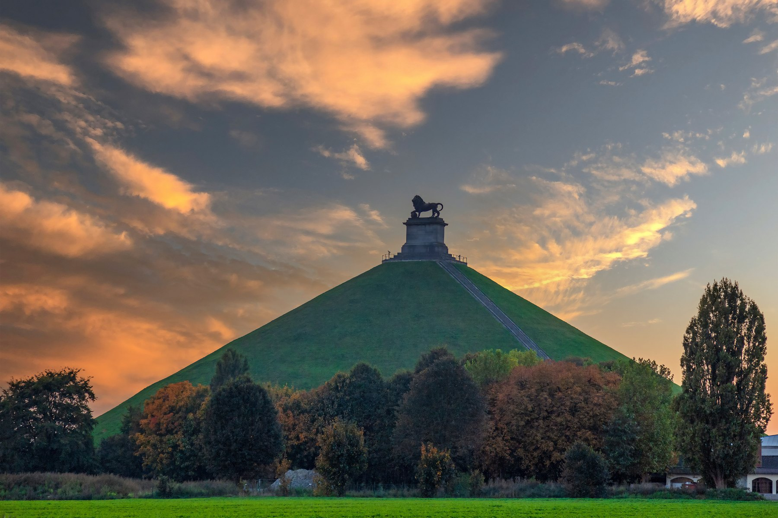
HISTOIRE I · 57 AV. J.-C. – 1815
Ruled by everyone else
57 BC
Rome conquers the Belgae
Caesar defeats the Belgic tribes and the land becomes the Roman province of Gallia Belgica. It stays Roman for four centuries.
5th c.
The Franks
Roman rule collapses. The Merovingians and then the Carolingians rule from the Meuse valley — Charlemagne's family heartland.
11th–15th c.
Cloth cities and Burgundy
Bruges, Ghent and Ypres grow rich weaving English wool. The Dukes of Burgundy unite the Low Countries and Flemish painting has its golden age.
1556–1794
The Habsburgs
The Spanish Netherlands, then the Austrian Netherlands. The Dutch Revolt splits the Protestant north from the Catholic south — the origin of today's border.
1795–1815
France, then Waterloo
Revolutionary France annexes the territory and makes French the language of law. Napoleon is beaten at Waterloo, and the powers hand the land to the Dutch.
THE LION'S MOUND, WATERLOO
Raised on the battlefield 15 km south of Brussels where Napoleon was finally defeated on 18 June 1815 — on what was not yet Belgian soil.
6
La Belgique · FREN 201 · Projet Francophonie
Notes:
[0:45] The through-line: for nearly two thousand years this land was ruled from somewhere else — Rome, Burgundy, Madrid, Vienna, Paris, The Hague. Independence in 1830 is very recent. Don't read every row; land the pattern and point at Waterloo.

Slide 7
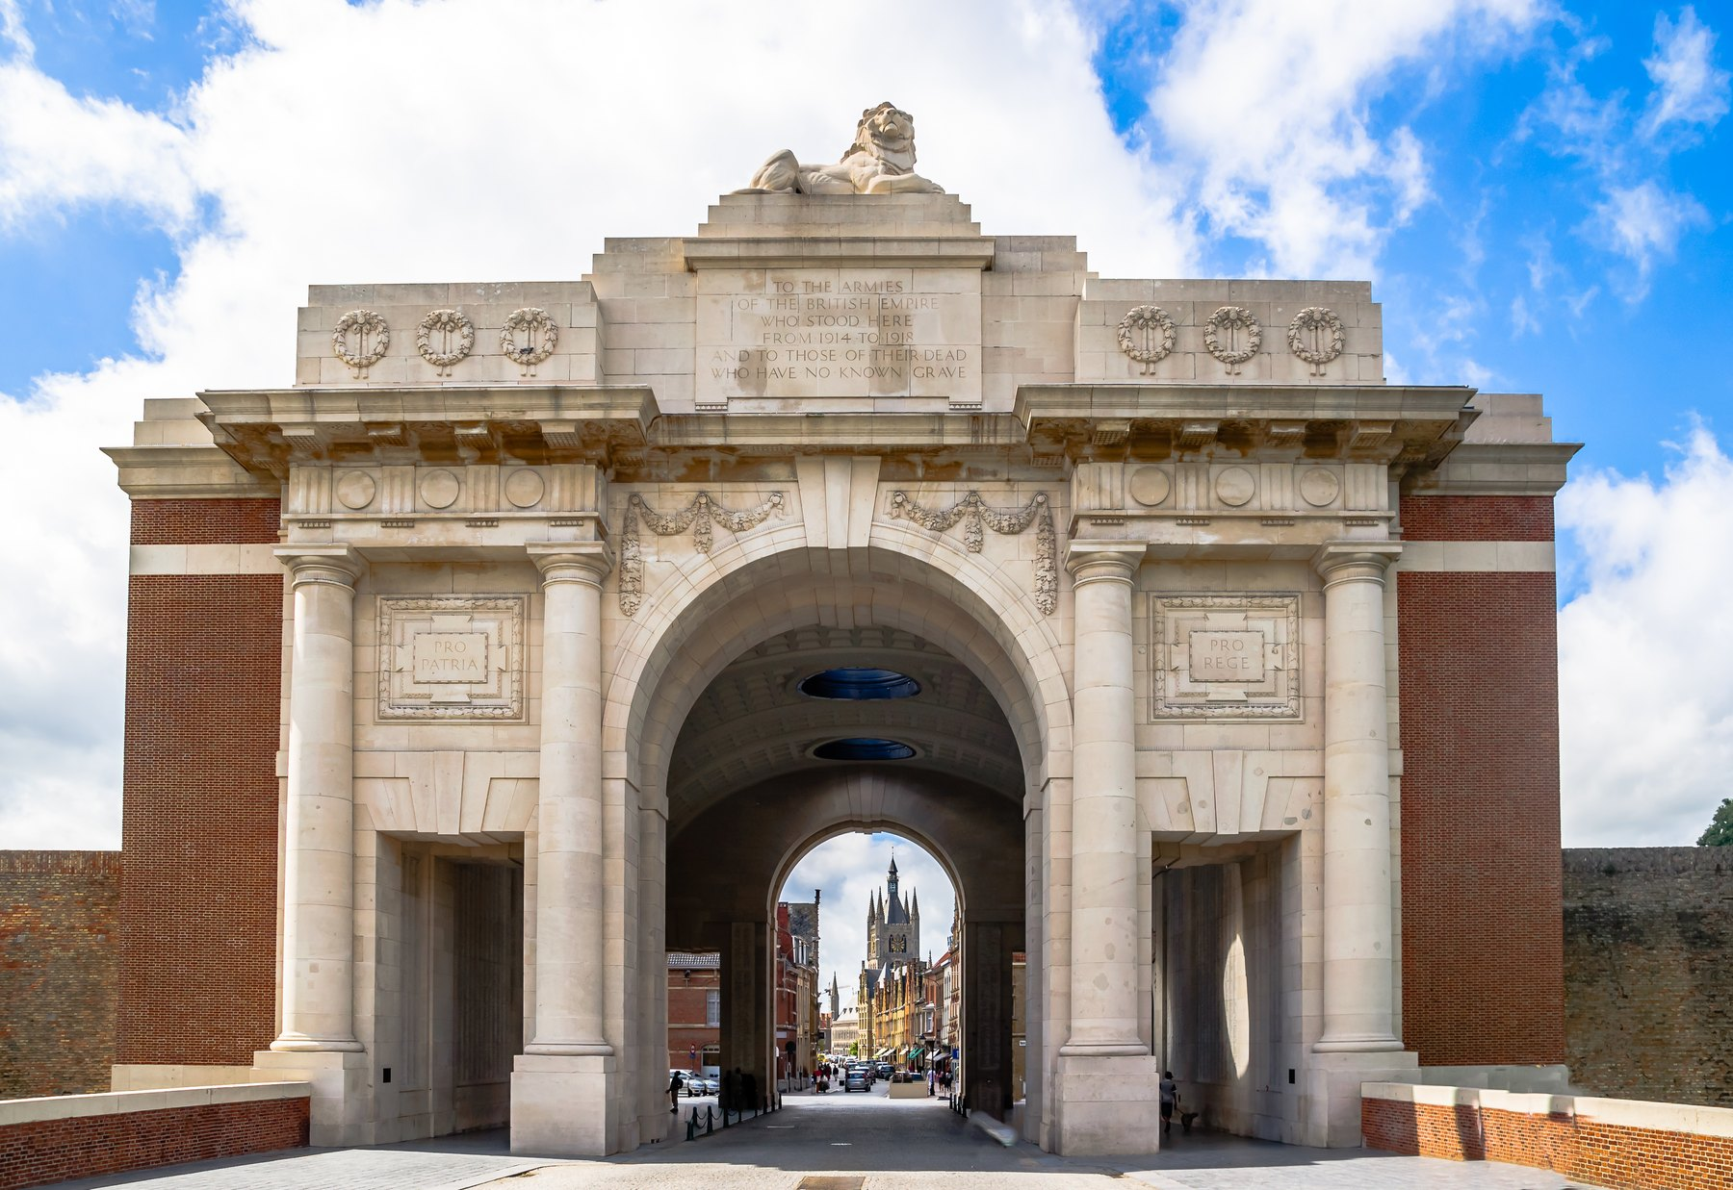
HISTOIRE II · 1830 – AUJOURD'HUI
Independence, empire and war
1830–31
Revolution and a king
A performance of the opera La Muette de Portici sets off riots in Brussels. Independence is declared on 4 October 1830, and Leopold I is sworn in on 21 July 1831 — still the national day.
1839
Recognised at last
The Treaty of London: the Netherlands accepts Belgian independence and the powers guarantee Belgium's permanent neutrality.
1885–1960
The Congo
Leopold II takes the Congo as personal property; his regime's violence forces Belgium to take it over in 1908. The Congo becomes independent in 1960, Rwanda and Burundi in 1962.
1914–1945
Neutrality broken twice
Germany invades in 1914 and again in 1940. The Western Front settles into Flanders — Ypres, Passchendaele — and the Ardennes see the Battle of the Bulge.
1970–2014
Six state reforms
Tension between Dutch and French speakers is answered by rebuilding the country from the inside, turning a unitary state into today's federation.
THE MENIN GATE, YPRES
A memorial to 54,000 missing soldiers of the Ypres Salient. The Last Post has been sounded here every evening since 1928.
7
La Belgique · FREN 201 · Projet Francophonie
Notes:
[0:50] The modern country in five beats. Worth saying out loud: in 2020 King Philippe expressed his 'deepest regrets' for the wounds of the colonial past — the first Belgian monarch to do so. Then the Menin Gate photo: the Last Post still sounds there every night.

Slide 8
ORGANISATION POLITIQUE
A federal parliamentary constitutional monarchy
DEMOCRACY
MONARCHY
FEDERAL
PARLIAMENTARY
not a dictatorship
not a republic
not unitary, since 1993
the government answers to parliament
THREE LEVELS OF GOVERNMENT
THE FEDERAL LEVEL
King Philippe, Head of State · Prime Minister Bart De Wever · Chamber of Representatives, 150 members elected by proportional representation · Senate, 60 members, mostly appointed by the regional and community parliaments
1
Defence, justice, police, foreign affairs, social security, most taxation.
THE THREE REGIONS
Flanders · Wallonia · Brussels-Capital — each with its own elected parliament and its own government
2
Territory: economy, employment, transport, housing, environment, agriculture.
THE THREE COMMUNITIES
Flemish Community · French Community (Fédération Wallonie-Bruxelles) · German-speaking Community
3
People: education, culture, language, health and welfare policy.
Voting is compulsory from the age of 18, and because parties are organised by language, every federal government is a coalition.
8
La Belgique · FREN 201 · Projet Francophonie
Notes:
[0:50] Answers the assignment's question directly: democracy not dictatorship, monarchy not republic. The four chips are the fastest way to say it. Then the three levels — a country of 11.8 million with six parliaments. Mention compulsory voting; it usually gets a reaction.

Slide 9
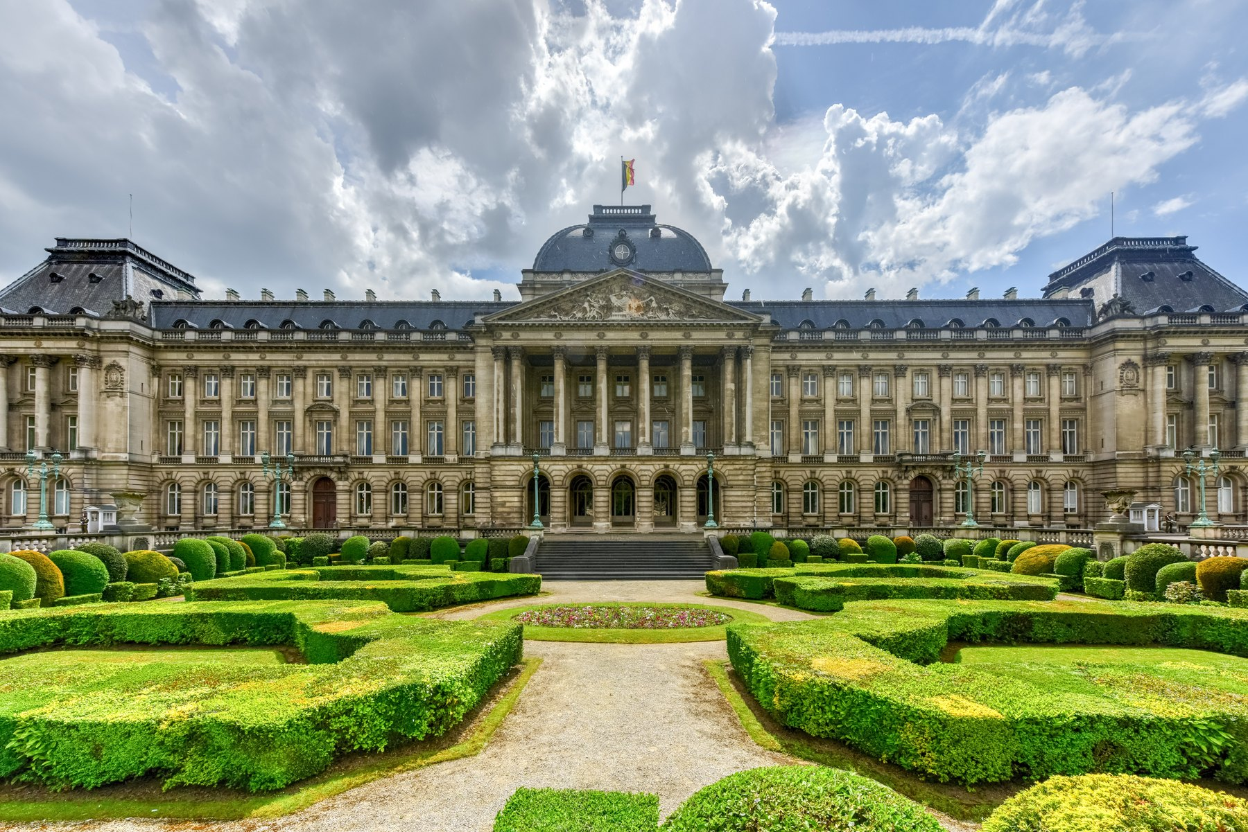
LE ROI ET LE GOUVERNEMENT
Who leads Belgium today
CHEF DE L'ÉTAT · HEAD OF STATE
King Philippe
Seventh King of the Belgians, on the throne since 21 July 2013, when his father Albert II abdicated. His heir is Princess Elisabeth, who will be Belgium's first reigning queen.
He signs laws but cannot veto them. His real power is quiet: choosing the negotiators who build a coalition.
PREMIER MINISTRE · PRIME MINISTER
Bart De Wever
Sworn in on 3 February 2025, leading the five-party “Arizona” coalition: N-VA · MR · Les Engagés · Vooruit · CD&V. Head of government, accountable to the Chamber.
It took eight months of negotiation to form. Belgium once went 541 days without an elected government.
THE ROYAL PALACE, BRUSSELS
The King's official workplace. The royal family actually lives at Laeken, on the edge of the city.
9
La Belgique · FREN 201 · Projet Francophonie
Notes:
[0:45] Two people, two jobs. The King reigns but does not rule — no veto. De Wever governs, and he is the first Flemish nationalist ever to lead the country. The 541-day record is the line people remember; use it to explain why the language split makes governing so hard.

Slide 10
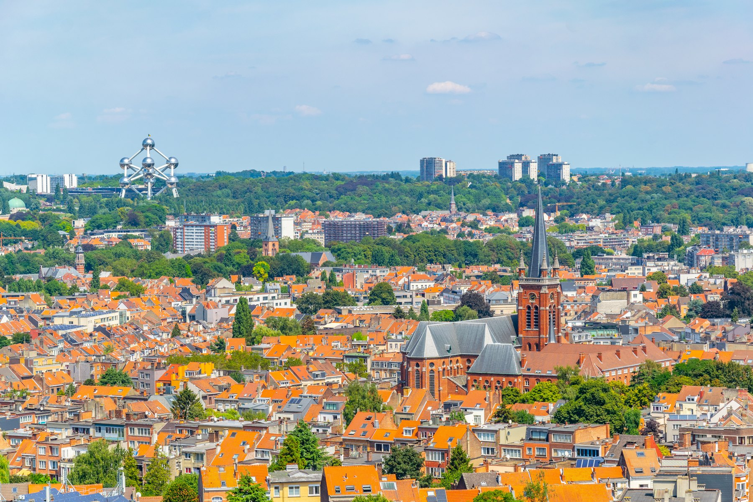
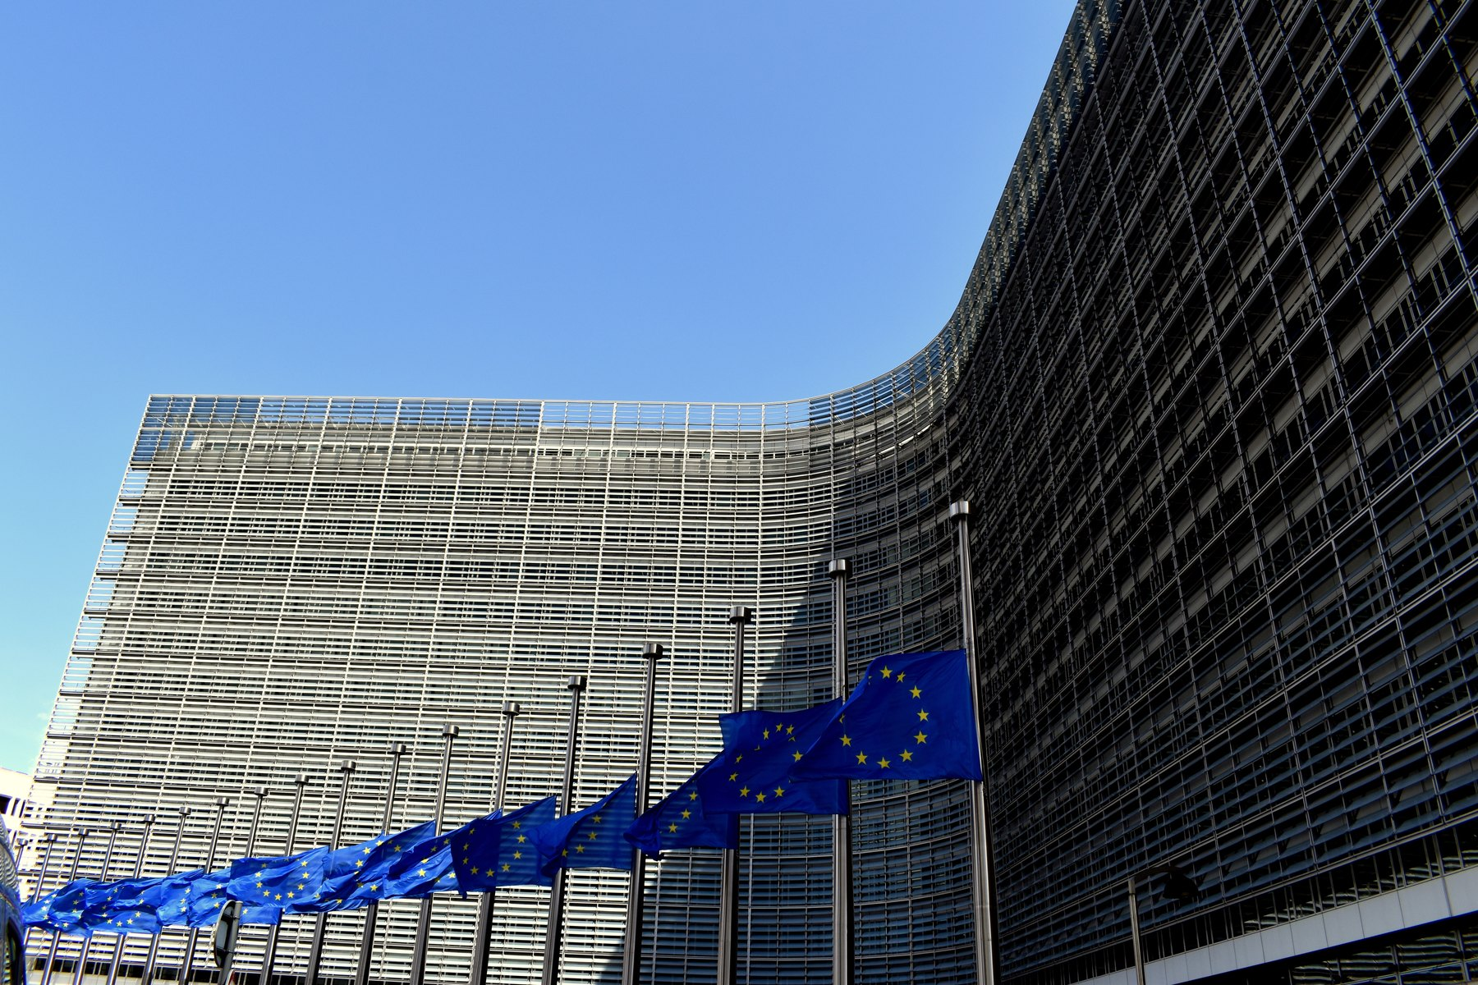
BRUXELLES
The capital of Belgium — and of Europe
1.25 million
people in the Brussels-Capital Region; about 2.1 million in the wider metropolitan area.
Officially bilingual
French and Dutch have equal status. In practice around 80 % of residents speak French — a French-speaking region surrounded by Flanders.
Capital of the EU
Home to the European Commission, the Council of the EU and part of the European Parliament.
NATO headquarters
Brussels from the Koekelberg basilica — the Atomium is on the horizon. Right: the Berlaymont, home of the European Commission.
Since 1967 — Belgium was a founding member in 1949.
WHAT TO SEE
The Grand-Place, a UNESCO World Heritage site since 1998 · Manneken Pis · the Art Nouveau town houses of Victor Horta, also UNESCO · the Atomium · the Magritte Museum · the Belgian Comic Strip Center
10
La Belgique · FREN 201 · Projet Francophonie
Notes:
[0:40] Brussels is the payoff slide. A city of 1.25 million that runs a continent: the Commission, the Council, and NATO. And it is a French-speaking island inside Dutch-speaking Flanders — which is exactly why it works as neutral ground.

Slide 11
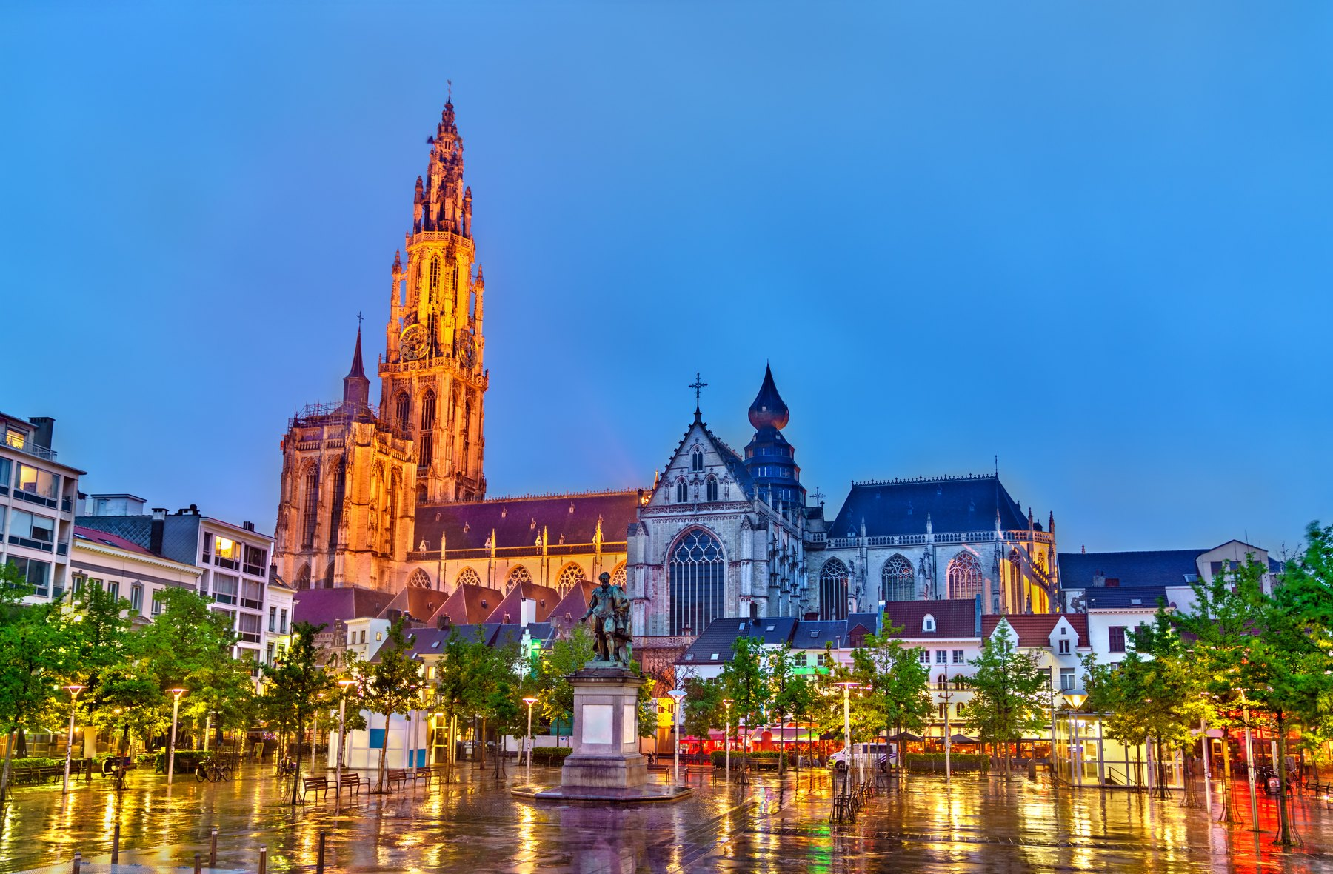
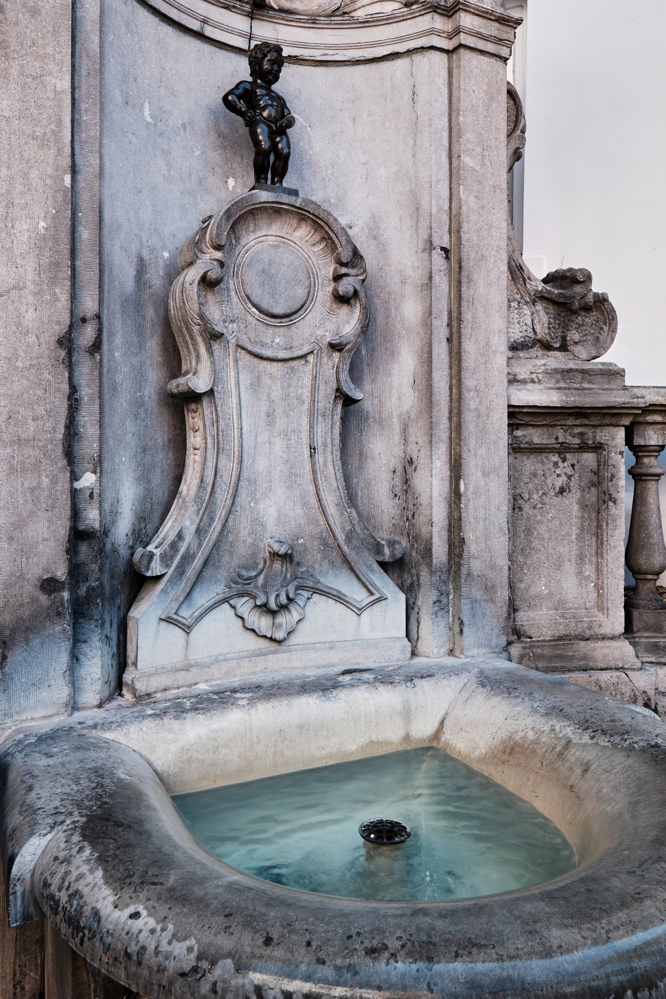
CULTURE
Painters, surrealists and the ninth art
LA PEINTURE
Jan van Eyck's Ghent Altarpiece (1432) is one of the founding works of European painting. Pieter Bruegel the Elder painted peasant life; Peter Paul Rubens made Antwerp a capital of the baroque; René Magritte turned Belgian surrealism into an image everyone knows — Ceci n'est pas une pipe.
LA BANDE DESSINÉE
Belgium invented the modern European comic and calls it the ninth art. Hergé created Tintin in 1929; Peyo created the Smurfs (Les Schtroumpfs); Morris created Lucky Luke. Brussels has a comic-strip museum and a walking trail of painted murals.
The Cathedral of Our Lady, Antwerp — its belfry is UNESCO-listed and it holds four Rubens altarpieces.
LA MUSIQUE ET LE CINÉMA
Adolphe Sax, born in Dinant in 1814, invented the saxophone. César Franck came from Liège, Jacques Brel from Brussels. The Dardenne brothers have won the Palme d'Or at Cannes twice.
Manneken Pis, Brussels — cast in bronze in 1619.
11
La Belgique · FREN 201 · Projet Francophonie
Notes:
[0:35] Pick two, don't read all three. Best bets: Magritte, because everyone has seen the pipe; and Tintin and the Smurfs, because almost nobody knows they are Belgian. Adolphe Sax and the saxophone is a good closer.

Slide 12
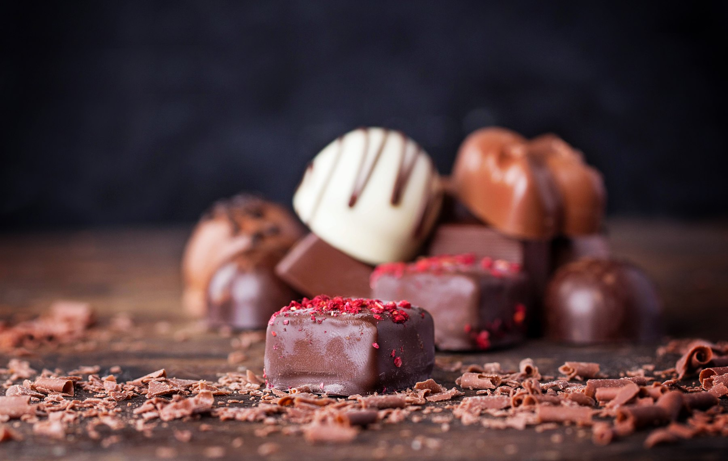
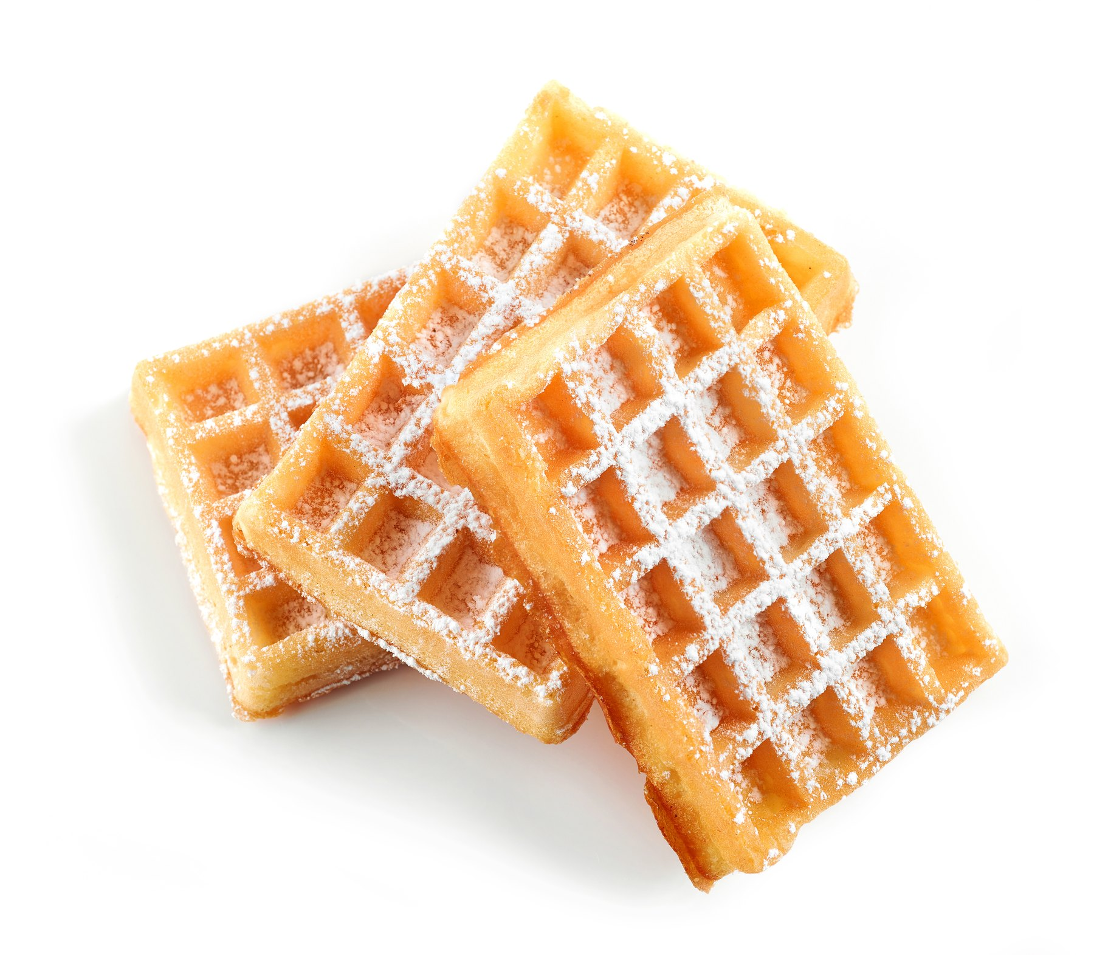
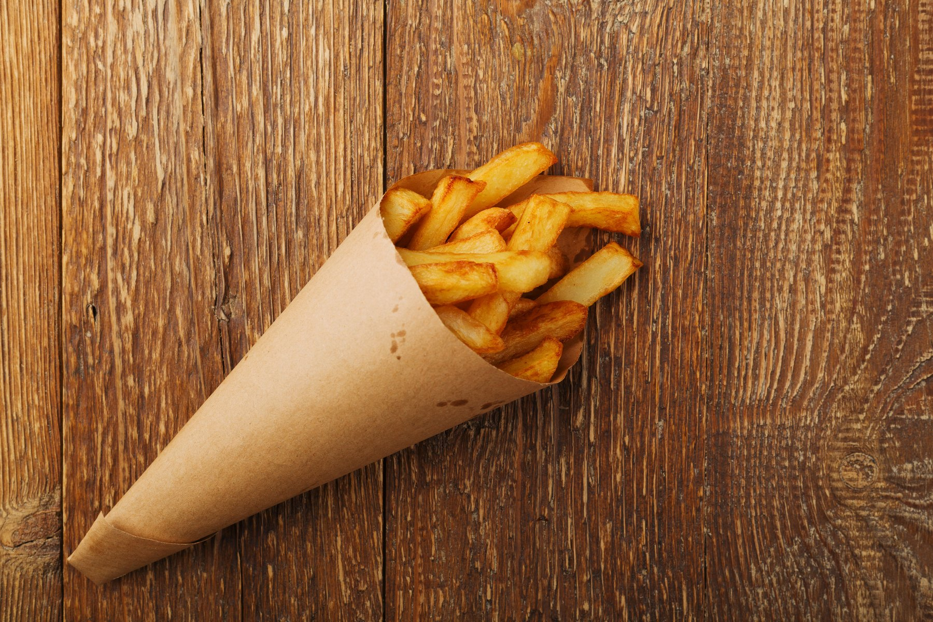
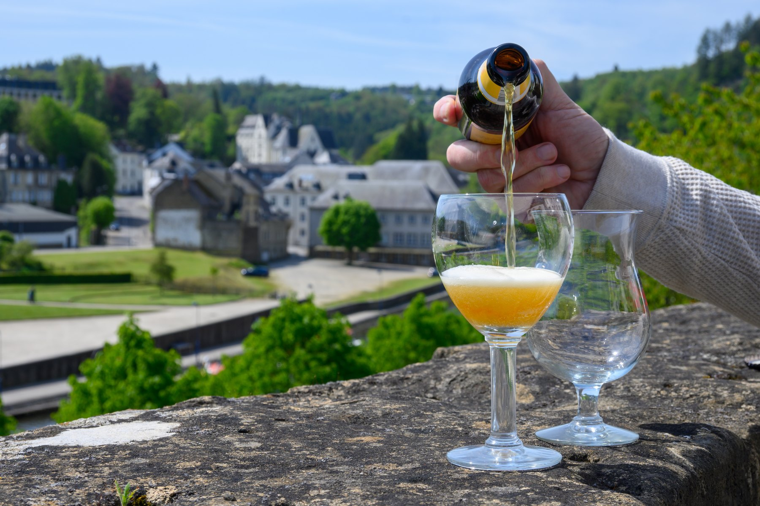
GASTRONOMIE
Four things Belgium is famous for — and rightly so
LE CHOCOLAT
LA GAUFRE
LES FRITES
LA BIÈRE
The filled praline was invented in Brussels by Jean Neuhaus II in 1912. Belgium has several hundred chocolatiers and exports chocolate worldwide.
Two rival waffles: the light rectangular gaufre de Bruxelles, and the dense, chewy gaufre de Liège studded with caramelised pearl sugar.
Belgians claim to have invented them, fry them twice, sell them from a friterie and eat them from a paper cone with mayonnaise — never as a side dish.
More than a thousand Belgian beers, from Trappist abbey ales to sour lambics. Belgian beer culture was added to UNESCO's Intangible Cultural Heritage list in 2016.
AT THE TABLE
Moules-frites · carbonnade flamande, beef stewed in beer · waterzooi from Ghent · chicons au gratin · speculoos biscuits · and, in season, the grey shrimp of the North Sea coast.
12
La Belgique · FREN 201 · Projet Francophonie
Notes:
[0:25] Move fast, the pictures do the work. Two facts worth saying: the praline was invented in Brussels in 1912, and Belgian beer culture is on the UNESCO heritage list. The frites-are-Belgian-not-French claim usually gets a laugh.

Slide 13
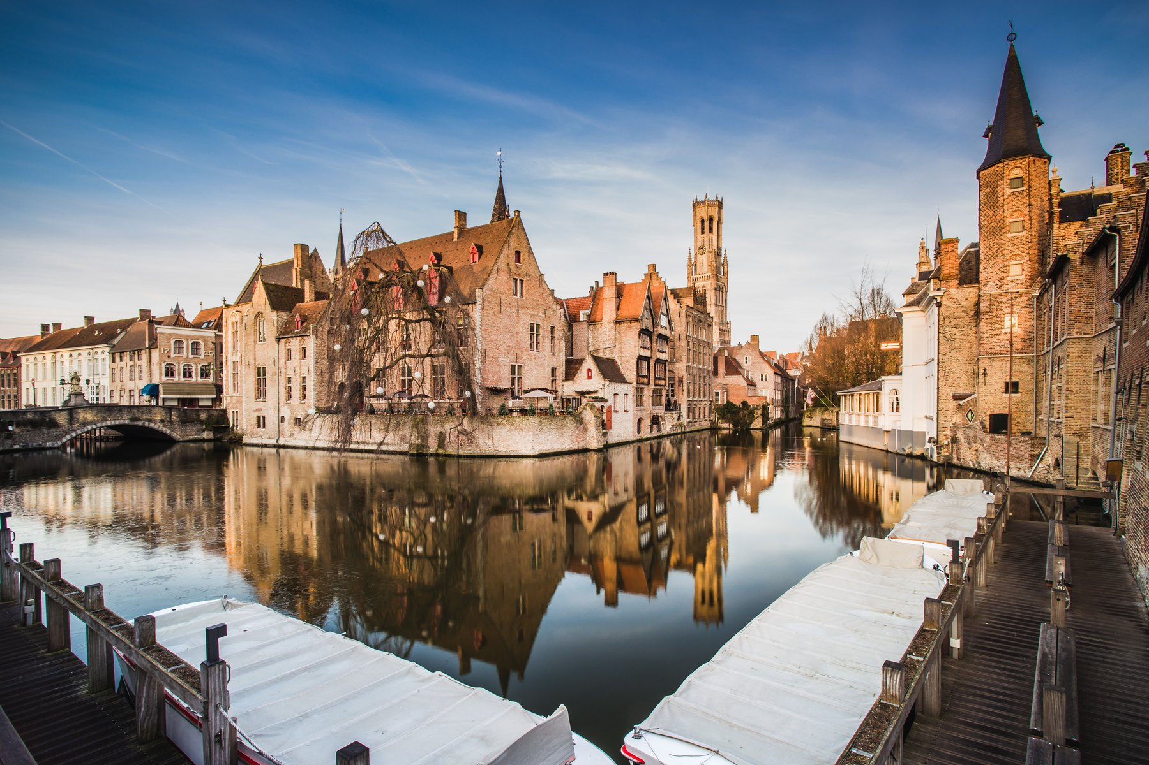
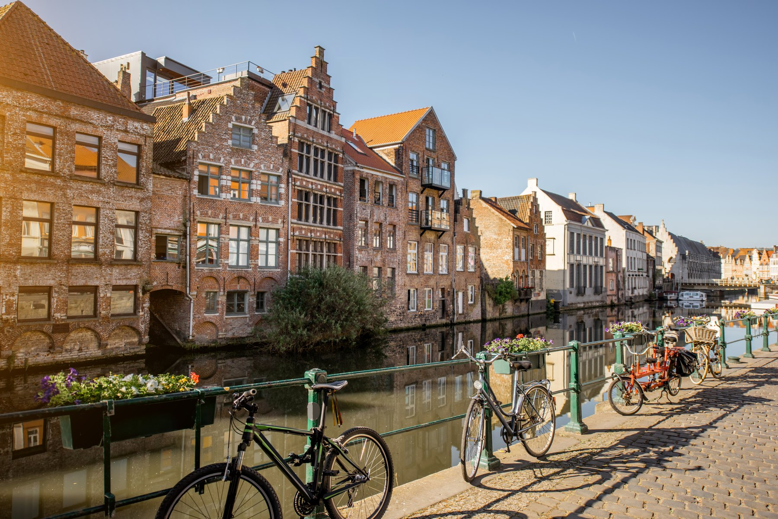
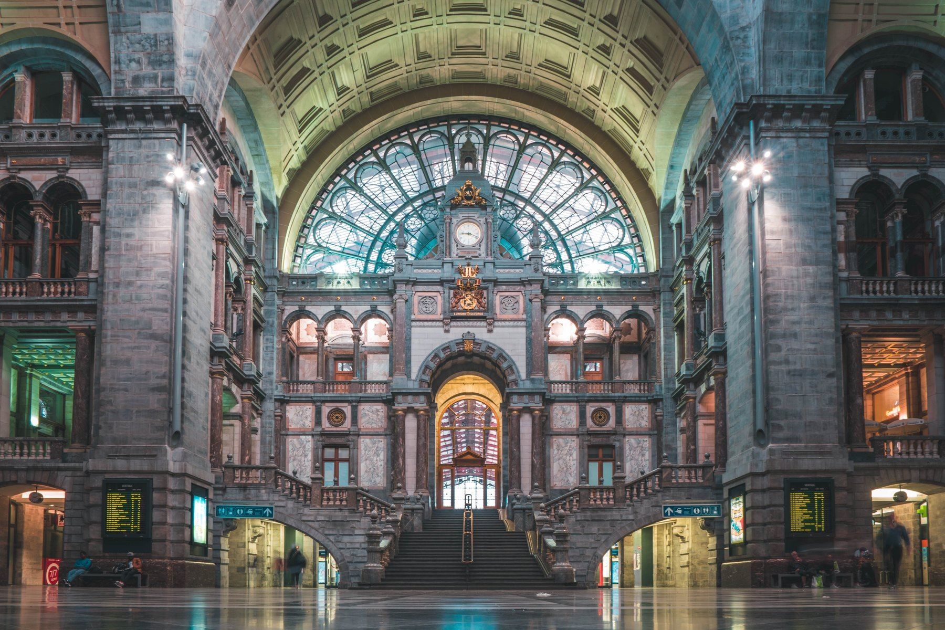
LES VILLES D'ART
Three cities worth the trip
BRUGES / BRUGGE
GAND / GENT
ANVERS / ANTWERPEN
The Venice of the North. The entire historic centre is a UNESCO World Heritage site, along with its belfry and its béguinage. Medieval brick gables, canals, and the Groeninge Museum's Flemish Primitives.
A working city rather than a museum. The Gravensteen castle, the guild houses of the Graslei, and van Eyck's Ghent Altarpiece in Saint Bavo's Cathedral. A UNESCO Creative City of Music.
Rubens' city and Belgium's port. Central Station is known as the railway cathedral. More than 70 % of the world's rough diamonds still pass through the Antwerp diamond district.
Belgium has 13 UNESCO World Heritage sites in a country the size of Maryland — including 33 of the belfries of Belgium and France, and the Carnival of Binche on the Intangible Heritage list.
13
La Belgique · FREN 201 · Projet Francophonie
Notes:
[0:30] Bruges is the postcard, Ghent is the one locals prefer, Antwerp is the working city. The diamond statistic — over 70 % of the world's rough diamonds — is the one that lands.

Slide 14
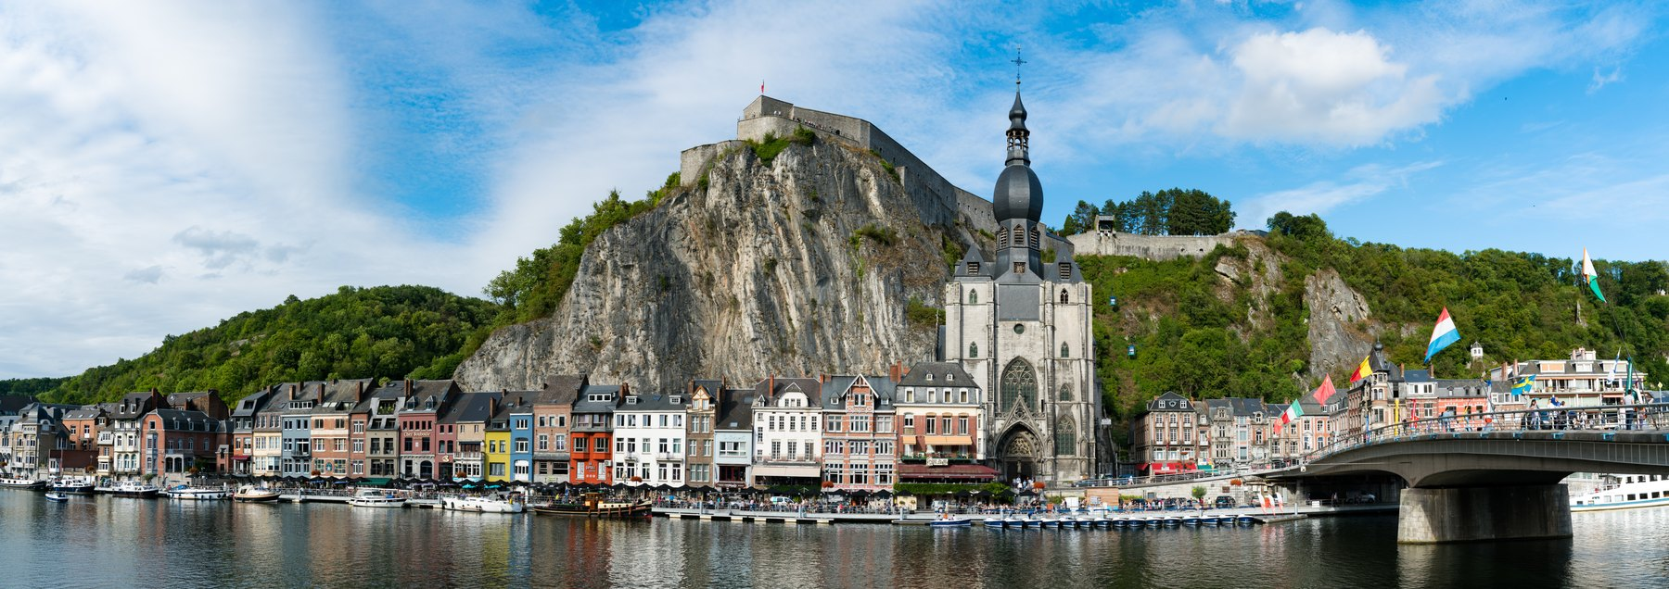
INFOS PRATIQUES
What a visitor needs to know
1
MONEY
2
GETTING IN
The euro. Cards and contactless are accepted almost everywhere; American Express often is not. Service is included and tipping is not expected.
Belgium is in the Schengen area. Visitors from the US, UK, Canada, Australia and Japan may stay 90 days without a visa; an ETIAS travel authorisation is being introduced. Fly into Brussels (BRU) or Charleroi (CRL).
3
GETTING AROUND
4
LANGUAGE
The rail network is one of the densest in the world and almost nowhere is more than about two hours from anywhere else. Trams and metro in the cities; bicycles everywhere in Flanders.
French in Wallonia and Brussels, Dutch in Flanders, German in the far east. English is widely spoken in cities. Open in French in Brussels and Wallonia, in Dutch or English in Flanders — the choice of language is never neutral.
5
WHEN TO GO
6
DON'T MISS
May to September for the best weather; December for the Christmas markets. Bring a raincoat in any month — the Belgians have a word for a downpour, une drache.
The Grand-Place lit up at night · a canal boat in Bruges · a cone of frites from a friterie · a Trappist beer in an abbey café · Dinant on the Meuse.
Dinant on the Meuse, in Wallonia — birthplace of Adolphe Sax, inventor of the saxophone.
14
La Belgique · FREN 201 · Projet Francophonie
Notes:
[0:25] Fastest slide in the deck — do not read the boxes. Say three things: it is in Schengen so no visa for 90 days, the trains reach everything in two hours, and which language you open with matters. Then move on.

Slide 15
LA BELGIQUE ET LA FRANCOPHONIE
A French-speaking country at the centre of Europe
≈ 40 %
2 seats
septante
of Belgians — roughly 4.5 million people — have French as their mother tongue, concentrated in Wallonia and Brussels.
Belgium is a founding member of the Organisation internationale de la Francophonie and is represented twice: the Kingdom of Belgium, and the French Community.
Belgian French keeps septante for 70 and nonante for 90, where France says soixante-dix and quatre-vingt-dix.
A few Belgicismes worth knowing
un GSM — a mobile phone · une drache — a sudden downpour · faire la file — to queue · savoir used where France would say pouvoir · un kot — a student room
Belgium is where Germanic and Latin Europe meet. It is a small, young, complicated country that has learned to hold three languages, six parliaments and two thousand years of other people's empires — and it houses the capital of Europe while doing it.
15
La Belgique · FREN 201 · Projet Francophonie
Notes:
[0:30] Close here. Read the gold box out loud — it is the thesis. Then stop and take questions. Do not click to the sources slide unless someone asks.

Slide 16
SOURCES
Where the facts in this presentation come from
1
belgium.be
The federal government's official portal — history, regions and institutions.
2
monarchie.be
The Belgian Monarchy — the King's role, duties and family.
3
premier.be · kanselarij.belgium.be
Office of the Prime Minister — the current federal government.
4
european-union.europa.eu
European Union country profile: Belgium.
5
whc.unesco.org
UNESCO World Heritage Centre — Belgium's listed sites and its beer culture.
6
diplomatie.belgium.be
Belgian Foreign Affairs — Belgium and the Organisation internationale de la Francophonie.
7
Britannica · CIA World Factbook
Population, area, borders, coastline and general geography.
8
visitflanders.com · visitbruges.be · visitwallonia.be
Official tourist boards — visitor information.
Photographs licensed from Adobe Stock. The map of Europe is the blank outline map supplied with the assignment, with Belgium marked and its neighbours labelled; the map of Belgium's regions was drawn from that same outline. Language and community boundaries are shown approximately.
16
La Belgique · FREN 201 · Projet Francophonie
Notes:
[0:05] Leave this up during questions. Timings on each slide add up to 9 minutes 15, leaving about 45 seconds of buffer in a 10-minute slot.

