Slide 1
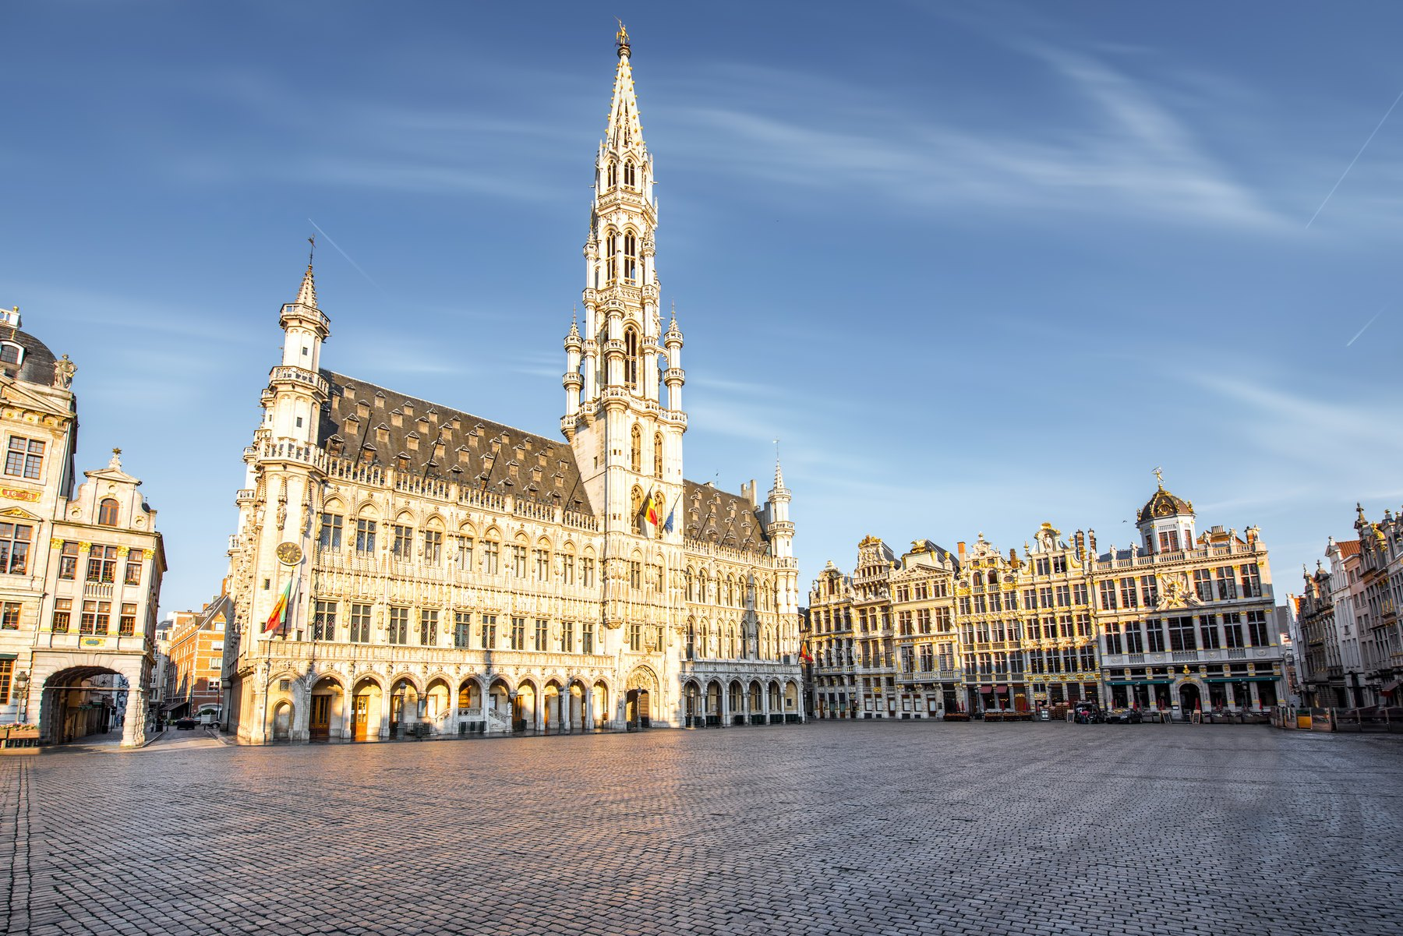
PROJET FRANCOPHONIE · FREN 201
LA BELGIQUE
Le Royaume de Belgique
Koninkrijk België · Königreich Belgien · Kingdom of Belgium
A French-speaking country in the heart of Europe —
and the capital of the European Union.
Nom ______________________________ Date ____________________
Notes:
FREN 201 Francophonie project. Region chosen: Europe. Country: Belgium — a French-speaking country in Western Europe.

Slide 2
AU SOMMAIRE
What this presentation covers
1
Où se trouve la Belgique ?
7
Statut et alliances
Location, neighbours and the map
An independent state at the centre of Europe
2
La Belgique en chiffres
8
Organisation politique
The country's identity card
A federal parliamentary constitutional monarchy
3
Géographie et paysages
9
Le Roi et le gouvernement
Three landscapes, one small country
Who leads Belgium today
4
Régions, communautés, langues
10
Bruxelles, capitale de l'Europe
How one country holds three languages
The EU, NATO and a bilingual city
5
Le nom, hier et aujourd'hui
11
Culture et gastronomie
From the Belgae to the Kingdom of Belgium
Painters, comic strips, chocolate and beer
6
Histoire
12
Infos pratiques
Rome, the Habsburgs, France, independence, the wars
What a visitor needs to know
2
La Belgique · FREN 201 · Projet Francophonie
Notes:
Roadmap of the presentation — every item required by the assignment is covered.

Slide 3
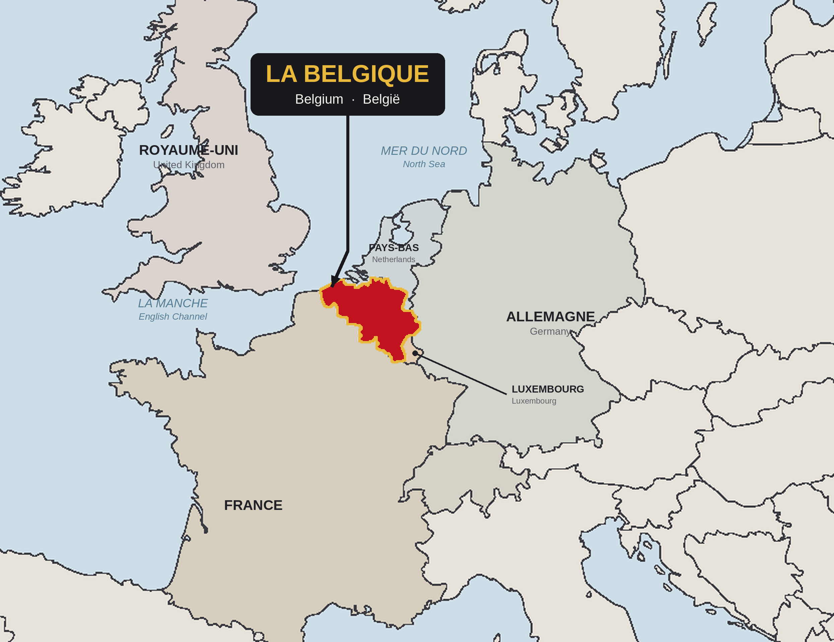
OÙ SE TROUVE LA BELGIQUE ?
Western Europe, on the North Sea
LAND BORDERS · 1,297 km IN TOTAL
France
556 km — south and south-west
Netherlands
478 km — north
Germany
133 km — east
Luxembourg
130 km — south-east
Plus 66.5 km of North Sea coastline.
POSITION
About 50° N, 4° E — the crossroads where Germanic northern Europe meets Latin southern Europe. That position made Belgium rich in trade, and made it a battlefield.
BY TRAIN FROM BRUSSELS
Paris 1 h 25 · London 2 h 00 · Amsterdam 1 h 50 · Cologne 1 h 50
Belgium marked in red on the blank outline map supplied with the assignment.
3
La Belgique · FREN 201 · Projet Francophonie
Notes:
Assignment requirement: mark the chosen country on a blank map of the region and show what surrounds it. Belgium sits between France, Germany, Luxembourg and the Netherlands, with a short North Sea coast.

Slide 4
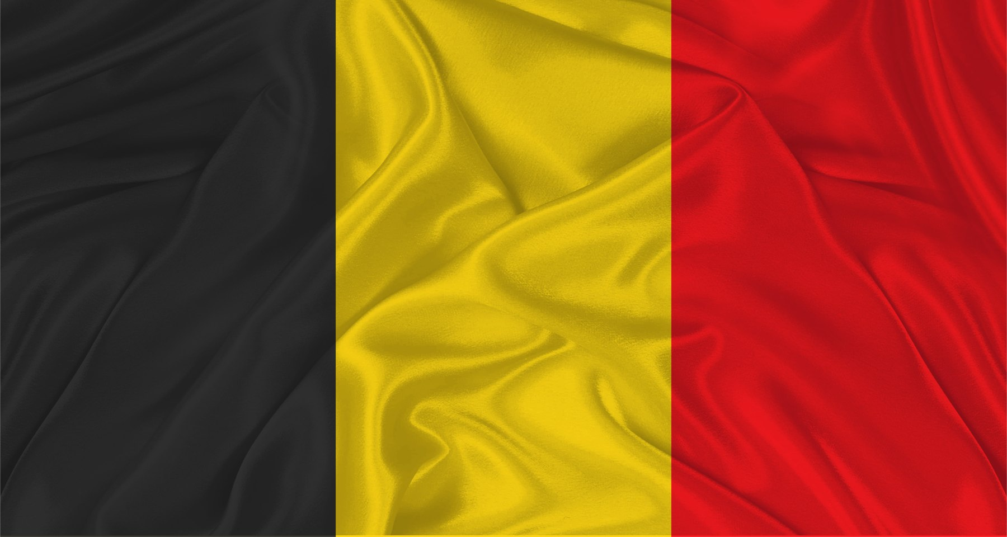
LA BELGIQUE EN CHIFFRES
The country's identity card
11.8 M
30,689
389
3
1830
inhabitants (2025)
square kilometres
people per km²
official languages
independence declared
CARTE D'IDENTITÉ
Official name
Royaume de Belgique · Koninkrijk België · Königreich Belgien
Capital
Brussels (Bruxelles / Brussel) — officially bilingual
Status
Fully independent sovereign state since 1830
Government
Federal parliamentary constitutional monarchy
Head of State
King Philippe, King of the Belgians (since 21 July 2013)
Prime Minister
Bart De Wever (since 3 February 2025)
Currency
Euro (€) — founding member of the eurozone
National day
21 July — accession of Leopold I in 1831
The tricolour of 1830 — black, yellow and red, taken from the arms of the Duchy of Brabant.
Member of
EU · NATO · UN · eurozone · Schengen · Benelux · Francophonie
4
Roughly the land area of Maryland, with twice the people.
La Belgique · FREN 201 · Projet Francophonie
Notes:
Key figures. Population 11.8 million; area 30,689 km2 — roughly the size of Maryland.

Slide 5
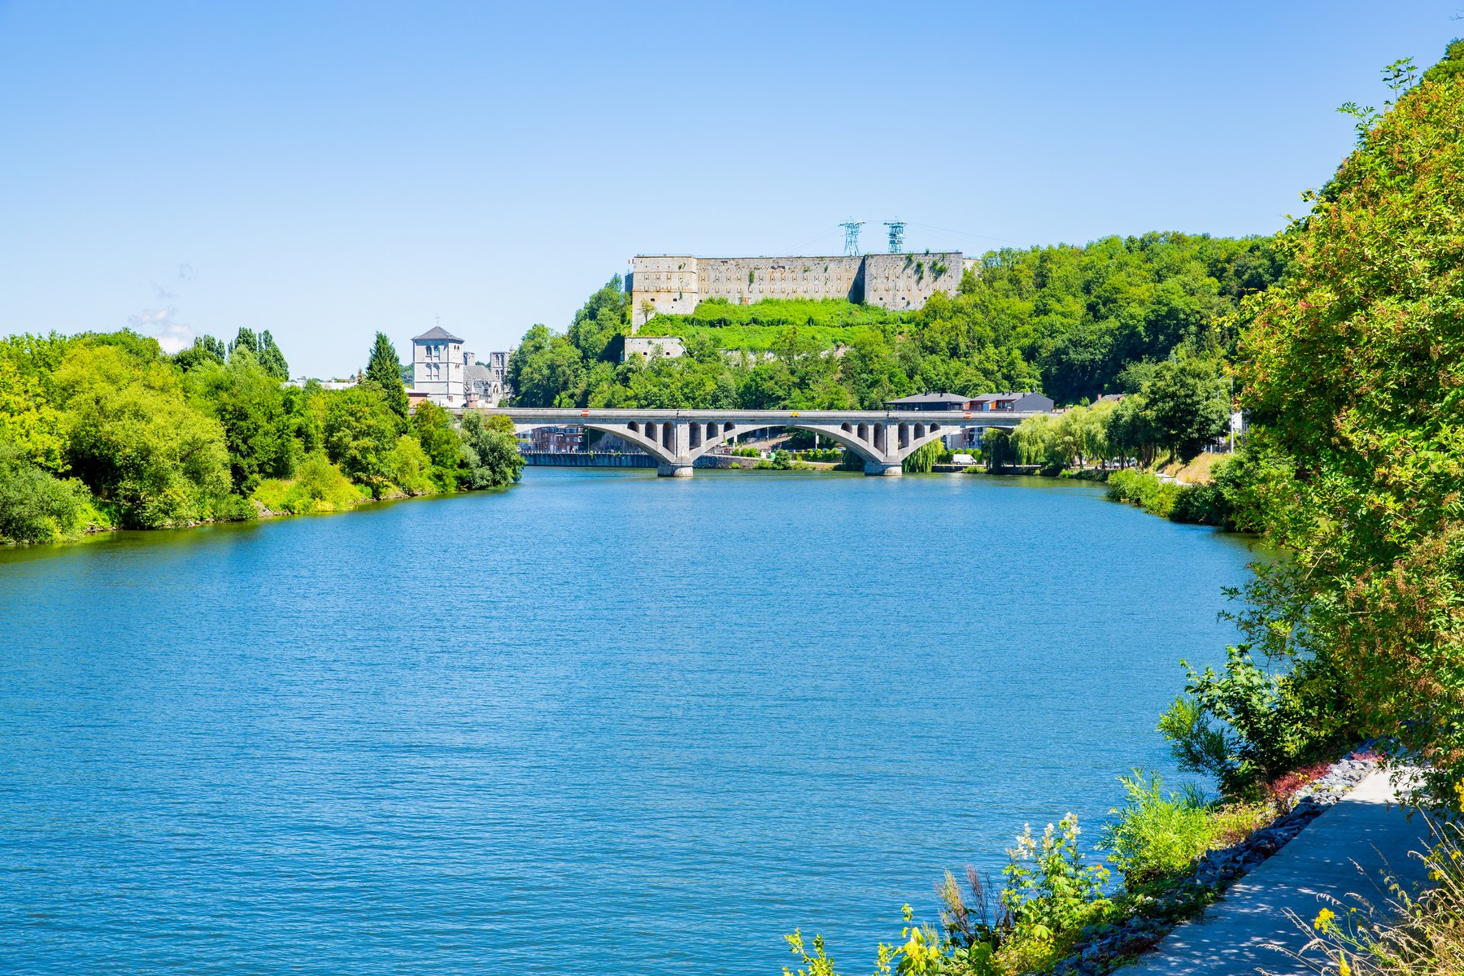
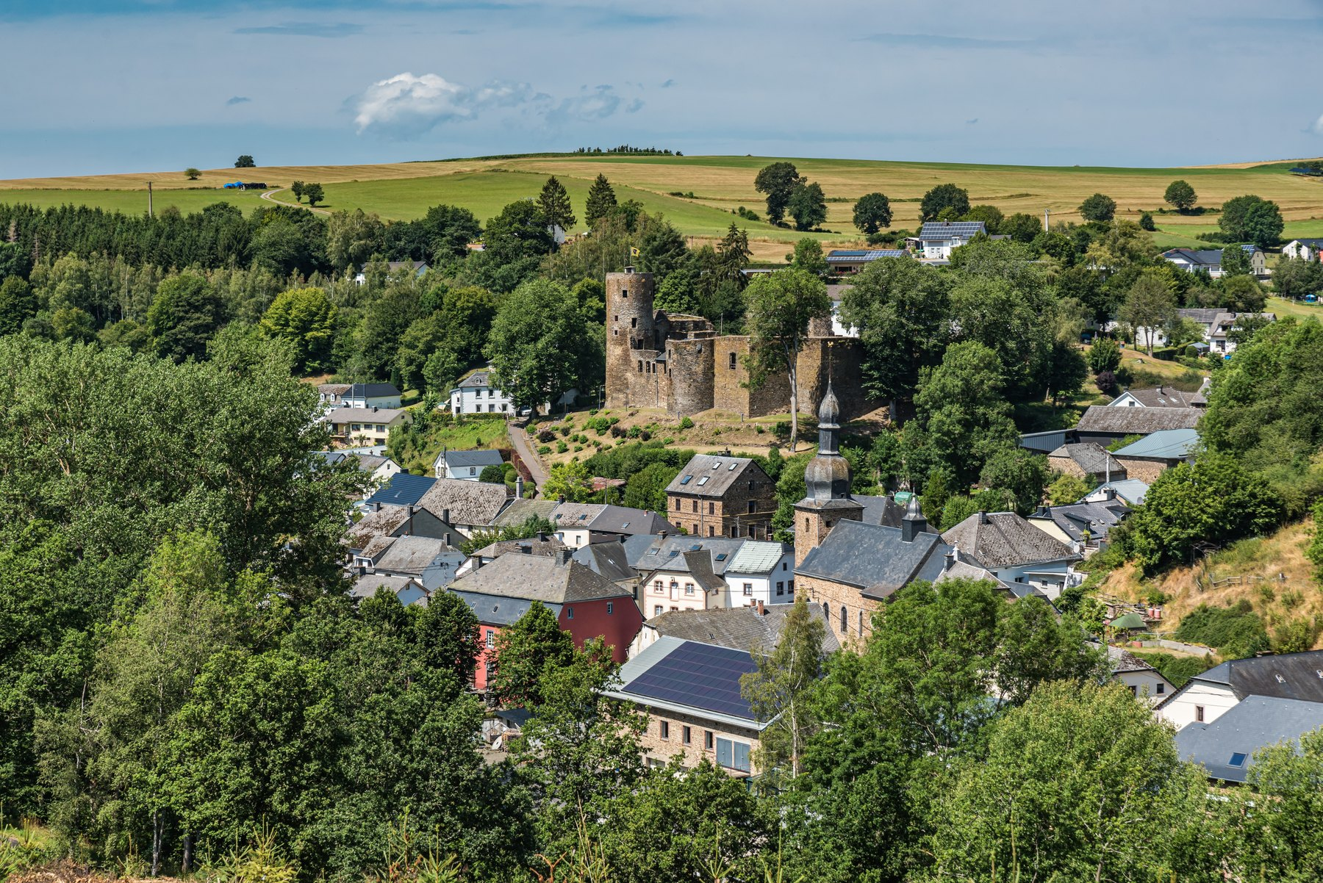
GÉOGRAPHIE ET PAYSAGES
Three landscapes in 30,689 km²
1
BASSE-BELGIQUE
Lower Belgium — 0 to 100 m
A flat coastal plain: 66.5 km of North Sea beaches, polders reclaimed from the sea, canals and the Flemish plain. Nearly all of it is below 50 m.
2
MOYENNE-BELGIQUE
Middle Belgium — 100 to 200 m
The Meuse near Huy, Wallonia — one of Belgium's two great rivers, with the Scheldt.
Gently rolling, very fertile loam plateaus. This is the busy, urban heart of the country: Brussels, Hainaut, Brabant and the Hesbaye farmland.
3
HAUTE-BELGIQUE
High Belgium — 200 to 700 m
The Ardennes: forest, deep river valleys, caves and moorland. The Signal de Botrange, 694 m, is the highest point in the country.
Burg-Reuland in the eastern Ardennes — the German-speaking corner of Belgium.
5
La Belgique · FREN 201 · Projet Francophonie
Notes:
Climate: temperate maritime — mild, grey and wet, about 800 mm of rain a year. Two major rivers: the Scheldt (l'Escaut) and the Meuse.

Slide 6
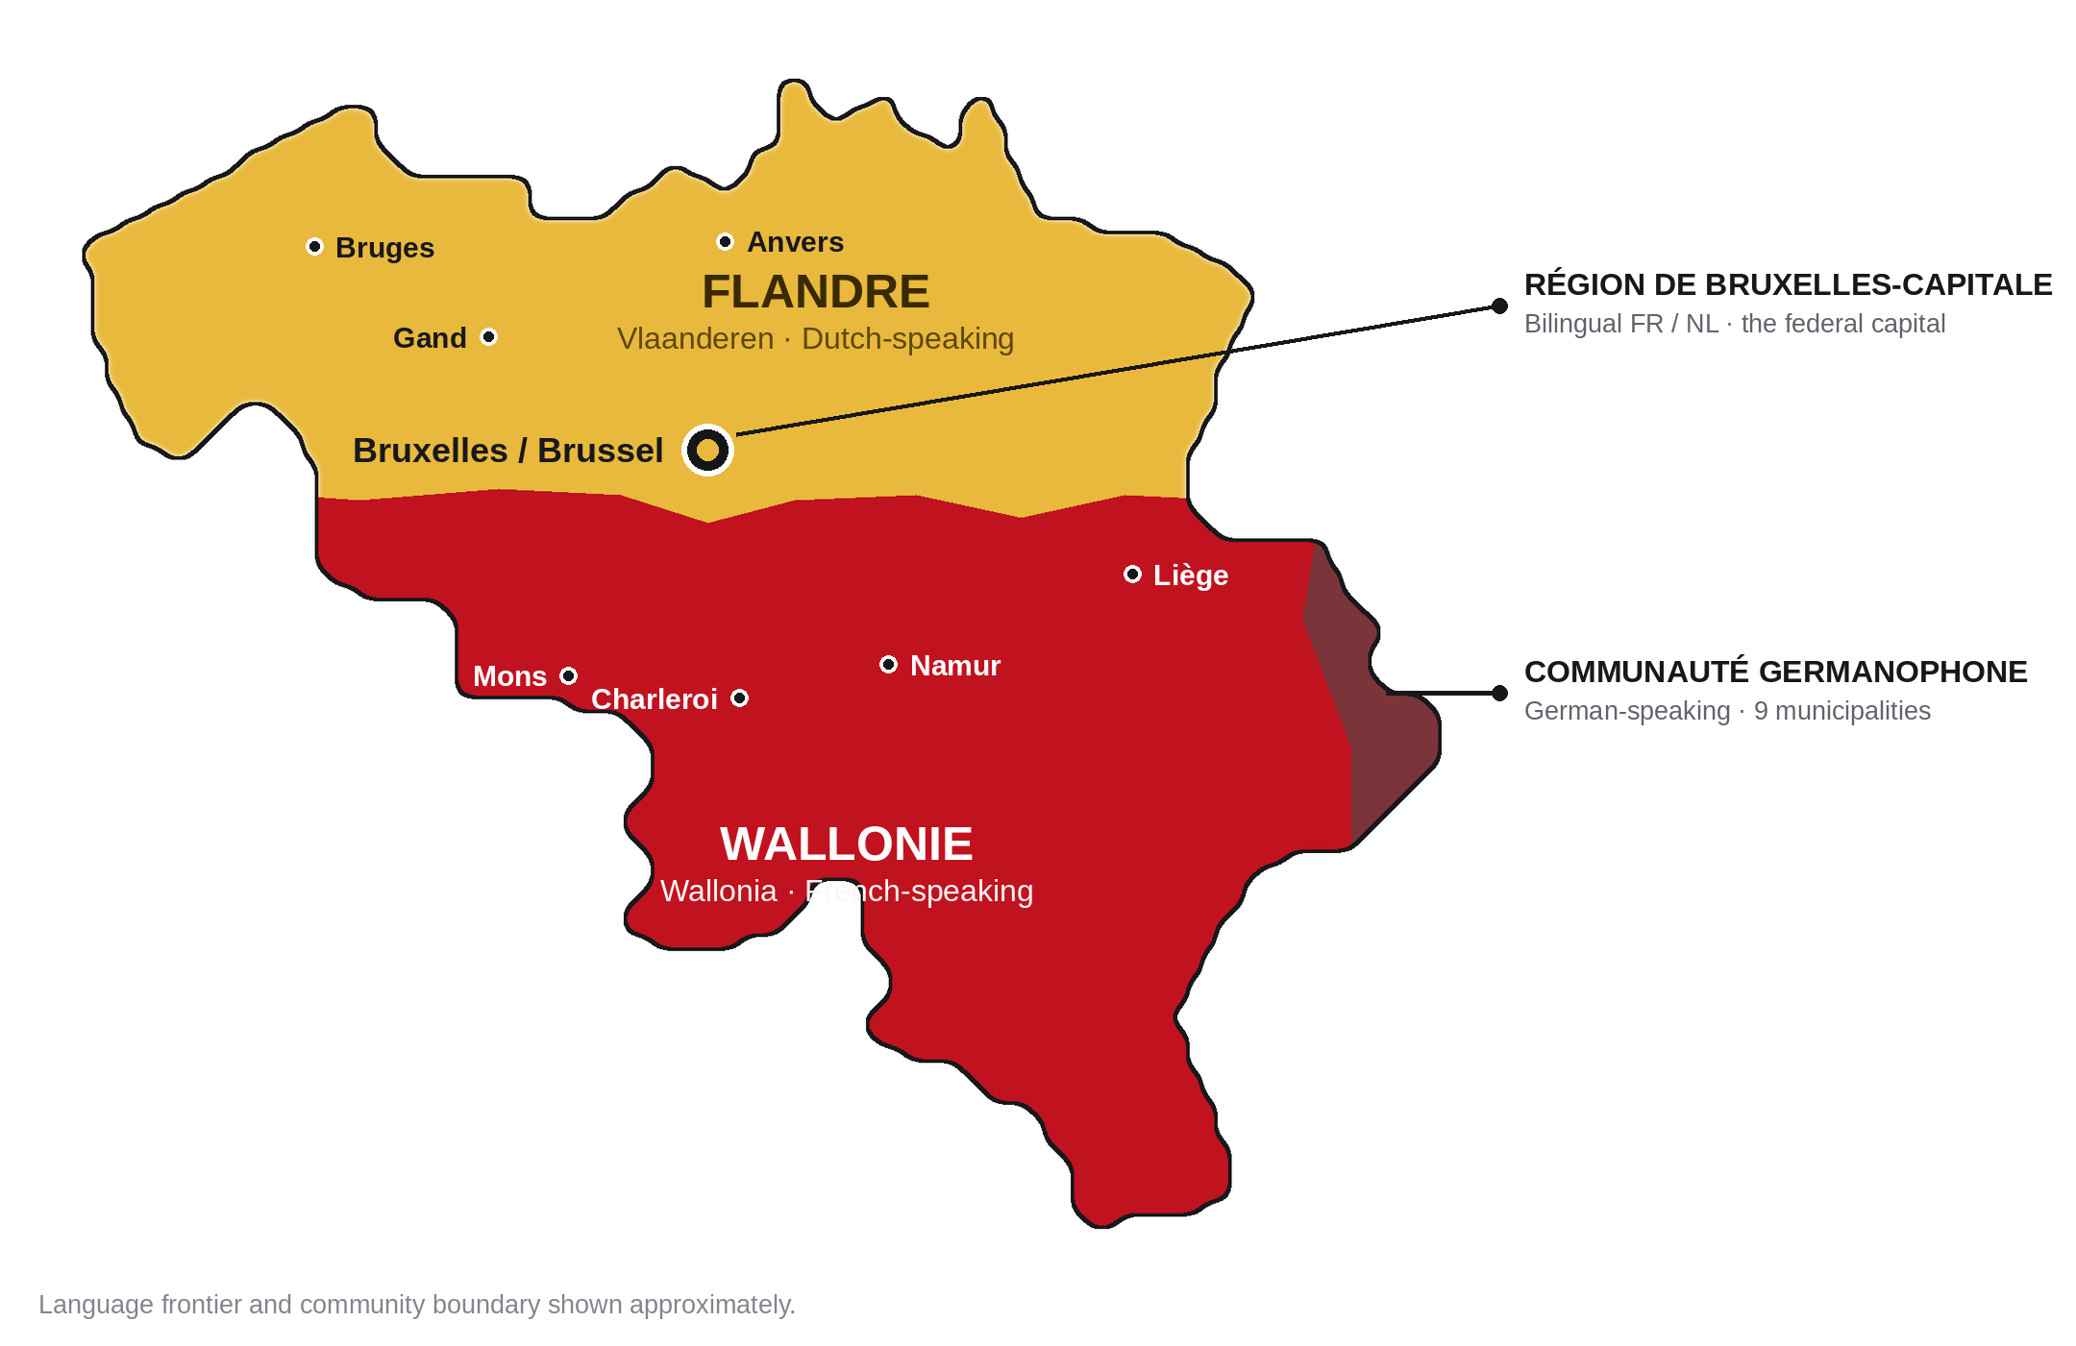
RÉGIONS, COMMUNAUTÉS, LANGUES
One country, three languages
FLANDRE / VLAANDEREN
Dutch-speaking · north
≈ 13,600 km² · 58 % of the population
WALLONIE
French-speaking · south
≈ 16,900 km² · 32 % of the population
BRUXELLES-CAPITALE
Bilingual French / Dutch
162 km² · 11 % of the population
AND THREE COMMUNITIES
Regions govern territory — economy, transport, environment. Communities govern people — language, education and culture. The German-speaking Community has about 78,000 members.
Dutch is spoken by about 60 % of Belgians, French by about 40 %, German by under 1 %.
6
La Belgique · FREN 201 · Projet Francophonie
Notes:
Federalisation ran through six state reforms from 1970 onward. Article 1 of the Constitution now reads: Belgium is a federal State composed of Communities and Regions.

Slide 7
LE NOM, HIER ET AUJOURD'HUI
Former names and the name today
57 BC
Belgae
Julius Caesar describes the Belgae, the tribes living between the Seine and the Rhine, in his account of the Gallic Wars. Their name is the root of every later one.
“Of all these peoples, the bravest are the Belgae.”
c. 22 BC
Gallia Belgica
Rome organises the conquered land as the province of Gallia Belgica — the first time the name marks a territory.
Julius Caesar, De Bello Gallico, Book I — the sentence Belgian schoolchildren still learn.
1556–1794
Pays-Bas espagnols, puis autrichiens
The Spanish Netherlands, then the Austrian Netherlands: the southern, Catholic half of the Low Countries, ruled from Madrid and then Vienna.
1790
États-Belgiques-Unis
A DETAIL THAT MATTERS
The short-lived United Belgian States — the first time a country actually calls itself Belgian. It lasted less than a year.
The monarch's title is Roi des Belges — King of the Belgians, not King of Belgium. The crown belongs to a people, not to a piece of land. That wording was deliberate in 1831 and it still says something about how the country understands itself.
1830 →
Royaume de Belgique
The modern kingdom. In Dutch Koninkrijk België, in German Königreich Belgien — three official names for one country.
7
La Belgique · FREN 201 · Projet Francophonie

Slide 8
HISTOIRE I · 57 AV. J.-C. – 1794
From Rome to the Habsburgs
57 BC
Rome conquers the Belgae
Caesar defeats the Belgic tribes. The land becomes the Roman province of Gallia Belgica and stays Roman for four centuries.
5th c.
The Franks
Roman rule collapses and Frankish kingdoms take over. The Merovingians and then the Carolingians rule from the Meuse valley — Charlemagne's family heartland.
11th–14th c.
The cloth cities
Bruges, Ghent and Ypres grow rich weaving English wool. Bruges becomes one of the great trading ports of Europe. Power sits with the County of Flanders, the Duchy of Brabant and the Prince-Bishopric of Liège.
1384–1477
The Burgundian Netherlands
The Dukes of Burgundy unite the Low Countries. Under Philip the Good, Flemish painting has its golden age — Jan van Eyck finishes the Ghent Altarpiece in 1432.
1477–1794
The Habsburgs
The territory passes to the Habsburgs: the Spanish Netherlands from 1556, then the Austrian Netherlands from 1714. The Dutch Revolt (1568–1648) splits the Protestant north away from the Catholic south — the origin of the border between Belgium and the Netherlands today.
8
La Belgique · FREN 201 · Projet Francophonie
Notes:
The key takeaway: for nearly 2,000 years this land was ruled from somewhere else — Rome, Burgundy, Madrid, Vienna, Paris, The Hague. Independence in 1830 is very recent.

Slide 9
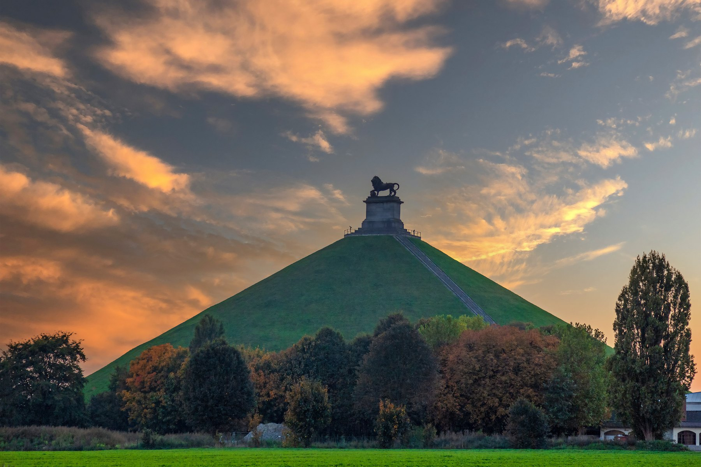
HISTOIRE II · 1795 – 1839
From France to independence
1795
Annexed by France
Revolutionary France annexes the Austrian Netherlands and divides it into départements. French becomes the language of law and administration — a legacy that has never gone away.
1815
Waterloo, then the Dutch
Napoleon is beaten at Waterloo. The great powers hand the territory to the Dutch, creating the United Kingdom of the Netherlands under William I.
1830
Revolution in Brussels
On 25 August a performance of the opera La Muette de Portici sets off riots. Dutch troops are driven out on 27 September, and on 4 October a provisional government declares independence.
1831
A king and a constitution
A strikingly liberal constitution is adopted on 7 February. On 21 July Leopold of Saxe-Coburg is sworn in as Leopold I, first King of the Belgians — still the national day.
1839
Recognised at last
The Treaty of London: the Netherlands finally accepts Belgian independence, and the powers guarantee Belgium's permanent neutrality.
THE LION'S MOUND, WATERLOO
Raised on the battlefield 15 km south of Brussels where Napoleon was finally defeated on 18 June 1815 — on what was not yet Belgian soil.
9
La Belgique · FREN 201 · Projet Francophonie

Slide 10
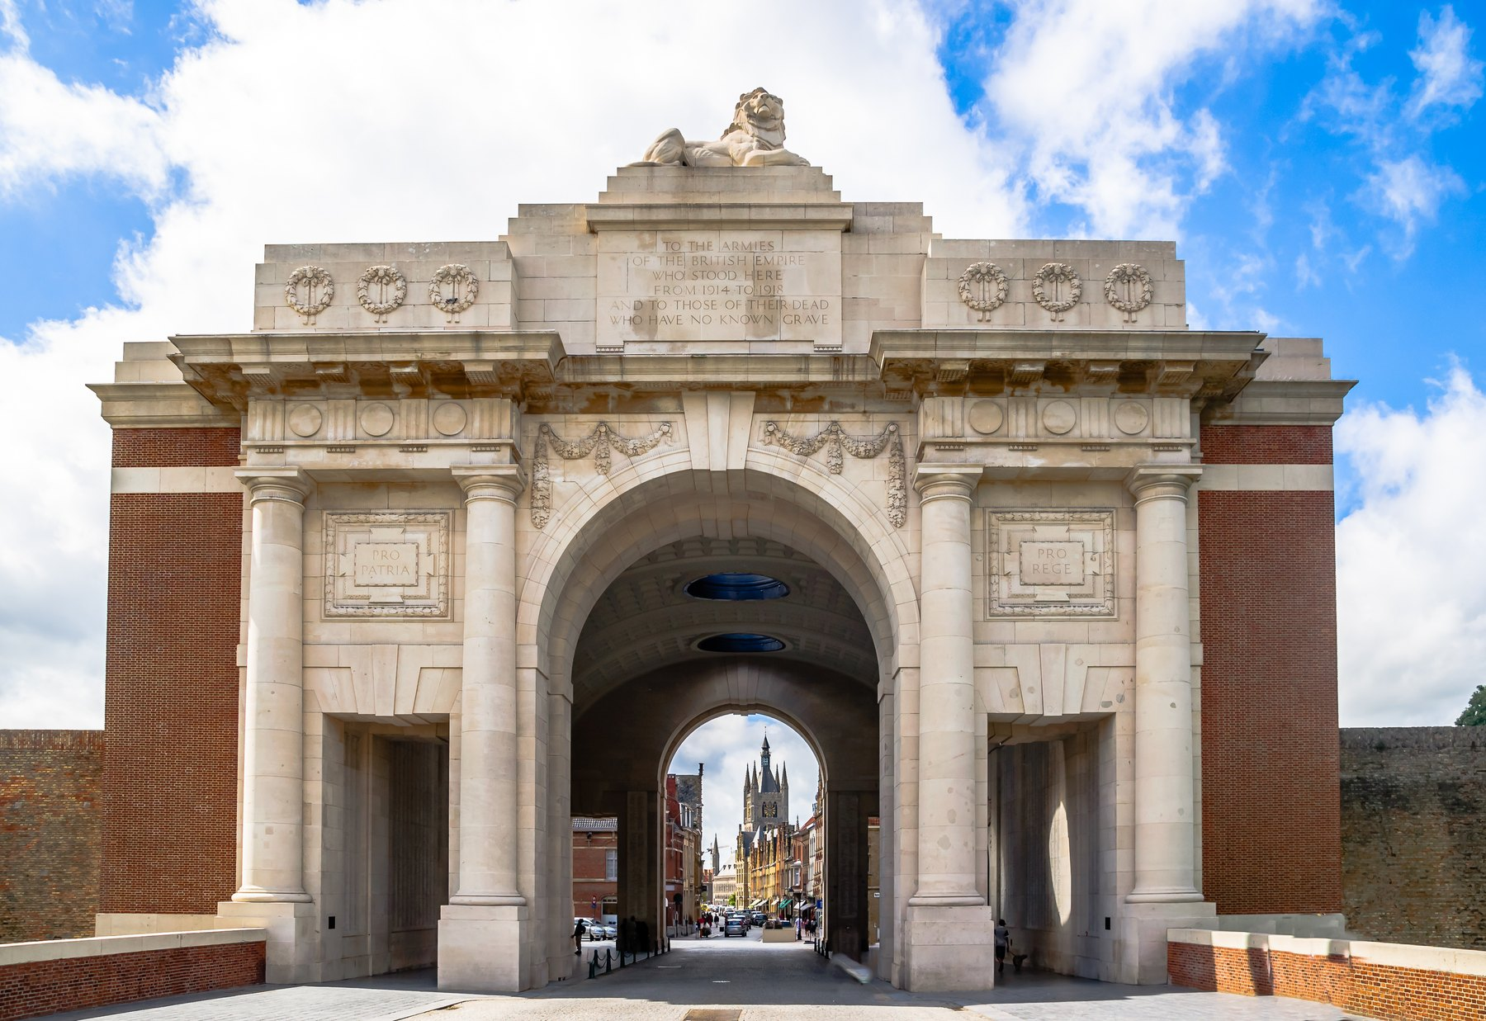
HISTOIRE III · 1885 – AUJOURD'HUI
Empire, war, and federalism
1885
The Congo Free State
King Leopold II takes the Congo as his personal possession. His regime's forced labour and violence cause enormous suffering; international outcry forces Belgium to take the colony over from him in 1908.
1914–18
Neutrality broken
Germany invades neutral Belgium. The Western Front settles into Flanders: Ypres, Passchendaele, the Yser. The poppies of Flanders Fields become the symbol of remembrance.
1940–45
Occupied again
A second German occupation. The last great German offensive of the war, the Battle of the Bulge, is fought in the Ardennes in the winter of 1944–45.
1960–62
Decolonisation
The Congo becomes independent on 30 June 1960; Rwanda and Burundi follow on 1 July 1962. In 2020 King Philippe expressed his “deepest regrets” for the wounds of the colonial past.
1970–2014
Six state reforms
Tension between Dutch and French speakers is answered by rebuilding the country from the inside. Six reforms turn a unitary state into the federation Belgium is today.
THE MENIN GATE, YPRES
A memorial to 54,000 missing soldiers of the Ypres Salient. The Last Post has been sounded here every evening since 1928.
10
La Belgique · FREN 201 · Projet Francophonie

Slide 11
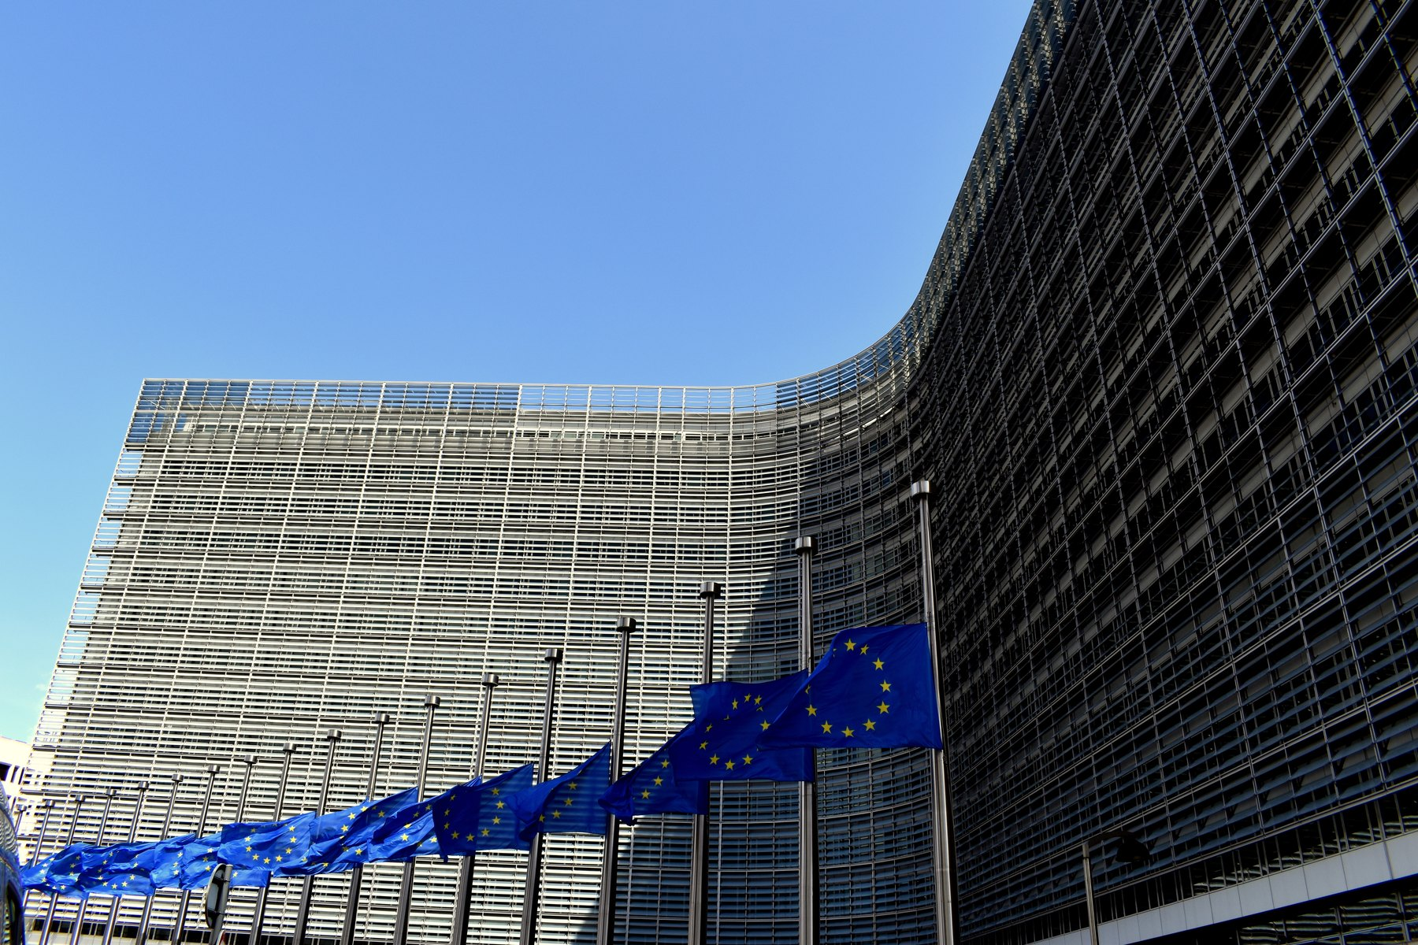
STATUT
Independent since 1830
INDEPENDENT — NOT A TERRITORY OF ANY OTHER COUNTRY
Belgium declared independence on 4 October 1830 and has been a fully sovereign state ever since, recognised internationally by the Treaty of London in 1839. It is not, and has never been, a French overseas territory — it simply shares France's language.
FROM NEUTRALITY TO ALLIANCE
The 1839 treaty made Belgium permanently neutral. Germany violated that neutrality in 1914 and again in 1940. After the Second World War Belgium abandoned neutrality for good and helped build the alliances that replaced it.
1944 · Benelux
1945 · United Nations
Customs union with the Netherlands and Luxembourg — a rehearsal for European integration.
A founding member.
The Berlaymont in Brussels — headquarters of the European Commission, and the reason Brussels is called the capital of Europe.
1949 · NATO
1951 / 1957 · The European Union
A founding member; the alliance's headquarters moved to Brussels in 1967.
Founding member of the Coal and Steel Community and then, by the Treaty of Rome, of the EEC.
1999 · The eurozone
1970 · La Francophonie
A founding member of both the EU and NATO — and the host of both.
A founding member of the single currency.
A founding member — with two seats, the Kingdom and the French Community.
11
La Belgique · FREN 201 · Projet Francophonie

Slide 12
ORGANISATION POLITIQUE
A federal parliamentary constitutional monarchy
DEMOCRACY
MONARCHY
FEDERAL
PARLIAMENTARY
not a dictatorship
not a republic
not unitary, since 1993
the government answers to parliament
THREE LEVELS OF GOVERNMENT
THE FEDERAL LEVEL
King Philippe, Head of State · Prime Minister Bart De Wever · Chamber of Representatives, 150 members elected by proportional representation · Senate, 60 members, mostly appointed by the regional and community parliaments
1
Defence, justice, police, foreign affairs, social security, most taxation.
THE THREE REGIONS
Flanders · Wallonia · Brussels-Capital — each with its own elected parliament and its own government
2
Territory: economy, employment, transport, housing, environment, agriculture.
THE THREE COMMUNITIES
Flemish Community · French Community (Fédération Wallonie-Bruxelles) · German-speaking Community
3
People: education, culture, language, health and welfare policy.
Voting is compulsory from the age of 18, and because parties are organised by language, every federal government is a coalition.
12
La Belgique · FREN 201 · Projet Francophonie
Notes:
Article 1 of the Constitution: Belgium is a federal State composed of Communities and Regions. Six state reforms: 1970, 1980, 1988-89, 1993, 2001 and 2011-14.

Slide 13
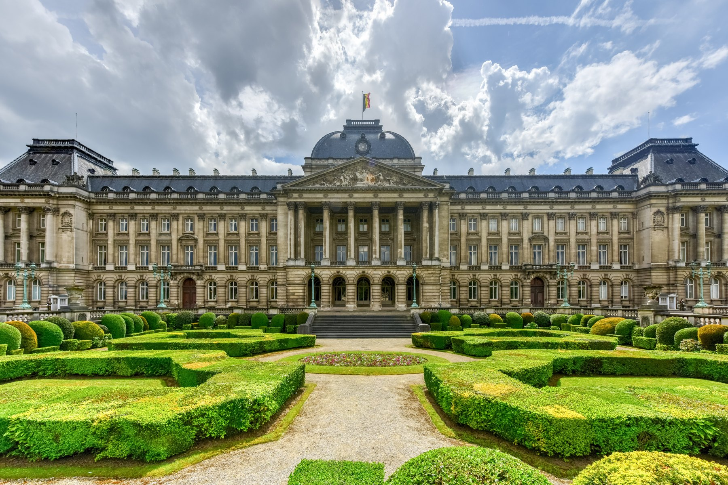
LE ROI PHILIPPE
Head of State since 21 July 2013
Full title
Philippe, Roi des Belges — King of the Belgians, the seventh since 1831
House
Saxe-Coburg and Gotha — the dynasty founded by Leopold I in 1831
Accession
21 July 2013, when his father Albert II abdicated for health reasons
Born
15 April 1960, Brussels. Married to Queen Mathilde; four children
Heir
Princess Elisabeth, Duchess of Brabant — Belgium's first reigning queen, under absolute primogeniture since 1991
Languages
Dutch, French, German, English, Italian and Spanish
WHAT THE KING CAN AND CANNOT DO
He appoints the government, signs laws and royal decrees, is commander-in-chief and represents Belgium abroad — but he has no veto and no personal policy. His real influence is quiet: appointing the negotiators who assemble a coalition, and holding the country together when its two language groups cannot agree.
THE ROYAL PALACE, BRUSSELS
The King's official workplace. The royal family actually lives at Laeken, on the edge of the city.
13
La Belgique · FREN 201 · Projet Francophonie

Slide 14
LE GOUVERNEMENT FÉDÉRAL
Who governs Belgium today
PREMIER MINISTRE · PRIME MINISTER
“L'ARIZONA” — THE COALITION
Bart De Wever
Five parties, named after the colours of the Arizona flag:
N-VA · MR · Les Engagés · Vooruit · CD&V
Sworn in on 3 February 2025. Leader of the New Flemish Alliance (N-VA) and the first Flemish nationalist ever to head the Belgian federal government.
Three Flemish parties and two French-speaking ones. Deputy prime ministers include Jan Jambon, David Clarinval, Maxime Prévot, Frank Vandenbroucke and Vincent Van Peteghem.
150
5
8
541
seats in the Chamber of Representatives, elected by proportional representation
parties needed to form the current federal majority
months of negotiation after the June 2024 election before a government was sworn in
days without an elected government in 2010–11 — a world record at the time
Why coalitions are so hard: Belgian parties do not compete nationally. Voters in Flanders and voters in Wallonia choose from two entirely separate sets of parties, so a federal majority must always be negotiated across the language border.
14
La Belgique · FREN 201 · Projet Francophonie

Slide 15
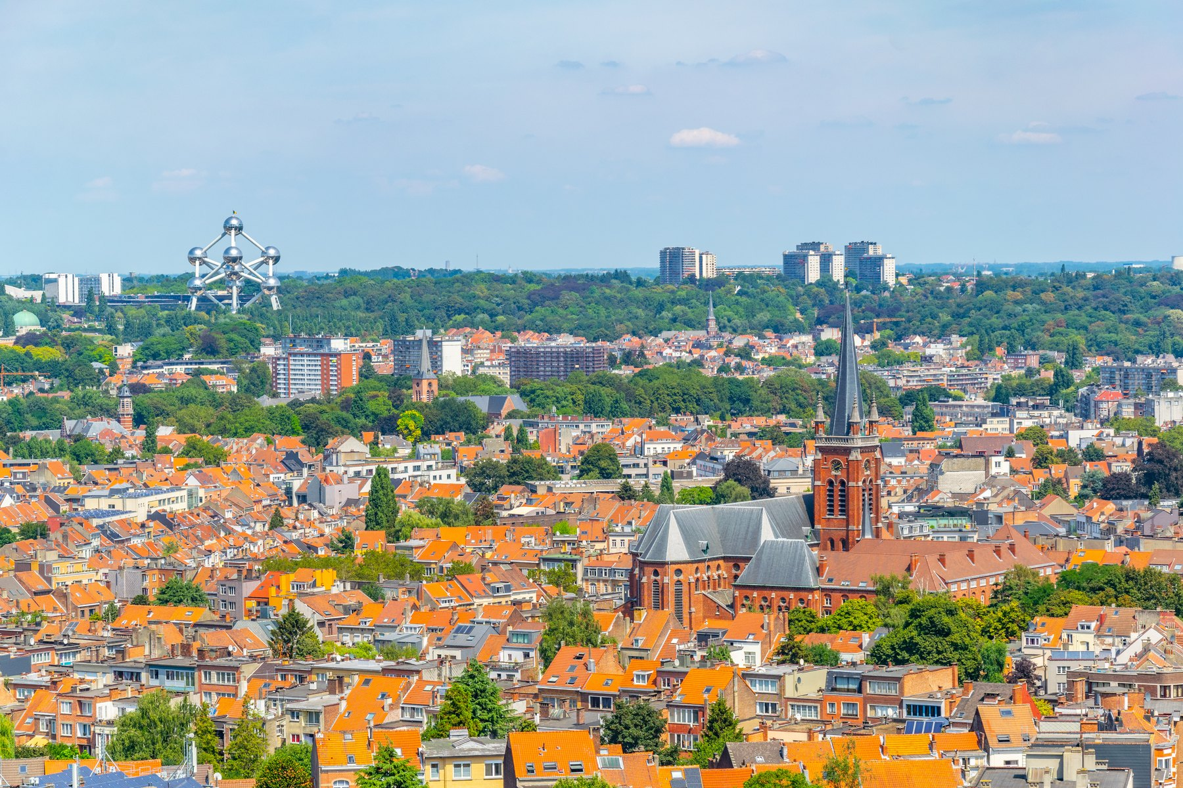
BRUXELLES
The capital of Belgium — and of Europe
1.25 million
people in the Brussels-Capital Region; about 2.1 million in the wider metropolitan area.
Officially bilingual
French and Dutch have equal status. In practice around 80 % of residents speak French — a French-speaking region surrounded by Flanders.
Capital of the EU
Home to the European Commission, the Council of the EU and part of the European Parliament.
NATO headquarters
Brussels from the Koekelberg basilica. The Atomium, built for the 1958 World's Fair, is visible on the horizon.
Since 1967.
WHAT TO SEE
The Grand-Place, a UNESCO World Heritage site since 1998 and one of the most complete baroque squares in Europe · Manneken Pis · the Art Nouveau town houses of Victor Horta, also UNESCO · the Atomium · the Royal Museums of Fine Arts and the Magritte Museum · the Belgian Comic Strip Center
15
La Belgique · FREN 201 · Projet Francophonie

Slide 16
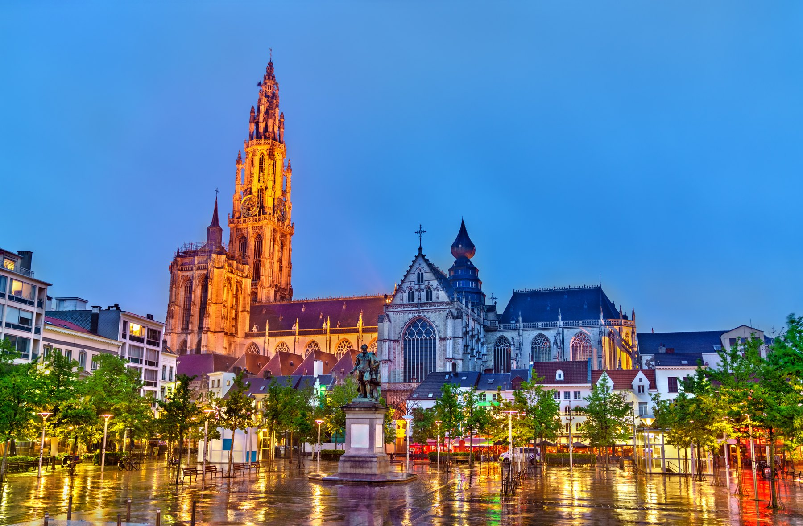
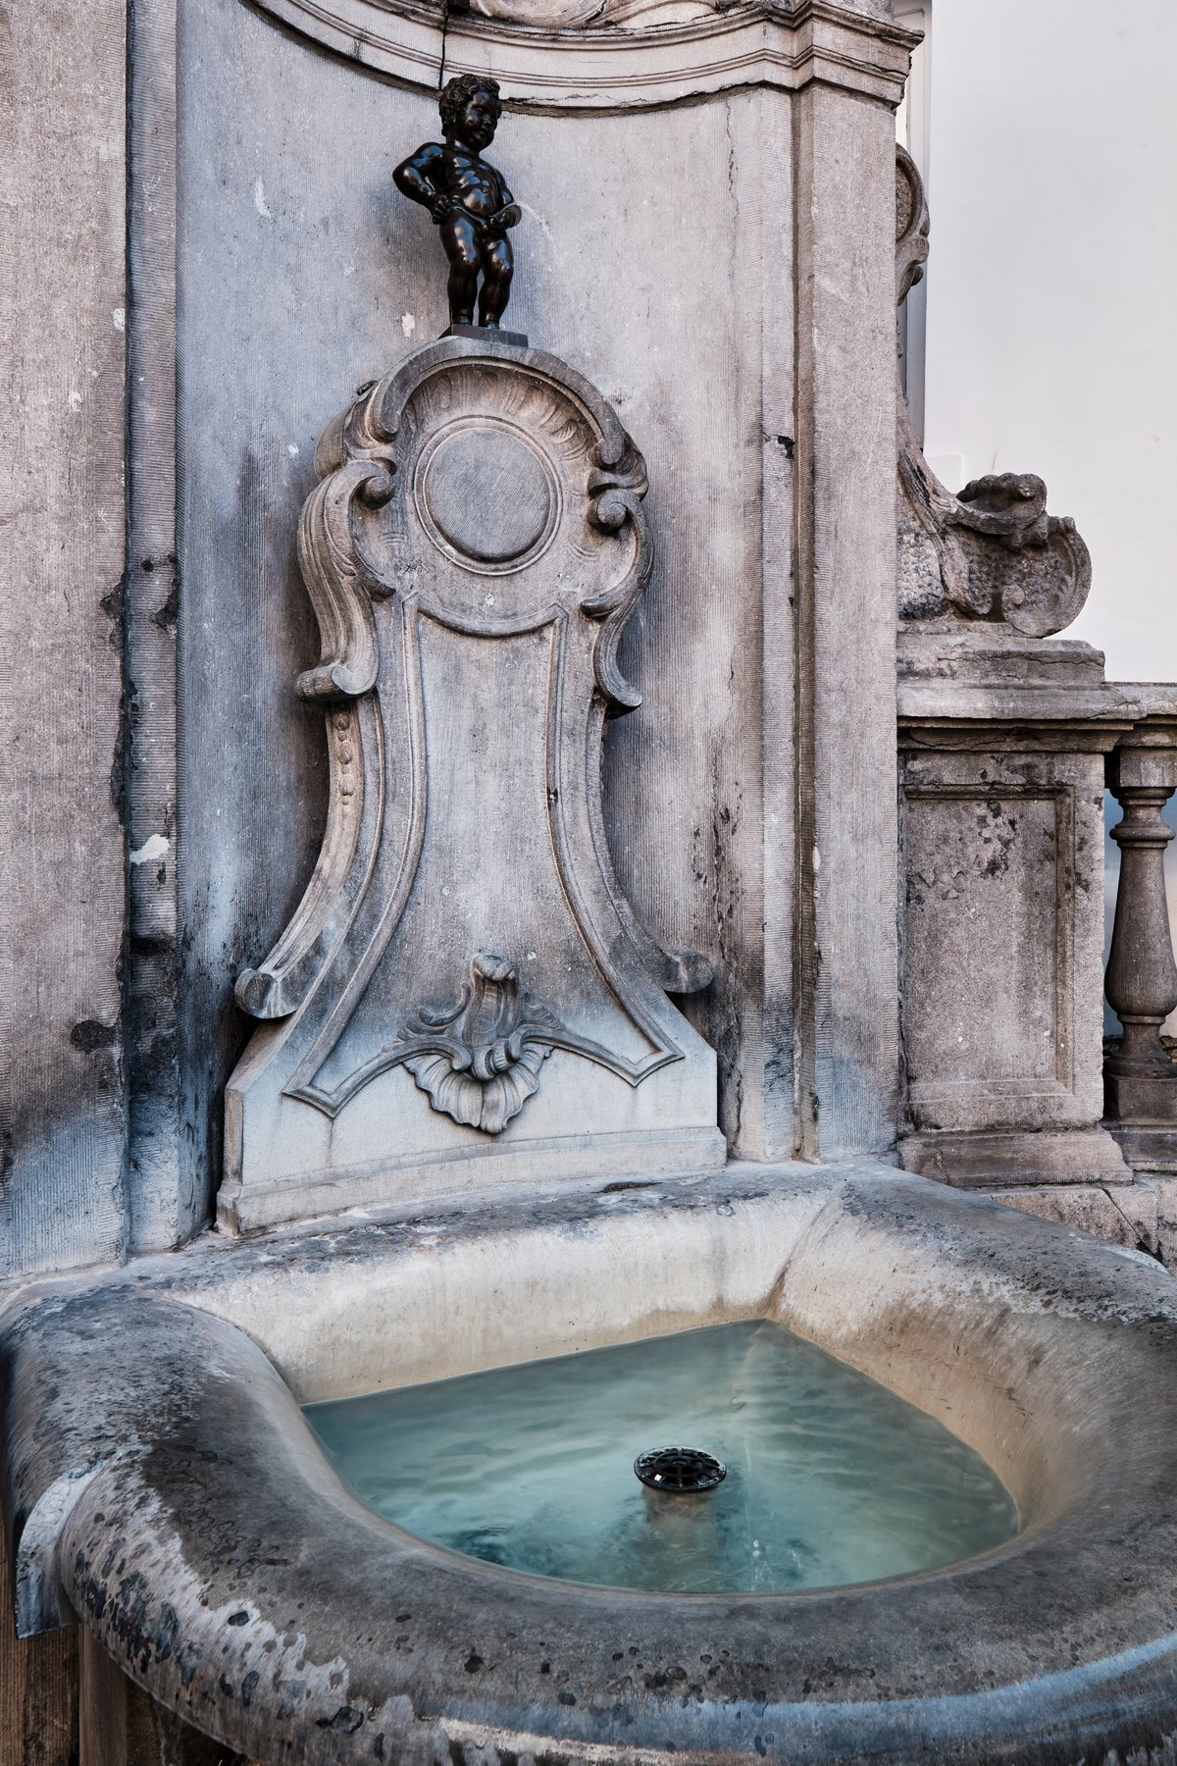
CULTURE
Painters, surrealists and the ninth art
LA PEINTURE
Jan van Eyck's Ghent Altarpiece (1432) is one of the founding works of European painting. Pieter Bruegel the Elder painted peasant life; Peter Paul Rubens made Antwerp a capital of the baroque; René Magritte turned Belgian surrealism into an image everyone knows — Ceci n'est pas une pipe.
LA BANDE DESSINÉE
Belgium invented the modern European comic and calls it the ninth art. Hergé created Tintin in 1929; Peyo created the Smurfs (Les Schtroumpfs); Morris created Lucky Luke. Brussels has a comic-strip museum and a walking trail of painted murals.
The Cathedral of Our Lady, Antwerp — its belfry is UNESCO-listed and it holds four Rubens altarpieces.
LA MUSIQUE ET LE CINÉMA
Adolphe Sax, born in Dinant in 1814, invented the saxophone. César Franck came from Liège, Jacques Brel from Brussels. The Dardenne brothers have won the Palme d'Or at Cannes twice.
Manneken Pis, Brussels — cast in bronze in 1619.
16
La Belgique · FREN 201 · Projet Francophonie

Slide 17
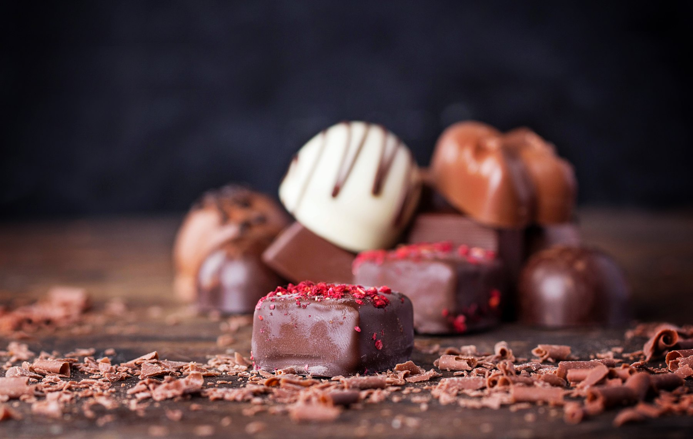
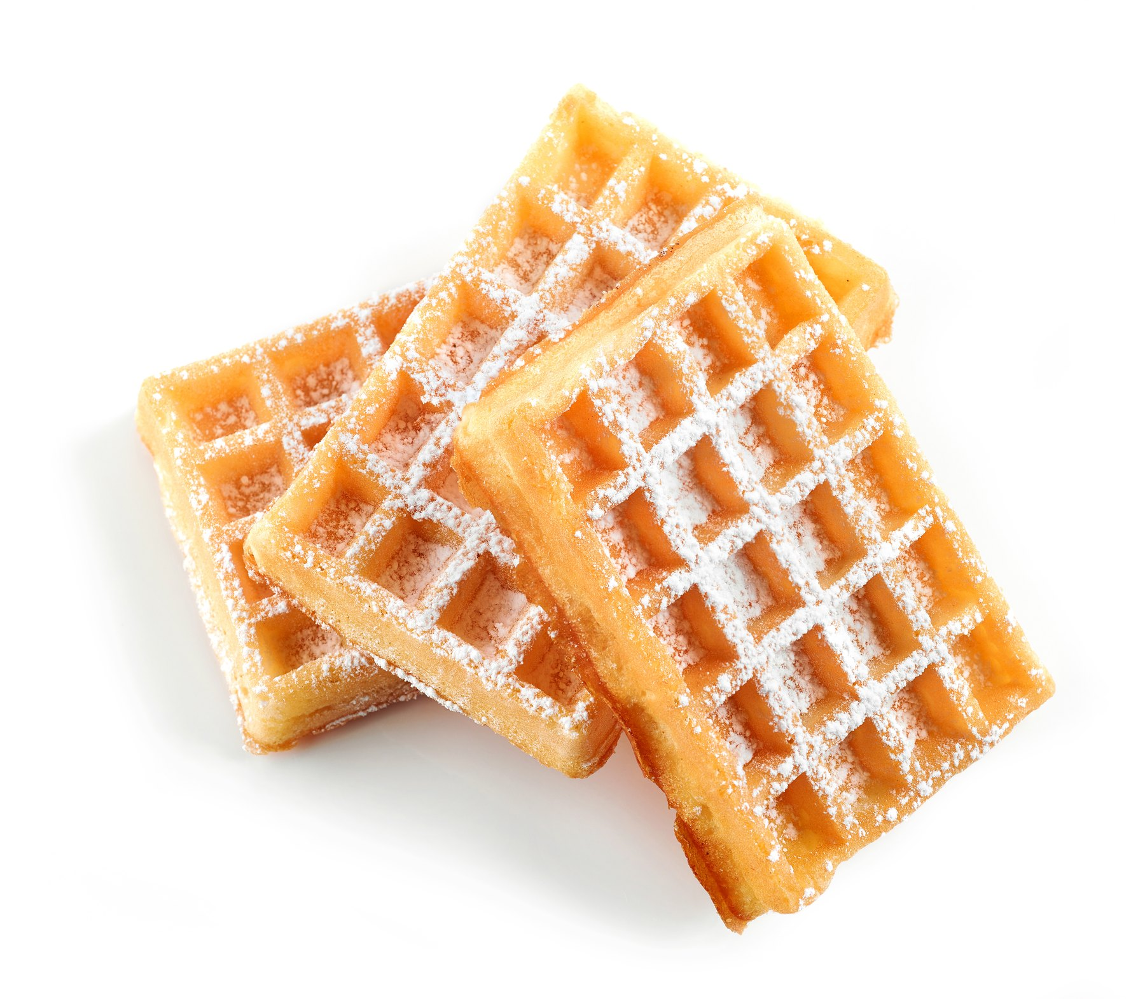
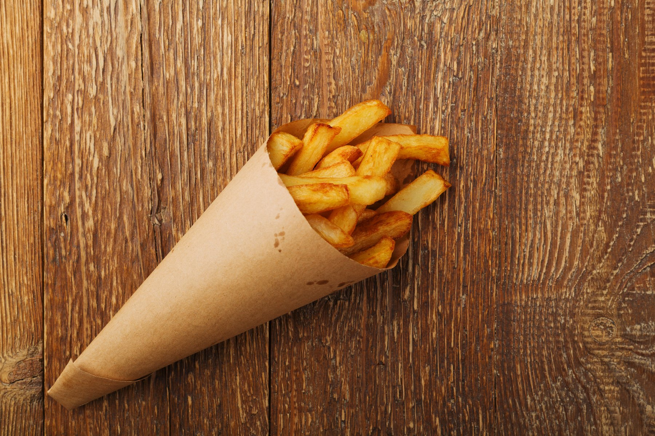
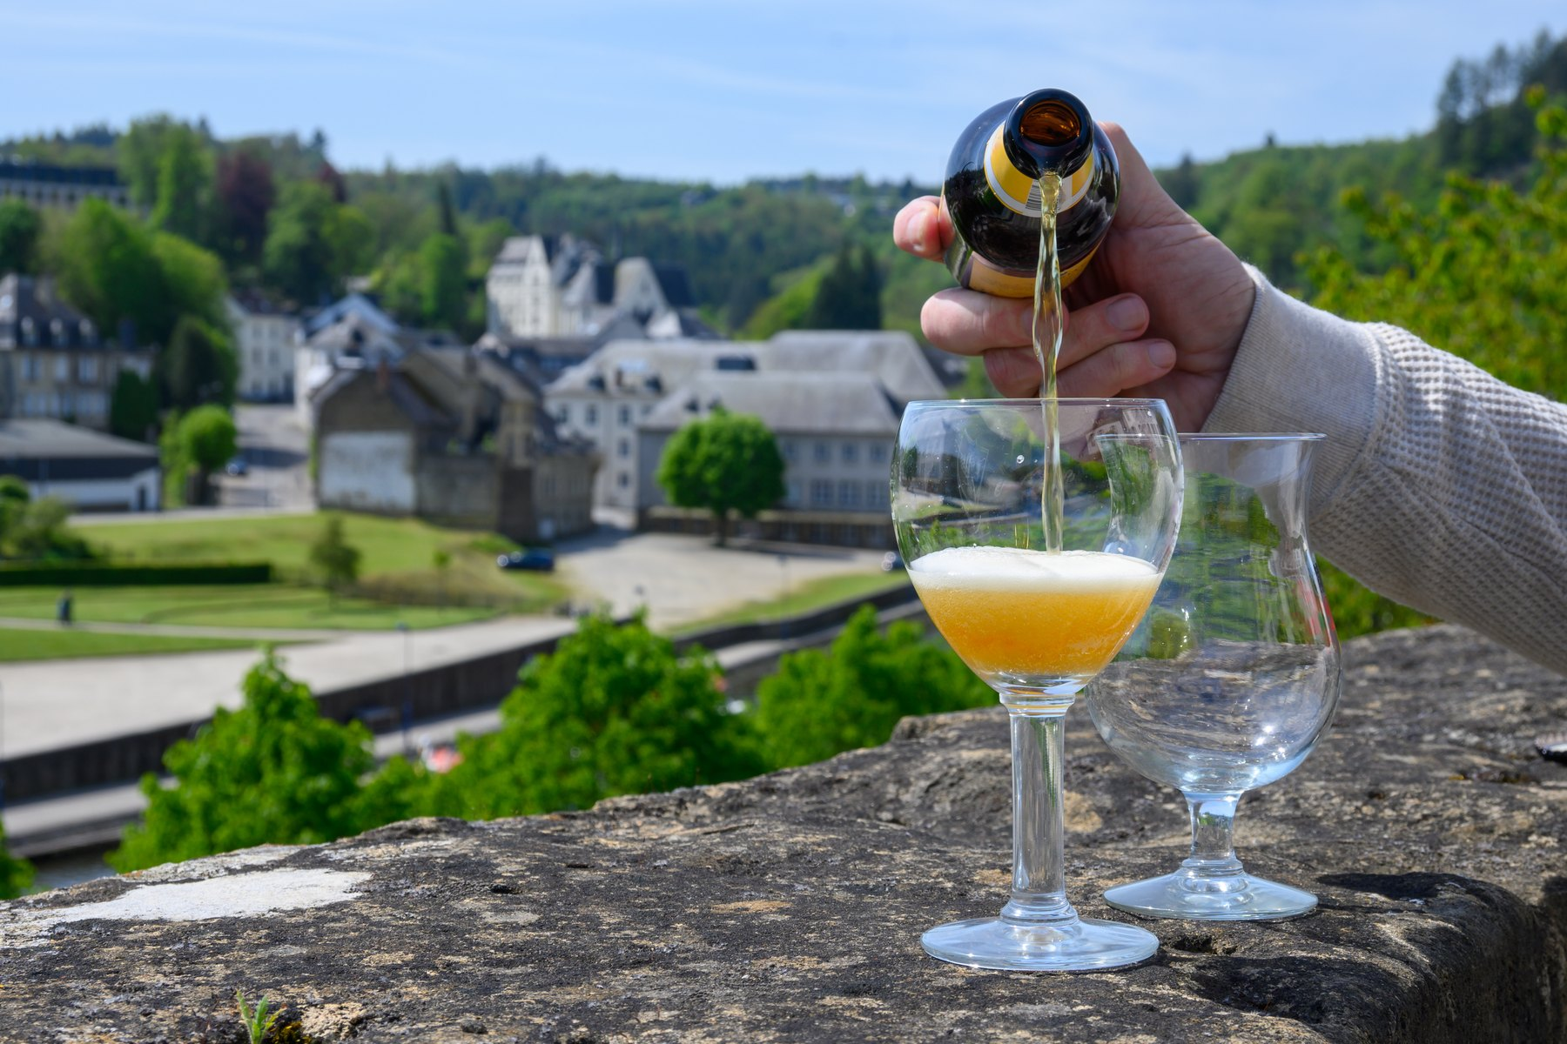
GASTRONOMIE
Four things Belgium is famous for — and rightly so
LE CHOCOLAT
LA GAUFRE
LES FRITES
LA BIÈRE
The filled praline was invented in Brussels by Jean Neuhaus II in 1912. Belgium has several hundred chocolatiers and exports chocolate worldwide.
Two rival waffles: the light rectangular gaufre de Bruxelles, and the dense, chewy gaufre de Liège studded with caramelised pearl sugar.
Belgians claim to have invented them, fry them twice, sell them from a friterie and eat them from a paper cone with mayonnaise — never as a side dish.
More than a thousand Belgian beers, from Trappist abbey ales to sour lambics. Belgian beer culture was added to UNESCO's Intangible Cultural Heritage list in 2016.
AT THE TABLE
Moules-frites · carbonnade flamande, beef stewed in beer · waterzooi from Ghent · chicons au gratin · speculoos biscuits · and, in season, the grey shrimp of the North Sea coast.
17
La Belgique · FREN 201 · Projet Francophonie

Slide 18
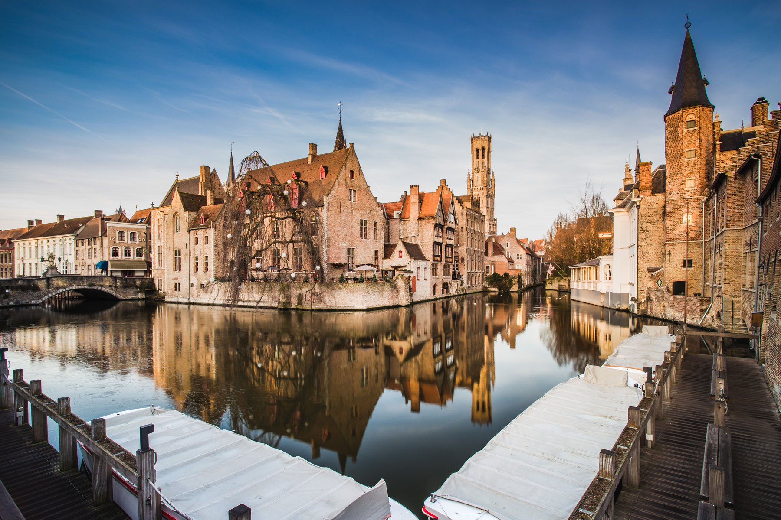
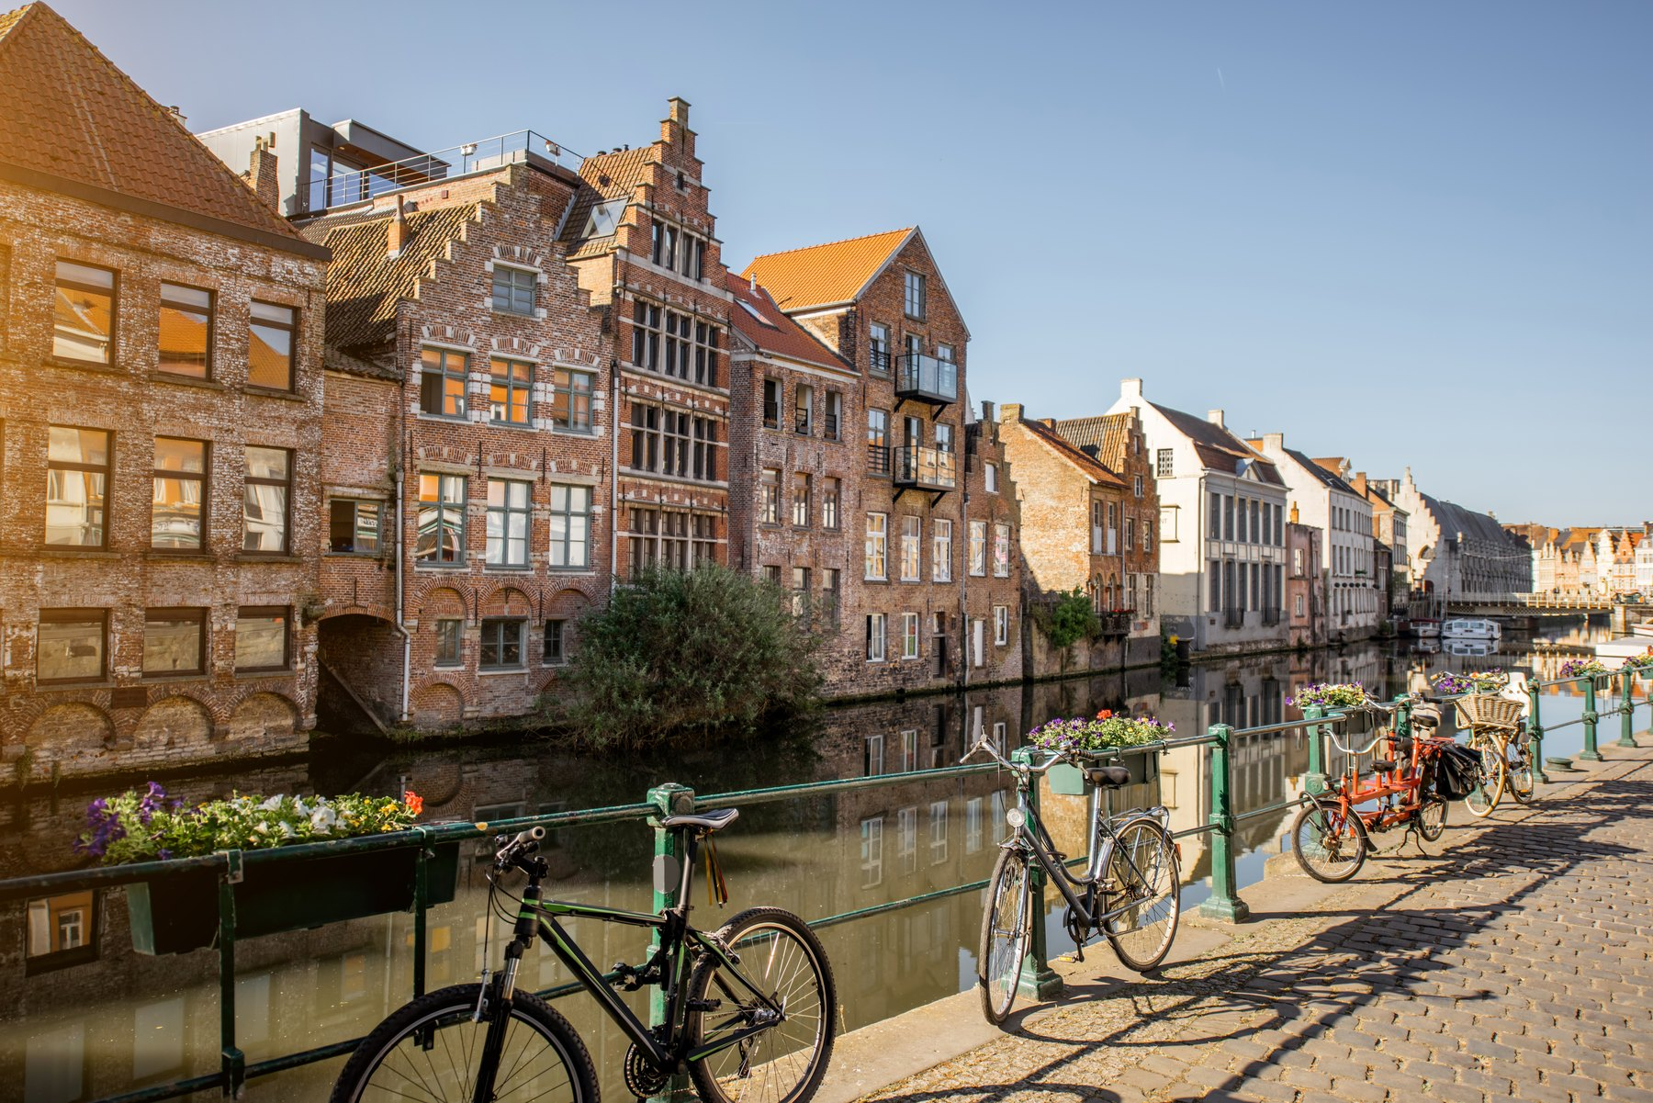
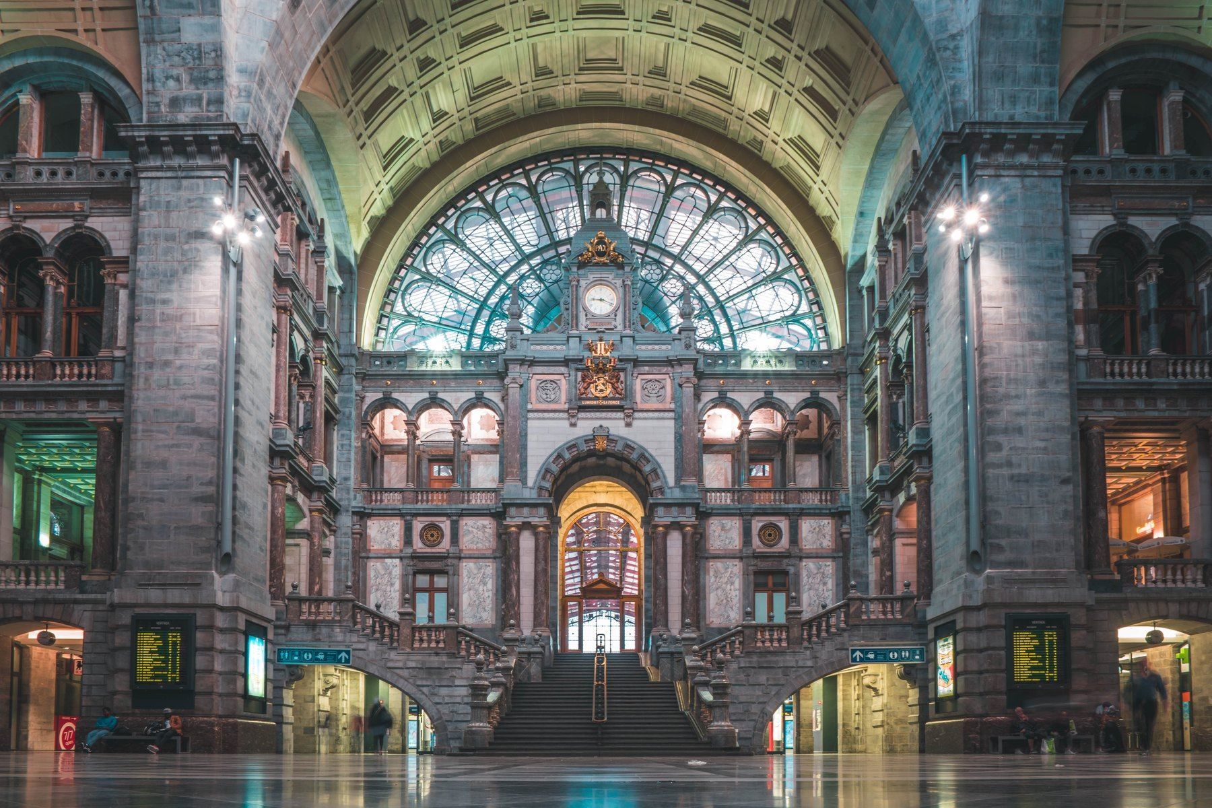
LES VILLES D'ART
Three cities worth the trip
BRUGES / BRUGGE
GAND / GENT
ANVERS / ANTWERPEN
The Venice of the North. The entire historic centre is a UNESCO World Heritage site, along with its belfry and its béguinage. Medieval brick gables, canals, and the Groeninge Museum's Flemish Primitives.
A working city rather than a museum. The Gravensteen castle, the guild houses of the Graslei, and van Eyck's Ghent Altarpiece in Saint Bavo's Cathedral. A UNESCO Creative City of Music.
Rubens' city and Belgium's port. Central Station is known as the railway cathedral. More than 70 % of the world's rough diamonds still pass through the Antwerp diamond district.
Belgium has 13 UNESCO World Heritage sites in a country the size of Maryland — including 33 of the belfries of Belgium and France, and the Carnival of Binche on the Intangible Heritage list.
18
La Belgique · FREN 201 · Projet Francophonie

Slide 19
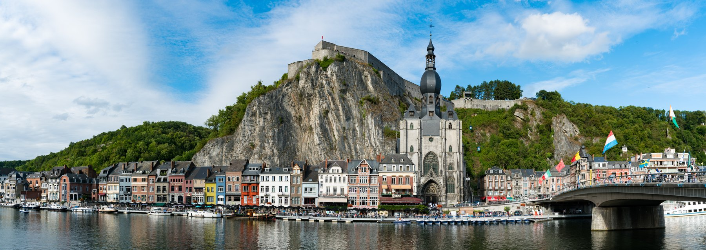
INFOS PRATIQUES
What a visitor needs to know
1
MONEY
2
GETTING IN
The euro. Cards and contactless are accepted almost everywhere; American Express often is not. Service is included and tipping is not expected.
Belgium is in the Schengen area. Visitors from the US, UK, Canada, Australia and Japan may stay 90 days without a visa; an ETIAS travel authorisation is being introduced. Fly into Brussels (BRU) or Charleroi (CRL).
3
GETTING AROUND
4
LANGUAGE
The rail network is one of the densest in the world and almost nowhere is more than about two hours from anywhere else. Trams and metro in the cities; bicycles everywhere in Flanders.
French in Wallonia and Brussels, Dutch in Flanders, German in the far east. English is widely spoken in cities. Open in French in Brussels and Wallonia, in Dutch or English in Flanders — the choice of language is never neutral.
5
WHEN TO GO
6
DON'T MISS
May to September for the best weather; December for the Christmas markets. Bring a raincoat in any month — the Belgians have a word for a downpour, une drache.
The Grand-Place lit up at night · a canal boat in Bruges · a cone of frites from a friterie · a Trappist beer in an abbey café · Dinant on the Meuse.
Dinant on the Meuse, in Wallonia — birthplace of Adolphe Sax, inventor of the saxophone.
19
La Belgique · FREN 201 · Projet Francophonie

Slide 20
LA BELGIQUE ET LA FRANCOPHONIE
A French-speaking country at the centre of Europe
≈ 40 %
2 seats
septante
of Belgians — roughly 4.5 million people — have French as their mother tongue, concentrated in Wallonia and Brussels.
Belgium is a founding member of the Organisation internationale de la Francophonie and is represented twice: the Kingdom of Belgium, and the French Community.
Belgian French keeps septante for 70 and nonante for 90, where France says soixante-dix and quatre-vingt-dix.
A few Belgicismes worth knowing
un GSM — a mobile phone · une drache — a sudden downpour · faire la file — to queue · savoir used where France would say pouvoir · un kot — a student room
Belgium is where Germanic and Latin Europe meet. It is a small, young, complicated country that has learned to hold three languages, six parliaments and two thousand years of other people's empires — and it houses the capital of Europe while doing it.
20
La Belgique · FREN 201 · Projet Francophonie
Notes:
Conclusion: Belgium's identity is built on being a meeting point rather than a single nation.

Slide 21
SOURCES
Where the facts in this presentation come from
1
belgium.be
The federal government's official portal — history, regions and institutions.
2
monarchie.be
The Belgian Monarchy — the King's role, duties and family.
3
premier.be · kanselarij.belgium.be
Office of the Prime Minister — the current federal government.
4
european-union.europa.eu
European Union country profile: Belgium.
5
whc.unesco.org
UNESCO World Heritage Centre — Belgium's listed sites and its beer culture.
6
diplomatie.belgium.be
Belgian Foreign Affairs — Belgium and the Organisation internationale de la Francophonie.
7
Britannica · CIA World Factbook
Population, area, borders, coastline and general geography.
8
visitflanders.com · visitbruges.be · visitwallonia.be
Official tourist boards — visitor information.
Photographs licensed from Adobe Stock. The map of Europe is the blank outline map supplied with the assignment, with Belgium marked and its neighbours labelled; the map of Belgium's regions was drawn from that same outline. Language and community boundaries are shown approximately.
21
La Belgique · FREN 201 · Projet Francophonie

