Slide 1
Predicting Plastic Degradation with Machine Learning
Core idea
This project moved from simply building classifiers to asking a more important question: which model is actually trustworthy when conditions get harder?
From descriptor baselines to reliability-aware model selection
Final recommendation
Aryamann Zutshi
EECS 692
Top-ranked feature set + Random Forest gave the best balance between accuracy, calibration, and robustness.
Instructor: Dr. David Johnson
Slide 1

Slide 2
Project Objective
The project changed from performance-first modeling to reliability-aware selection.
Predict biodegradability from molecular descriptor data
Compare classical ML, neural networks, and graph-inspired methods
Stress-test the pipeline with validation, feature engineering, and uncertainty analysis
Choose a final model that is accurate and trustworthy
Research shift
The most important change in the project was moving from “which model scores highest?” to “which model can actually be defended?”
Why this matters
A high score alone does not show whether the model generalizes, calibrates well, or knows when it might be wrong.
Final framing
The final model should be selected by reliability, not just by a single favorable metric.
Slide 2

Slide 3
Dataset and Scope
QSAR biodegradation dataset used throughout the project
1,055
41
2
samples
molecular descriptors
target classes
Key limitation
The data supported biodegradability classification well, but it did not directly support every original project goal, so the later weeks had to be adapted honestly.
Target: RB vs NRB
Examples of descriptors: SpMax_L, SpMax_B_m, SM6_B_m, nN, LOC
Good for QSAR classification, but not a true polymer graph dataset
No continuous degradation-rate constants or true pathway labels
What that changed
Regression on true rate constants, pathway labels, and chemistry-native polymer graphs became future-work directions instead of claims I could make from this dataset.
Slide 3

Slide 4
How the Project Evolved
Project Highlights
Each week answered a different modeling question instead of repeating the same experiment.
Slide 4

Slide 5
Model Progression: Weeks 5 to 7
Starting with classical baselines before testing more complex models
Week 5 established the first strong baseline
Random Forest outperformed Logistic Regression on the standard split
Week 6 and Week 7 tested whether more complex models would help
They did not beat the strongest classical baseline
Main takeaway
Model complexity alone did not improve results. Representation quality mattered more.
Transition
This set up the next question: do these models still hold up once the data distribution changes?
Figure on next slide
The next slide shows the direct comparison between the baseline, the FNN, and the descriptor-graph prototype.
Slide 5

Slide 6
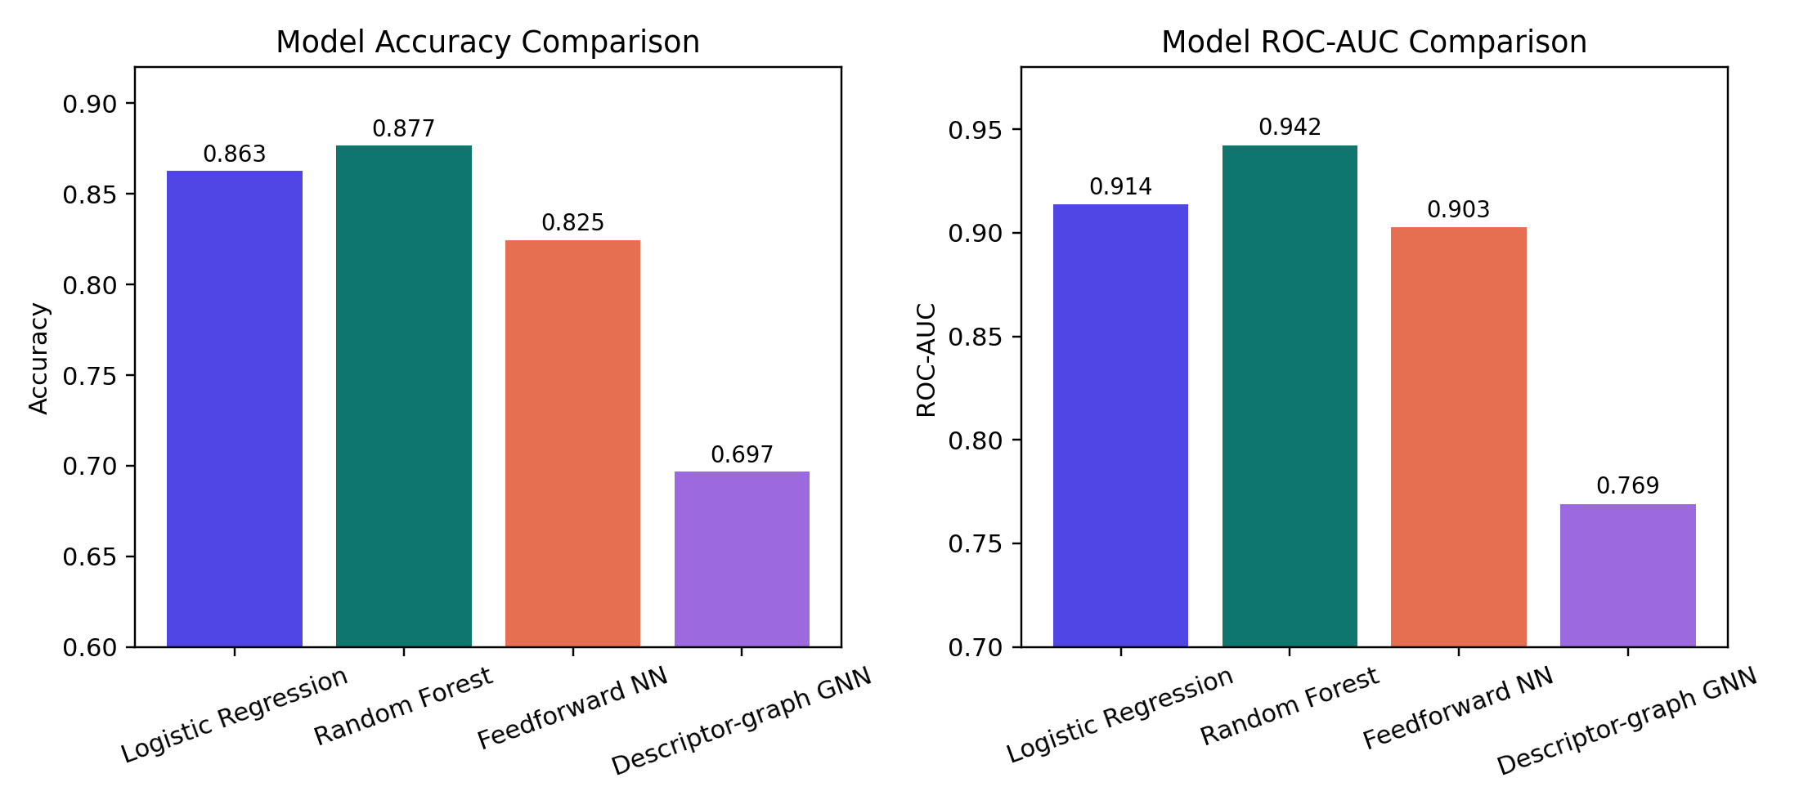
Figure: Model Progression Comparison
Direct comparison of Weeks 5 to 7 models on the standard evaluation setup
What it showed
Random Forest stayed strongest, while the FNN and descriptor-graph prototype did not justify their extra complexity.
Why it matters
This figure is one of the main pieces of evidence for the final project conclusion.
Slide 6

Slide 7
Cross-Environment Validation
Week 8 tested whether learned patterns transferred under distribution shift
I created 3 proxy environments using descriptor-space clustering
Then I ran leave-one-environment-out validation
All models dropped hard under the shifted distribution
This was where generalization clearly became the central problem
Most important result
Random Forest still performed best, but even it dropped to about 0.421 mean held-out accuracy.
What changed
From this point on, the project was no longer just about prediction quality. It was about generalization and reliability.
Figure on next slide
The next slide shows the full cross-environment comparison clearly on its own.
Slide 7

Slide 8
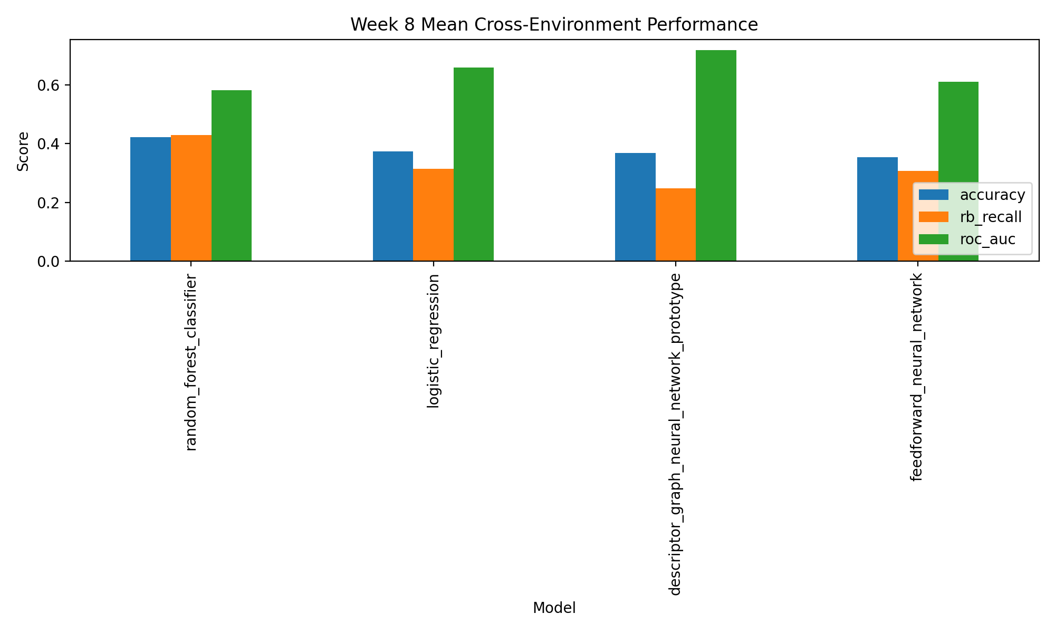
Figure: Cross-Environment Performance
Week 8 leave-one-environment-out validation across proxy environments
What it showed
Even the strongest models struggled under distribution shift, which made robustness the real bottleneck in the project.
Why it matters
This figure is one of the main pieces of evidence for the final project conclusion.
Slide 8

Slide 9
Validation Repair and Feature Engineering
Weeks 9 and 10 focused on pipeline correctness and chemistry-aware expansion
I repaired the validation setup with 5-fold stratified cross-validation
SMOTE was applied only on training folds
Then I added chemistry-aware proxy features for polarity, heteroatoms, and topology
The best Week 10 setup improved RB recall without changing the core dataset
Best Week 10 result
Tier 1 + Tier 2 with FNN and SMOTE reached 0.8758 accuracy and 0.8399 RB recall.
Why this mattered
It showed that chemistry-aware features could help, but they did not remove the broader robustness problem.
Figure on next slide
The next slide isolates the Week 10 feature-engineering chart.
Slide 9

Slide 10
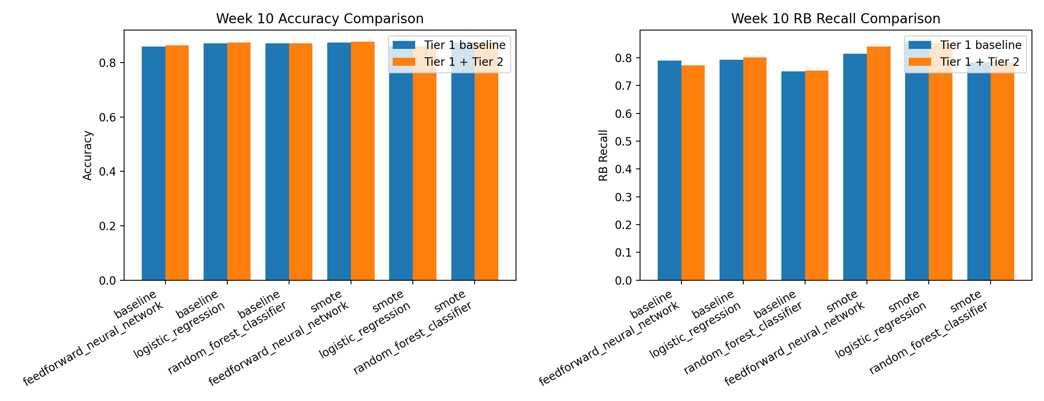
Figure: Week 10 Feature Engineering
Comparing baseline descriptors against the chemistry-aware proxy feature expansion
What it showed
The added chemistry-aware features helped in some settings, especially for recall, but they did not solve the deeper generalization issue.
Why it matters
This figure is one of the main pieces of evidence for the final project conclusion.
Slide 10

Slide 11
Feature Selection Changed the Story
Week 11 showed that smaller, more meaningful feature sets could stay competitive
The strongest ranked features included SpMax_B_m, SpMax_L, SM6_B_m, and SpPosA_B_p
Proxy features like mass_topology_proxy and polarity_proxy also mattered
Top-ranked and reduced-hybrid stayed competitive
Proxy-only features were clearly the weakest set
Why this mattered
The top-ranked feature set did not just reduce dimensionality. It ended up supporting the strongest final reliability result in Week 13.
Figure on next slide
The next slide isolates the Week 11 feature-importance chart so the ranking is easy to read.
Slide 11

Slide 12
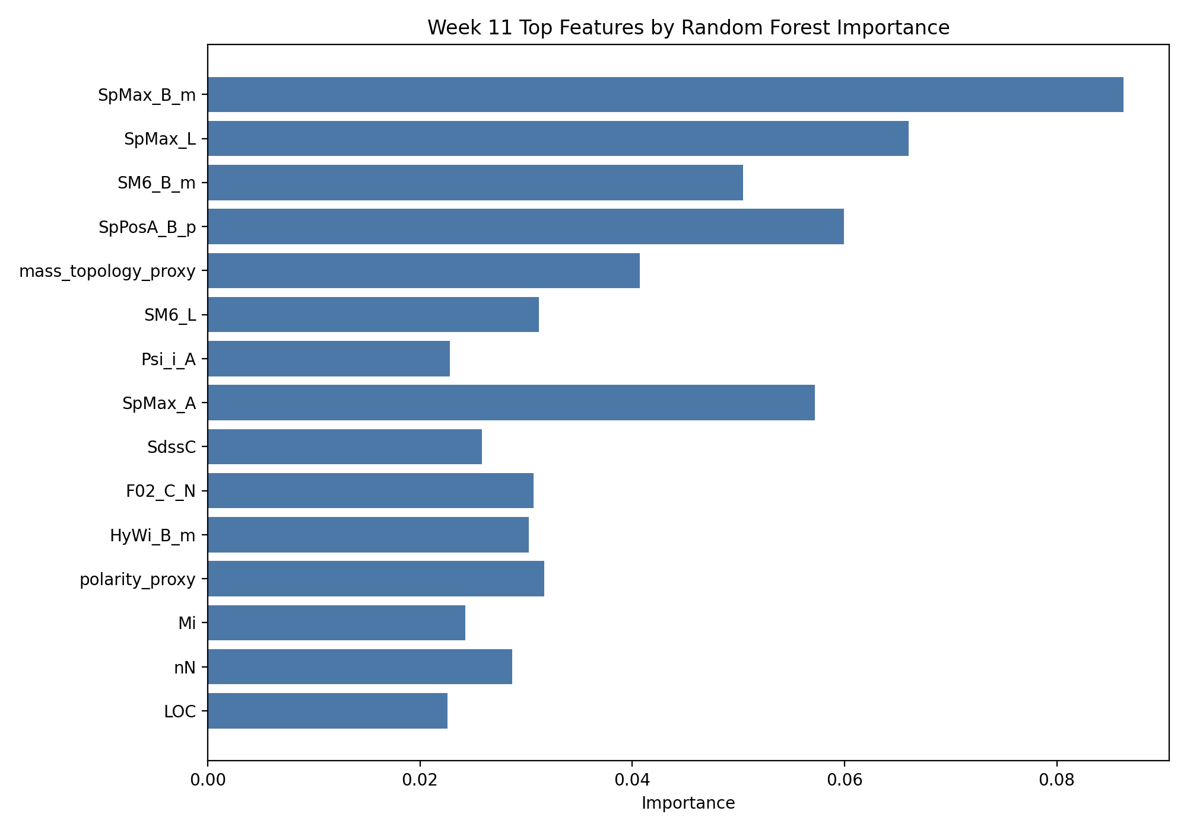
Figure: Week 11 Feature Importance
Top-ranked features from Random Forest importance, permutation importance, and mutual information
What it showed
A smaller, more focused feature set preserved strong signal and supported the strongest final recommendation.
Why it matters
This figure is one of the main pieces of evidence for the final project conclusion.
Slide 12

Slide 13
Uncertainty and Calibration
Week 12 asked whether the model knew when it might be wrong
I measured confidence, uncertainty, entropy, Brier score, ECE, and log loss
Top-ranked was the best overall calibrated Random Forest feature set
Wrong predictions were usually more uncertain in-distribution
Under cross-environment shift, some models stayed confidently wrong
What changed
At this point the project stopped being only about performance and became more about trustworthiness.
Main caution
Distribution shift could still produce overconfident wrong predictions, which is exactly the kind of failure accuracy alone misses.
Figures on next slides
The next two slides show the calibration and selective-prediction graphs separately.
Slide 13

Slide 14
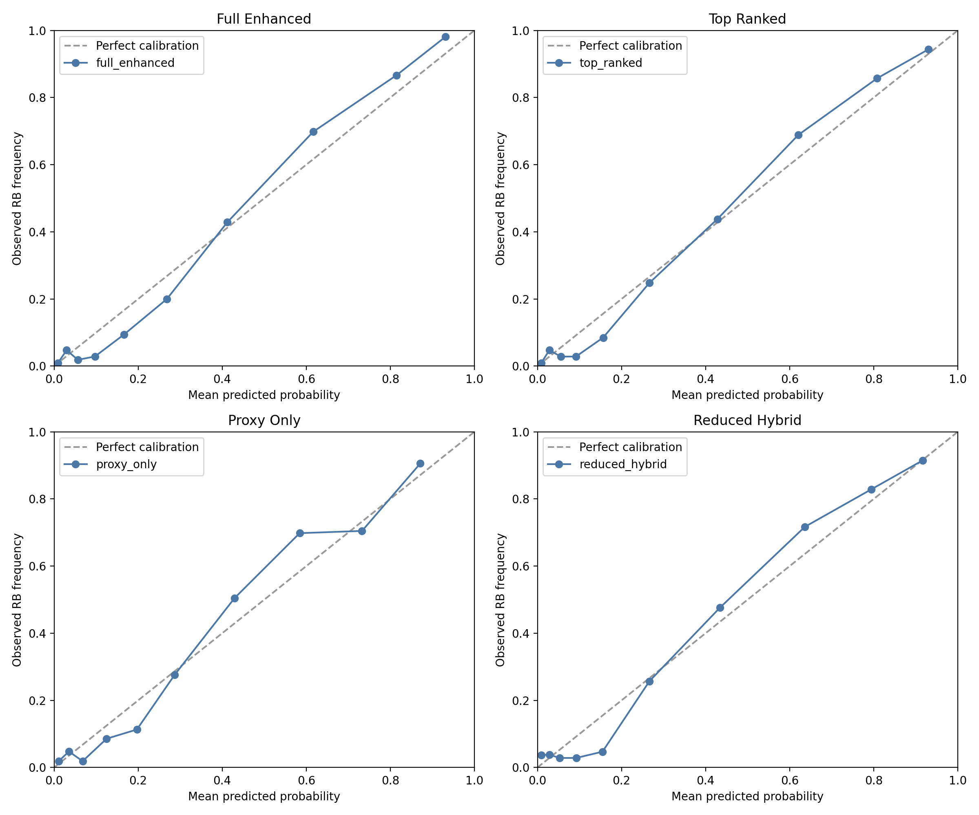
Figure: Week 12 Calibration Curve
Comparing predicted confidence against observed biodegradability frequency
What it showed
The top-ranked feature set gave the best overall calibrated Random Forest behavior across the Week 12 comparison.
Why it matters
This figure is one of the main pieces of evidence for the final project conclusion.
Slide 14

Slide 15
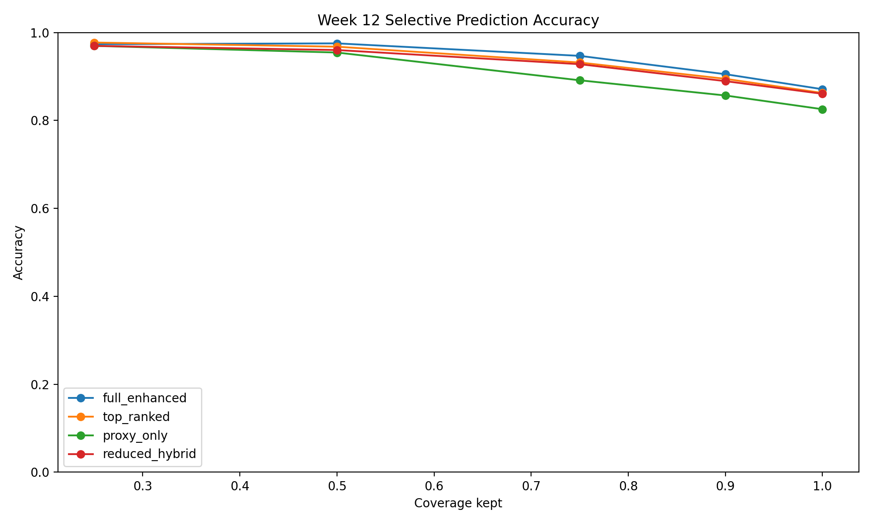
Figure: Week 12 Selective Prediction
Accuracy when keeping only the most confident predictions
What it showed
Confidence could help improve trust, but it did not fully remove the cross-environment weakness.
Why it matters
This figure is one of the main pieces of evidence for the final project conclusion.
Slide 15

Slide 16
Final Model Selection
Week 13 combined performance and trustworthiness into one recommendation
I ranked candidates using accuracy, calibration, uncertainty behavior, selective prediction, and cross-environment robustness
The final choice was not made from one metric
The recommendation came from the full reliability profile
Best overall candidate
top_ranked | random_forest_classifier reliability score: 0.8860
Best raw cross-env accuracy
top_ranked | logistic_regression at 0.6455
Figures on next slides
The next two slides show the final scoreboard and the calibration-versus-accuracy tradeoff clearly on their own.
Slide 16

Slide 17
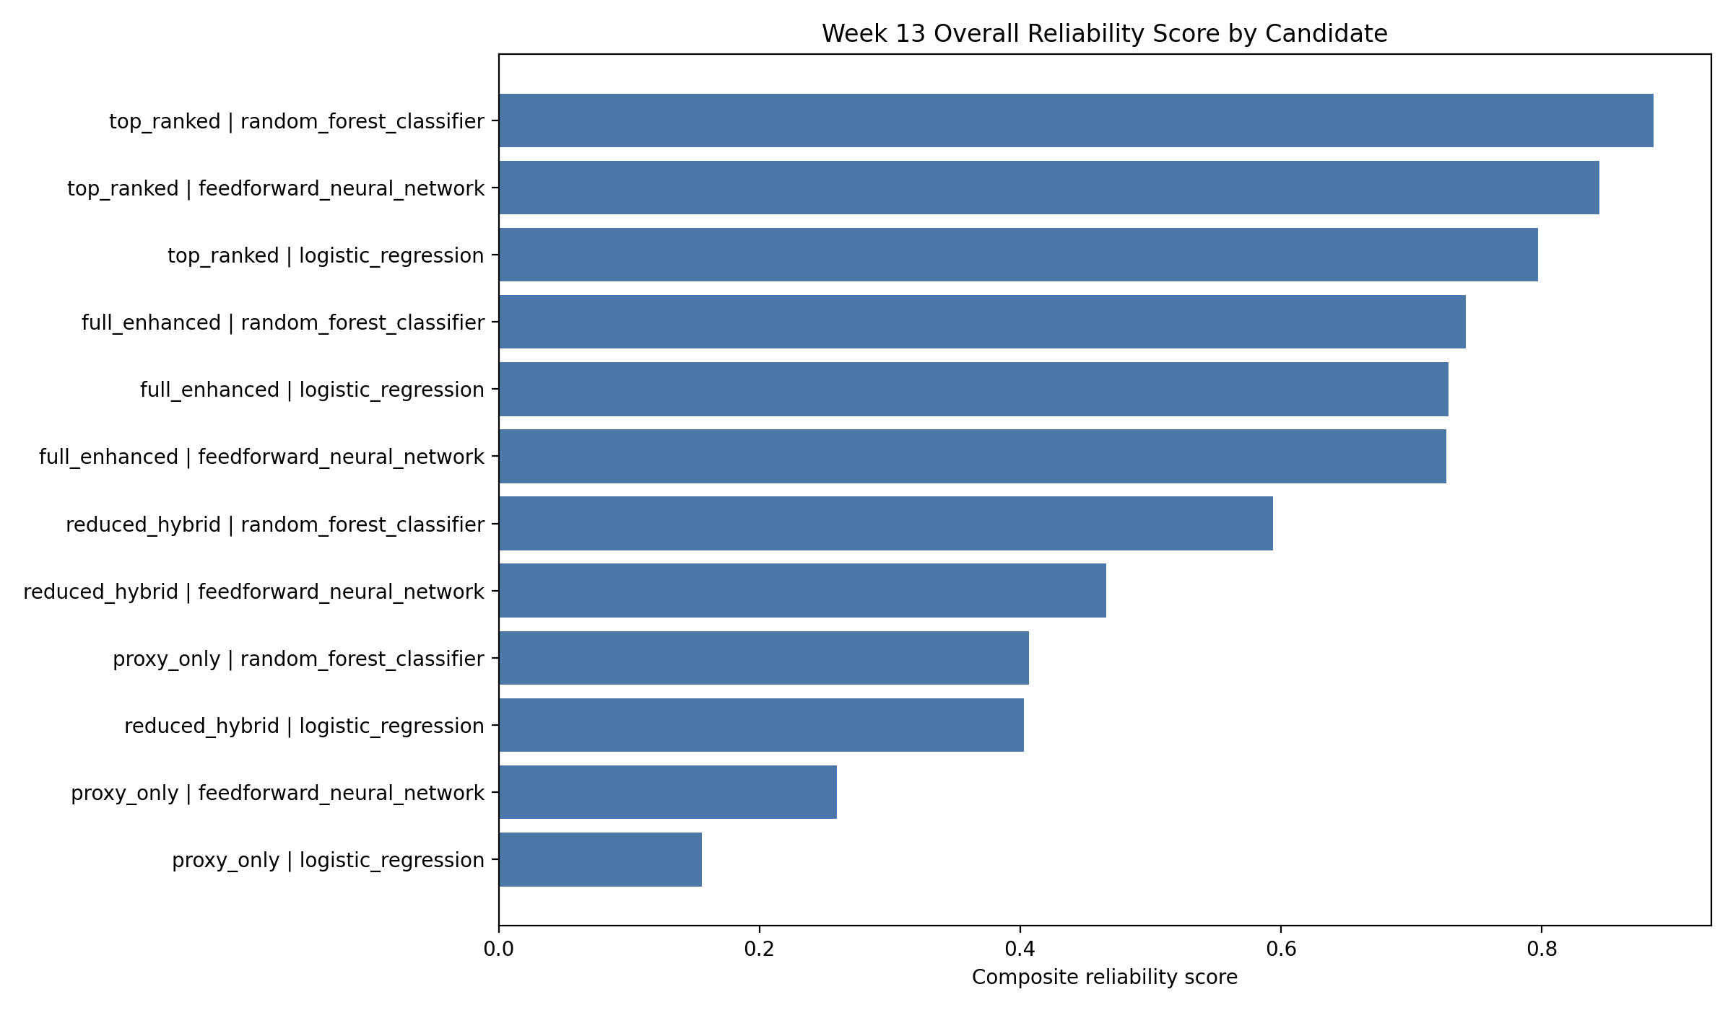
Figure: Week 13 Overall Scoreboard
Composite reliability ranking across all model and feature-set candidates
What it showed
Top-ranked Random Forest came out first once the project used reliability rather than only raw performance.
Why it matters
This figure is one of the main pieces of evidence for the final project conclusion.
Slide 17

Slide 18
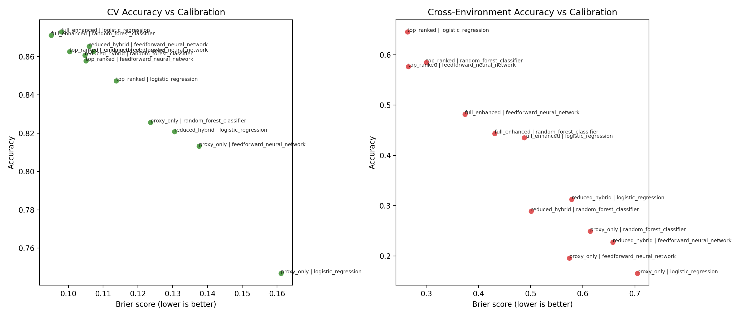
Figure: Accuracy vs Calibration Tradeoff
Comparing in-distribution and cross-environment tradeoffs across final candidates
What it showed
The strongest final model was the one that stayed competitive across several metrics instead of dominating only one.
Why it matters
This figure is one of the main pieces of evidence for the final project conclusion.
Slide 18

Slide 19
Final Recommendation
What I would defend as the final model choice from the whole project
Recommended final model
Competitive standard accuracy
Strong calibration for a high-performing model
Useful uncertainty separation between right and wrong predictions
Much better cross-environment behavior than the weaker feature sets
Top-ranked Random Forest
This combination was not the winner in every single category, but it was the strongest overall once I looked at accuracy, calibration, uncertainty behavior, and shifted data performance together.
Bottom line
The best final model was not just the highest-scoring model. It was the most defensible one.
Slide 19

Slide 20
Limitations and Next Steps
What this project answered well, and what still needs stronger data
Descriptor-based dataset, not a true polymer graph dataset
No real degradation-rate constants
No pathway labels such as oxidation or hydrolysis
Cross-environment robustness remains the biggest weakness
Best next step
Move to a dataset with real polymer structure and stronger chemistry labels so that graph-based learning can be evaluated honestly.
Validation next step
Test the final model on a genuinely separate dataset or environment source instead of only proxy distribution shifts.
Final lesson
Trustworthiness ended up being the most important outcome of the project, not just raw model performance.
Slide 20

