Slide 1
RELIABILITY-AWARE BIODEGRADATION ML
PolyDegradeML
1,055
A research case study in teaching models when not to trust themselves
QSAR biodegradation samples
41
descriptor features
0.8860
final reliability score
Sources: datasets/qsar_biodegradation_descriptor_benchmark/metadata/qsar_biodegradation_metadata.json; reports/model_reliability_report.md
Notes:
Open by framing the talk as a story about trust. The project is not claiming to solve all plastic degradation, and it is not claiming quantum advantage. It asks a more scientific question: when we build a model for biodegradation prediction, how do we know when to trust it? PolyDegradeML started as a course-style ML project and matured into a reliability-aware research case study.

Slide 2
THE REAL-WORLD PROBLEM
Plastic degradation is not one problem.
It is chemistry, biology, time, and environment interacting.
Hydrolysis
water-mediated cleavage
Photo-oxidation
UV + oxygen chemistry
Biodegradation
microbial transformation
The current model predicts a descriptor-based ready-biodegradability label.
It does not simulate every degradation mechanism.
That boundary makes the science stronger, not weaker.
Sources: source_materials/reports/Week_01_Applied_Work.docx; manuscript Section 6.1
Notes:
For a broad audience, make this concrete. A plastic object can crack in sunlight, weaken in water, fragment under abrasion, and be transformed by microbes. These are related but not identical processes. The paper is careful because the dataset supports descriptor-based ready biodegradability classification, not a full mechanistic simulation of the environment.

Slide 3
CENTRAL QUESTION
The scientific question changed.
From: Which model is most accurate? To: Which model is most trustworthy?
Can chemistry-informed feature engineering and reliability-focused evaluation improve the trustworthiness of machine learning models for biodegradation prediction?
Source: paper/manuscript_draft.md
Notes:
This is the thesis sentence. The early project could have ended with an accuracy table. The stronger research version asks whether the model remains calibrated, whether it knows when it is uncertain, and whether it behaves sensibly outside its comfort zone.

Slide 4
FROM CHEMISTRY TO DATA
QSAR turns chemical structure into numbers.
Descriptor-based models use numerical chemical features to predict biological or environmental outcomes.
Chemical
compound
41 molecular
descriptors
ML model
RB / NRB
prediction
The current dataset is descriptor-only: no polymer names, no SMILES, no BigSMILES, no measured degradation rates.
Sources: datasets/qsar_biodegradation_descriptor_benchmark/metadata/qsar_biodegradation_metadata.json; reports/dataset_curation.md
Notes:
Explain QSAR without assuming prior knowledge. Instead of giving the model a full molecular movie, we give it numerical descriptors. That is useful, but it also imposes limits. This slide is a guardrail against overclaiming.

Slide 5
DATASET REALITY
A reusable framework begins with honest metadata.
The dataset is useful for classification, but not complete for polymer degradation science.
1,055
41
2
0
samples
features
target classes
missing values
Target labels: readily biodegradable and not readily biodegradable.
Limitations: no structures, no continuous rates, limited environmental metadata.
This is why reliability and uncertainty matter.
Source: datasets/qsar_biodegradation_descriptor_benchmark/metadata/qsar_biodegradation_metadata.json
Notes:
This slide should reassure professors and peers: the work is not hiding limitations. It names them. For younger students, emphasize that good science starts by saying exactly what the data can and cannot answer.

Slide 6
MODEL BASELINES
The first models learned real signal.
But initial accuracy was only the beginning of the story.
Random Forest
0.8768
Logistic Regression
0.8626
Feedforward NN
0.8246
Descriptor graph
0.6967
Sources: reports/baseline_modeling.md; reports/neural_network_baseline_summary.txt; reports/descriptor_graph_prototype_summary.txt
Notes:
Walk through this as the first major evidence step. Random Forest and Logistic Regression performed well, the neural network was useful but not dominant, and the descriptor-graph prototype underperformed. The important point is not to shame any model. The point is that model complexity alone did not solve the scientific problem.

Slide 7
THE TURNING POINT
Accuracy can be the wrong kind of confidence.
A model can score well on familiar data and still fail under shift.
High accuracy alone was insufficient for trustworthy degradation prediction.
Calibration asks: are probabilities meaningful?
Uncertainty asks: does the model know when it may be wrong?
Cross-environment testing asks: what happens outside the training distribution?
Source: reports/main_findings.md
Notes:
This is the TED-style pivot. A student can understand this through daily life: being confident is only useful if confidence tracks reality. The same is true for machine learning. A confident wrong answer is more dangerous than an uncertain wrong answer.

Slide 8
RELIABILITY TOOLKIT
The project evaluated trust as a measurable property.
Reliability was operationalized through multiple stress tests.
Calibration
Uncertainty
Selective prediction
Brier score, log loss, ECE
entropy and uncertainty gap
accuracy when retaining confident cases
Cross-environment validation
Overconfidence checks
proxy distribution-shift behavior
confidence on incorrect predictions
Sources: reports/uncertainty_reliability_summary.txt; reports/model_reliability_report.md
Notes:
This slide is for academic rigor. Say that trust was not treated as a vibe. It was translated into metrics. Each metric catches a different failure mode, so the final decision does not depend on one fragile number.

Slide 9
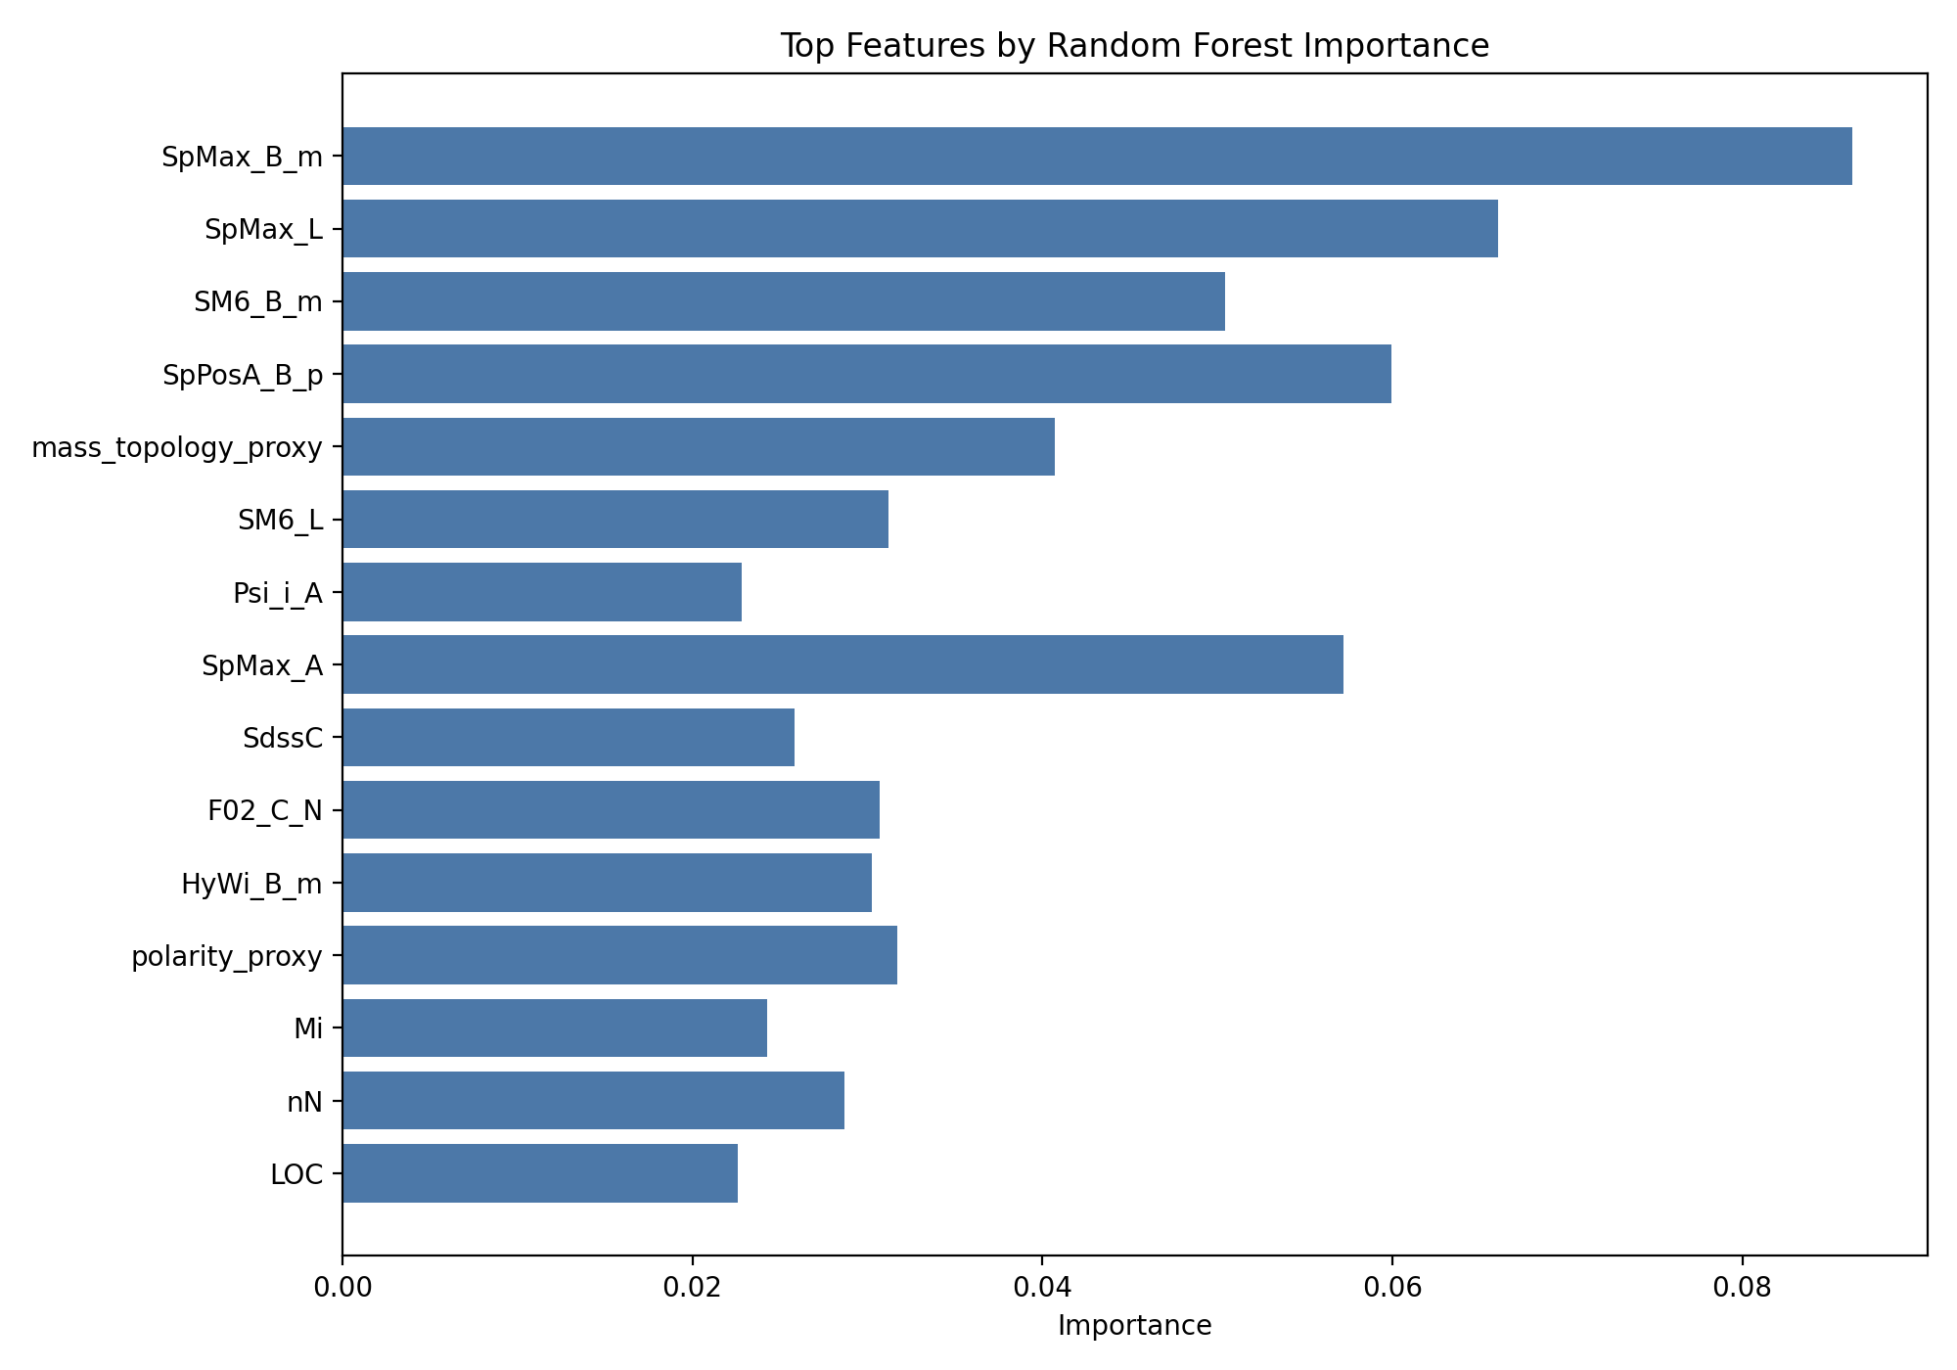
CHEMISTRY-INFORMED FEATURES
Chemistry-aware proxies helped, but did not magically solve the problem.
The FNN improved under engineered features, while reliability still required full evaluation.
Proxy features summarized heteroatom, halogen, polarity, donor/acceptor, and topology signals.
FNN recall improved from 0.8145 to 0.8399 in the reported feature-engineering comparison.
Proxy features are not true quantum descriptors.
Sources: reports/feature_engineering_summary.txt; results/tables/feature_engineering_model_results.csv
Notes:
This is where the chemistry enters the ML story. The engineered features were useful, especially for the neural baseline, but the paper stays cautious. Proxy chemistry is not the same as measured or computed quantum chemistry.

Slide 10
GENERALIZATION STRESS TEST
Cross-environment validation revealed fragility.
Models that looked strong in ordinary validation dropped under proxy descriptor-space shift.
Random Forest
0.4210
Logistic Regression
0.3727
Descriptor graph
0.3688
Feedforward NN
0.3532
Source: reports/cross_environment_validation.md
Notes:
This is one of the strongest scientific findings. Ordinary validation told one story. Proxy cross-environment validation told a more cautious story. Random Forest remained strongest in that test, but the absolute performance drop showed that generalization is the hard part.

Slide 11
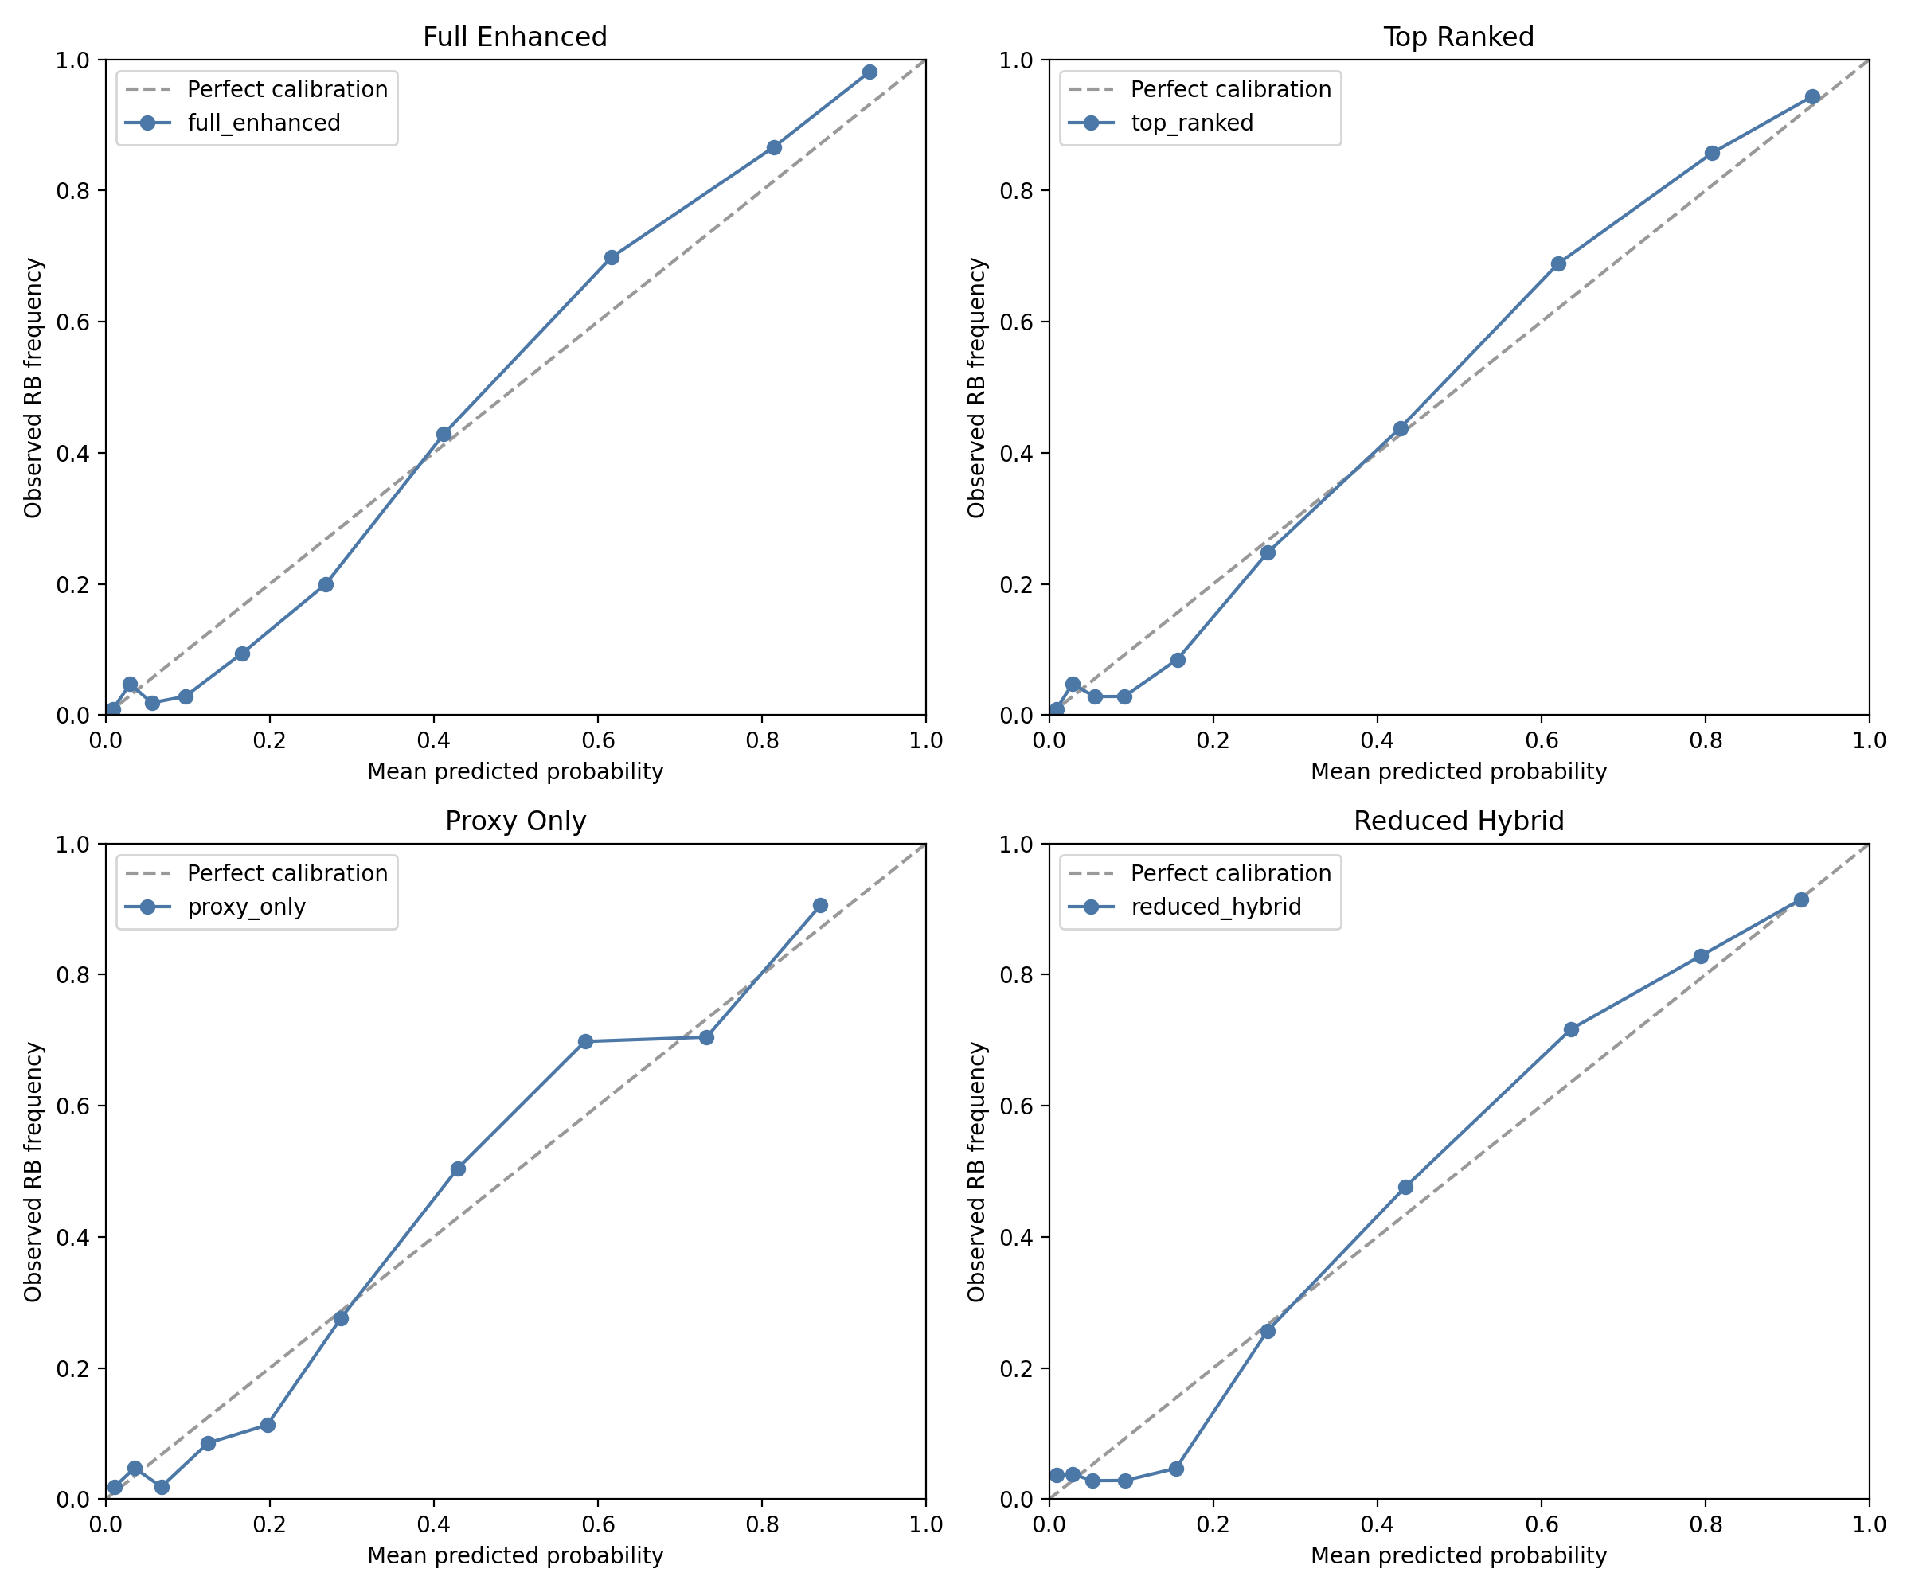
CALIBRATION AND UNCERTAINTY
The question became: can the model know when it may be wrong?
Uncertainty matters most when predictions enter scientific or environmental decisions.
0.0950
0.0297
RF full-enhanced Brier
RF top-ranked ECE
Overconfidence under shift became a key risk.
Selective prediction tested whether confidence filtering improved accuracy.
Source: reports/uncertainty_reliability_summary.txt
Notes:
Make the calibration idea intuitive: if a model says 80 percent confidence, it should be right about 80 percent of the time across similar predictions. The project found that uncertainty behavior helped distinguish candidates that accuracy alone could not separate.

Slide 12
QUANTUM PRIMER
Start with the simplest distinction: states versus amplitudes.
Classical computation can represent probabilities, but quantum computation physically evolves probability amplitudes.
Classical bit
0 or 1
Classical probability
p(0), p(1)
Quantum state
amplitudes alpha, beta
Measurement
probable outcome
A probability is nonnegative and directly describes likelihood.
A quantum amplitude can carry sign or phase before measurement.
Interference is what lets amplitudes reinforce or cancel.
Conceptual primer. Add quantum information citation before external submission.
Notes:
This is the small intro for people who are new to the idea. A classical digital state is explicit: a bit is zero or one. A classical probability distribution can say how likely each state is, but the probabilities themselves do not interfere. A quantum state is described by amplitudes. Those amplitudes can combine with phase, so the computation can change the geometry of likelihood before measurement.

Slide 13
PROBABILITY AND STATISTICAL MECHANICS INTUITION
Many scientific systems are understood through distributions.
Statistical mechanics gives an intuition: we often cannot track every microscopic path, so we reason over ensembles and likely states.
Microscopic possibilities
Observed behavior
sampling / measurement
most likely states
become visible
probability distribution
In ML, predicted probabilities are a classical distribution over labels.
In quantum computing, amplitudes evolve before becoming probabilities.
This project used classical probabilities, but the mindset reinforced why uncertainty had to be measured.
Conceptual analogy only. This project did not implement statistical mechanics simulation or quantum ML.
Notes:
Use statistical mechanics as an intuition, not as a claim that the project simulated thermodynamics. In many scientific problems, we cannot follow every microscopic event, so we reason about distributions and likely macroscopic outcomes. Machine learning probabilities are classical distributions over labels. Quantum computing goes one level deeper by manipulating amplitudes before probabilities appear through measurement.

Slide 14
A QUANTUM DETOUR, CAREFULLY BOUNDED
Classical computing manipulates states. Quantum computing manipulates amplitudes.
That distinction matters conceptually, but it is not a result of this project.
Classical
explicit states
0 or 1
Quantum
probability amplitudes
superposition
Interference
amplify / suppress
candidate outcomes
Conceptual rationale only. Citation needed before submission. No quantum ML implemented in this repository.
Notes:
This is the bridge into the quantum idea. Be explicit: this is not a claim that the current project used quantum computing. It is a conceptual reason quantum methods were considered. Classical systems manipulate explicit states. Quantum systems manipulate probability amplitudes. Interference can reshape which outcomes become likely when measured.

Slide 15
WHY NOT STOP AT CLASSICAL DESCRIPTORS?
Quantum was considered alongside classical descriptors, not chosen over them.
Classical descriptors powered the current results; quantum thinking clarified what richer future representations could add.
Current project
classical QSAR descriptors
Proxy chemistry
engineered summaries
Future direction
computed quantum descriptors
Classical descriptors are practical, reproducible, and already supported by the dataset.
They may not fully represent electronic structure, conformational behavior, or interaction-driven chemistry.
Quantum descriptors could eventually add HOMO-LUMO gap, dipole moment, polarizability, and charge-distribution information.
Sources: reports/feature_engineering_summary.txt; paper/manuscript_draft.md. Future-work rationale only.
Notes:
This slide directly answers the user's requested framing while protecting rigor. We did not choose quantum over classical descriptors in the implemented model. We used classical descriptors. Quantum was considered because classical descriptors are fixed summaries, while true quantum chemical descriptors may capture electronic properties that matter for chemical reactivity and degradation mechanisms.

Slide 16
HOW DID IT BENEFIT THE PROJECT?
The benefit was conceptual and methodological.
Quantum framing did not improve metrics yet, but it sharpened the scientific roadmap.
It separated proxy chemistry features from true computed quantum descriptors.
It reinforced that biodegradation prediction is probabilistic, not merely deterministic label lookup.
It supported the decision to evaluate calibration, uncertainty, and overconfidence.
It created a future benchmark question: do richer representations improve reliability, not just accuracy?
No implemented quantum model. No claimed quantum advantage. No metric improvement attributed to quantum methods.
Evidence boundary: current results come from classical ML models and reliability analysis.
Notes:
This is the benefit section. The benefit was not empirical performance, because the project did not implement a quantum model. The benefit was intellectual discipline: it helped clarify the difference between proxy descriptors and future computed quantum descriptors, and it strengthened the probability-centered reliability story.

Slide 17
WHY QUANTUM METHODS WERE CONSIDERED
The motivation was representation, not hype.
For chemical prediction, the interesting question is whether alternative probabilistic representations help.
High-dimensional chemical relationships can be nonlinear and uncertain.
Quantum algorithms can be understood as engineering probability-amplitude evolution.
Future work would need a defined encoding, simulator or hardware constraints, and direct comparison against classical reliability metrics.
No claim of quantum speedup or quantum advantage is made here.
Source: paper/manuscript_draft.md, Section 4.7. Quantum information citation still needed.
Notes:
This slide protects rigor. It says why the idea is intellectually interesting without turning into quantum hype. The right research question is not 'is quantum faster?' It is 'does a quantum or quantum-inspired representation produce measurable, reproducible improvements under the same reliability tests?'

Slide 18
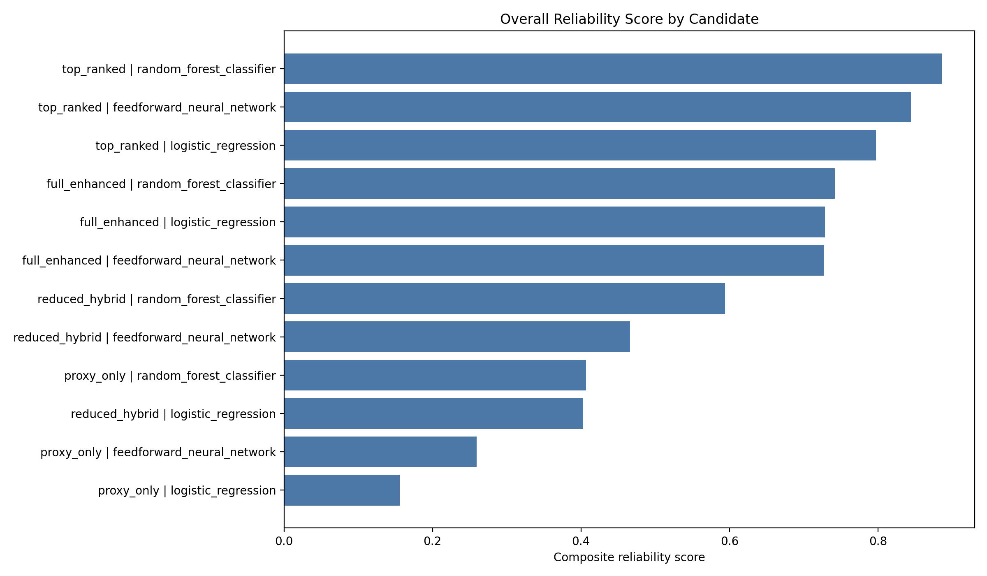
FINAL MODEL SELECTION
The final choice was balanced, not one-metric-best.
The top-ranked Random Forest was selected by the composite reliability scoreboard.
0.8860
0.8626
reliability score
CV accuracy
0.5848
0.1003
cross-env accuracy
Brier score
Source: reports/model_reliability_report.md; results/tables/model_reliability_scoreboard.csv
Notes:
Make clear that the selected model did not win every individual metric. That is the point. It was chosen because it was the best balance across accuracy, calibration, selective prediction, uncertainty behavior, and cross-environment behavior.

Slide 19
WHAT WE LEARNED
The strongest finding is methodological.
Trustworthy biodegradation prediction needs evaluation beyond accuracy.
Random Forest gave the strongest overall reliability profile.
Chemistry-aware features helped selected models, especially the neural baseline.
Neural complexity alone did not dominate classical baselines.
Cross-environment testing exposed generalization risk.
Overconfidence under shift is a scientific reliability problem.
Source: reports/main_findings.md
Notes:
This is the clean summary slide. The contribution is not 'we got high accuracy.' The contribution is that reliability metrics changed how model quality was interpreted.

Slide 20
FOR YOUNG SCIENTISTS
The exciting part is not that the model was perfect.
The exciting part is learning how to ask a better question.
Good science is not being certain. Good science is knowing what would make you less certain.
Chemistry explains what might matter.
Machine learning tests patterns at scale.
Reliability tells us when the pattern may break.
Educational framing based on PolyDegradeML manuscript and generated reports.
Notes:
This is the TED-talk moment. Invite young students in. The point is not to make science look easy. The point is to show that science is a disciplined way of being curious. The model's limits are not embarrassing; they are the doorway to the next experiment.

Slide 21
NEXT RESEARCH STEPS
The path forward is clearer now.
Stronger data, better representation, and experimental validation come next.
Polymer-specific structures: SMILES, BigSMILES, repeat units
True quantum chemical descriptors, not proxy features
Graph neural networks with chemically meaningful atom/bond inputs
External datasets and measured environmental metadata
Continuous degradation-rate modeling
Active learning and experimental validation
Source: paper/manuscript_draft.md, Future Work
Notes:
End by showing that the project creates a launchpad. The present work is a reliable classical baseline and a reproducible evaluation template. Future work should improve representation and validation rather than making broader claims too early.

Slide 22
CLOSING
A model is useful only when we understand its uncertainty.
PolyDegradeML is a case study in turning prediction into scientific judgment.
From biodegradation chemistry to descriptor-based ML to reliability-centered evaluation, the project shows how computational tools can become more honest, reusable, and scientifically useful.
PolyDegradeML | Draft academic and TED-style conference presentation
Notes:
Close with humility and confidence together. The project does not claim to predict all environmental degradation. It does show how a model can be evaluated more responsibly. That is the contribution.

