Slide 1
Lab 3
Processes and File I/O

Slide 2
open(), read(), write().
Options to open a file:
O_RDONLY: Open for reading only.
O_WRONLY: Open for writing only.
O_RDWR: Open for reading and writing.
O_CREAT: If the file exists, this flag has no effect, Otherwise, the file shall be created
O_TRUNC: causes the file to be truncated if it exists.
Syntax: “fd = open("txt/out2.txt", O_WRONLY | O_CREAT | O_TRUNC, 0644)”
Read a file:
Syntax: “read(file_directory, variable_name, # of bytes)”
Write in a file:
Syntax: write(fd, variable_name, xBytes)

Slide 3
open(), read(), write().
Options to open a file:
O_RDONLY: Open for reading only.
O_WRONLY: Open for writing only.
O_RDWR: Open for reading and writing.
O_CREAT: If the file exists, this flag has no effect, Otherwise, the file shall be created
O_TRUNC: causes the file to be truncated if it exists.

Slide 4
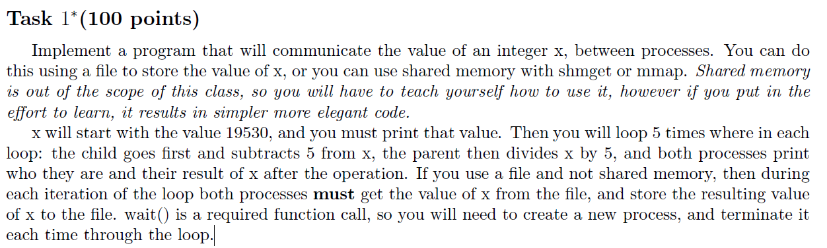
Task

Slide 5
System Calls
Required
fork()
wait()
Optional
open(), read() and write()
sleep(x)
Make the process wait for x seconds
atoi()
Converts string to integer
sprintf()
Convert integer to string
fflush():
Force a file buffer to flush. This is useful to flush stdout before creating a child process.
Useful to fix printing behaviour

Slide 6
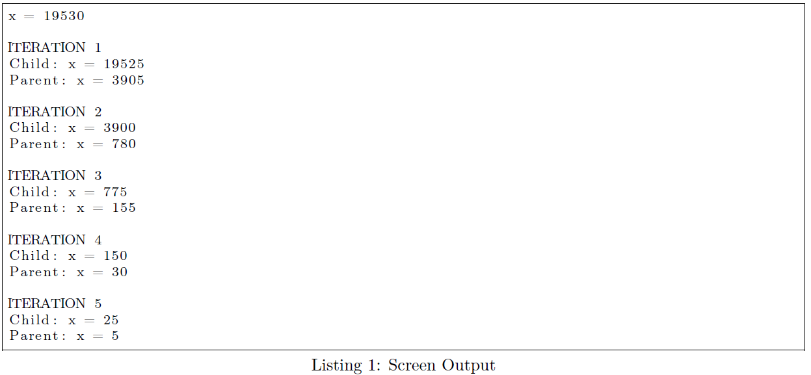
Example: Solution Output

