Slide 1
SPACE RACE
Zach McKee, Kevin Hance, Andrew Yang
CPSC 224 | Dr. Zhang

Slide 2
PROBLEM STATEMENT
Increase complexity of a Yahtzee program using a Space theme
Gain experience using Java Swing components
Notes:
ANDREW

Slide 3




FEATURES: BUILD PHASE
Fuel Reserves
Cockpit
Thrusters
Rocket
Requires:
Hull Parts
Electronics
Fuel (x2)
Requires:
Hul Parts
Electronics
Glass
Crew Members
Requires:
Hull Parts (x2)
Electronics
Fuel
Notes:
KEVIN

Slide 4






FEATURES: SPACE PHASE
 | Distance | Fuel | Accident
Cautious | x1 | -2 | 0%
Normal | x1 | -1 | 20 - (Crew * 4) %
Fast | x3 | -2 | 20 - 2(Crew * 4) %
Notes:
ANDREW

Slide 5
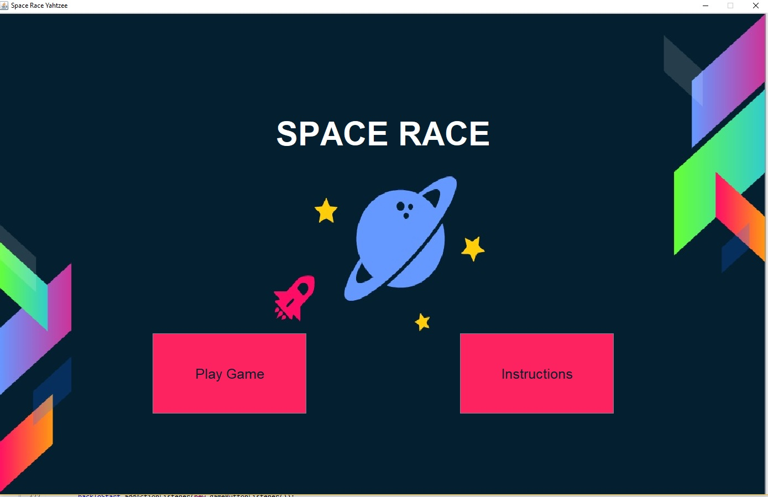
SPACE RACE DEMO
Place your screenshot here
Notes:
ZACH

Slide 6


ARCHITECTURE: SEQUENCE DIAGRAM
Player
PlayGame
BuildPhase
SpacePhase
Notes:
KEVIN

Slide 7
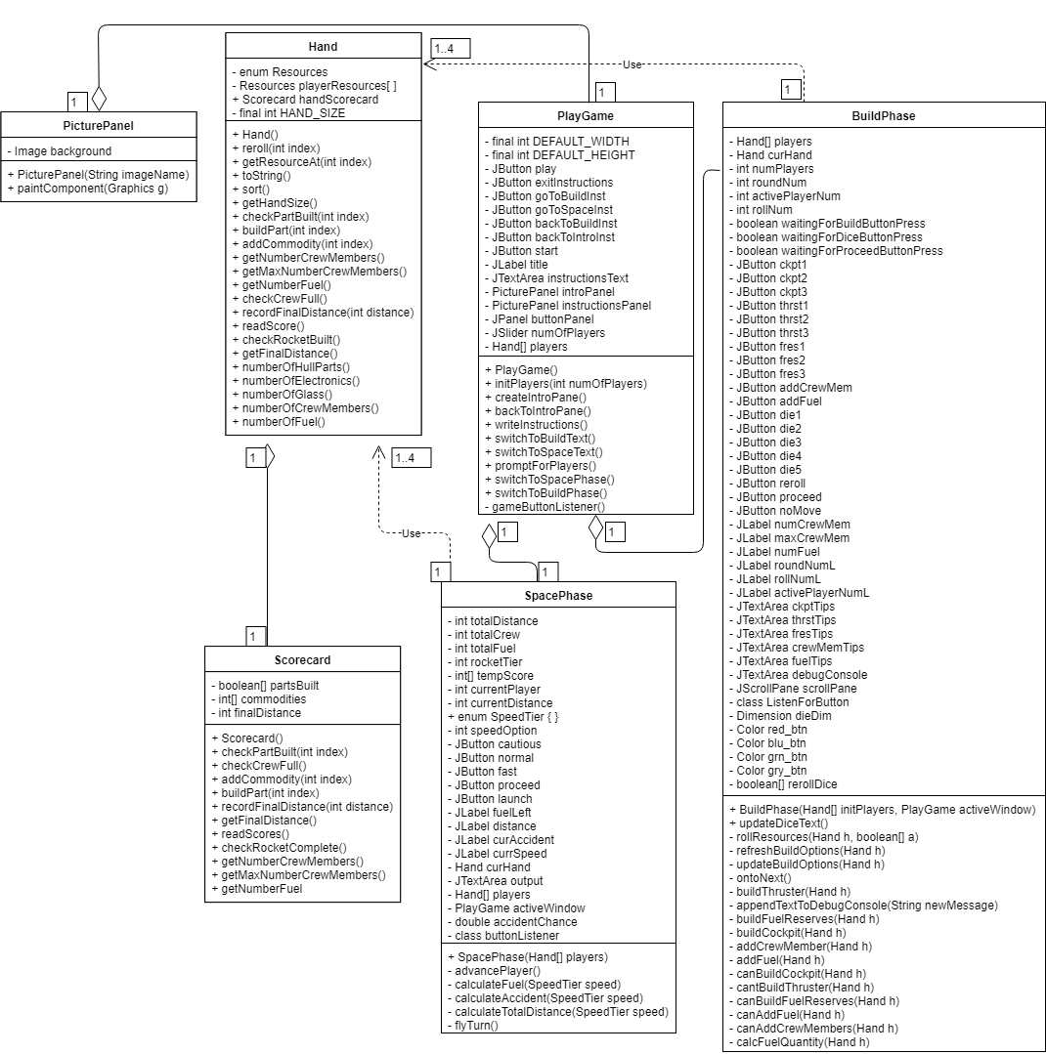
ARCHITECTURE & UML DIAGRAM
Notes:
KEVIN

Slide 8
FUTURE IMPROVEMENTS
1. Mobile Apps (Android/iOS)
Implement Space Race to be playable on mobile devices
2. Online Capabilities
Implement online multiplayer
3. Increase Rocket Customization
More options for different kinds of engines, fuel sources, etc.
4. Create Animated Graphics
Create animations at various stages of gameplay
5. Improve GUI
Research alternatives to Java Swing for enhanced GUI
Notes:
ANDREW

Slide 9
Conclusion
Issues:
Difficulty of Swing
Controlling User Flow
Communication of Ideas to all project partners

Slide 10
THANK YOU
Questions?

