Slide 1
css动画
讲师：孟庆和

Slide 2
补间动画 transition
帧动画 animation

Slide 3
transition
过渡
transition：<single-transition>[,<single-transition>]*
<single-transition> = [ none | <single-transition-property> ] || <time> || <single-transition-timing-function> || <time>

Slide 4
transtion-property 属性 默认值 all
transition - duration 持续时间. 默认值 是 0s
transition- timing-function 动效 默认值 ease
transition-delay 延迟时间。默认值 0s

Slide 5
transition-timing-funtion
transition-timing-function：<single-transition-timing-function>[,<single-transition-timing-function>]*
<single-transition-timing-function> = ease | linear | ease-in | ease-out | ease-in-out | step-start | step-end | steps(<integer>[, [ start | end ] ]?) | cubic-bezier(<number>, <number>, <number>, <number>)
取值： 分别是关键字、steps函数和bezier函数

Slide 6
ease: 开始和结束慢，中间快。相当于cubic-bezier(0.25,0.1,0.25,1)
linear: 匀速。相当于cubic-bezier(0,0,1,1)
ease-in: 开始慢。相当于cubic-bezier(0.42,0,1,1)
ease-out: 结束慢。相当于cubic-bezier(0,0,0.58,1)
ease-in-out: 和ease类似，但比ease幅度大。相当于cubic-bezier(0.42,0,0.58,1)
step-start: 直接位于结束处。相当于steps(1,start)
step-end: 位于开始处经过时间间隔后结束。相当于steps(1,end)

Slide 7
https://easings.net/

Slide 8
需要用户进行交互
:hover :active :checked :foucs
add/remove class
@media
只能定义第一帧 和最后一帧

Slide 9
不支持动画的属性
background-image
float none->float
width/height auto -> 10px
display none->block
visibility hidden -> visible
position static -> absolute

Slide 10
animation
animation：<single-animation>[,<single-animation>]*
<single-animation> = <single-animation-name> || <time> || <single-animation-timing-function> || <time> || <single-animation-iteration-count> || <single-animation-direction> || <single-animation-fill-mode> || <single-animation-play-state>

Slide 11
animation-name 动画名称
animation-duration 持续时间
animation-timing-funtion。动效
animation-delay 延迟时间
animation-interation-count 次数
animation-direction 方向
animation-fill-mode 动画开始与结束的帧样式
animation-play-state. 动画执行的状态

Slide 12
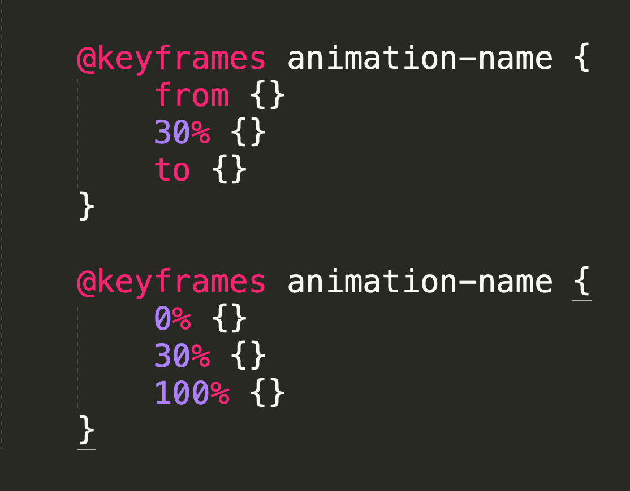
定义动画
首先用关键帧声明动画，再用animation调用动画
关键帧 语法：

Slide 13
animation-name
动画名称
animation-name：<single-animation-name>[,<single-animation-name>]*
<single-animation-name> = none | <identifier>

Slide 14
animation-duration
持续时间
animation-duration：<time>[,<time>]*
默认值: 0s

Slide 15
animation-delay
animation-delay：<time>[,<time>]*
默认值:0s

Slide 16
animation-iteration-count
次数
animation-iteration-count：<single-animation-iteration-count>[,<single-animation-iteration-count>]*
<single-animation-iteration-count> = infinite | <number>
默认值：1

Slide 17
animation-direction
animation-direction：<single-animation-direction>[,<single-animation-direction>]*
<single-animation-direction> = normal | reverse | alternate | alternate-reverse
默认值：normal
normal：正常方向
reverse：反方向运行
alternate：动画先正常运行再反方向运行，并持续交替运行
alternate-reverse：动画先反运行再正方向运行，并持续交替运行

Slide 18
animation-play-state
animation-play-state：<single-animation-play-state>[,<single-animation-play-state>]*
<single-animation-play-state> = running | paused
默认值：running

Slide 19
animation-fill-mode
animation-fill-mode：<single-animation-fill-mode>[,<single-animation-fill-mode>]*
<single-animation-fill-mode> = none | forwards | backwards | both
默认值：none

Slide 20
即可自动，也可交互
可以控制多帧
控制暂停播放

Slide 21
常见动画库
Animate.css
Magic CSS3 Animation
Hover CSS
Effeckt
Single Element CSS Spinners

Slide 22
感谢！

