Slide 1
Quick, Draw! Doodle Recognition Challenge
How accurately can you identify a doodle?
Meng Zhang
Yizhen Wang
Notes:
介绍下 我们的项目是什么 40s

Slide 2
A Kaggle competition
What is “Quick Draw!”?
Notes:
"Quick, Draw!" was released as an experimental game to educate the public in a playful way about how AI works. The game prompts users to draw an image depicting a certain category, such as ”banana,” “table,” etc. The game generated more than 1B drawings, of which a subset was publicly released as the basis for this competition’s training set. That subset contains 50M drawings encompassing 340 label categories.

Slide 3
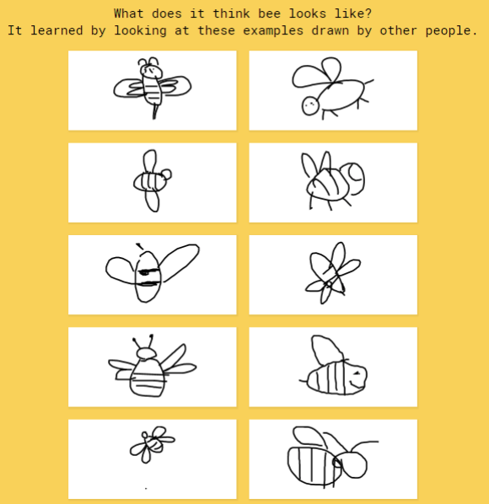
Our Motivation
Build a BETTER classifier for the existing Quick, Draw! dataset

Slide 4
Show Time!!!
Notes:
Let’s have a look at this fun game!. Each time, you will be given a category to draw. The system will try to recognize your drawing.
However, the system does not always work perfectly. Sometimes however you try, it just fails to recognize what it is.
This is obviously a turtle, but the system can not recognize it.

Slide 5
Main Idea & method
Tensorflow
Transfer Learning
Inception V3
Notes:
什么是transfer learning？
Tensorflow & inception V3 的好坏
15s other
60s

Slide 6
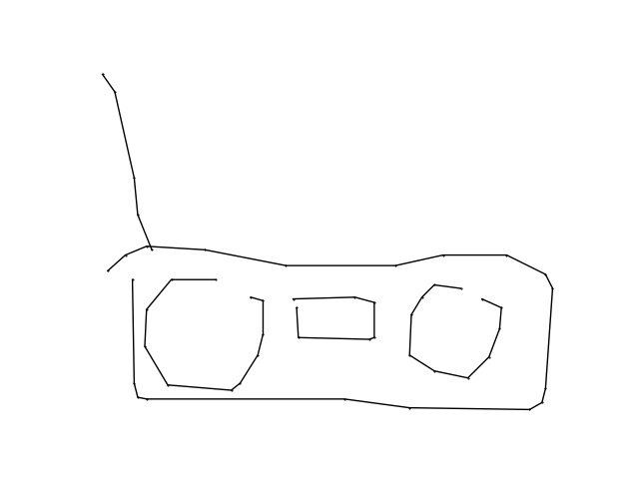
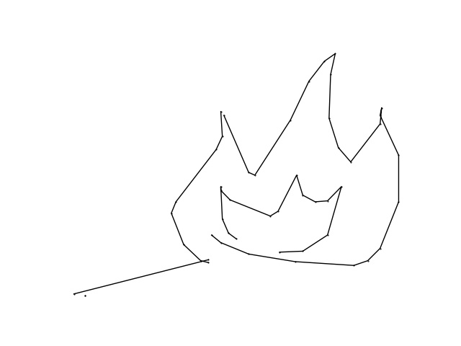
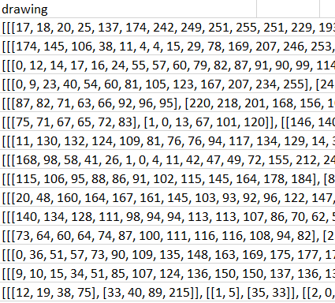
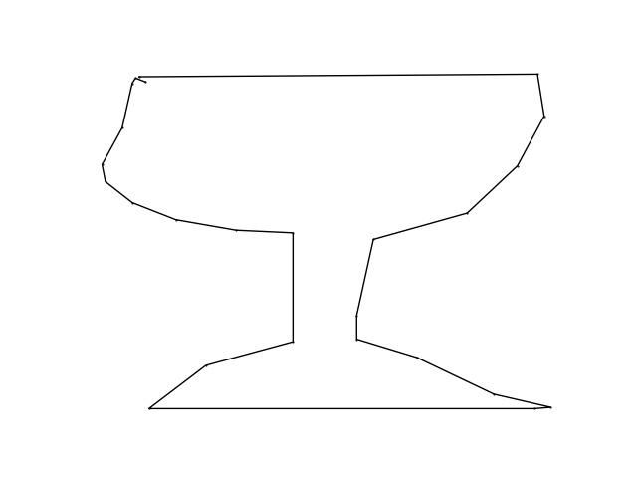
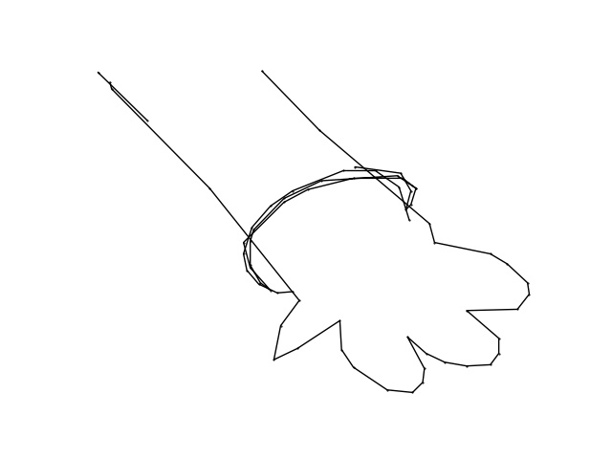
DataSEts
Notes:
The raw data are a lot of the coordinates of dots. So we first convert the dots collections into several images files.

Slide 7
DataSEts
Training & evaluation data
340 * 20000 images
340 categories
Test data
112199 images
Notes:
This dataset contains 340 categories. So we created 20000 images for each category for training and evaluation.
We also convert all the test data into image files as well.

Slide 8
Training
Fine-tune Parameters：
Batch Size
Optimizer
Notes:
Our training process is mainly about the fine-tune of the parameters of our system. We take some experiments to determine what batch size and which optimizer to choose for our model.

Slide 9
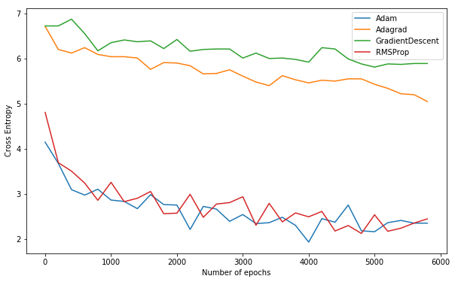
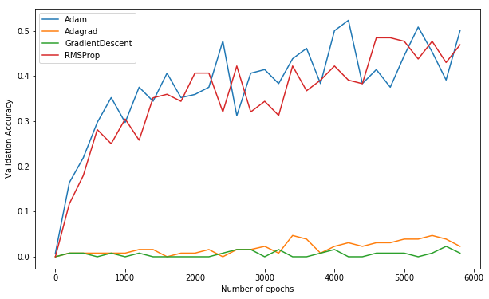
Comparision -- Optimizers
Notes:
According to our result, the Adam optimizer seems to have the quickest drop speed of the loss function, as well as the quickest rising curve of the validation accuracy.

Slide 10
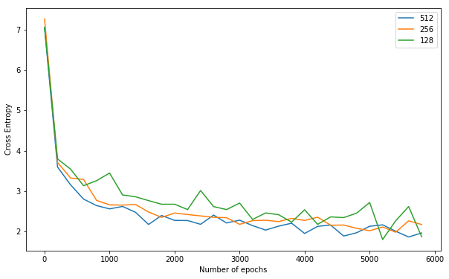
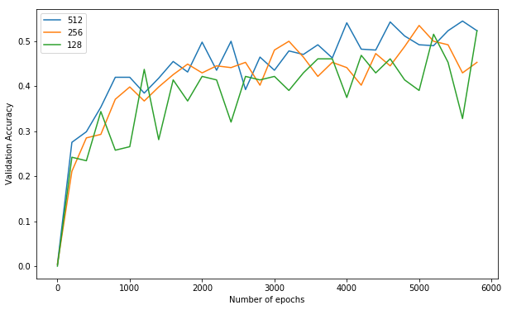
Comparision – Batch Size
Notes:
As for the batch size, all three numbers have really close performances in terms of loss function and validation accuracy.

Slide 11
Training
Fine-tune Parameters：
Batch Size: 256
Optimizer: AdamOptimizer
Notes:
Based on our experiments, we finally chose 256 as the batch size, and the Adam as our optimizer.

Slide 12
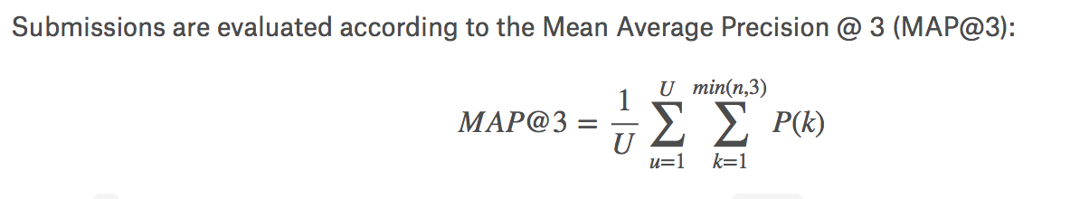
Evaluation METRICS
Evaluation of our model
Top 1 prediction Accuracy: ~ 60%
Top 3 prediction Mean Average Precision: ~ 80%
Notes:
For this competition, we choose the mean average precision @ 3 as our evaluation metrics, as it is required by kaggle.
After weeks of training, our model has achieved the top 1 prediction accuracy of around 60 percentage.
And we achieve the score of MAP@3 at around 80 percentage.

Slide 13
Test Result
Notes:
Finally we fit our model to predict the top 3 labels of the test dataset
This is our final test file

Slide 14

Notes:
This project is sponsored by Microsoft Azure, thanks Microsoft to provide powerful virtual machines for the computation!

Slide 15
Credits
BGM:
1.
2. The Party Troll (song) by D1ofAquavibe https://www.youtube.com/watch?v=j9jbEIKIKTk
3. Kevin MacLeod ~ Fluffing a Duck
https://www.youtube.com/watch?v=Sbdutn8Q1T0
Kaggle Competition and the Game:
https://www.kaggle.com/c/quickdraw-doodle-recognition
https://quickdraw.withgoogle.com/

