Slide 1


< Response Time, DB Time 1 >
SELECT *
FROM emp;
DB

Slide 2
< Response Time, DB Time 2 >
King 3000 10
Jimmy 5000 20
DB

Slide 3
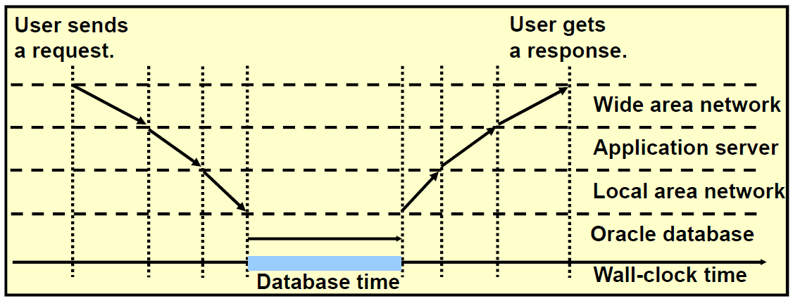
< Response Time, DB Time 3 >
Response Time

Slide 5
< DB Server >
Shared Pool
DB Buffer Cache
Redo Log Buffer
SGA
SMON
PMON
DBWn
CKPT
RECO
LGWR
Control File
Data File
Redo Log File

Slide 6
< Dedicated Server 1 >
S
SELECT * FROM employees;
hr / hr
U
SELECT * FROM employees;
King 3000 10
Jimmy 5000 20

Slide 7
< Dedicated Server 2 >
S
U
exit;

Slide 9
< SQL 최적화 >
EMPLOYEES
DEPARTMENTS
EMPLOYEE_ID | LAST_NAME | DEPARTMENT_ID
100 | King | 90
101 | Kochhar | 60
102 | De Haan | 90
103 | Hunold | 50
DEPARTMENT_ID | DEPARTMENT_NAME
90 | Administration
50 | Shipping
60 | IT
Report
LAST_NAME | DEPARTMENT
King | Administration
Kochhar | IT
De Haan | Administration
Hunold | Shipping
SELECT last_name, department_name
FROM employees, departments
WHERE department_id=department_id;

Slide 10
< SELECT 1 : parse >
Shared Pool
DB Buffer Cache
Redo Log Buffer
P-code
Exec Plan
SQL
Soft Parse
Shared SQL Area
S
S
SELECT name
FROM emp
WHERE id=1;
SELECT name
FROM emp
WHERE id=1;
id | name | salary
1 | Jone | 1000
2 | Adam | 2000
Control File
Data File
Redo Log File

Slide 11
< SELECT 2 : execute>
Shared Pool
DB Buffer Cache
Redo Log Buffer
P-code
Exec Plan
SQL
Shared SQL Area
10 May 100
S
S
Logical Read
1 Jone 1000
SELECT name
FROM emp
WHERE id=1;
SELECT name
FROM emp
WHERE id=10;
Physical Read
10 May 100
1 Jone 1000
2 Adam 2000
Control File
Data File
Redo Log File

Slide 12
< SELECT 3 : fetch >
PGA
Stack Space
S
Session Memory
U
Jone
Cursor Stack
Jone
SQL Workarea

Slide 14
< Soft Parse 1 >
Shared Pool : Library Cache
P-code
Exec Plan
SQL
LC addr1
S
S
Shared SQL Area
SELECT *
FROM EMP
WHERE ID=1;
select *
from emp
where id=1;
LC addr2
0x74 0x45 0x32…
0x41 0x22 0x32…
Hash
Function
Hash
Function
LC addr2
LC addr1

Slide 16
< Bind Variables 2>
SQL Developer(Host)
SQL> variable b number
SQL> exec :b := 7788
7788
b
SQL> SELECT *
FROM emp
WHERE empno = :b;
2. BIND
SQL
SELECT * FROM emp
WHERE empno = :b;
1. PARSE
plan1

Slide 17
< Bind Variables 3>
SQL Developer(Host)
SQL> variable b number
SQL> exec :b := 7788
7788
b
SQL> SELECT *
FROM emp
WHERE empno = :b;
2. BIND
SQL
SELECT * FROM emp
WHERE empno = 7788;
1. PARSE
plan1
3. EXECUTE
4. FETCH

Slide 18
< Bind Variables 4>
SQL Developer(Host)
SQL> exec :b := 7409
7409
b
SQL> SELECT *
FROM emp
WHERE empno = :b;
2. BIND
SQL
SELECT * FROM emp
WHERE empno = :b;
1. PARSE
plan1
<- Soft Parse
3. EXECUTE
4. FETCH

Slide 20
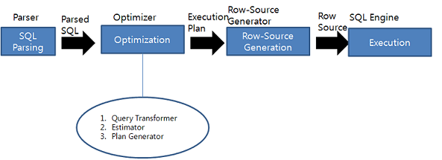
< SQL 처리 과정 >
Hard Parse
(gurubee.net)

Slide 21
< Height-Balanced Histogram 1 >
 | X
 | 1
 | 1
 | 2
 | 2
 | …
 | 50
 | 50
 | Y
 | 1
 | 2
 | 3
 | …
 | 50
 | 50
 | 50
1 ~ 10
11 ~ 20
21 ~ 30
31 ~ 40
41 ~ 50
50 50 ..
50 50 ..
50 50 ..
50 50 ..
50 50 ..
100 rows
where X=50
100 rows
where Y=50
20 30 40 50 50 50 50 50 50
<- end point value
Selectivity : 1/50
Selectivity : 1/50 ?

Slide 23
< Read Consistent : CR Block 1 >
Shared Pool
DB Buffer Cache
Redo Log Buffer
P-code
Exec Plan
SQL
tx51 … 1000
tx51 … 2000
 |  | 1000
tx51
Shared SQL Area
10 May 100
Lock!!!
S
S
X
1 Jone 2000
UPDATE emp
SET salary=2000
WHERE id=1;
SELECT salary
FROM emp
WHERE id=1;
UNDO
10 May 100
1 Jone 1000
2 Adam 2000
Control File
Data File
Redo Log File

Slide 24
< CR Block 2 >
Shared Pool
DB Buffer Cache
Redo Log Buffer
P-code
Exec Plan
SQL
tx51 … 1000
tx51 … 2000
 |  | 1000
10 May 100
tx51
1 Jone 1000
Shared SQL Area
CR Block 생성
S
10 May 100
X
1 Jone 2000
S
UPDATE emp
SET salary=2000
WHERE id=1;
SELECT salary
FROM emp
WHERE id=1;
UNDO
1000
10 May 100
1 Jone 1000
2 Adam 2000
Control File
Data File
Redo Log File

Slide 25
< parent cursor, child cursor 1>
Library Cache
select * from employees
where department_id=10;
Parent Cursor
plan1
plan2
Child Cursor
SQL> alter session set optimizer_mode=first_rows_1;
SQL> select * from employees
where department_id=10;
SQL> alter session set optimizer_mode=all_rows;
SQL> select * from employees
where department_id=10;

Slide 27
< Bind Variables 1>
SQL Developer(Host)
SQL> variable b number
SQL> exec :b := 7788
7788
b
SQL> SELECT *
FROM emp
WHERE empno = :b;
SQL
SELECT * FROM emp
WHERE empno = :b;
1. PARSE
plan1

Slide 28
< Bind Variables 2>
SQL Developer(Host)
SQL> variable b number
SQL> exec :b := 7788
7788
b
SQL> SELECT *
FROM emp
WHERE empno = :b;
2. BIND
SQL
SELECT * FROM emp
WHERE empno = :b;
1. PARSE
plan1

Slide 29
< Bind Variables 3>
SQL Developer(Host)
SQL> variable b number
SQL> exec :b := 7788
7788
b
SQL> SELECT *
FROM emp
WHERE empno = :b;
2. BIND
SQL
SELECT * FROM emp
WHERE empno = 7788;
1. PARSE
plan1
3. EXECUTE
4. FETCH

Slide 30
< Bind Variables 4>
SQL Developer(Host)
SQL> exec :b := 7409
7409
b
SQL> SELECT *
FROM emp
WHERE empno = :b;
2. BIND
SQL
SELECT * FROM emp
WHERE empno = :b;
1. PARSE
plan1
<- Soft Parse
3. EXECUTE
4. FETCH

Slide 32
< Table Data >
DB Block (8k)
CREATE TABLE test
( id number,
name varchar2(10),
loc varchar2(10))
TABLESPACE ts2;
INSERT INTO test
VALUES (1, ‘Jone’, ‘Seoul’);
(2, NULL, ‘Jeju’);
(3, NULL, NULL);
Header
TS2
Header Block
0 | 4 | Jeju
 | 1 | 3
 | 1 | 1 | 4 | Jone | 5 | Seoul
 | 1 | 2

Slide 34
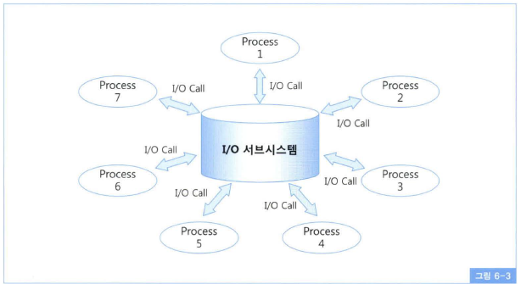
< I/O Call >
I/O Call 하고 CPU 반환
-> SLEEP

Slide 35
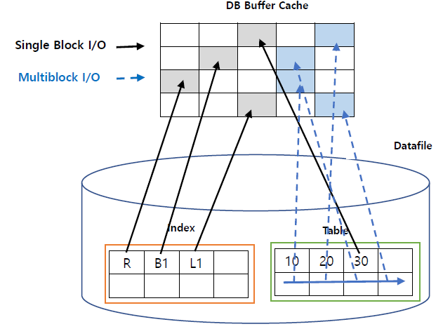
< Single Block I/O, Multiblock I/O >
WHERE deptno = 30

Slide 36
< HWM : High Water Mark 1 >
HWM

Slide 37
< HWM : High Water Mark 2 >
HWM

Slide 38
< HWM : High Water Mark 3 >
HWM

Slide 40
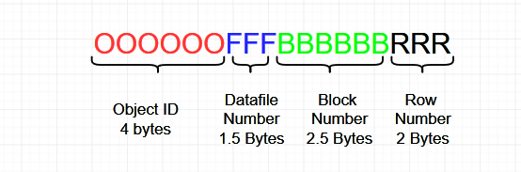

Slide 42
< Full Table Scan vs Index Scan 1 >
WHERE 사원명 = 장보고
사번 | 사원명 | 직급
7900 | 김유신 | 과장
7699 | 신윤복 | 관장
7499 | 강감찬 | 과장
7777 | 장보고 | 사원
7839 | 조자룡 | 부장
7531 | 김두한 | 부장
사번 | 사원명 | 직급
사번 | 사원명 | 직급
사번 | 사원명 | 직급
사번 | 사원명 | 직급
7856 | 홍길동 | 차장
7654 | 류관순 | 차장
7369 | 안중근 | 과장
7432 | 이순신 | 사장
7777 | 윤정원 | 부장
7827 | 장보고 | 부장
사번 | 사원명 | 직급
HWM
Full Table Scan

Slide 43
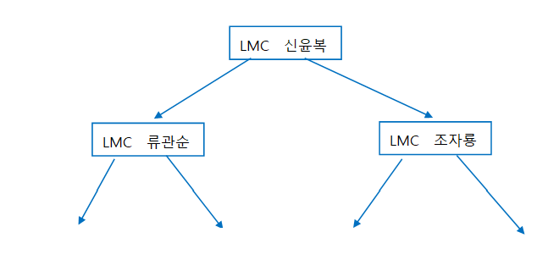

< Full Table Scan vs Index Scan 2 >
WHERE 사원명 = 장보고
사번 | 사원명 | 직급
7900 | 김유신 | 과장
7699 | 신윤복 | 관장
7499 | 강감찬 | 과장
7777 | 장보고 | 사원
7839 | 조자룡 | 부장
7531 | 김두한 | 부장
사번 | 사원명 | 직급
사번 | 사원명 | 직급
사번 | 사원명 | 직급
조자룡
홍길동
…
사번 | 사원명 | 직급
7856 | 홍길동 | 차장
7654 | 류관순 | 차장
7369 | 안중근 | 과장
7432 | 이순신 | 사장
7777 | 윤정원 | 부장
7827 | 장보고 | 부장
사번 | 사원명 | 직급
HWM
Index Range Scan

Slide 44
< Full Table Scan vs Index Scan 3 >
WHERE 사원명 = 장보고
사번 | 사원명 | 직급
7900 | 김유신 | 과장
7699 | 신윤복 | 관장
7499 | 강감찬 | 과장
7777 | 장보고 | 사원
7839 | 조자룡 | 부장
7531 | 김두한 | 부장
사번 | 사원명 | 직급
사번 | 사원명 | 직급
사번 | 사원명 | 직급
조자룡
홍길동
…
사번 | 사원명 | 직급
7856 | 홍길동 | 차장
7654 | 류관순 | 차장
7369 | 안중근 | 과장
7432 | 이순신 | 사장
7777 | 윤정원 | 부장
7827 | 장보고 | 부장
사번 | 사원명 | 직급
HWM
Index Range Scan

Slide 46
< Index Range Scan : NonUnique Index 1 >
CREATE INDEX idx
ON T(id);
25 50 75
Root
5 10 15
20 25 30
…
90 95
Branch
R1
R2
R3
R4
R5
R6
R7
R8
R9
R10
96 R96
97 R97
98 R98
99 R99
100 R100
Leaf
WHERE id = 3

Slide 47
< Index Range Scan : NonUnique Index 2 >
CREATE INDEX idx
ON T(id);
25 50 75
Root
5 10 15
20 25 30
…
90 95
Branch
R1
R2
R3
R4
R5
R6
R7
R8
R9
R10
96 R96
97 R97
98 R98
99 R99
100 R100
Leaf
WHERE id = 3

Slide 49
< Index Range Scan : Unique Index >
WHERE id between 3 and 7;
25 50 75
Root
5 10 15
20 25 30
…
90 95
Branch
R1
R2
R3
R4
R5
R6
R7
R8
R9
R10
96 R96
97 R97
98 R98
99 R99
100 R100
Leaf

Slide 50
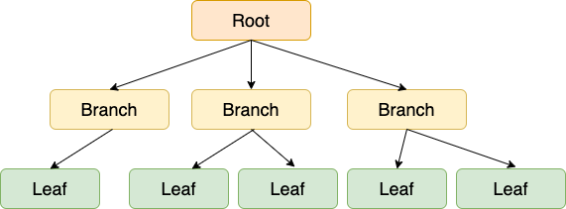
< IRS >
사번 | 사원명 | 직급
7900 | 김유신 | 과장
7699 | 신윤복 | 관장
7499 | 강감찬 | 과장
7777 | 장보고 | 사원
7839 | 조자룡 | 부장
7531 | 김두한 | 부장
사번 | 사원명 | 직급
사번 | 사원명 | 직급
사번 | 사원명 | 직급
사번 | 사원명 | 직급
7856 | 홍길동 | 차장
7654 | 류관순 | 차장
7369 | 안중근 | 과장
7432 | 이순신 | 사장
7777 | 윤정원 | 부장
7827 | 장보고 | 부장
사번 | 사원명 | 직급

Slide 52
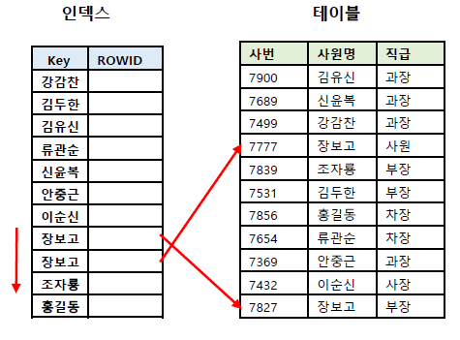
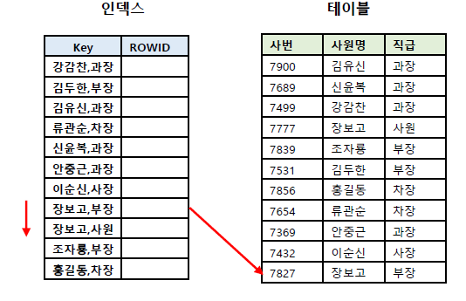
< 결합 인덱스 1 >
WHERE 사원명 = ‘장보고‘ and 직급 = ‘부장＇

Slide 53
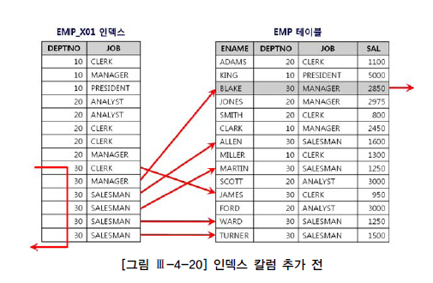
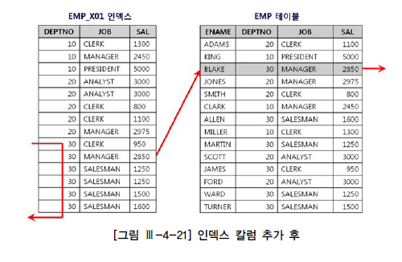
< 결합 인덱스 2 >
WHERE deptno = 30 and sal > 2000

Slide 54
< Index Full Scan 1 : Logical 순서 >
Root
Branch1
Branch2
R1
R2
R3
R4
4 R5
R6
R7
R8
R9
R10
11 R11
12 R12
13 R13
14 R14
15 R15
16 R16
17 R17
18 R18
19 R19
20 R20
Leaf1
1
Leaf2
2
Leaf3
3
Leaf4
4

Slide 55
< Index Full Scan 2 : Physical 순서 >
 | Root | Branch1 | Leaf1
1
Leaf2 | Branch2 | Leaf3 | Leaf4
2
3
4

Slide 56
< Index Join 1 >
ename | sal | deptno
King | 2000 | 90
Smith | 900 | 60
Adam | 1000 | 90
Merry | 5000 | 50
Bob | 3000 | 60
Adam | R3
Bob | R5
King | R1
Merry | R4
Smith | R2
900 | R2
1000 | R3
2000 | R1
3000 | R5
5000 | R4
Adam 1000
SELECT /*+ INDEX_JOIN(e) */
ename, sal
FROM emp e;
Bob 3000
King 2000
Merry 5000
Smith 900

Slide 58
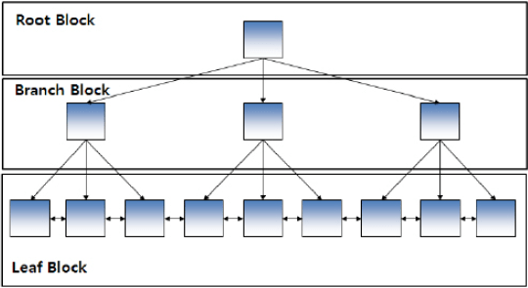
< Inlist Iterator 1 >
WHERE empno IN (7876, 7900, 7902)

Slide 60
WHERE 사원명 = ‘장보고‘ and 직급 = ‘부장＇

Slide 61
WHERE deptno = 30 and sal > 2000

Slide 63
< Index Maintenance 1>
Insert : 3
25 50 75
Root
5 10 15
20 25 30
…
90 95
Branch
R1
R2
R3
R4
R5
R6
R7
R8
R9
R10
96 R96
97 R97
98 R98
99 R99
100 R100
Leaf
10
5
3
1
2
3
7

Slide 64
< Index Maintenance 2>
Insert : 3
25 50 75
Root
5 10 15
20 25 30
…
90 95
Branch
R1
R2
R3
3 R101
R4
R5
R6
R7
R8
R9
R10
96 R96
97 R97
98 R98
99 R99
100 R100
Leaf

Slide 65
< Index Maintenance 3>
Insert : 3
25 50 75
Root
5 10 15
20 25 30
…
90 95
Branch
R1
R2
R3
R6
R7
R8
R9
R10
96 R96
97 R97
98 R98
99 R99
100 R100
Leaf
3 R101
R4
R5

Slide 66
< Index Maintenance 4>
Insert : 3
25 50 75
Root
5 10 15
20 25 30
…
90 95
Branch
R1
R2
R3
3 R101
R4
R5
R6
R7
R8
R9
R10
96 R96
97 R97
98 R98
99 R99
100 R100
Leaf

Slide 67
< Index Maintenance 5>
delete : 6 7 8 9
25 50 75
Root
5 10 15
20 25 30
…
90 95
Branch
R1
R2
R3
R4
R5
R6
R7
R8
R9
R10
96 R96
97 R97
98 R98
99 R99
100 R100
Leaf

Slide 68
< Index Maintenance 6>
delete : 6 7 8 9
25 50 75
Root
5 10 15
20 25 30
…
90 95
Branch
R1
R2
R3
R4
R5
10 R10
96 R96
97 R97
98 R98
99 R99
100 R100
Leaf

Slide 69
< Index Maintenance 7>
update : 3 -> 33
25 50 75
Root
5 10 15
20 25 30
…
90 95
Branch
R1
R2
R3
R4
R5
R6
R7
R8
R9
R10
96 R96
97 R97
98 R98
99 R99
100 R100
Leaf

Slide 70
< Index Maintenance 8 >
update : 3 -> 33
25 50 75
Root
5 10 15
20 25 30
…
90 95
Branch
R1
R2
R4
R5
R6
R7
R8
R9
R10
96 R96
97 R97
98 R98
99 R99
100 R100
Leaf
33 R3

Slide 71
< IOT : Index Organized Table >
25 50 75
5 10 15
20 25 30
…
90 95
Smith 100
Adam 200
Jone 300
King 600
Scott 100
R6
R7
R8
R9
R10
96 R96
97 R97
98 R98
99 R99
100 R100

Slide 73
< Nested Loops Join 1 >
DEPARTMENTS
EMPLOYEES
DEPARTMENT_NAME | DEPT_ID
Administration | 10
Shipping | 20
IT | 30
DEPT_ID | LAST_NAME | EMP_ID
20 | King | 100
10 | Kochhar | 101
20 | De Haan | 102
30 | Hunold | 103
Administration 10 10 Kochhar 101

Slide 74
< Nested Loops Join 2 >
DEPARTMENTS
EMPLOYEES
DEPARTMENT_NAME | DEPT_ID
Administration | 10
Shipping | 20
IT | 30
DEPT_ID | LAST_NAME | EMP_ID
20 | King | 100
10 | Kochhar | 101
20 | De Haan | 102
30 | Hunold | 103
Administration 10 10 Kochhar 101
Shipping 20 20 King 100
Shipping 20 20 De Haan 102

Slide 75
< Nested Loops Join 3 >
DEPARTMENTS
EMPLOYEES
DEPARTMENT_NAME | DEPT_ID
Administration | 10
Shipping | 20
IT | 30
DEPT_ID | LAST_NAME | EMP_ID
20 | King | 100
10 | Kochhar | 101
20 | De Haan | 102
30 | Hunold | 103
Administration 10 10 Kochhar 101
Shipping 20 20 King 100
Shipping 20 20 De Haan 102
IT 30 30 Hunold 103

Slide 76
< Nested Loops Join 4 >
DEPARTMENTS (OUTER)
EMPLOYEES (INNER)
DEPARTMENT_NAME | DEPT_ID
Administration | 10
Shipping | 20
IT | 30
DEPT_ID | LAST_NAME | EMP_ID
20 | King | 100
10 | Kochhar | 101
20 | De Haan | 102
30 | Hunold | 103
NESTED LOOPS
OUTER TABLE
INNER TABLE

Slide 78
< Nested Loops Join with Index 1 >
DEPARTMENTS
EMPLOYEES
DEPARTMENT_NAME | DEPT_ID
Administration | 10
Shipping | 20
IT | 30
DEPT_ID | ROWID
10 | R2
20 | R1
20 | R3
30 | R4
DEPT_ID | LAST_NAME | EMP_ID
20 | King | 100
10 | Kochhar | 101
20 | De Haan | 102
30 | Hunold | 103

Slide 79
< Nested Loops Join with Index 2 >
DEPARTMENTS
EMPLOYEES
DEPARTMENT_NAME | DEPT_ID
Administration | 10
Shipping | 20
IT | 30
DEPT_ID | ROWID
10 | R2
20 | R1
20 | R3
30 | R4
DEPT_ID | LAST_NAME | EMP_ID
20 | King | 100
10 | Kochhar | 101
20 | De Haan | 102
30 | Hunold | 103

Slide 80
< Nested Loops Join with Index 3 >
DEPARTMENTS
EMPLOYEES
DEPARTMENT_NAME | DEPT_ID
Administration | 10
Shipping | 20
IT | 30
DEPT_ID | ROWID
10 | R2
20 | R1
20 | R3
30 | R4
DEPT_ID | LAST_NAME | EMP_ID
20 | King | 100
10 | Kochhar | 101
20 | De Haan | 102
30 | Hunold | 103

Slide 81
< Nested Loops Join with Index 4 >
DEPARTMENTS
EMPLOYEES
DEPARTMENT_NAME | DEPT_ID
Administration | 10
Shipping | 20
IT | 30
DEPT_ID | ROWID
10 | R2
20 | R1
20 | R3
30 | R4
DEPT_ID | LAST_NAME | EMP_ID
20 | King | 100
10 | Kochhar | 101
20 | De Haan | 102
30 | Hunold | 103

Slide 82
< Nested Loops Join with Index 5 >
DEPARTMENTS (OUTER)
EMPLOYEES (INNER)
DEPARTMENT_NAME | DEPT_ID
Administration | 10
Shipping | 20
IT | 30
DEPT_ID | ROWID
10 | R2
20 | R1
20 | R3
30 | R4
DEPT_ID | LAST_NAME | EMP_ID
20 | King | 100
10 | Kochhar | 101
20 | De Haan | 102
30 | Hunold | 103
NESTED LOOPS
OUTER TABLE
INNER TABLE
INNER TABLE INDEX

Slide 84
< Nested Loops Join with outer table Index 1 >
DEPARTMENTS (OUTER)
EMPLOYEES (INNER)
DEPT_ID
10
20
30
DEPARTMENT_NAME | DEPT_ID
Administration | 10
Shipping | 20
IT | 30
DEPT_ID | ROWID
10 | R2
20 | R1
20 | R3
30 | R4
DEPT_ID | LAST_NAME | EMP_ID
20 | King | 100
10 | Kochhar | 101
20 | De Haan | 102
30 | Hunold | 103
select department_name,
last_name
from departments d,
employees e
where d.dept_id=e.dept_id
and d.dept_id=30;
NESTED LOOPS
OUTER TABLE
OUTER TABLE INDEX
INNER TABLE
INNER TABLE INDEX

Slide 86
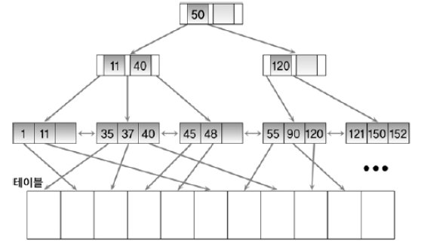
< Nested Loops Join : Prefetching 1 >
INNER TABLE
NESTED LOOPS
OUTER TABLE
INNER TABLE INDEX
Disk

Slide 88
< Nested Loops : NLS_Batching 1 >
DEPARTMENTS
EMPLOYEES
DEPARTMENT_NAME | DEPT_ID
Administration | 10
Shipping | 20
IT | 30
DEPT_ID | ROWID
10 | R2
20 | R1
20 | R3
30 | R4
DEPT_ID | LAST_NAME | EMP_ID
20 | King | 100
10 | Kochhar | 101
20 | De Haan | 102
30 | Hunold | 103
Disk
30 Hunold 103
20 King 100
SGA

Slide 89
< Nested Loops : NLS_Batching 2 >
DEPARTMENTS
EMPLOYEES
DEPARTMENT_NAME | DEPT_ID
Administration | 10
Shipping | 20
IT | 30
DEPT_ID | ROWID
10 | R2
20 | R1
20 | R3
30 | R4
DEPT_ID | LAST_NAME | EMP_ID
20 | King | 100
10 | Kochhar | 101
20 | De Haan | 102
30 | Hunold | 103
Disk
cache miss!
30 Hunold 103
20 King 100
SGA

Slide 90
< Nested Loops : NLS_Batching 3 >
DEPARTMENTS
EMPLOYEES
DEPARTMENT_NAME | DEPT_ID
Administration | 10
Shipping | 20
IT | 30
DEPT_ID | ROWID
10 | R2
20 | R1
20 | R3
30 | R4
DEPT_ID | LAST_NAME | EMP_ID
20 | King | 100
10 | Kochhar | 101
20 | De Haan | 102
30 | Hunold | 103
Disk
DB Buffer Cache
30 Hunold 103
20 King 100
SGA

Slide 91
< Nested Loops : NLS_Batching 4 >
DEPARTMENTS
EMPLOYEES
DEPARTMENT_NAME | DEPT_ID
Administration | 10
Shipping | 20
IT | 30
DEPT_ID | ROWID
10 | R2
20 | R1
20 | R3
30 | R4
DEPT_ID | LAST_NAME | EMP_ID
20 | King | 100
10 | Kochhar | 101
20 | De Haan | 102
30 | Hunold | 103
Disk
Shipping 20 20 King
cache miss!
30 Hunold 103
20 King 100
SGA

Slide 92
< Nested Loops : NLS_Batching 5 >
DEPARTMENTS (OUTER)
EMPLOYEES (INNER)
DEPARTMENT_NAME | DEPT_ID
Administration | 10
Shipping | 20
IT | 30
DEPT_ID | ROWID
10 | R2
20 | R1
20 | R3
30 | R4
DEPT_ID | LAST_NAME | EMP_ID
20 | King | 100
10 | Kochhar | 101
20 | De Haan | 102
30 | Hunold | 103
Disk
Shipping 20 20 King
IT 30 30 Hunold
30 Hunold 103
20 King 100
SGA

Slide 93
< Nested Loops : NLS_Batching 6 >
DEPARTMENTS (OUTER)
EMPLOYEES (INNER)
DEPARTMENT_NAME | DEPT_ID
Administration | 10
Shipping | 20
IT | 30
DEPT_ID | ROWID
10 | R2
20 | R1
20 | R3
30 | R4
DEPT_ID | LAST_NAME | EMP_ID
20 | King | 100
10 | Kochhar | 101
20 | De Haan | 102
30 | Hunold | 103
Disk
Shipping 20 20 King
NESTED LOOPS
NESTED LOOPS
OUTER TABLE
INNER TABLE INDEX
INNER TABLE
IT 30 30 Hunold
Admin 10 10 Kochhar
30 Hunold 103
Shipping 20 20 De Haan
20 King 100
SGA

Slide 95
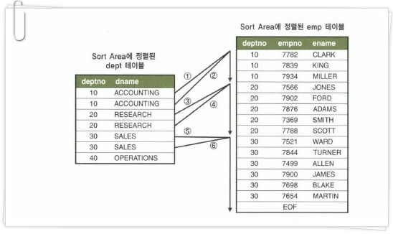
< Sort Merge Join 1 >
PGA
Stack Space
S
Session Memory
Cursor Stack
SQL Workarea
Sort area
For DEPT
Sort area
For EMP

Slide 97
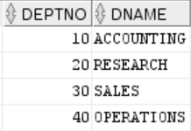
< Hash Join 1 >
Stack Space
Build Table
S
Session Memory
Cursor Stack
SQL Workarea
Hash Map for hash table
10
20
30
40

Slide 98
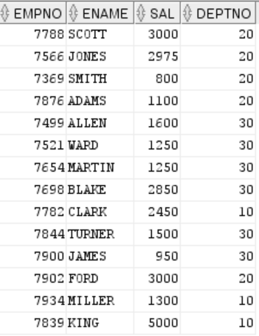
< Hash Join 2 >
Probe Table
Stack Space
S
Session Memory
Cursor Stack
SQL Workarea
Hash Map for hash table
10
20
30
40

Slide 99
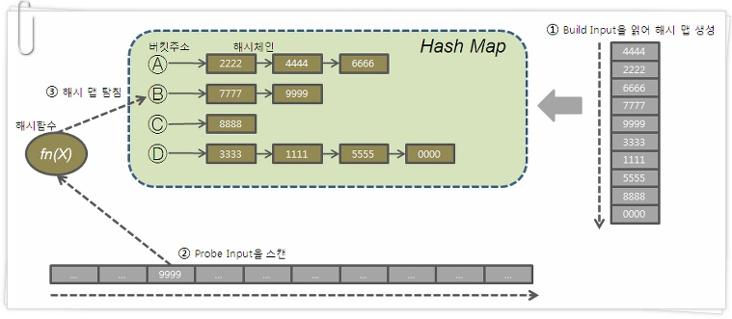
< Hash Join 3 >
Stack Space
S
Session Memory
Cursor Stack
SQL Workarea
Hash Map for hash table

