Slide 1


Capstone #3: Unleashing Strategy in a Puzzle Game with Reinforcement Learning
Zeliha Ural Merpez – M2M Tech
Dark – Zeliha Ural Merpez
Imagine a playing field filled with interconnected squares, each initially set to either white or black. The goal is simple: turn every square black.
However, there's a twist. When you press a square, not only does it change color, but all of its neighboring squares also change their color.
But what if you could leave the puzzle-solving to an intelligent agent capable of learning the best strategies? That's where reinforcement learning (RL) comes in.
In this capstone project, we will explore how RL, specifically Q-learning, can be applied to solve this intriguing puzzle game.

Slide 2

The Math Behind the Puzzle: Understanding the Problem Structure
Inversion of Actions: Each action is its own inverse. We can treat the color of each square as a binary value (0 for white, 1 for black).
Commutativity of Actions: The order of actions doesn’t affect the resulting configuration which significantly reduces the complexity.
Optimization of Actions: The minimum number of actions to solve the puzzle, initially found through brute force, can now be efficiently solved by reinforcement learning.
Solvability: While not every state is solvable, all solvable states can be transformed into one another.

Slide 3
Applying Reinforcement Learning
to the Puzzle
Reinforcement learning is a branch of machine learning where an agent learns how to achieve a goal by interacting with an environment.
The agent receives feedback in the form of rewards based on its actions, which helps it learn the most effective strategies over time.
In our case, the environment consists of the grid of squares, and the goal is to toggle them all to black.
The agent learns through trial and error, selecting actions (pressing squares) and receiving rewards or penalties based on the state of the grid after each action.

Slide 4
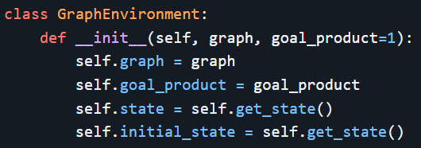
The Graph Environment
Each square is represented as a node in a graph, and the edges between them represent their adjacency.
The environment tracks the state of each square (whether it is black or white) and updates the state whenever a square is pressed.

Slide 5
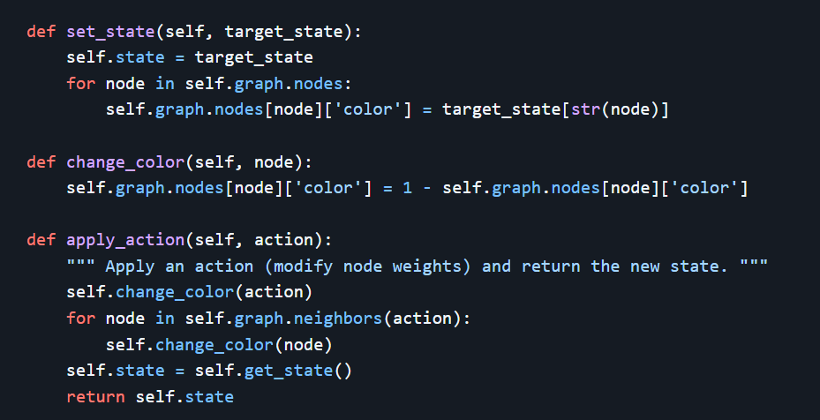
Cont. The Graph Environment

Slide 6


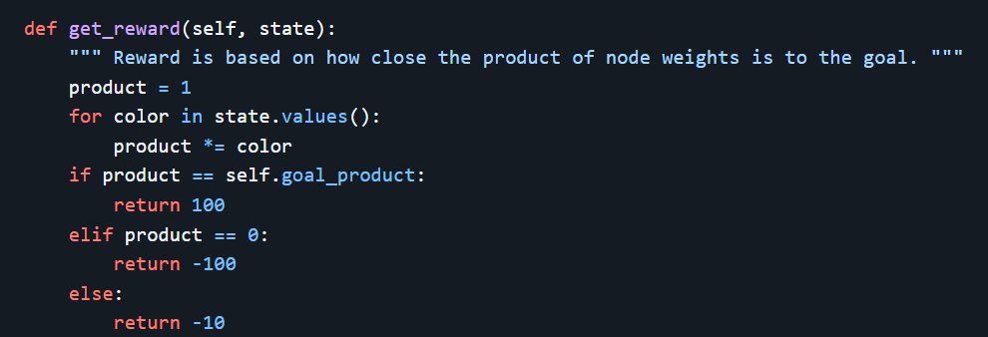
Cont. The Graph Environment

Slide 7
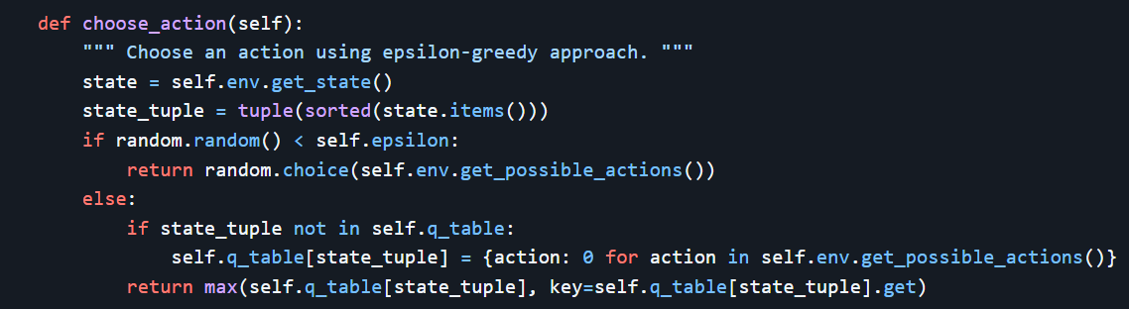
The Q-Learning Agent
Q-learning is an off-policy RL algorithm that helps an agent learn the best actions by estimating the long-term value (reward) of each action in each state.
The Q-learning algorithm maintains a Q-table that stores the expected future rewards for each state-action pair. During training, the agent explores different actions and updates the Q-table based on the rewards it receives.

Slide 8
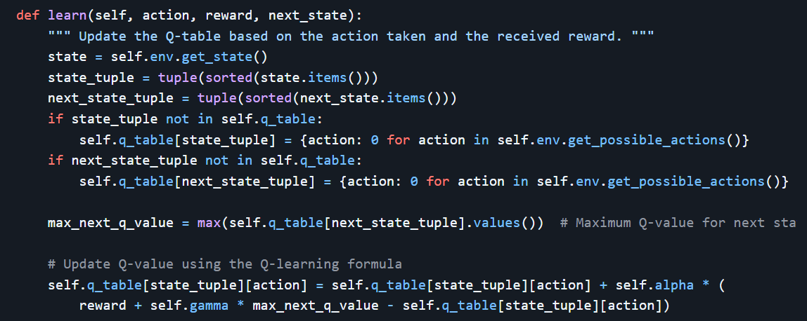
Cont. The Q-Learning Agent

Slide 9
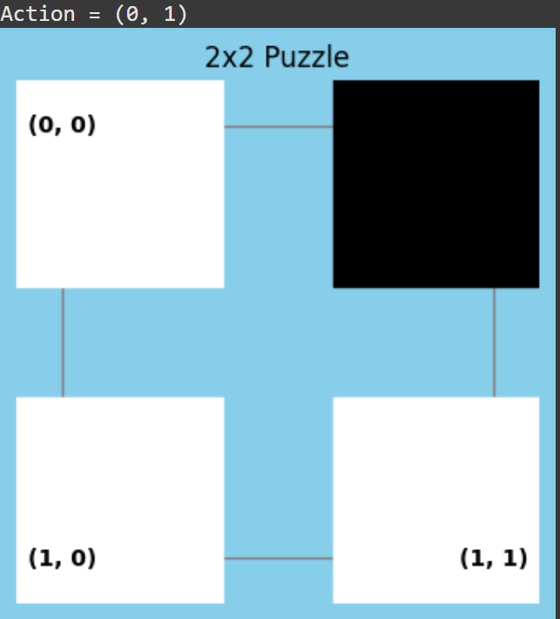
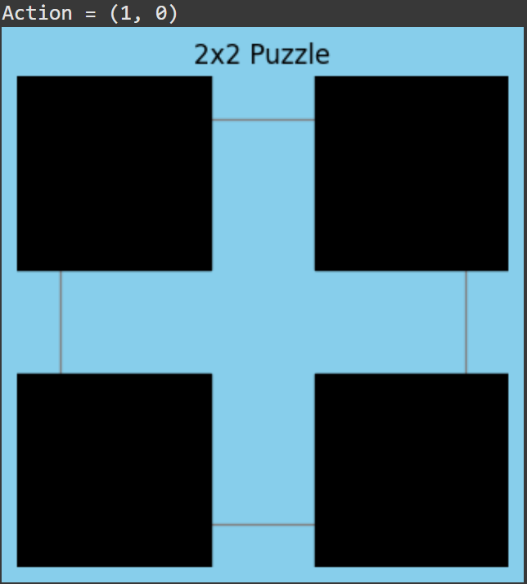
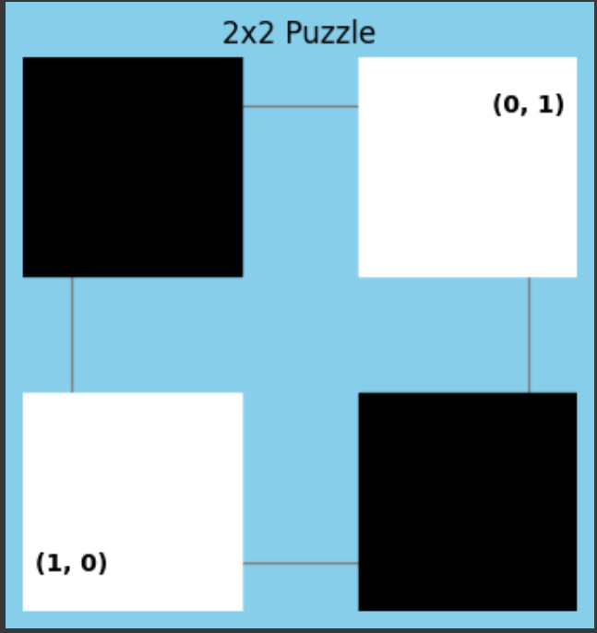

Testing 2x2 Puzzle

Slide 10
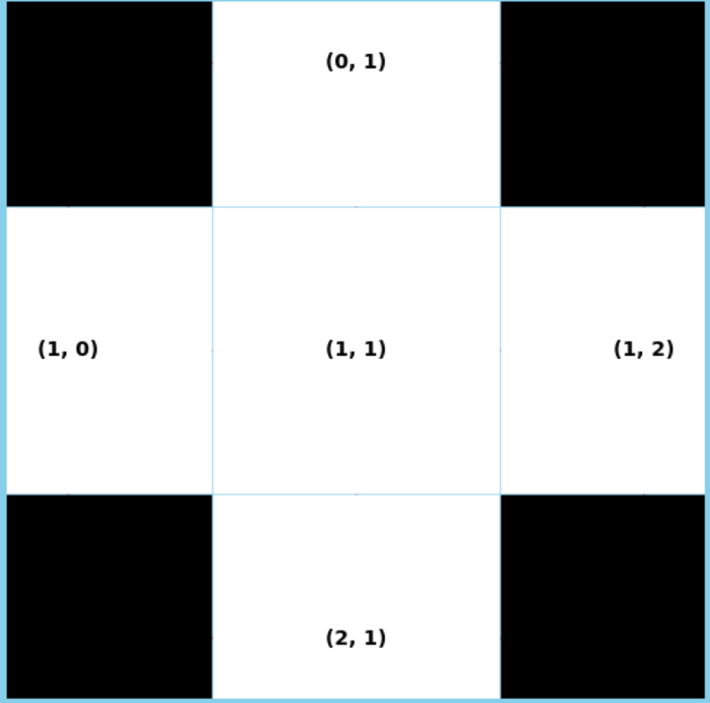
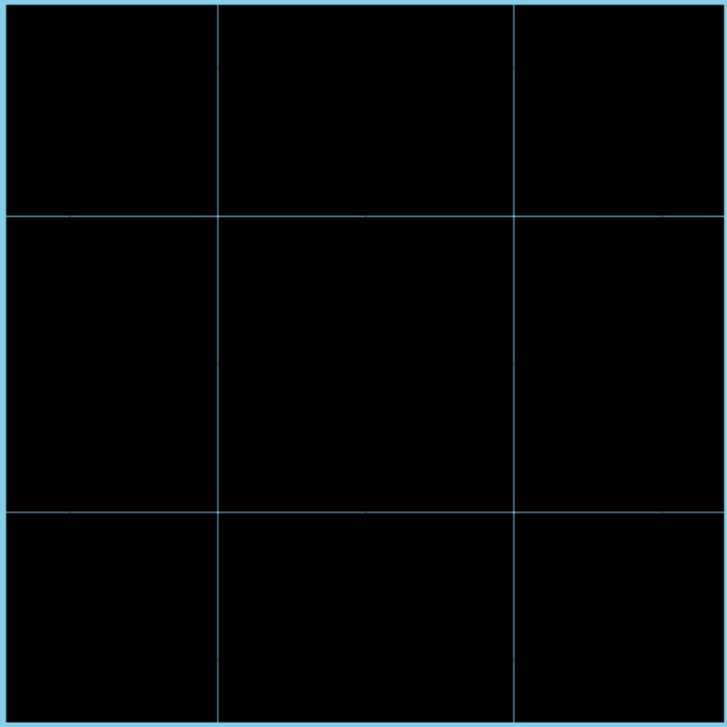

Testing 3x3 Puzzle

Slide 11


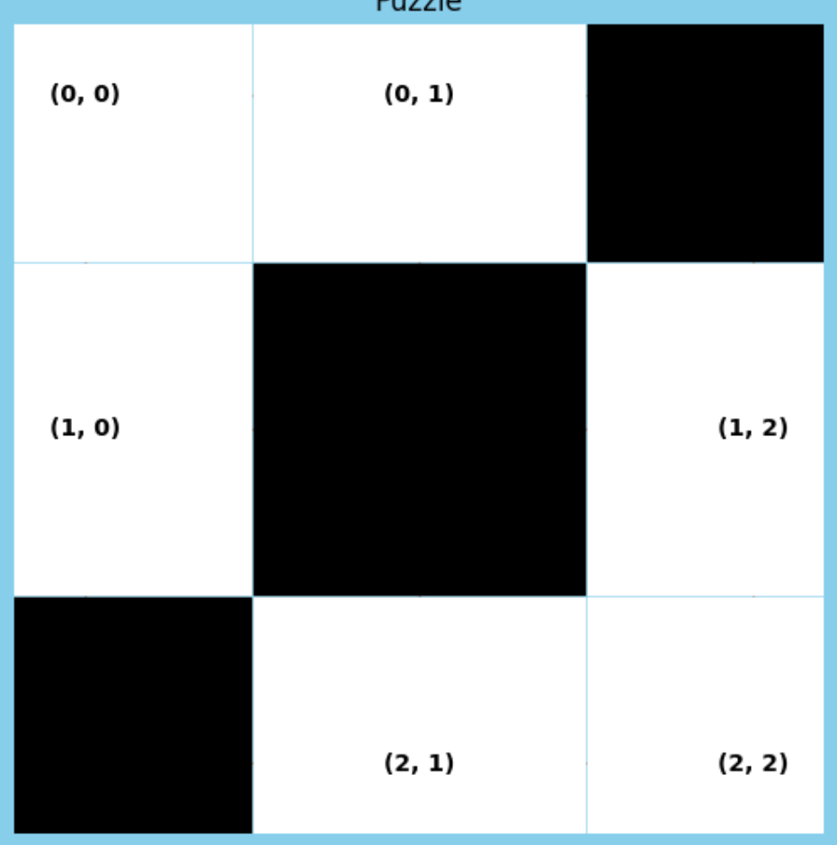
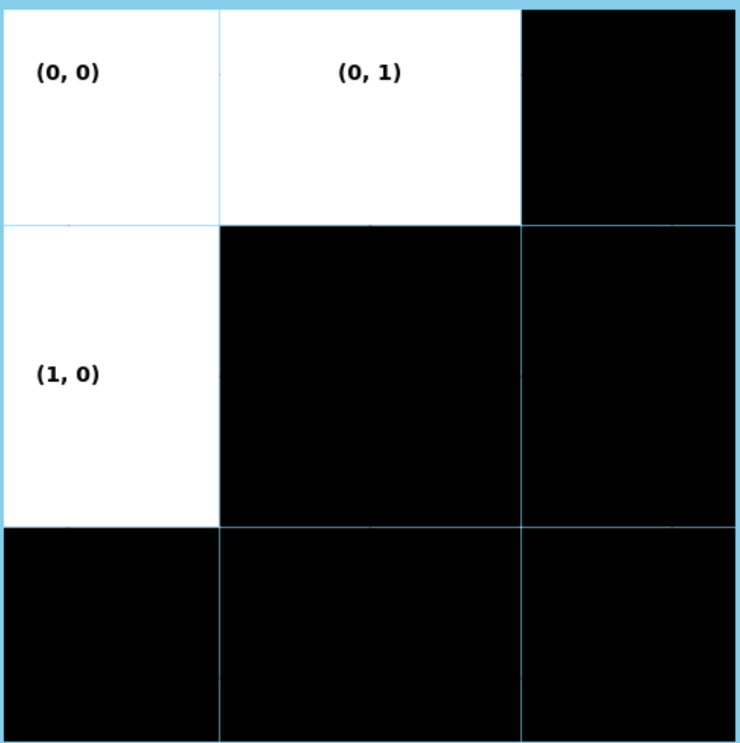
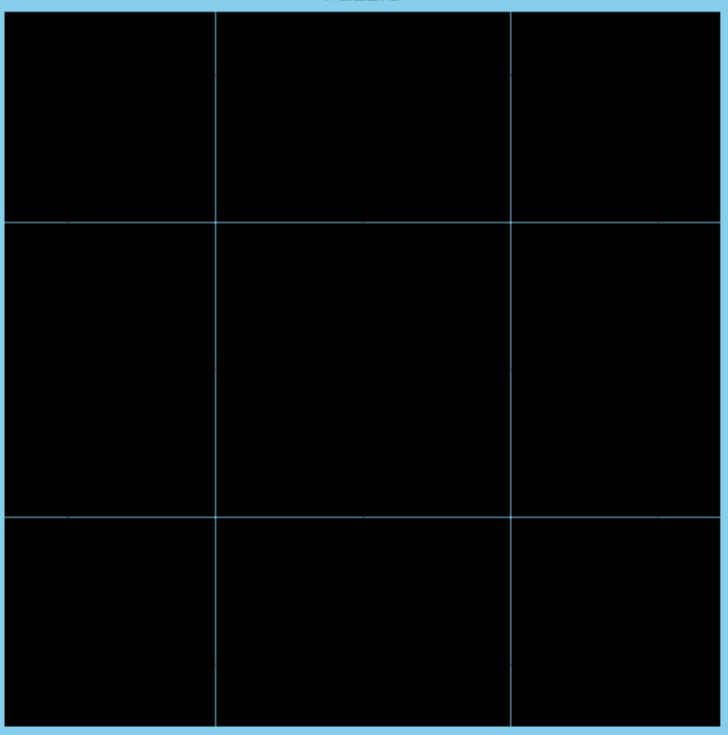


Slide 12
The Power of Reinforcement Learning in Puzzle Games
The results of the experiment show that the agent was able to effectively solve simple tasks requiring 1-2 steps.
However, as the complexity of the tasks increased, particularly in cases requiring more steps, the agent struggled to generate the desired solutions.
Potential Improvements:
Extended Training: Training the agent for a longer period could help it better explore and adapt to complex tasks.
Adjusting the Reward Mechanism: Tweaking the reward structure could better guide the agent's decision-making process.

Slide 13
Thanks!
Link for game:
https://play.google.com/store/apps/details?id=com.appercute.dark&pcampaignid=web_share
Link for code:
https://github.com/zmerpez/dark-RL
Zeliha Ural Merpez

