Slide 1
Stephanie Koesters Zachary Merrill John De Los Reyes
MyNewMedia

Slide 2
Introduction
What is MyNewMedia?
A site to combine different types of hosted media into one site
Goal: To unite media in one place
Solve the problem for podcasters
Need for a user-friendly site
Client referred to layout issues, inconsistencies
Make it easier to share with everyone

Slide 3
System Functions
Create accounts
Create channels
Made from links and RSS feed media content
Subscribe to channels
Promote channels
Link to aggregated content
Recommend channels
Use subscription data to recommend new channels to users

Slide 4
Functional Requirements
The user must be able to create accounts
Used for basic functions of site and to log data
The user must be able to create channels
Must populate channels with owned media from other sites
Shall promote site with an HTML button
The user must be able to subscribe to channels
The subscribed content is what is presented to the user on the dashboard
The user should be able to search for more channels

Slide 5
Nonfunctional Requirements
The layout must be simple for users
Viewing or listening to media shall take minimal button clicks
Subscribing shall require one click
Recommendations and other layout elements shall not complicate the interface
The site must accommodate multiple types of media
Information must be secured
The project shall follow the minimal budget requirements

Slide 6
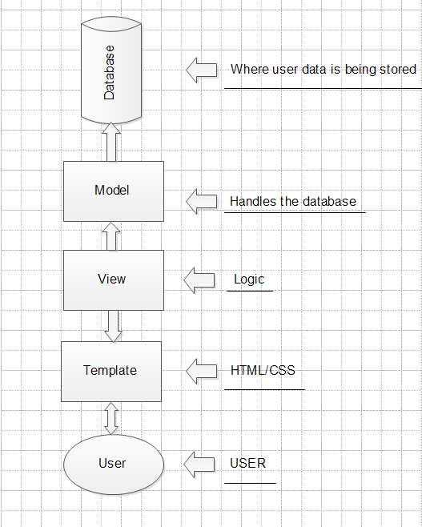
Architecture and Design

Slide 7
Architecture and Design
Example of how the architecture will work is when a user subscribing or unsubscribing from another user’s channel.
Subscription Model
Subscription View
Subscription Methods and Properties
User | Foreign key to the authenticated user.
Channel | Foreign key relationship to the channel.
Unread | Number of unread posts.
View Methods and Properties
Subscribe() | Adds a subscription under the logged in user for the passed extension.
Unsubscribe() | If the user is subscribed to another user’s channel, this will remove a subscription.

Slide 8
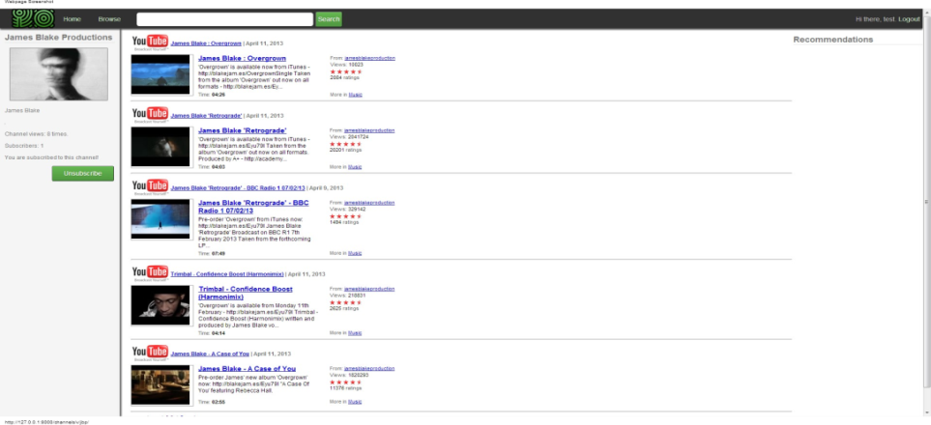
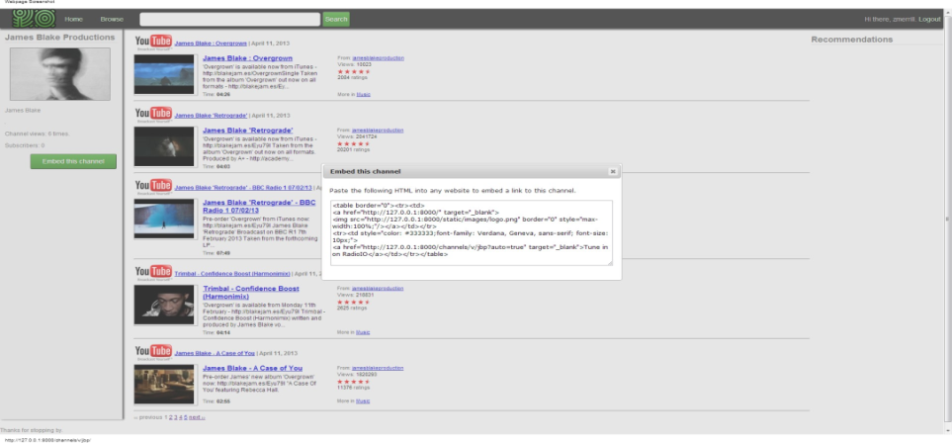
Architecture and Design
User Interface

Slide 9
Architecture and Design
Third Party Plugins:
Django-hitcount
Feedparser
Unipath
Django-messages
Django-taggit
Django-registration

Slide 10
Implementation Issues
Problems using Github
Syncing issues, inconsistent test data
Downloading multiple third party plugins
Older versions with deprecated functions
Setting up Django
New to Python
New to models/views/templates
Client absence

Slide 11
Conclusion
Success: The site functions as intended
Users can create channels, subscribe, and track viewed media
Users are recommended new channels based on their interests
Problem: Unable to deploy site
Unknown status of client’s server

