Slide 1
DHCP

Slide 2
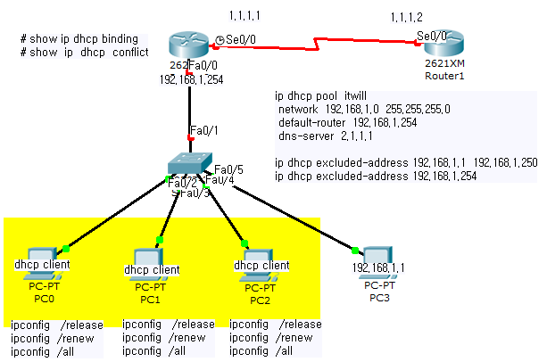
■ DHCP Server
Discover -> Offer -> Request -> Ack = broadcast (255.255.255.255)
network_1

