Slide 1
Data
Structures
and
Controlflow

Slide 2

Parenthesis Operator
2+3
5 : number
(+) 2 3
5 : number
(+) 3
<function> : number-> number

Slide 3
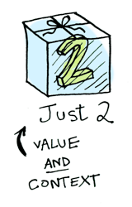
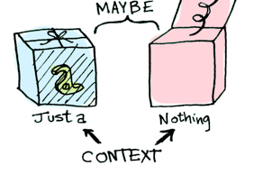
Context
Different results
depending
on the context.
The Maybe data type defines
two related contexts

Slide 4
NaN ????
case String.toFloat model.input of
Just celsius ->
viewConverter model.input "blue"
(String.fromFloat (celsius * 1.8 + 32))
Nothing ->
viewConverter model.input "red" "???"

Slide 5
Disallowed Apostrophes
https://github.com/elm-lang/elm-plans/issues/4
Elm <0.18
results' = List.map pretty results
Elm 0.18
prettyResults = List.map pretty results
https://gist.github.com/rtfeldman/3a8487309f9fc03b2715
https://gist.github.com/rtfeldman/54019bf63b7dbe4636fc

