Slide 1
Hello
world ;-)

Slide 2
What are we going to do?
What are we going to do?
Show and Tell - Anybody ?
What is Elm ?
The Elm Community
Install Elm
Learn Elm
SPA

Slide 3
Show and tell (default)
What is Elm
the Elm community
Install Elm
Learn Elm
SPA

Slide 4
What is ELM
Elm is a functional programming language
  somehow like functions in mathematics
Elm compiles to JavaScript
emphasis on usability, performance, and robustness
  happy Programmer
  React takes about 50% longer to do the same work
  no runtime exceptions in practice

Slide 5
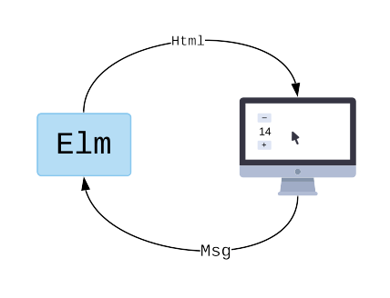
Model-View-Controller
The Elm program produces HTML to show on screen
Computer sends back messages of what is going on.
"They clicked a button!"
Model — the state of your application
View — a way to turn your state into HTML
Update — a way to update your state based on messages
These three concepts are the core of The Elm Architecture

Slide 6
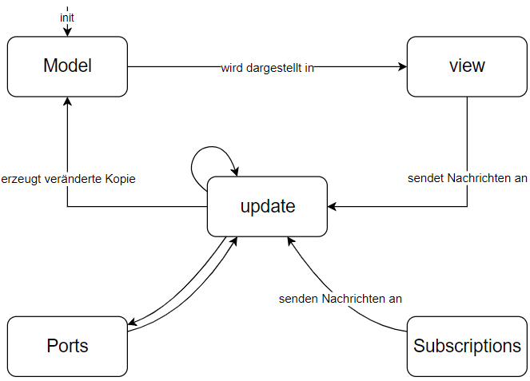
Model-View-Controller
Grafik aus dem Artikel vom
Heise-Verlag: Weboberflächenentwicklung mit Elm vom 08.02.2019:

Slide 7
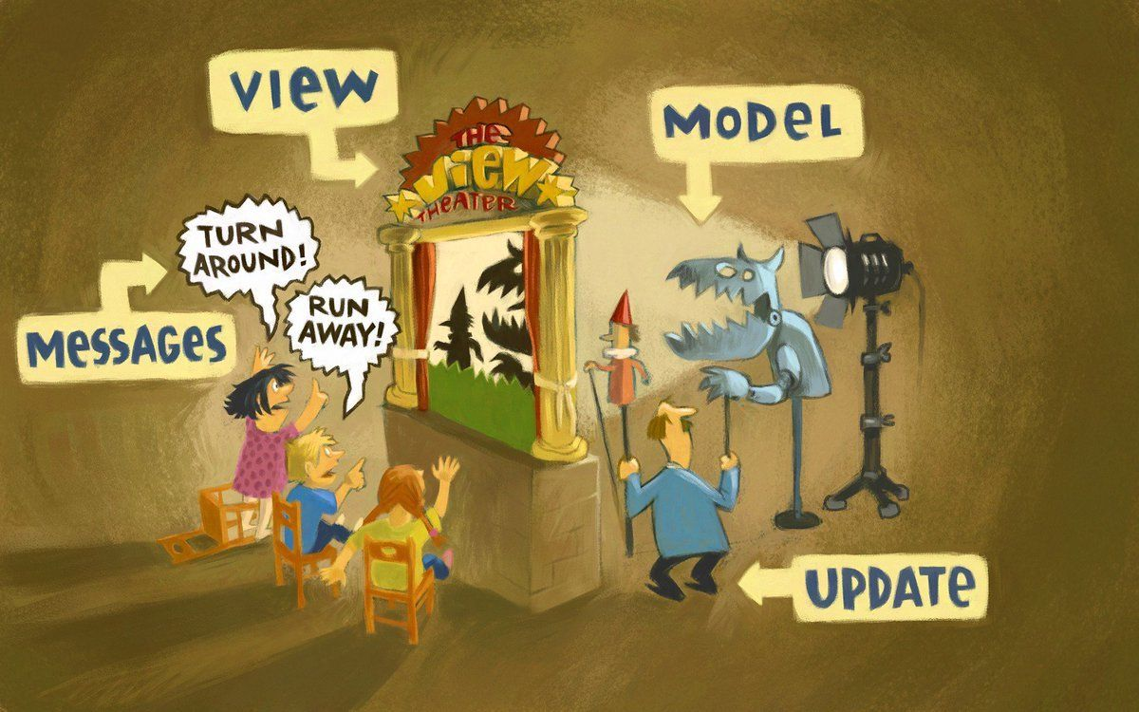
Model-View-Controller

Slide 8
the ELM community
Meetups
  London, Paris, Berlin, Munich, Cologne, Leipzig,
  Frankfurt and Dortmund
elm Europe in Paris
http://www.elmweekly.nl
slack
  #beginners/#general/#jobs
ELMTOWN
  https://elmtown.simplecast.fm

Slide 9

Hello World
https://elm-lang.org/examples/cat-gifs

