Slide 1
Colvio
The free in-browser toolkit for Microsoft Dynamics 365 / Dataverse
Explore · Load · Test · Audit — zero configuration, zero data collection
Product walkthrough · v1.11.154 · August 2026

Slide 2
THE PITCH
Why Colvio?
D365 has always lacked a free, fast, in-browser tool for data exploration and debugging. Colvio rides your existing browser session — open a D365 page, click the icon, work.
0
19
100%
API keys, app registrations,
accounts or subscriptions
modules — from query builder
to adoption analytics to security audit
local — no telemetry, no external
servers, open source (MIT)
Free forever — no freemium, no “Pro” tier.
Colvio · v1.11.154

Slide 3
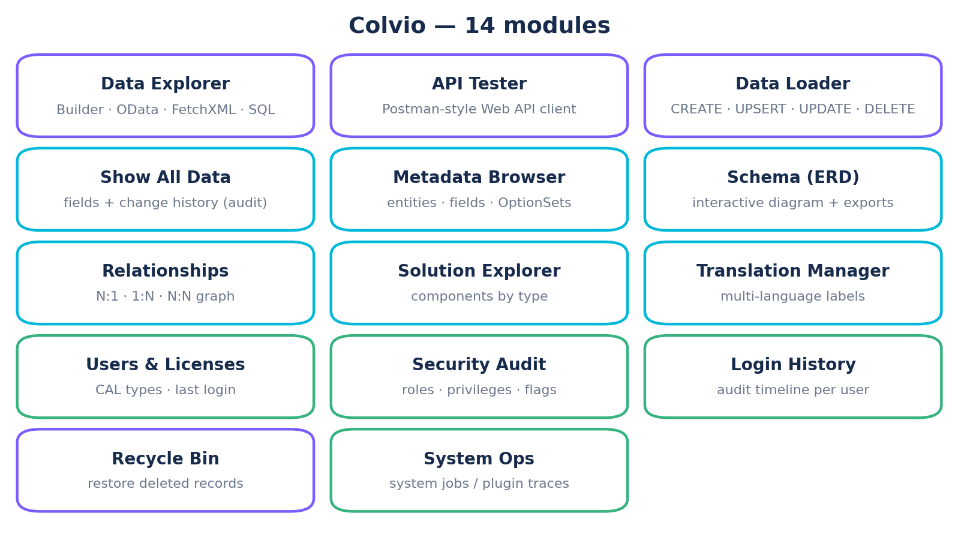
OVERVIEW
One panel, nineteen modules
Colvio · v1.11.154

Slide 4
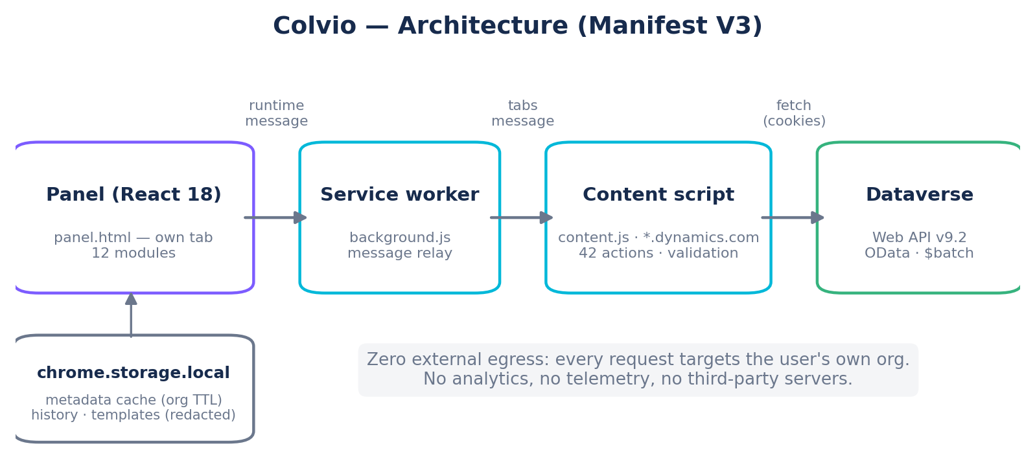
ARCHITECTURE
Zero backend, zero egress
Manifest V3 — React 18 panel, relay-only service worker, one privileged content script
Auth = your session cookies. No token is ever extracted or stored
42 validated actions; every fetch is same-origin to your org
Org-scoped metadata cache (chrome.storage.local)
Colvio · v1.11.154

Slide 5
DATA EXPLORER
Query anything, four ways
Builder
SQL
Visual columns, AND/OR filter groups (14 operators), parent & child $expand with per-expand filters, sort, limit.
SELECT / JOIN / WHERE / GROUP BY / TOP — auto-translated to FetchXML: reliable pagination, link-entity joins.
FetchXML & OData
Results that work
Raw editors with templates and paging-cookie pagination. Copy the OData URL for Postman or a browser.
No 5,000-row cap, 60fps virtual scrolling, inline cell edit (PATCH), bulk update/delete, CSV/XLSX/JSON exports.
Colvio · v1.11.154

Slide 6
API TESTER
A Postman for Dataverse — built in
GET / POST / PATCH / PUT / DELETE on your org — auth rides the active session, zero OAuth setup
Header autocomplete: Prefer, If-Match, MSCRM.* bypass headers
JSON body editor with live validation pointing at the exact error line
Templates: WhoAmI, CREATE, PATCH, UPSERT by alternate key, DELETE
History ×50 with secret headers redacted · Copy as cURL · multiple tabs
Use it for
Testing a call before wiring it into a plugin or Flow.
Reproducing a support ticket payload.
Checking how an MSCRM header changes behavior.
Colvio · v1.11.154

Slide 7
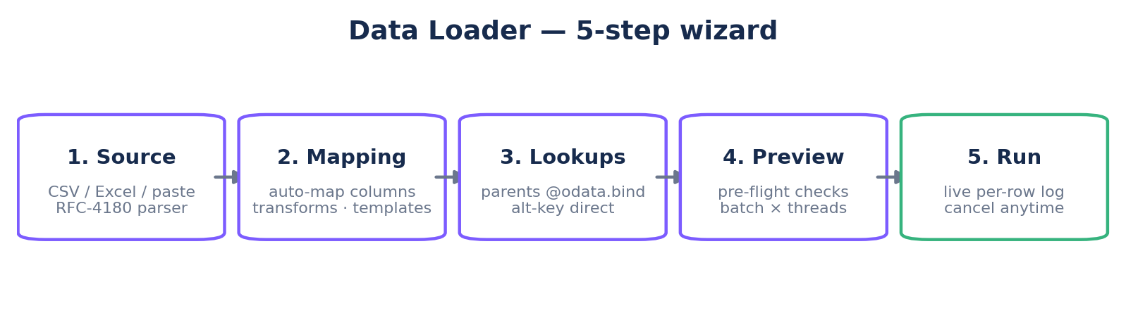
DATA LOADER
Bulk loading, wizard-guided
CSV / TSV / Excel or paste — RFC-4180 parser (quoted cells, embedded commas & line breaks), delimiter auto-detect
Auto-mapping, label→value picklist transforms, locale-aware dates & numbers, mapping templates per entity
Colvio · v1.11.154

Slide 8
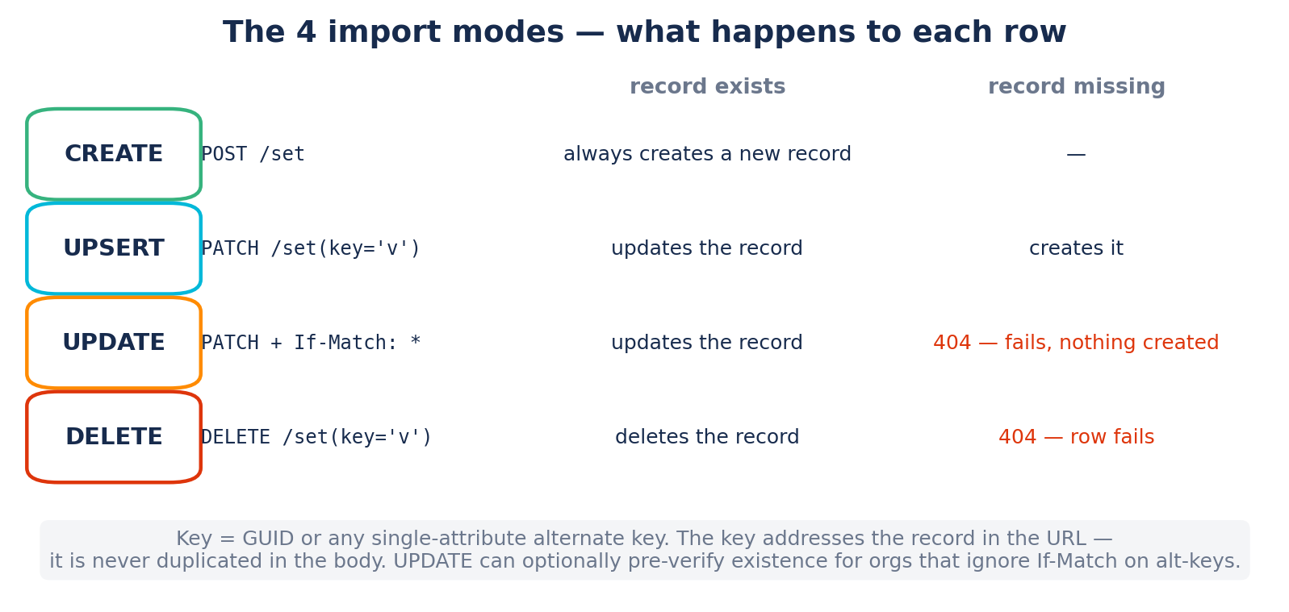
IMPORT MODES
CREATE · UPSERT · UPDATE · DELETE
UPDATE
Never creates:
If-Match: * on every PATCH.
Missing key → 404, row fails.
Empty key → rejected.
Colvio · v1.11.154

Slide 9
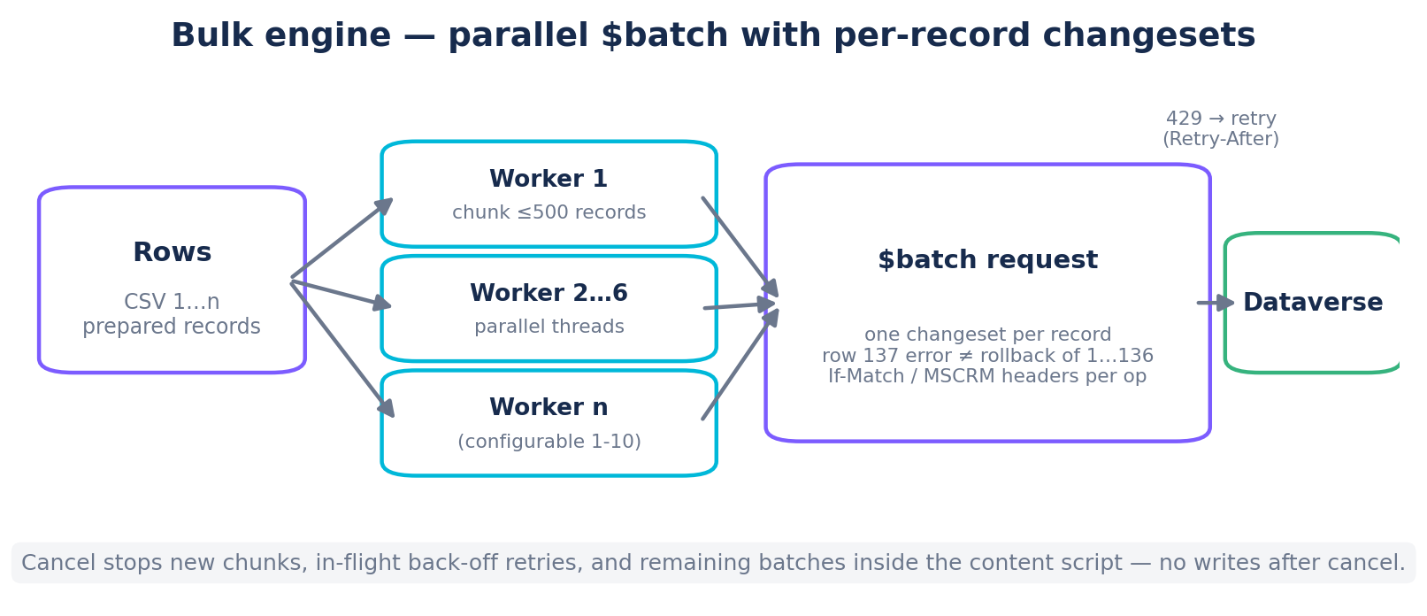
PERFORMANCE
Built for hundreds of thousands of rows
3-4k
records / second
(default 200 × 6 threads)
One changeset per record — a bad row never rolls back its batch
429 throttling retried with Retry-After
Cancel = hard stop, no writes after
Live per-row log + exact request sent
Colvio · v1.11.154

Slide 10
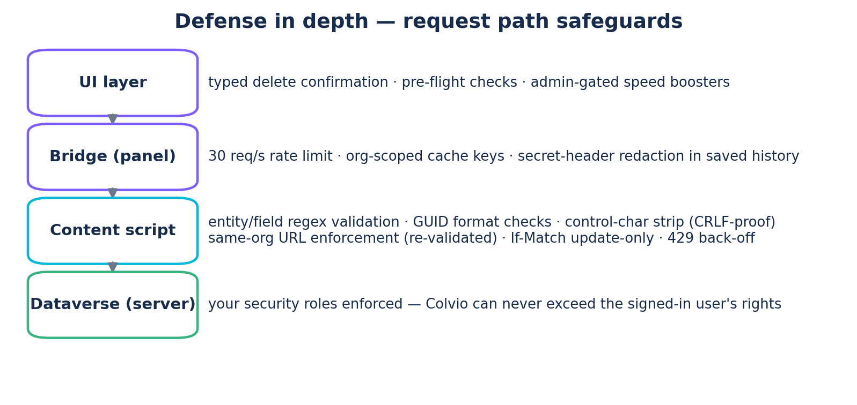
SECURITY & PRIVACY
Audited, defense in depth
Full 4-dimension audit + 7-angle code review: 0 open critical/high findings
Zero egress verified at code level
Secrets redacted in saved history; CSV formula-injection guards
260 automated tests
Colvio · v1.11.154

Slide 11
GOVERNANCE
Insight for admins
Users & Licenses
Security Audit
Login History
Every user with Access Mode, CAL type, BU, roles and last login (from audit).
Spot unused licenses: disabled users, never-logged-in accounts.
Full CSV export.
All roles with readable privilege labels and depth badges (User / BU / Org).
30+ sensitive privileges flagged automatically.
Org-level grants highlighted in red.
Login/logout timeline per user from the audit log.
Session durations and access-type breakdown.
CSV export for compliance reviews.
Colvio · v1.11.154

Slide 12
Get Colvio
Chrome Web Store
Search “Colvio for Dynamics 365” — installs in one click.
Open source
github.com/zmissoum/colvio — MIT license. Audit it, fork it, contribute.
Free forever. No accounts. Your data never leaves your browser.

