Slide 1
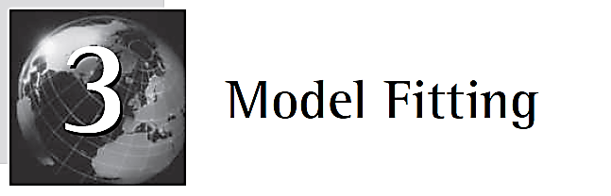

Slide 2

The preceding discussion identifies three possible tasks when we are analyzing a collection of data points:
1. Fitting a selected model type or types to the data.
2. Choosing the most appropriate model from competing types that have been fitted.
3. Making predictions from the collected data.

Slide 3
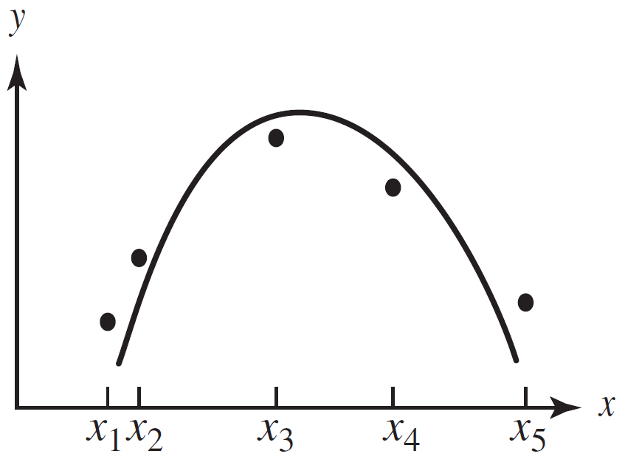
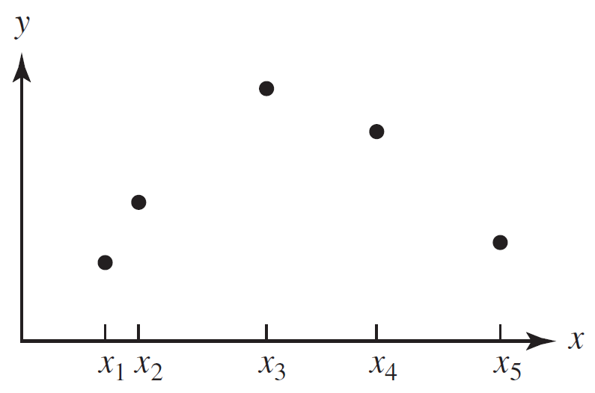
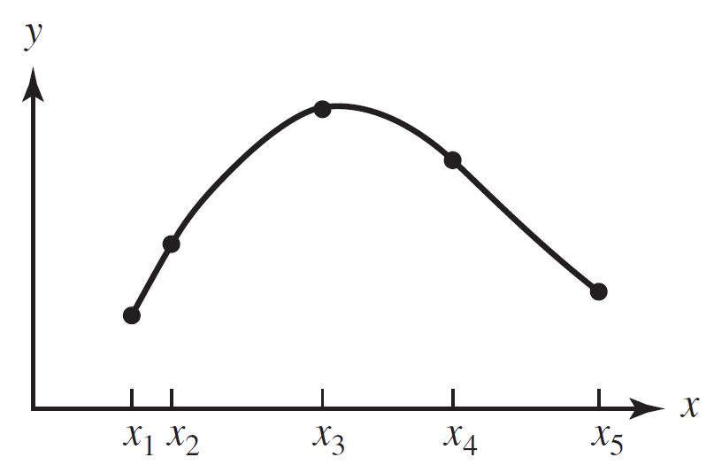
Relationship Between Model Fitting and Interpolation
Fig 3.1 Observations
Fig 3.2 Interpolation
Fig 3.3 Curve fitting
Note the difference in the modeler's attitude in each of these situations. In the two model-fitting tasks a relationship of a particular type is strongly suspected, and the modeler is willing to accept some deviation between the model and the collected data points to have a model that satisfactorily explains the situation under investigation. In fact, the modeler expects errors to be present in both the model and the data. On the other hand, when interpolating, the modeler is strongly guided by the data that have been carefully collected and analyzed, and a curve is sought that captures the trend of the data to predict in between the data points. Thus, the modeler generally attaches little explicative significance to the interpolating curves.
Notes:
注意建模者在这些情况下的态度差异。在两个模型拟合任务中，一个特定类型的关系被强烈怀疑，建模者愿意接受模型和收集的数据点之间的一些偏差，从而得到一个能够令人满意地解释所调查情况的模型。实际上，建模者希望模型和数据中都存在错误。另一方面，在插值时，建模者受到仔细收集和分析的数据的强烈指导，并寻求一条曲线来捕获数据的趋势，以便在数据点之间进行预测。因此，建模者通常对插值曲线没有什么解释性意义。

Slide 4
Sources of Error in the Modeling Process
Before discussing criteria on which to base curve-fitting and interpolation decisions, we need to examine the modeling process to ascertain where errors can arise. If error considerations are neglected, undue confidence may be placed in intermediate results, causing faulty decisions in subsequent steps. Our goal is to ensure that all parts of the modeling process are computationally compatible and to consider the effects of cumulative errors likely to exist from previous steps.
1. Formulation error
2. Truncation error
3. Round-off error
4. Measurement error
Notes:
在讨论曲线拟合和插值决策的基础标准之前，我们需要检查建模过程，以确定哪里会出现错误。如果忽略了错误考虑因素，可能会在中间结果中放置不适当的信心，从而导致后续步骤中的错误决策。我们的目标是确保建模过程的所有部分都在计算上兼容，并考虑前面步骤中可能存在的累积错误的影响。
1.方法误差
2. 截断误差
3. 舍入误差
4. 测量误差

Slide 5
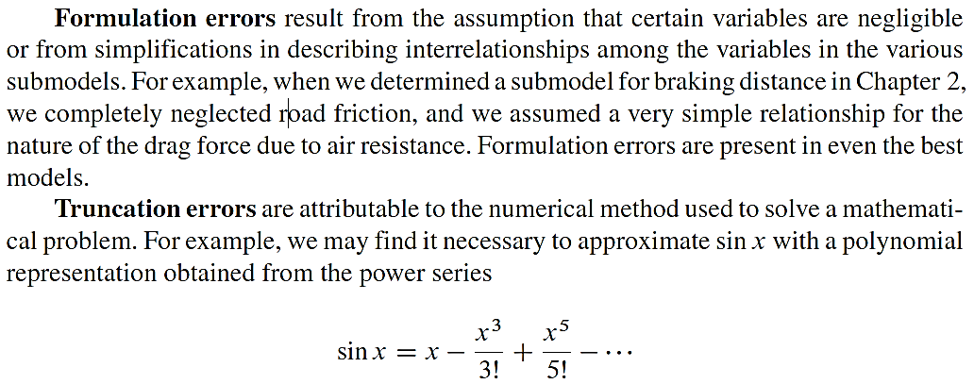

Slide 6
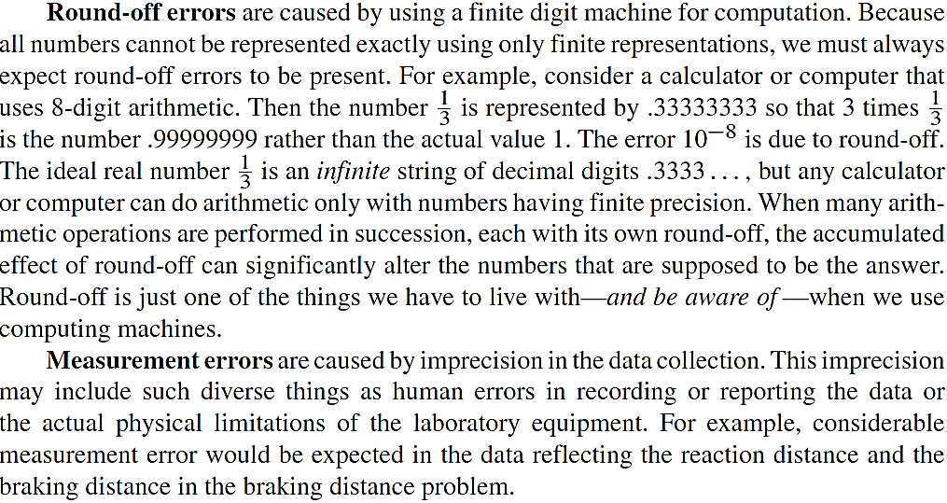

Slide 7
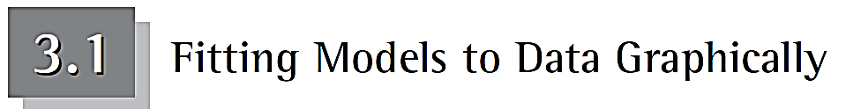
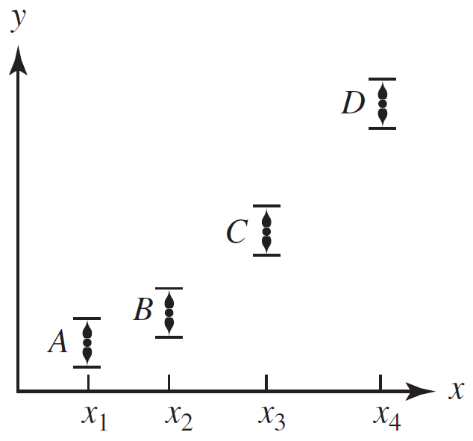
Assume the modeler has made certain assumptions leading to a model of a particular type. The model generally contains one or more parameters, and sufficient data must be gathered to determine them. Let's consider the problem of data collection.
How many data points to collect ?
The spacing of the data points within that interval is important ！
The accuracy of the data before attempting to fit the model.
Figure 3.4 Each data point is thought of as an interval of confidence.
Notes:
假设建模者做出了某些假设，从而得出特定类型的模型。模型通常包含一个或多个参数，必须收集足够的数据来确定这些参数。让我们考虑一下数据收集的问题。

Slide 8
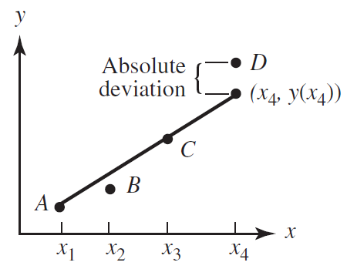
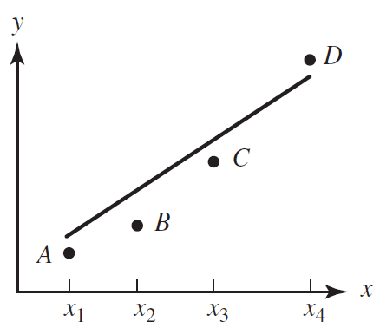
Visual Model Fitting with the Original Data
Figure 3.5 Minimizing the sum of the absolute deviations from the fitted line
Figure 3.6 Minimizing the largest absolute deviation from the fitted line
A visual inspection of the model fitted graphically to the data immediately gives an impression of how good the fit is and where it appears to fit well. Unfortunately, these important considerations are often overlooked in problems with large amounts of data analytically fitted via computer codes.

Slide 9
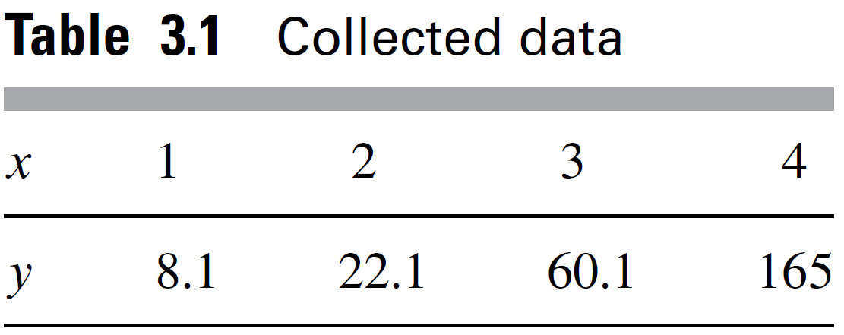
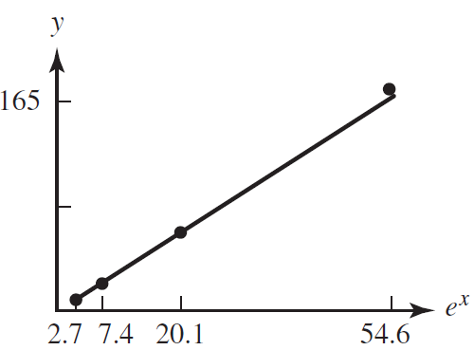
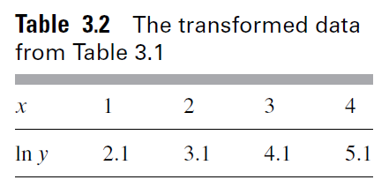
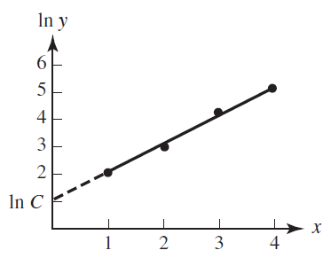
Transforming the Data
Suppose, for example, that a relationship of the form is suspected for some sub model and the data shown in Table 3.1 have been collected.
Most of us are limited visually to fitting only lines.
Figure 3.7 Plot of y versus e^{x} for the
data given in Table 3.1

Slide 10
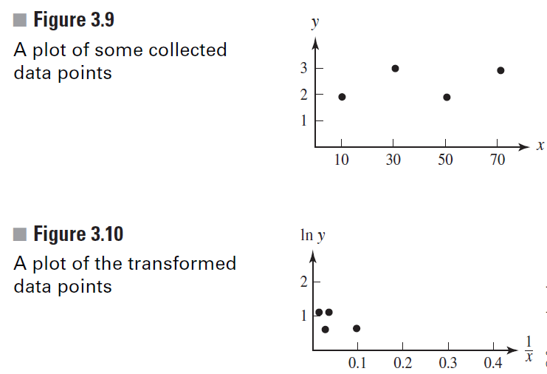
If a modeler is not careful when using transformations, he or she can be tricked into selecting a relatively poor model.

Slide 11

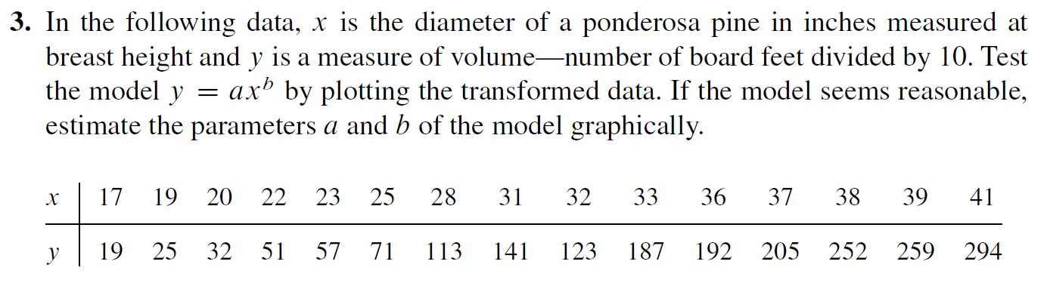

Slide 12
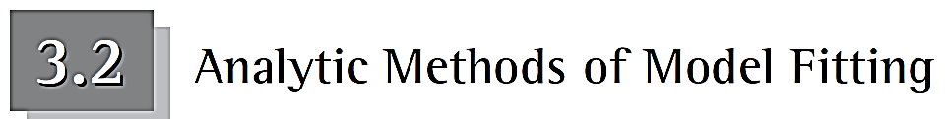
In this section we investigate several criteria for fitting curves to a collection of data points. Each criterion suggests a method for selecting the best curve from a given family so that according to the criterion, the curve most accurately represents the data. We also discuss how the various criteria are related.
Chebyshev Approximation Criterion
Minimizing the Sum of the Absolute Deviations
Least-Squares Criterion

Slide 13
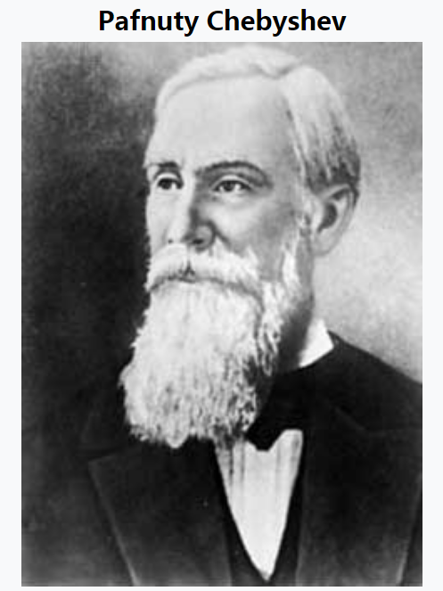
Chebyshev Approximation Criterion
Given a collection of m data points
fit the collection to the line
determined by the parameters a and b, that minimizes the distance between any data point
and its corresponding data point on the
Notes:
Born 16 May 1821
Akatovo, Kaluga Governorate, Russian Empire
Died 8 December 1894 (aged 73)
St. Petersburg, Russian Empire
Nationality Russian
Other names Chebysheff, Chebyshov, Tschebyscheff, Tschebycheff
Alma mater Moscow University
Known for Work on probability, statistics, mechanics, analytical geometry and number theory
Awards Demidov Prize (1849)
Scientific career
Fields Mathematician
Institutions St. Petersburg University
Academic advisors Nikolai Brashman
Notable students Dmitry Grave
Aleksandr Korkin
Aleksandr Lyapunov
Andrey Markov
Vladimir Andreevich Markov
Konstantin Posse

Slide 14
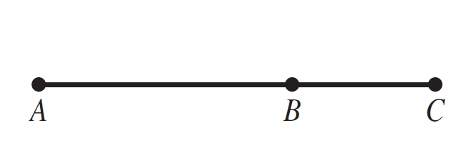
Now let's generalize this criterion. Given some function type
that minimizes the number
(3.1)
This important criterion is often called the Chebyshev approximation criterion.
For example, suppose you want to measure the line segments AB, BC, and AC represented in Figure 3.12.
Figure 3.12 The line segment AC is
divided into two segments AB and BC.
Assume your measurements yield the estimates AB = 13, BC = 7,
and AC = 19. As you should expect in any physical measuring process, discrepancy results.

Slide 15
In this situation, the values of AB and BC add up to 20 rather than the estimated AC = 19. Let's resolve the discrepancy of 1 unit using the Chebyshev criterion. That is, we will assign values to the three line segments in such away that the largest absolute deviation between any corresponding pair of assigned and observed values is minimized. Assume the same degree of confidence in each measurement so that each measurement has equal weight. In that case, the discrepancy should be distributed equally across each segment, resulting in the predictions
Notes:
在这种情况下，ab和bc的值加起来是20，而不是估计的ac=19。让我们用切比雪夫准则来解决1个单元的差异。也就是说，我们将把值赋给三个直线段，使任何对应的赋值和观测值对之间的最大绝对偏差最小化。假设每个测量的置信度相同，以便每个测量的权重相等。在这种情况下，差异应平均分布在每个路段上，从而得出预测结果。

Slide 16
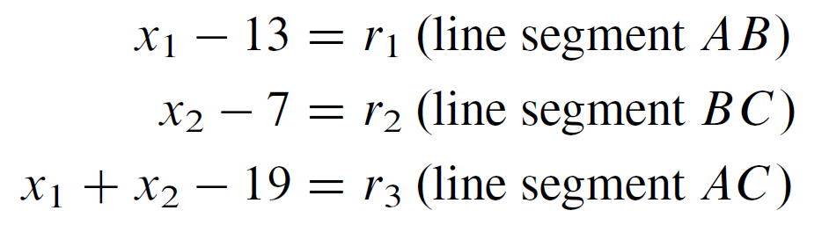
Let x₁ represent the true value of the length of the segment AB and x₂ the true value for BC. For ease of our presentation, let r₁, r₂, and r₃ represent the discrepancies between the true and measured values as follows:
The numbers r₁, r₂, and r₃ are called residuals. Note that residuals can be positive or negative, whereas absolute deviations are always positive.
If the Chebyshev approximation criterion is applied, values are assigned to x₁ and x₂ in such a way as to minimize the largest of the three numbers |r₁|, |r₂ |, and | r₃ | . If we call that largest number r, then we want to Minimize r.

Slide 17
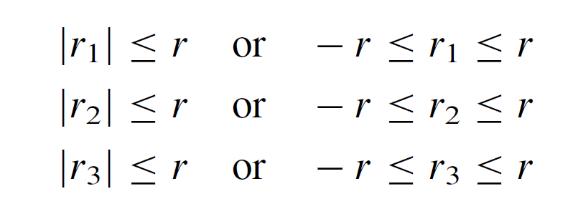
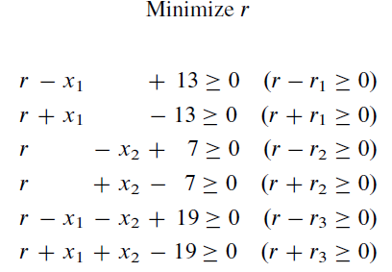
Minimize r
subject to the three conditions:
To summarized
subject to:
This problem is called a linear program

Slide 18
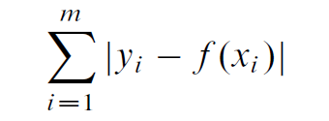
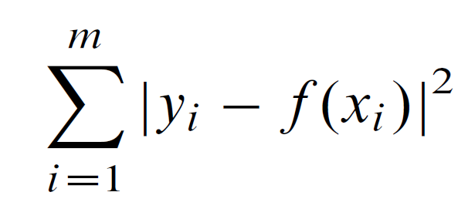
Minimizing the Sum of the Absolute Deviations
Minimize
(3.2)
Least-Squares Criterion
Minimize
(3.3)
The geometric interpretations of the three curve-fitting criteria help in providing a qualitative description comparing the criteria. Minimizing the sum of the absolute deviations tends to treat each data point with equal weight and to average the deviations. The Chebyshev criterion gives more weight to a single point potentially having a large deviation. The least-squares criterion is somewhere in between as far as weighting individual points with significant deviations is concerned.
Notes:
三条曲线拟合标准的几何解释有助于提供比较标准的定性描述。最大限度地减少绝对偏差之和往往会以相等的权重处理每个数据点，并平均偏差。切比雪夫准则对可能存在较大偏差的单点给予了更大的权重。对于具有显著偏差的单个点的加权，最小二乘准则介于两者之间。

Slide 19

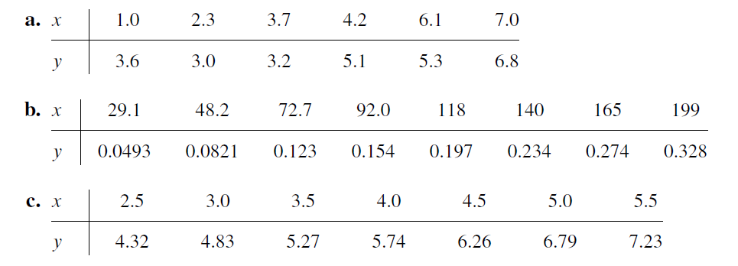
2. For each of the following data sets, formulate the mathematical model that minimizes the largest deviation between the data and the line y = ax + b. If a computer is available, solve for the estimates of a and b.

Slide 20
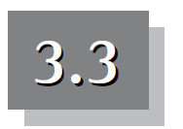
Applying the Least-Squares Criterion
Suppose that our assumptions lead us to expect a model of a certain type and that data have been collected and analyzed. In this section the least-squares criterion is applied to estimate the parameters for several types of curves.
Fitting a Straight Line
Fitting a Power Curve
Transformed Least-Squares Fit

Slide 21
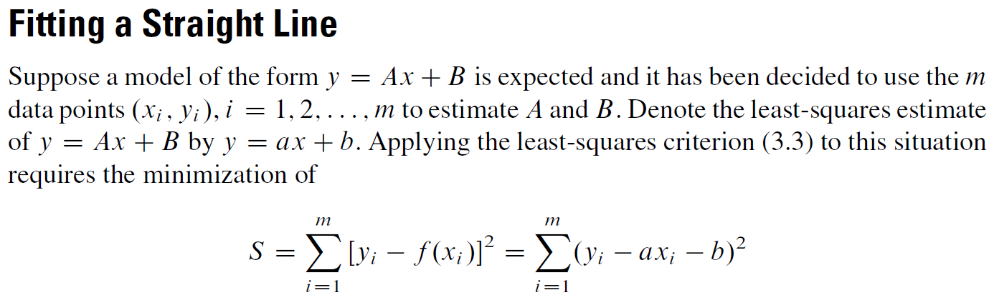
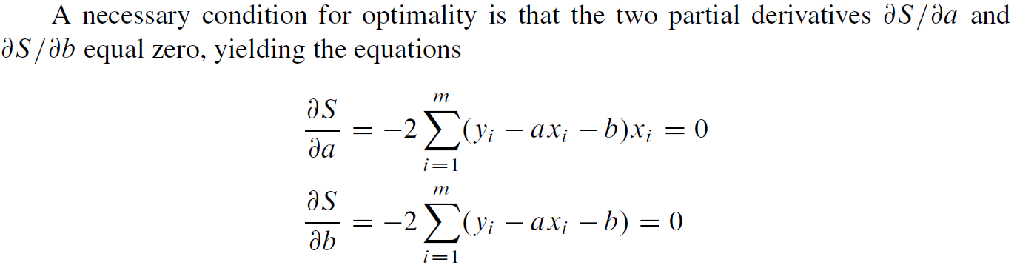

Slide 22
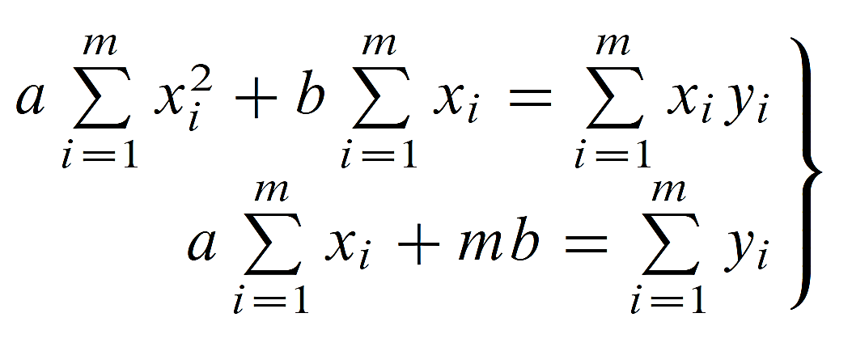
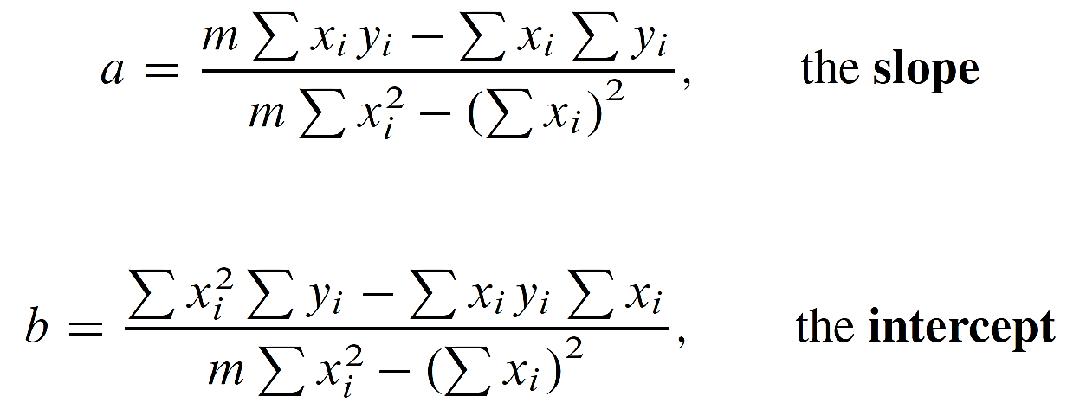
These equations can be rewritten to give
normal equations.
(3.4)
The preceding equations can be solved for a and b once all the values for x_{i} and y_{i} are substituted into them. The solutions (see Problem 1 at the end of this section) for the parameters a and b are easily obtained by elimination and are found to be
(3.5)
(3.6)

Slide 23
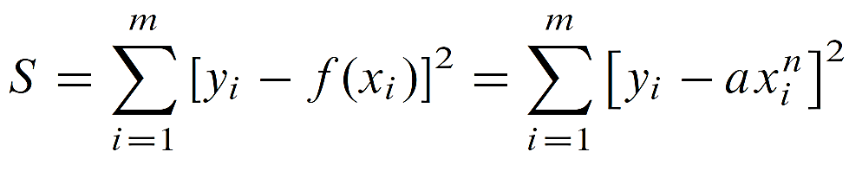
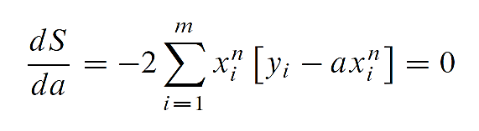
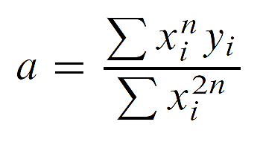
Fitting a Power Curve
Now let's use the least-squares criterion to fit a curve of the form y = Ax^{n}, where n is fixed, to a given collection of data points. Call the least-squares estimate of the model
f (x) = ax^{n}.
Application of the criterion then requires minimization of
A necessary condition for optimality is that the derivative ds/da equal zero, giving the equation
(3.7)

Slide 24
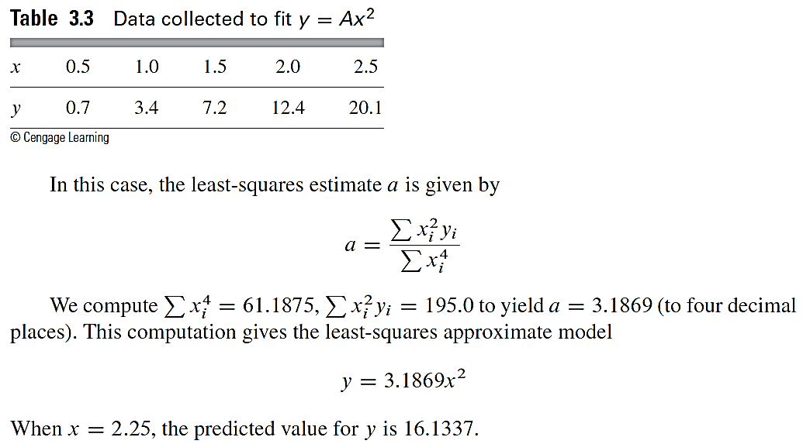
A Power Curve Fitting Example

Slide 25
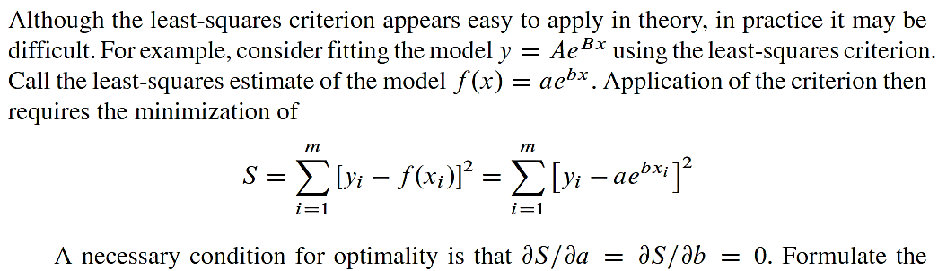
Transformed Least-Squares Fit
conditions and convince yourself that solving the resulting system of nonlinear equations would not be easy. For this reason, we use transformations that allow us to approximate the least-squares model.

Slide 26

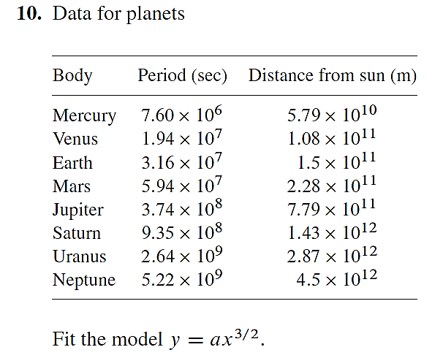

Slide 27
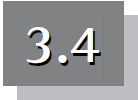
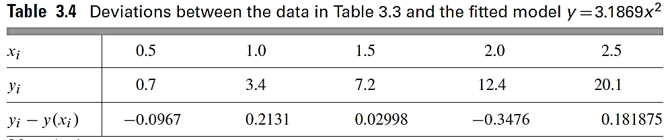
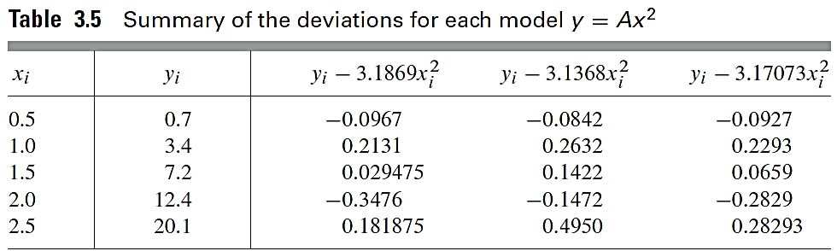
Choosing a Best Model

Slide 28
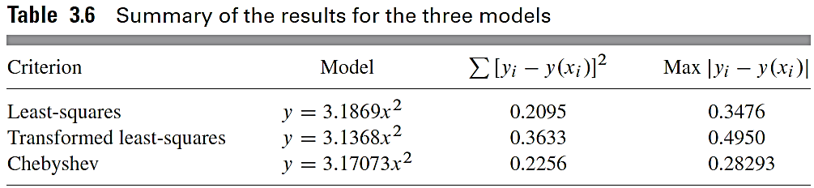
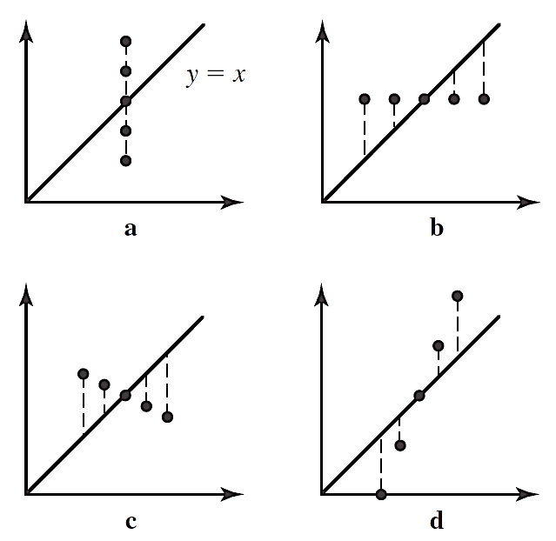
Figure 3.15 In all of these graphs, the model
y = x
has the same sum of squared deviations.

Slide 29
So we need to answer the question of which model is best on a case-by-case basis, taking into account such things as the purpose of the model, the precision demanded by the scenario, the accuracy of the data, and the range of values for the independent variable over which the model will be used.
Notes:
因此，我们需要根据具体情况来回答哪一个模型最好的问题，考虑到模型的目的、方案要求的精度、数据的准确性以及模型将要使用的自变量的值的范围等因素。

