Slide 1
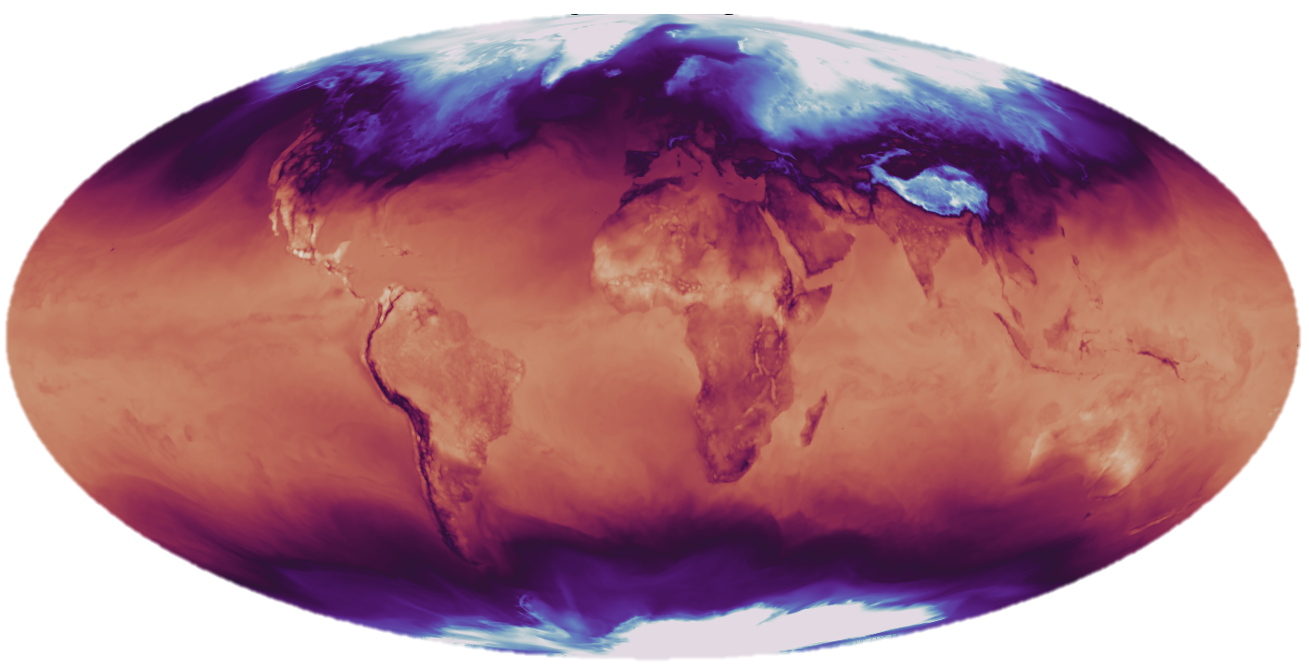
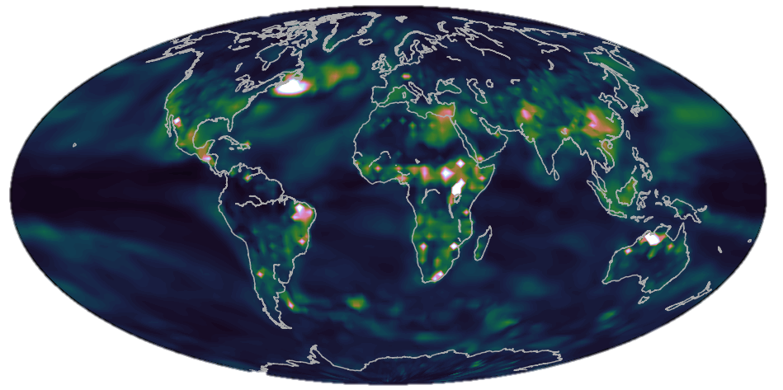
Surface Temperature Map
INPUT LAYER
HIDDEN LAYERS
OUTPUT LAYER
DECADE CLASS
“1920-1929”
“2000-2009”
“2070-2079”
Layer-wise Relevance Propagation
BACK-PROPAGATE THROUGH NETWORK = EXPLAINABLE AI

