Slide 1



Welcome!
Thank you for coming
Apologies to the skiers…
Why we will be strict about timing
Why we want the workshop to be interactive
NIPS 2007 Workshop
Hierarchical organization of behavior

Slide 2
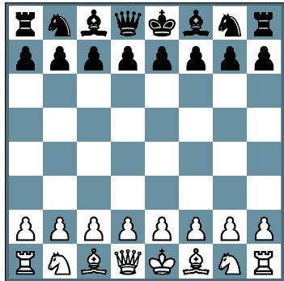


RL: Decision making
Goal: maximize reward (minimize punishment)
Rewards/punishments may be delayed
Outcomes may depend on sequence of actions
⇒ Credit assignment problem

Slide 3


RL in a nutshell: formalization
4
0
2
2
S₂
S₃
Components of an RL task
L
S₁
R
Policy: p(S,a)
State values: V(S)
State-action values: Q(S,a)
states - actions - transitions - rewards - policy - long term values

Slide 4
RL in a nutshell: forward search
4
0
2
2
S₂
S₃
L
S₁
R
Model based RL
L
= 4
learn model through experience
(cognitive map)
choosing actions is hard
goal directed behavior; cortical
S₂
= 0
L
R
S₁
L
R
S₃
= 2
R
= 2
Model = T(ransitions) and R(ewards)

Slide 5
RL in a nutshell: cached values
4
0
2
2
S₂
S₃
L
S₁
R
Model-free RL
Trick #1: Long-term values are recursive
Q(S,a) = r(S,a) + V(S_{next})
TD learning:
start with initial (wrong) Q(S,a)
Q(S,a) = r(S,a) + max Q(S’,a’)
PE = r(S,a) + max Q(S’,a’) - Q(S,a)
Q(S,a)_{new} = Q(S,a)_{old} + αPE
temporal difference learning

Slide 6
RL in a nutshell: cached values
4
0
2
2
S₂
S₃
L
S₁
R
Model-free RL
Trick #2: Can learn values without a model
Q(S₁,L)
4
Q(S₁,R)
2
Q(S₃,L)
2
4
Q(S₃,R)
2
Q(S₂,L)
choosing actions is easy
(but need lots of practice to learn)
habitual behavior; basal ganglia
Q(S₂,R)
0
temporal difference learning

Slide 7
RL in real world tasks…
4
0
2
2
S₂
S₃
L
S₁
R
Scaling problem!
Q(S₁,L)
4
L
= 4
Q(S₁,R)
2
2
L
S₂
= 0
Q(S₃,L)
R
2
S₁
L
Q(S₂,L)
4
Q(S₃,R)
R
= 2
S₃
Q(S₂,R)
0
R
= 2
model based vs. model free learning and control

Slide 8
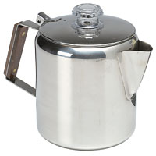


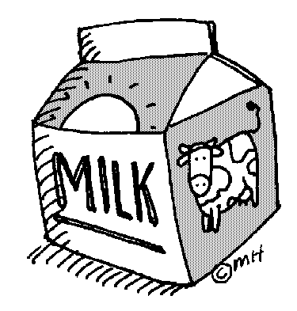

Real-world behavior is hierarchical
1. pour coffee
2. add sugar
3. add milk
Hierarchical RL: What is it?
add hot
4. stir
too cold
add cold
1. set water temp
too hot
wait 5sec
change
2. get wet
just right
success
3. shampoo
4. soap
5. turn off water
6. dry off
simplified control, disambiguation, encapsulation

Slide 9
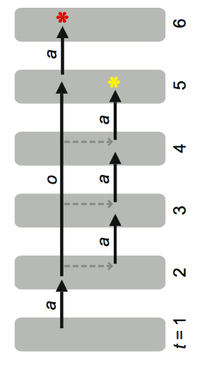
HRL: (in)formal framework
Option: set water temperature
S₁
0.8
S₁ (0.1)
S₂
S₁
0.1
S₂ (0.1)
0.1
0
S₈
S₃
1
S₃ (0.9)
Hierarchical RL: What is it?
0.1
0
…
S₂
0.1
…
0.8
initiation set
termination conditions
policy
Termination condition = (sub)goal state
Option policy learning: via pseudo reward
(model based or model free)
options - skills - macros - temporally abstract actions
(Sutton, McGovern, Dietterich, Barto, Precup, Singh, Parr…)

Slide 10
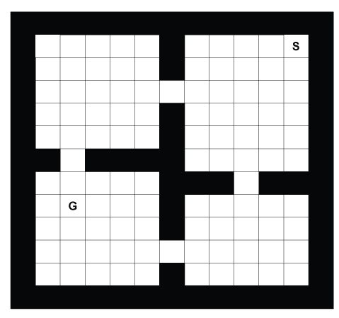
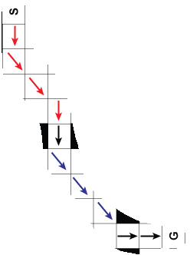
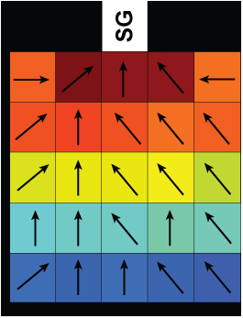

HRL: a toy example
Hierarchical RL: What is it?
S: start G: goal
Options: going to doors
Actions: + 2 door options

Slide 11
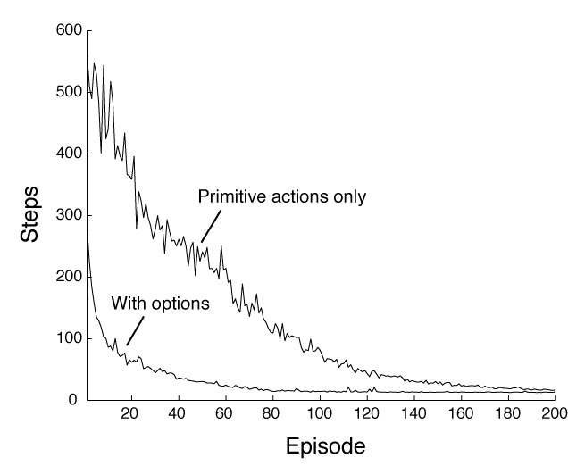
Advantages of HRL
1. Faster learning
(mitigates scaling problem)
2. Transfer of knowledge from previous tasks
(generalization, shaping)
Hierarchical RL: What is it?
RL: no longer ‘tabula rasa’

Slide 12
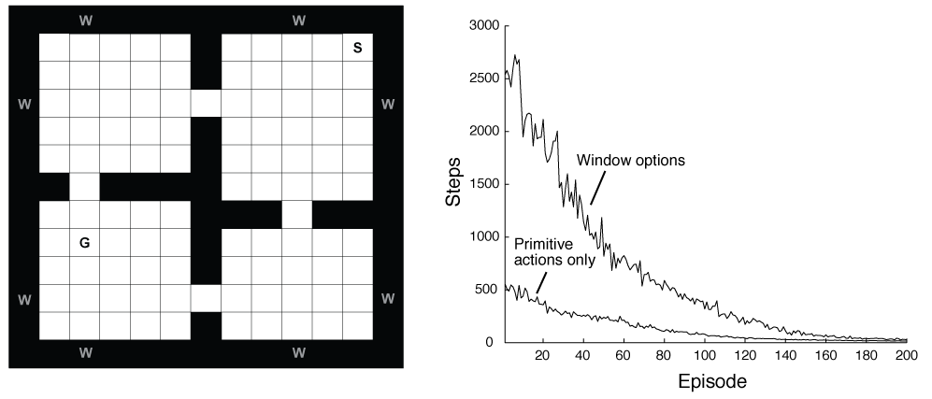
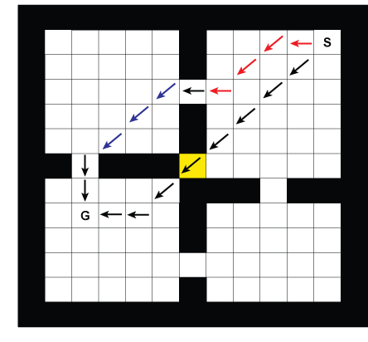
Disadvantages (or: the cost) of HRL
Need ‘right’ options - how to learn them?
Suboptimal behavior (“negative transfer”; habits)
More complex learning/control structure
Hierarchical RL: What is it?
no free lunches…

