Slide 1
Introduction to Hierarchical Reinforcement Learning
Jervis Pinto
Slides adapted from Ron Parr (From ICML 2005 Rich Representations for
Reinforcement Learning Workshop )
and Tom Dietterich (From ICML99).

Slide 2
Contents
Purpose of HRL
Design issues
Defining sub-components (sub-task, options, macros)
Learning problems and algorithms
MAXQ
ALISP (briefly)
Problems with HRL
What we will not discuss
Learning sub-tasks, multi-agent setting, etc.

Slide 3
Contents
Purpose of HRL
Defining sub-components (sub-task, options, macros)
Learning problems and algorithms
MAXQ
ALISP (briefly)
Problems with HRL

Slide 4
Purpose of HRL
“Flat” RL works well but on small problems
Want to scale up to complex behaviors
but curses of dimensionality kick in quickly!
Humans don’t think at the granularity of primitive actions

Slide 5
Goals of HRL
Scale-up: Decompose large problems into smaller ones
Transfer: Share/reuse tasks
Key ideas:
Impose constraints on value function or policy (i.e. structure)
Build learning algorithms to exploit constraints

Slide 6
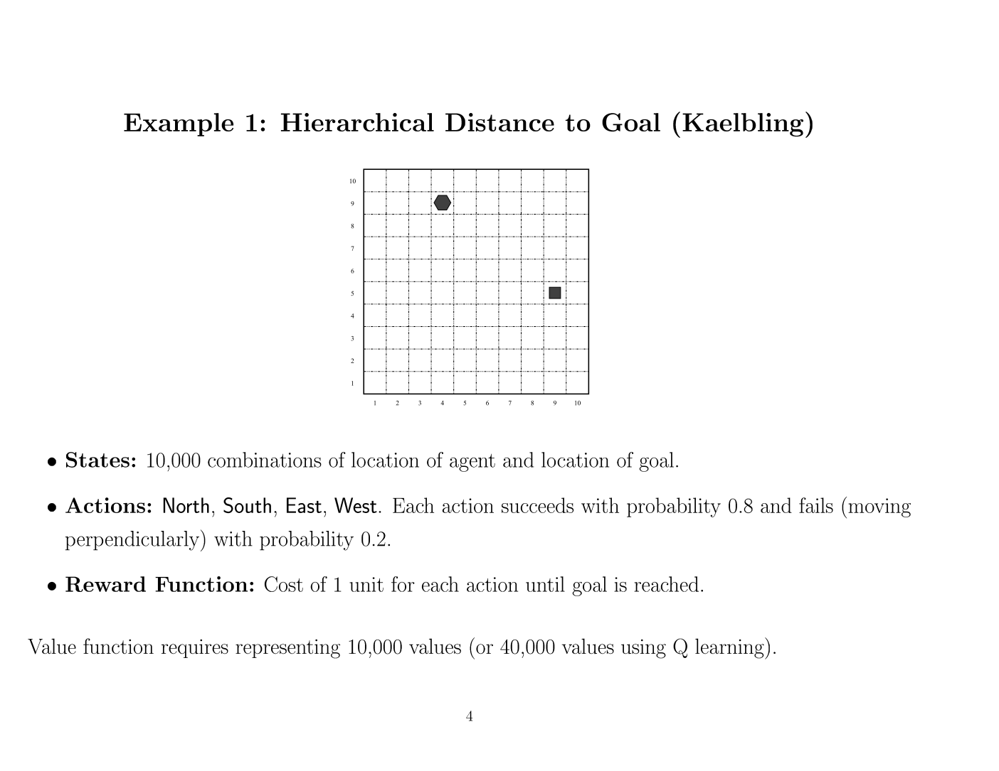

Slide 7
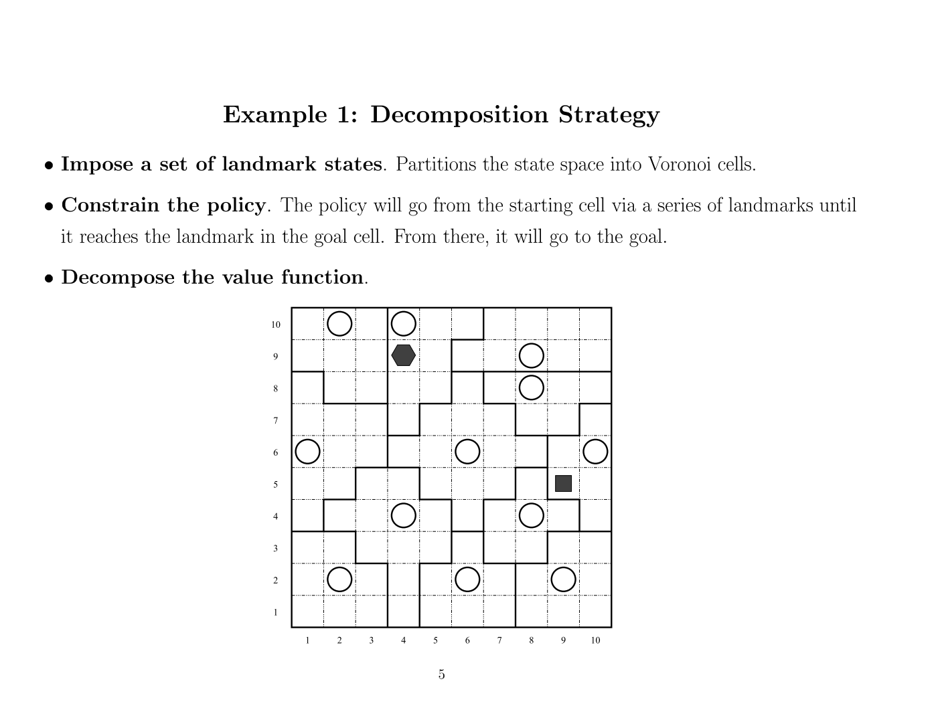

Slide 8
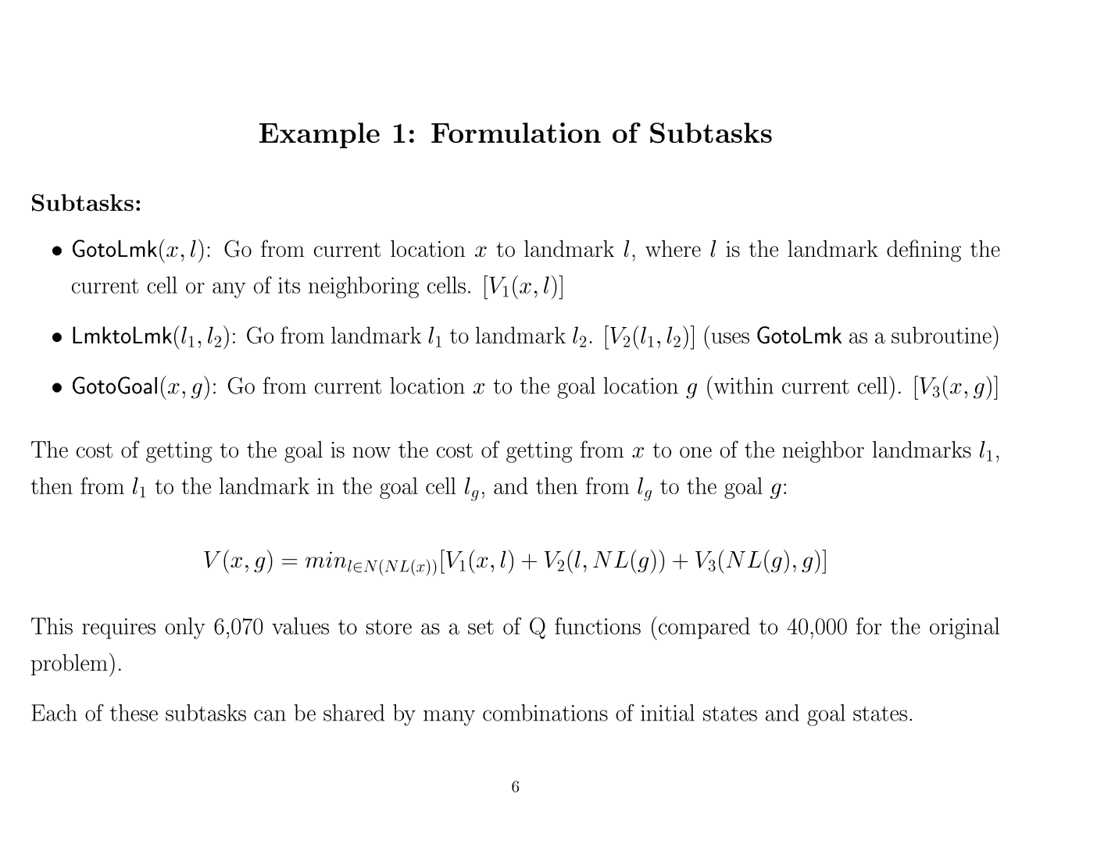

Slide 9
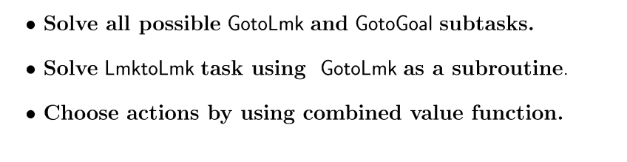
Solution

Slide 10
Contents
Purpose of HRL
Design issues
Defining sub-components (sub-task, options, macros)
Learning problems and algorithms
MAXQ
ALISP (briefly)
Problems with HRL

Slide 11
Design Issues
How to define components?
Options, partial policies, sub-tasks
Learning algorithms?
Overcoming sub-optimality?
State abstraction?

Slide 12
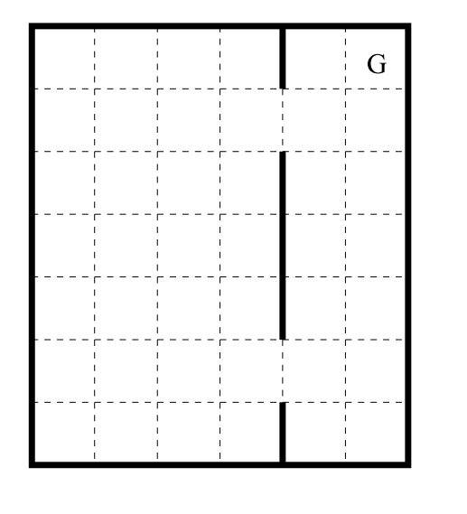
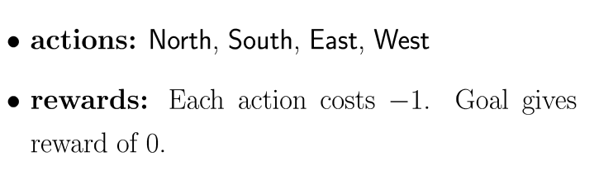
Example problem

Slide 13
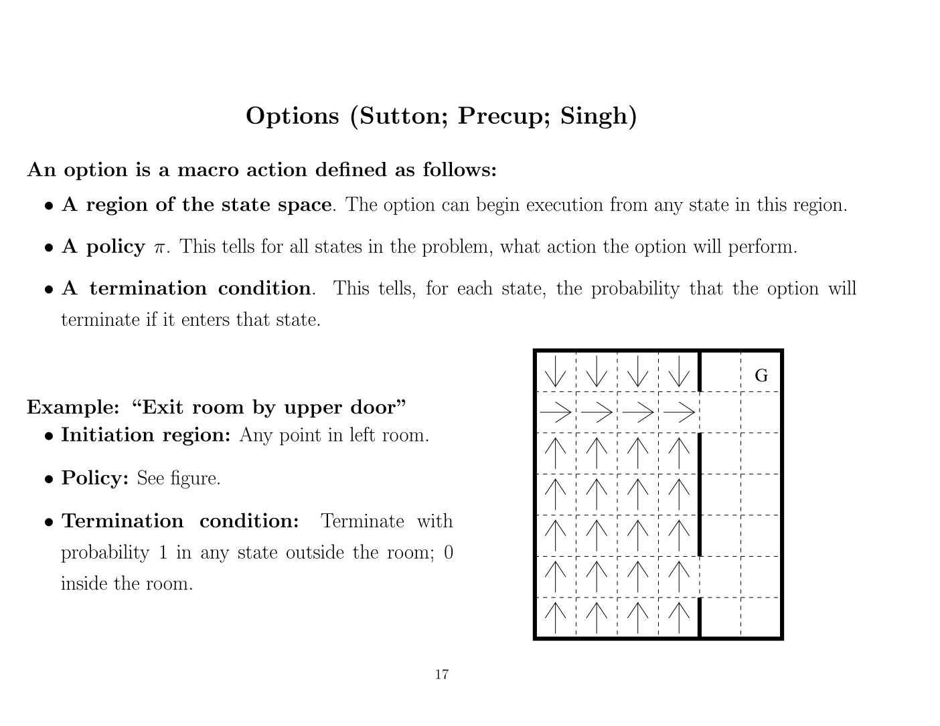

Slide 14
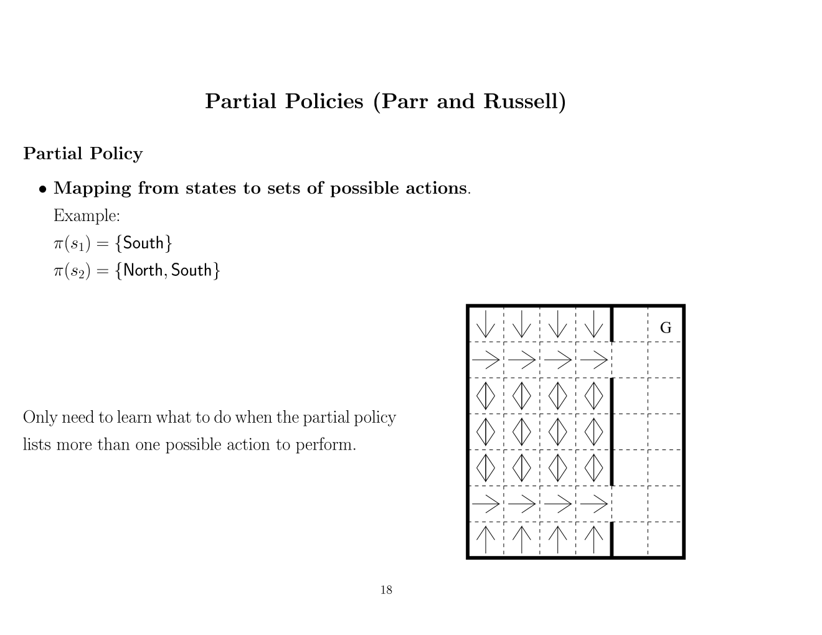

Slide 15
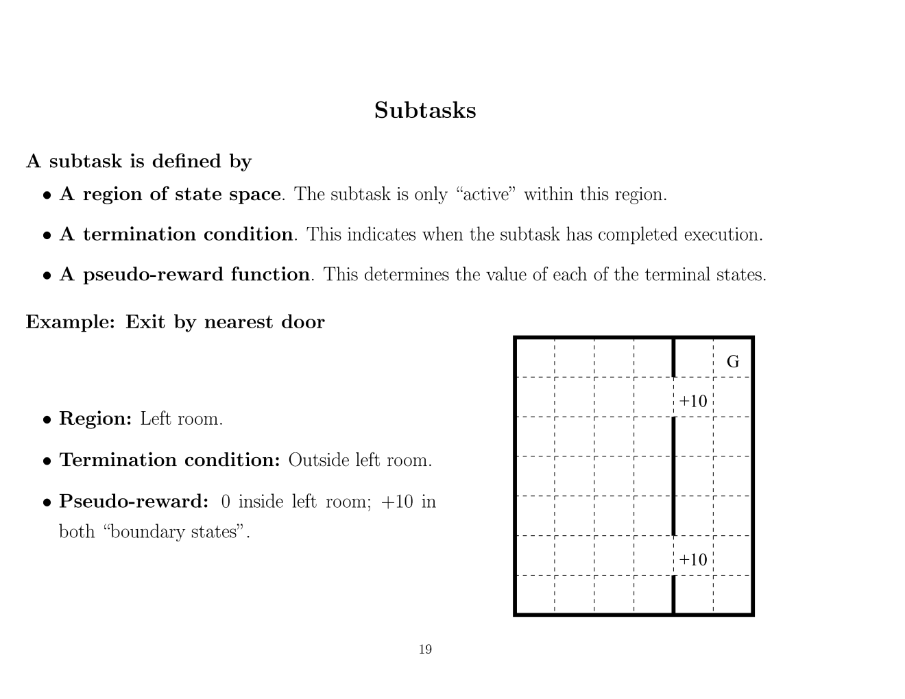

Slide 16
Contents
Purpose of HRL
Design issues
Defining sub-components (sub-task, options, macros)
Learning problems and algorithms
MAXQ in detail
ALISP in detail
Problems with HRL

Slide 17
Learning problems
Given a set of options, learn a policy over those options.
Given a hierarchy of partial policies, learn policy for the entire problem
HAMQ, ALISPQ
Given a set of sub-tasks, learn policies for each sub-task
Given a set of sub-tasks, learn policies for entire problem
MAXQ

Slide 18
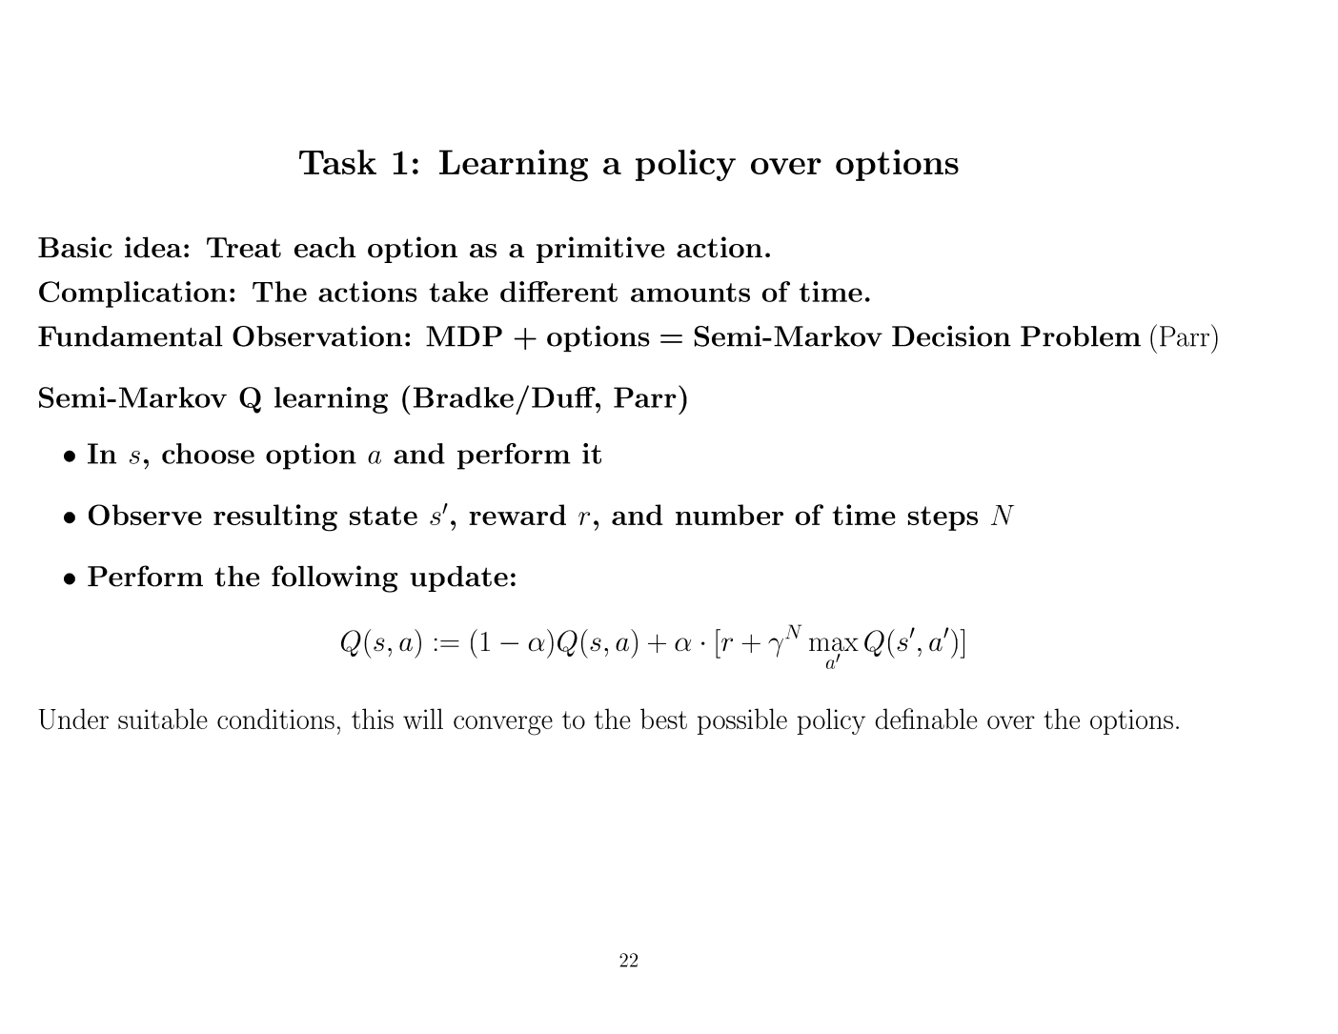

Slide 19
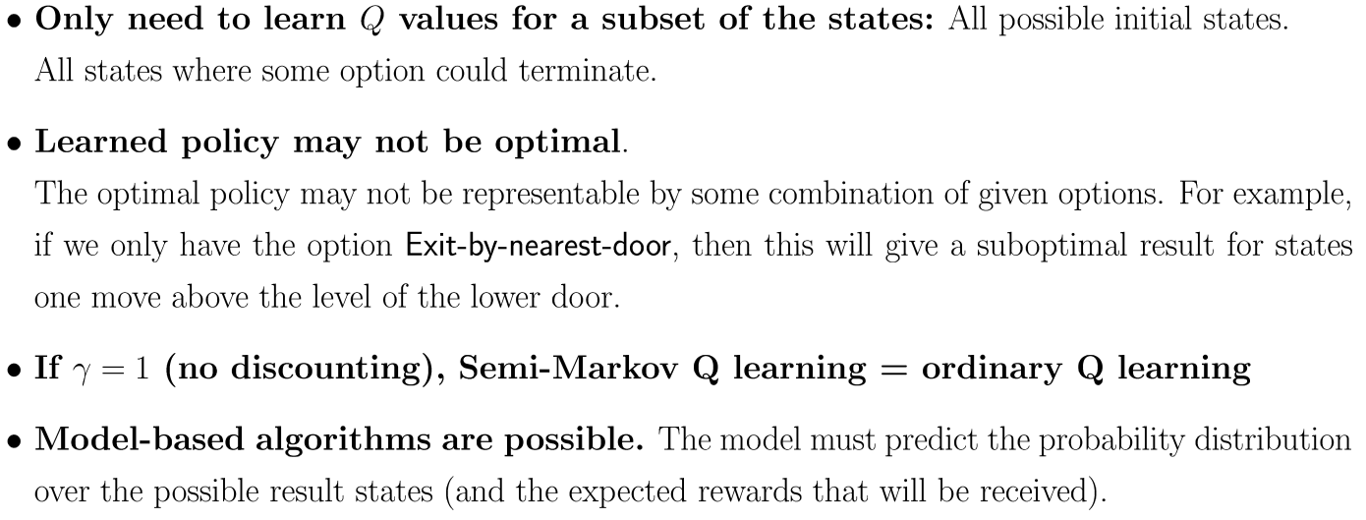
Observations

Slide 20
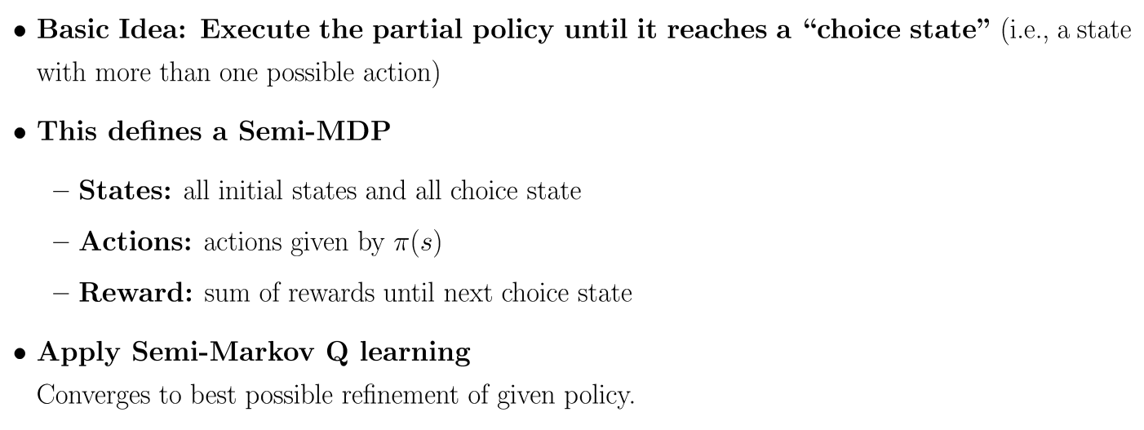
Learning with partial policies

Slide 21
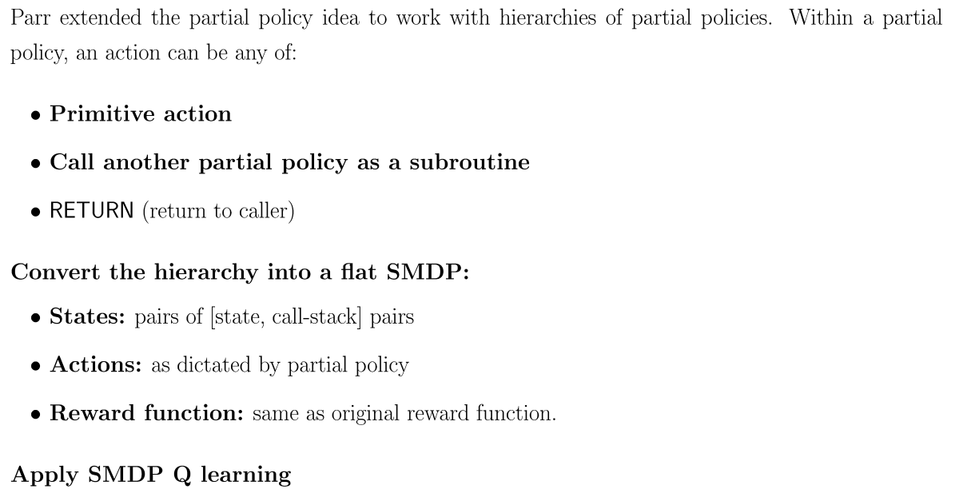
Hierarchies of Abstract Machines (HAM)

Slide 22
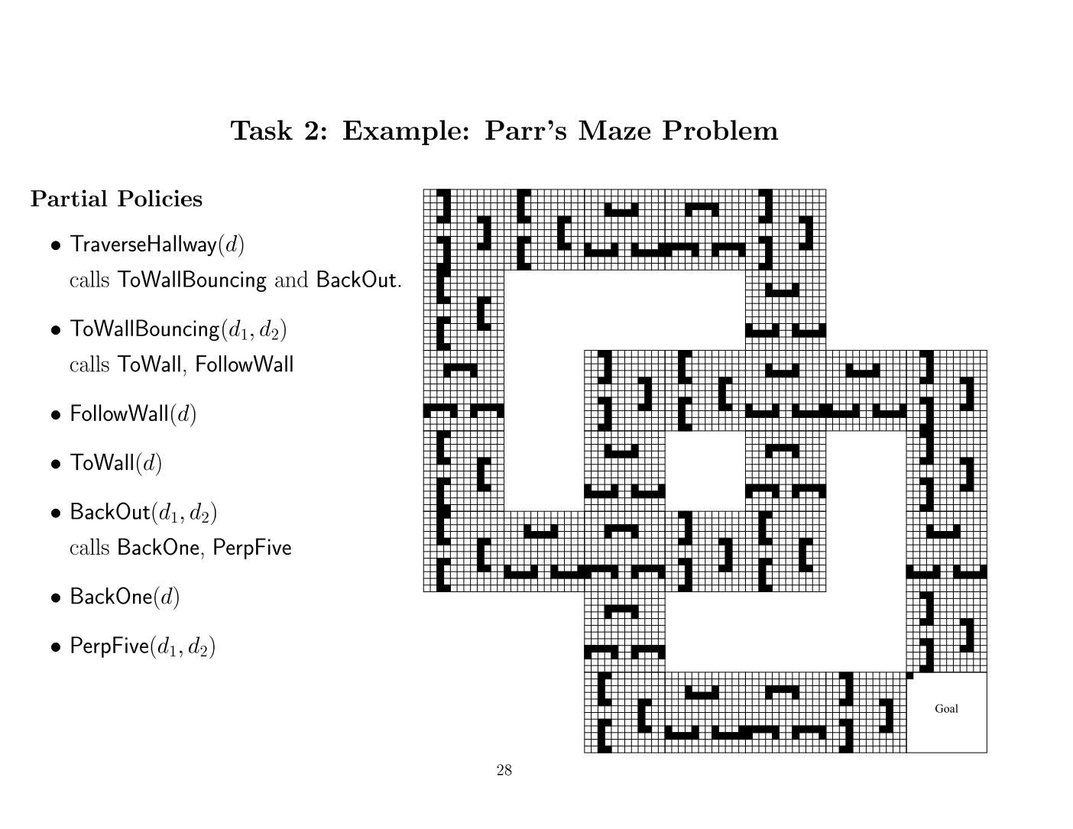

Slide 23
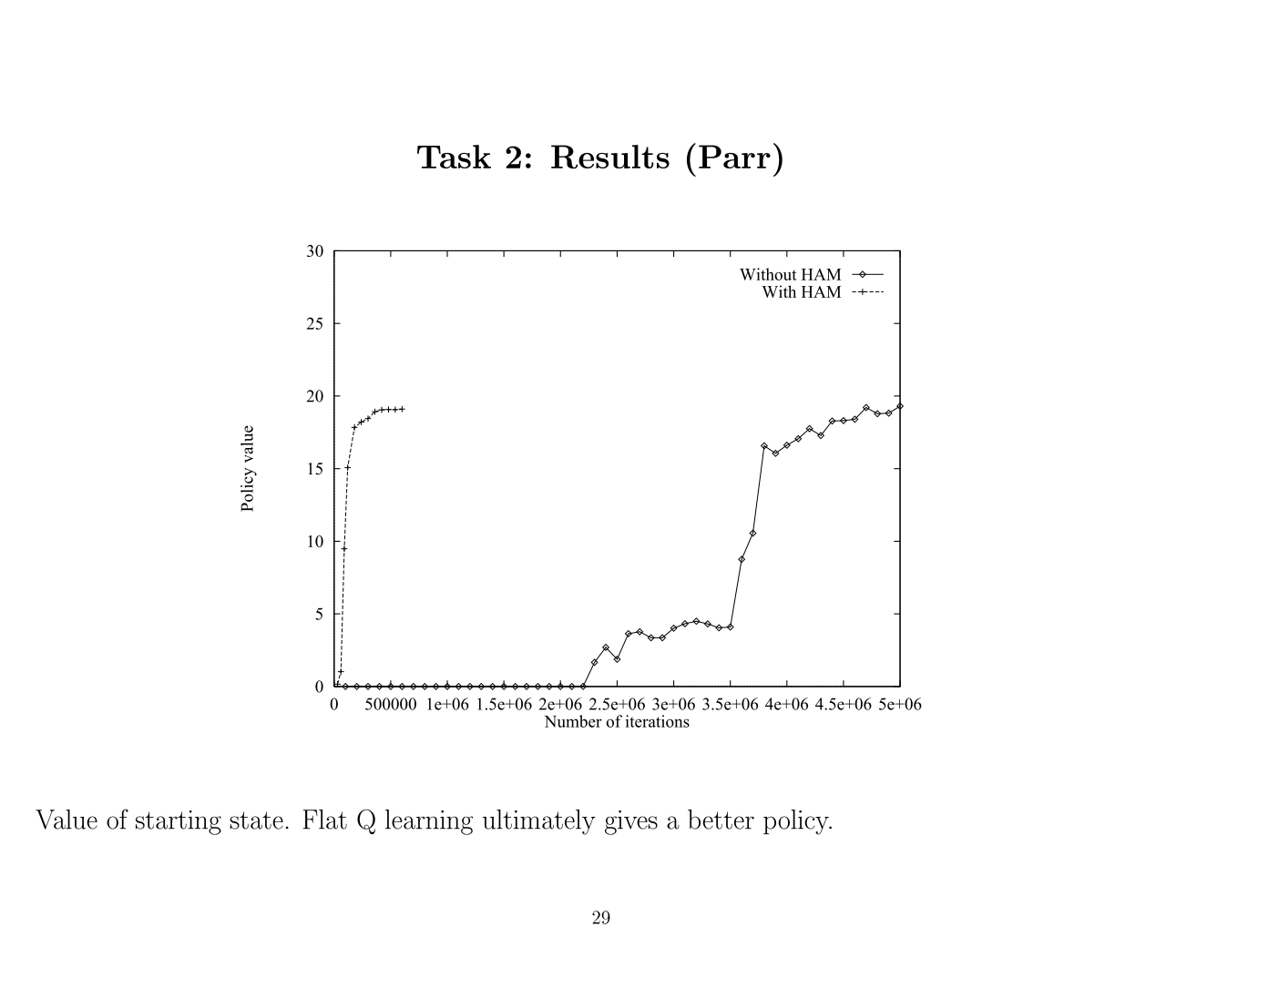

Slide 24
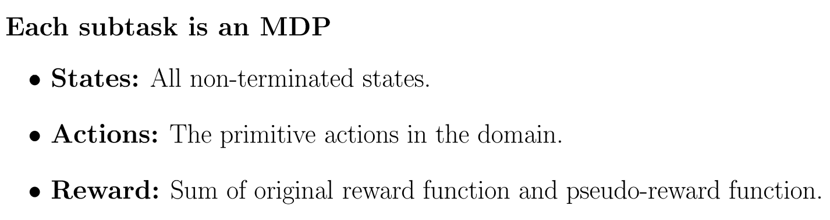
Learn policies for a given set of sub-tasks

Slide 25
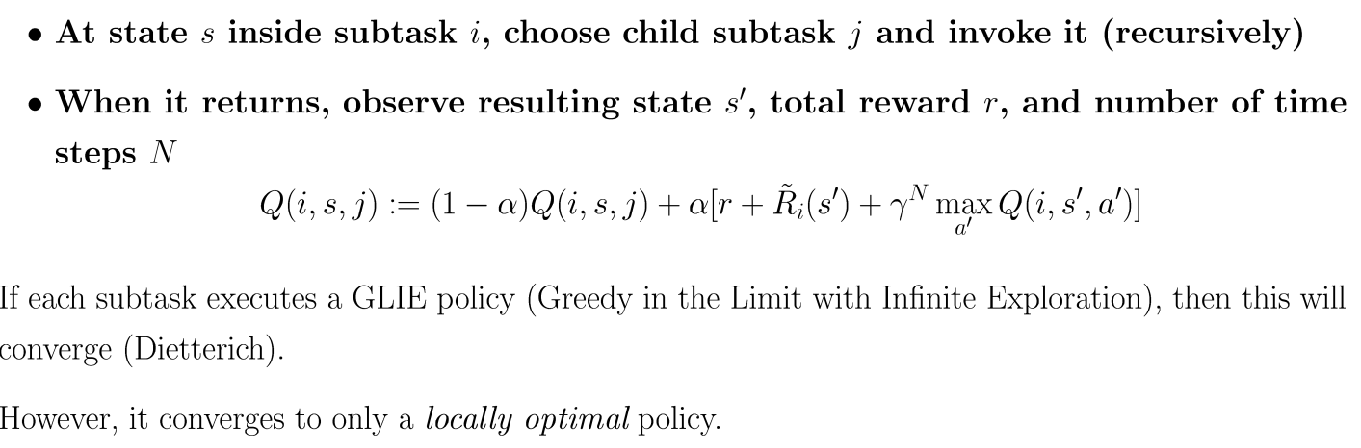
Learning hierarchical sub-tasks

Slide 26
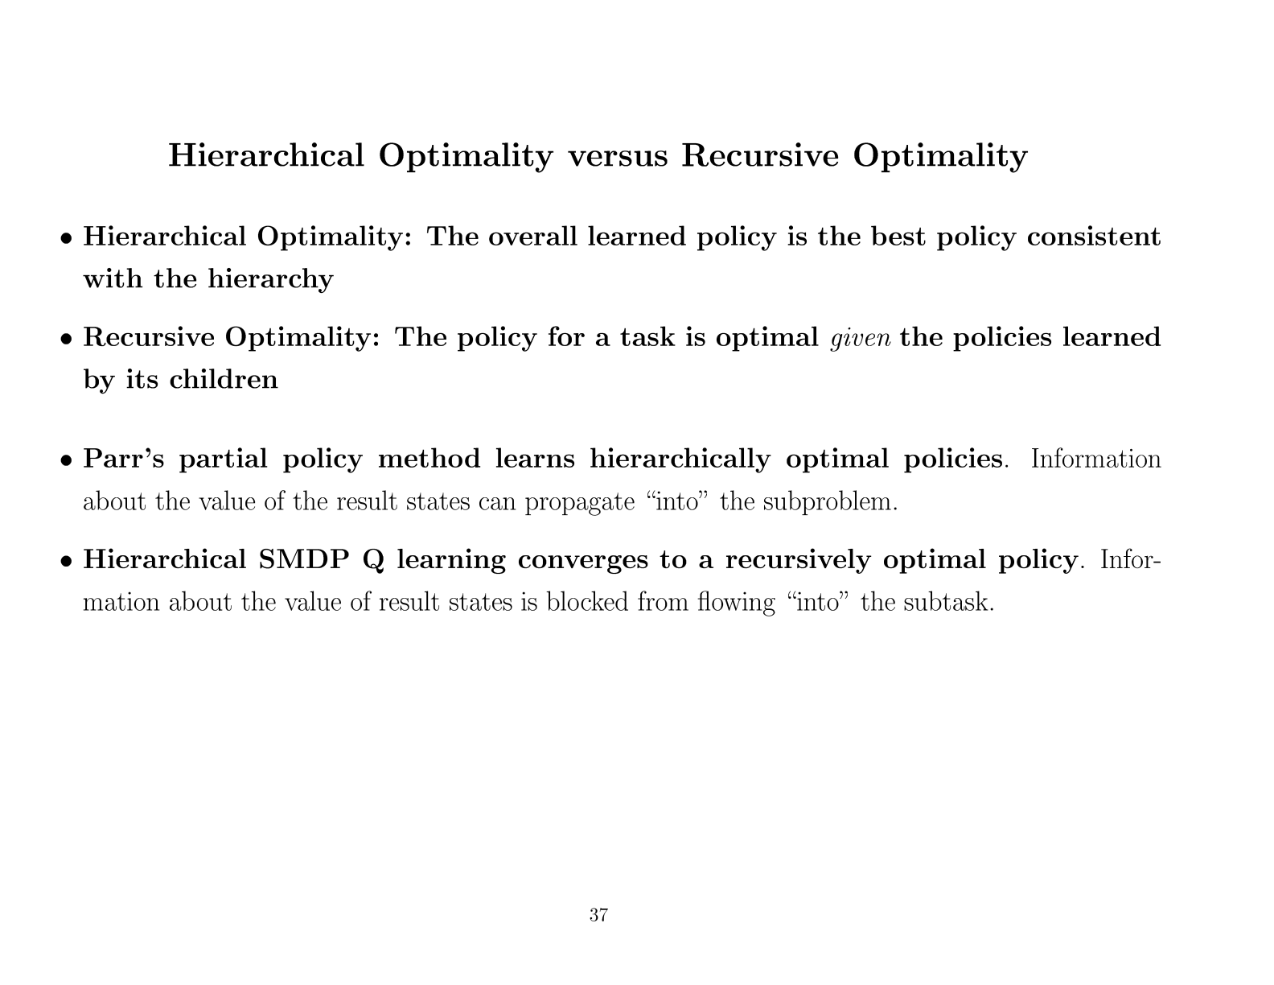

Slide 27
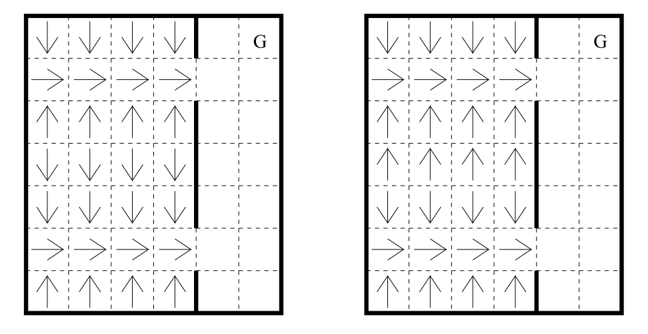
Example
Locally optimal
Optimal for the entire task

Slide 28
Contents
Purpose of HRL
Design issues
Defining sub-components (sub-task, options, macros)
Learning problems and algorithms
MAXQ
ALISP (briefly)
Problems with HRL

Slide 29
Recap: MAXQ
Break original MDP into multiple sub-MDP’s
Each sub-MDP is treated as a temporally extended action
Define a hierarchy of sub-MDP’s (sub-tasks)
Each sub-task M_{_i} defined by:
T = Set of terminal states
A_{_i} = Set of child actions (may be other sub-tasks)
R’_i = Local reward function

Slide 30
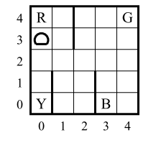
Taxi
Passengers appear at one of 4 special location
-1 reward at every timestep
+20 for delivering passenger to destination
-10 for illegal actions
500 states, 6 primitive actions
Subtasks: Navigate, Get, Put, Root

Slide 31
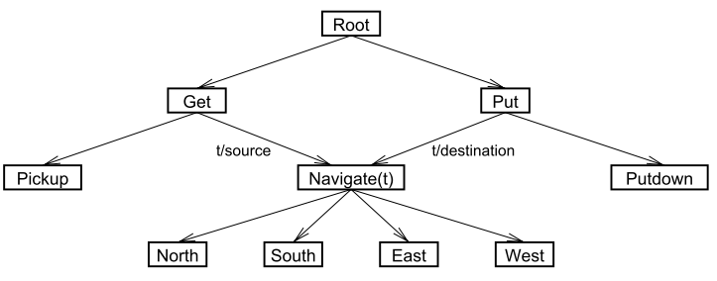
Sub-task hierarchy

Slide 32
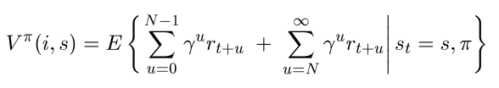

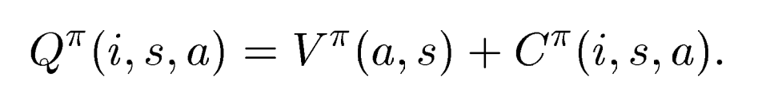
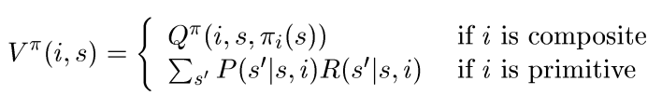
Value function decomposition
“completion
function”
Must be learned!

Slide 33
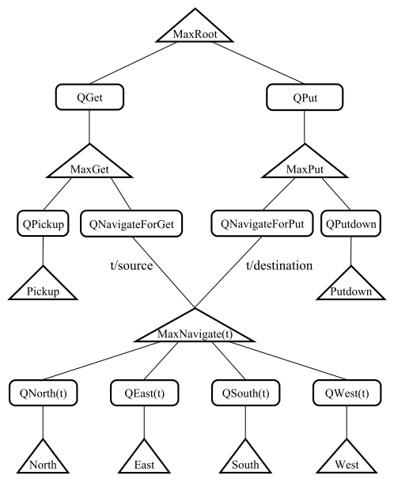
MAXQ hierarchy
Q nodes store the completion C(i, s, a)
Composite Max nodes compute values
V(i,s) using recursive equation.
Primitive Max nodes estimate value directly
V(i,s)

Slide 34
How do we learn the completion function?
Basic Idea: C(i,s,a) = V(i,s’)
For simplicity, assume local rewards are all 0
Then at some sub-task ‘i', when child ‘a’ terminates with reward r, update
V_{t}(i,s’) must be computed recursively by searching for the best path through the tree (expensive if done naively!)

Slide 35
When local rewards may be arbitrary…
Use two different completion functions C, C’
C reported externally while C’ is used internally.
Updates change a little:
Intuition:
C’(i,s,a) used to learn locally optimally policy at sub-task so adds local reward in update
C updates using best action a* according to C’

Slide 36
Sacrificing (hierarchical) optimality for….
State abstraction!
Compact value functions (i.e C, C’ is a function of fewer variables)
Need to learn fewer values (632 vs. 3000 for Taxi)
Eg. “Passenger in car or not” irrelevant to navigation task
2 main types of state abstraction
Variables are irrelevant to the task
Funnel actions: Subtasks always end in a fixed set of states irrespective of what the child does.

Slide 37
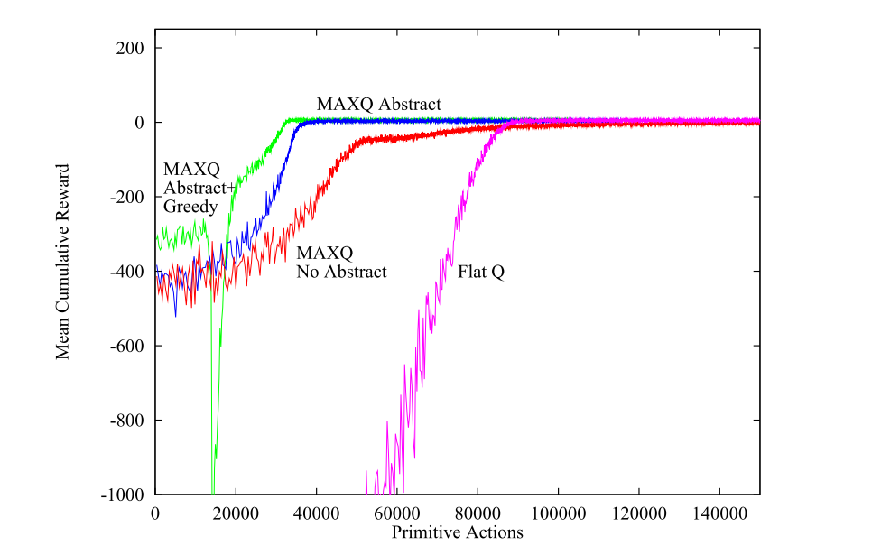

Slide 38
Tradeoff between hierarchical optimality and state abstraction
Preventing sub-tasks from being context dependent leads to compact value functions
But must pay a (hopefully small!) price in optimality.

Slide 39
ALISP
Hierarchy of partial policies like HAM
Integrated into LISP
Decomposition along procedure boundaries
Execution proceeds from choice point to choice point
Main idea: 3-part Q function decomposition
Q_{r}, Q_{c}, Q_{e}
Q_{e} = Expected reward outside sub-routine till the end of the program.
Gives hierarchical optimality!!

Slide 40
Why Not? (Parr 2005)
Some cool ideas and algorithms, but
No killer apps or wide acceptance, yet.
Good idea that needs more refinement:
More user friendliness
More rigor in specification
Recent / active research:
Learn hierarchy automatically
Multi-agent setting (Concurrent ALISP)
Efficient exploration (RMAXQ)

Slide 41
Conclusion
Decompose MDP into sub-problems
Structure + MDP (typically) = SMDP
Apply some variant of SMDP-Q learning
Decompose value function and apply state
abstraction to accelerate learning
Thank You!

