Slide 1
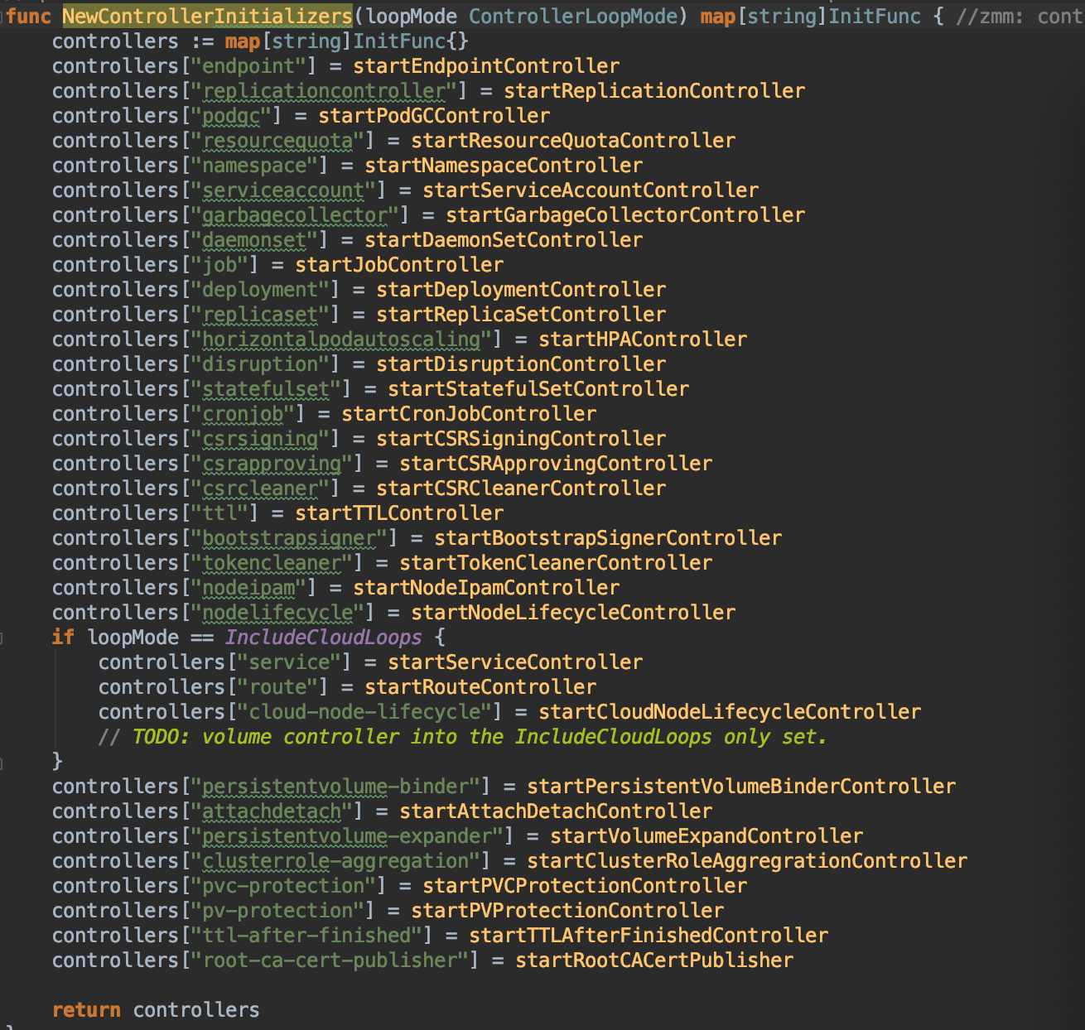
NewControllerManagerCommand()
- controllermanager.go
ControllerContext
deploymentInformer
sharedInformerFactory
CreateControllerContext()
- controllermanager.go
factory
Informers[]
StartControllers()
- controllermanager.go
sharedInformerFactory
sharedProcessor
Run() - controllermanager.go
listeners[]
sharedIndexInformer
distribute()
processor
pop()
Call each of methods
controler
processorListener
Take deployment
For example
startDeploymentController()
AddEventHandler()
handler
nextCh
Run()
add()
HandleDeltas()
pop()
addCh
run()
handler
run()
xxx
DeploymentController
OnUpdate()
updateNotification
OnAdd()
controllerContext.InformerFactory.Start()
- controllermanager.go
queue
OnDelete()
addNotification
enqueueDeployment() = enqueue()
updateDeployment()
deleteNotification
addDeployment()
deleteDeployment()
Run()
controller
Worker()
config
Config
syncHandler() = syncDeployment()
reflector
ListerWatcher
Run()
Queue
processLoop()
Process()
ListWatcher
Reflector
xx
ListerWatcher
Watch()
store
Run()
ListAndWatch()
watchHandler()
Queue
watchHandler()
xx
watch.Added
Add()
Update()
watch.Modified
Delete()
Pop()
watch.Deleted

