Slide 1
Demographic Disparities in Cancer Rates Across U.S. States
INFO 511
Zeb Moffat

Slide 2
Do cancer incidence rates differ significantly between demographic groups (sex, race/ethnicity) across U.S. States?
Why?
Cancer is a leading cause of mortality in the U.S.
Understanding disparities can inform for targeted interventions

Slide 3
Dataset: U.S. Chronic Disease Indicators
Publisher: Centers for Disease Control and Prevention (CDC) via data.gov
Asthma, cancer, arthritis, etc.
States + Territories
URL: https://catalog.data.gov/dataset/u-s-chronic-disease-indicators
License: Open Data Commons Open Database License (ODbL) v1.0
Publicly available, aggregated population-level data
No IRB required
2015 2022

Slide 4
Data Cleaning & Processing
Transformation
331,109 total records
Filter 1 - Cancer Topic
Filter 2 - Age-Adjusted Rate (fair comparison across age)
Filter 3 - Removed records with missing values
Filter 4 - Removed US aggregates and Puerto Rico
Final Dataset
1,118 records for sex stratification
2,702 records for race/ethnicity stratification

Slide 5
Features & Outcome
Demographic, State, Cancer Type
Model
Cancer Rate / 100k
Male/Female
White, Black, Hispanic, Asian/Pacific Islander, American Indian/Alaskan Native
States + Washington D.C.
Invasive, Lung, Colon, Cervical, Prostate, Breast Cancer

Slide 6
Modeling (Multiple Linear Regression)
Cancer Rate = β₀ + β₁(Demographics) + β₂(State) + β₃(Cancer Type) + error
80/20 Training and Test sets
Dummy Variables for categorical variables
Sex Model
1,118 sample size
2 sexes, 51 locations, 7 cancers
R² Score: 0.987
RMSE: 18.5 per 100k
Excellent accuracy
Race/Ethnicity Model
2702 sample size
5 races/ethnicities, 51 locations, 7 cancers
R² Score: 0.883
RMSE: 50.5 per 100k
Strong accuracy

Slide 7
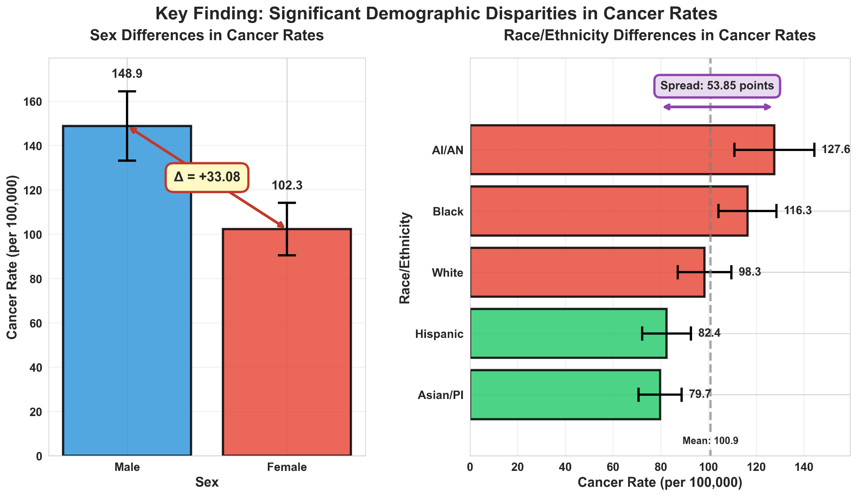

Slide 8
Conclusion
YES - Cancer rates differ significantly by demographic groups across U.S. states
Key Takeaways
Males face 33.08 per 100,000 higher cancer rates than females
Racial/ethnic groups show disparities up to 53.85 points per 100,000
Patterns are consistent across all U.S. states (controlled)
Findings are statistically robust and clinically significant

Slide 9
Next Steps
Immediate Actions Needed:
Targeted screening programs for high-risk groups
Resource allocation adjusted to risk patterns
Prevention campaigns for specific groups
Policy Recommendations:
Address social factors contributing to disparities
Improve healthcare access for high risk populations
Invest in community-based interventions

Slide 10
End

