Slide 1
Happiness
An Exploratory data analysis by Zach Mumbauer

Slide 2
Statistical Question
What are the primary factors that significantly influence the happiness score (Life Ladder) of countries, and how do these factors compare in terms of impact?

Slide 3
Hypothesis
Higher GDP per capita, greater social support, higher healthy life expectancy, and more freedom to make life choices are positively correlated with higher happiness scores.

Slide 4
Key Variables
Life Ladder (Happiness Score) => Dependent Variable
Log GDP per Capita
Social Support
Healthy Life Expectancy
Freedom to Make Life Choices
Generosity
Perceptions of Corruption

Slide 5
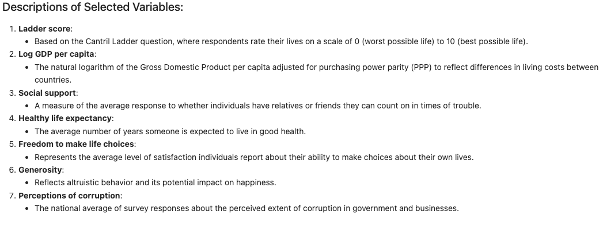

Slide 6
Histograms

Slide 7
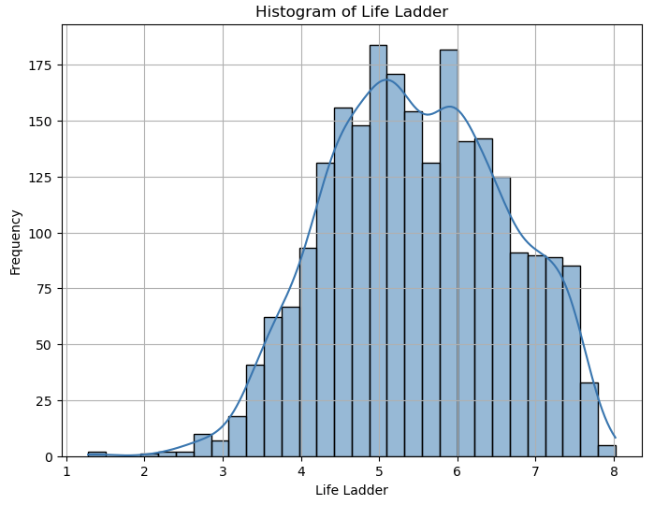

Slide 8
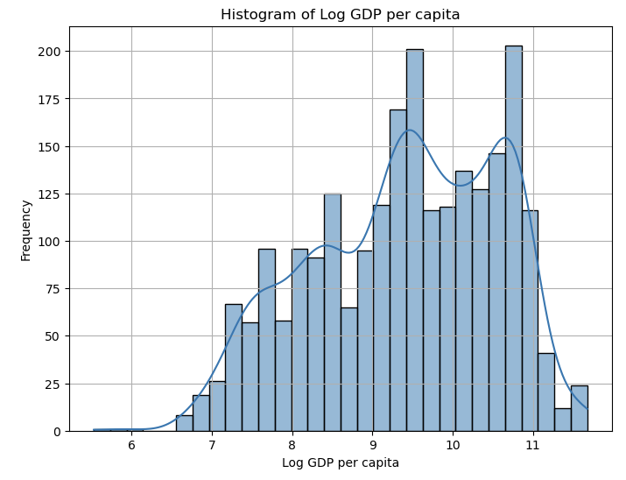

Slide 9
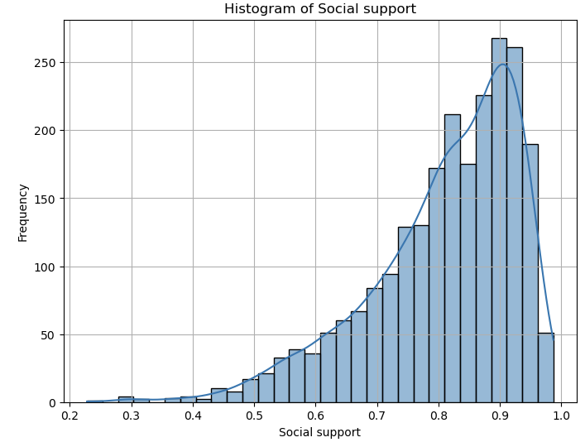

Slide 10
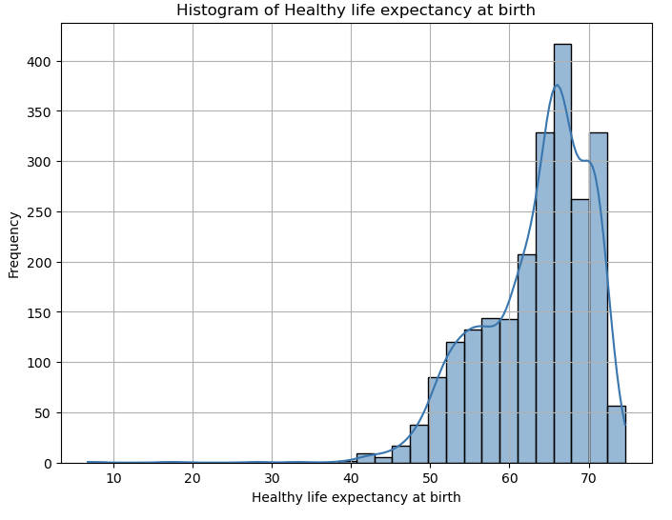

Slide 11
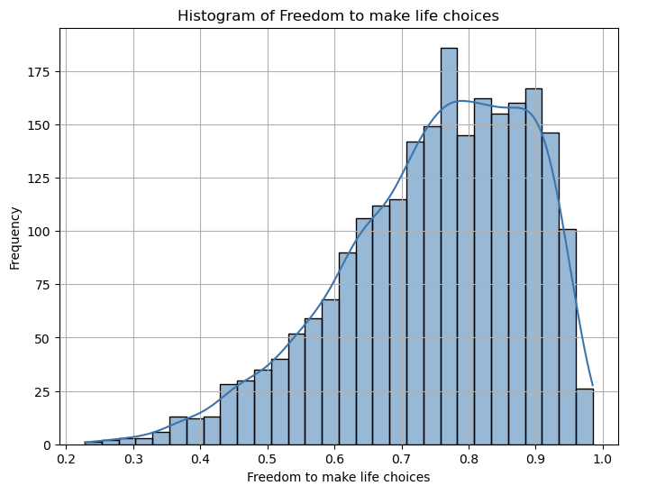

Slide 12
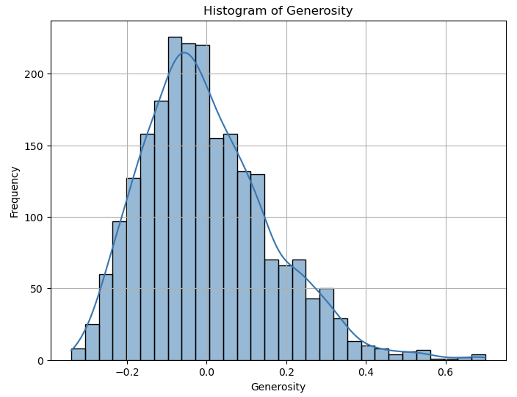

Slide 13
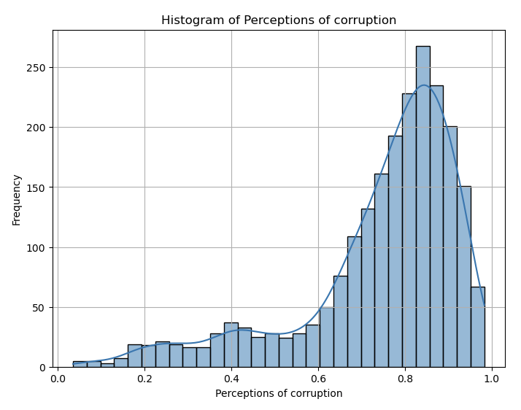

Slide 14
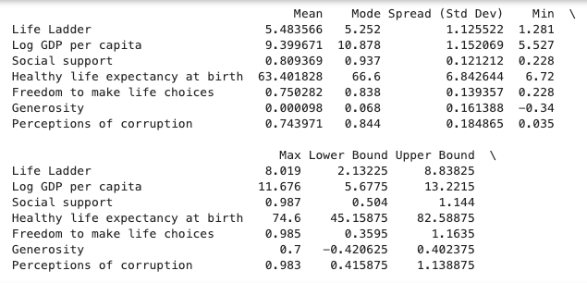

Slide 15
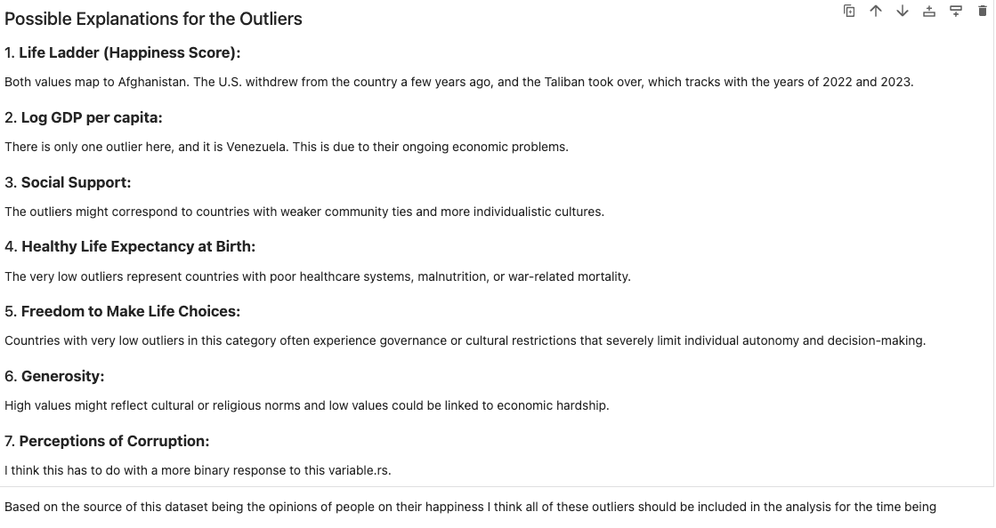

Slide 16
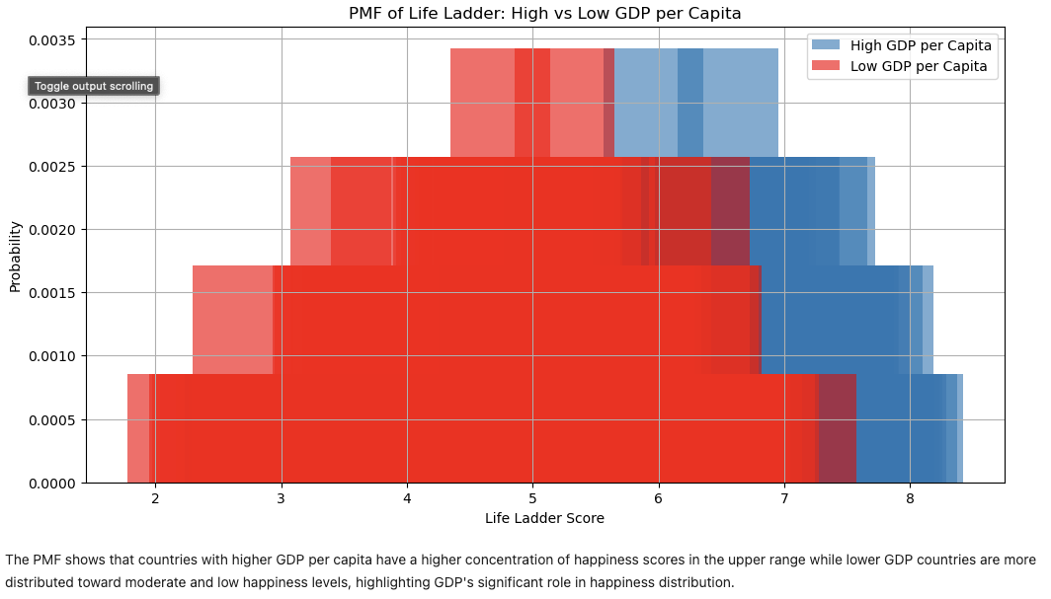

Slide 17
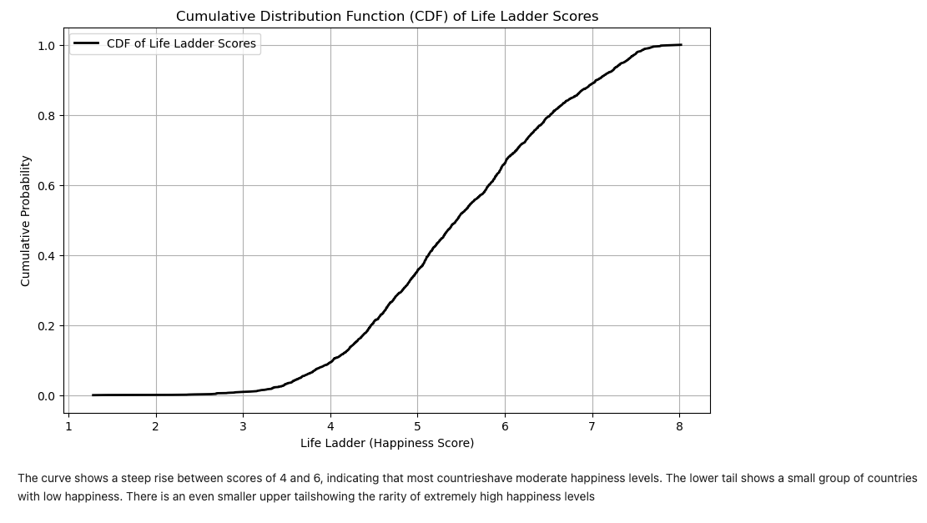

Slide 18
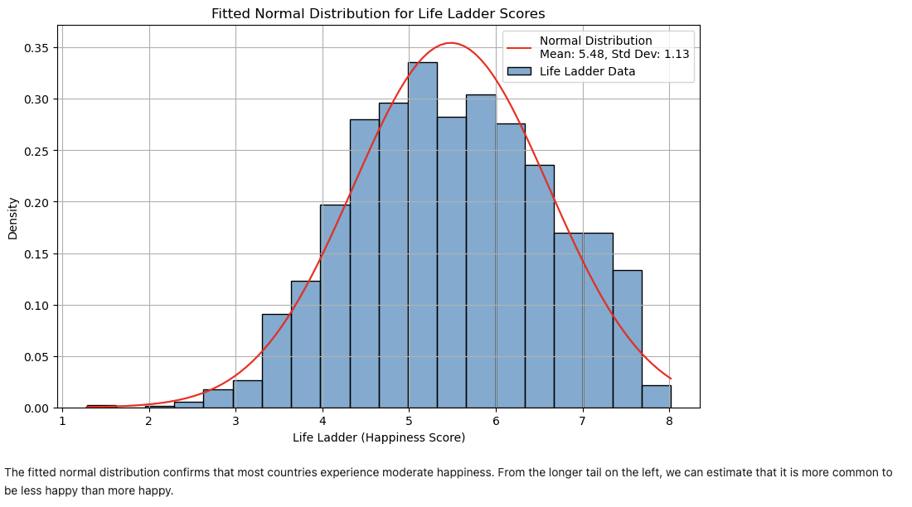

Slide 19
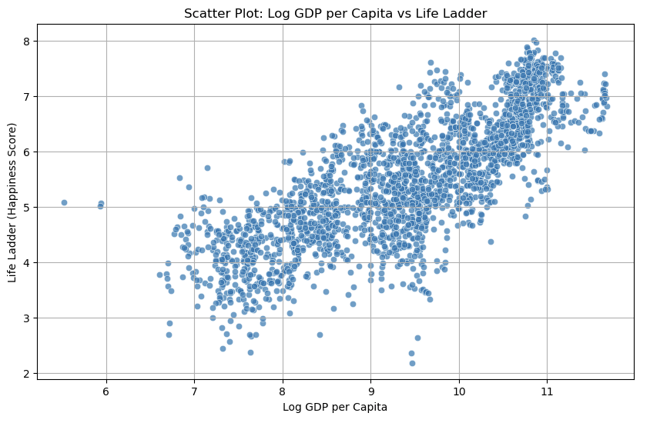

Slide 20
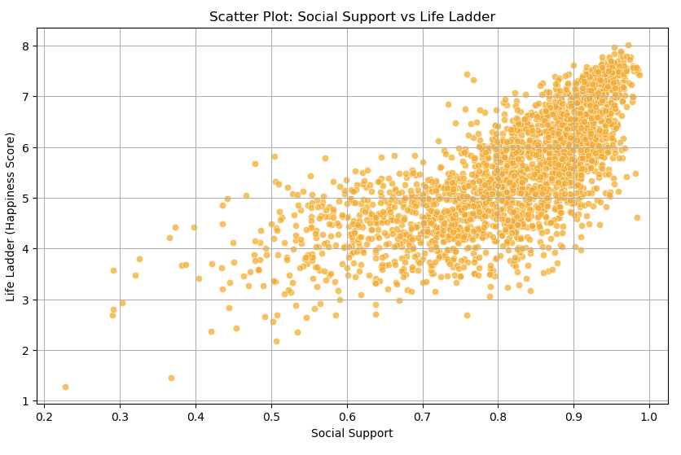

Slide 21


Slide 22
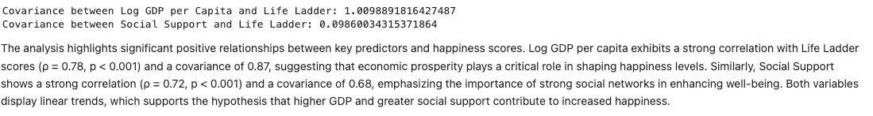

Slide 23
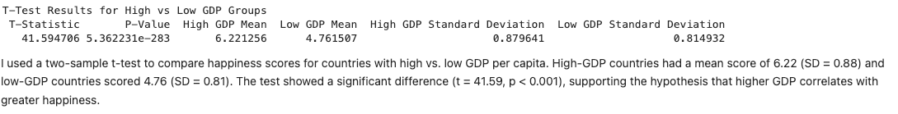

Slide 24
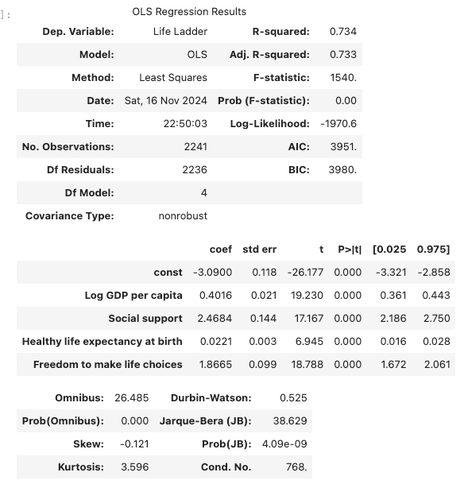

Slide 25
