Slide 1
HW 4
Spring 2018
Due Friday, April 13

Slide 2



HW 1 – Notch Delta
Here we will look at a small extension of the Notch-Delta model described in the course notes. There, we considered a system containing two mutually interacting cells. Here we will extend that to a system of 3 cells. The setup is simple, but this will require numerical simulation. Consider the scenario where cells 1, 2, and 3 form a linear array with each cell communicating with its neighbor in the following way.
This leads to a system of 3 ODE's describing the evolution of Notch in each cell.
Beginning with a random initial condition where 0<Ni<1 for each cell, simulate this system until it reaches a steady state.
On a single figure, plot the time evolution (time on the x-axis, Notch on the y axis) of Notch in all three cells. You should have 3 curves on the single figure. You can use any ODE simulator for this.
What do you notice about the relationship between Notch in neighboring cells?
Note that this is a warmup for the following problem. All students do this problem, only 8122 students are required to do the extension (3122 students are more than welcome do so if they like).

Slide 3
Results

Slide 4




HW 2 – Notch / Delta (2)
8122 Students
Here we are going to perform a parameter space screen on the Notch Delta Model for a slightly more realistic geometry. Consider the following model of Notch Delta activity. Suppose we have a linear array of N=101 cells, each of which is connected to its left and right neighbors (note the end cells only have one neighbor). Each cell is governed by the canonical Notch – Delta model that we discussed in class, and which is in Ch. 20 of PBoC. For this simplified geometry, the model equations are.
This encodes the neighbor interactions via Delta activity (though be sure to note that the equations will differ for I=1,N). Note that the resulting model is a system of N=101 differential equations. In this model, c1 and c2 denote the sensitivity of the activation and inhibition components of the Notch-Delta model respectively. For example, if c1 is large, it is hard to initiate the activation of Notch by Delta. We want to know how organization of the resulting system depends on these parameters.
To get at this, we will perform a brute force 2-Dim parameter screen over c1 and c2. Lay out a parameter mesh consisting of 50 values each of c1 and c2 linearly spaced in the range 0.01<c<10. So this parameter mesh contains 50² total parameter sets. We are going to simulate this system for each of these sets.
As discussed in class, the Notch – Delta System is good at ensuring neighbor cells have different Notch expression levels. But how does this depend on parameters? In order to quantify this, we need to come up with a way to determine if a particular parameter set gives rise to an alternating pattern.
SEE NEXT PAGE

Slide 5



HW 2 – Notch / Delta (2)
8122 Students
To quantify the type of organization, we will use an order parameter that measures how "alternating" the pattern of Notch expression is.
This “order parameter” (K) quantifies the average, normalized strength of the oscillation between Notch activities in adjacent cells.
Before continuing, lets take a look at a single parameter set. For the values c1=0.1, c2=10, simulate the system of N=101 ODE's, starting with an initial randomized initial condition with Ni between 0 and 1, until a steady state is reached. Plot that final state. Is it homogeneous or alternating? Calculate the order parameter for this state.
For each of the ~2500 parameter sets, simulate the system of N=101 ODE's until a steady state is achieved. Calculate this order parameter for the steady state at each parameter set in the screen. We now want to visualize this data set. One way to do so is to plot a "heatmap". Do this. Does the order parameter depend continuously on c1 and c2 or sharply? What can you say about how the function of this system depends on those parameters.
Simulating this system of 101 ODE's for 2500 different parameter sets may seem daunting. With a plan and some ingenuity, it can be made relatively simple though. You will have to use a loop to generate the system of ODE's in whatever language you are using. DO NOT write 101 ODE's by hand. In total, this took ~60 lines of matlab code and 30 seconds of desktop simulation time. If you need some advice, let me know.

Slide 6
Results

Slide 7

Results

Slide 8
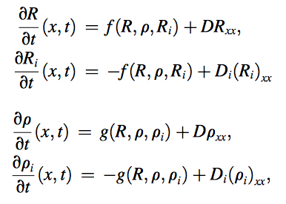
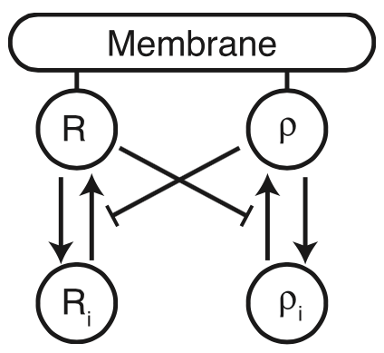
HW 3: Patterning in Cell Polarity
Here, we will take a look at a canonical patterning system associated with polarization of motile cells. A family of proteins, known as the Rho GTPases are known to polarize in many cell types during motility. Two members of this family, Rac and Rho are known to localize to the front and rear of the cells respectively. Here we will analyze the pattern formation properties of this system.
Each Rho GTPase can exist in one of two forms, a form that is bound to the membrane that is active and a form that is in the cytosolic interior that is inactive. It is the localization of the active form that is of importance. There are three important features of these proteins.
  They can be activated and deactivated, but not produced or degraded on the timescales of interest. Thus the total integrated amount if each is conserved.
  Cytosolic proteins are significantly more mobile than membrane bound.
  These proteins inhibit each other, so Rac inhibits Rho and vice versa.
  The system of equations above encodes each of these properties.
Continued …

Slide 9
HW 3: Patterning in Cell Polarity
We will investigate the stability and pattern forming properties of this system.
Consider the following base parameter set. n=4, k_{ρ}=k_{R}=0, a₁=a₂=δ_{R}=δ_{ρ}=I_{ρ}=I_{R}=1, R_{tot}=ρ_{tot}=2, D=0.1, D_{i}=10.
Note that the parameters R_{tot} and ρ_{tot} do not show up directly in the equations. If you look closely at the equations, you will notice that the equations for the active and inactive variables are mirror images of each other (with the exception of diffusion). This ensures conservation but places a constraint on the system. Namely, your initial conditions implicitly determine the average concentration of each GTPases. These “tot” parameters are the values of those conserved quantities. In all simulations to come, you must set your initial conditions carefully to ensure that you they sum to these conserved amounts.
First, let’s assess the stability.
  To do so, let’s first neglect the spatial terms, so that we simply have a system of 4 ODE’s. Simulate this system of ODE’s to find a steady state. State the values of this SS.
  Next, calculate the Jacobian (J₀) of the non-spatial system at this SS to determine it’s well mixed stability. What are they? You’ll notice some 0 eigenvalues. Any idea why you get these 0’s? If you play around with parameters, you’ll notice that you always get those 0’s.
  Finally, perform a Turing analysis. Recall that this requires you calculate eigenvalues of the augmented Jacobian: J_{k}=J₀-k²D, where k is the wave number under consideration and D is a matrix containing the diffusion coefficients. Do so for the values k=1, 2, 3, 4, 5.
  Are any of these wave numbers unstable? If so, which ones and what is the associated growth rate (eigenvalue).
  Now, let’s verify the results of this analysis. You’ve already simulated the non-spatial system and found that you get a steady state. Now, let’s use Virtual Cell to simulate the spatial version of this on a 1D domain of length x=5. Note, if you are looking for spatial patterns, it is useful to simulate the system from a spatially heterogeneous initial condition. So using an initial condition of the form R=Rss + 0.01*sin(x) or something of the such us appropriate (though ensure that you perturb the inactive forms commensurately to ensure you maintain the conserved quantities. Provide plots of the active Rac and Rho concentration distributions (hint, you should get a pattern here).

Slide 10
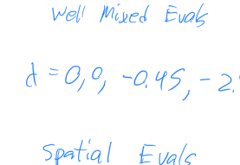

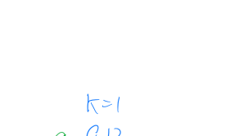

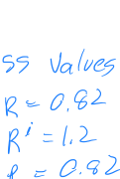
Results

Slide 11
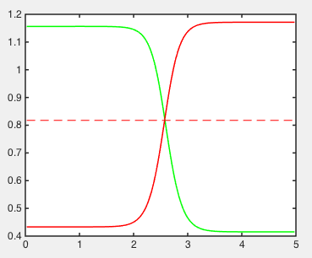
Results: Rac / Rho / space

Slide 12
HW 4– FitzHugh Nagumo
Consider the following simplified model of nerve conduction, typically referred to as the FitzHugh Nagumo model. In this model, ‘v’ is loosely associated with membrane voltage while ‘w’ is associated with the slower negative feedback that arises when ion exchangers kick in at high voltage. The parameter ‘epsilon’ is a timescale parameter.
We will investigate the different kinds of dynamics this system is capable of and show that it can give rise to single pulses and wave trains alike. First note that v=w=0 is a steady state for all values of parameters.
Consider the values a=0.1, epsilon = 0.005. Is the previously mentioned steady state stable or unstable? Perform a linear stability analysis (non-spatial) to address this. To further understand the stability of this steady state, perform non-spatial simulations (using whatever ODE simulator you like) with a variety of initial conditions.
Now simulate this system using Virtual Cell on a 1D domain of size 1000 microns. The goal here will be to determine how the steady state of the system responds to a spatial perturbation. Begin the simulation with the system at the previously determined steady state and apply a perturbation of the voltage variable (v) on the left 10 microns of the domain. What do you find?
  Present your results here in two ways. First, provide a kymograph, a color plot showing the value of v over time and space. Virtual Cell will generate these plots.
  Second, for a single point somewhere in the middle of the domain, plot the value of 'v' as a function of time. Vcell can do this as well. For an example of these types of plots generated from Vcell, see the next slide.
Perform the same analysis as above (1 and 2) with a=-0.1, epsilon=0.005. What do you find?

Slide 13
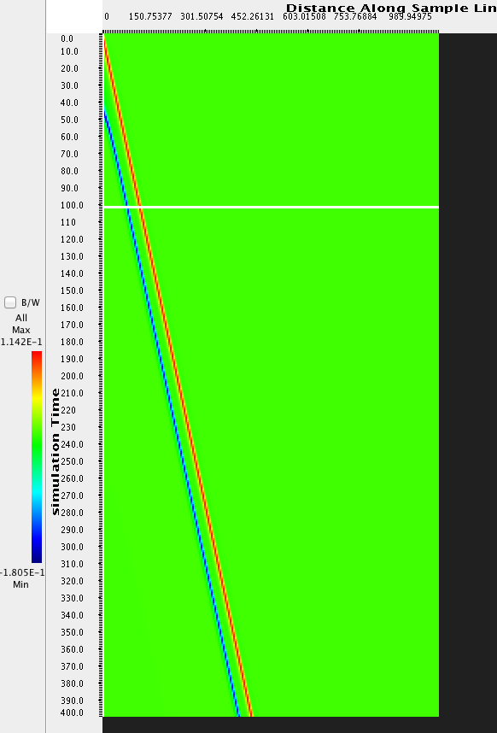
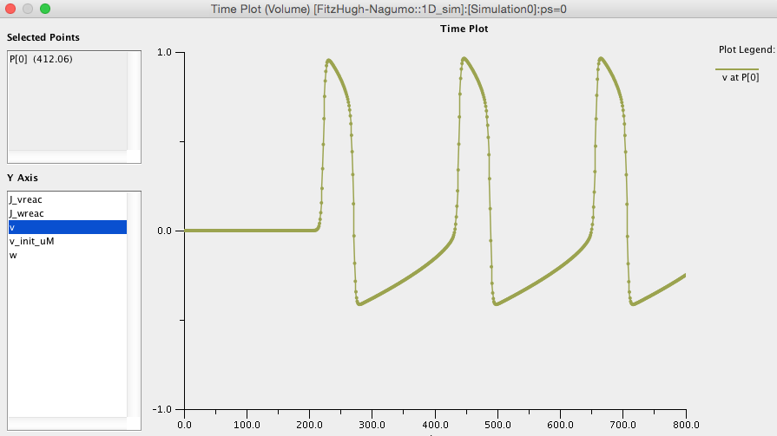
Examples (not from the same sim)

Slide 14



Solution

Slide 15
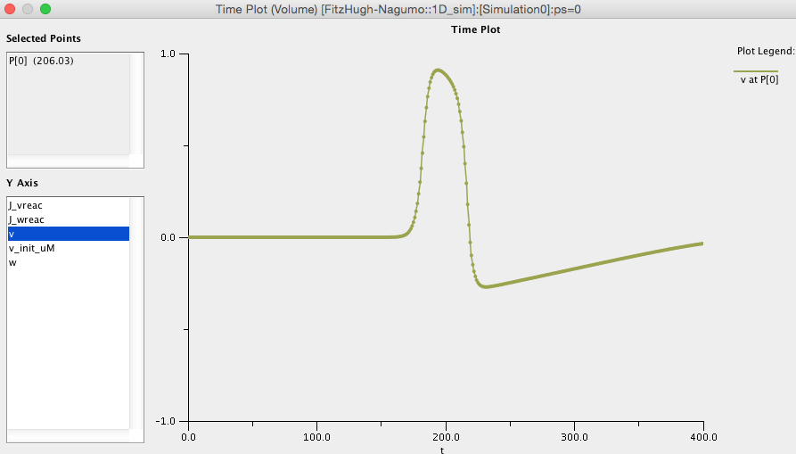
A=0.01 solution

Slide 16
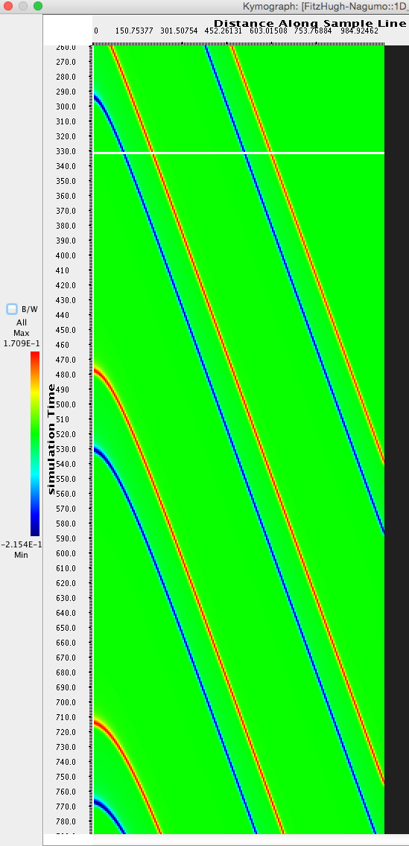
A=-0.01 solution

Slide 17
HW
Base a problem on Herb Levine’s 2017 NJP article about Min proteins.
Or alternatively, pick one of the Morphogen papers and have them simulate the gradients that result under different conditions.

