Slide 1
Teaching Stochastic
Local Search
Todd W. Neller

Slide 2
Motivation
Intro AI course has many topics, little time
Best learning is experiential, but experience takes time!
  "One must learn by doing the thing; for though you think you know it, you have no certainty, until you try." -Sophocles
How to introduce stochastic local search
  Simply
  Concisely
  Experientially

Slide 3
The Drunken Topographer
Drunken Topographer Analogy
Formalize the problem
  Longitude, latitude → state
  Altitude → energy (objective function)
  Random step → next state generation
  Goal: Find the lowest energy!

Slide 4
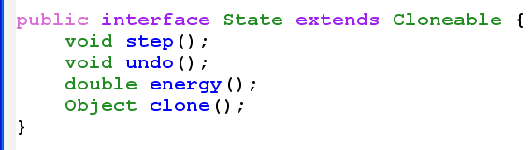
State Interface
step – take a stochastic local step in the state space
undo – revert one step (never two!)
energy – measure state “badness”
clone – copy state for future reference

Slide 5
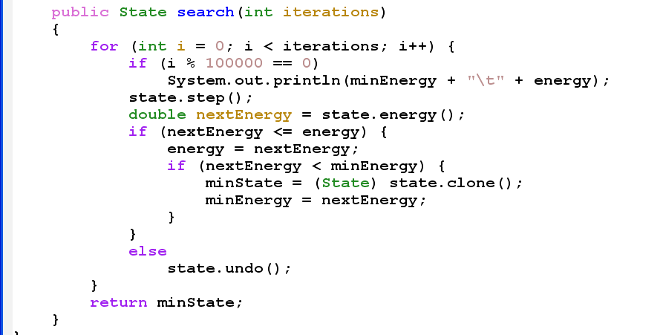
Simple Hill Descent

Slide 6
Simple Hill Descent
For a fixed number of iterations:
  [Report state every 100000 iterations]
  Step to next state.
  If step is not uphill,
    check if it is the best (minimal energy) yet,
    Otherwise reject (undo) the step.
Return best state

Slide 7
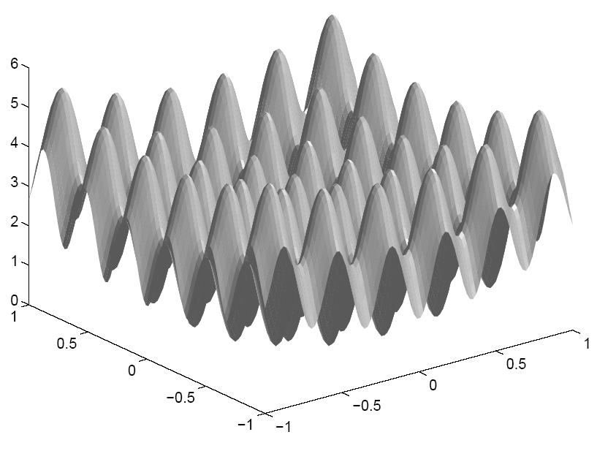
Observing Local Minima
The Rastrigin Function
  sinusoidally perturbed parabolic bowl
  energy(x, y)
  = x² + y² − cos(18x)
  − cos(18y) + 2
  Initialize at (10,10)
  x, y Gaussian step distribution with σ = .05
  Apply simple hill descent

Slide 8
Uphill Steps
Allow uphill steps with some probability
Experiment with acceptance rate:
  0.0 = hill descent
  1.0 = random walk
  0.1 → close approximation
  0.01 → closer approximation
  0.001 → local minima

Slide 9
Discerning Uphill Steps
Not all uphill steps are equal
Introduce Boltzmann distribution
What is the behavior at temperature extremes?
  High temperature: random walk (“super drunk”)
  Low temperature: hill descent (“dead-tired drunk”)
  Vary from high to low temperature…

Slide 10
Simulated Annealing
Why simulated annealing?
  Simple
  Powerful
However, annealing (cooling) schedules are a “black art”.
  Side note: decision-theoretic simulated annealing
There is no substitute for experience.

Slide 11
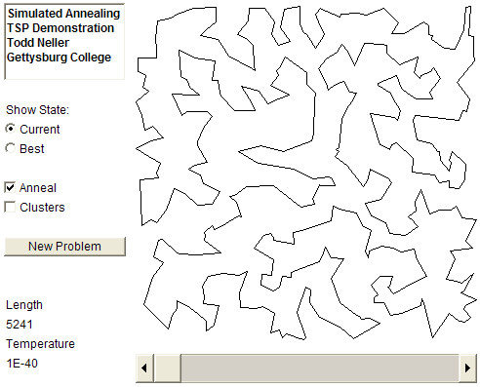
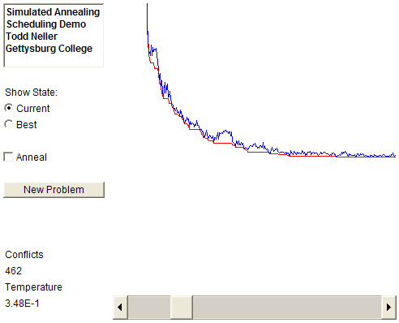
Applet Annealing Experiences

Slide 12
Next Steps
Homework: Assign one or more simple combinatorial optimization problems (e.g. TSP, n-queens, etc.)
Optional Labs:
  Project group formation problem
  Pizza ordering problem

Slide 13
Web Resources
http://cs.gettysburg.edu/~tneller/resources/sls/index.html
  FLAIRS’05 paper
  Relevant code
  Links to demo applets
  Readings on SA and SLS in general
  Suggested Syllabus

Slide 14
In Conclusion
“We can only possess what we experience. Truth, to be understood, must be lived.” – Charlie Peacock
Further exploration: Hoos and Stutzle text
Other SLS distillations are possible. May you and your students benefit from our good experiences!

