Slide 1
The Theory and Implementation of DVFS on Linux

Slide 2

Energy!!!

Slide 3
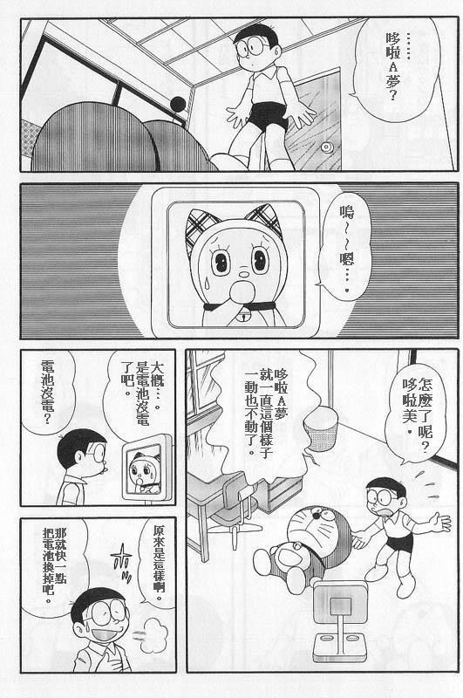
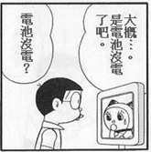
No Power!!!

Slide 4
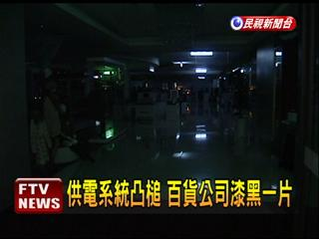
No Power Again!!!

Slide 5

我該怎麼辦 ?????

Slide 6
Off-line Optimization
Static Power Management (SPM)
Dynamic Power Management (DPM)
On-line Optimization

Slide 7
Static Power Management (SPM)
System/Component Under Test | Level of Detail | Evaluation
CPU | RTL level | Cycle-level simulation
 | Instruction level | Instruction-level simulation
System | Hardware component level | Functional simulation
 | Software component level | Monitoring tool
 | Hardware & Software component level | Complete system simulation

Slide 8
Dynamic Power Management (DPM)
System/Component Under Test (SUT/CUT) | Implementation Level | Methodology
CPU | CPU and System software | DVS (Dynamic Voltage Scaling)
System | Components hardware | Low power mode of operation
Cluster System | CPU and System software | CVS (Coordinated Voltage Scaling)

Slide 9
IDEA?

Slide 10
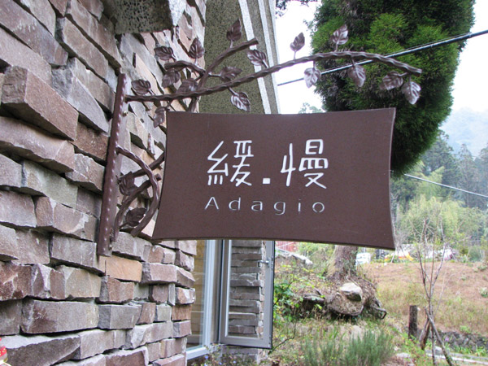
慢活，能活得更快樂、更長久

Slide 11
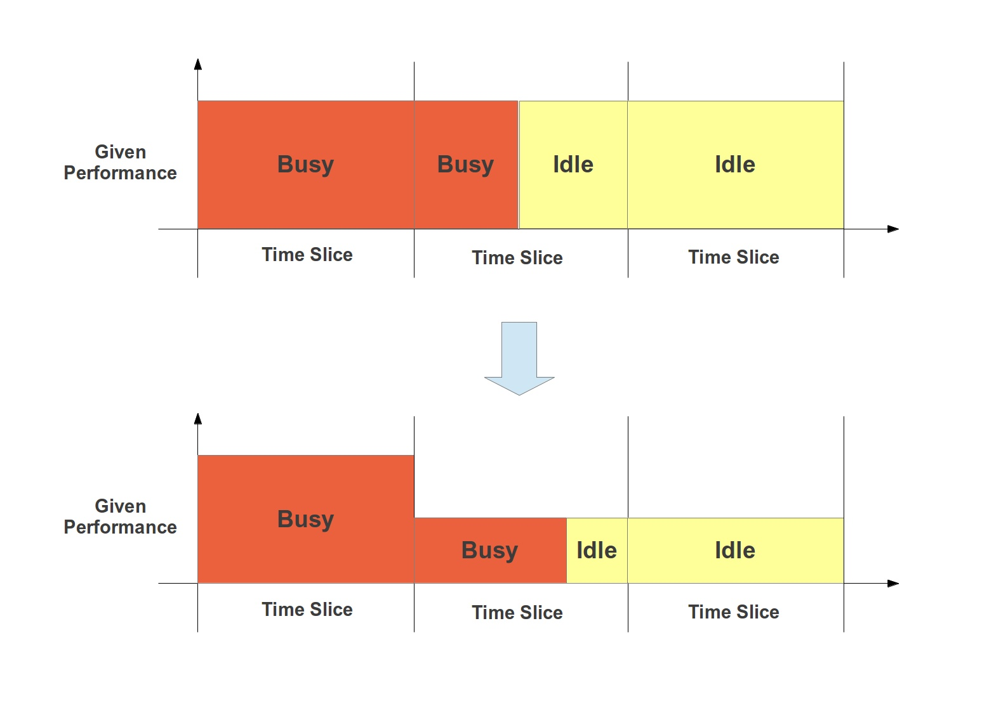
CPU-Level DPM

Slide 12

一下睡
一下又醒來

Slide 13
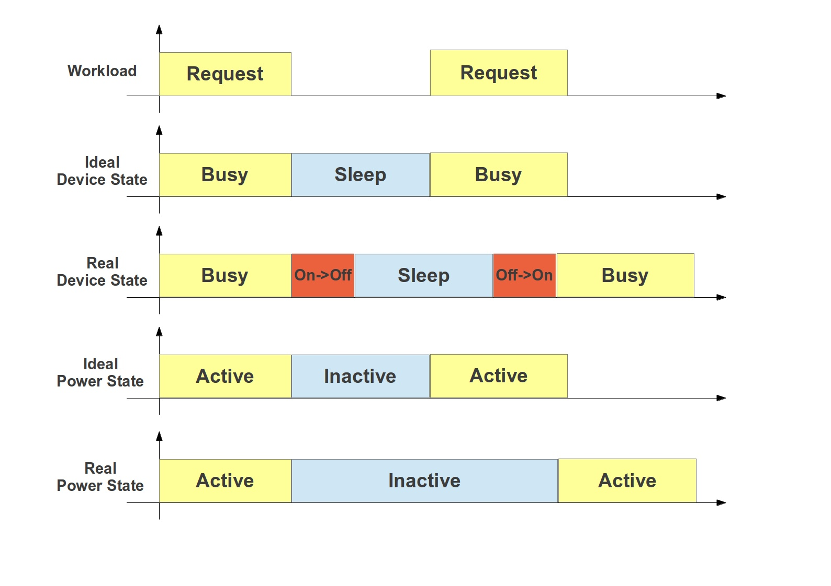
System-Level DPM

Slide 14
Dynamic Power of CMOS Circuits
Core Voltage
Clock Frequency

Slide 15
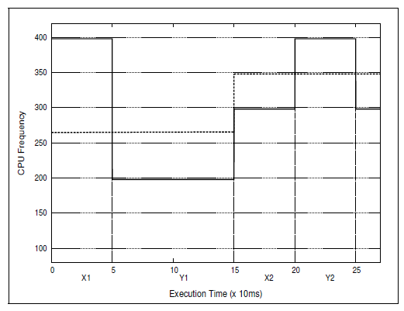
Dynamic Voltage and Frequency Scaling (DVFS)

Slide 16
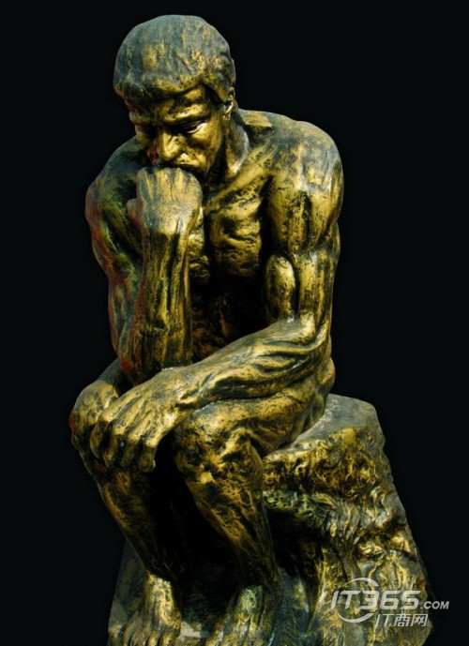
思考實際的使用……

Slide 17
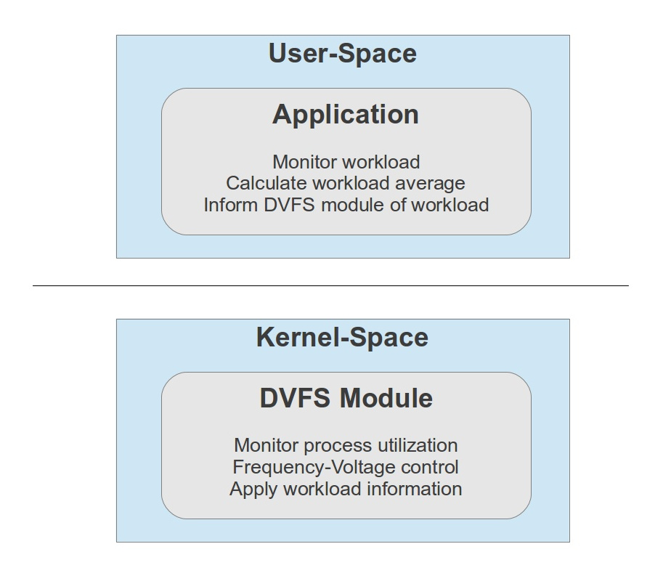
Routine in User Space

Slide 18
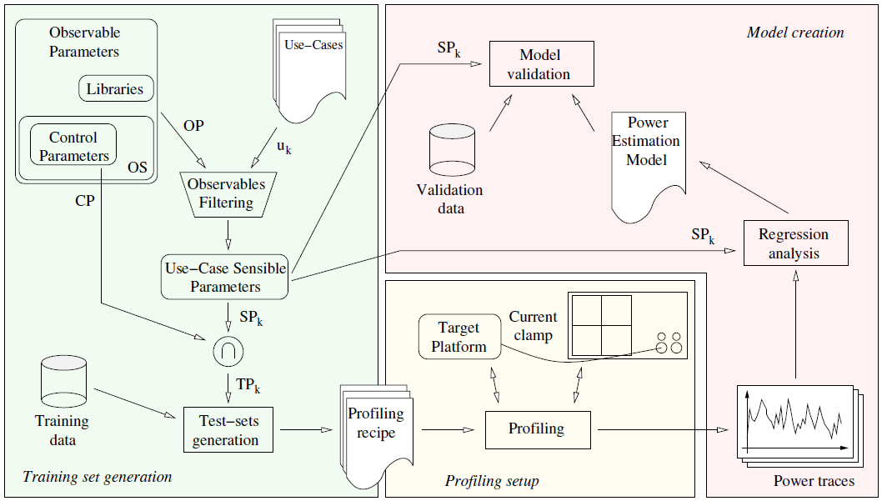
Workflow of the Power Estimation Models

Slide 19
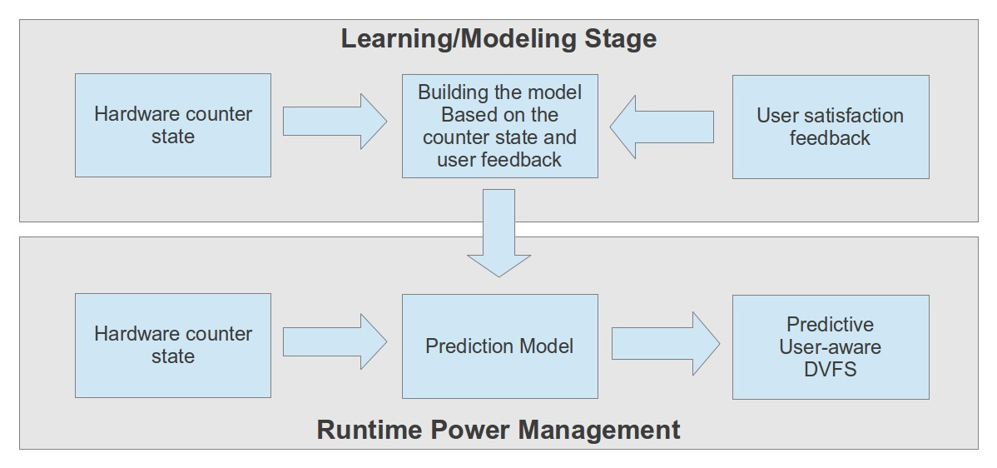
Framework of the Predictive User-Aware Power Management

Slide 20
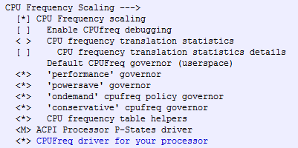
Linux Kernel支援了基本的架構

Slide 21
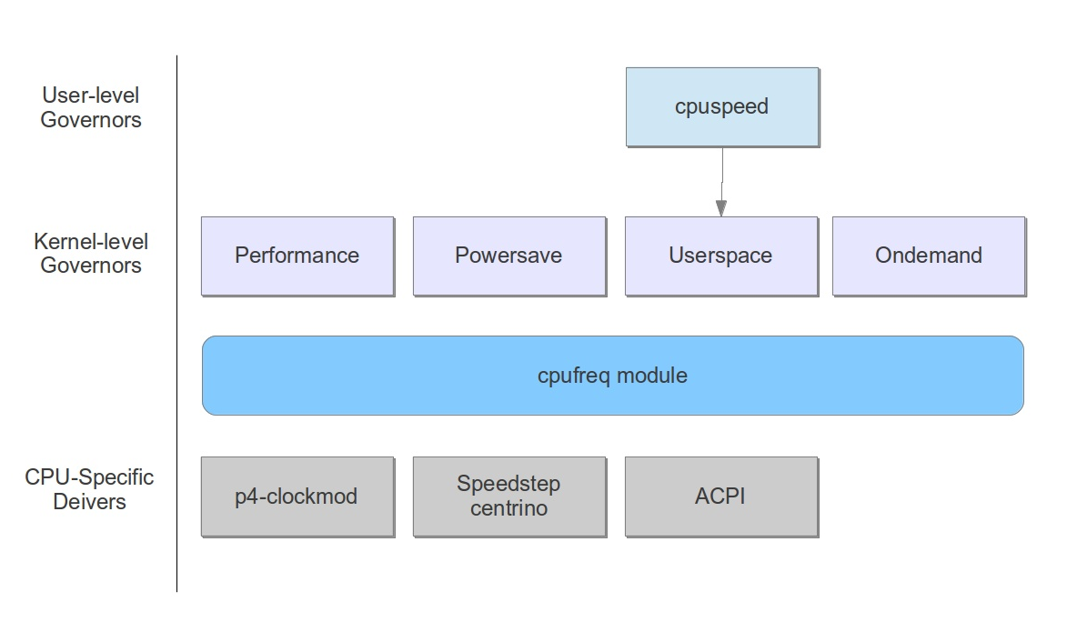
Linux電源管理架構

Slide 22
Kernel Module | Governor | Functionality
cpufreq_ondemand | ondemand | 按需求調節，不是很強大，但實現了動態頻率調節
cpufreq_powersave | powersave | 省電模式，通常以最低頻率運行，
cpufreq_userspace | userspace | 用戶模式，一些調頻工具軟件需要在此模式下才能運行
cpufreq_conservative | conservative | “保守”模式，類似於ondemand，但調整相對較緩
N/A | performance | 不降頻

Slide 23
Implementation on
Intel XScale-PXA270

Slide 24
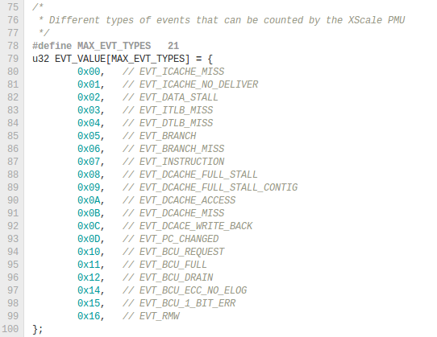
Performance Monitoring Unit

Slide 25
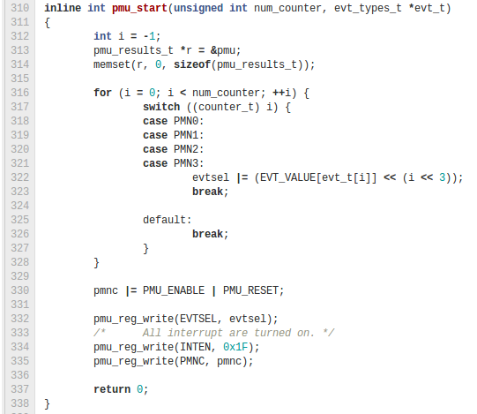

Slide 26
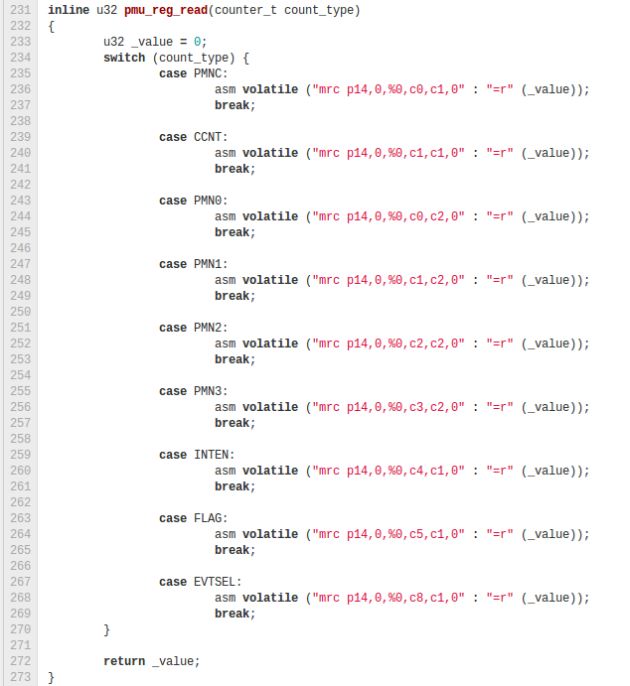

Slide 27
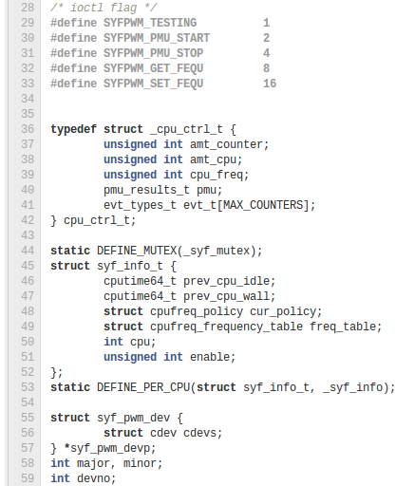
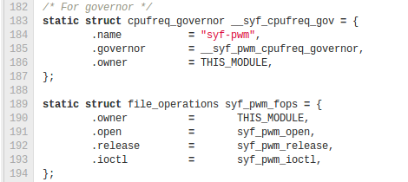
CPUFreq Definition

Slide 28
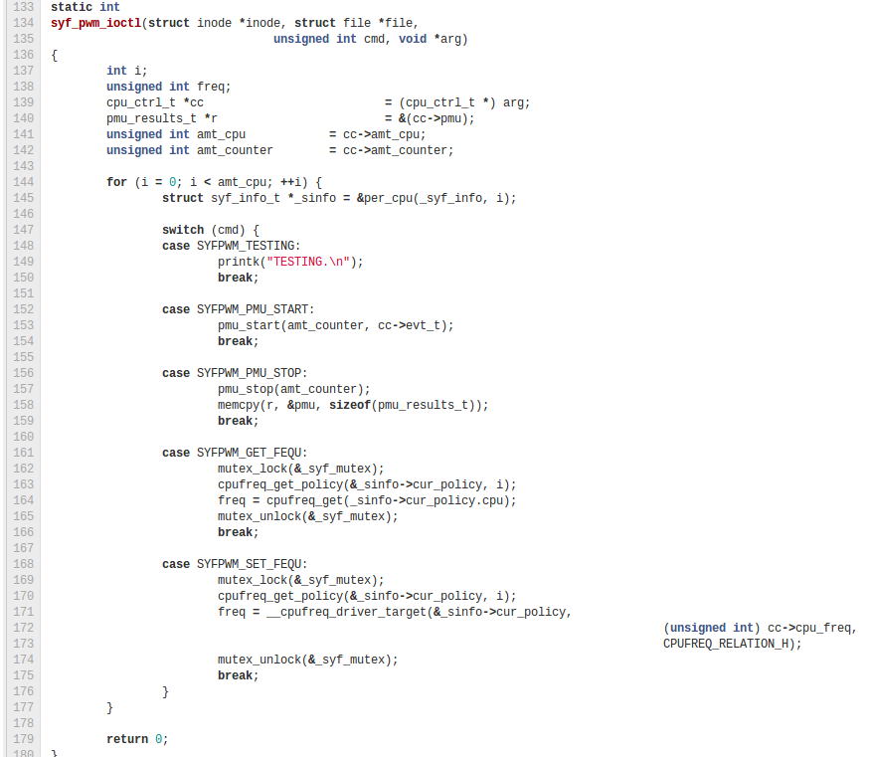

Slide 29
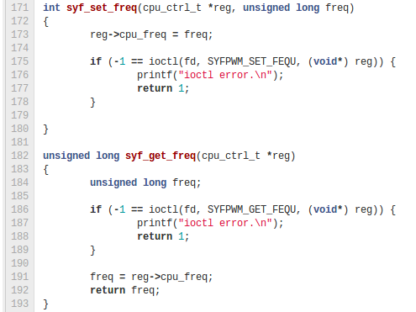
User-Space Application

Slide 30
Open Source
https://github.com/pickerweng/syf-pwm

