Slide 1
Exhaustive search
CS 466
Saurabh Sinha

Slide 2
Agenda
Two different problems
  Restriction mapping
  Motif finding
  Common theme: exhaustive search of solution space
Reading: Chapter 4.

Slide 3
Restriction Mapping

Slide 4
Restriction enzymes
A protein that cuts DNA at very specific sites (occurrences of a particular word)
Foreign (viral) DNA entering a bacterium is usually unable to do anything
Reason: Restriction enzymes shred the DNA
Do not cleave “methylated” DNA
  Host DNA is suitably methylated, hence protected
1973 Nobel Prize in Medicine: discovery of restriction enzymes

Slide 5
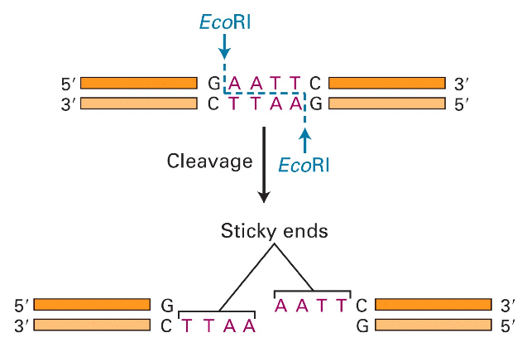
Molecular Scissors
Molecular Cell Biology, 4th edition

Slide 6
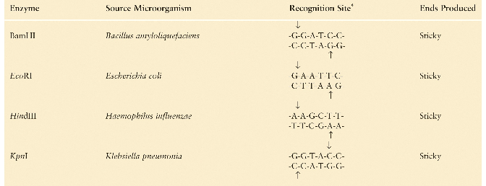
Recognition Sites of Restriction Enzymes
Molecular Cell Biology, 4th edition

Slide 7
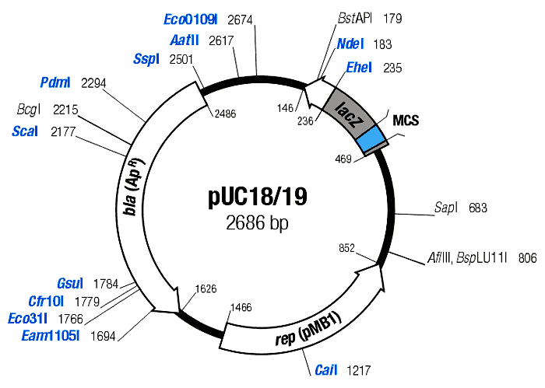
Restriction Maps
• A map showing positions of restriction sites in a DNA sequence
• If DNA sequence is known then construction of restriction map is a trivial exercise
• In early days of molecular biology DNA sequences were often unknown
• Biologists had to solve the problem of constructing restriction maps without knowing DNA sequences
What is this?
A “plasmid”; Read more about this

Slide 8
Measuring Length of Restriction Fragments
Restriction enzymes break DNA into restriction fragments.
Gel electrophoresis is a process for separating DNA by size and measuring sizes of restriction fragments
Can separate DNA fragments that differ in length in only 1 nucleotide for fragments up to 500 nucleotides long

Slide 9
Partial Restriction Digest
The sample of DNA is exposed to the restriction enzyme for only a limited amount of time to prevent it from being cut at all restriction sites
This experiment generates the set of all possible restriction fragments between every two (not necessarily consecutive) cuts
This set of fragment sizes is used to determine the positions of the restriction sites in the DNA sequence

Slide 10
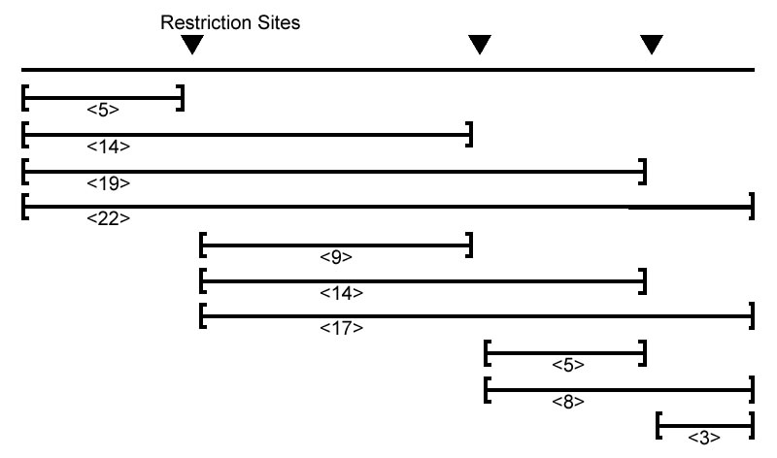
Partial Restriction Digest
Multiset of fragment lengths:
{3, 5, 5, 8, 9, 14, 14, 17, 19, 22}

Slide 11

Partial Digest Problem (PDP)
Let X = { x₁, x₂, x₃, … x_{n} }
Given pairwise distances between each pair {x_{i}, x_{j}}
Given ∆X = { x_{j} - x_{i} | 1 ≤ i < j ≤ n }
Reconstruct X
Does a unique solution exist ?

Slide 12
Partial Digest Problem (PDP)
Let X = { x₁ = 0, x₂, x₃, … x_{n} }
Given pairwise distances between each pair {x_{i}, x_{j}}
Given ∆X = { x_{j} - x_{i} | 1 ≤ i < j ≤ n }
Reconstruct X

Slide 13
Brute force algorithm
Also called enumerative algorithms
Used in some problems in bioinformatics
If the program runs in reasonable time …
If the “goodness” of the algorithm is in a special objective function, enumerative search can guarantee finding the optimal solution

Slide 14

Brute Force PDP
Given L = set of all pairwise distances
Need to find X such that ∆X = L
Know that x₁ = 0 and …
… x_{n} = M (where M is the largest number in L)
x₂, x₃, … x_{n-1} must all be integers between 1 and M-1.
Try all possible solutions:
Approximately O(M^{n-2})

Slide 15

Brute Force PDP 2
Do we need to try every integer between 0 and M ?
Since x₁ = 0, …
… for every x_{i} in X, the number (x_{i} - x₁) = x_{i} must be in ∆X
We need to find X such that ∆X = L. Therefore, only consider x_{i} that are in L
Therefore, only |L| possibilities from which to choose n-2 numbers
Try all possible solutions:
Approximately O(|L|^{n-2}), i.e., O(n^{2n-4})

Slide 16
A practical solution: key idea
0
M
Pick the largest (other than M) number from L
Let this be ∂

Slide 17
A practical solution: key idea
∂
0
M
Case i
∂

Slide 18
A practical solution: key idea
∂
0
M
Case ii
M-∂

Slide 19
Notation
D(y, X) = {|y – x₁|, |y – x₂|, …, |y – x_{n}|}
for X = {x₁, x₂, …, x_{n}}

Slide 20
An Example
L = { 2, 2, 3, 3, 4, 5, 6, 7, 8, 10 }
X = { 0 }

Slide 21
An Example
L = { 2, 2, 3, 3, 4, 5, 6, 7, 8, 10 }
X = { 0 }
Remove 10 from L and insert it into X. We know this must be
the length of the DNA sequence because it is the largest
fragment.

Slide 22
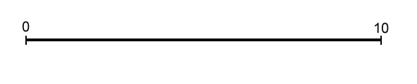
An Example
L = { 2, 2, 3, 3, 4, 5, 6, 7, 8, 10 }
X = { 0, 10 }

Slide 23
An Example
L = { 2, 2, 3, 3, 4, 5, 6, 7, 8, 10 }
X = { 0, 10 }
Take 8 from L and make y = 2 or 8. Let us go with y = 2.

Slide 24
An Example
L = { 2, 2, 3, 3, 4, 5, 6, 7, 8, 10 }
X = { 0, 10 }
We find that the distances from y=2 to other elements in X are D(y, X) = {8, 2}, so we remove {8, 2} from L and add 2 to X.

Slide 25
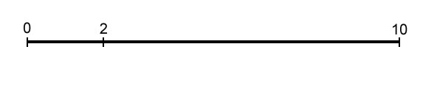
An Example
L = { 2, 2, 3, 3, 4, 5, 6, 7, 8, 10 }
X = { 0, 2, 10 }

Slide 26
An Example
L = { 2, 2, 3, 3, 4, 5, 6, 7, 8, 10 }
X = { 0, 2, 10 }
Take 7 from L and make y = 7 or y = 10 – 7 = 3. We will
explore y = 7 first, so D(y, X ) = {7, 5, 3}.

Slide 27
An Example
L = { 2, 2, 3, 3, 4, 5, 6, 7, 8, 10 }
X = { 0, 2, 10 }
For y = 7 first, D(y, X ) = {7, 5, 3}. Therefore we
remove {7, 5 ,3} from L and add 7 to X.
D(y, X) = {7, 5, 3}

Slide 28
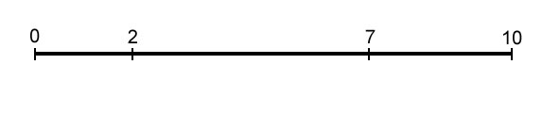
An Example
L = { 2, 2, 3, 3, 4, 5, 6, 7, 8, 10 }
X = { 0, 2, 7, 10 }

Slide 29
An Example
L = { 2, 2, 3, 3, 4, 5, 6, 7, 8, 10 }
X = { 0, 2, 7, 10 }
Take 6 from L. We can have y = 4 or y = 6. Let’s make y = 6. Unfortunately D(y, X) = {6, 4, 1 ,4}, which is not a subset of L. Therefore we won’t explore this branch.
6

Slide 30
An Example
L = { 2, 2, 3, 3, 4, 5, 6, 7, 8, 10 }
X = { 0, 2, 7, 10 }
This time make y = 4. D(y, X) = {4, 2, 3 ,6}, which is a
subset of L so we will explore this branch. We remove
{4, 2, 3 ,6} from L and add 4 to X.

Slide 31
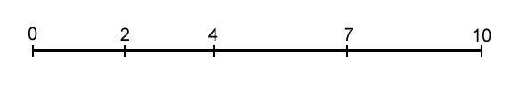
An Example
L = { 2, 2, 3, 3, 4, 5, 6, 7, 8, 10 }
X = { 0, 2, 4, 7, 10 }

Slide 32
An Example
L = { 2, 2, 3, 3, 4, 5, 6, 7, 8, 10 }
X = { 0, 2, 4, 7, 10 }
L is now empty, so we have a solution, which is X.

Slide 33
An Example
L = { 2, 2, 3, 3, 4, 5, 6, 7, 8, 10 }
X = { 0, 2, 7, 10 }
To find other solutions, we backtrack.

Slide 34
An Example
L = { 2, 2, 3, 3, 4, 5, 6, 7, 8, 10 }
X = { 0, 2, 10 }
More backtrack.

Slide 35
An Example
L = { 2, 2, 3, 3, 4, 5, 6, 7, 8, 10 }
X = { 0, 2, 10 }
This time we will explore y = 3. D(y, X) = {3, 1, 7}, which is
not a subset of L, so we won’t explore this branch.

Slide 36
Algorithm
Given L, build X incrementally, starting from X = {0, M}
At each step, extract y = maximum element in L
Consider the two possibilities:
    y is in X
    M - y is in X
Check if either possibility is consistent with L, and if so, include that in X, remove the induced pairwise distances from L, and proceed
Backtracking
Pseudo code of algorithm in Section 4.3.
If you are new to algorithms, please read this.

Slide 37
Time complexity
At each step, two possibilities to pursue
Checking each possibility takes O(n) time
T(n) = 2T(n-1) + O(n)
T(n) = O(n2^{n})
This is an “exponential time algorithm”
Actually, a “polynomial time algorithm” exists
  Maurice Nivat and colleagues, 2002.
What is “n” here?

Slide 38
Second example of exhaustive search:
Motif finding

Slide 39
My fruitfly has a bacterial infection
When attacked by bacteria, the fruitfly’s immune system kicks in
Many genes that were lying “dormant” now producing their proteins, to fight the infection. (Some otherwise active genes may now become inactive.)
Which genes are these ?

Slide 40
Looking for differentially expressed genes
Measure the activity level of all genes in normal fly and in infected fly
Find genes whose activity levels are significantly different between the two conditions
How to measure gene activity level ?

Slide 41
DNA Arrays--Technical Foundations
An Introduction to Bioinformatics Algorithms
www.bioalgorithms.info
An array works by exploiting the ability of a given mRNA molecule to hybridize to the DNA template.
Using an array containing many DNA samples in an experiment, the expression levels of hundreds or thousands genes within a cell by measuring the amount of mRNA bound to each site on the array.
With the aid of a computer, the amount of mRNA bound to the spots on the microarray is precisely measured, generating a profile of gene expression in the cell.
<date/time>May, 11, 2004
http://www.ncbi.nih.gov/About/primer/microarrays.html

Slide 42
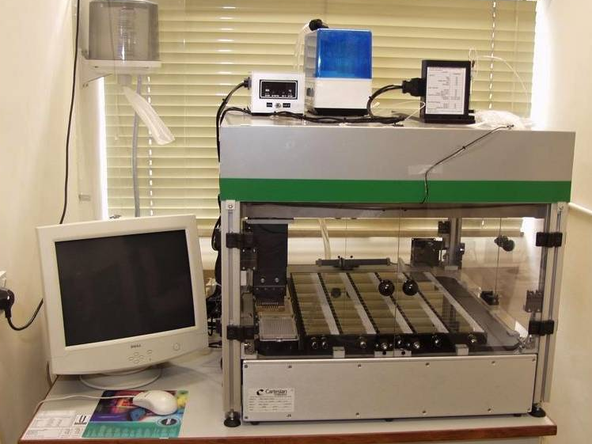
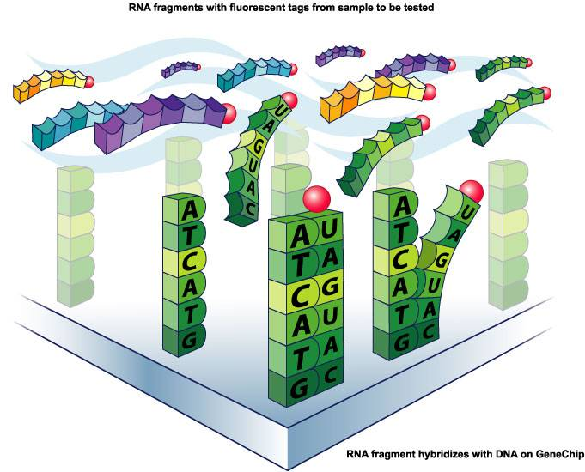
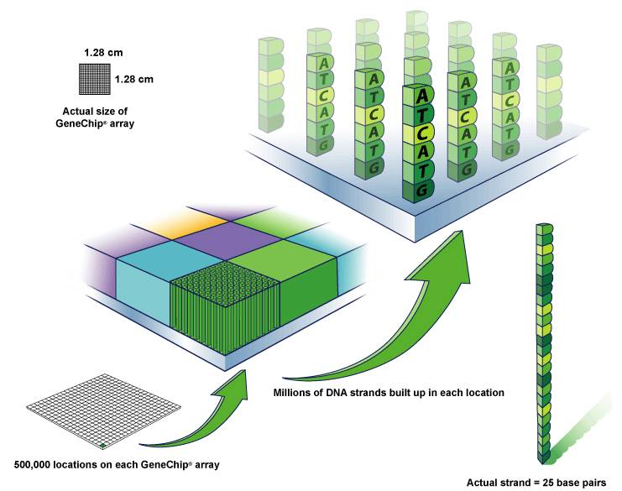
DNA Microarray
An Introduction to Bioinformatics Algorithms
www.bioalgorithms.info
Millions of DNA strands
build up on each location.
Tagged probes become hybridized to the DNA chip’s microarray.
<date/time>May, 11, 2004
http://www.affymetrix.com/corporate/media/image_library/image_library_1.affx

Slide 43
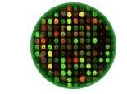
An experiment on a microarray
In this schematic:
GREEN represents Control DNA
RED represents Sample DNA
YELLOW represents a combination of Control and Sample DNA
BLACK represents areas where neither the Control nor Sample DNA
Each color in an array represents either healthy (control) or diseased (sample) tissue.
The location and intensity of a color tell us whether the gene is present in
the control and/or sample DNA.
May 11,2004
http://www.ncbi.nih.gov/About/primer/microarrays.html
10

Slide 44
Differentially expressed genes
Find a set of genes differentially expressed in the infected fly
These are perhaps the ones orchestrating the immune response
Look at promoters of these genes
Find that the substring TCGGGGATTTCC occurs often (modulo minor spelling mistakes) in these promoters

Slide 45
Regulatory motif
TCGGGGATTTCC is the canonical binding site recognized by the NFkB transcription factor
Infer that NFkB is turning on the immunity !
What if we did not know that NFkB binds TCGGGGATTTCC ?
Could we have just gazed at the promoter sequences, and discovered this binding site ?

Slide 46
Finding motifs ab initio
Enumerate all possible strings of some fixed (small) length
For each such string (“motif”) count its occurrences in the promoters
Report the most frequently occurring motif
Does the true motif pop out ?

Slide 47
Today’s summary
Restriction enzymes and restriction site maps
Partial Digest Problem: an enumerative algorithm
DNA Microarrays and differentially expressed genes. Prelude to the motif finding problem.

