Slide 1
Text Understanding Using Convolutional Neural Network
Yuxin Cui
Mingxiang Zhu
Md Modasshir

Slide 2
PROBLEM

Slide 3
Text Understanding
Text Understanding refers to reading texts in human language and deriving both explicit or implicit meaning. [1]
It also means making inferences about the implicit and explicit properties of these texts. [1]
Texts include words, phrases, sentences and paragraphs. [1]

Slide 4
Difficulties in Text Understanding
This problem has been traditionally difficult because of the extreme variability in language formation[2].
Every language is unique in its formation and varies widely from others.[2]
To handle text understanding, human written parsing program or statistically learnt model has been used.[3]

Slide 5
Our Choice: Convolutional Neural Network
CNN does not require knowledge of words - working with characters is fine.
Working with character inherently excludes problem with high dimensionality.
CNN does not require knowledge of syntax or semantic structures.

Slide 6
data

Slide 7


Data Description
Data Source: Rotten Tomatoes.
Label | Reviews
Fresh | ('Age of Ultron') is, to paraphrase an old saying, 10 pounds of movie in a five-pound bag.
Rotten | More does not necessarily equal better; here, more is just ... meh.

Slide 8
model

Slide 9
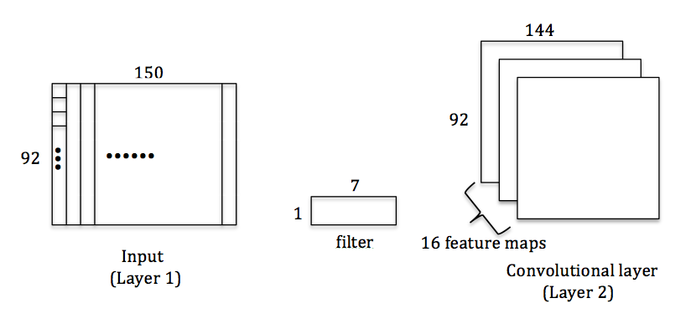
Convolutional neural network model
Note that, only the first 150 characters of each review is used
The total number of different characters is 92

Slide 10
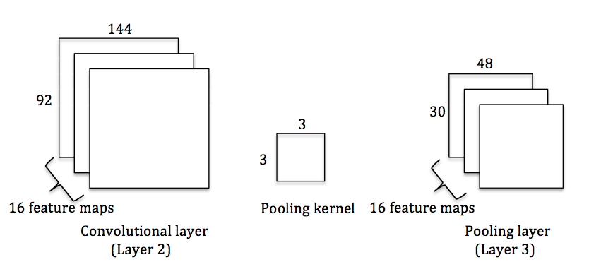

Slide 11
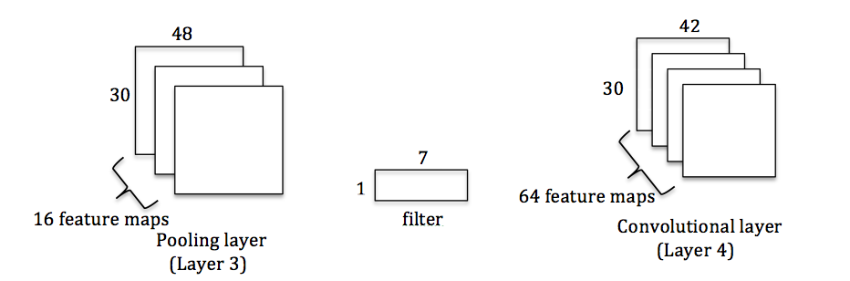

Slide 12
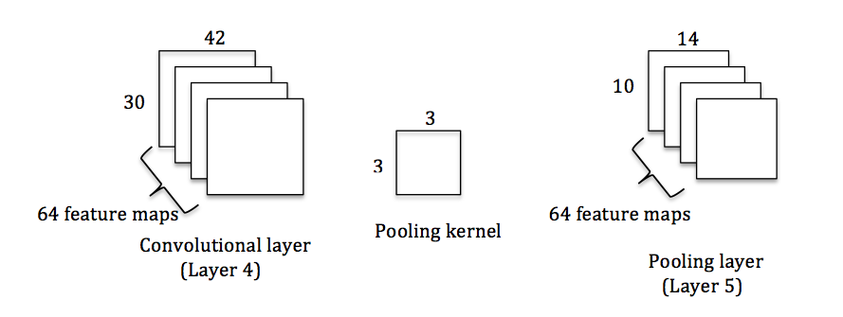

Slide 13
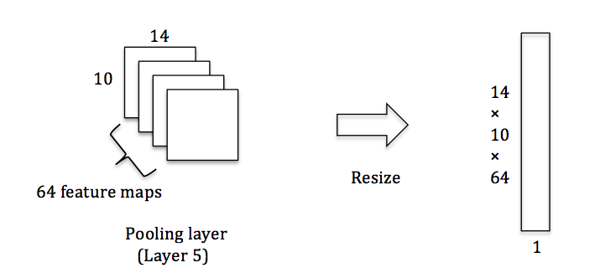

Slide 14
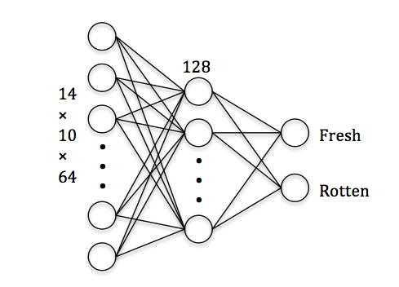

Slide 15
Result
Training sample: 50,000
Testing sample: 10,000
Accuracy: 99.98%
Result obtained using traditional neural network: 78%

Slide 16
Reference
Norvig, Peter. Inference in text understanding. In AAAI, pp. 561–565, 1987.
Linell, P. The Written Language Bias in Linguistics. 1982
Zhang, Xiang, and Yann LeCun. "Text Understanding from Scratch." arXiv preprint arXiv:1502.01710 (2015).

Slide 17
Thanks!

