Slide 1
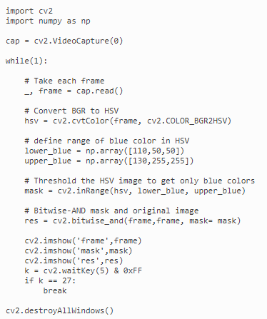
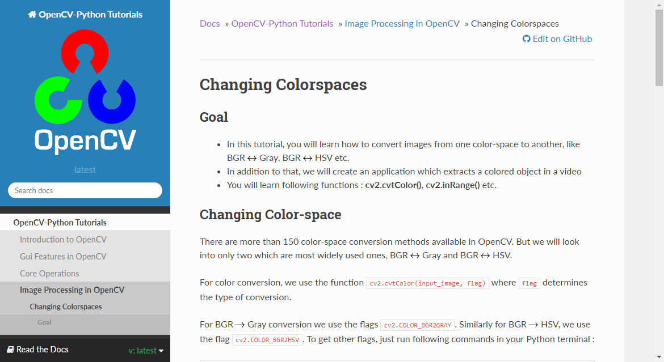
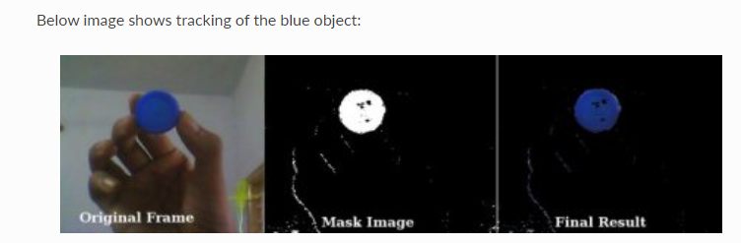
Sep 4, Week 1
brief toturials on opencv
https://opencv24-python-tutorials.readthedocs.io/en/latest/py_tutorials/py_imgproc/py_colorspaces/py_colorspaces.html

Slide 2
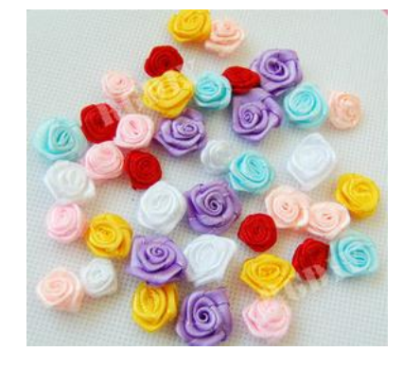
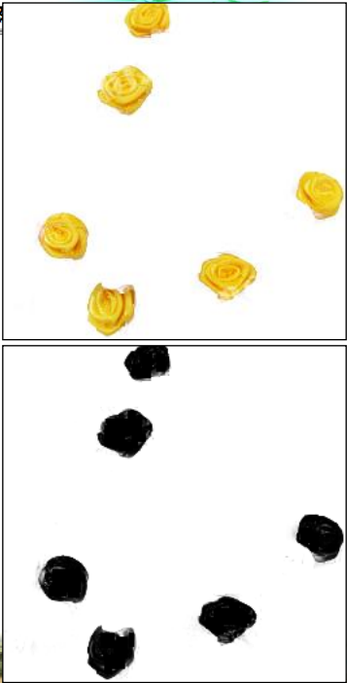
Sep 11, Week 2
Assignment 1: How to improve detection performance?
Three or more images should be included to verify enhancement performance based on different methods.

Slide 3
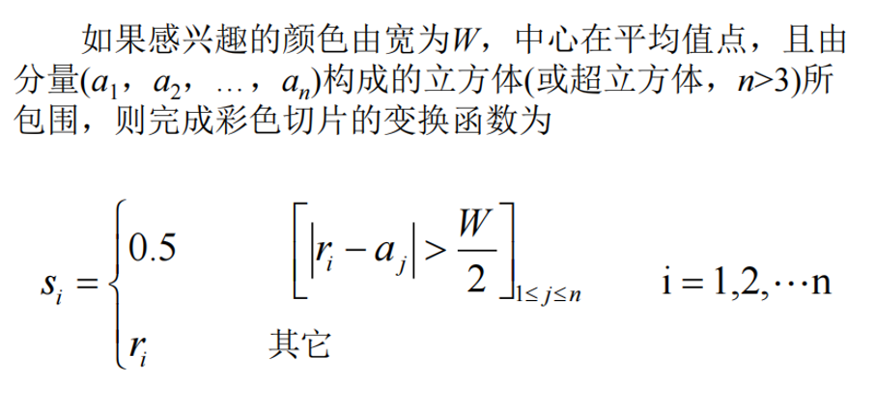
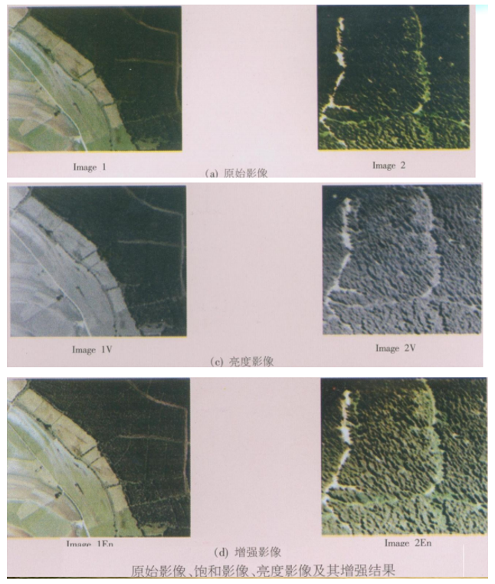
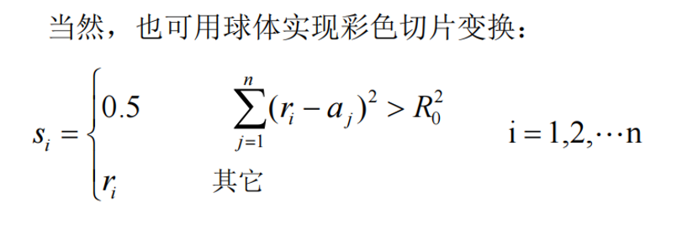
Sep 11, Week 2
Assignment 1: How to improve detection performance?

Slide 4
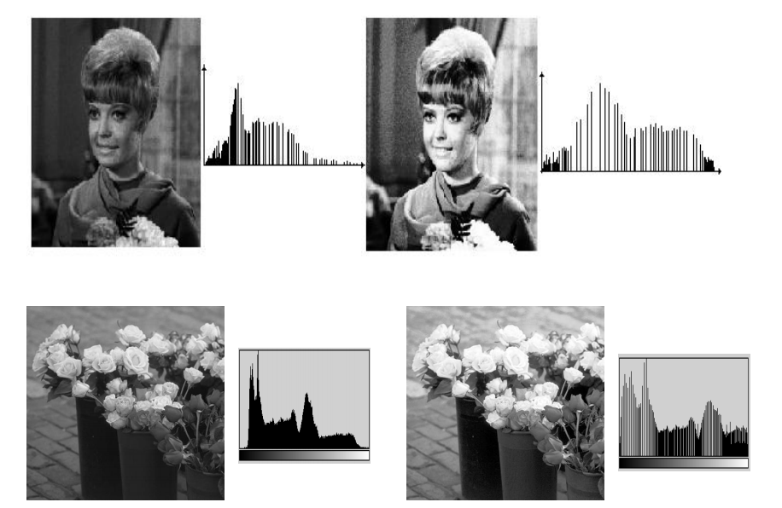
Sep 18, Week 3
尝试使用直方图均衡化的方案对前一次作业的三张图像进行改进，检测效果是否有提升？如果效果不好，是哪里出了问题？

Slide 5
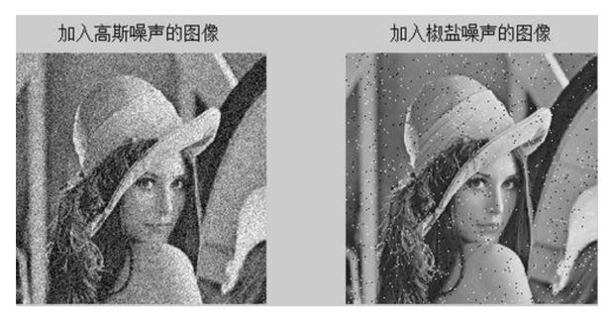
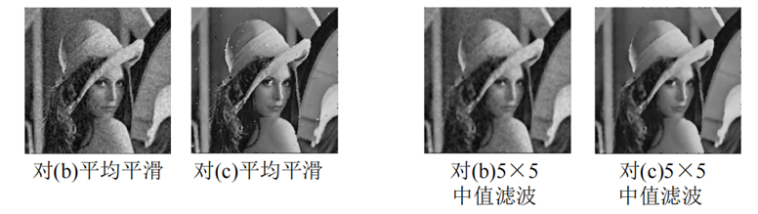
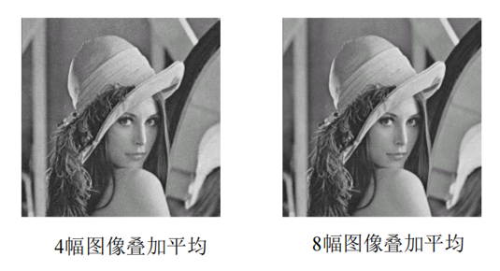
Sep 25, Week 4
Assignment 2: Will the detection performance decrease a lot after adding noise on the three selected images?
How to adopt image enhancement methods to improve the detection performance on noisy images?

Slide 6
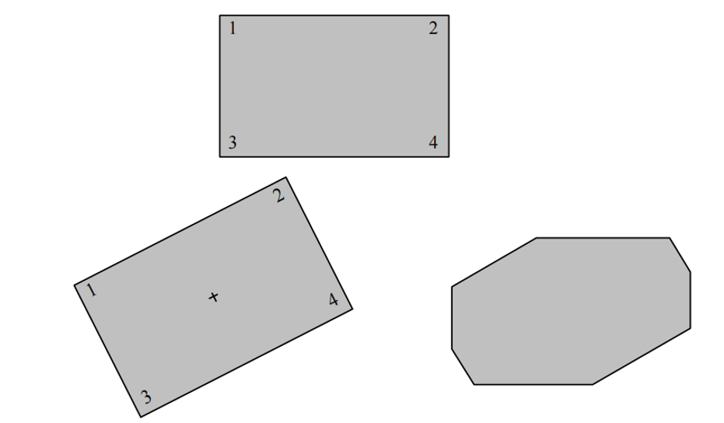
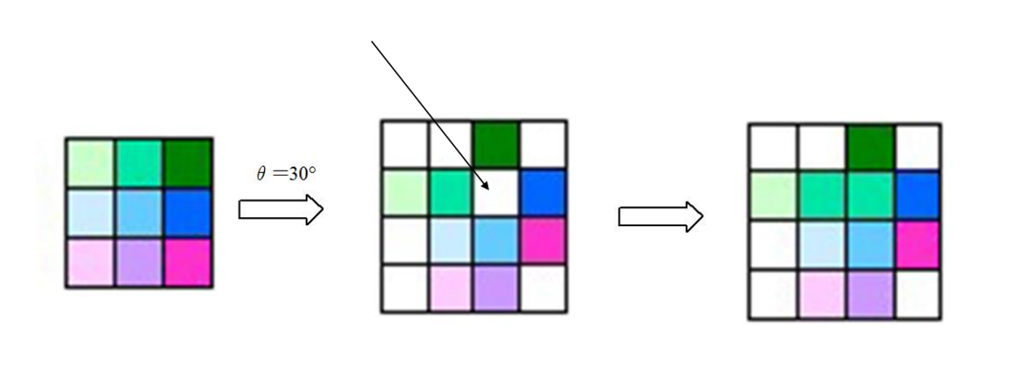
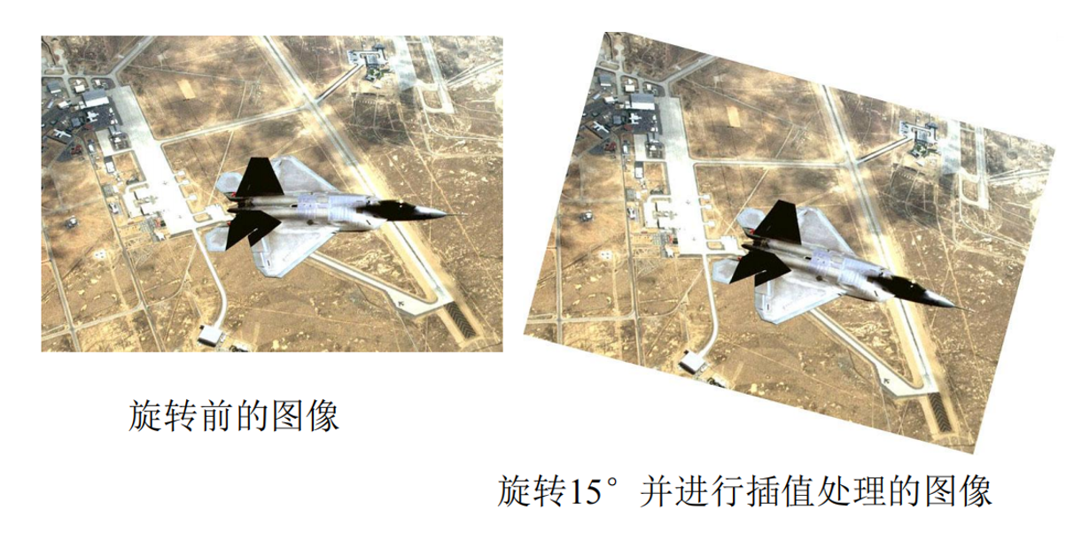
Oct 9, Week 6
尝试使用多种复合变换对原始图像进行旋转变换，其中包括选择后的裁剪和空缺插值

Slide 7
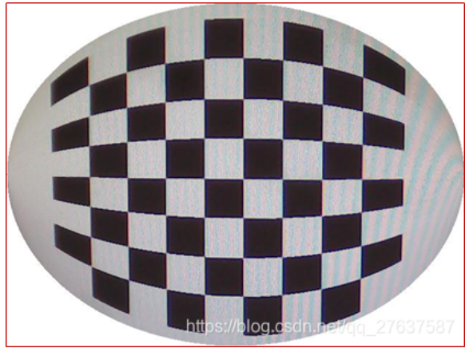
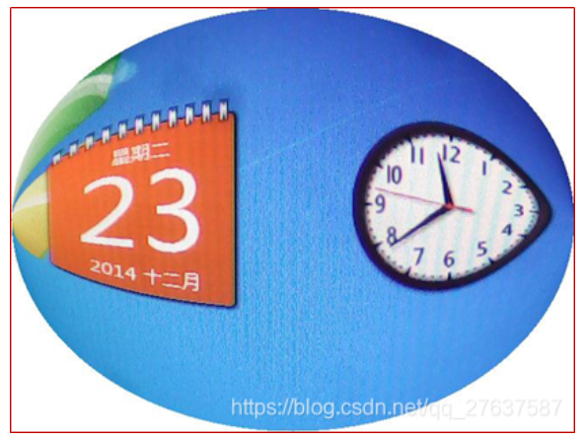
Oct 16, Week 7
Assignment 3：相同条件下拍到的棋盘图和日历钟表图，尝试建立几何畸变关系，并且对他们进行恢复。注意：不能采用椭圆变换。

Slide 8
Oct 30, Week 9
Do you remember color-based segmentation?
如果不使用基于颜色的方案，而是基于边缘检测，是否可以得到良好的分割效果？
tips：可以直接使用各类成熟算子，但是如何针对RGB图像进行处理呢？

Slide 9
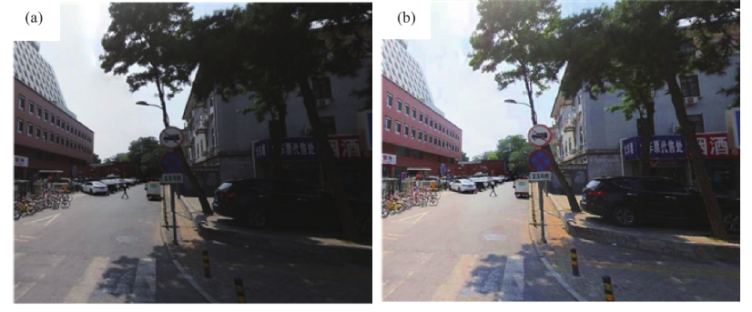
Nov 6, Week 10
Assignment 4: Canny算子的原理和使用
使用Canny算子对下述图像进行边缘提取，尝试搭建一个光照鲁棒的边缘提取算法。Tips：留意这张街景图像的重点区域，e.g. 交通标识，车/人/路肩等

