Slide 1
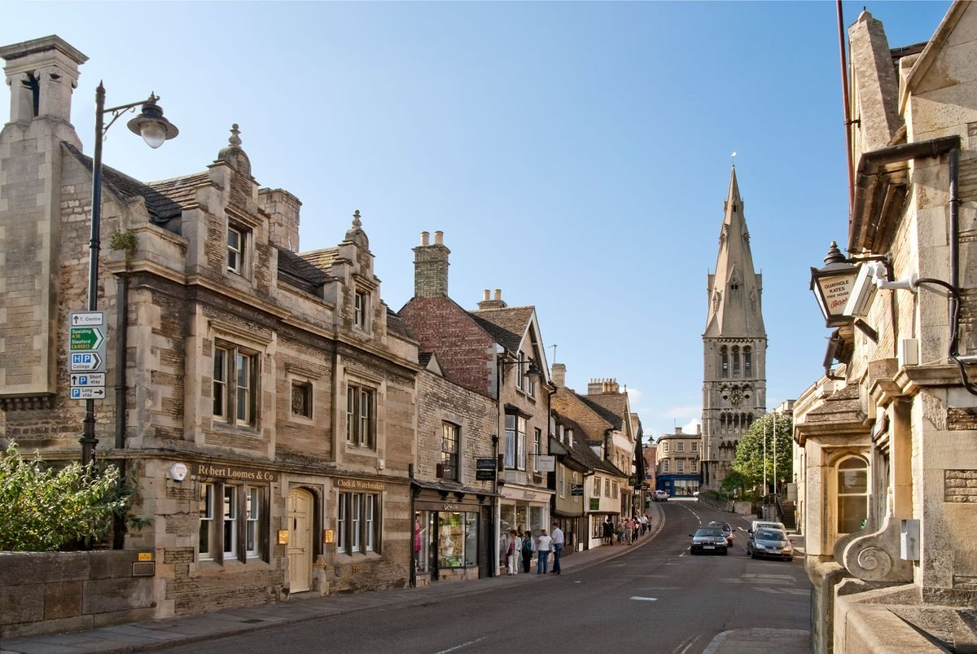
15–18 OCTOBER 2026
London to York
A relaxed autumn road trip · Stamford lunch stop · Three nights in York · Castle Howard and Robin Hood’s Bay
Car pickup: Thursday 15 October, 9am, Canary Wharf

Slide 2
Your four days
Thursday 15 to Sunday 18 October
Day | Plan
Thursday | Canary Wharf → Stamford → York
Friday | York Minster, old town and Shambles Market
Saturday | Castle Howard and Robin Hood’s Bay
Sunday | Leave York. London return is provisional
Railway House York: 3 nights, 15–18 October · 128 Holgate Road, YO24 4FL · Free private parking
All driving times are estimates. Traffic and comfort stops may change arrival times.

Slide 3
Thursday: Stamford, then York
15 October 2026
Time | Plan
9am | Pick up car in Canary Wharf
9.30am–12pm | Drive to Stamford
12–1pm | Lunch in town
1–3.30pm | Shops, old streets and river walk
3.30–6pm | Drive to York
6pm / 7pm | Railway House check-in / dinner
About 3½ hours in Stamford. Thursday is not the main market day.

Slide 4
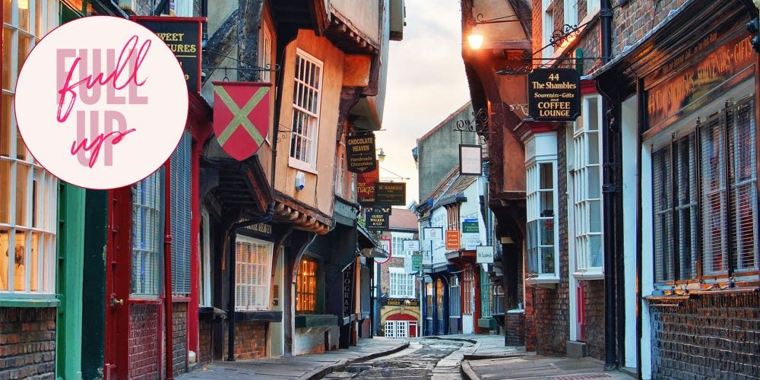
Friday: York at an easy pace
16 October 2026 · Leave the car at Railway House
Time | Plan
8.30am | Breakfast
10–11.30am | York Minster
11.30–12.30 | Stonegate shops and coffee
12.30–1.30pm | Lunch
1.30–2.30pm | The Shambles and market
2.30–3.30pm | Optional short city walls walk
3.30pm onwards | Rest, shops, then 7pm dinner
Leave around 9.15am. Allow 30–40 minutes to walk to the Minster, or take a taxi.

Slide 5
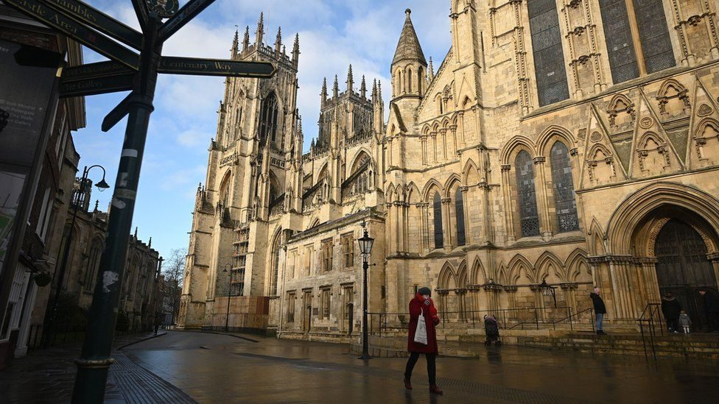
York Minster and the city walls
York Minster
The cathedral is York’s main landmark. Allow 1–1½ hours for Gothic architecture and stained glass.
A short wall walk
Choose a section near the Minster. The full circuit is 3.4km — a shorter walk is more comfortable.
Book Minster entry. Walls close at dusk and can close in poor weather.

Slide 6
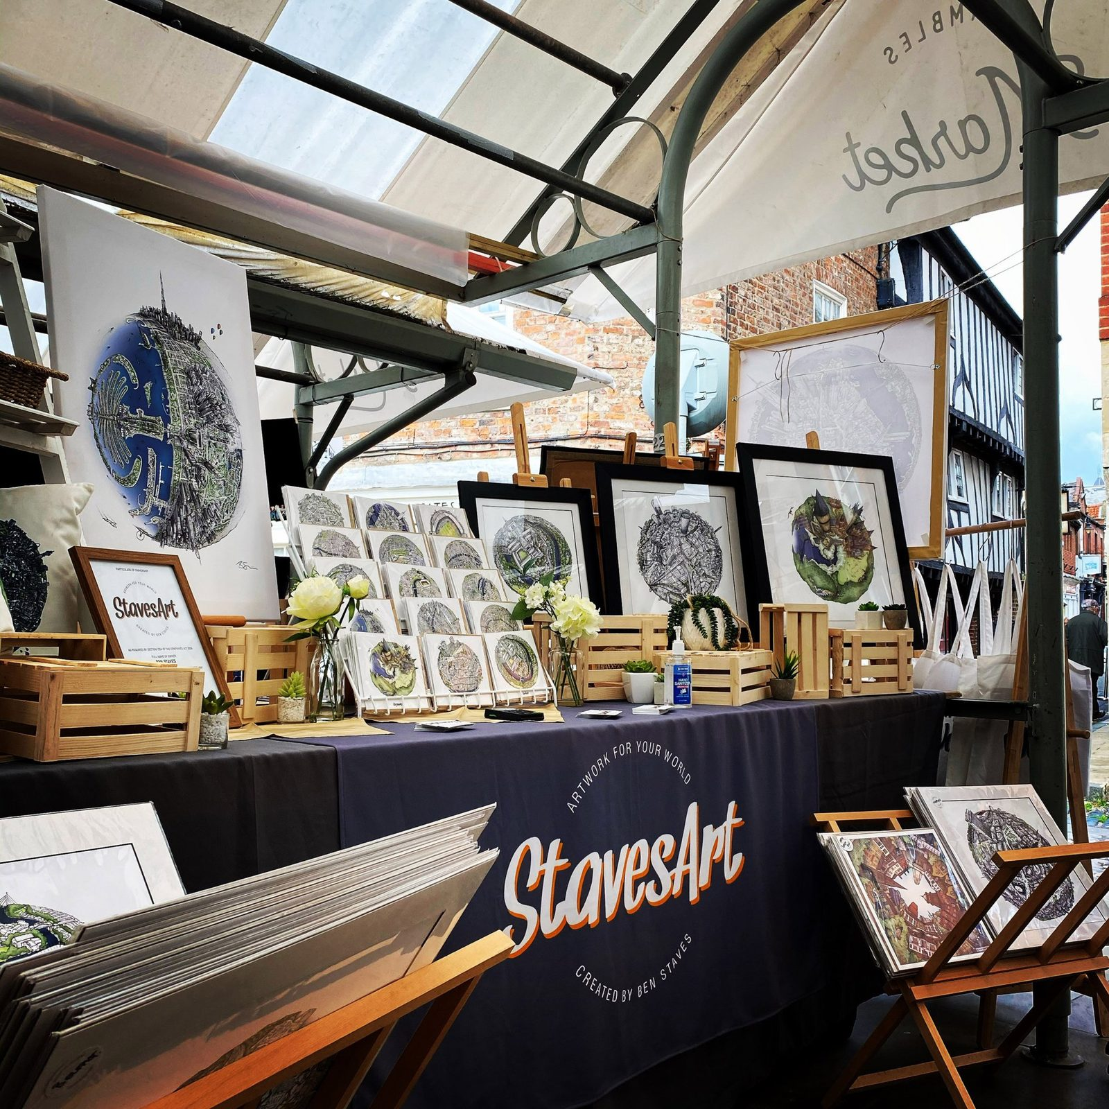
Shambles Market
Friday afternoon · Allow around an hour with The Shambles
A local market in the old town
Browse independent stalls for gifts and local produce, with street food nearby. An easy stop while exploring The Shambles.
Open daily, 9am–5pm
Individual traders’ days and hours vary.

Slide 7
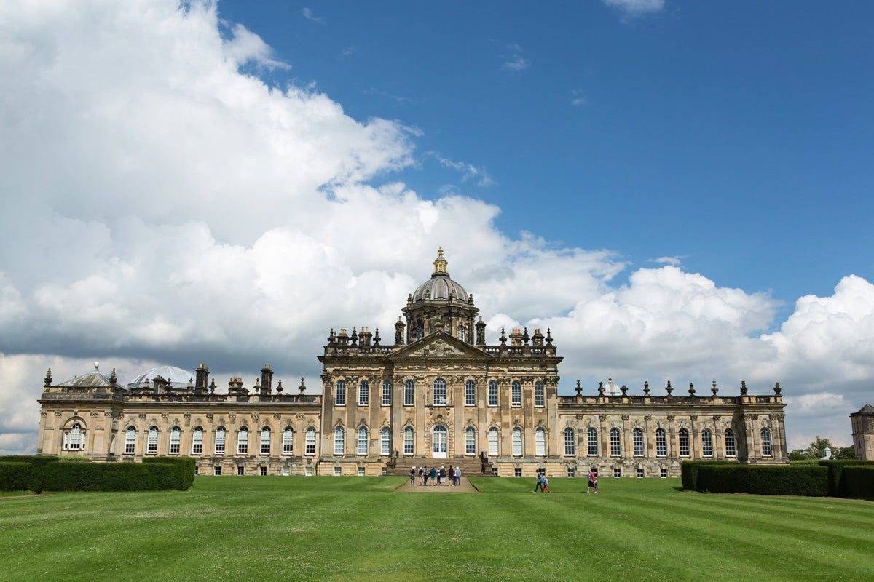
Saturday: Castle Howard
17 October 2026 · Country house morning, coast afternoon
Time | Plan
9am | Breakfast
9.30–10.15am | Drive to Castle Howard
10.15–12.15 | House and a short garden stroll
12.15–1pm | Lunch at Castle Howard
1–2.15pm | Drive to Robin Hood’s Bay
2.15–5pm | Village, sea views and café stop
5–6.30pm | Back to York · dinner 7.30pm
A shorter house visit leaves time for the coast. Around 3 hours of driving today.

Slide 8
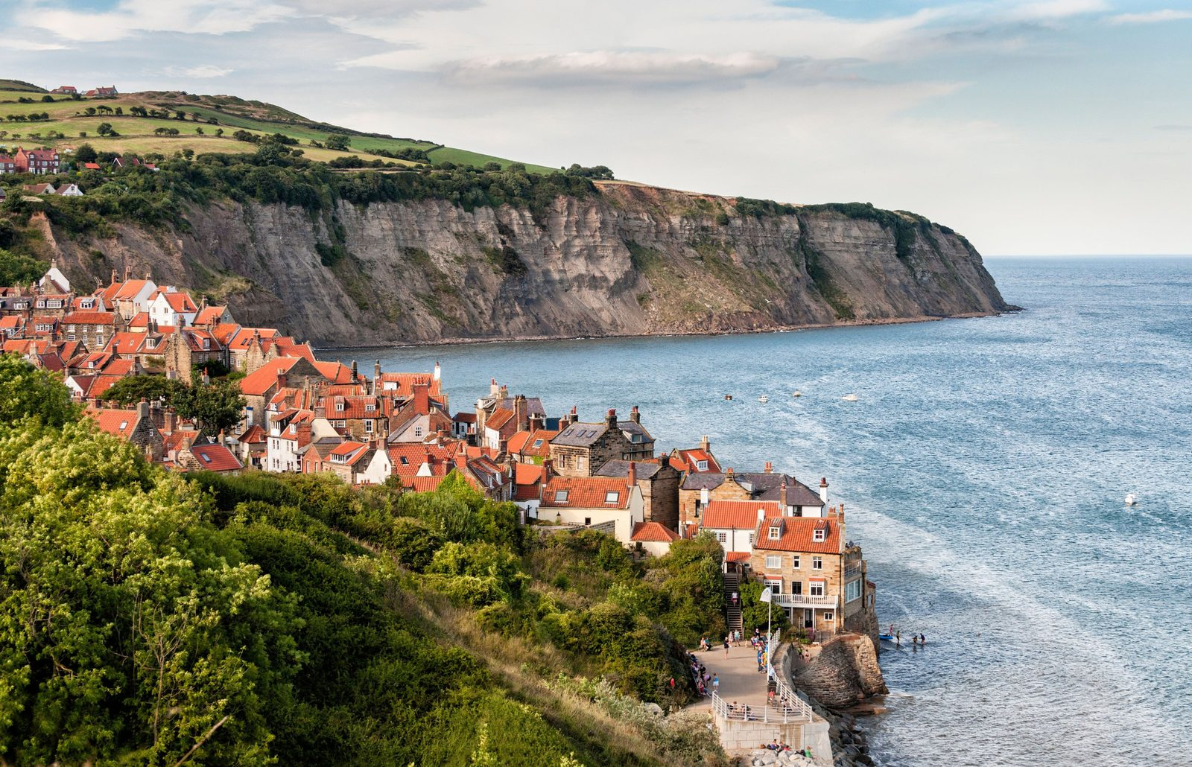
Robin Hood’s Bay
Saturday afternoon · Around 2¾ hours to explore
A fishing village by the sea
Red-roofed cottages and narrow lanes lead down to the shore. Enjoy the village, coastal views and a café stop. Beach time depends on the tide.
Parking and the hill
Park at the top. The walk down and back up is steep, so pace yourself and wear comfortable shoes.

Slide 9
Sunday: departure and trip notes
18 October 2026 · London return is an assumption
Time | If returning to London
8.30–9.30am | Breakfast and pack
10am | Check out and leave York
12–1pm | Lunch and comfort stop en route
3.30–4.30pm | Target arrival in London
Your accommodation
Railway House York
128 Holgate Road
York YO24 4FL
Free private parking
Check-in: 3–10pm
Check-out: 10–10.30am
Allow 4½–5½ hours of driving plus breaks. London traffic may extend the journey.
Wear comfortable shoes and bring a rain jacket. Photos are place previews, not a forecast.

