Slide 1
Asynchronous programming & Working with persisted data

Slide 2
What is asynchronous programming?
A way of executing programming code in a thread without having to wait task to finish
Idea of asynchronous programming is to divide our logic into awaitable tasks
Benefits: better responsiveness of the app, better performance, avoiding bottlenecks

Slide 3
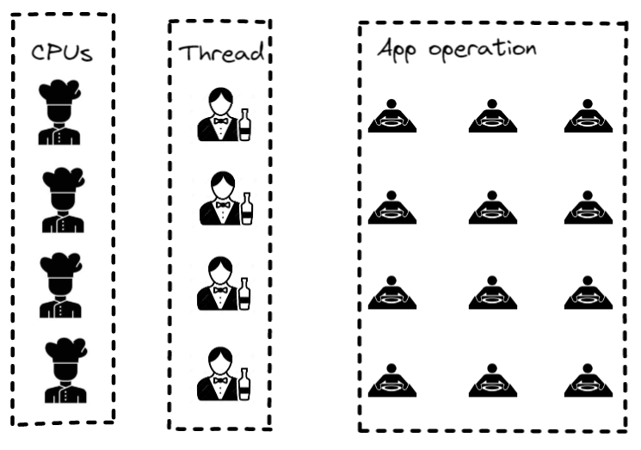
Example

Slide 4
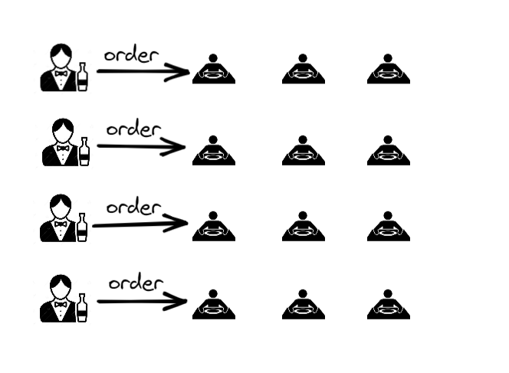
Example

Slide 5
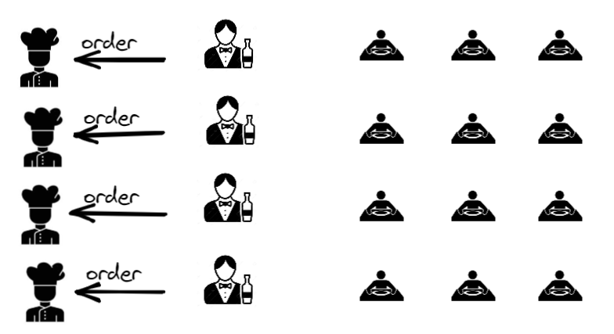
Example

Slide 6
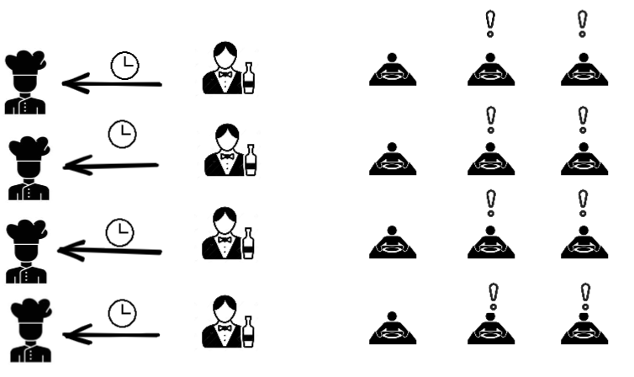
Synchronous

Slide 7
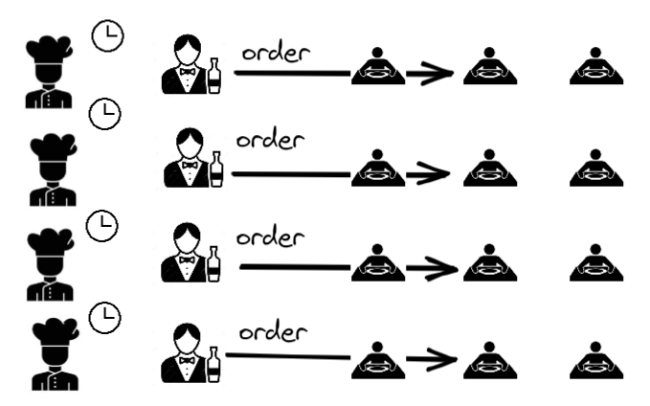
Asynchronous

Slide 8
Intro to Async, Await and Tasks
Asynchronous programming in C# can be accomplished by using Task based asynchronous patterns
Async/Await enable us to see asynchronous code as synchronous (code is much cleaner and easier to read)
It is an abstraction over asynchronous code
An asynchronous operation occurs in parallel and relives the calling thread of the work

Slide 9
Async & Await Demo

Slide 10
Things to remember
await converts Task<T> to <T> (Task to void)
Using await means that awaited method has to change signature to async Task[<T>]
Never create an method async void but always async Task[<T>]
You will get warning if you are calling async Task[<T>] method without using async
Async all the way (to the top)

Slide 11
NuGet
NuGet is the package manager for .NET.
The NuGet Gallery is the central package repository used by all package authors and consumers

Slide 12
NuGet Demo

Slide 13
Dapper
Tool that enables us to easily create, read, update and delete data
It provide us with easy way of mapping database data to objects
It has two main methods QueryAsync<T> (Get), ExecuteAsync (Insert, Update, Delete)

Slide 14
Dapper Demo

Slide 15
Let`s code!
Go to /week5/example.md

