Slide 1
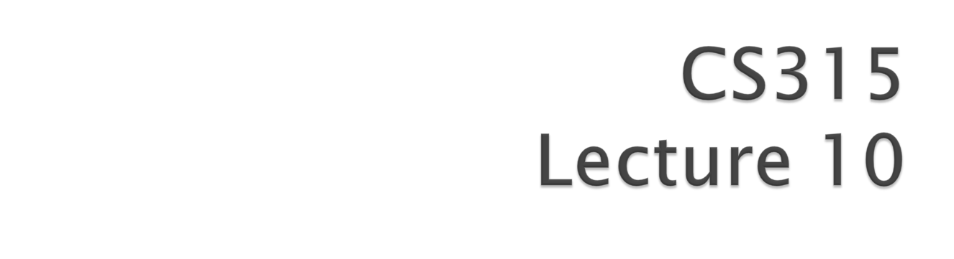

Slide 2

Client-side scripting generally refers to the class of computer programs on the web that are executed client-side, by the user's web browser instead of server-side (on the web server).
This type of computer programming is an important part of the Dynamic HTML.
Web authors write client-side scripts in languages such as JavaScript (Client-side JavaScript) and VBScript.

Slide 3

Client-side scripts are often embedded within an HTML document, but they may also be contained in a separate file.
The user's web browser executes the script, then displays the document, including any visible output from the script.
Client-side scripts may also contain instructions for the browser to follow in response to certain user actions, (ex: clicking a button).

Slide 4
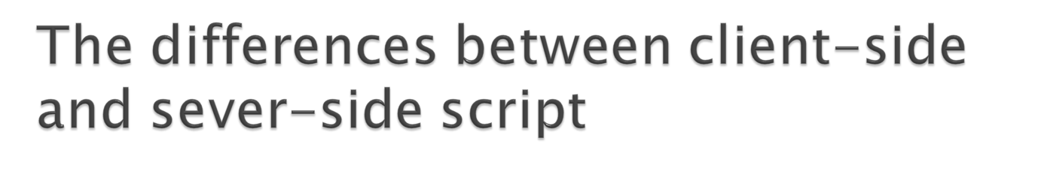
By viewing the file that contains the client-side script, users may be able to see its source code.
In contrast, the user cannot see server-side script's source code.
Client-side scripts have greater access to the information and functions available on the user's browser.
server-side scripts have greater access to the information and functions available on the server.
Server-side scripts require that their language's interpreter be installed on the server
Client-side scripts do not require additional software on the server.

Slide 5

JavaScript was designed to add interactivity to HTML pages
A scripting language is a lightweight programming language
JavaScript is usually embedded directly into HTML pages
JavaScript is an interpreted language (means that scripts execute without preliminary compilation)

Slide 6
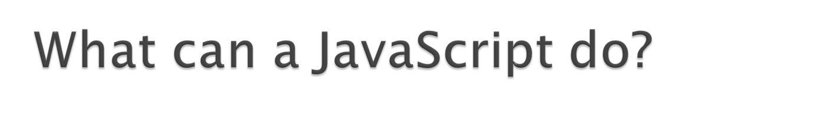
JavaScript gives HTML designers a programming tool
JavaScript can manipulate HTML
JavaScript can read and change the content of HTML elements.
JavaScript can manipulate CSS
JavaScript can read and change the style of HTML elements.
JavaScript can validate data
JavaScript can be used to validate data, like validating forms input.

Slide 7
JavaScript can react to events
JavaScript can be set to execute when something happens, like when a user clicks on an HTML element.
A JavaScript can be used to detect the visitor's browser, and - depending on the browser - load another page specifically designed for that browser.
JavaScript can be used to create cookies.

Slide 8
The HTML <script> tag is used to insert a JavaScript into an HTML page.
Scripts can be in the either <head> section or <body> section
<html>
<head>
<script type="text/javascript">
...
</script>
</head>
<body>
<script type="text/javascript">
...
</script>
</body>
</html>

Slide 9
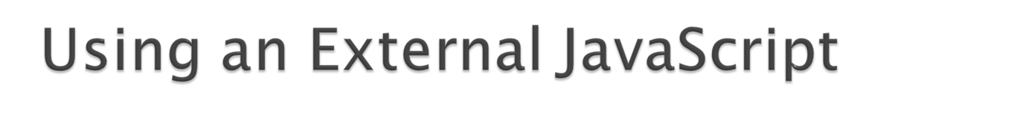
If you want to run the same JavaScript on several pages, without having to write the same script on every page, you can write a JavaScript in an external file.
Save the external JavaScript file with a .js file extension.
Note: The external script cannot contain the <script></script> tags!
To use the external script, point to the .js file in the "src" attribute of the <script> tag:
<html>
<head>
<script type="text/javascript" src="xxx.js"></script>
</head>
<body>
</body>
</html>

Slide 10
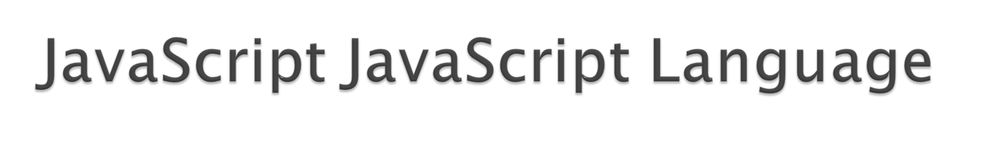
JavaScript Variable
Variable names are case sensitive.
Variable names must begin with a letter, the $ character, or the underscore character.
You create a variable with or without the var statement
  var strname = some value
  strname = some value
When you declare a variable within a function, the variable can only be accessed within that function.
If you declare a variable outside a function, all the functions on your page can access it
The lifetime of these variables starts when they are declared, and ends when the page is closed

Slide 11
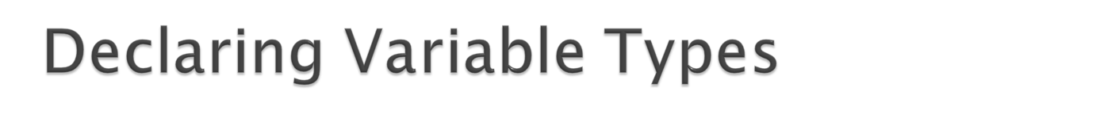
When you declare a new variable, you can declare its type using the "new" keyword:
var carname=new String;
var x= new Number;
var y= new Boolean;
var cars= new Array;
var person= new Object;
JavaScript variables are all objects. When you declare a variable you create a new object.

Slide 12
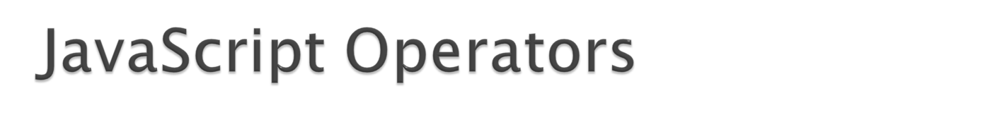
JavaScript Arithmetic Operators
Given that y=5, the table below explains the arithmetic operators:
Operator | Description | Example | Result
+ | Addition | x=y+2 | x=7
- | Subtraction | x=y-2 | x=3
* | Multiplication | x=y*2 | x=10
/ | Division | x=y/2 | x=2.5
% | Modulus (division remainder) | x=y%2 | x=1
++ | Increment | x=++y | x=6
-- | Decrement | x=--y | x=4

Slide 13

Given that x=10 and y=5, the table below explains the assignment operators:
Operator | Example | Same As | Result
= | x=y |  | x=5
+= | x+=y | x=x+y | x=15
-= | x-=y | x=x-y | x=5
*= | x*=y | x=x*y | x=50
/= | x/=y | x=x/y | x=2
%= | x%=y | x=x%y | x=0

Slide 14

The + operator can also be used to add string variables or text values together.
<html>
<body>
<script type="text/javascript">
  txt1="What a very";
  txt2="nice day";
  txt3=txt1+txt2;
  document.write(txt3);
  document.write("<br>"+txt1+" "+txt2 );
</script>
</body>
</html>

Slide 15
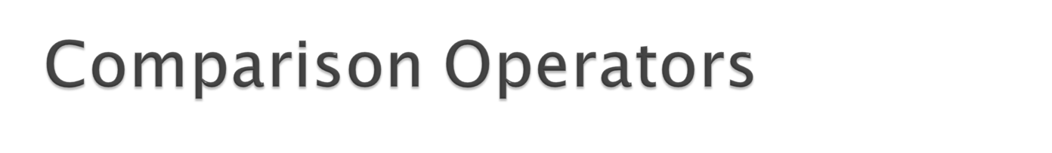
Given that x=6 and y=3, the table below explains the logical operators:
Operator | Description | Example
== | is equal to | x==8 is false
=== | is exactly equal to (value and type) | x===6 is true x===“6" is false
!= | is not equal | x!=8 is true
> | is greater than | x>8 is false
< | is less than | x<8 is true
>= | is greater than or equal to | x>=8 is false

Slide 16
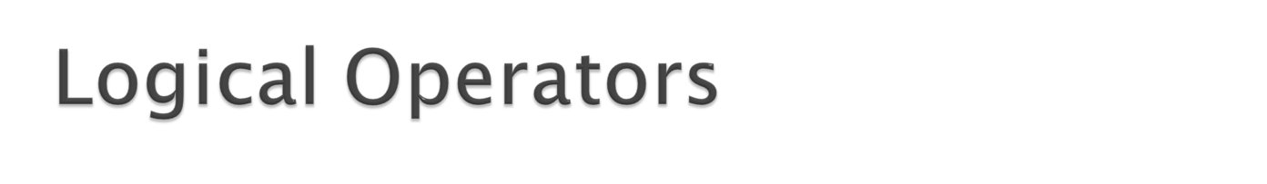
Given that x=6 and y=3, the table below explains the logical operators:
Operator | Description | Example
&& | and | (x < 10 && y > 1) is true
|| | or | (x==5 || y==5) is false
! | not | !(x==y) is true

Slide 17

If Statement
  Use the if statement to execute some code only if a specified condition is true.
  Syntax
    if (condition)
    {
    code to be executed if condition is true
    }
  Note that if is written in lowercase letters. Using uppercase letters (IF) will generate a JavaScript error!

Slide 18
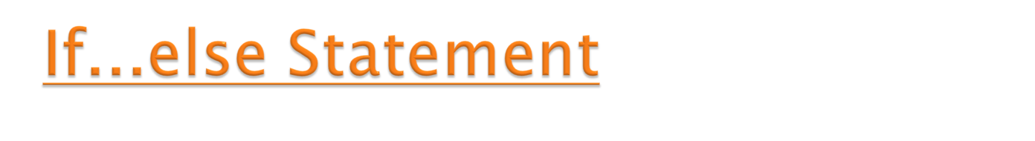
Syntax
  if (condition)
  {
  code to be executed if condition is true
  }
  else
  {
  code to be executed if condition is not true
  }

Slide 19
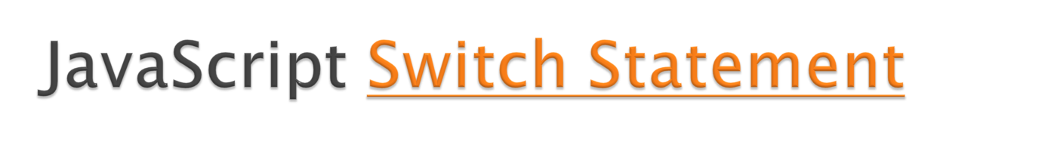
Syntax
  switch(n)
  {
  case 1:
  execute code block 1
  break;
  case 2:
  execute code block 2
  break;
  default:
  code to be executed if n is different from case 1 and 2
  }

Slide 20
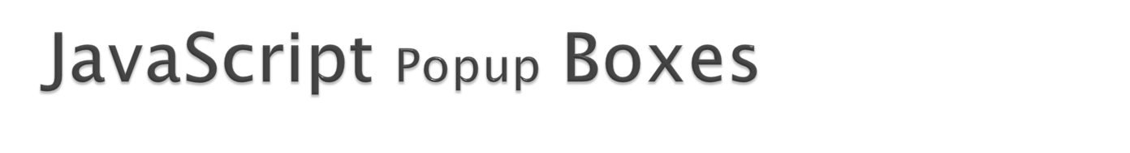
Alert box
  User will have to click "OK" to proceed
  alert("sometext")
Confirm box
  User will have to click either "OK" or "Cancel" to proceed confirm("sometext")
  If the user clicks "OK", the box returns true. If the user clicks "Cancel", the box returns false.
Prompt box
  User will have to click either "OK" or "Cancel" to proceed after entering an input value
  prompt("sometext","defaultvalue")
If the user clicks "OK" the box returns the input value. If the user clicks "Cancel" the box returns null.

Slide 21
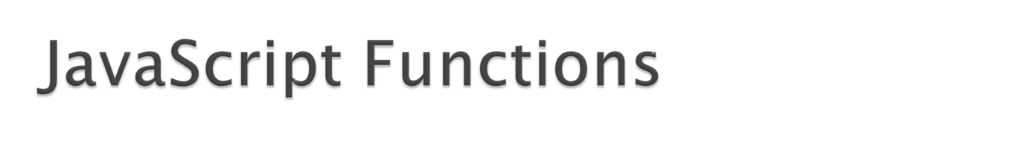
To keep the browser from executing a script when the page loads, you can put your script into a function.
A function contains code that will be executed by an event or by a call to the function.
You may call a function from anywhere within a page (or even from other pages if the function is embedded in an external .js file).
Functions can be defined both in the <head> and in the <body> section of a document. However, to assure that a function is read/loaded by the browser before it is called, it could be wise to put functions in the <head> section.

Slide 22
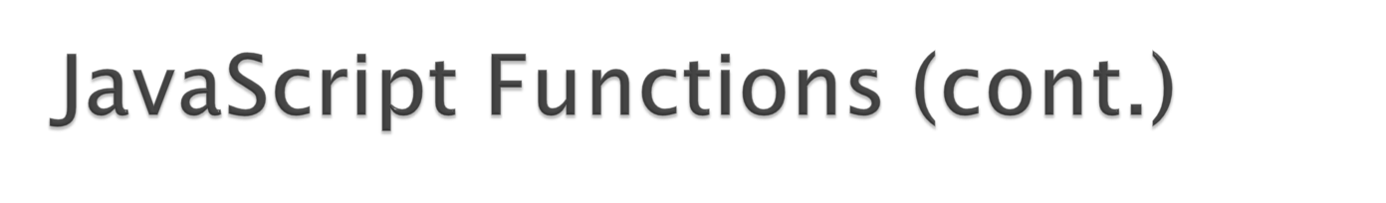
Syntax
  function functionname(var1,var2,...,varX)
  {
  some code
  }
A function with no parameters must include the parentheses () after the function name.
The word function must be written in lowercase letters, otherwise a JavaScript error occurs.
you must call a function with the exact same capitals as in the function name.

Slide 23
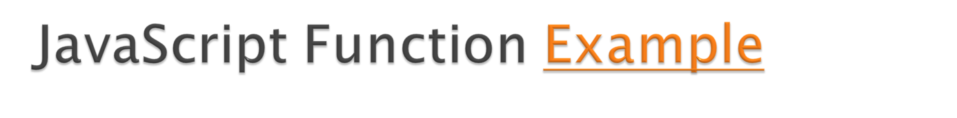
<html>
<head>
<script type="text/javascript">
function displaymessage()
{
alert("Hello World!");
}
</script> </head>
<body>
<form>
<input type="button" value="Click me!" onclick="displaymessage()" >
</form>
<p>By pressing the button above, a function will be called. The function will alert a message.</p>
</body>
</html>

Slide 24
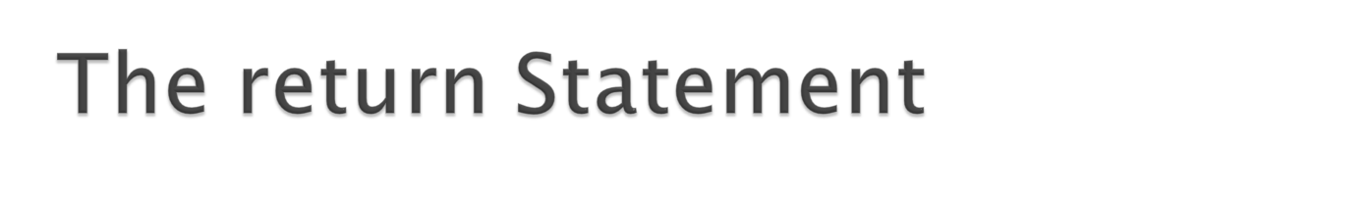
The return statement is used to specify the value that is returned from the function.
functions that are going to return a value must use the return statement.
Example
  <html>
  <head>
  <script type="text/javascript">
  function product(a,b)
  {
  return a*b;
  }
  </script>
  </head>
  <body>
  <script type="text/javascript">
  document.write(product(4,3));
  </script>
  </body>
  </html>

Slide 25
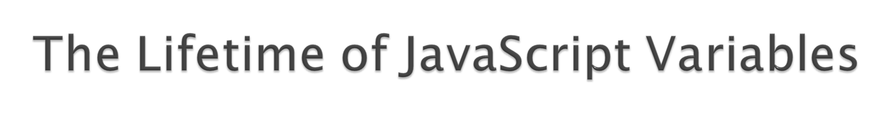
if you declare a variable within a function, the variable can only be accessed within that function.
  When you exit the function, the variable is destroyed.
  These variables are called local variables.
  You can have local variables with the same name in different functions, because each is recognized only by the function in which it is declared.
If you declare a variable outside a function, all the functions on your page can access it.

