Slide 1
Beginning Scala
David Pollak
Silicon Valley Code Camp
October 3rd, 2009

Slide 2
David Pollak
Not strict, but pretty lazy
Lead developer for Lift web framework
Scala since November 2006, Ruby/Rails, Java/J2EE
Spreadsheet junky (writing more than using)
Wrote Beginning Scala

Slide 3
Scala
Fast, Compatible, JVM language
Superset of Java's object model
  Everything that Java's got plus better type system
  100% compatible with Java objects
  Everything is an object (or a method or new)
Functional
  Immutable data structures
  Type inferencing
  Super-easy to pass functions as parameters

Slide 4









Scala in the Wild

Slide 5
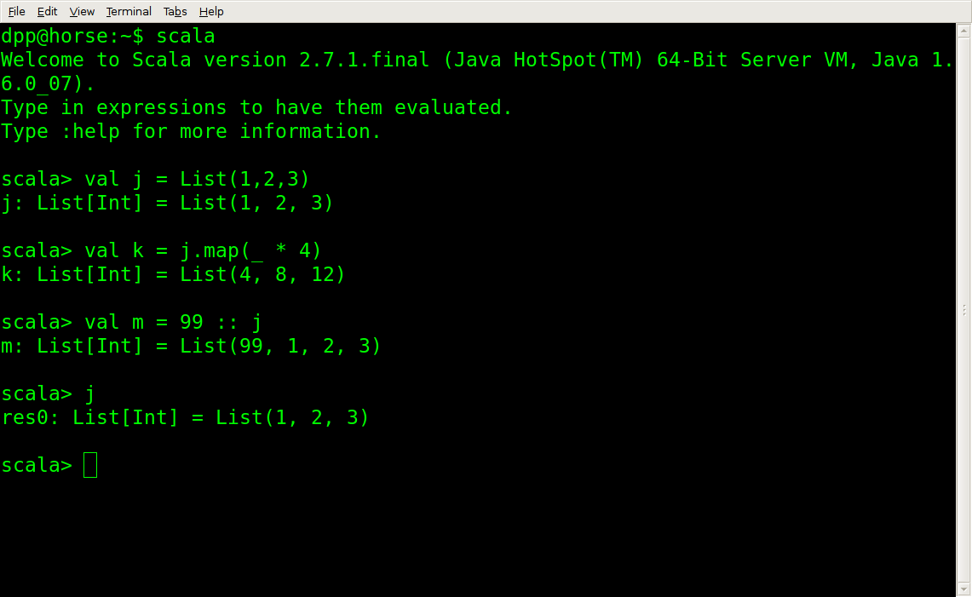
At the command line

Slide 6
Collections
List[T]
  Immutable
  Linked List of type T (String, Int, FooClass)
  Very efficient for small collections
Array[T]
  Mutable
  Thin veneer on JVM Array
  Lots of methods (map, filter, toList, etc.)

Slide 7
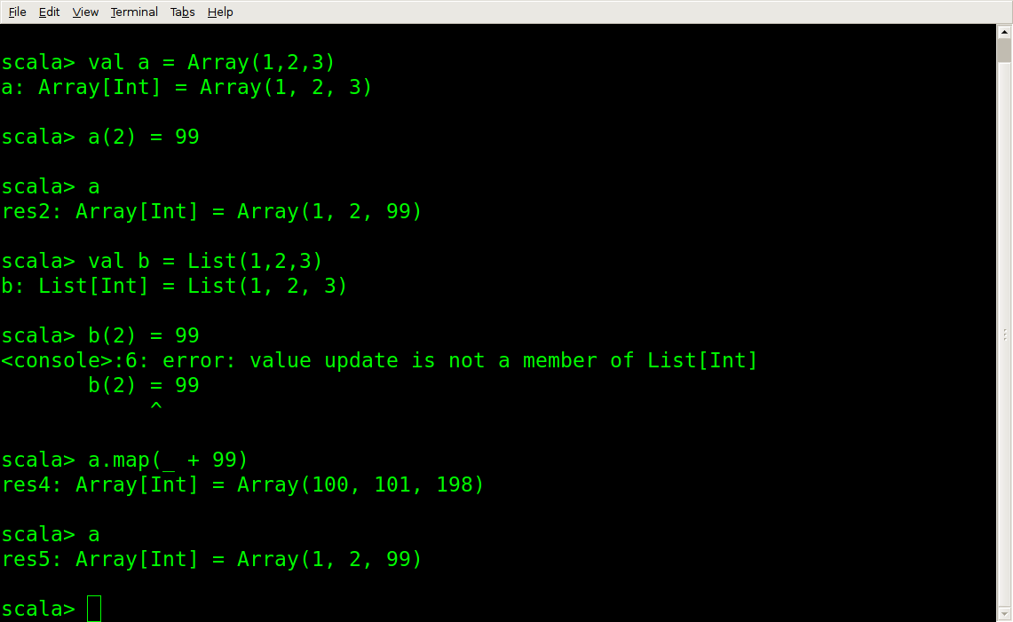
Collections

Slide 8
map & filter
map
  Apply a function to each element in original
  Return a new collection containing the result
  List(1,2,3).map(_ + 1) // List(2,3,4)
filter
  Test each element against a function that returns Boolean
  Return a new collection containing items that passed

Slide 9
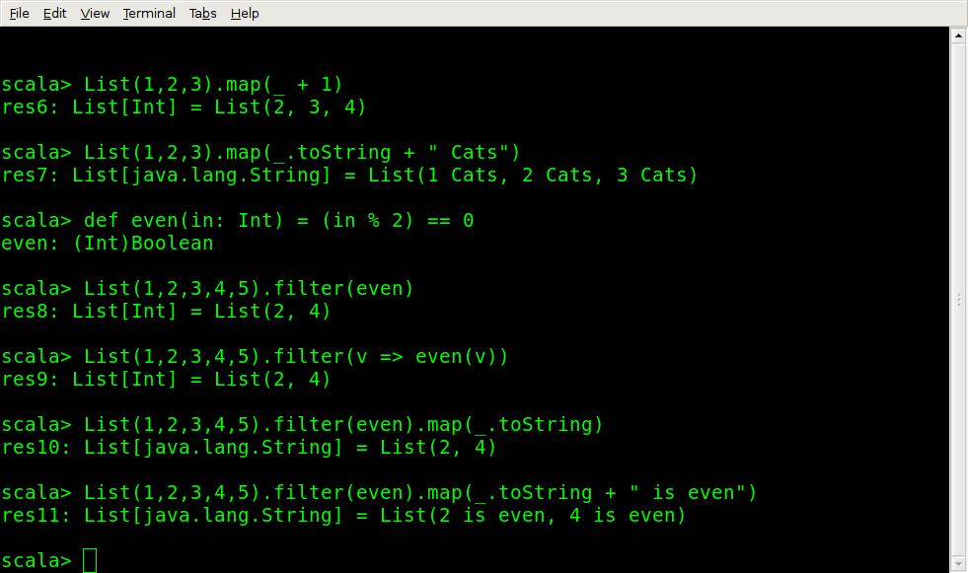
map & filter

Slide 10
flatMap
flatMap
  Flattens the collection the function returns
  Useful for nesting operations on collections
  "99 red balloons".toList
  List[Char] = List(9, 9, , r, e,...)
  List("99 red balloons", "88 lines", "44 women").
  flatMap(s => s.filter(Character.isDigit))
  List[Char] = List(9, 9, 8, 8, 4, 4)

Slide 11
foldLeft & reduceLeft
Perform an operation on adjacent members of a collection
Good for: sum, product, etc.
List(1,2,3,4).reduceLeft(_ + _)
Int = 10
def sq(in: Int) = in * in
def sum(in: List[Int]) = in.foldLeft(0)(_ + _)
def sumSq(in: List[Int]) = sum(in.map(sq))
def sqSum(in: List[Int]) = sq(sum(in))

Slide 12
Parser Calculator
object Calc extends JavaTokenParsers {
def expr = term ~ rep("+" ~ term | "-" ~ term)
def term = factor ~ rep("*" ~ factor | "/" ~ factor)
def factor = floatingPointNumber | "(" ~ expr ~ ")"
}

Slide 13
Parser Calculator
import scala.util.parsing.combinator._
object Calc extends JavaTokenParsers {
def expr = term ~ rep("+" ~ term | "-" ~ term) ^^ {
case v ~ f => f.foldLeft(v) {
case (x, "+" ~ term) => x + term
case (x, "-" ~ term) => x – term }}
def term = factor ~ rep("*"~factor | "/"~factor) ^^ {
case v ~ f => f.foldLeft(v) {
case (x, "*" ~ term) => x * term
case (x, "/" ~ term) => x / term }}
def factor: Parser[Double] =
(floatingPointNumber ^^ (_.toDouble)) |
"(" ~> expr <~ ")"
}

Slide 14
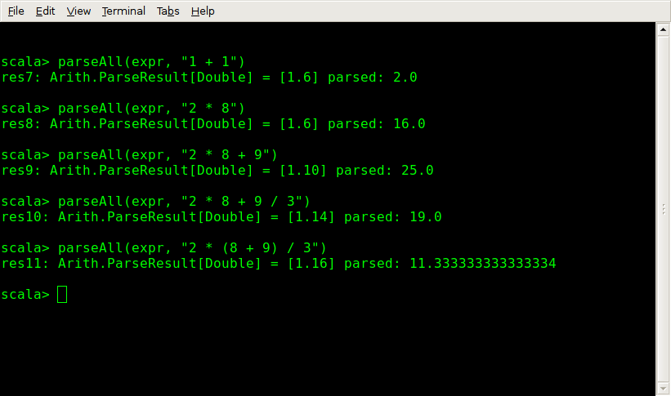
Calculator in Action

Slide 15
Domain Specific Languages
User.find(By(email, ”dpp@athena.com”),
OrderBy(signupDate, Descending))
Type Safe
SetValById(inputName, "") &
SetValById(hiddenName, "") &
SetElemById(clrLinkName, "none", "style.display")
<button onclick={
jsonCall("submit", JsArray(ValById(inputName),
ValById(hiddenName)))}>Yep</button>

Slide 16
DSL definitions
This separates the library consumers from the architects
def find(by: QueryParam[A]*)
abstract class QueryParam[A<:Mapper[A]]
case class Cmp[A<:Mapper[A], T](...)
extends QueryParam[A]
object By {
import OprEnum._
def apply[O <: Mapper[O], T, U <% T](...) =
Cmp[O,T](field, Eql, Full(value), Empty)

Slide 17
DSL definitions
case class SetValById(id: String, right: JsExp) extends JsCmd {
def toJsCmd = "document.getElementById("+id.encJs+").value = "+
right.toJsCmd+";"}
trait JsCmd extends HtmlFixer with ToJsCmd {
def &(other: JsCmd): JsCmd =
JsCmds.CmdPair(this, other)
def toJsCmd: String }

Slide 18
Questions?
Thanks for participating!

