Slide 1

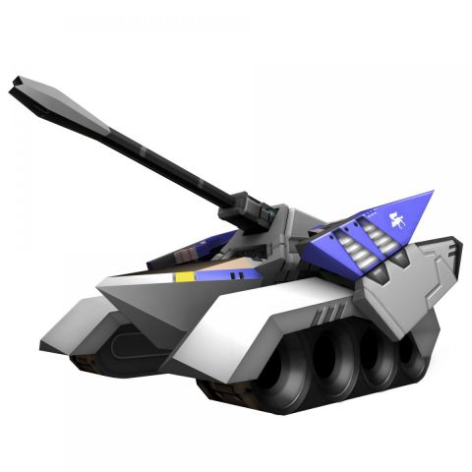
Score:
Doesn't look the best but the actual game will be much prettier...
100
Challenge!
Hit the blue octagon.
Enter angle:
80

