Slide 1

By Jan Kustra & Szymon Kuc

Slide 2
Who are we?
We are students from ZSTI high school. We are interested in coding, writing websites and, of course, reading books.
What is the goal of this website?
The main goal of the website is to find out about interesting books online, view their reviews and check the lowest prices of them.

Slide 3
Who are the audience of this website?
The targeted customers are everyone who love reading or are beginners in it, we love everybody who’s interested. Though lots of books are great for teenagers and adolescents.
What users can do on our website?
Users can read the description and review of the chosen book, they can also check and find the cheapest price. There’s an option to leave comments on this website, as well as feedback. On the contact us page users can find a way to communicate with us.

Slide 4
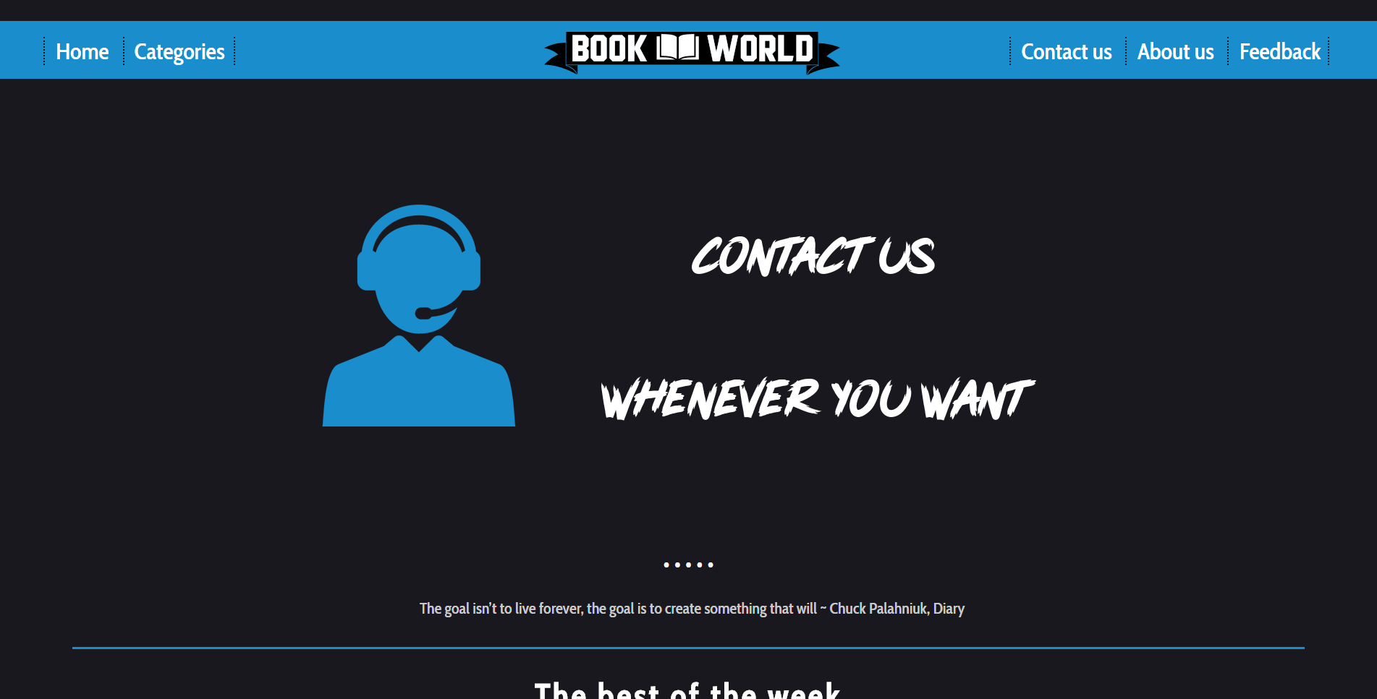
Design
The whole website is mainly in blue, white, gray and some dark colors. This color-coding will help the user find the information quicker by not being distracted. The dark design of our color palette helps the visitor to protect his eyes from the bright and striky colors. The site is clear and simply to use.

Slide 5
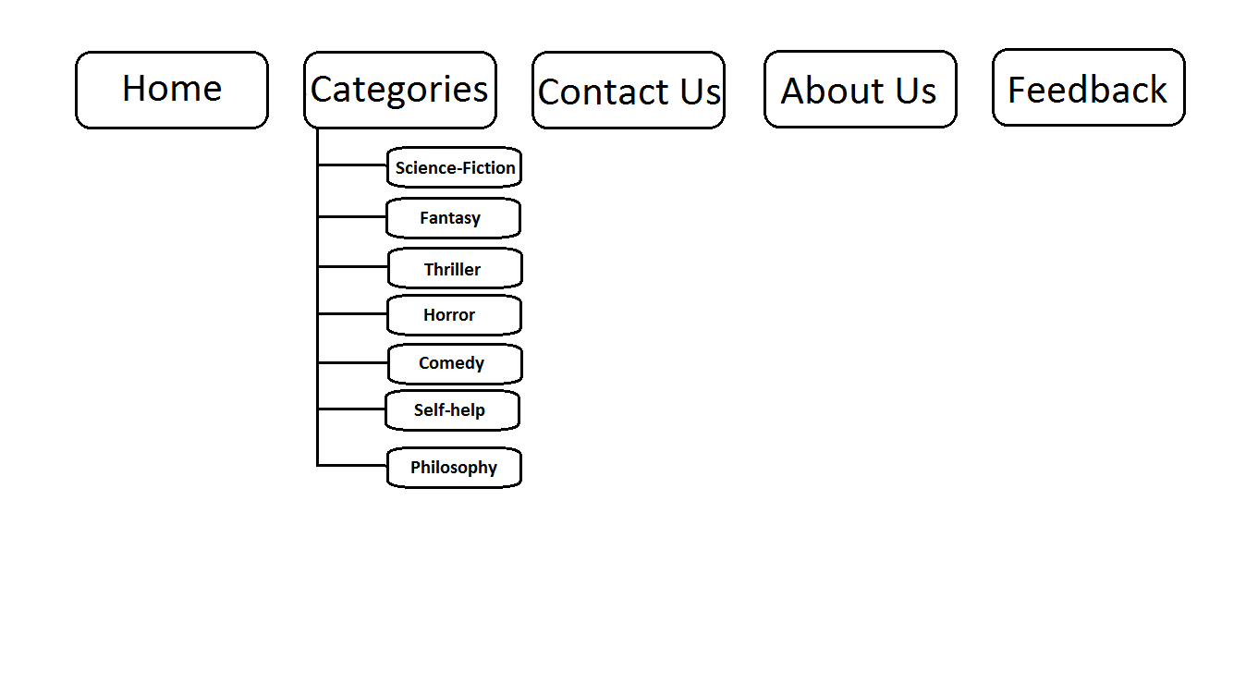
Site Map

Slide 6
Home page
There are buttons for navigating on our website
This is slider
There are quotes from books, which are changing automatically.
You can use this to go to other slide

Slide 7
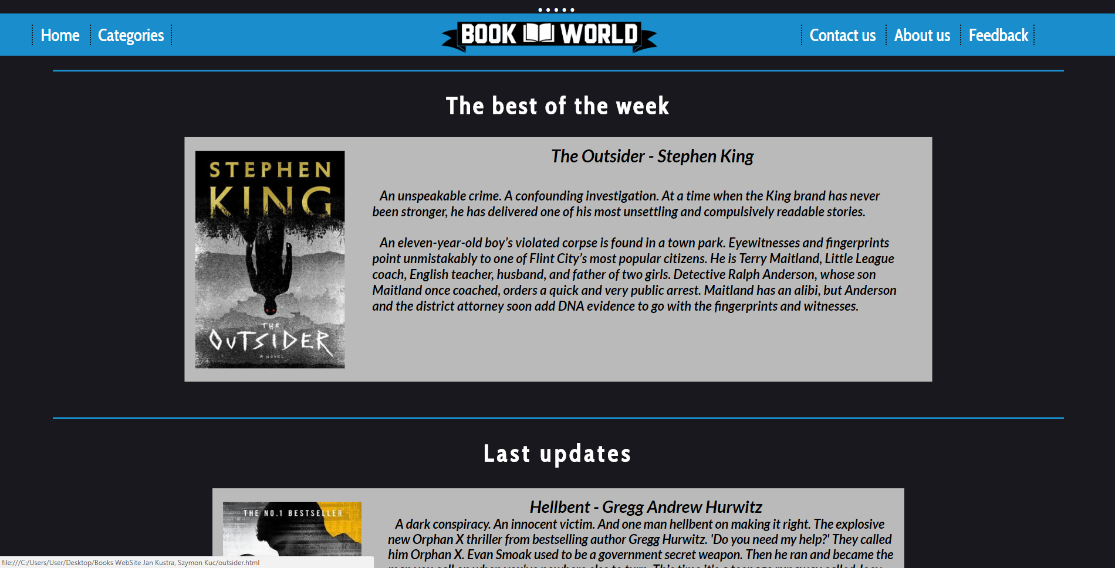
Home page
There you can find the most popular book of the week.
You can click on this box and go to subpage, witch contains description, review and more.
There are few more updates bellow.

Slide 8
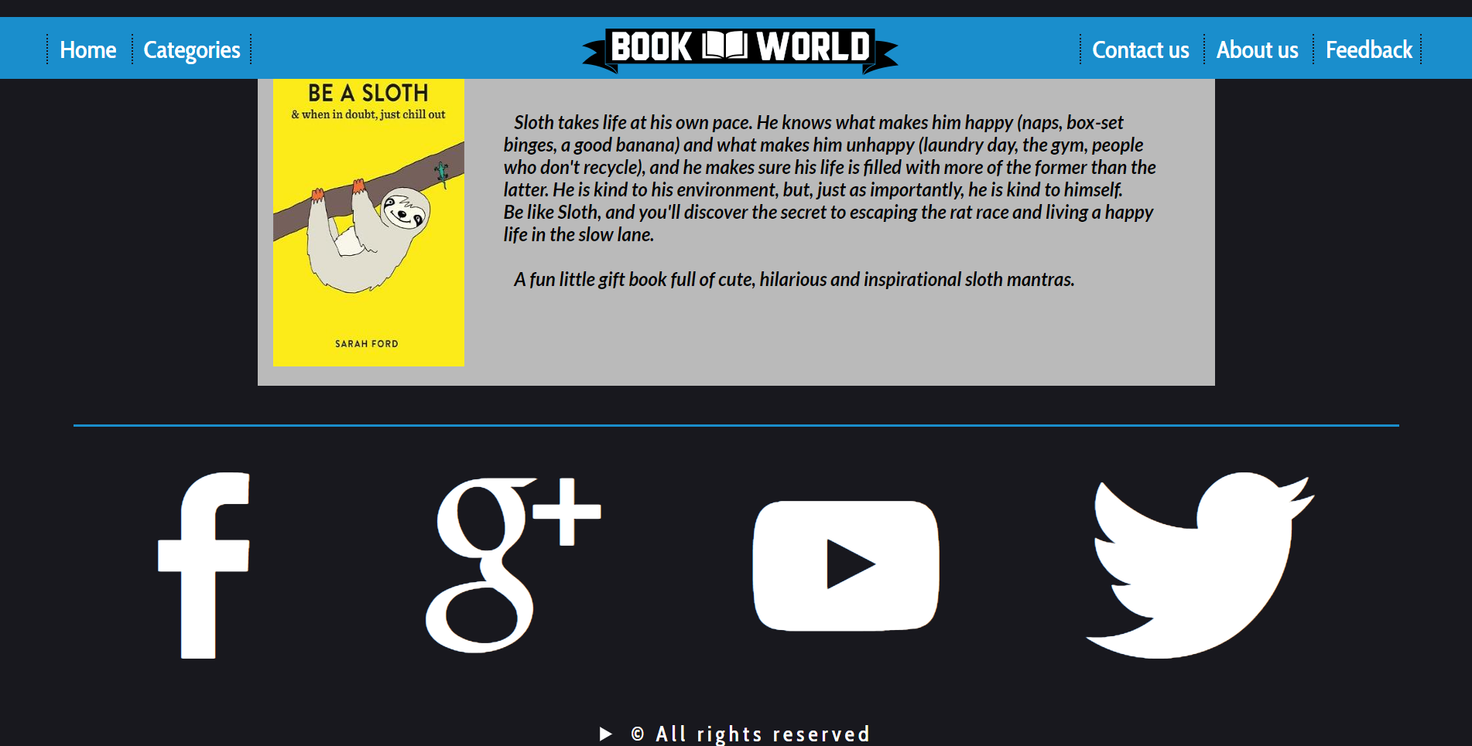
Footer

Slide 9
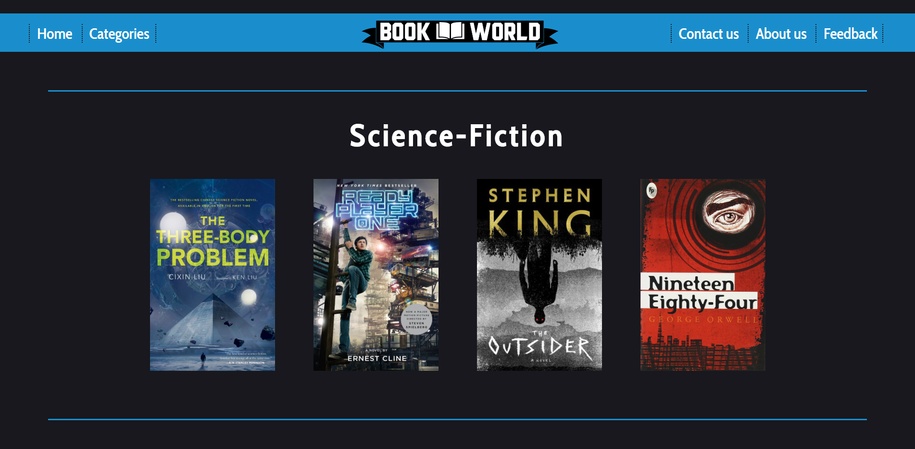
Categories
You can click those books and go to the description.
There are more categories bellow (Science-Fiction, Fantasy, Thriller, Horror, Comedy, Self-help, Philosophy).

Slide 10
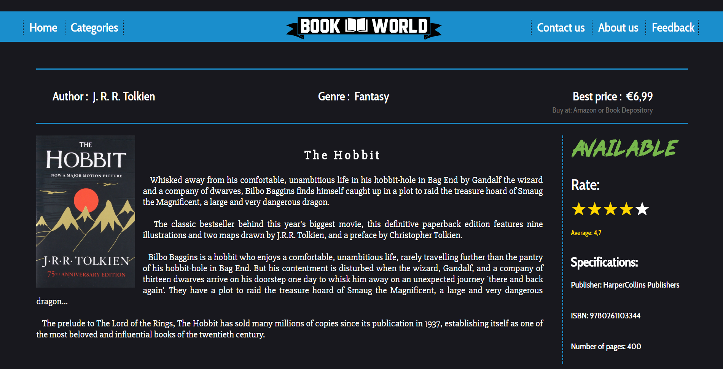
Subpage of one book
You can just click on one of the stars from 1-5 and rate this book.

Slide 11
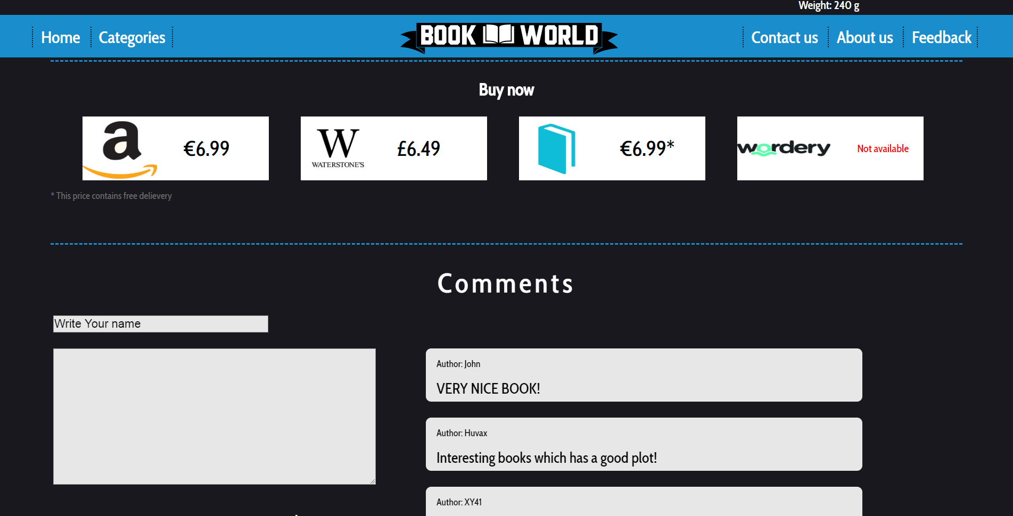
Subpage of one book
You can compare prices from different shops and check whether it’s available.
There you can leave your comment and see comments from other users.

Slide 12
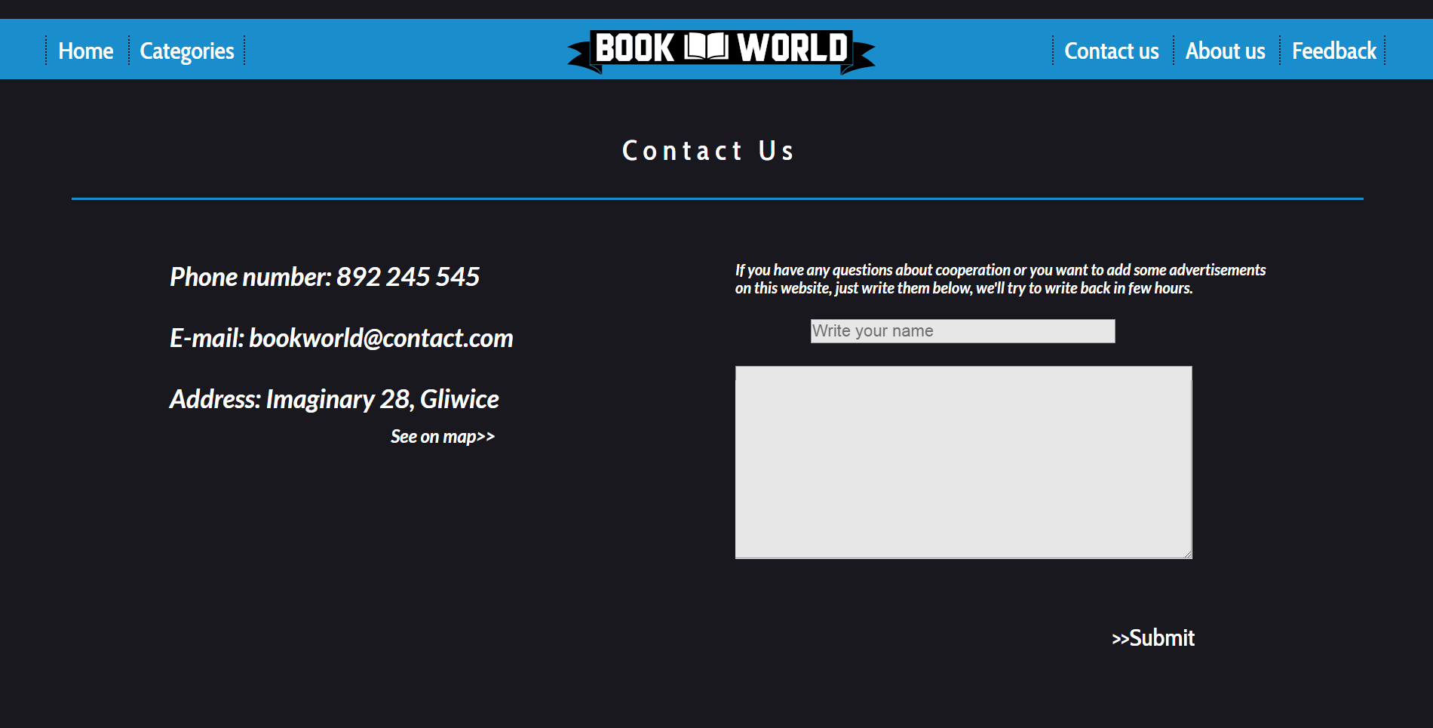
Contact Us

Slide 13
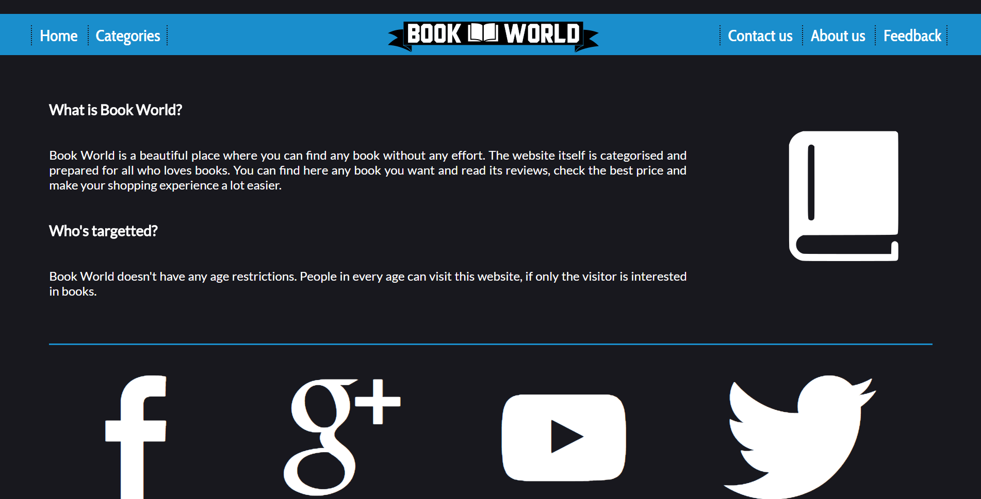
About Us

Slide 14
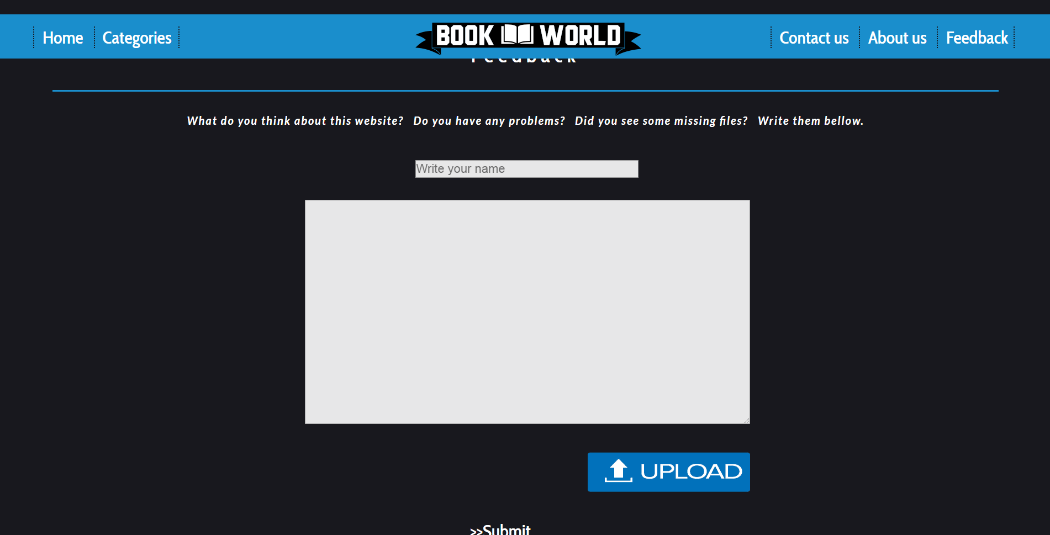
Feedback

Slide 15
THE END
Thank you for attention!

