Slide 1

重庆邮电大学
Chongqing University of Posts and Telecommunications
Y X | 0 | 1
0 | 1/3 | 0
1 | 1/3 | 1/3
汇报人：xxx

Slide 2
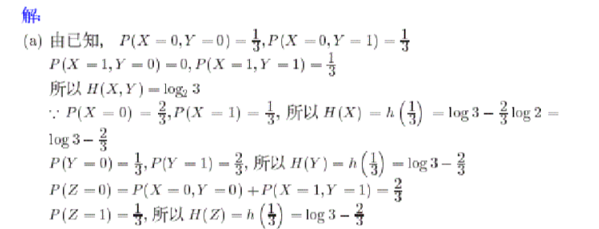
重庆邮电大学
Chongqing University of Posts and Telecommunications
汇报人：xxx

Slide 3
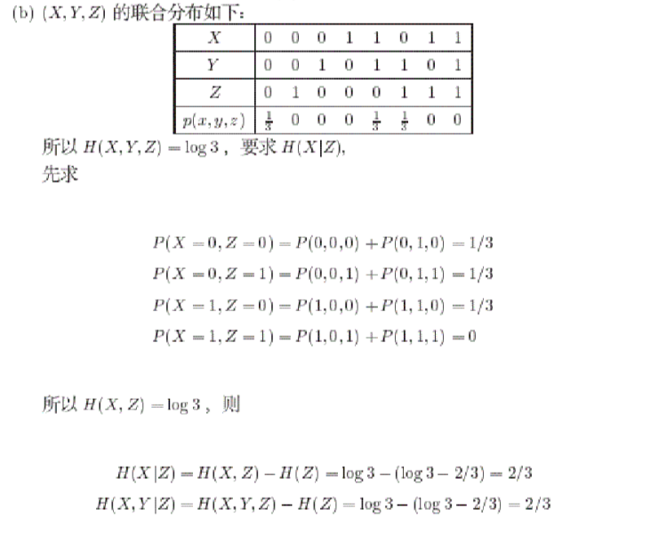
重庆邮电大学
Chongqing University of Posts and Telecommunications
汇报人：xxx

Slide 4
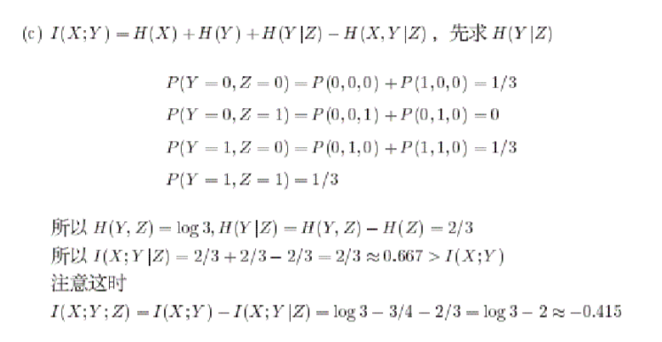
重庆邮电大学
Chongqing University of Posts and Telecommunications
汇报人：xxx

Slide 5
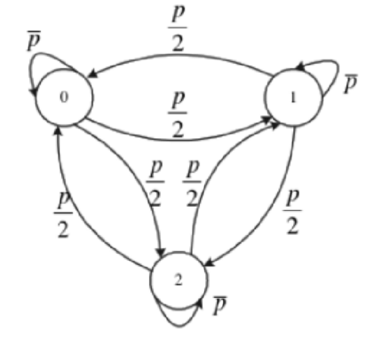
重庆邮电大学
Chongqing University of Posts and Telecommunications
汇报人：xxx

Slide 6
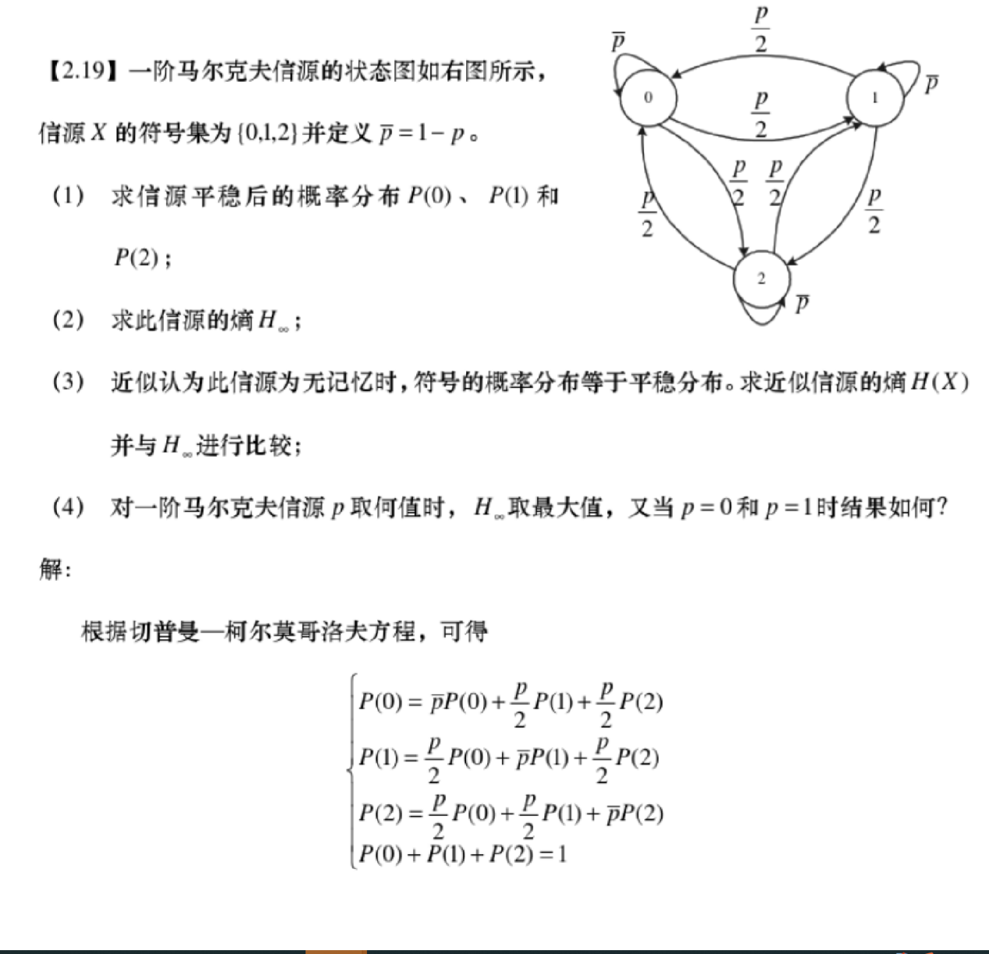
重庆邮电大学
Chongqing University of Posts and Telecommunications
汇报人：xxx

Slide 7
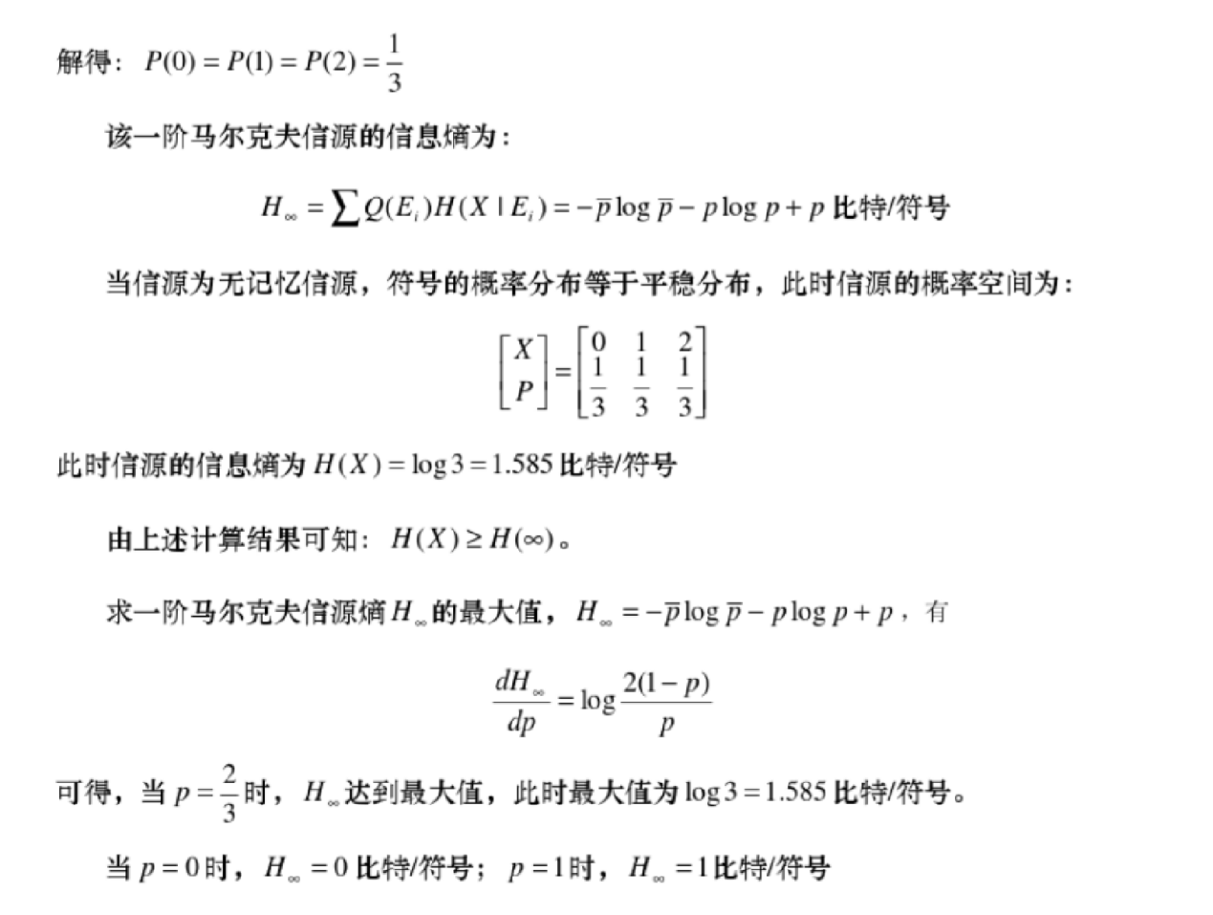
重庆邮电大学
Chongqing University of Posts and Telecommunications
汇报人：xxx

Slide 8
重庆邮电大学
Chongqing University of Posts and Telecommunications
汇报人：xxx

Slide 9
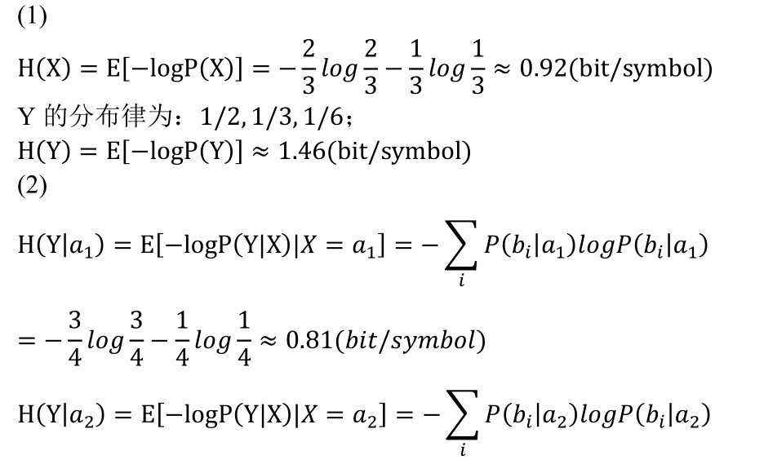
重庆邮电大学
Chongqing University of Posts and Telecommunications
汇报人：xxx

Slide 10
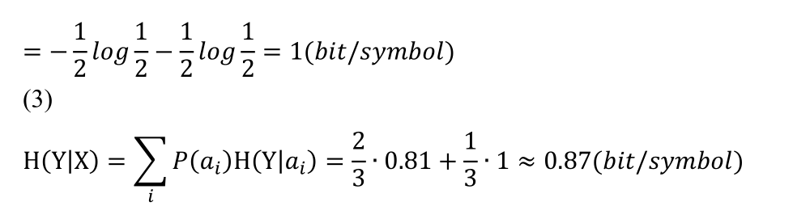
重庆邮电大学
Chongqing University of Posts and Telecommunications
汇报人：xxx

Slide 11
重庆邮电大学
Chongqing University of Posts and Telecommunications
汇报人：xxx

Slide 12
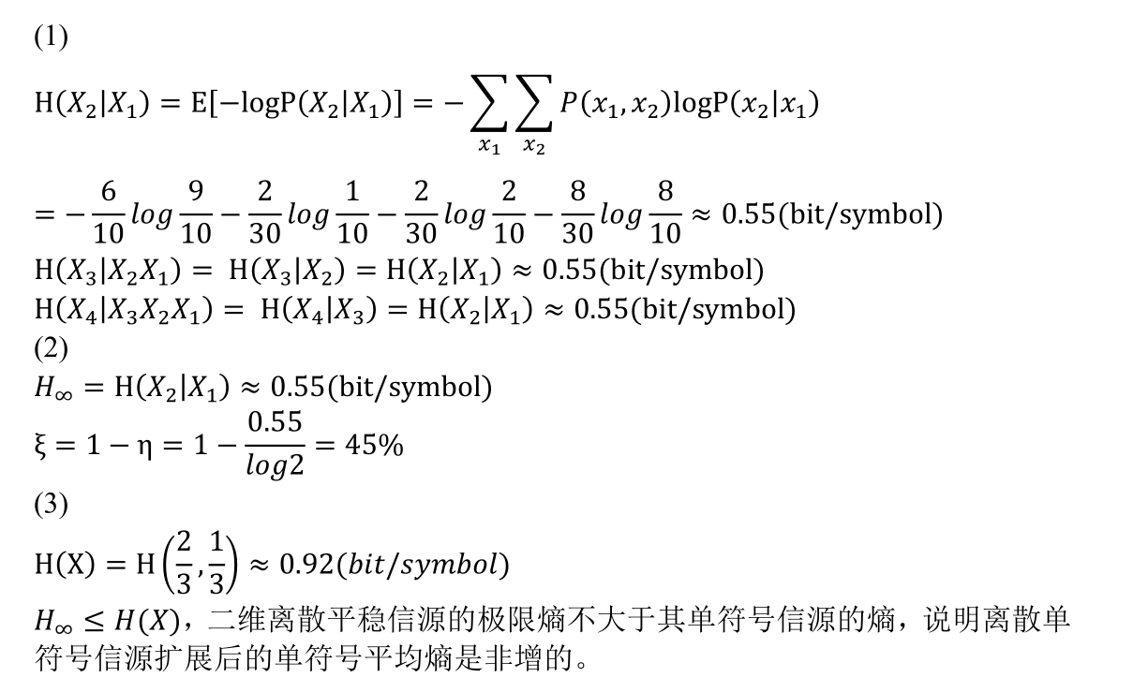
重庆邮电大学
Chongqing University of Posts and Telecommunications
汇报人：xxx

Slide 13
重庆邮电大学
Chongqing University of Posts and Telecommunications
条件概率
 | 1 | 2 | 3
1 | 1/2 | 1/4 | 1/4
2 | 2/3 | 0 | 1/3
3 | 2/3 | 1/3 | 0
汇报人：xxx

Slide 14
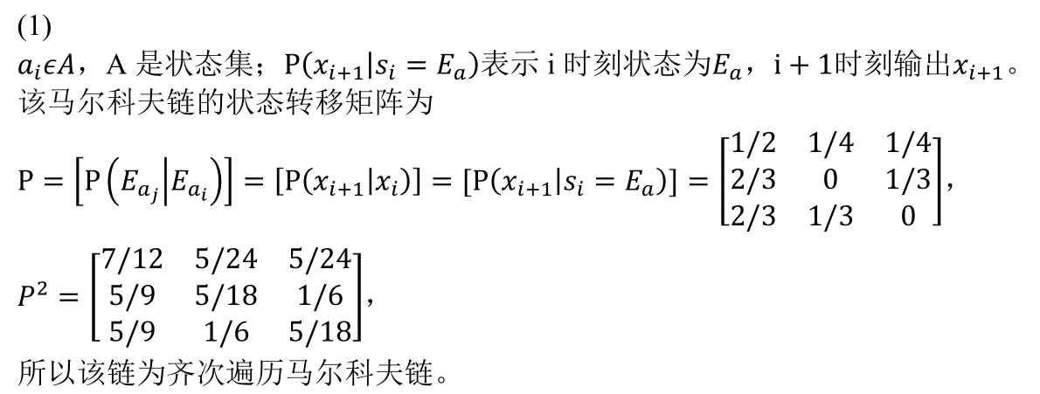
重庆邮电大学
Chongqing University of Posts and Telecommunications
汇报人：xxx

Slide 15
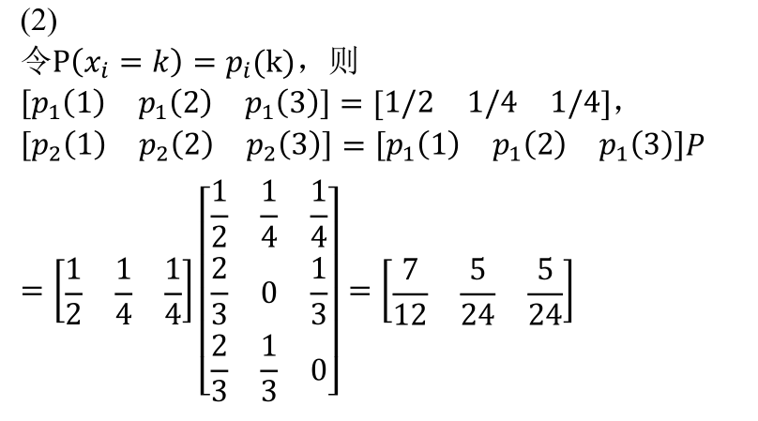
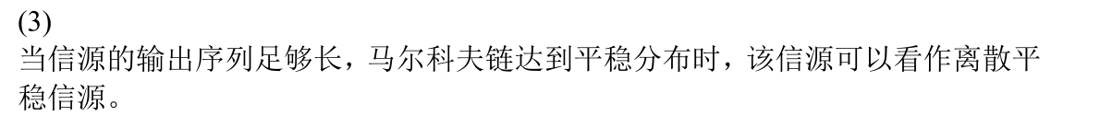
重庆邮电大学
Chongqing University of Posts and Telecommunications
汇报人：xxx

Slide 16
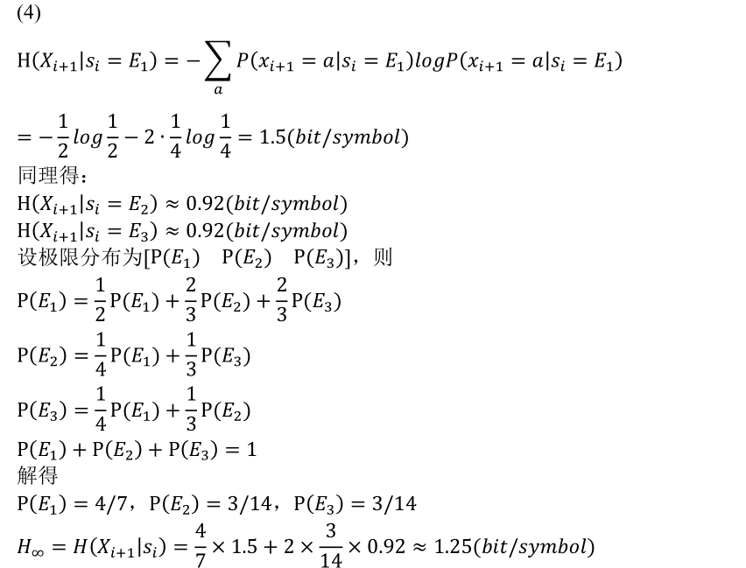
重庆邮电大学
Chongqing University of Posts and Telecommunications
汇报人：xxx

Slide 17
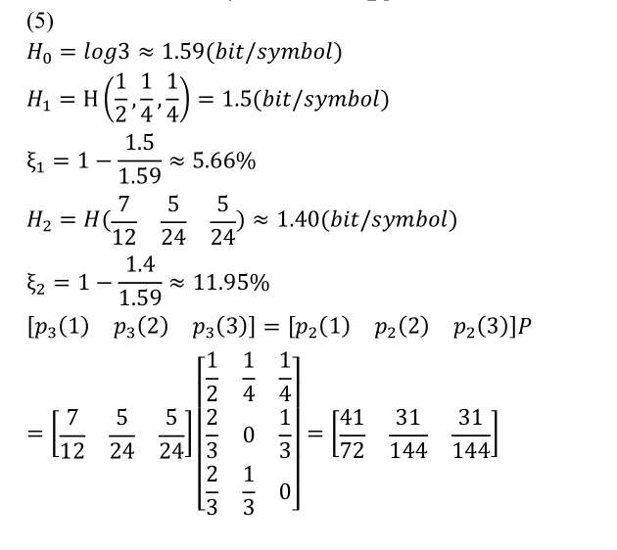
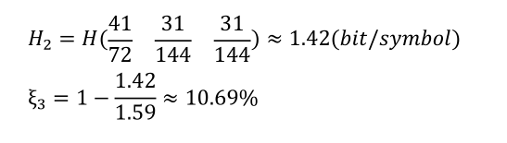
重庆邮电大学
Chongqing University of Posts and Telecommunications
汇报人：xxx

Slide 18
重庆邮电大学
Chongqing University of Posts and Telecommunications
汇报人：xxx

Slide 19
重庆邮电大学
Chongqing University of Posts and Telecommunications
汇报人：xxx

Slide 20
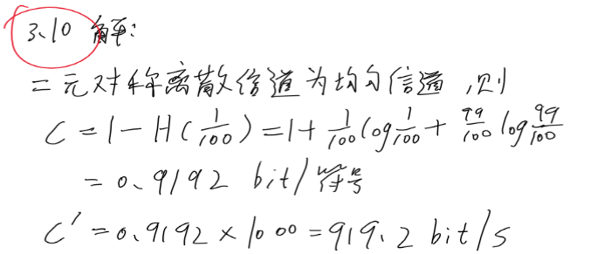
重庆邮电大学
Chongqing University of Posts and Telecommunications
汇报人：xxx

