Slide 1
CS 6476 Project 1
Hardik Goel
hgoel7@gatech.edu
hgoel7
903536536

Slide 2
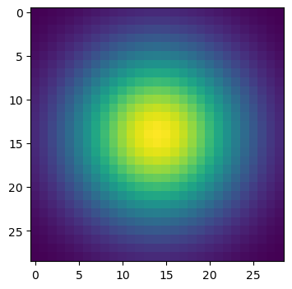
Part 1: Image filtering
my_conv2d_numpy()
For my implementation of conv2d I start with initiating the output filtered image with dimensions (m, n, c) same as input image.
We find the desired pad size for output image made from convolution image with filter. Using the padding size we pad our input image and loop it over to run filter and produce filtered image.

Slide 3
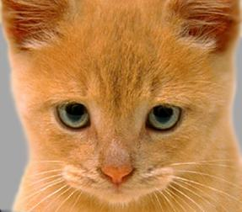
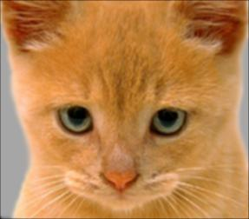
Part 1: Image filtering
Identity filter
Small blur with a box filter

Slide 4
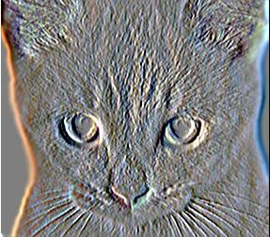
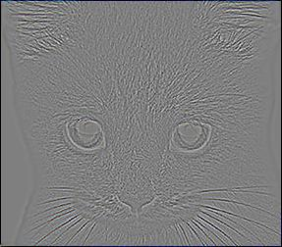
Part 1: Image filtering
Sobel filter
Discrete Laplacian filter

Slide 5
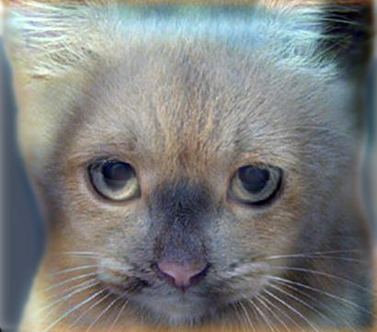
Part 1: Hybrid images
Create hybrid images has 3 main steps:
Find low frequencies of image1
Find high frequencies of image2
Clipping low and high frequencies together to generate a new hybrid image
Cat + Dog
Cutoff frequency: 7

Slide 6
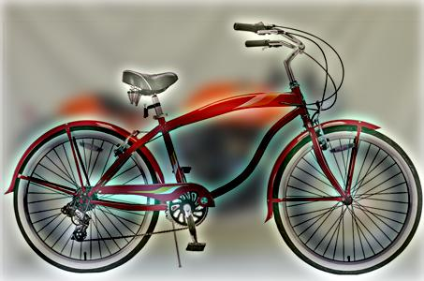
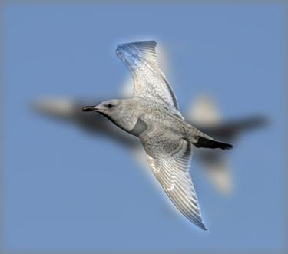
Part 1: Hybrid images
Motorcycle + Bicycle
Cutoff frequency: 7
Plane + Bird
Cutoff frequency: 7

Slide 7
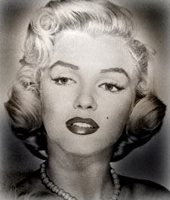
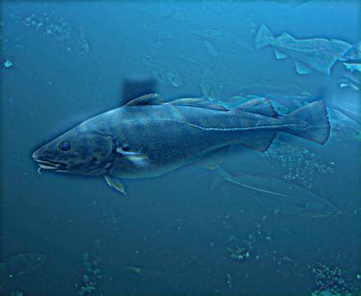
Part 1: Hybrid images
Einstein + Marilyn
Cutoff frequency: 13
Submarine + Fish
Cutoff frequency: 3

Slide 8


Part 2: Hybrid images with PyTorch
Cat + Dog
Motorcycle + Bicycle

Slide 9

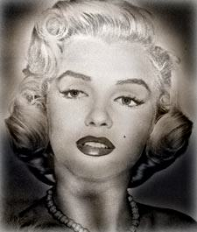
Part 2: Hybrid images with PyTorch
Plane + Bird
Einstein + Marilyn

Slide 10
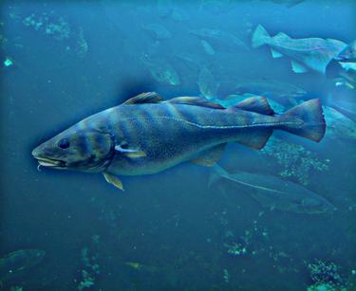
Part 2: Hybrid images with PyTorch
Submarine + Fish
Part 1 vs. Part 2
Runtime of Part 2 was WAY faster than part 1. Part 1 took about 14 seconds to generate while Part 2 took 3 seconds, which is a huge improvement.

Slide 11
Part 3: Understanding input/output shapes in PyTorch
Consider a 1-channel 5x5 image and a 3x3 filter. What are the output dimensions of a convolution with the following parameters?
Stride = 1, padding = 0 => (3, 3, 1)
Stride = 2, padding = 0 => (2, 2, 1)
Stride = 1, padding = 1 => (5, 5, 1)
Stride = 2, padding = 1 => (3, 3, 1)
What are the input & output dimensions of the convolutions of the dog image and a 3x3 filter with the following parameters:
Stride = 1, padding = 0 =>
Input: (410, 361, 1) Output: (408, 359, 3)
Stride = 2, padding = 0 =>
Input: (410, 361, 1) Output: (204, 180, 3)
Stride = 1, padding = 1 =>
Input: (410, 361, 1) Output: (410, 361, 3)
Stride = 2, padding = 1 =>
Input: (410, 361, 1) Output: (205, 181, 3)

Slide 12
Part 3: Understanding input/output shapes in PyTorch
How many filters did we apply to the dog image?
4
Section 3 of the handout gives equations to calculate output dimensions given filter size, stride, and padding. What is the intuition behind this equation?
The equation works because:
(+2p) part of the equation adjusts for padding on either sides of the image making it symmetric
(1/s) part of the equation represents stride i.e. the no. pixels the filter moves over. Higher stride results in lower resolution and vice versa. The 1/s represents that it’s inversely proportional.

Slide 13
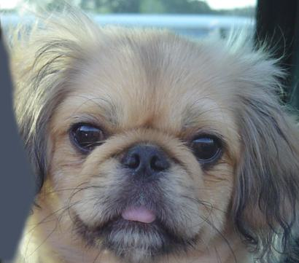

Part 3: Understanding input/output shapes in PyTorch
[insert visualization 0 here]
[insert visualization 1 here]

Slide 14
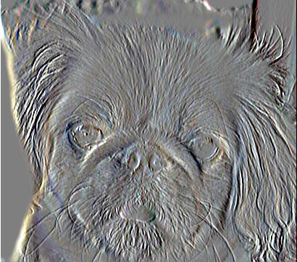
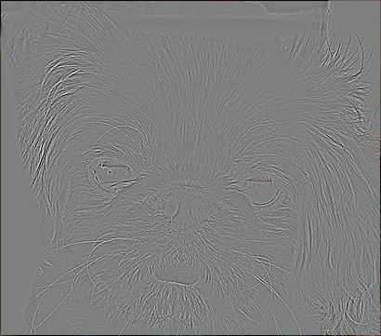
Part 3: Understanding input/output shapes in PyTorch
[insert visualization 2 here]
[insert visualization 3 here]

Slide 15
Part 4: Frequency Domain Convolutions
[Insert the visualizations of the dog image in the spatial and frequency domain]
[Insert the visualizations of the blurred dog image in the spatial and frequency domain]

Slide 16
Part 4: Frequency Domain Convolutions
[Insert the visualizations of the 2D Gaussian in the spatial and frequency domain]
[Why does our frequency domain representation of a Gaussian not look like a Gaussian itself? How could we adjust the kernel to make these look more similar?]

Slide 17
Part 4: Frequency Domain Convolutions
[Briefly explain the Convolution Theorem and why this is related to deconvolution]

Slide 18
Part 4: Frequency Domain Convolutions
[Insert the visualizations of the mystery image in the spatial and frequency domain]
[Insert the visualizations of the mystery kernel in the spatial and frequency domain]

Slide 19
Part 4: Frequency Domain Convolutions
[Insert the de-blurred mystery image and its visualizations in the spatial and frequency domain]
[Insert the de-blurred mystery image and its visualizations in the spatial and frequency domain after adding salt and pepper noise]

Slide 20
Part 4: Frequency Domain Convolutions
[What factors limit the potential uses of deconvolution in the real world? Give two possible factors]
[We performed two convolutions of the dog image with the same Gaussian (one in the spatial domain, one in the frequency domain). How do the two compare, and why might they be different?]

Slide 21
Conclusion
[How does varying the cutoff frequency value or swapping images within a pair influences the resulting hybrid image?]

