Slide 1
CS 4476/6476 Project 2
Hardik Goel
hgoel7@gatech.edu
hgoel7
903536536

Slide 2
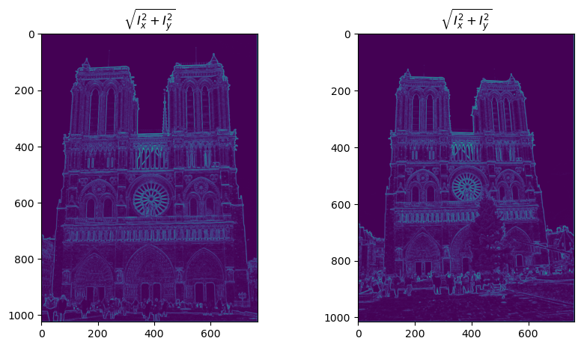
Part 1: Harris corner detector
[insert visualization of \sqrt(I_{x}² + I_{y}²) for Notre Dame image pair from proj2.ipynb here]
[Which areas have highest magnitude? Why?
The bright areas near the clock, arc birdge in middle and the two top tower’s edges have highest magnitude. These areas have strong x-direction and y-direction gradients which contributes signifactly more to the second momentum and the cornerness score.

Slide 3
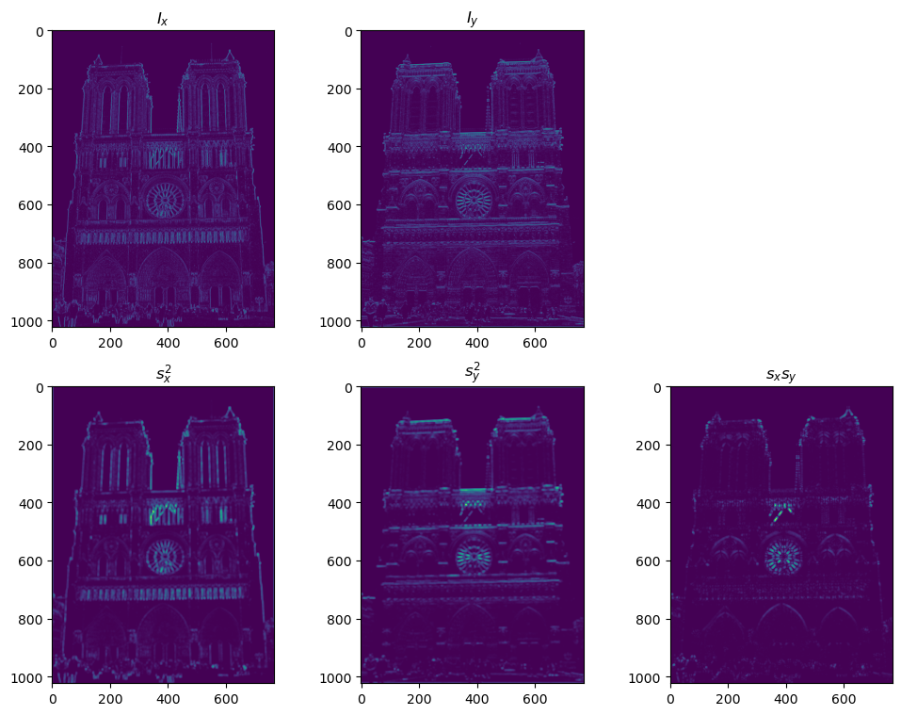
Part 1: Harris corner detector
[insert visualization of I_{x}, I_{y}, s_{x}², s_{y}², s_{x}s_{y} for Notre Dame image pair from proj2.ipynb here]

Slide 4
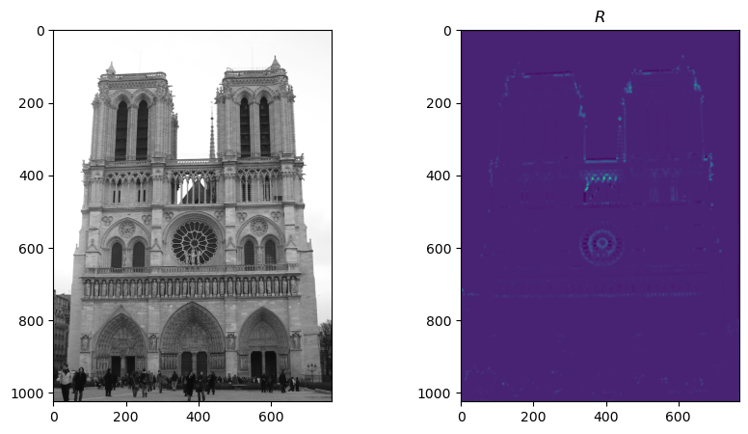
Part 1: Harris corner detector
[insert visualization of corner response map of Notre Dame image from proj2.ipynb here]
[Are gradient features invariant to both additive shifts (brightness) and multiplicative gain (contrast)? Why or why not? See Szeliski Figure 3.2]
Yes the gradient fatures are invariant to additive shifts and multiplication gain due to superpositon principle.

Slide 5
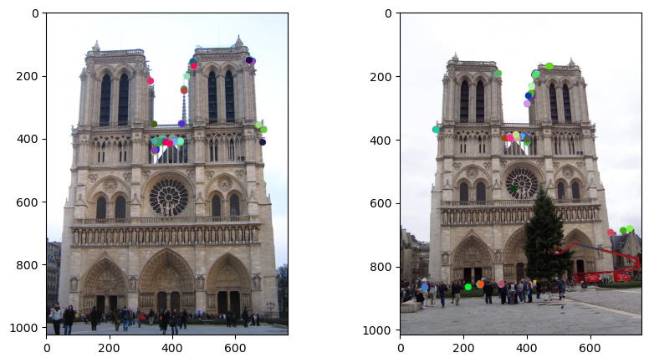
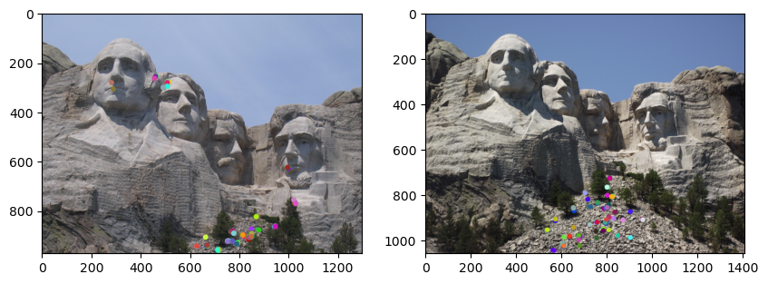
Part 1: Harris corner detector
[insert visualization of Notre Dame interest points from proj2.ipynb here]
[insert visualization of Mt. Rushmore interest points from proj2.ipynb here]

Slide 6
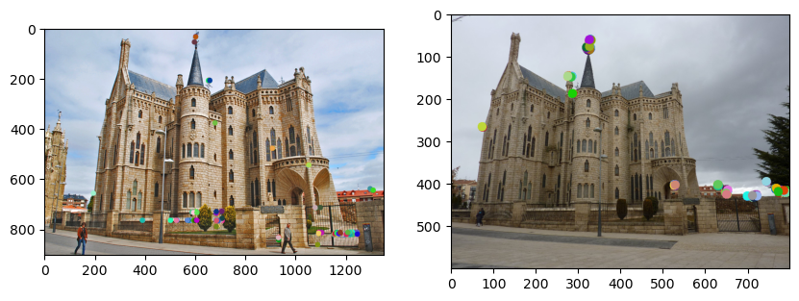
Part 1: Harris corner detector
[insert visualization of Gaudi interest points from proj2.ipynb here]
[What are the advantages and disadvantages of using maxpooling for non-maximum suppression (NMS)?]

Slide 7
Part 1: Harris corner detector
[What is your intuition behind what makes the Harris corner detector effective?]
I think the change in intesities of momentum around the corner is what makes Harris corner detector effective.

Slide 8
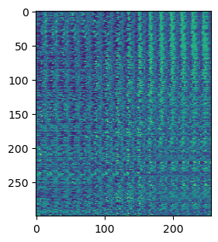
Part 2: Normalized patch feature descriptor
[insert visualization of normalized patch descriptor from proj2.ipynb here]
[Why aren't normalized patches a very good descriptor?]

Slide 9
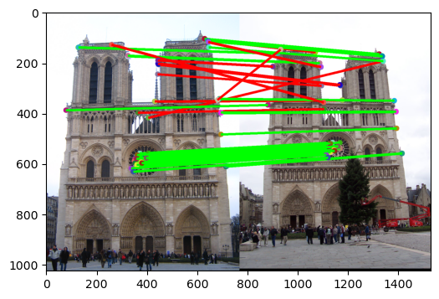
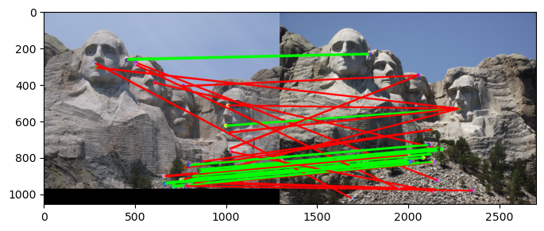
Part 3: Feature matching
[insert visualization of matches (with green/red lines for correct/incorrect correspondences) for Notre Dame image pair from proj2.ipynb here]
# matches (out of 100): 114
Accuracy: 0.82
[insert visualization of matches for Mt. Rushmore image pair from proj2.ipynb here]
# matches: 165
Accuracy: 0.63

Slide 10
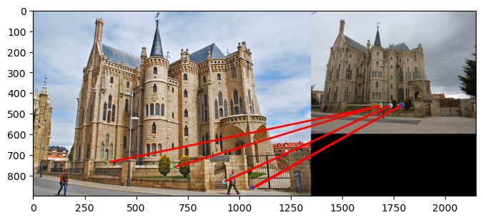
Part 3: Feature matching
[insert visualization of matches for Gaudi image pair from proj2.ipynb here]
# matches: 3
Accuracy: 0
[Describe your implementation of feature matching here]
For feature matching I’m mainting a list of distance between each feature. Since two fetures are relatively fixed to each other, a list of features and their distances which can be found again in a new variant image and looked for to match.

Slide 11
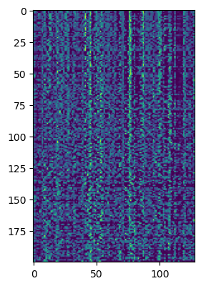
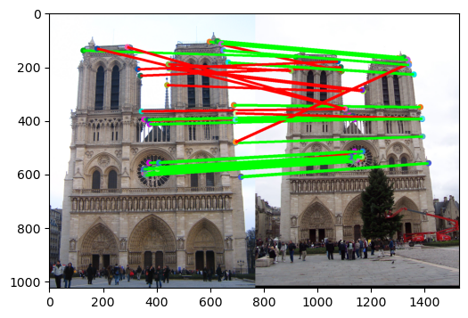
Part 4: SIFT feature descriptor
[insert visualization of SIFT feature descriptor from proj2.ipynb here]
[insert visualization of matches (with green/red lines for correct/incorrect correspondences) for Notre Dame image pair from proj2.ipynb here]
# matches (out of 100): 100
Accuracy: 0.83

Slide 12
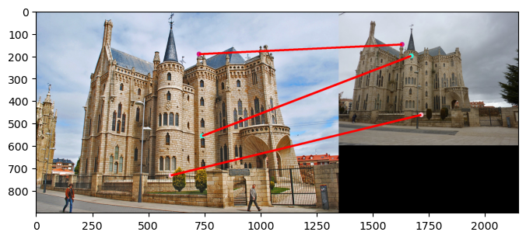
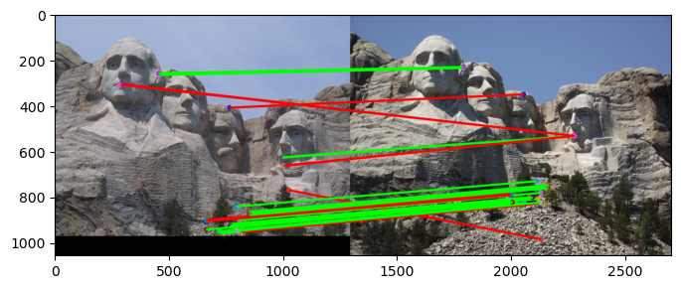
Part 4: SIFT feature descriptor
[insert visualization of matches for Mt. Rushmore image pair from proj2.ipynb here]
# matches: 88
Accuracy: 0.61
[insert visualization of matches for Gaudiimage pair from proj2.ipynb here]
# matches: 3
Accuracy: 0

Slide 13
Part 4: SIFT feature descriptor
[Describe your implementation of SIFT feature descriptors here]
I begin by getting magnitude and orientation gradient for each pixel. We use the magnitude and orientation gradient to create a weighted histogram for all features. The weighted histograms are used for feature vectors, which are the computed features.
[Why are SIFT features better descriptors than the normalized patches?]

Slide 14
Part 4: SIFT feature descriptor
[Why does our SIFT implementation perform worse on the given Gaudi image pair than the Notre Dame image and Mt. Rushmore pairs?]

Slide 15
Part 5: SIFT Descriptor Exploration
Describe the effects of changing window size around features. Did different values have better performance?

Slide 16
Part 5: SIFT Descriptor Exploration
Describe the effects of changing the number of local cells in a window around a feature? Did different values have better performance?

Slide 17
Part 5: SIFT Descriptor Exploration
Describe the effects of changing number of orientations (bins) per histogram. Did different values have better performance?

Slide 18
Part 5: SIFT Descriptor Exploration
[insert visualization of matches for your image pair from proj2.ipynb here]

Slide 19
Part 5: SIFT Descriptor Exploration
[Discuss why you think your SIFT pipeline worked well or poorly for the given building. Are there any characteristics that make it difficult to correctly match features]?

Slide 20
Conclusion
[Why aren't our version of SIFT features rotation- or scale-invariant? What would you have to do to make them so?]

