Slide 1
CS 4476/6476 Project 3
Hardik Goel
Hgoel7@gatech.edu
hgoel7
903536536

Slide 2
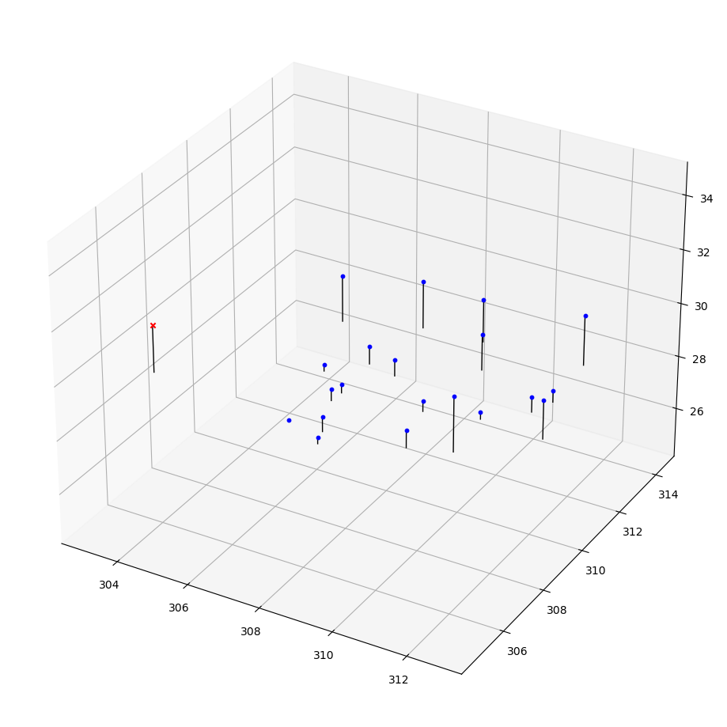
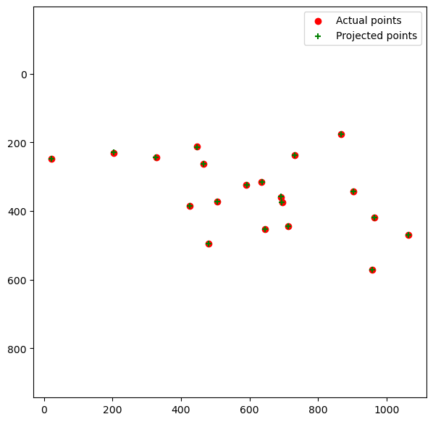
Part 1: Projection matrix

Slide 3
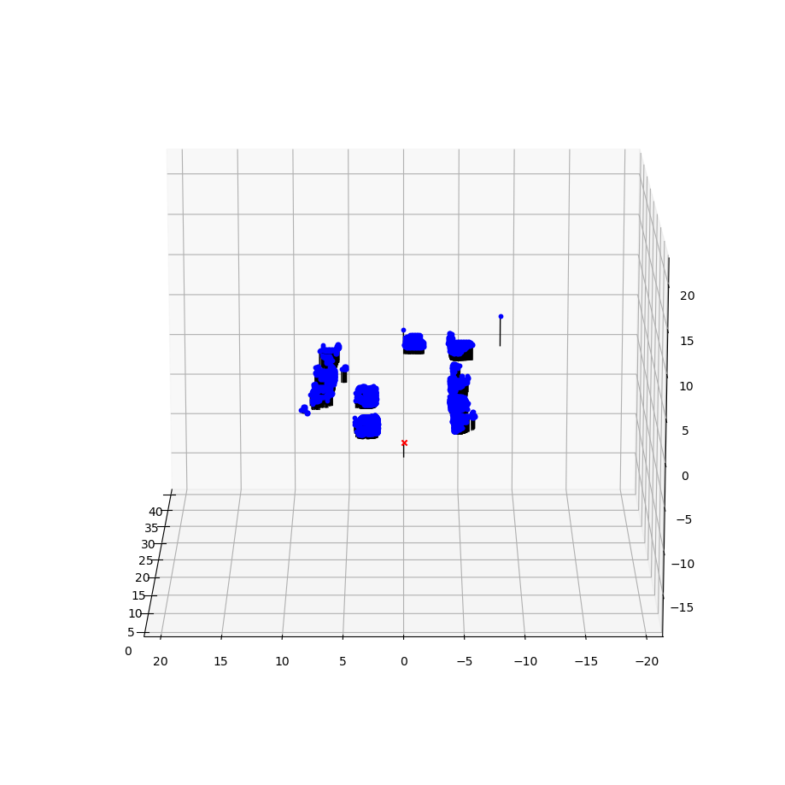
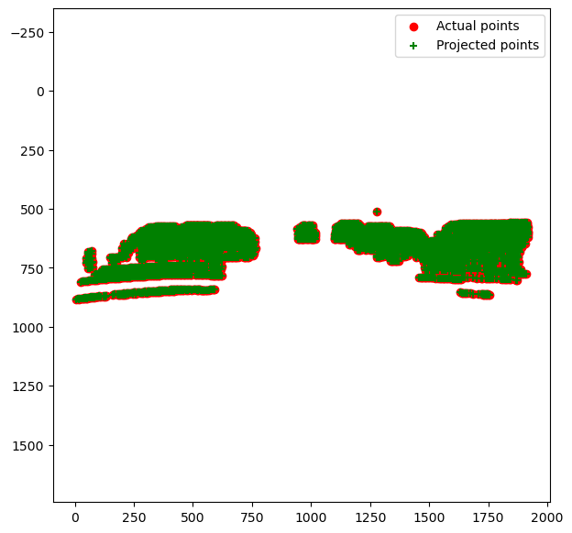
Part 1: Projection matrix

Slide 4
Part 1: Projection matrix
[What two quantities does the camera matrix relate?]
Camera matrix map 3D world coordinates to 2D image coordinates.
[What quantities can the camera matrix be decomposed into?]
Intrinsic params - matrix K
Extrinsic params - matrix [R|T]
[List any 3 factors that affect the camera projection matrix.]
Image Skew
Scale / Aspect Ratio
Focal Length, Optical Centre Position

Slide 5
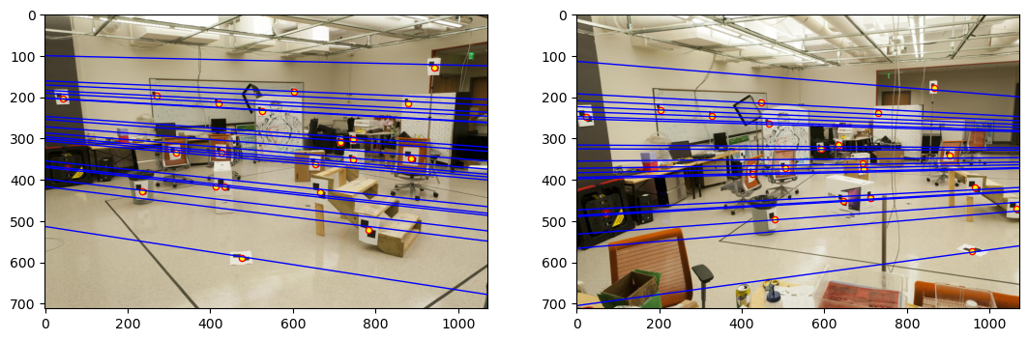
Part 2: Fundamental matrix

Slide 6
Part 2: Fundamental matrix
[Why is it that points in one image are projected by the fundamental matrix onto epipolar lines in the other image?]
The relation between the fundamental matrix and epipolar line is given by l’=Fx.The F matrix is a mapping between a point and a line from different images.
For instance, reversing the projection of point x, a point in image, we can estimate wh it falls on the ray l’, but cannot exactly estimate it’s position, which means points from one image can be projected by the matrix onto epipolar lines in the other image.
[What happens to the epipoles and epipolar lines when you take two images where the camera centers are within the images? Why?]
The epipolar lines intersect at the centers of the camera. This happens because epipolar lines represents the project from a camera, and every projective lines goes through the camera center. The intersections can also be observed within the image.

Slide 7
Part 2: Fundamental matrix
[What does it mean when your epipolar lines are all horizontal across the two images?]
Horizontal epipolar lines across two images indicates that every point in the first image is mapped to the horizontal epipolar line in second image.
[Why is the fundamental matrix defined up to a scale?]
Multiplying fundamental matrix expression any scalar value still results in a valid matrix. It is defined up to scale, where there are infinite valid solutions.
[Why is the fundamental matrix rank 2?]
Fundamental matrix is rank 2 since it maps maps 2D image onto a 1-D projective space.
We decompose F using singular value decomposition (det =0) into the matrices U ΣV ′ = F and reconstruct F from F = UΣ2V ′.

Slide 8
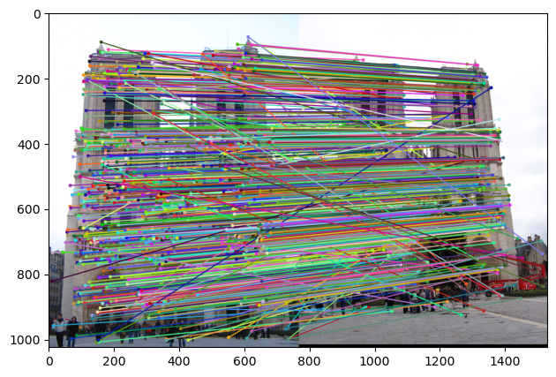
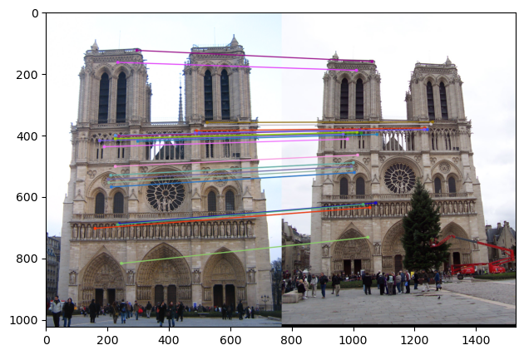
Part 3: RANSAC

Slide 9
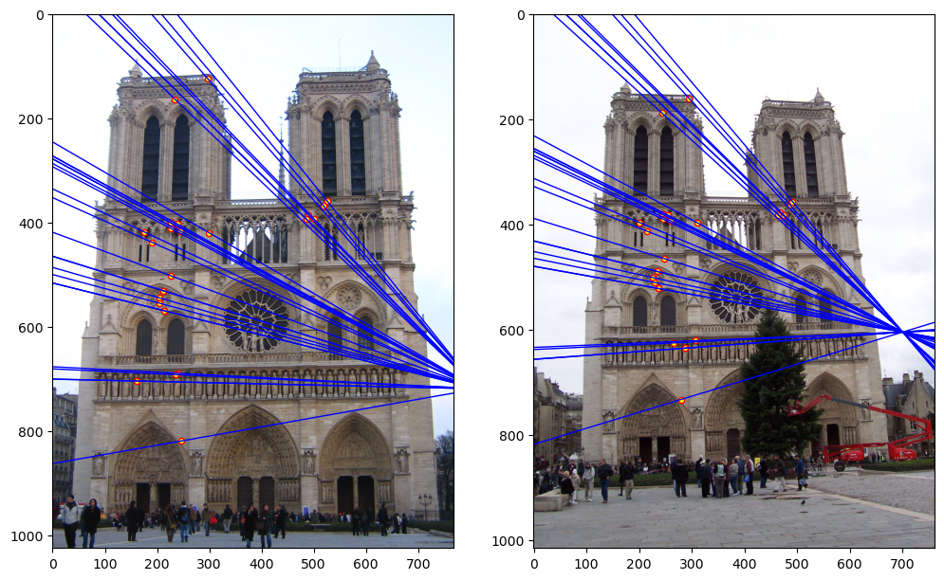
Part 3: RANSAC

Slide 10
Part 3: RANSAC
[How many RANSAC iterations would we need to find the fundamental matrix with 99.9% certainty from your Mt. Rushmore and Notre Dame SIFT results assuming that they had a 90% point correspondence accuracy if there are 9 points?]
14 Iterations
[One might imagine that if we had more than 9 point correspondences, it would be better to use more of them to solve for the fundamental matrix. Investigate this by finding the # of RANSAC iterations you would need to run with 18 points.]
13 Iterations at correspondence = 99.9% and E = 0.95
[If our dataset had a lower point correspondence accuracy, say 70%, what is the minimum # of iterations needed to find the fundamental matrix with 99.9% certainty?]
At least 241 iterations for sample size 10.

Slide 11
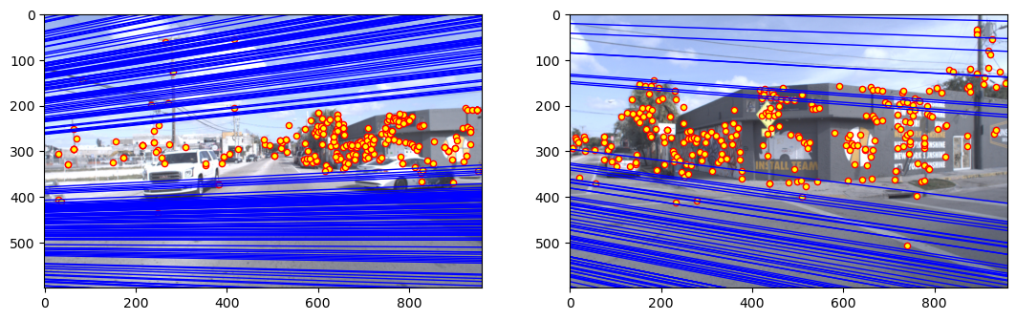
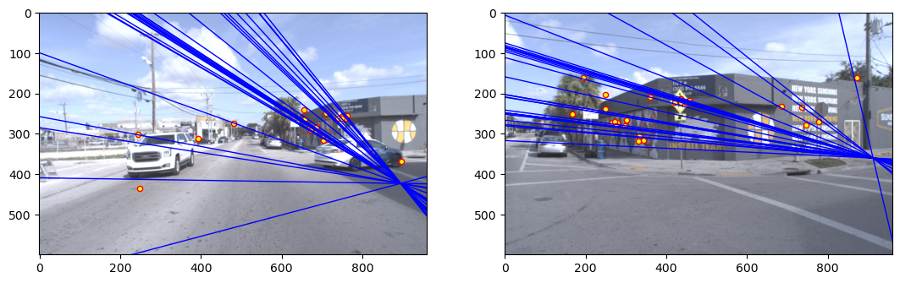
Part 4: Performance comparison
LINEAR
RANSAC

Slide 12
Part 4: Performance comparison
[Describe the different performance of the two methods.]
Linear produced near parallel lines that didn’t interest each other. Has more number of matches than RANSAC.
RANSAC performed better overall and we see epipolar lines that intersect and pass through a common point. RANSAC ends up producing more accurate matches.
[Why do these differences appear?]
Linear is sensitive to outliers. RANSAC on the other hand uses sampling, and takes care of outliers, while taking in consideration of the inliers.
[Which one should be more robust in real applications? Why?]
RANSAC would be a better because of its ability to pick high accuracy matches. Random sampling of data points and estimation of fundamental matrix based on a thresholds for distance makes it better at handling outliers efficiently and generalization.

Slide 13
Part 5: Visual odometry
[How can we use our code from part 2 and part 3 to determine the “ego-motion” of a camera attached to a robot (i.e., motion of the robot)?]
To determine the ego-motion of a camera attached to a robot:
Find matches in images.
Use RANSAC and estimate the fundamental matrix in a robust way.
Use the estimation function (already from part 2), and then we use the intrinsic parameters of the camera, and estimate the essential matrix.
[In addition to the fundamental matrix, what additional camera information is required to recover the ego-motion?]
To estimate ego-motion we need focal length as well as position.

Slide 14
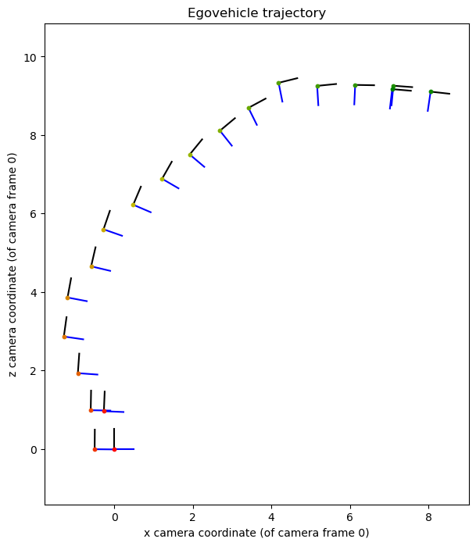
Part 5: Visual odometry

Slide 15
Part 6: Panorama Stitching
[Please add a README style documentation here for your implementation of panorama stitching with: description of what you implemented, instructions on how to replicate the results in clear steps that can be followed by course staff. Failure to replicate results by following this documentation will result in point penalties on this question of the assignment.]

Slide 16
Part 6: Panorama Stitching
[Insert visualizations of your stitched panorama here along with the 2 images you used to stitch this panorama (there should be 3 images in this slide)].

