Slide 1
CS 4476/6476 Project 4
Hardik Goel
hgoel7@gatech.edu
hgoel7
903536536

Slide 2
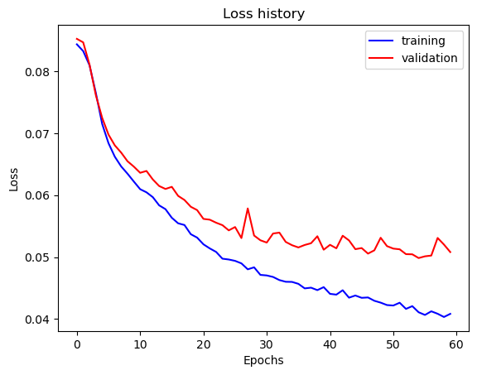
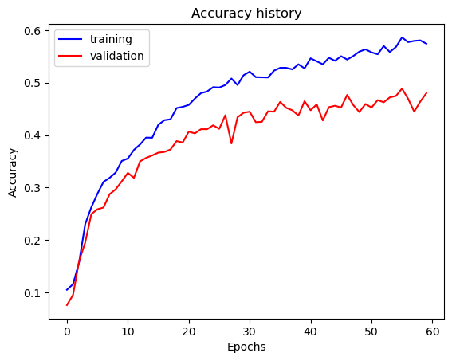
Part 1: SimpleNet
Final training accuracy: 0.5720
Final validation accuracy: 0.4800

Slide 3
Part 2: SimpleNetFinal
Add each of the following (keeping the changes as you move to the next row):
 | Training accuracy | Validation accuracy
SimpleNet | 0.568 | 0.470
Jittering | 0.527 | 0.452
Zero-centering & variance-normalization | 0.772 | 0.59
Dropout regularization | 0.731 | 0.568
Making network "deep" | 0.785 | 0.599
Batch normalization | 0.72 | 0.603

Slide 4
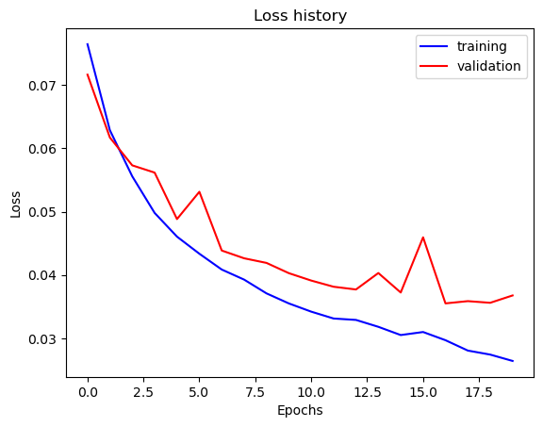
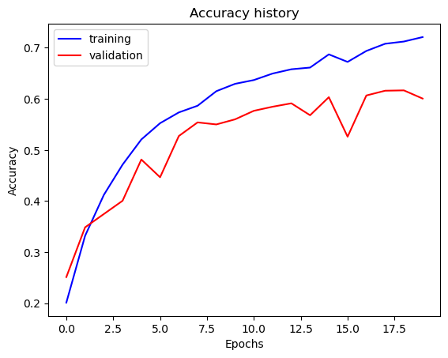
Part 2: SimpleNetFinal
Final training accuracy: 72.09%
Final validation accuracy: 60.06%

Slide 5
Part 2: SimpleNetFinal
Name 10 different possible transformations for data augmentation.
Cropping
Mirroring
Rescaling
Color Jittering
Rotations
Normalization
Translations
Noise
Flipping
What is the desired variance after each layer? Why would that be helpful?
Unit variance is desired after each layer because transforms after each input have unit variances hence the layers ideally should too.

Slide 6
Part 2: SimpleNetFinal
[What distribution is dropout usually sampled from?]
Bernoulli’s distribution
[How many parameters does your base SimpleNet model have? How many parameters does your SimpleNetFinal model have?]
SimpleNet: 56985
SimpleNetFinal: 1316930
[What is the effect of batch norm after a conv layer with a bias?]
Batch normalization by mean values shifts the activation which eliminates constants.

Slide 7
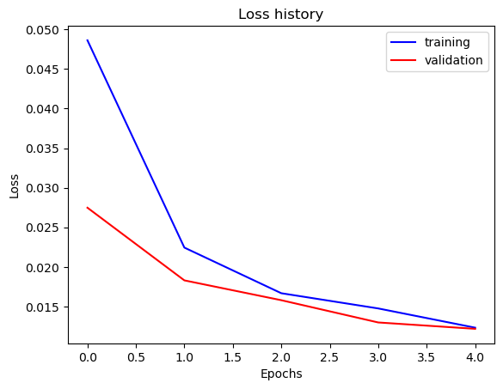
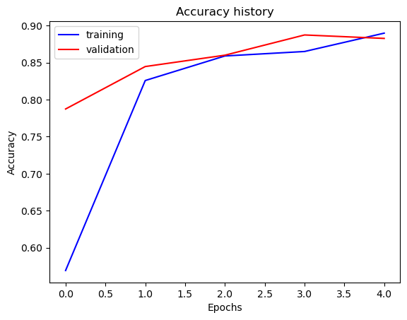
Part 3: ResNet
Final training accuracy: 88.97%
Final validation accuracy: 88.26%

Slide 8
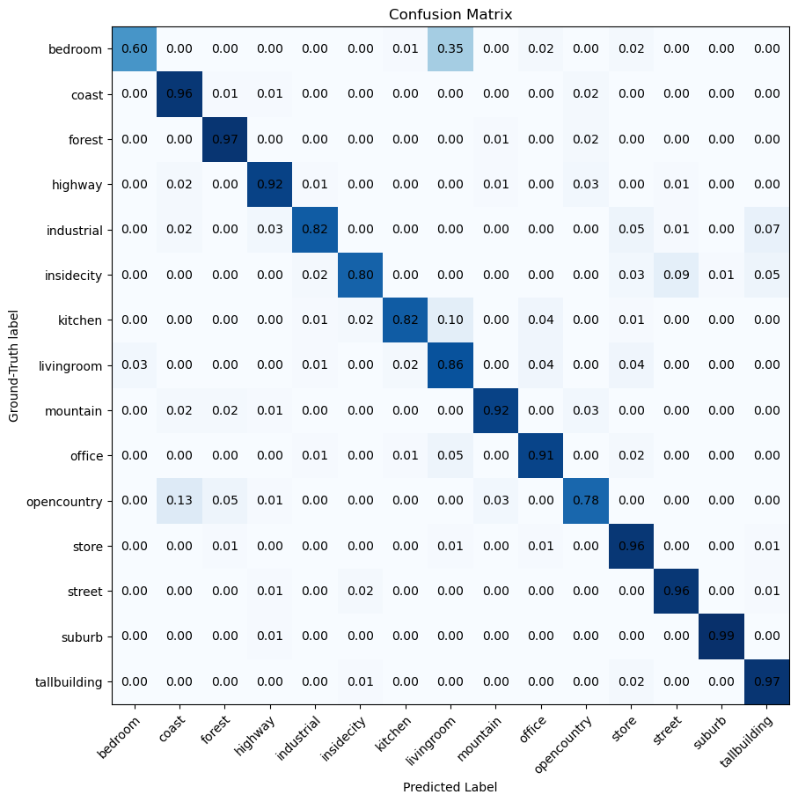
Part 3: ResNet Confusion Matrix

Slide 9
Part 3: ResNet
[Insert visualizations of 3 misclassified images from the most misclassified class according to your confusion matrix. Explain why this may have occurred.]
My function for viewing images failed, I was able to retrieve indices but not load them.

Slide 10
Part 3: ResNet
[What does fine-tuning a network mean?]
Finetuning a network means to take a pretained model’s weights to create .a new model
[Why do we want to "freeze" the conv layers and some of the linear layers from a pre-trained ResNet? Why can we do this?]
We freeze layers to ensure that weights are not updated during training. It’s used to prevent overfitting and improve speed. This is possible since the weights for pretrained models already exist and now we would just like to update how it’s been classified.

Slide 11
Part 4: Multi-label Scene Attributes
[Insert loss plot here]
Final training accuracy:
Final validation accuracy:
[Insert accuracy plot here]

Slide 12
Part 4: Multi-label Scene Attributes
[Insert visualization of accuracy table obtained from your final MultilabelResNet model.]

Slide 13
Part 4: Multi-label Scene Attributes
[List 3 changes that you made in the network compared to the one in part 3.]
[Is the loss function of the ResNet model from part 3 appropriate for this problem? Why or why not?]

Slide 14
Part 4: Multi-label Scene Attributes
[Explain a problem that one needs to be wary of with multilabel classification. HINT: consider the purpose of visualizing your results with the accuracy table. You might want to do some data exploration here.]

