Slide 1
DBSCAN CLUSTERING
Machine Learning Final Project
Zeinab Namakizadeh Esfahani

Slide 2
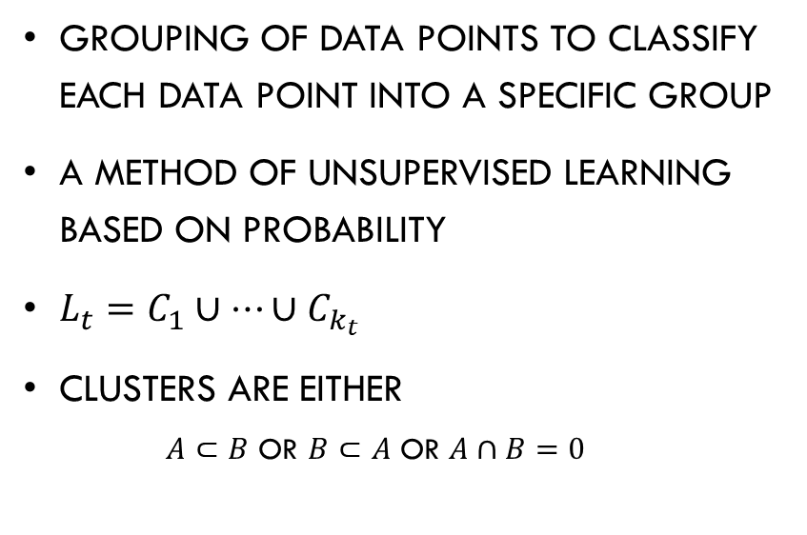
Density based Clustering Concepts
grouping of data points to classify each data point into a specific group
a method of unsupervised learning based on probability
$L_{t}=C_{1}∪…∪C_{k_{t}}$
Clusters are either
$A⊂B$ or $B⊂A$ OR $A∩B=0$
Density-based spatial clustering of applications with noise
each cluster has a density of points, considerably higher than outside
Counting : as the distribution check to reach the threshold(MinPoints)

Slide 3
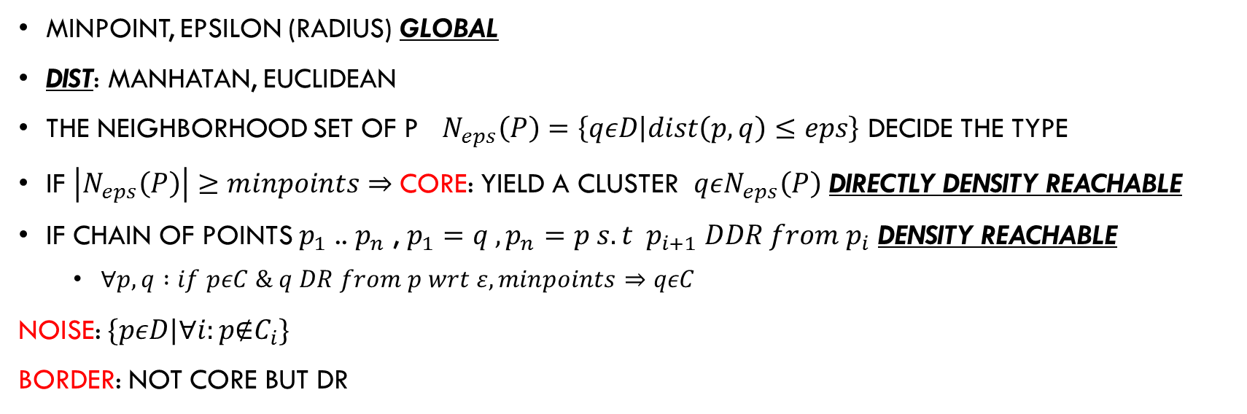
DBSCAN algorithm- How it works[1]
Minpoint, epsilon (radius) GLOBAL
Dist: Manhatan, Euclidean
The neighborhood set of p $N_{eps}\left(P\right)=\left\{qεD | dist\left(p,q\right)≤eps\right\}$ DECIDE the type
If $\left|N_{eps}\left(P\right)\right|≥minpoints⇒$ CORE: yield a cluster $qεN_{eps}\left(P\right)$ Directly density reachable
if chain of points $p_{1}$ .. $p_{n}$ , $p_{1}=q ,p_{n}=p s.t p_{i+1} DDR from{ p}_{i}$ Density reachable
$∀p,q :if pεC \& q DR from p wrt ε, minpoints⇒qεC$
noise: $\{pεD|∀i:p\text{∉}C_{i}\}$
BORDER: not core but DR
Notes:
[1] A Density-Based Algorithm for Discovering Clusters in Large Spatial Databases with Noise, Martin Ester, Hans-Peter Kriegel, Jörg Sander, Xiaowei Xu Institute for Computer Science, University of Munich Oettingenstr. 67, D-80538 München, Germany

Slide 4
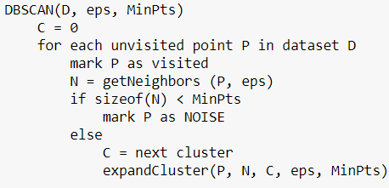
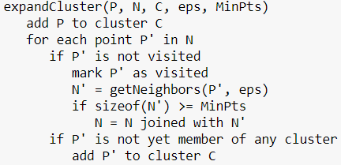
DBSCAN algorithm- How it works
DBSCAN begins with an arbitrary starting data point that has not been visited
Density reachable points???
dist [n*n]
visited [1*n]
N queue
whichC [1*n]
CBO [1*n]

Slide 5
Points
Friend of friend of a core not limited
Higher Eps : more reachable
lower eps : more and smaller clusters
Higher minpoints : lower chance of cluster forming
Point p is density-reachable from point q
Notes:
This is because the setting of the distance threshold ε and minPoints for identifying the neighborhood points will vary from cluster to cluster when the density varies. This drawback also occurs with very high-dimensional data since again the distance threshold ε becomes challenging to estimate.

Slide 6
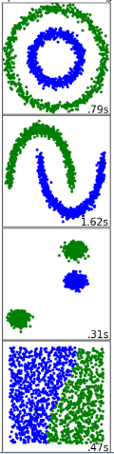
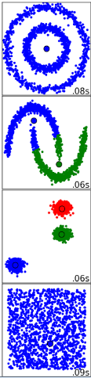
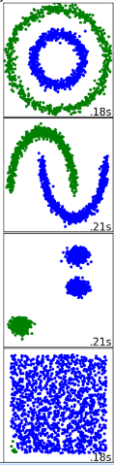
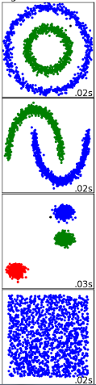
Superiority - Pros
SPECTRAL
MEAN SHIFT
AGGLOMORATIVE
DBSCAN
It does not require a pRe-set number of clusters
identifies outliers as noises
it can find arbitrarily sized and arbitrarily shaped clusters quite well

Slide 7
CONS - works
doesn’t perform as well as others when the clusters are of varying density
ST-DBSCAN solves this problem by assigning to each cluster a density factor.[1]
ADBSCAN modifies the existing DBSCAN algorithm so that it can adapt the values of Eps and MinPts. on the basis of the density distribution of the clusters. If in an iteration, over 10% of similar data has been identified, it is considered that a cluster has been discovered[2]
Minpoints and eps setting
Determination of Optimal Epsilon (Eps) Value on DBSCAN[4]
Notes:
[2] Derya Birant *, Alp Kut Department of Computer Engineering, Dokuz Eylul University, 35100 Izmir, Turkey Available online 13 March 2006
[3] Mohammad Mahmudur Rahman Khan1*, Md. Abu Bakr Siddique2#, Rezoana Bente Arif2@, and Mahjabin Rahman Oishe3$ 1Dept. of ECE, Mississippi State University, Mississippi State, MS 39762, USA 2Dept. of EEE, International University of Business Agriculture and Technology, Dhaka 1230, Bangladesh 3Dept. of CSE, Rajshahi University of Engineering and Technology, Rajshahi 6204, Bangladesh
[4] Nadia Rahmah and Imas Sukaesih Sitanggang 2016 IOP Conf. Ser.: Earth Environ. Sci. 31 012012

