Slide 1
WORLD WAR II Casualties
Zeinab Namakizadeh Esfahani

Slide 2
ABOUT THE DATA and tools
Dataset
.csv
638 entry
Content
Additional Data for Flag/population/occupied countries/battles,…
Developed using:
HTML5
CSS, ..
D3

Slide 3

Initial View
Logo, contact, general information
Bubble chart
Relative (death to population) %
Nice view
Flags
Motion
Continent,..
Size change during time
Hover to see Details
Exact #

Slide 4

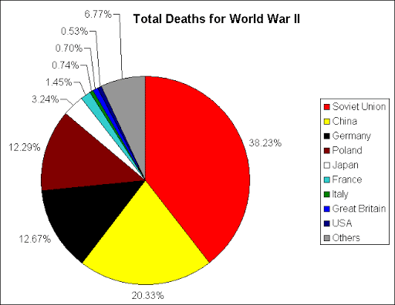
Visualization – Based on time period
Check boxes to choose YEAR
1939
1940
1941
1942
1943
1944
1945
1946
1947
Click to see Other Countries

Slide 5
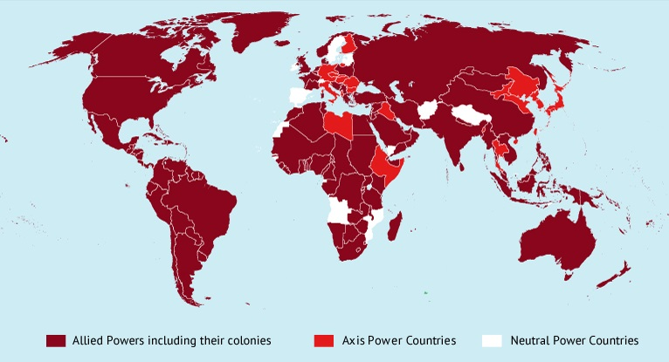
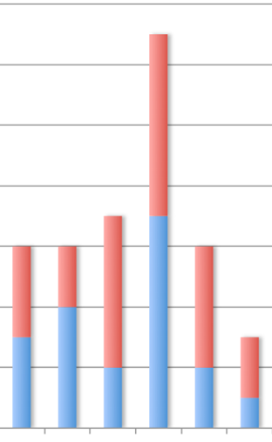
Visualization – based on country
World map
Allied & Axis
4 colors
The Occupied countries by another mark
Either Zoom or find a way
Click to see
Information: battles,…
Civilian/Military Death
Stacked BarChart

Slide 6
Suggestions/critics
Cumulative Pie chart
Thank you for your attention

