Slide 1
Website Link Portal
Speaker：Alex Gong
Notes:
Hello every one,
I’m Alex, and I’m intern in ux team, I’ve been here for more than 3 moths,I get a good workout in here and improved my ability of self-study, Now, I'm going to tell you about my application. Let's take a look at it.

Slide 2
Outline
What website link portal is for?
Requirement analysis
Functionality showcase
Technological overview
Application highlights
Summary
Notes:
The above points are the main content,I’m going to take about,respectively.Next,let’s take a look at. What website Portal Link is for?

Slide 3
I. What website link portal is for?
This application is used to save commonly used website links:
Easy to access frequently used websites.
Don't have to worry about forgetting the URLs.
Notes:
This application have some advantages ,
Next,let’s take a look at. Requirement analysis.

Slide 4
II. Requirement analysis
Users can register and login.
Users can also create, delete and modify the website links.
The website link can be public or private.
Logged in users can view both public links and their own private links,
but they can only modify and delete the links they created.
Anonymous users can only view public links list. They can’t view the information of any link or manipulate any link.
Notes:
Next, let’s take a look at.Functionality showcase.

Slide 5
III. Functionality showcase
application
Notes:
This is the application home page, now we start using the application.
Now let’s take a look at .Technological overview

Slide 6
IV. Technological overview
This is a meteor application, but the front end is implemented by AngularJS framework. This is a full-stack JavaScript application
The stack of main technologies used:
Meteor.js
Client
Server
ui-Bootstrap
ui-router
MongoDB
Node.js
AngularUI
AngularJS
Notes:
This is a meteor application，Although it is a meteor application, but it is the front-end is achieved by angularjs, The front end use the angular-ui, ui-router, and ui-bootstrap，
Need to pay attention to.ui-bootstrap is derived from bootstrap, it doesn’t depend on the bootstrap,
the back-end use Node.js and MongoDB.
OK,next.Let’s take a look at the :application highlights

Slide 7
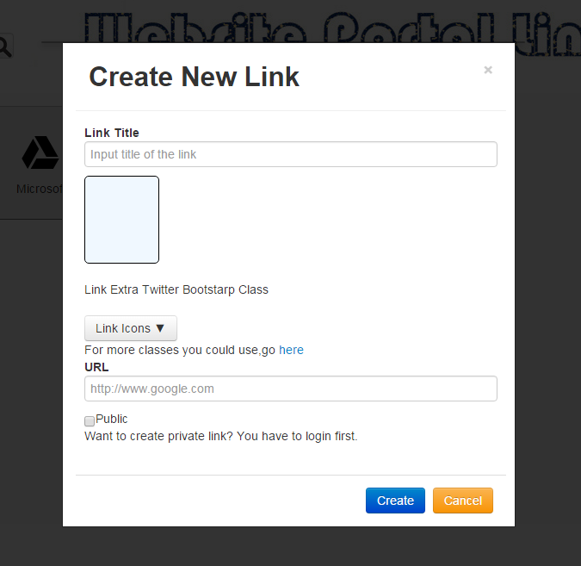
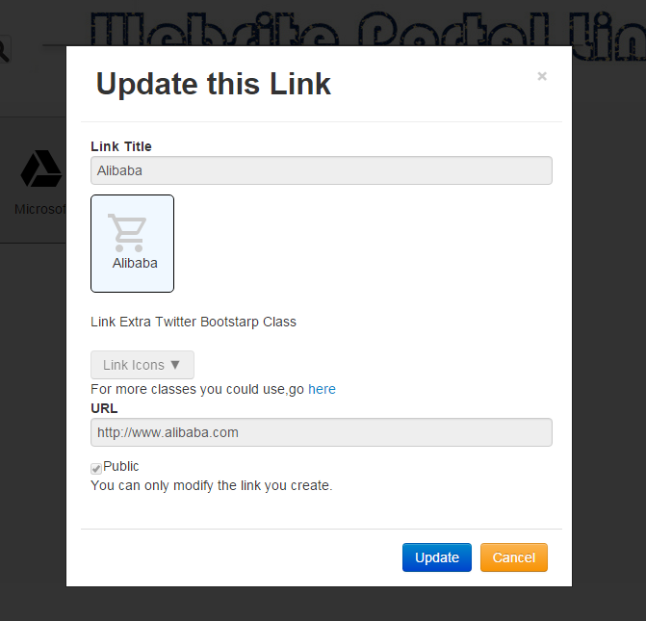
V. Application Highlights (i)
Below is the application’s highlights:
Use the service to reuse template
Notes:
The highlights of the application，I summarized that there are two highlights，the first highlight is reuse template. For the first point, I think use the same way to achieve these two functions, unified the page style, the user's feeling will be better, so I think this is a highlight,
Because add pages and modify the layout of the page is the same, it is recommended to reuse templates, reuse of the template will be increase the utilization rate of the code,
, so we use of the service to achieve the reuse of the template, next, let’s take a look at the second highlghts ,

Slide 8
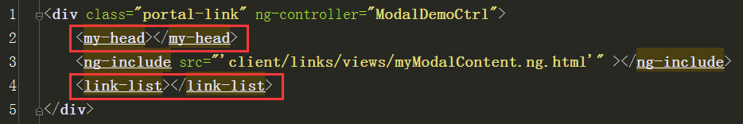
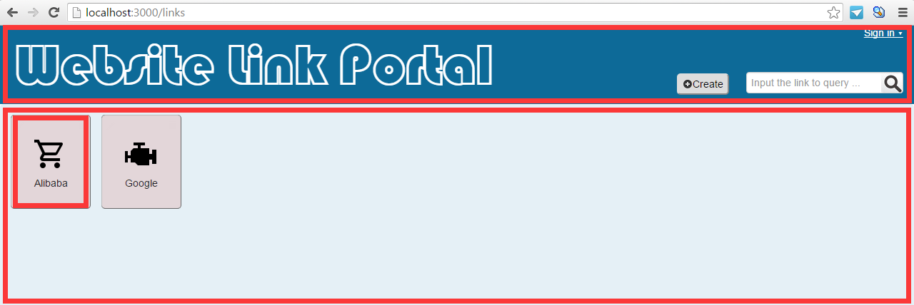
V. Application Highlights (ii)
Use the directive
Notes:
the second highhight is use the directive,I think for a developer to code concise, program readable, it is very important, so I also think this is a highlight.
Because use the directive, it will make the program's code is concise, increases the readability of the program，the program doesn’t seem to be very bloated,other developers will be easy to read the program，
.Use the directive, the home page is split into multiple templates, The head is a template, each link is a template, this area is also a template,
This is a directive,Each template corresponds to a directive ,the head template will be fill in here,if we don’t use the directive，there will be a lot of code here,and it will be lead to lower the readability of the program
Ok ,this is highlights of the application. Finally. I make a summary.

Slide 9
VI. Summary
Feelings and experiences about the application
Short-term and long-term goals
Notes:
Since I came to the team to the present, I have learned a lot of knowledge, and I was the first contact the front-end,gradually, I found that I fell in love with the front-end,I learnt a lot while I was working on this application. I met different kinds of problems. But I eventually got them all solved, on my own or with the help of my mentor or other colleagues，I tend to the learning in actual combat ,I like front-end development and my short-term goal is to grasp AngularJS. As to the long-term goal, I want to be a full-stack development engineer and do my best to contribute to our powerful UX team.
I hope you can point out my shortcomings, I will try to correct them , Thank you very much , That’s all

Slide 10
Thanks
Notes:
Sorry, can you speak a little more slowly,
I haven’t been in touch with this.
angular-ui is a stack of modules written on angularjs to make angular applications easy to develop,
Router is used to create a single page application,
1.What is MVC?
AngularJS is also a kind of MVC framework
Model View Controller or MVC as it is popularly called, is a software design pattern for developing web applications. A Model View Controller pattern is made up of the following three parts −
Modal:
The model is the data that is responsible for managing the application. It responds to requests from the view, while also responding to commands from the controller to self update.
View:
View is responsible for displaying all or a portion of the data to the user.
Controller:
The controller controls the flow of data in the application ,and this is a software Code that controls the interactions between the Model and View.
2. What is meteor?
Meteor is a group of new technologies for building high quality Web applications, to provide a lot of ready-made packages, can be directly run in the browser or cloud platform.
3.Why use meteor?
Before this, I don’t know what is the meteor，It's not my choice to use the meteor to do the application. But after use the meteor, I found the meteor is strengths.，meteor is powerful，It provides a lot of interfaces for developers，Developers call these interfaces is convenient，For us to save a lot of time, so that we have more time to focus on AngularJS.
4. What type of framework is AngularJS?
AngularJS is also a kind of MVC framework
5. AngularJS’s strengths?
AngularJS has many characteristics, such as, modular, two-way data binding, semantic label, dependency injection, etcetera. AngularJS use different methods, it try to make up the defect HTML itself in building applications

