Slide 1

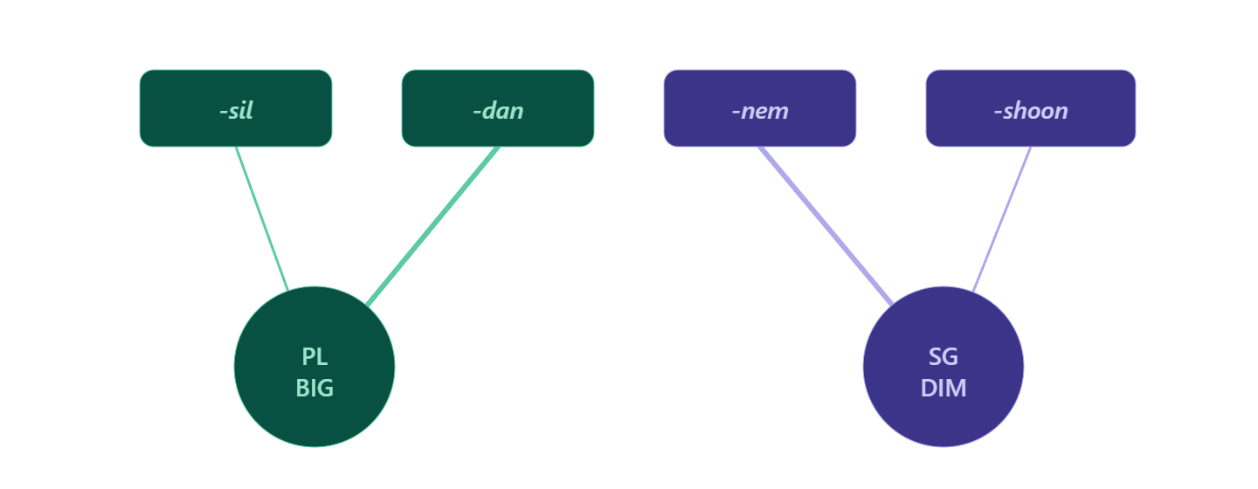
Figure 1
STATISTICAL LEARNING 2026
The effects of type and token frequency on generalizations
Zachary Nicholas Houghton^{1,2,3}, Zara Harmon⁴, Vsevolod Kapatsinski¹
¹University of Oregon
²University of California, Davis
³Vail Systems, Inc.
⁴Max Planck Institute for Psycholinguistics
Introduction / Motivation
Figure 1
Figure 3
Ability to generalize is paramount to learning language
Some have argued that different types of generalizations may leverage different cognitive abilities [1]
For example, extending a word’s meaning to a novel context (semantic extension) vs extending a word’s form to a novel context (productivity)
Present study examines whether semantic extension and linguistic productivity are both driven by type and token frequency.
Mixed-effects regression model results for statistical analysis examining production and form-choice data.
The x-axis indicates the condition, y-axis corresponds to the proportion of responses with a frequent suffix.
Blue points indicate that the meaning was novel while purple points indicate that the meaning was original. The facet indicates whether the stem was novel or familiar.
RW and human results side-by-side.
RW model contained configural cues plus modified salience of semantic cues
The y-axis is the probability of producing the frequent meaning. The top facet corresponds to novel meanings and the bottom axis corresponds to original meanings.
Methods
Artificial language experiment
Four suffixes: -sil_{PL}, -dan_{PL}, nem_{DIM}, -shoon_{DIM},
Three conditions: type, token, and type-token
In each condition, dan was made either frequent or infrequent relative to nem (balanced between whether dan was the frequent suffix or nem was)
Type condition: frequent suffix occurred in more types than infrequent suffix
Token condition: frequent suffix occurred in more tokens
Type-token condition: frequent suffix occurred in more types and more tokens than infrequent suffix
Examined production, 2AFC, and comprehension of diminutive plural meaning, which is compatible with the meaning of both suffixes
Specifically tested which suffix they selected in novel contexts (novel stems and/or novel meanings)
Results
Discussion
Production
High type and high token frequency → Semantic extension of frequent suffix
Extension more likely for novel stems
High type frequency only → Extension when stem and meaning are both novel
High token frequency only → Preference for the frequent form only when meaning is original
Comprehension
High token-to-type ratio → Original meaning preferred
As many types as tokens → Novel meaning preferred
Logistic Perceptron
Accounts for human data best when configural cues are included along with increased salience for semantic cues
Results suggest that both type and token frequency drive semantic extension
Further evidence that accessibility drives semantic extension (and that accessibility is mediated by both type and token frequency)
Results also suggest that linguistic productivity and semantic extension may both be driven by the same factors (accessibility)
Linguistic productivity is similarly driven by type frequency and token frequency [2]
Holistic storage may also play a role in semantic extension, evidenced by the improved prediction of RW with configural cues
Condition | Freq Type | Freq Token | Infreq Type | Infreq Token
Type | 12 | 12 | 3 | 12
Token | 3 | 12 | 3 | 3
Type-Token | 12 | 12 | 3 | 3
Figure 2
Mixed-effects regression model results for statistical analysis examining comprehension data.
The x-axis indicates the condition, y-axis corresponds to the proportion of participant responses for the novel meaning.
Conclusions
Type/Token frequency → Increased accessibility
Increased accessibility → Semantic Extension
Increased accessibility → Linguistic productivity
References
[1] Bybee, J. (2010). Language, usage and cognition. Cambridge University Press.
[2] Jarosz, G., Hughes, C., Lamont, A., Prickett, B., Baird, M., Kim, S., & Nelson, M. (2025). Type and token frequency jointly drive learning of morphology. Journal of Memory and Language, 104666.

