Slide 1


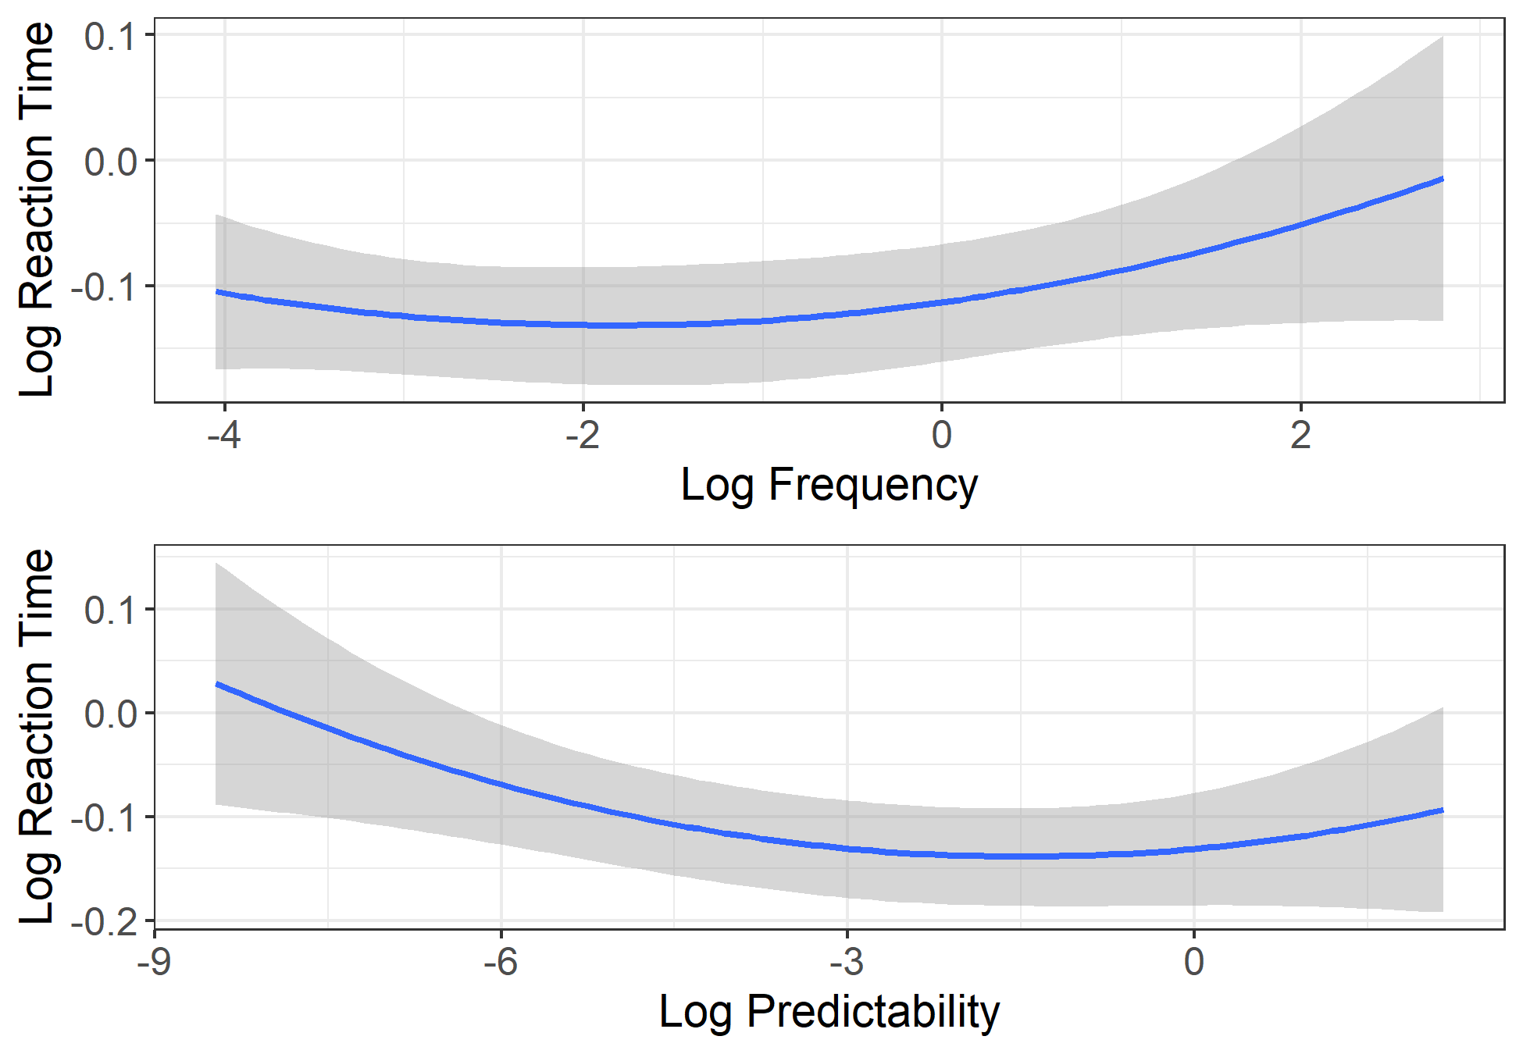
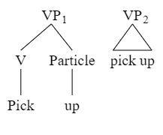
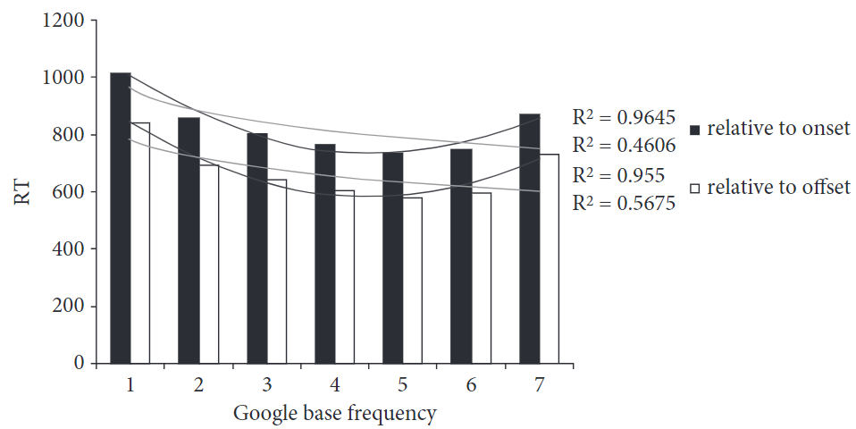
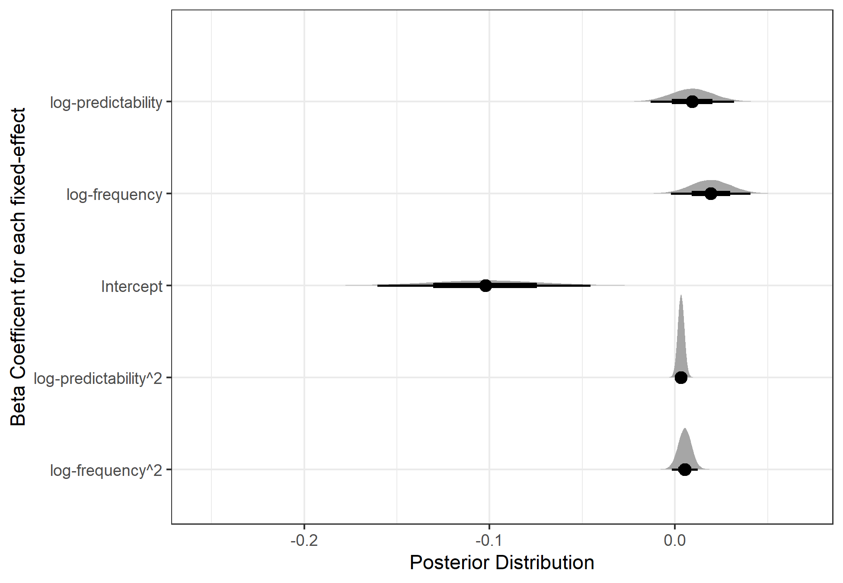
The effects of frequency and predictability on the recognition of up in English
Zachary Houghton¹ (znhoughton@ucdavis.edu) , Jungah Lee², Casey Felton¹, Georgia Zellou¹, and Emily Morgan¹
¹University of California, Davis; ²Chosun University
Introduction
Results
Summary
What is stored in the lexicon?
Words, idioms.
Phrases?
Frequency → Storage
High frequency phrases are more phonologically reduced:
I don’t know.
Harder to recognize components of high-frequency items:
pick up.
Predictability → Storage?
Harder to recognize components?
summed up
U-shaped effect for both frequency and predictability, suggesting storage for high-frequency and high-predictability items.
As frequency/predictability increases, participants get faster and faster, until reaching the highest frequency/predictability items.
Our results suggest that high frequency and high predictability items are stored.
These items seem to lack internal representation.
Increased recognition times.
Both frequency and predictability drive storage.
Stored items may lack internal representation (Figure 1, right side).
One possibility is that experience with the items over time results in a loss of internal structure.
Maybe due to learning mechanisms.
Another possibility is that the internal structure was never present to begin with.
Maybe due to word-segmentation processes.
Fig 2. A visualization of our Bayesian quadratic model results. The model suggests a u-shaped effect of both frequency and predictability.
Present Study
What drives storage?
Is it harder to recognize up in high-predictability phrases?
i.e., do we see a U-shaped effect?
Can we replicate the effect of frequency?
what are the processing consequences of storage?
Methods
Fig 1. Two possible representations of holistic storage. The left represents internal structure intact.
Extension of Kapatsinski & Radicke, (2009).
Presented with sentences that contained V+up phrases.
Pressed a button when they heard up.
Phrasal verbs varied in frequency and predictability.
Fig 3. Results from Kapatsinski & Radicke (2009)
Future Work
Examining how the lack of internal structure arises.
Artificial language paradigm.
Word-segmentation computational models.
Analysis
Generalized Additive. Mixed effects models as
Bayesian quadratic models.
These methods allow us to account for nonlinear effects.
References
Fig 4. The posterior distribution for our quadratic model.
Bybee, J. (2003). Phonology and language use (Vol. 94). Cambridge University Press.
Kapatsinski, V., & Radicke, J. (2009). Frequency and the emergence of prefabs: Evidence from monitoring. Formulaic language, 2, 499-520.

